Slide 1
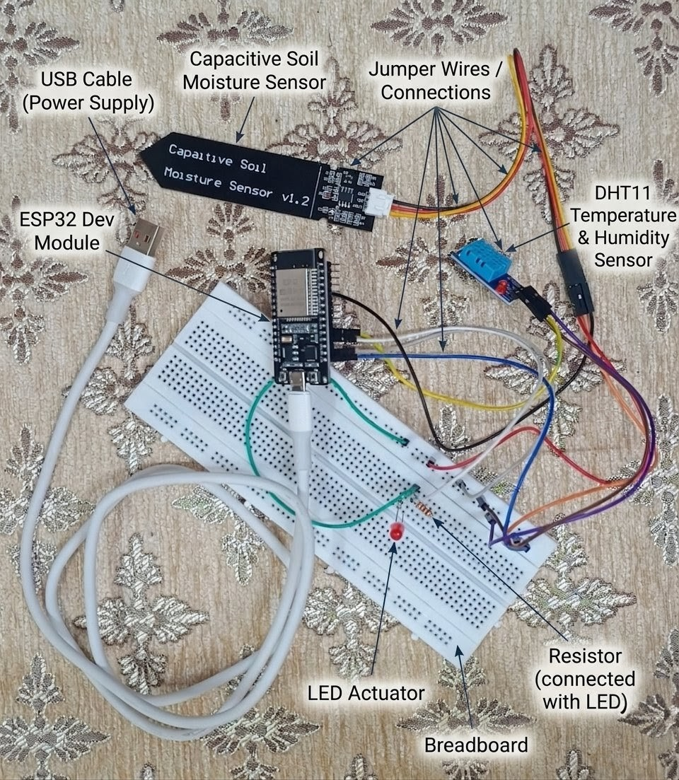
SmartAgri
AI enabled smart agriculture
using IoT and MQTT
Fuzzy irrigation control and
exploratory crop recommendation
Rishit Chaudhary 23BCT0157
Siddharth Verma 23BCT0159
Prototype assembly
Reported operational evidence uses simulation
SmartAgri / Project Review 1
01
Notes:
Course: Programming for IoT Boards. Authors: Rishit Chaudhary 23BCT0157 and Siddharth Verma 23BCT0159. Faculty: Dr. Syamasudha Veeragandham. Photograph: project-owned prototype assembly from the supplied paper. No physical outcome is claimed. https://github.com/rizzit17/SmartAgri

Slide 2
Problem and motivation
Environmental readings need a consistent path from sensing to an interpretable interface.
A local controller should expose its output during faults and telemetry interruptions.
Crop-model scores need separate evaluation because public training features differ from physical sensors.
The project will make rules, inputs and test evidence reproducible.
SmartAgri / Project Review 1
02
Notes:
Sources: https://doi.org/10.3390/s18082674; https://doi.org/10.3390/iot4030012. Proposed project scope, not measured farmer outcomes.

Slide 3
Objectives
01 Specify sensor types, units, pin assignments and filtering.
02 Compare a complete fuzzy controller with a moisture-threshold reference on identical inputs.
03 Demonstrate MQTT telemetry, dashboard accounts, history and reports.
04 Archive boundary, fault, timer and outage tests, then evaluate crop labels on an untouched holdout.
SmartAgri / Project Review 1
03
Notes:
SmartAgri proposal objectives. Sources: Review-1 draft and the project specification.

Slide 4
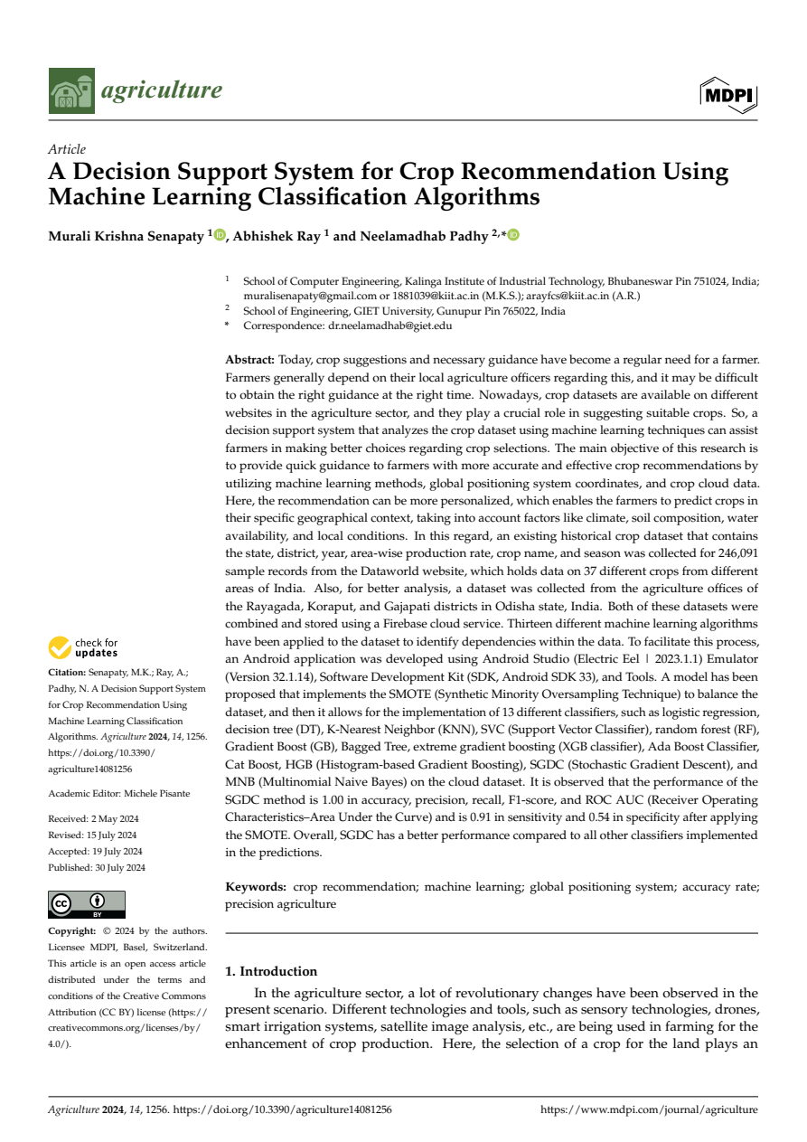
Selected Q1 base paper
A Decision Support System for Crop Recommendation Using Machine Learning Classification Algorithms
Senapaty, Ray and Padhy
Agriculture 14(8), 1256 (2024)
Q1 in Agronomy
2024 JCR metrics, rank 19/129
DOI 10.3390/agriculture14081256
SmartAgri / Project Review 1
04
Notes:
https://doi.org/10.3390/agriculture14081256
Q1 verification: https://www.mdpi.com/about/announcements/12506
Agriculture 2024 JCR metrics: Agronomy Q1, 19/129, publisher announcement 3 July 2025. The original PDF retains its authors and licence. Its findings are not SmartAgri results.

Slide 5
Literature review
Study | Established contribution | Relation to this project
Pereira 2023 | ESP32 sensing and physical irrigation tests | Reference for later hardware evaluation
Senapaty 2024 | Regional crop records and classifier comparison | Base for separate dataset evaluation
TerraGrow 2025 | Local ESP32 fuzzy control and hardware evidence | Prior art for local control
Cartolano 2024 | SHAP and LIME on crop classification | Explainability remains future work here
SmartAgri / Project Review 1
05
Notes:
Pereira et al. 2023: https://doi.org/10.3390/iot4030012
Senapaty et al. 2024: https://doi.org/10.3390/agriculture14081256
Wijayakusuma et al. 2025: https://doi.org/10.1016/j.ohx.2025.e00724
Cartolano et al. 2024: https://doi.org/10.1007/s11042-023-17978-z
The table summarizes scope; no prior-work percentages are adopted as project outcomes.

Slide 6
Research gap identified
Sensor and model consistency
A rainfall-derived moisture proxy needs calibration before it can represent a capacitive probe.
Reproducible functional evaluation
Rules, matched baseline inputs and failure handling need explicit tests and archived records.
Physical effectiveness
Water delivery, sensor drift and crop outcomes still require controlled physical trials.
SmartAgri / Project Review 1
06
Notes:
Sources: https://doi.org/10.3390/agriculture14081256; https://doi.org/10.1016/j.ohx.2025.e00724; https://doi.org/10.1007/s11042-023-17978-z. These are gaps in the present prototype's evidence, not claims that the capabilities are absent from all prior work.

Slide 7
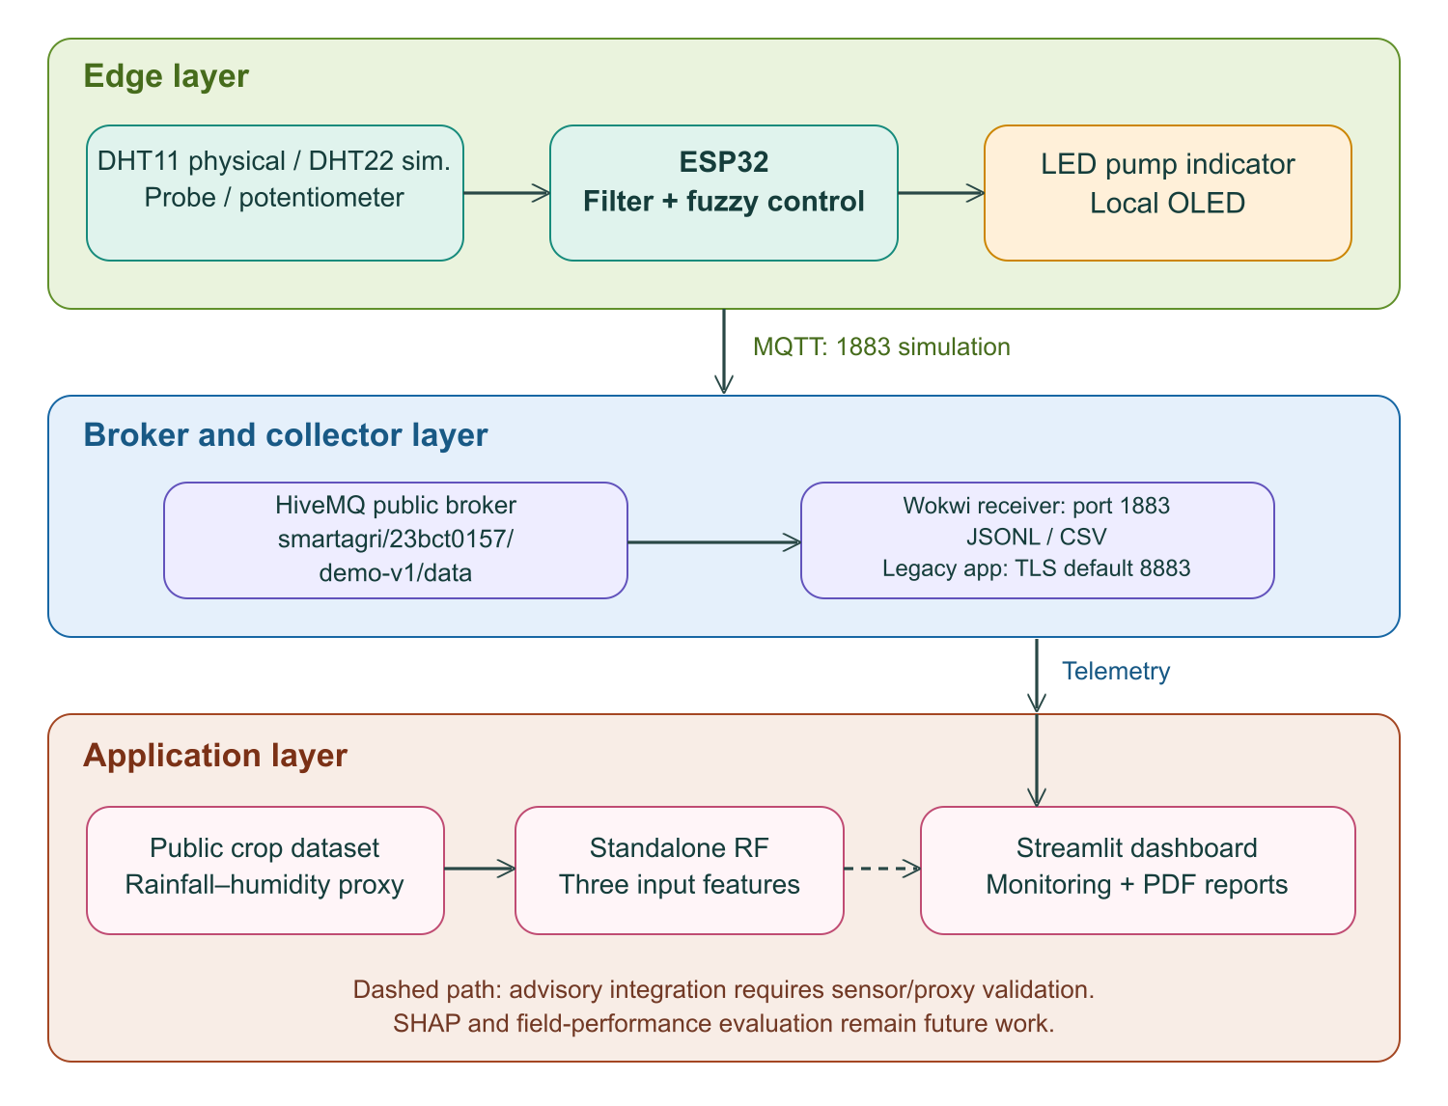
Proposed system architecture
Local control
Synthetic MQTT telemetry
Dashboard and reports
Separate crop experiment
SmartAgri / Project Review 1
07
Notes:
Project architecture from the corrected paper. Asset: work/corrected_image1.png. Wokwi uses broker.hivemq.com:1883 and smartagri/23bct0157/demo-v1/data; the legacy collector defaults to TLS 8883. Browser replay uses a separate transport surrogate. https://github.com/rizzit17/SmartAgri

Slide 8
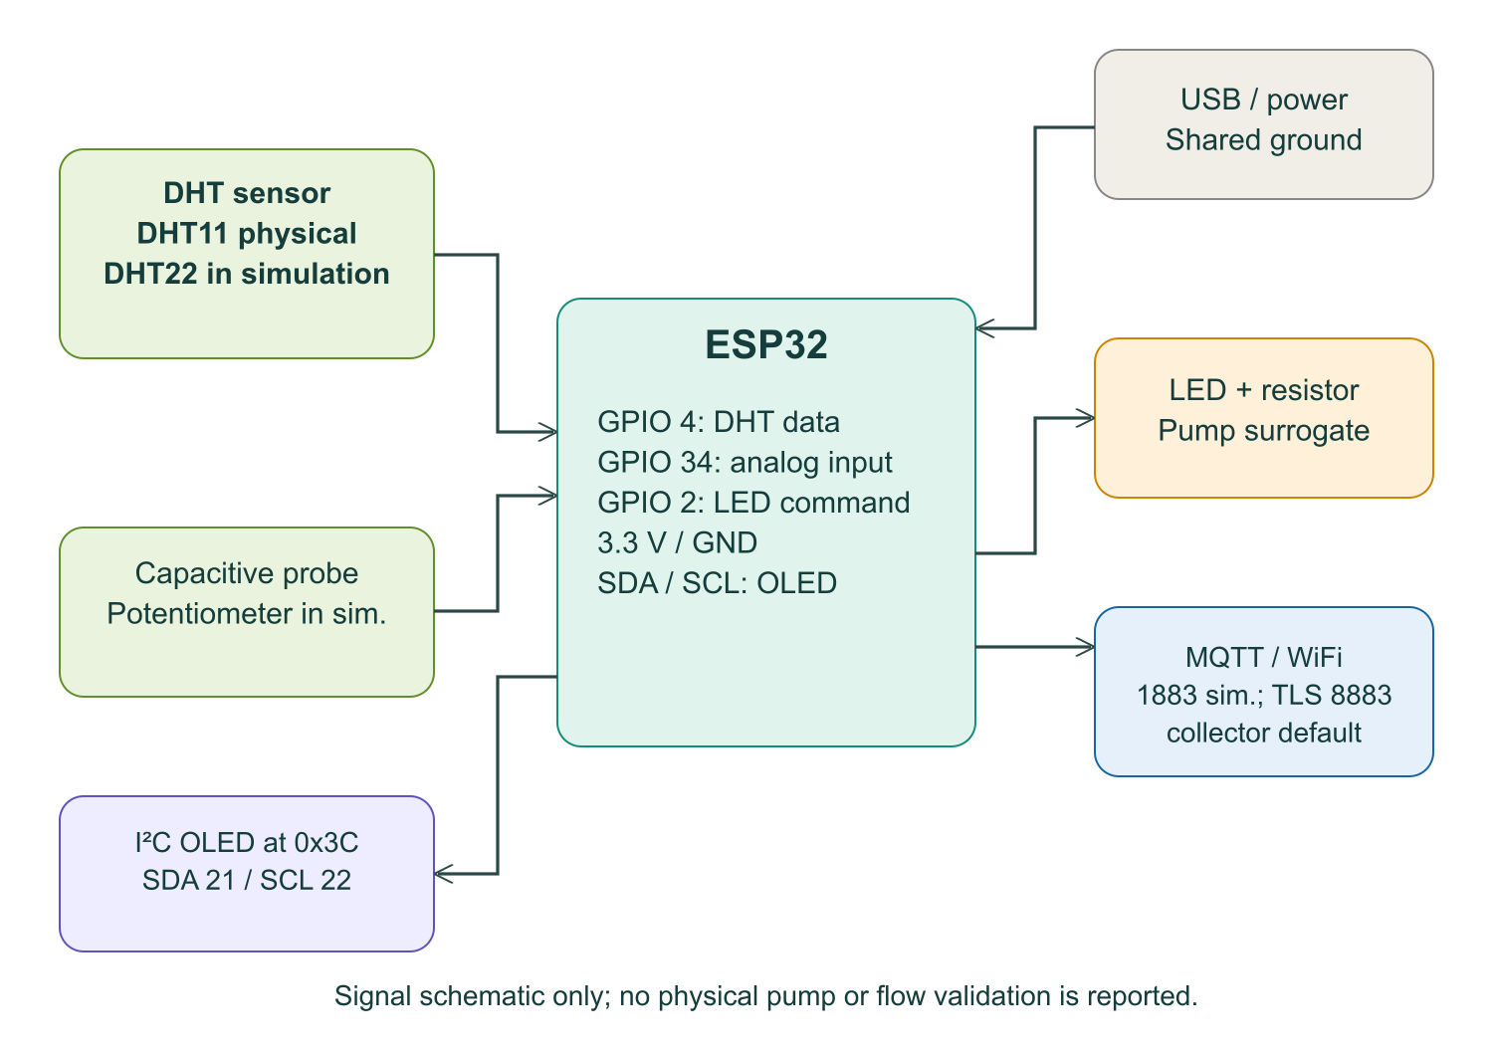
Sensors and circuit scope
Physical design
DHT11 and capacitive probe
Wokwi model
DHT22 and potentiometer
Output
GPIO 2 LED, with no water-flow model
SmartAgri / Project Review 1
08
Notes:
Project pin mapping and supplied physical photo. DHT11 physical assembly is distinct from the Wokwi DHT22 model. The LED is a logical pump surrogate. Source: wokwi/diagram.json and sketch.ino.

Slide 9
Control policy
27 zero-order Sugeno rules
Minimum antecedent firing with a weighted average of constant rule consequences
y = sum(w × consequence) / sum(w)
Reference policy: 10 command minutes below 30% filtered moisture, otherwise zero
Simulation scale: one commanded minute equals one simulator second
SmartAgri / Project Review 1
09
Notes:
Source: simulator/engine.py, wokwi/controller.h and Appendix A of the final paper. The constants are controller design choices, not crop-specific irrigation prescriptions.

Slide 10

Dashboard scope
Local sign-in and account creation
Readings, history and threshold alerts
Crop-model scores with stated limits
Rules-based helper and PDF reports
SmartAgri / Project Review 1
10
Notes:
Application reference: dashboard.py. Asset: docs/screenshots/dashboard-login.png. Current interface illustrates the proposed application layer. Local accounts are prototype authentication. No usability study or agronomic validation is claimed. https://github.com/rizzit17/SmartAgri

Slide 11
Evaluation plan
Level | Procedure | Evidence
Browser model | Identical traces for fuzzy and threshold policies | Input settings, commands, timers and exports
Wokwi firmware | Boundary, sensor fault, outage and recovery cases | Circuit plus Serial, GPIO and MQTT records
Crop dataset | Stratified holdout and training-only preprocessing | Accuracy, macro F1 and top-three accuracy
Physical work | Calibrated sensors and measured water delivery | Future controlled and replicated trials
SmartAgri / Project Review 1
11
Notes:
Proposed functional evaluation plan. The completed results and raw records are supplied separately in the final paper and implementation for Reviews 2 and 3. Deterministic checks are not independent field trials.

Slide 12
Scope and limitations
Simulation establishes selected program behaviour under prescribed conditions.
A potentiometer and LED do not measure soil-water dynamics or delivered irrigation volume.
Public-dataset crop labels do not validate physical sensor input or geographical transfer.
Sensor calibration, hydraulic safety, deployment cost and field trials remain future work.
SmartAgri / Project Review 1
12
Notes:
Project evidence boundary, consistent with the final research paper. No affordability, water-saving, yield or SHAP result is claimed.

Slide 13
Review deliverables
Review 1
Q1 base paper, presentation and eight-section research draft
Review 2
Final editable research paper and complete implementation ZIP
Review 3
One ZIP with the paper named using both registration numbers, implementation and repository link
SmartAgri / Project Review 1
13
Notes:
Prepared for submission now. This slide does not assert that earlier deadlines or prior reviews were completed on time. Requirements supplied by the course notice.

Slide 14
References
Senapaty et al. (2024). Agriculture 14(8), 1256.
10.3390/agriculture14081256
Pereira et al. (2023). IoT 4(3), 221–243.
10.3390/iot4030012
Wijayakusuma et al. (2025). HardwareX 24, e00724.
10.1016/j.ohx.2025.e00724
Cartolano et al. (2024). Multimedia Tools and Applications 83, 37225–37246.
10.1007/s11042-023-17978-z
Liakos et al. (2018). Sensors 18(8), 2674.
10.3390/s18082674
SmartAgri / Project Review 1
14
Notes:
https://doi.org/10.3390/agriculture14081256
https://www.mdpi.com/about/announcements/12506
https://doi.org/10.3390/iot4030012
https://doi.org/10.1016/j.ohx.2025.e00724
https://doi.org/10.1007/s11042-023-17978-z
https://doi.org/10.3390/s18082674
https://github.com/rizzit17/SmartAgri

