Slide 1
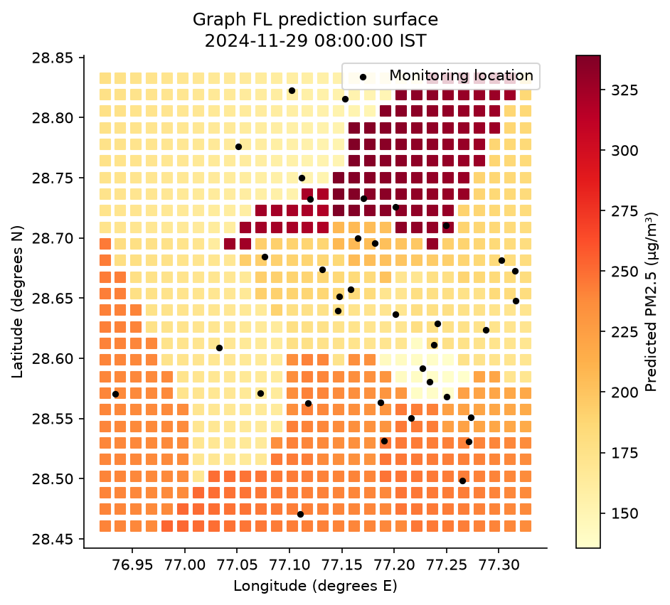
REVIEW 3 · BCSE316L · AY 2026–27
AirTrust
Federated Learning for
City-Wide Air Pollution Mapping
Without centralizing sensor data
Team 10 · Project 9
Rishit Chaudhary 23BCT0157 · Siddharth Verma 23BCT0159
Jashan Sahasrabudhe 23BCT0022 · Adarsh Narayan 23BCT0155
Historical graph-model surface · 29 Nov 2024
Design of Smart Cities · VIT Vellore
Notes:
Opening: Ma’am, AirTrust is our implementation of federated city-wide pollution mapping. We use real reference-monitor data and explicitly simulated low-cost sensor faults. The image is an executed historical model surface, not a photograph or observed truth at every grid point. This is a single-computer federation simulation. Source: results/figures/pollution_surface.png and /api/map, seed17, hour8000. Exact assigned project title: Federated Learning for City-Wide Air Pollution Mapping Without Centralizing Sensor Data.

Slide 2
The challenge is uneven sensing quality
Can a shared model map pollution across locations with different sensor quality?
One city.
Different readings.
01
Learn across clients
Keep aggregation inputs to model parameters and scalar weights.
02
Test unseen locations
Bias, drift and missing hours can distort local models. Spatial coverage is also uneven.
Separate spatial mapping from known-station forecasting.
03
Measure the tradeoffs
Research question
Compare accuracy, robustness, privacy probe and communication.
Does co-location calibration improve
federated pollution prediction?
AIRTRUST / REVIEW 3
02
Notes:
Motivation and gap: previous pollution FL forecasting does not by itself validate completely unseen Delhi stations or heterogeneous calibration quality. Related work reviewed includes Hu et al.2024 FedDeep, Putra et al.2021 compressed FL, and Zheng et al.2018 calibration. A25-paper comparison is in docs/LITERATURE_REVIEW.md. SDG relevance:3 exposure monitoring,11.6 urban air quality,13 environmental observation; health and climate improvements are not measured. Sources:10.3390/app14051979;10.3390/s21134586;10.5194/amt-11-4823-2018.

Slide 3
Real public observations, with distinct roles
All source snapshots, attribution and checksums are retained for submission.
Sources: XKDR Forum / CPCB CAAQM and Song Chen / UCI · CC BY 4.0
Source and period | Rows | Coverage | Role
Delhi PM2.5 · 2024 | 317,627 | 39 catalog entries | Primary FL reference target
Delhi PM10 · 2024 | 323,061 | 39 catalog entries | Contextual pollutant trends
Delhi NO₂ · 2024 | 325,379 | 39 catalog entries | Contextual pollutant trends
UCI Beijing · 2013–17 | 420,768 | 12 stations | Independent persistence benchmark
966,067
300,355
Delhi pollutant-source rows
Valid Delhi PM2.5 labels retained
AIRTRUST / REVIEW 3
03
Notes:
Delhi source: India Air Quality Database, XKDR Forum, compiling CPCB Continuous Ambient Air Quality Monitoring observations. https://github.com/xKDR/Air-Quality-Database ; https://airquality.xkdr.org. UCI dataset DOI https://doi.org/10.24432/C5RK5G. Both CC BY4.0. Delhi timestamps are hourly IST in2024; Beijing is local time Mar2013–Feb2017. Delhi expanded by648,440 contextual rows. Beijing rows contain several variables, while Delhi rows each represent one pollutant; do not sum these as equivalent samples. OpenAQ and sensor.community were proposal candidates but are not used. Beijing does not establish federated cross-city transfer. Data evidence: datasets/manifest.json and expansion.json.

Slide 4
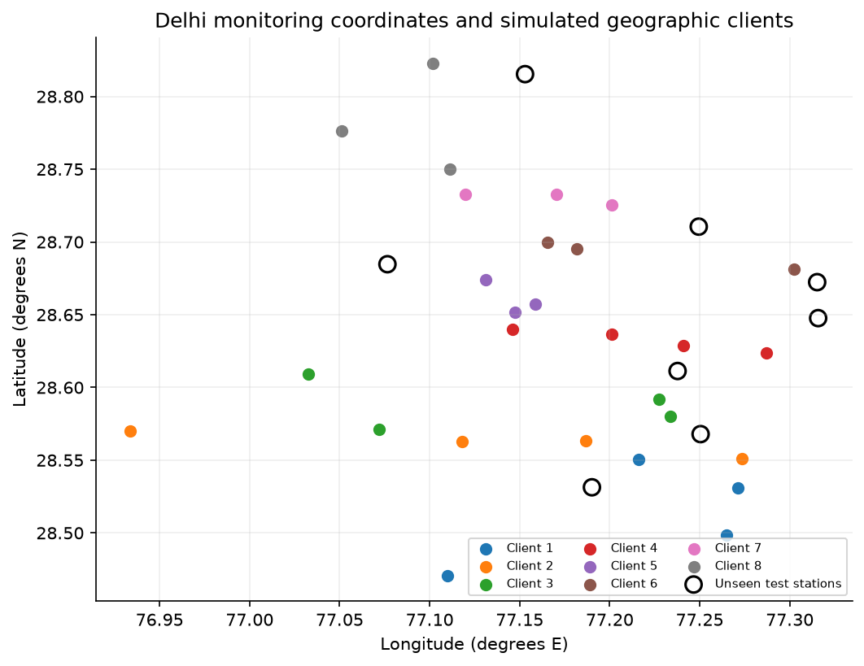
A real station network becomes the benchmark
36 distinct retained locations grouped into eight simulated geographic clients.
39 → 36
Catalog entries → retained sites
70%
Minimum hourly coverage
Reference labels stay unimputed
Input fill ≤ 3 h · PM2.5 outside 0–2,000 µg/m³ excluded · Entries within 50 m consolidated
AIRTRUST / REVIEW 3
04
Notes:
Show actual coordinates, not an illustrative9-station network. Open circles mark the eight primary held-out stations. Geographic clients are balanced latitude/longitude strips, not real administrative owners. Coverage and co-location checks retain36 distinct sites with300,355 valid observations on8784hours. Values are not fabricated to fill missing reference truth. Full-year coverage was used to construct the retrospective benchmark, a limitation for prospective deployment. Image: results/figures/station_map.png. Data: airtrust/data.py and datasets/raw/delhi_stations.json.

Slide 5
How the federated simulation works
Only model parameters and scalar weights enter the aggregation interface.
Global parameters broadcast for the next round
8 geographic clients
Local sensor histories
Local model optimization
Shared model
Historical spatial
predictions
Trust-weighted
aggregation
Client updates
Parameters
Calibration prefix
Separate evaluator
Early co-located residuals produce
one confidence score per client.
Reference truth scores future times
and locations excluded from fitting.
AIRTRUST / REVIEW 3
05
Notes:
Explain one round: broadcast global parameters, initialize each local model, optimize12minibatch steps, aggregate states and repeat20rounds. The simulator/evaluator loads public reference data; this is algorithmic data locality, not independent protected devices or an OS/cryptographic security boundary. Calibration uses only first10% of seen-station hours. The held-out stations are excluded from calibration and donors. Source: airtrust/experiment.py train_one; airtrust/models.py aggregate; airtrust/data.py prepare.

Slide 6
Two learners, two information sets
Spatial mapping and temporal forecasting answer different questions.
Spatial graph learner
Temporal LSTM
3 donors
6 past hours
Messages +
attention
Target
PM2.5
Own history
6 past hours
LSTM
16 units
Next
hour
Coordinates are available; the target’s
own reading is excluded.
Uses a known target’s history;
no unseen-station score is assigned.
Confidence = max(exp(−calibration RMSE / 35), 0.05)
Aggregation weight ∝ training sample count × confidence
AIRTRUST / REVIEW 3
06
Notes:
GNN is an inductive star-graph message-passing learner: donor features are6PMlags plus relative x/y; shared8→24→16 message layers, attention pooling,16+4timecontext→24→1head with residual persistence. LSTM16hidden units uses own history with timecontext. Neither is a reproduction of a named state-of-the-art architecture. Trust uses the same-coordinate virtual/reference RMSE, scale35andfloor.05fixed a priori. Clean known-station validation chooses checkpoints. Neural centralized/FedAvg/trust comparators use matched noisy tasks. Sources: models.py and data.py.

Slide 7
Evaluation protects time and location boundaries
Three seeds: 17, 29 and 43 · 20 rounds · 12 local steps · Adam 0.002
10%
60%
15%
15%
Calibrate
Train
Validate
Test
Primary holdout
Five station folds
8 unseen stations
28 seen stations
Future-period scoring only
8
8
8
8
4
Fold 1
Fold 2
Fold 3
Fold 4
Fold 5
Every station is unseen once per seed.
AIRTRUST / REVIEW 3
07
Notes:
Time split is10%calibration-only, next60%training,15%validation,15%test; do not call all first70%training. Test starts7Nov2024 at02IST. Full station holdouts are excluded from training labels, validation labels, calibration and donor inputs. Five folds hold out8,8,8,8,4stations perseed, covering36once. Report15fold-seed means/SDs, not15independent datasets or confidence intervals. Primary holdout is the original8fixedsites and is preserved separately. Checkpoints use validation RMSE, not test errors. Sources: results/audit_17.json; results/spatial_cv/audit_*.json; scripts/run_spatial_cv.py.

Slide 8
Trust weighting does not outperform FedAvg here
Unseen-station cross-validation · lower RMSE is better · units: µg/m³
Run variability
FedAvg
± 12.11
Trust FL
± 11.35
Centralized
± 11.35
Kriging
± 25.11
Trust MAE 68.01 · R² 0.465
Means and SDs over 5 folds × 3 seeds; fold variability is not a confidence interval.
AIRTRUST / REVIEW 3
08
Notes:
Read actual outcomes rather than claiming a desired gain. FedAvg RMSE96.1554±12.1115;trust96.6926±11.3471;central99.2511±11.3525;kriging109.8027±25.1080. Trust MAE68.0117andR².46509. All graph/geostatistical results use donor histories that exclude the target’s readings. The full tables include median, trimmed mean, Krum, update consistency and IDW. CV folds vary in size and are averaged equally; shared data limit independence. Source: results/spatial_cv/summary.csv.

Slide 9
Correcting sensor inputs improves the simulation
Separate calibration ablation · original fixed station holdout · three seeds
21.3%
Lower trust-model RMSE
after early input correction
Correction is fitted on the
first 10% of seen-site pairs.
Corrected trust 78.67 ± 2.02; corrected FedAvg 78.49 ± 2.05 µg/m³.
AIRTRUST / REVIEW 3
09
Notes:
Calibration and trust are different operations. Fit one linear least-squares correction per seen station using only early noisy/reference pairs; apply it to later noisy inputs and training labels. Held-out sites fit no coefficients, and reference test truth is unchanged. Trust RMSE99.9178→78.6653,21.27%reduction. Corrected FedAvg78.4906means trust superiority is still not established. This is a fixed-holdout ablation and must not be presented as five-fold performance. Source: results/calibration/summary.csv; comparison.csv; audit_*.json; scripts/run_calibration.py.

Slide 10
The Simulation lab makes assumptions visible
CRRI Mathura Road · seed 17 · future-period sensor RMSE, not graph-model error
Change the sensor
Bias · gain · drift
Noise · dropout
Then Run scenario
More drift leaves
more residual error.
Map inference, sensor controls, pollutant trends, coverage audits and dataset exports work offline.
AIRTRUST / REVIEW 3
10
Notes:
Demo controls at the named station: Ideal bias0,gain1,drift0,noise0,dropout0 givesRMSE0→0. Default bias20,gain1.1,annualdrift20,noiseSD10,dropout.05 gives59.4→18.1. Stronger drift80withotherdefaultvalues gives114.0→64.1. Values were verified against /api/scenario. Correction fit uses first10%pairs; RMSE uses valid futurehourlypairs, monthly curves are display summaries. These are sensor-level diagnostics, not newly trained FL results. Main stress suite also sweeps actual corrupted-client shares0%,25%,37.5%,62.5%with median/trimmed comparators. Separate Kanpur scenario and temporal reputation are in results/sensitivity. No Delhi low-cost hardware fit is claimed.

Slide 11
Privacy and communication are measured tradeoffs
A specified empirical probe and parameter accounting; no formal privacy guarantee.
0.502
1.49 MB
Membership-inference AUC
Logical parameter payload
± 0.005 over three seeds
0.5 is random ranking for this probe.
Uploads + broadcasts over 20 rounds
Excludes protocol and calibration costs.
No secure aggregation or differential privacy · No measured radio-energy or bandwidth-saving claim
AIRTRUST / REVIEW 3
11
Notes:
Threat: honest-but-curious aggregator observes individual final-round client updates. Attack score is decrease in candidate noisy-label squared loss before versus after the update. Random training-era nonmember reserve is not optimized on; overlapping windows weaken the test. AUC near.5does not establish privacy against stronger attacks. Graph has1162parameters; float32×8clients×20rounds=743680bytes upload plus same download=1487360decimalbytes. Raw comparator uses overlapping prepared tensors, not unique raw readings. Code: experiment.py privacy/overhead; results/privacy.csv; results/communication.csv.

Slide 12
What Review 3 demonstrates
A reproducible implementation with evidence for both gains and limitations.
Implemented
Evidence
Federated graph + temporal learners
Real source snapshot and saved models
Map, Simulation lab and export workflow
Five station folds × three seeds
25-paper comparison · 17 test checks
Version-controlled code and final report
Next validation
Paired low-cost hardware · seasonal calibration transfer · stronger privacy protocols
Live demo: Pollution map → Experiments → Simulation lab
AIRTRUST / REVIEW 3
github.com/rizzit17/airtrust
12
Notes:
Close: the research prototype is implemented and tested. Trust weighting alone did not consistently improve on FedAvg; early input correction improved the separate fixed-holdout scenario. Source data and all reported measurements are reproducible. Publication status remains not submitted; this presentation is not acceptance evidence or field deployment. AI assisted code, documentation and debugging. Images are data-drawn outputs, charts use measured values, and diagrams describe actual implemented logic. Suggested10minute demo follows docs/Team10_Study_and_Demo_Guide.pdf pages5–7.

