Slide 1

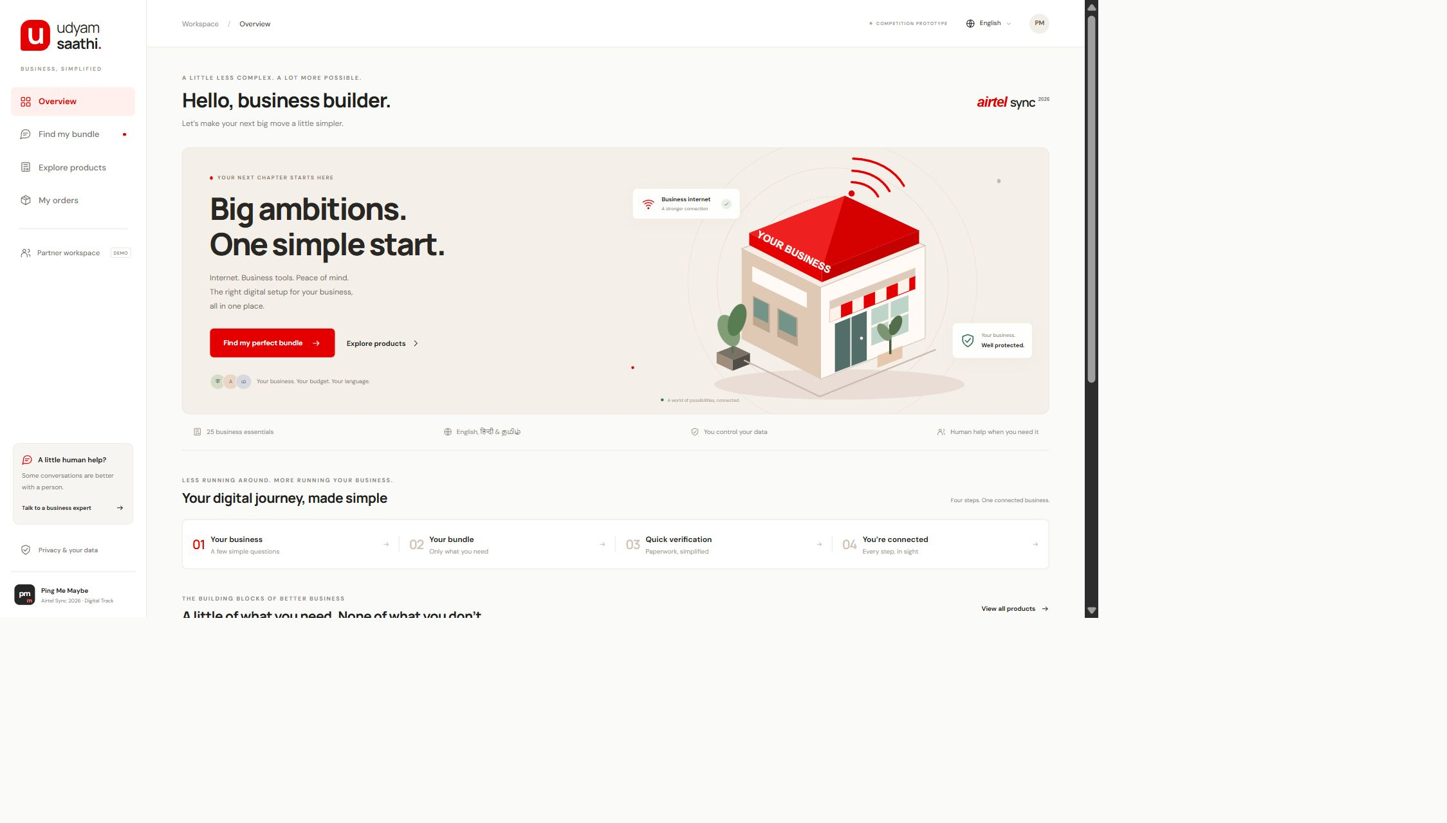
Udyam Saathi
A simpler digital start
for small businesses
Discover a useful bundle, verify documents
and follow activation in one workspace.
7.36%
baseline lead-to-activation
368 activations from 5,000 synthetic leads
Ping Me Maybe / VIT Vellore / 1
Notes:
Source: Airtel_SYNC_Case.pdf, Project Udyam Digital. Baseline: 368 / 5,000 = 7.36%. All underlying businesses and documents are fictional. The working prototype supports catalogue-grounded Gemini or OpenAI when a server-side credential is configured; guided mode remains explicitly labelled.

Slide 2
Professional offices are the first pilot segment
11.07% observed conversion
vs 4.06% for micro retail. Clinics, CA firms and
coaching centres need reliable internet and secure tools.
Five-person clinic, one site | Quantity | Monthly INR
Biz Fibre 300 | 1 site | 1,499
Backup 4G/5G Failover | 1 site | 499
Cloud Email & Office Suite | 5 users | 625
Endpoint Security | 5 devices | 495
Total |  | 3,118
INR 1,500 setup
INR 4,618 first month
12-month minimum
Starting case prices, excluding taxes.
Existing tools are retained where possible.
Multi-site and manufacturing follow later.
Ping Me Maybe / VIT Vellore / 2
Notes:
Source: data/source/smb_leads.csv and product_catalogue.csv. Professional offices: 138 / 1,247 = 11.07%; micro retail: 110 / 2,709 = 4.06%. Higher observed conversion does not establish causality. Office bundle calculation: P02 1499 + P09 499 + P16 5*125 + P20 5*99 = INR 3118/month; P09 setup INR 1500. Each selected product has a 12-month minimum. Prices use the synthetic catalogue minimum and exclude taxes.

Slide 3
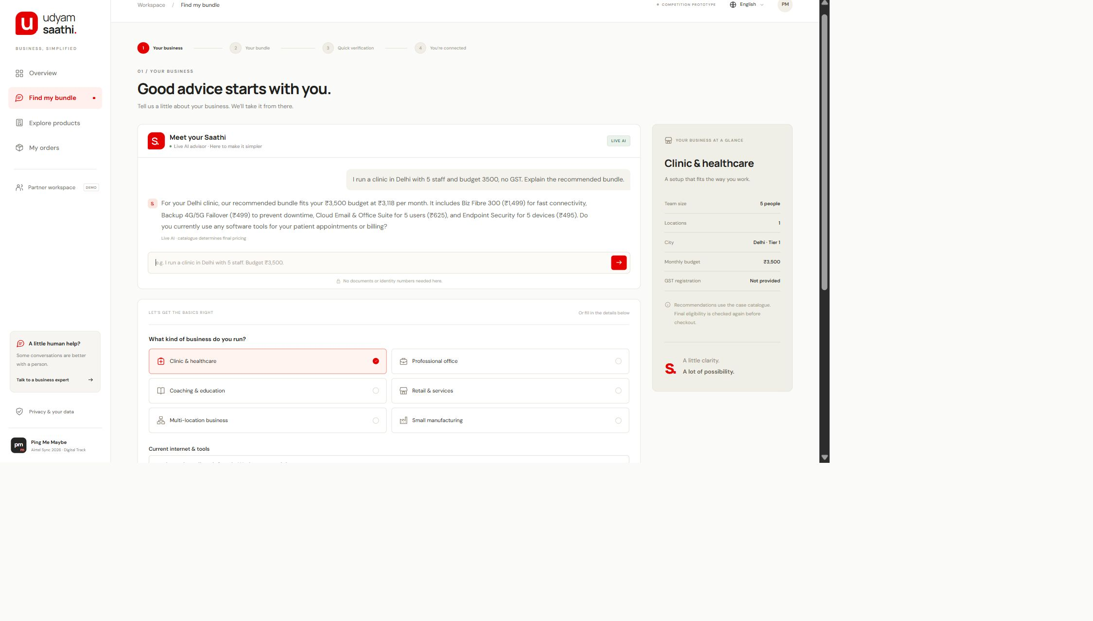
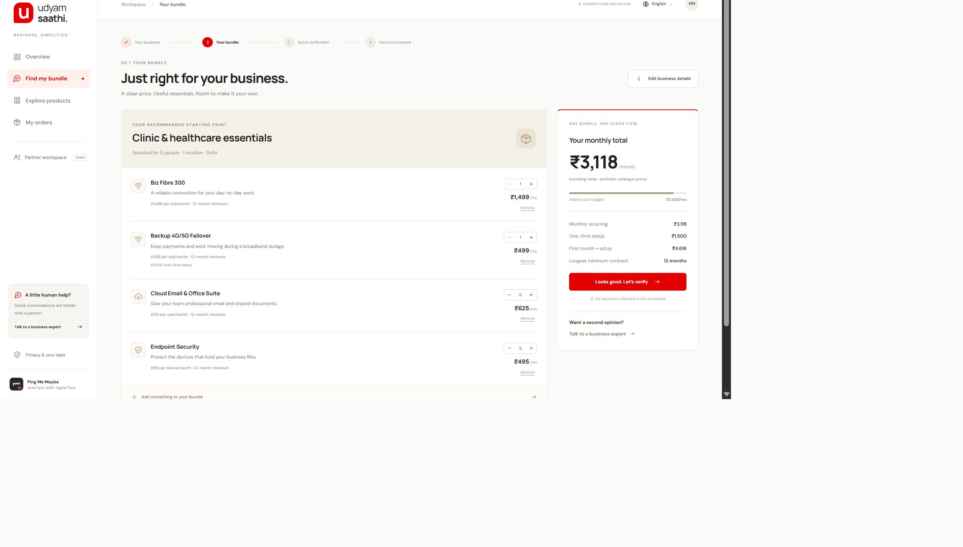
One journey, with human help for exceptions
01 Discover and explain
02 Review the bundle
English, Hindi or Tamil advice. Catalogue rules
control prices, quantities and dependencies.
Itemised charges and clear terms. Consent, local
OCR and order tracking follow in the same workspace.
Ping Me Maybe / VIT Vellore / 3
Notes:
Source: working Udyam Saathi prototype in https://github.com/rizzit17/ping-me-maybe . Screenshots show real app state. Live GenAI needs a server-side API key. Mock registration lookups and simulated order stages have no government or operator integration. Product names and some supporting screens remain English.

Slide 4
Integrated bundles already exist; the journey must improve
Offer | Established strength | Observed public entry | Implication for us
Airtel Business [1] | Broad connectivity, cloud and security portfolio | Request a callback for tailored solutions | Reuse product depth; reduce discovery effort
JioBusiness [2] | Integrated connectivity and digital services | Product plans and digital self-care | A bundle alone is not differentiation
Vi ReadyForNext [3] | MSME digital-readiness assessment and advisory | Assessment-led discovery | Connect discovery to a transparent next step
Udyam Saathi | Catalogue rules + local OCR + partner handoff | One demonstrable onboarding prototype | Test completion and clarity in the pilot
Differentiation hypothesis: multilingual guidance, explainable bundles and visible exceptions
in one flow. Competitor KYC speed and end-to-end conversion remain unverified.
Ping Me Maybe / VIT Vellore / 4
Notes:
Sources reviewed 7 November 2026: [1] https://www.airtel.in/b2b/ [2] https://www.jio.com/business/services/connectivity/jiobusiness-solution/ [3] https://www.myvi.in/business/enterprise-segments/smb/msme-readyfornext . These public product pages establish advertised features, not independently tested onboarding performance. A feature not described on a page is unverified, not absent. Udyam Saathi is a prototype, not a market-leading product.

Slide 5
The model advises; the catalogue and checks decide
Owner workspace
English / Hindi / Tamil
Server-side advisor
Gemini or OpenAI
Catalogue engine
25 products and rules
Explicit KYC consent
On-device document OCR
Mock registries + review
Dates, names and address
Order tracker
Partner exception queue
Data flow: preferences and chat reach the advisor; document images stay in the browser.
Controls: consent withdrawal clears KYC, identifiers are masked in results, credentials stay
on the server, and owners can reset session data. Legal and operator approval remain rollout gates.
Ping Me Maybe / VIT Vellore / 5
Notes:
Architecture follows current source: advisor.mjs, server.mjs, dist/engine.js and dist/app.js. Gemini documentation: https://ai.google.dev/gemini-api/docs/structured-output . The API key stays server-side. Gemini free-tier submitted content may improve Google products; this demo should use fictional inputs only. No KYC images are attached to advisor requests. OCR and registry fixtures run in the browser.

Slide 6
A 90-day pilot tests conversion before expansion
1,000 leads, two cities, professional offices first
Days 1–30
Operator and privacy review
Serviceability integration
Partner training
Days 31–60
Assisted launch
Instrument the funnel
Fix document exceptions
Days 61–90
Compare with a control
Audit support and retention
Expand only after review
Illustrative pilot economics
15% conversion = 150 activations
Same lead spend + INR 20 digital cost per lead
Modelled CAC: INR 8,024 vs INR 10,695 segment baseline
25% lower CAC
Planning scenario only
Ping Me Maybe / VIT Vellore / 6
Notes:
Professional-office baselines: acquisition spend INR 1,475,870 / 138 activations = INR 10,694.71 CAC. Segment conversion 11.0666%. Planning assumptions: 1,000 comparable office leads, 15% conversion, same segment spend per lead INR 1,183.5365, INR 20 incremental digital cost per lead. CAC = (1,183,536.49 + 20,000) / 150 = INR 8,023.58, 24.98% below the office baseline. Spend, margin, attribution and outcomes need experimental validation. 1,000 pilot leads are directional evidence, not guaranteed statistical power.

Slide 7
Five measures determine whether the pilot expands
Metric | Office baseline | Proposed target | Measurement
Lead-to-activation | 11.07% | 15% | Activated / all pilot leads
Mean lead-to-activation | 16.9 days | 10 days | Same eligible cohorts
Acquisition cost | INR 10,695 | ≤ INR 9,000 | All acquisition cost / activated
Customer follow-up calls | 3.07 | ≤ 1.5 | Mean per activated customer
Six-month churn | 13.8% | ≤ 12% | Review at month six
Rollout gates
Hallucinations: catalogue-controlled quotes. Document fraud: authorised verification + human review.
Installation delays: serviceability checks. Partner adoption: shared leads and explicit ownership.
Ping Me Maybe / VIT Vellore / 7
Notes:
Professional-office baselines from 1,247 synthetic leads and 138 activations: 11.0666% conversion, 16.9203 mean activation days, INR 10,694.71 CAC, 3.0652 follow-up calls and 13.7681% six-month churn. See docs/case-metrics.json and scripts/analyse-case.py for reproducible calculations. Targets are proposed pilot hypotheses. Churn cannot be measured in a 90-day pilot; review after six months. Sources: data/source/smb_leads.csv and docs/BUSINESS_CASE.md. Repository: https://github.com/rizzit17/ping-me-maybe .

