Slide 1
OGN corporate slide deck template
PLEASE NOTE THIS DOCUMENT IS A TEMPLATE THAT IS NOT TO BE DISTRIBUTED EXTERNALLY. ANY DERIVATIVE CONTENT DEVELOPED USING THIS TEMPLATE (IN WHOLE OR IN PART) MUST UNDERGO APPROPRIATE INTERNAL REVIEW AND APPROVAL PROCESS.
Revised September 11, 2025

Slide 2
How to use this document
[DELETE THIS SLIDE AND SECTION DIVIDERS PRIOR TO PRESENTATION]
Presentations created from this slide template must undergo appropriate local review and approval prior to use. Each new job derived from this template should link back to it in Veeva PromoMats and retain the same expiration date. See additional notes/guidance on each slide’s notes section.
Section 1 – company overview, high-level positioning; franchise one-pager, global reach one-pager, ORD and OMS overviews; key partnerships and accomplishments, culture and values, social channels
[The content of Section 1 cannot be altered.]
Section 2 – templates
Notes:
PLEASE NOTE THIS DOCUMENT IS A TEMPLATE THAT IS NOT TO BE DISTRIBUTED EXTERNALLY. ANY DERIVATIVE CONTENT DEVELOPED USING THIS TEMPLATE (IN WHOLE OR IN PART) MUST UNDERGO APPROPRIATE INTERNAL REVIEW AND APPROVAL PROCESS.

Slide 3
Section 1 – core content
Notes:
Section 1 slides provide a high-level overview of Organon’s core business and should be included in most presentations.

Slide 4

Organon: Here for her health
Date

Slide 5

Our vision, mission and purpose
Vision
A better and healthier every day
for every woman
Mission
Deliver impactful medicines and solutions for a healthier every day
Purpose
Help women and girls achieve their promise through better health. By addressing gender-related disparities in health, we build a more sustainable future for women, families, economies and society.

Slide 6
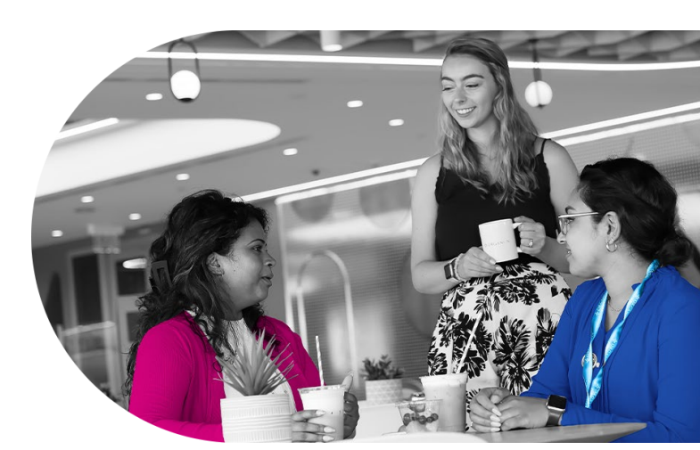
Living our values
A fearless team we call “founders,” we are united in pursuit of our vision, mission, and purpose. With an entrepreneurial spirit, our team leads the change we want to see reflected in the world. At Organon, we live our values every day.
Be real
Own it
Rise together
We are authentic and transparent.
We drive accountability and empowerment with high integrity and ethical standards.
We will collaborate and succeed as a team.
Keep moving
Bring your fire
We all belong
We will be entrepreneurial and resilient, lean into challenges and embrace change.
We maintain passion for our purpose and what we do.
We are enriched by the voices and perspectives of many different backgrounds.
Above all, we act with integrity, embracing our values in everything we do.
Notes:
Content derived from corporate narrative and website

Slide 7
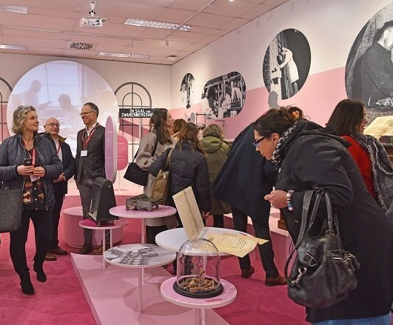
A new company with a 100+ year legacy in women’s health
Organon was established in 1923 at the forefront of innovation in women’s reproductive health.
Today, we are an independent, publicly traded global healthcare company with a diverse portfolio that offers solutions across a range of areas.
The original company has had many iterations since its establishment and was most recently re-launched following a spin-off from Merck & Co., Inc., Rahway, NJ, USA. However, one thing that has remained constant is our commitment to advancing the health of women.
Together, we are working to create a better and healthier every day for every woman around the world.
Notes:
Content adapted from ORD narrative

Slide 8
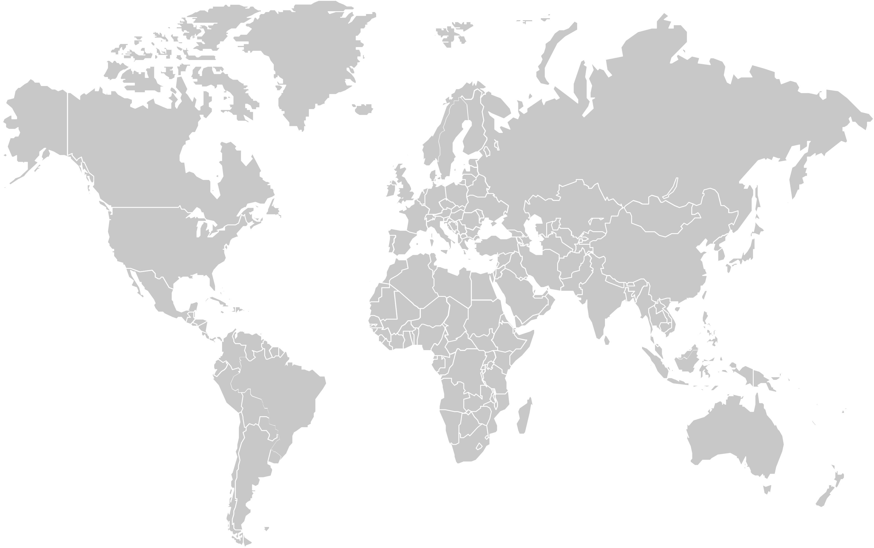

A global company
A global portfolio of more than 70 medicines and products across a range of therapeutic areas
Medicines and other products are available in more than 140 markets
~10,000 employees
Manufacturing sites in 6 countries
More than 60% of the board of directors are female
Notes:
Content from US-NON-110767
Data points should be rechecked for current business conditions.

Slide 9

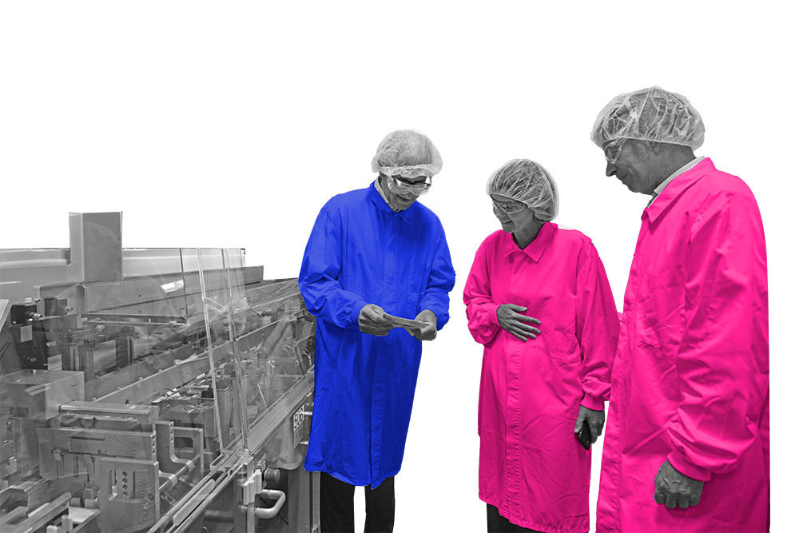
Our focus
Our diverse portfolio offers products and devices across a range of areas including reproductive health, cardiovascular disease, neurology, dermatology, autoimmune and respiratory conditions.
Our global footprint and network of patients, providers and payers enable our agility in adapting to local needs, ensuring we bring these necessary therapies and devices to those who need them around the world.
Notes:
Content adapted from corporate narrative

Slide 10
Driving new research in women’s health
We aspire to transform the entire landscape of the health of women.
Uniquely
As part of our growth strategy, we seek to continue to identify scientific collaborations and acquisitions to further build and maintain an industry leading pipeline across women’s health with both early- and late-stage assets that enables scientific and commercial leadership and continue to solidify our position as a women’s health partner of choice.
Disproportionately
Differently
Notes:
Content adapted from 10-k Feb 2025 and Founders Forum from Dec 2024

Slide 11



An ecosystem of like-minded partners and innovators
We believe that our efforts can spark collective action to deliver a new era in healthcare that empowers women globally - improving research, enhancing education, investing in partnerships to expand options, and advancing gender equity.
Our research and development organization supports our products through global registration, pharmacovigilance, medical affairs and health economics and outcomes research activities.
Our science spans the full research and development lifecycle, from Discovery through Phase IV studies, and is driven by seasoned researchers, scientists, regulatory, pharmacovigilance, and medical affairs experts.
OB/GYNs, PhDs, nurses and pharmacists are an invaluable part of our team, helping us to better understand needs from the perspectives of clinicians, physicians and patients.
Notes:
Content adapted from 10-k February 2025 and corporate narrative

Slide 12
Organon manufacturing and supply (OMS)

Slide 13
Our footprint: 6 manufacturing sites support global market access with world class capabilities
Cramlington, United Kingdom
Oral solid dosage formulation and packaging
Supporting areas including respiratory, pain and dermatology
Oss, The Netherlands
Organon International founded at this site in 1923
Formulation and packaging for women’s health oral solid dosage and specialty formulations
Heist, Belgium
Formulation and packaging for specialty devices, steroids, and oral solid dosage
Supporting areas including respiratory, pain and dermatology
Regional Packaging Network (Campinas, Pandaan & Xochimilco)
Geographically dispersed to meet global customer needs
Cramlington, UK
Oss, Netherlands
Heist, Belgium
Xochimilco,
Mexico
Pandaan, Indonesia
Manufacturing focus aligned with specific site roles
Superior expertise and supply performance
Demonstrated quality and compliance
Campinas,
Brazil
Notes:
Content adapted from OMS narrative

Slide 14
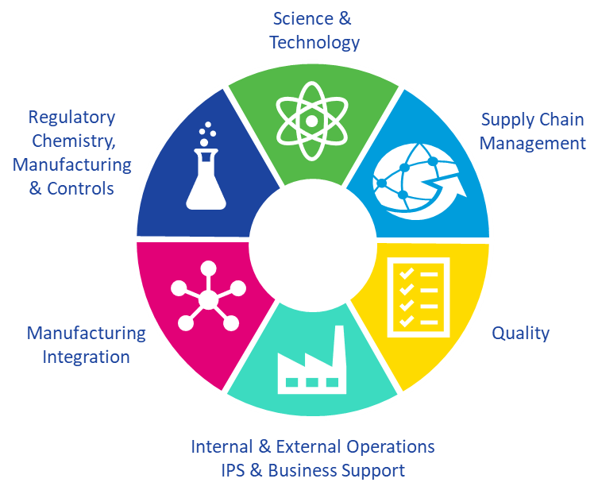
Our manufacturing & supply organization
Science &
Technology
Organon Manufacturing & Supply (OMS) is designed to support the complex product portfolio of over 70 product families – our wide-ranging technology platforms and our global supply chains reach patients in the 140 markets we serve around the world.
OMS also drives pipeline growth with technical, regulatory CMC & supply chain capabilities in Clinical Development.
Regulatory
Chemistry,
Manufacturing
& Controls
Supply Chain
Management
Manufacturing
Integration
Quality
14
14
Internal & External Operations
IPS & Business Support
Notes:
Content adapted from OMS narrative

Slide 15
Corporate responsibility

Slide 16

Focus: Committed to reducing unplanned pregnancies so women and girls can achieve their promise through:
Innovation
Championing and advancing
innovation in contraception access
Education
Increasing awareness so women can make informed decisions about their sexual and reproductive health, including contraceptive options and their correct use
Access
Expanding access to contraceptives through traditional and non-traditional interventions
Advocacy
Working with partner organizations to strengthen healthcare systems via stronger policies, data, capacity and representation of voices of women and girls
Notes:
Content pulled from US-NON-110767

Slide 17

Key achievements*
THE CONTENT ON THIS SLIDE IS BASED ON 2024 ESG REPORT. THIS SLIDE SHOULD NOT BE UTILIZED FOLLOWING PUBLICATION OF THE 2025 ESG REPORT.
13
~76M
transactions completed since 2021, with four in 2024, which allows us to advance meaningfully toward our mission.
Helped prevent ~76 million unintended pregnancies through the Her Promise Access Initiative, reaching over 63% of our goal.
63M
94%
Provided over 63 million women and girls in low- and middle-income countries (LMICs) with affordable access to contraceptive options.
of our operational waste is reused, recycled, or otherwise beneficially used.**
*As reported from Organon 2024 ESG Report
**Otherwise beneficially used includes composting and combusting with energy recovery.
Notes:
Content pulled from ESG website

Slide 18
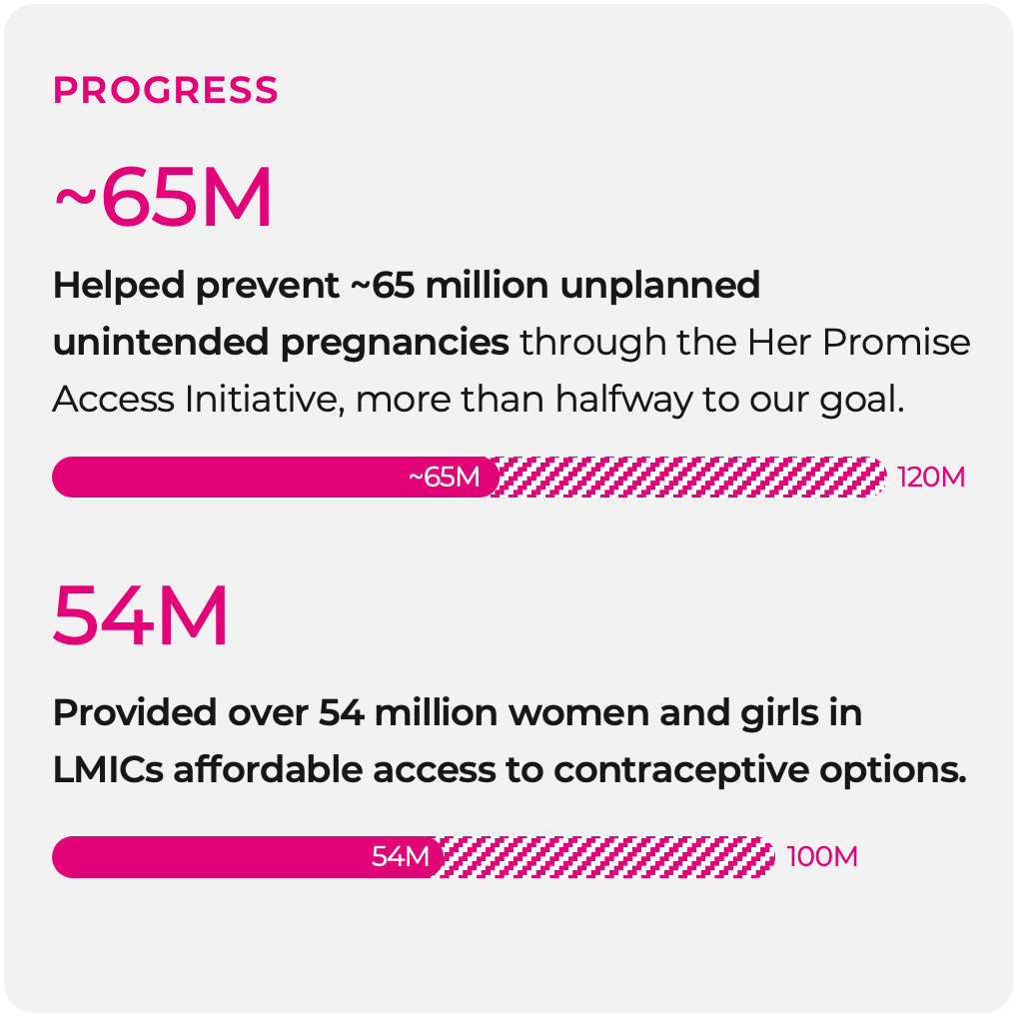
Her equity*
THE CONTENT ON THIS SLIDE IS BASED ON 2024 ESG REPORT. THIS SLIDE SHOULD NOT BE UTILIZED FOLLOWING PUBLICATION OF THE 2025 ESG REPORT.
Throughout the world, women have vast unmet medical needs. Our goal is to redefine and harness innovation to help women and girls achieve their promise and lead healthier, more empowered lives.
Goal
Work together with partners to help prevent an estimated 120 million unintended pregnancies by 2030 by providing 100 million women and girls in low- and middle-income countries (LMICs) with affordable access to contraceptive options by 2030.
PROGRESS
~76M
Helped prevent ~76 million unplanned
unintended pregnancies through the Her Promise
Access Initiative, more than halfway to our goal.
~76M
120M
63M
Provided over 63 million women and girls in LMICs affordable access to contraceptive options.
63M
100M
*As reported from Organon 2024 ESG Report
Notes:
Content pulled from ESG website

Slide 19
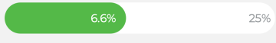
Her planet*
THE CONTENT ON THIS SLIDE IS BASED ON 2024 ESG REPORT. THIS SLIDE SHOULD NOT BE UTILIZED FOLLOWING PUBLICATION OF THE 2025 ESG REPORT.
The health of women depends on the health of our planet. While the ongoing climate crisis affects the entire world, pervasive gender inequality magnifies its impact on women and girls. Our goal is to implement environmentally friendly practices and long-term sustainability initiatives across our operations and value chain to positively impact women everywhere.
Goal
Support the transition to a low-carbon economy, with a long-term ambition to achieve net zero GHG emissions in our operations and through our supply chain.
By 2025:
Aim to reduce our Scope 1 and 2 GHG emissions by more than 25% from 2020 levels.
PROGRESS
5%
Reduced Scope 1 and 2 GHG emissions** by 5% against a 2020 baseline.
5%
25%
*As reported from Organon 2024 ESG Report
** Including biogenic emissions.
Notes:
Content pulled from ESG website

Slide 20
Her trust*
THE CONTENT ON THIS SLIDE IS BASED ON 2024 ESG REPORT. THIS SLIDE SHOULD NOT BE UTILIZED FOLLOWING PUBLICATION OF THE 2025 ESG REPORT.
We aim to be a credible voice for women’s rights and gender equity. Doing so and operating our business effectively requires that we uphold the highest levels of ethics and integrity across our operations. This effort begins with our Board of Directors, which oversees our rigorous approach to ethics and compliance.
Goal
Aspire to maintain the expertise, gender and racial diversity that characterizes our Board composition today.
PROGRESS
65%
Since our founding in 2021, nearly 65% of our Board of Directors have been women.
*As reported from Organon 2024 ESG Report
Notes:
Content pulled from ESG website

Slide 21
We believe in the power of collaboration
A sampling of the organizations Organon is currently working with:
NPWH
RESOLVE
Healthy Women
Power to Decide
HBA (Healthcare Business Association)
Family Equality
Direct Relief
UNFPA
Biosimilars Forum
Notes:
Content pulled from US-NON-110767

Slide 22


Creating a brighter future for her
We imagine a world where women, the backbone of a thriving and resilient society, can readily access solutions which meet her health needs. A world where she prospers, and so does her family, her community, and her world for generations to come. Together, we are building a brighter future for her.
Notes:
Content pulled from US-NON-110767
Video is sourced from job #US-NON-110965

Slide 24
Section 2 - templates
ANY CONTENT CREATED FROM THESE TEMPLATE SLIDES MUST UNDERGO APPROPRIATE REVIEW AND APPROVAL BEFORE USE.
Notes:
Section 2 slides are templates that may be adapted for specific use cases. Consistent with the section 1 slides, this content must also undergo appropriate review and approval before use.

Slide 25
Welcome message – [insert name]
[insert subheader – optional]
[insert message here]
ANY CONTENT CREATED FROM THESE TEMPLATE SLIDES MUST UNDERGO APPROPRIATE REVIEW AND APPROVAL BEFORE USE.
Notes:
Content created from this template must undergo appropriate review and approval before use.

Slide 26
ANY CONTENT CREATED FROM THESE TEMPLATE SLIDES MUST UNDERGO APPROPRIATE REVIEW AND APPROVAL BEFORE USE.
“
[insert quote here]
”
[Insert speaker name here]
[insert speaker title here]
Notes:
Content created from this template must undergo appropriate review and approval before use.

Slide 27
Leadership team template
First Last Name
Title
First Last Name
Title
First Last Name
Title
First Last Name
Title
First Last Name
Title
First Last Name
Title
ANY CONTENT CREATED FROM THESE TEMPLATE SLIDES MUST UNDERGO APPROPRIATE REVIEW AND APPROVAL BEFORE USE.
Notes:
Content created from this template must undergo appropriate review and approval before use.

Slide 28





ANY CONTENT CREATED FROM THESE TEMPLATE SLIDES MUST UNDERGO APPROPRIATE REVIEW AND APPROVAL BEFORE USE.
Cluster Name
[Insert region/market name]
Listing of markets
in cluster
Population of
INSERT
Market Name
X Clusters
+INSERT
founders
X Markets
Market Name
Market Name
X Manufacturing sites
Cluster Name
Commercial operations in + INSERT markets
Cluster Name
Cluster Name
Listing of markets in
cluster
Listing of markets in
cluster
Listing of markets in
cluster
Xx offices
Notes:
This is an example regional slide. User may adapt to reflect key facts and figures for a different region. Subject to appropriate review and approval.

Slide 29
[Insert name of partner organization]
[Insert description of partner organization and connection to Organon.]
[Describe the efforts to date in further detail.]
Insert graphic
ANY CONTENT CREATED FROM THESE TEMPLATE SLIDES MUST UNDERGO APPROPRIATE REVIEW AND APPROVAL BEFORE USE.
Notes:
Content created from this template must undergo appropriate review and approval before use.

Slide 30






Be a part of her story
SOCIAL MEDIA LINKS ARE FOR U.S./CORPORATE SOCIAL MEDIA PAGES AND MAY NOT BE USED FOR EX-US MARKETS. THESE SHOULD BE REPLACED FOR YOUR LOCAL CHANNELS OR THIS SLIDE SHOULD BE REMOVED.
Follow us on our journey as we seek to create a better future for her.
https://www.linkedin.com/company/organon
https://www.instagram.com/organonllc
https://www.facebook.com/OrganonLLC
https://x.com/OrganonLLC
https://www.youtube.com/@organonllc
https://www.tiktok.com/@organon_llc
Notes:
SOCIAL MEDIA LINKS ARE FOR U.S./CORPORATE SOCIAL MEDIA PAGES AND MAY NOT BE USED FOR EX-US MARKETS. THESE SHOULD BE REPLACED FOR YOUR LOCAL CHANNELS OR THIS SLIDE SHOULD BE REMOVED.

