Slide 1
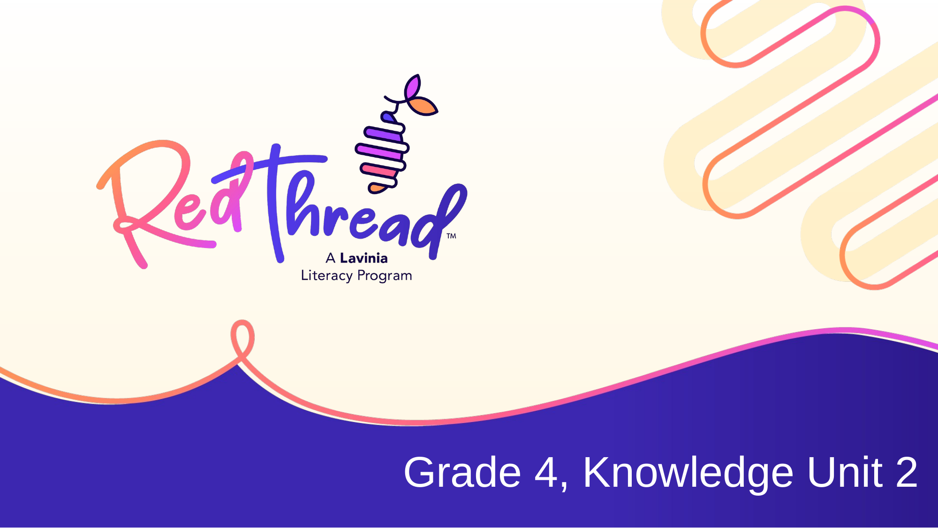

Slide 2
LESSON 6a
Lesson 6a: Reading
Grade 4, Knowledge Unit 2: A Road to Belonging: The Great Migration
Finding Langston by Lesa Cline-Ransome
Copyright © 2026 Lavinia Group. All Rights Reserved. RedThread is a trademark of K12 Coalition.

Slide 3
ESSENTIAL QUESTION
How can we understand characters by examining their responses to conflict?
TEACHING POINT
LANGUAGE GOAL
Fiction readers know that a story's conflict changes as the narrative progresses. They track the conflict as the plot progresses and ask themselves, "How does the conflict develop and intensify?"
Not specified in this lesson's source material.
Grade 4, Knowledge Unit 2 | A Road to Belonging: The Great Migration
2

Slide 4



Engage Vocabulary
develop
progress
To become more complex, complete, or advanced. An idea is usually developed by presenting details that add to or change an understanding of a topic.
To move forward into a new phase.
intensify
To grow stronger or more serious.
Grade 4, Knowledge Unit 2 | A Road to Belonging: The Great Migration
3

Slide 5




Launch Vocabulary
internal
external
Coming from inside of oneself.
Coming from outside of oneself.
isolated
Feeling distant and far from others. Feeling isolated often means you feel like you have to rely on yourself without the help of others.
Grade 4, Knowledge Unit 2 | A Road to Belonging: The Great Migration
4

Slide 6
Launch Chart
Read pages 46–50 of Finding Langston by Lesa Cline-Ransome.
Event | How the Conflict Develops or Intensifies
Langston focuses on memories of mother and Alabama. Not focusing on Chicago because he is so sad over his mother's death and missing his old life. | Langston struggles even more to fit in at school because instead of paying attention and focusing on starting a new life in Chicago, he constantly thinks about his sadness over his mother's death and life in Alabama he misses.
Bullies at school are now violent and hit him. Hint that they will hurt him more. | Conflict intensifies as Langston is afraid to go to school and cannot escape to his memories of Alabama and his mother. Makes Langston feel miserable.
Cannot share the bullying with his only parent—his dad—or the only neighbor who knows him—Miss Fulton. Teachers do not protect Langston from bullies. | Langston's loneliness intensifies as he feels he does not have anyone to help him, even when he is in fear of his physical safety. Conflict develops because not only does Langston feel isolated, he starts to feel hopeless that the upcoming days at school will get worse.
Grade 4, Knowledge Unit 2 | A Road to Belonging: The Great Migration
5

Slide 7
Independent Reading
TEACHING POINT
Event | How the Conflict Develops or Intensifies
Fiction readers know that a story's conflict changes as the narrative progresses. They track the conflict as the plot progresses and ask themselves, "How does the conflict develop and intensify?"
Read pages 51–55 of Finding Langston by Lesa Cline-Ransome. Take notes in your Unit Portfolio as you read.
IMPORTANT VOCABULARY
handkerchief: A small square cloth used for wiping the nose or mouth.
plot (of land): A piece of land.
debt: Something, usually money, owed as payment for something else.
plant: A factory that manufactures a product.
Grade 4, Knowledge Unit 2 | A Road to Belonging: The Great Migration
6

Slide 8
Discourse Clubs
DISCOURSE CLUBS
Prompt: How has Langston's conflict developed or intensified throughout the text so far?
Grade 4, Knowledge Unit 2 | A Road to Belonging: The Great Migration
7

Slide 9

Discourse Clubs
Prompt
How has Langston's conflict developed or intensified throughout the text so far?
Discourse Clubs
Collaborate with your club to discuss and deepen your understanding of the text.
Grade 4, Knowledge Unit 2 | A Road to Belonging: The Great Migration
8

Slide 10

Whole-Class Discourse
Prompt
How has Langston's conflict developed or intensified throughout the text so far?
Whole-Class Discourse
Share your ideas, listen to your classmates, and build on each other's thinking.
Grade 4, Knowledge Unit 2 | A Road to Belonging: The Great Migration
9

Slide 11
Closing
ESSENTIAL QUESTION
How can we understand characters by examining their responses to conflict?
TEACHING POINT
Fiction readers know that a story's conflict changes as the narrative progresses. They track the conflict as the plot progresses and ask themselves, "How does the conflict develop and intensify?"
Grade 4, Knowledge Unit 2 | A Road to Belonging: The Great Migration
10

Slide 12
Lesson Vocabulary Review
internal
external
Coming from inside of oneself.
Coming from outside of oneself.
isolated
Feeling distant and far from others. Feeling isolated often means you feel like you have to rely on yourself without the help of others.
Grade 4, Knowledge Unit 2 | A Road to Belonging: The Great Migration
11

