Slide 1

VOIS TIRTC AICTE Project
Healthcare Analytics for Doctor Visits
Student Name :
Rishabh Jain
College Name :
University Institute of Engineering and Technology, Kurukshetra University
AICTE STU ID :
STU6a27ded24e6791780997842

Slide 2

PROBLEM STATEMENT
Analyse Patient visit data to identify which groups visit doctors more frequently.
Explore how illness ,health status, chronic conditions to visit patterns.
Provide data driven insights to help hotel management improve healthcare services.

Slide 3
Project Description
Project uses Python, Pandas, and data visualization to analyse doctor visit patterns.
It explores how illness, health status, age groups, and chronic conditions are associated with healthcare utilization.
The insights help hospital management understand patient needs and identify opportunities to improve healthcare services.

Slide 4

WHO ARE THE END USERS?
Hospital management and administrators.
Doctors and healthcare professionals.
Healthcare planners and data analysts.
Public health organizations.

Slide 5

Technology Used
Python
Numpy
Pandas
Matplotlib
Seaborn

Slide 6
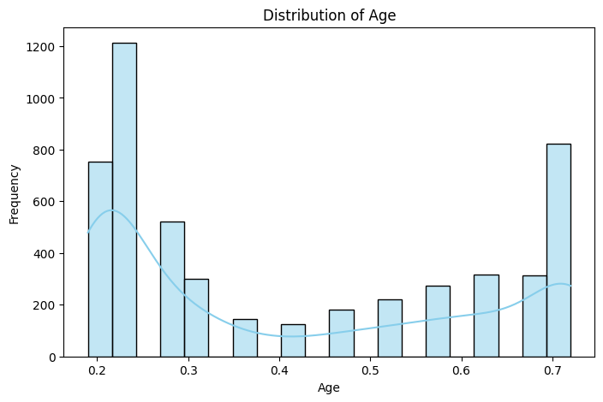
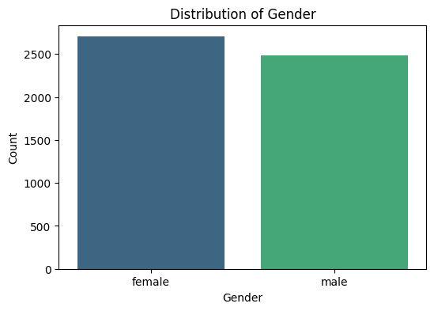
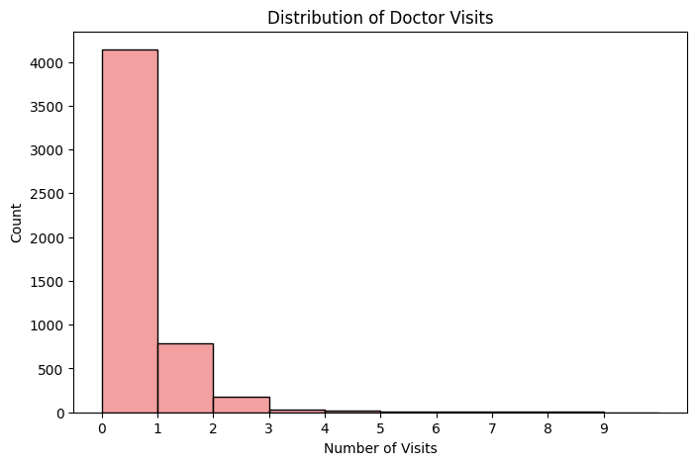
RESULTS

Slide 7
GitHub Link
https://github.com/rj-rishabhjain/Healthcare-Analysis-For-Doctor-Visit.git

Slide 8
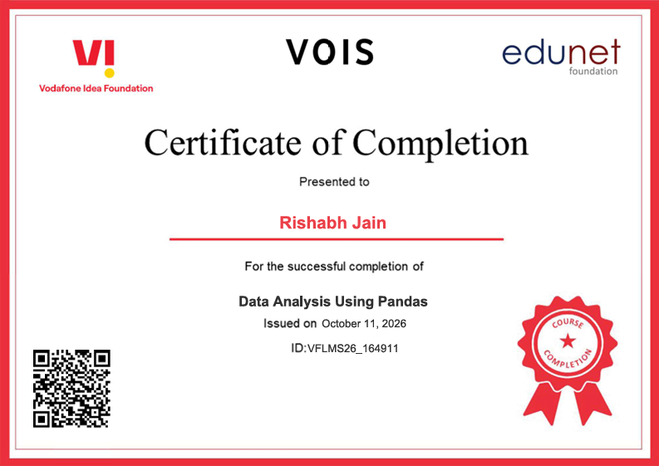
VOIS Course Completion Certificate
Course name : Data Visualization

Slide 9
Thank You
.
.

