Slide 1

VOIS AICTE Project
Seasonal Agriculture Performance Analysis
Student Name :
Rishabh Jain
College Name :
University Institute of Engineering and Technology, Kurukshetra University
AICTE STU ID :
STU6a27ded24e6791780997842

Slide 2

PROBLEM STATEMENT
Agricultural activities are influenced by seasonal variations in environmental conditions, farming practices, resource availability and market conditions. As a result, agricultural performance may differ from one season to another.
However, raw agricultural data does not clearly explain how agricultural performance changes across seasons or what patterns can be observed in different seasonal conditions.
The problem is to analyse the given agricultural dataset and investigate seasonal differences in agricultural performance by identifying meaningful patterns, trends, relationships and variations within the available data.

Slide 3
Project Description
Seasonal Agriculture Performance Analysis is a Data Analytics project focused on understanding how agricultural performance varies across different seasons, geographical areas, and farming conditions. The project uses agricultural data containing information about farming practices, environmental conditions, crop production, resource usage, and economic performance.
The analysis involves exploring, cleaning, and preparing the dataset, followed by identifying meaningful seasonal patterns, trends, relationships, variations, and differences in agricultural performance. Statistical analysis and data visualization techniques are used to compare agricultural outcomes across seasons and examine how environmental conditions, resource utilization, and other factors relate to agricultural performance.
The project aims to transform raw agricultural data into evidence-based insights that can help understand seasonal variations, identify significant or unusual patterns, compare performance across different periods and regions, and highlight areas requiring further investigation.
The final analysis provides data-driven conclusions and recommendations that can support better understanding and planning of seasonal agricultural activities.
The complete analysis is documented and presented through a Jupyter Notebook.

Slide 4

WHO ARE THE END USERS?
Farmers
Agricultural Planners
Researchers
Government Agricultural Departments
Agro Business & Resource Managers
Data Analysts

Slide 5

Technology Used
Python
Numpy
Pandas
Matplotlib
Seaborn
Jupyter Notebook

Slide 6
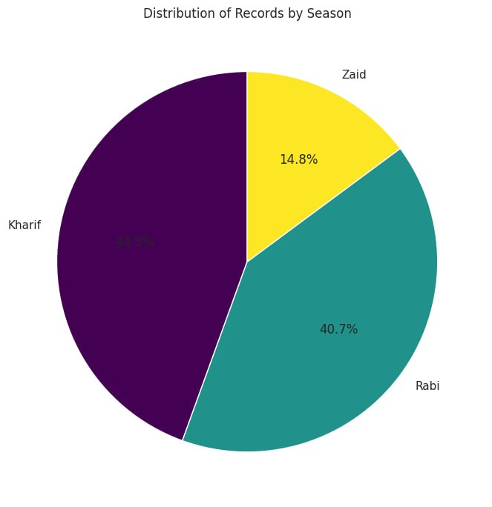
RESULTS

Slide 7
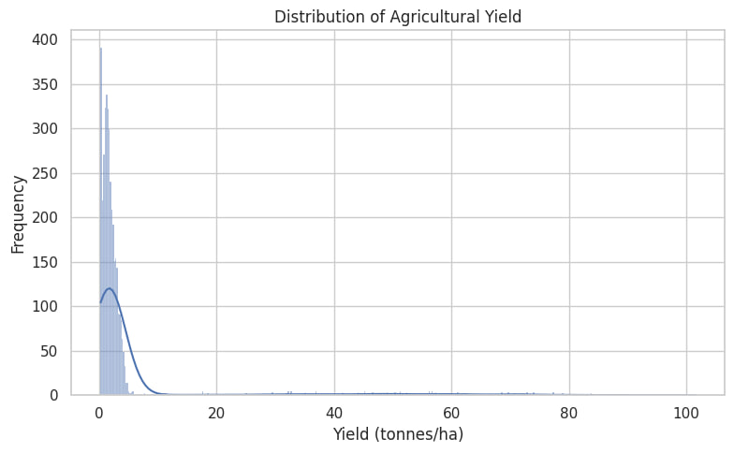
RESULTS

Slide 8
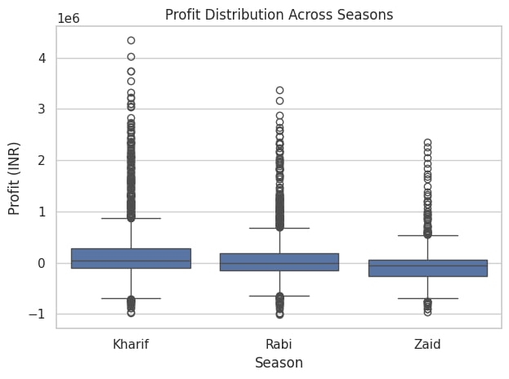
RESULTS

Slide 9
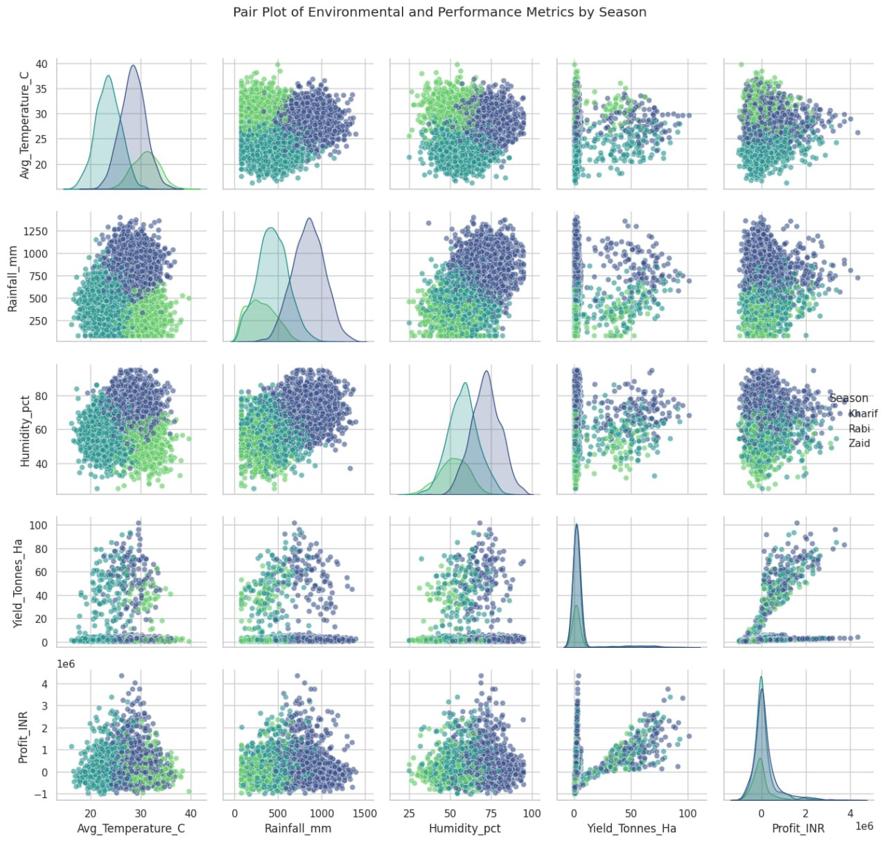
RESULTS

Slide 10
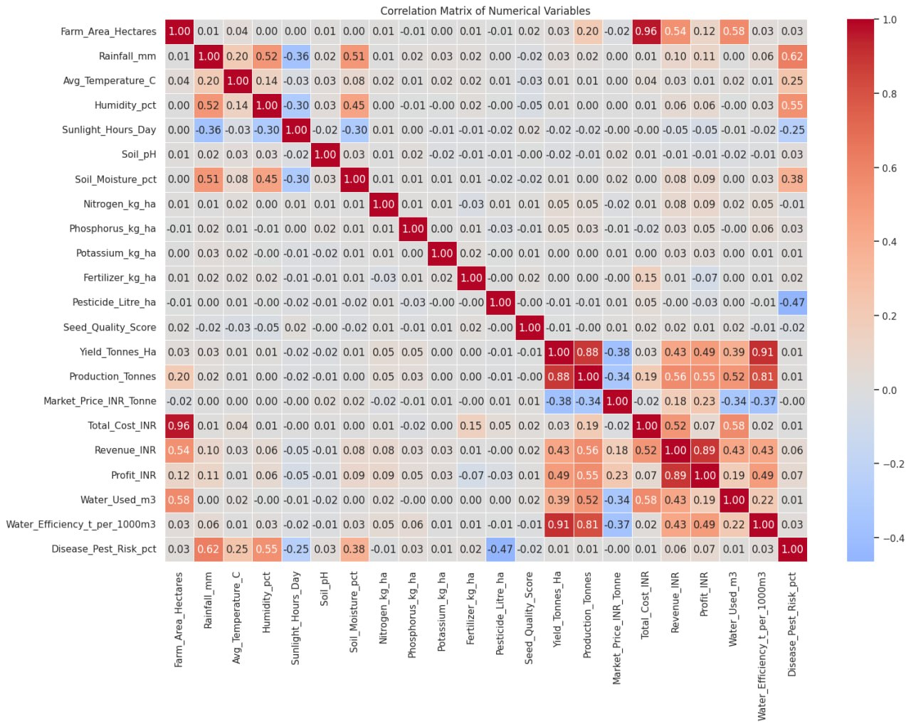
RESULTS

Slide 11
Future scope:
Predictive Analysis: Develop machine-learning models to predict agricultural performance and crop outcomes for upcoming seasons.
Weather Integration: Incorporate real-time weather and climate data to study the impact of changing environmental conditions.
Regional Comparison: Expand the analysis to more geographical regions and compare seasonal agricultural performance.
Crop-Level Analysis: Analyze individual crops to identify which crops perform differently under specific seasonal conditions.
Resource Optimization: Study water, fertilizer, land, and other resource usage to identify opportunities for more efficient utilization.
Economic Forecasting: Extend the project to predict crop prices, revenue, and profitability across different seasons.
Interactive Dashboard: Develop an interactive dashboard using tools such as Power BI, Tableau, or Stream lit for real-time exploration of agricultural insights.
Decision-Support System: Build a data-driven system that can provide farmers and agricultural stakeholders with seasonal insights and planning support.

Slide 12
GitHub Link
https://github.com/rj-rishabhjain/Seasonal-Agriculture-Performance-Analysis.git

Slide 13

VOIS Course Completion Certificate
Course name : Data Visualization

Slide 14
Thank You
.
.

