Slide 1

2022 IEEE International Students Conference on Electrical, Electronics and Computer Science(SCEECS 2022)
Paper Title : Monitoring and Control of COVID Vaccine Storage Temperature Using IoT and Machine Learning
Paper Id : 27
Royam Jain, Suresh Kumar Gawre
Department of Electrical Engineering,
Maulana Azad National Institute of Technology,
Bhopal, Madhya Pradesh

Slide 2
Purpose of the study
Designing a system to control and monitor the temperature of vaccine storage rooms to keep the vaccines safe
Using Internet of Things technology to bring the system online and Machine Learning to make predictions and bringing the system to life

Slide 3
Introduction
It is mandatory to maintain vaccines at a restricted temperature (2-8˚C)
Proposed system will maintain the temperature at the desired range and will also monitor it
Technologies used:
Internet of Things
Machine Learning
Z-score analysis
Cloud Computing and more..

Slide 4
Previous study and work
Previous work was done by keeping the patients in consideration[1] like making IoT oximeters[2], blood pressure monitoring[3], etc.
Work is done on controlling the temperature or making storage boxes but are lacking the use of internet technologies[4]
Work here is done by keeping the vaccines in consideration because they are also needed to be taken care of and protected

Slide 5
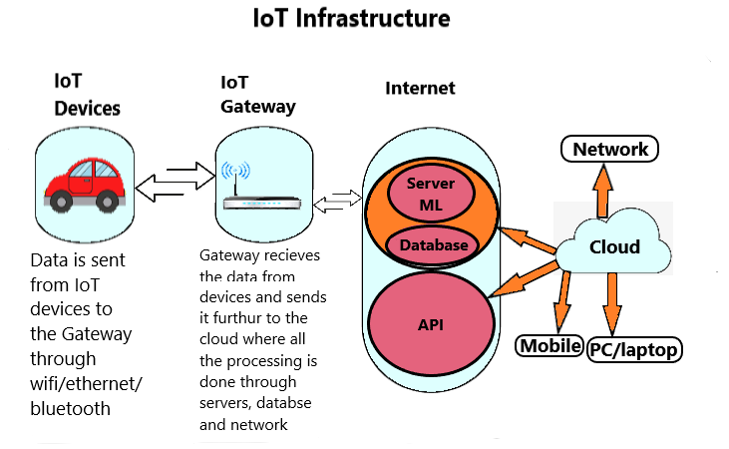
Internet of Things
IoT is a technology which can be used to connect devices to the internet
In this study, IoT has principle role of connecting the system to internet.

Slide 6
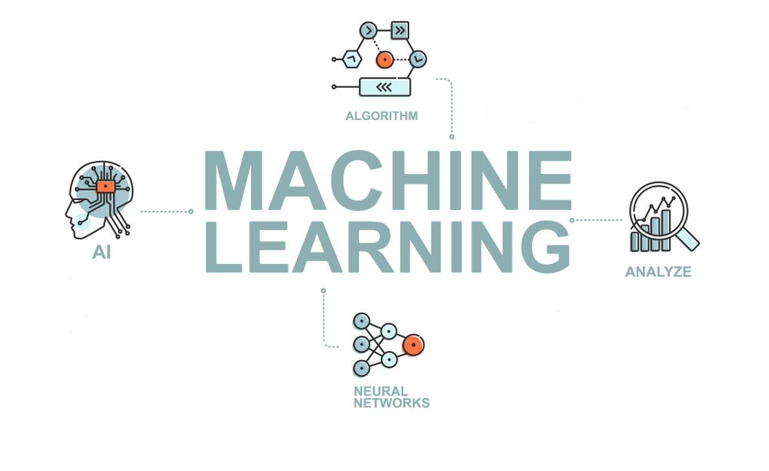
Machine Learning
Machine learning is a method of data analysis that automates analytical model building, used for data predictions, classification and clustering
In this system, ML is used for temperature prediction using it’s linear regression algorithm

Slide 7
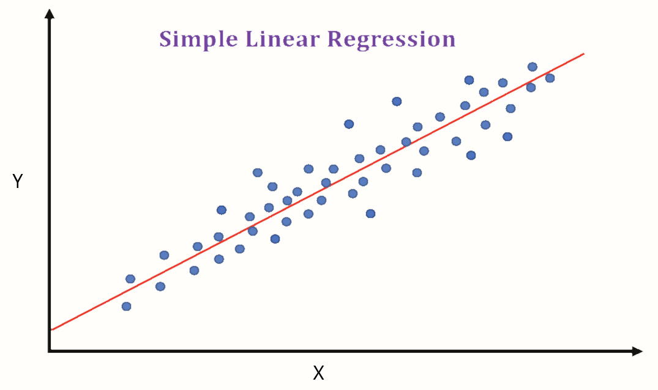
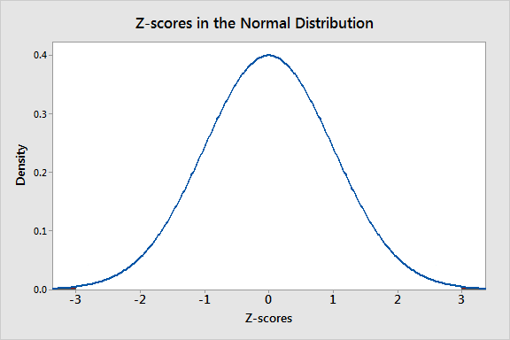

Methodology Algorithms used
The following algorithms are used in the proposed system:
Linear Regression
This algorithm is used for making predictions for the next 20 minutes
Uses the equation 𝑌 = 𝛼 ∗ 𝑋 + β
Z-Score analysis
This algorithm is used for finding out anomalies in temperature
It is found by using equation $Z=\frac{x −μ }{σ}$

Slide 8
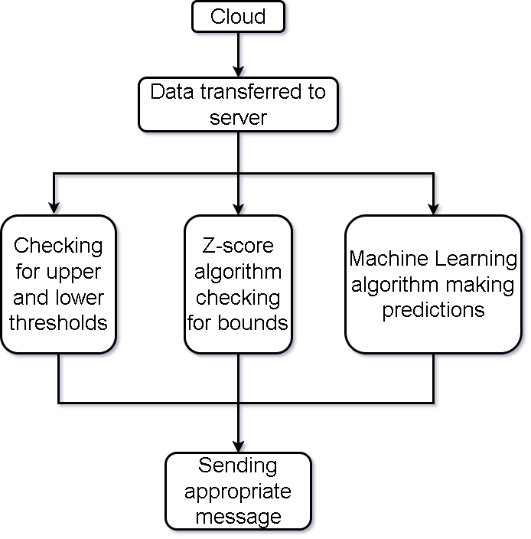
Methodology Working
The data picked up from the cloud will be processed as shown in flow chart:

Slide 9
Methodology Alarming and Controlling
Alarming and Controlling systems:
Fan is used to control the temperature, it’s speed will be adjusted automatically
Buzzer and LEDs are used for alarming the workers so that they can take fast actions before it’s too late
A message will be delivered to the authorities in case of any abnormality

Slide 10
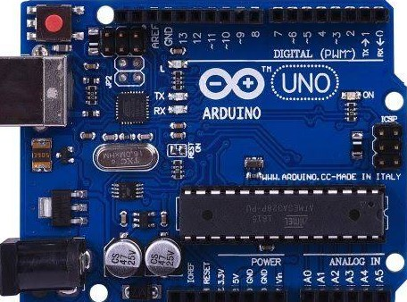
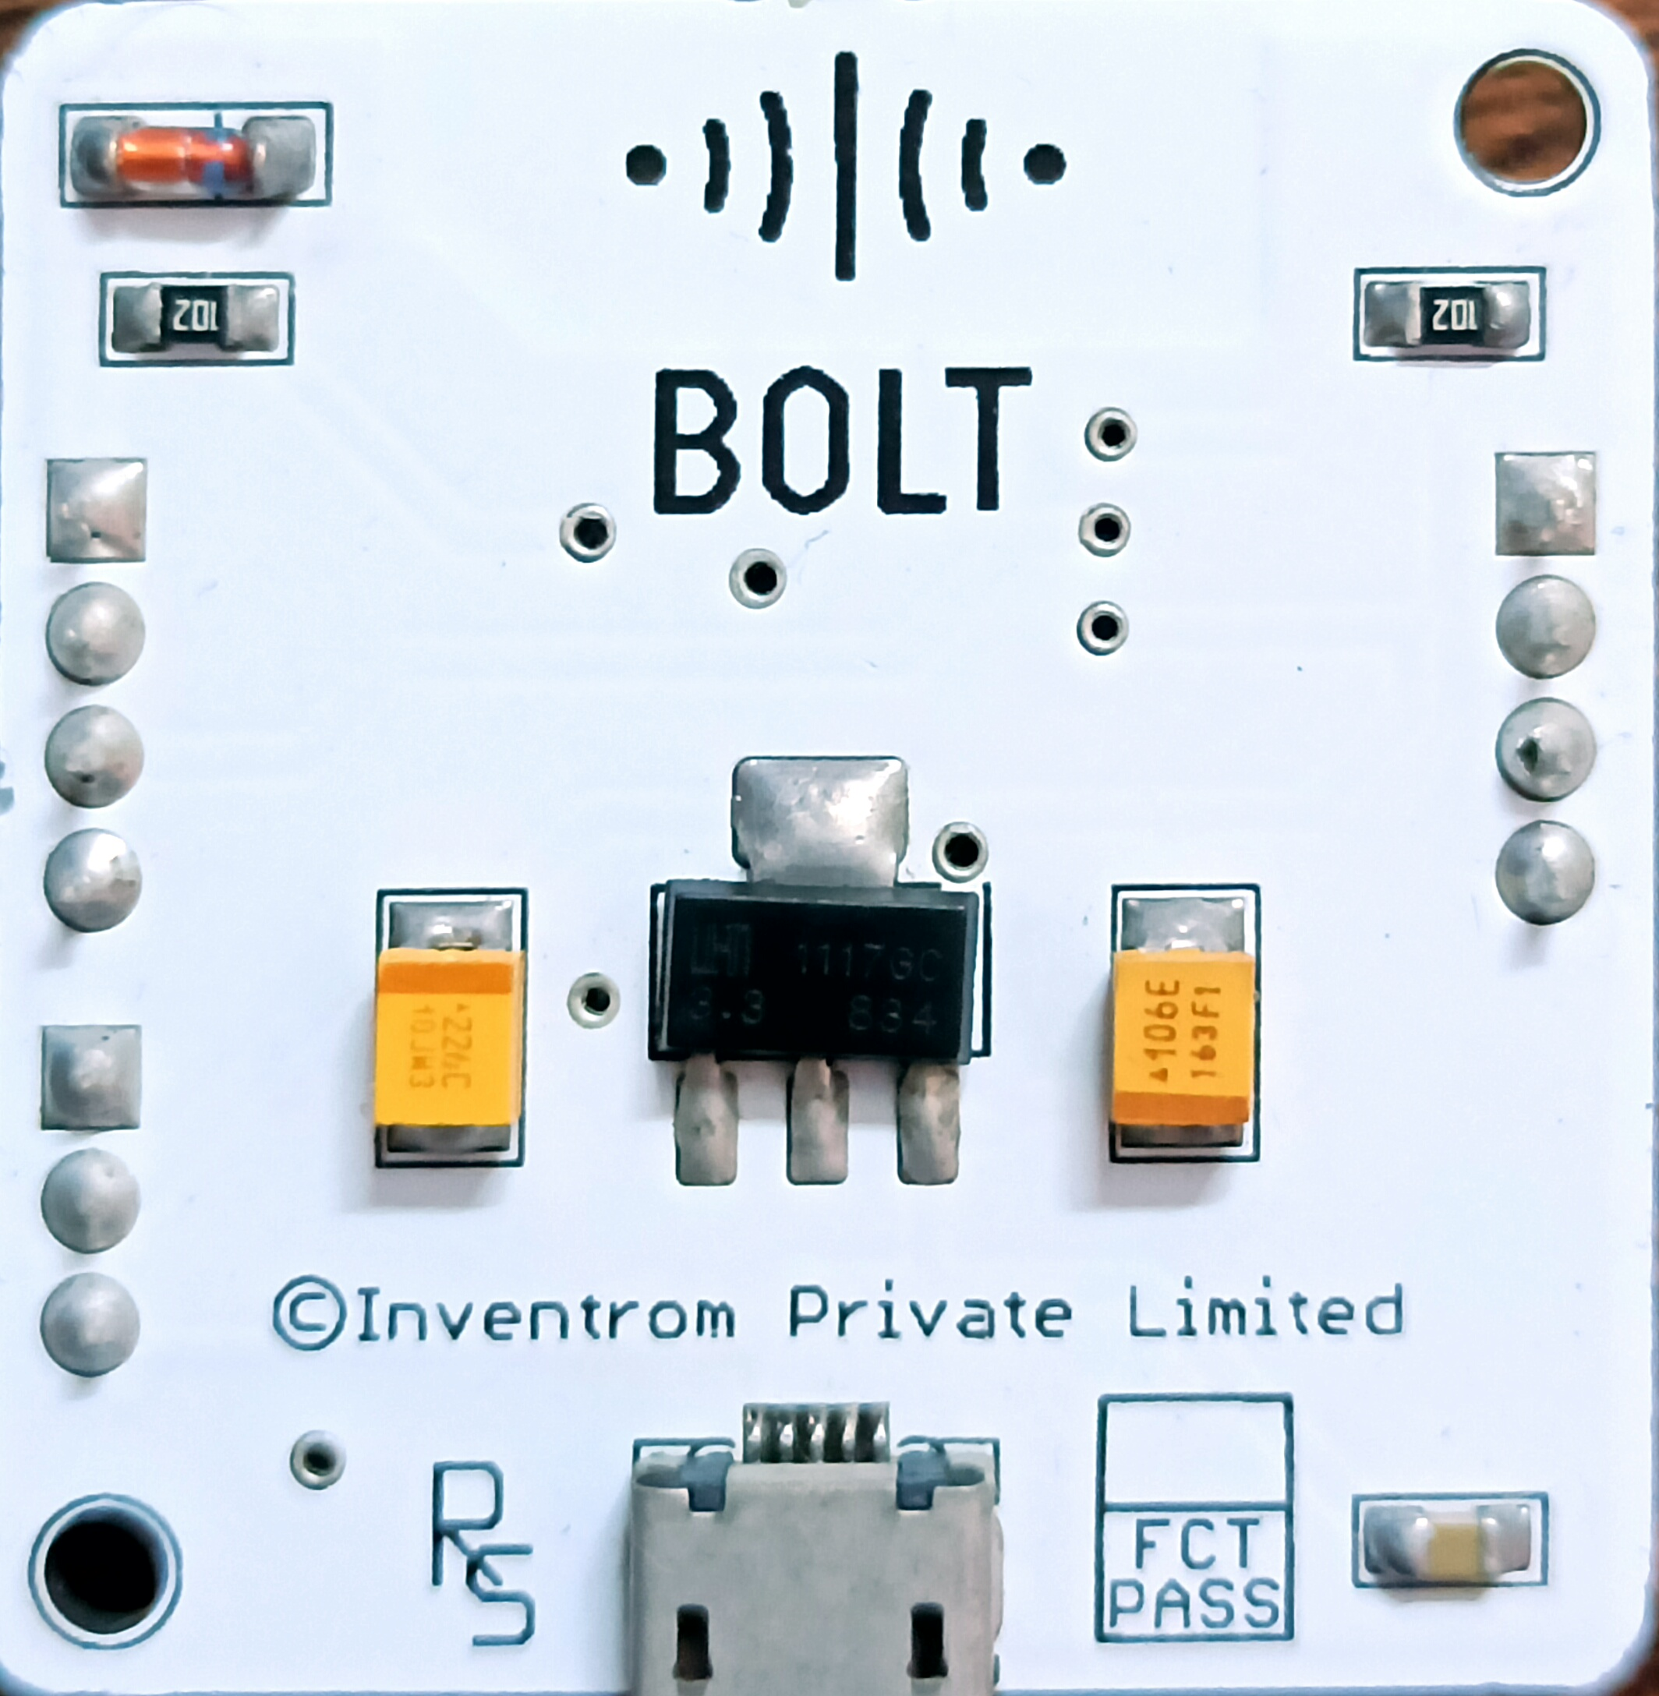

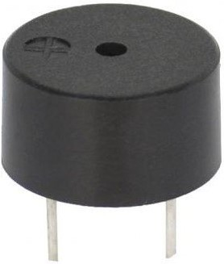

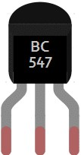
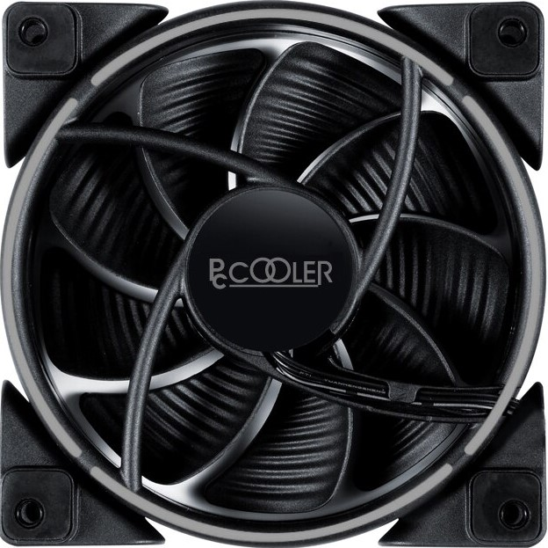
Hardware used
Image | Description | Used for
 | Arduino Uno with ATmega 328P microcontroller | Controlling the hardware circuit
 | Bolt Wi-Fi module with ESP8266 Wi-Fi chip | Connecting through the internet
 | LM 35 temperature sensor | Measuring the temperature of the room
 | Piezo buzzer (5V) | Alarm for workers
 | LED x 3 (red, yellow, green) | Visual indicator for workers
 | BC 547 transistor | Triggering the buzzer
 | Cooling fan (5V) | Cooling purpose

Slide 11
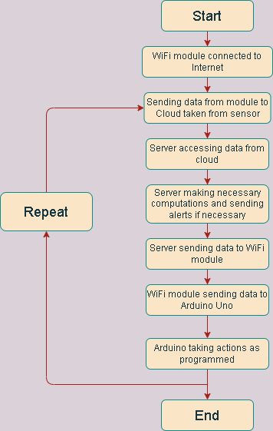
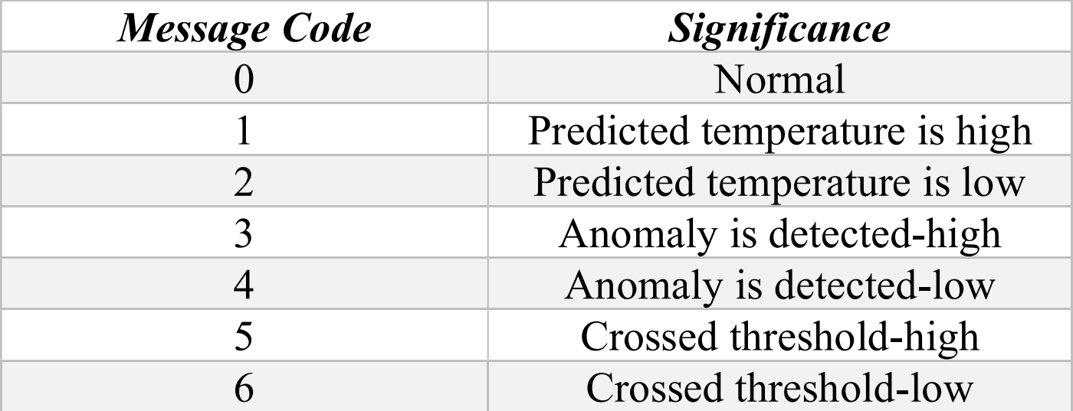
Proposed Model Flow chart

Slide 12
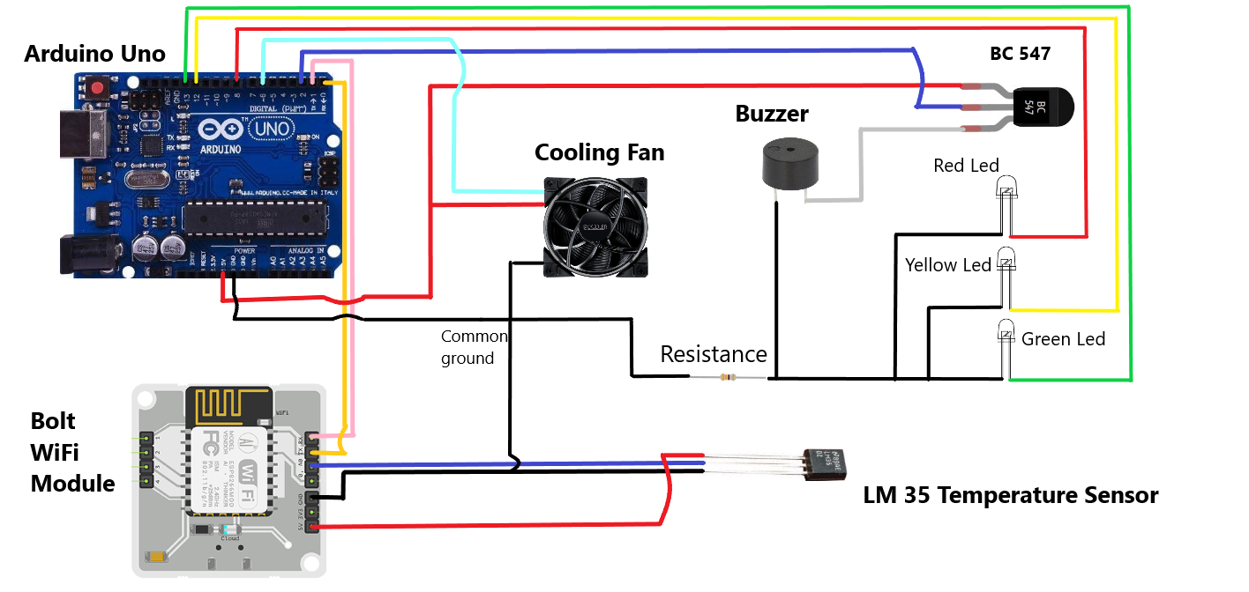
Proposed Model Hardware Line Diagram

Slide 13
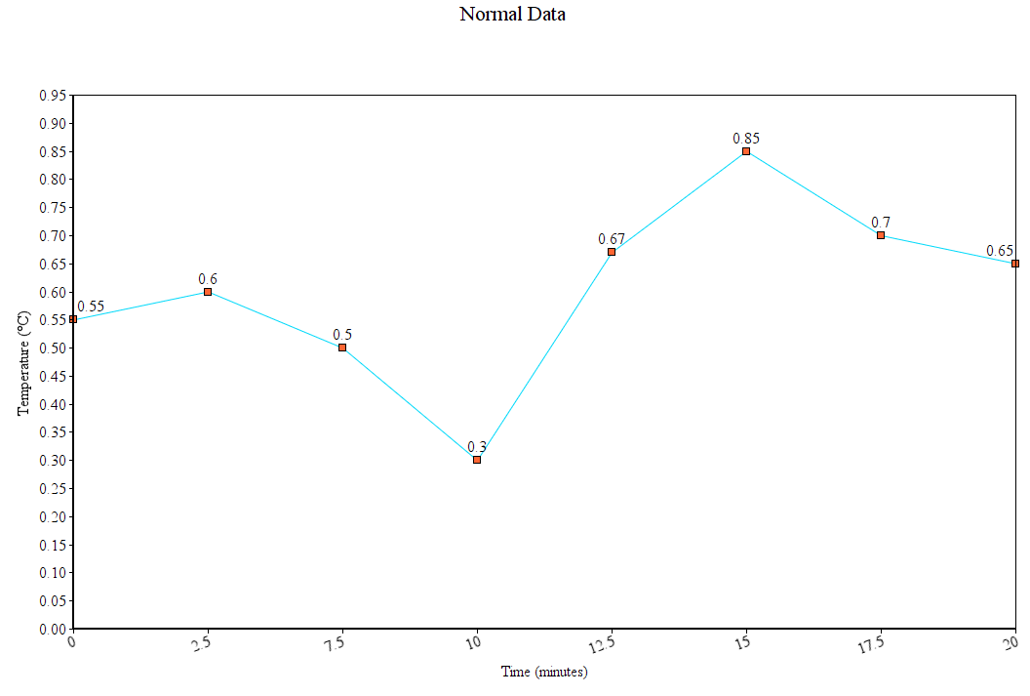
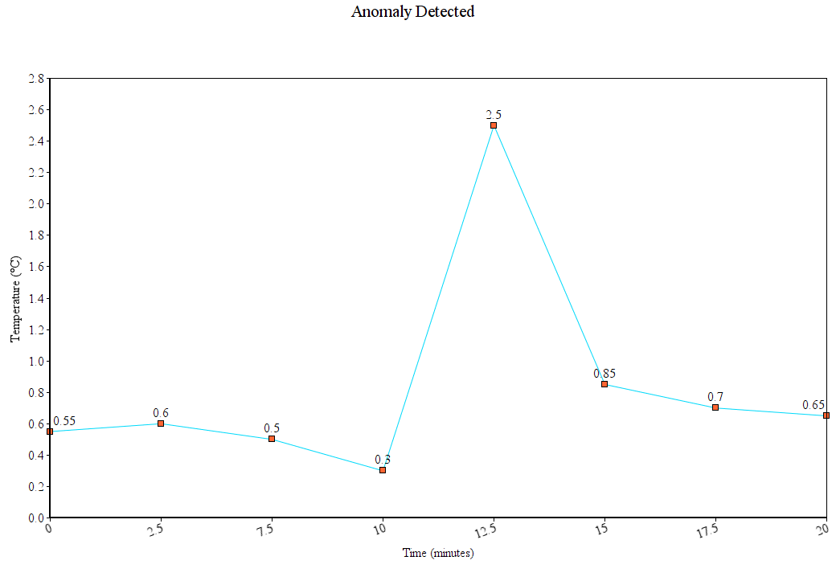
Data Visualization
Visual representation of normal data
Visual representation when anomaly is caught

Slide 14
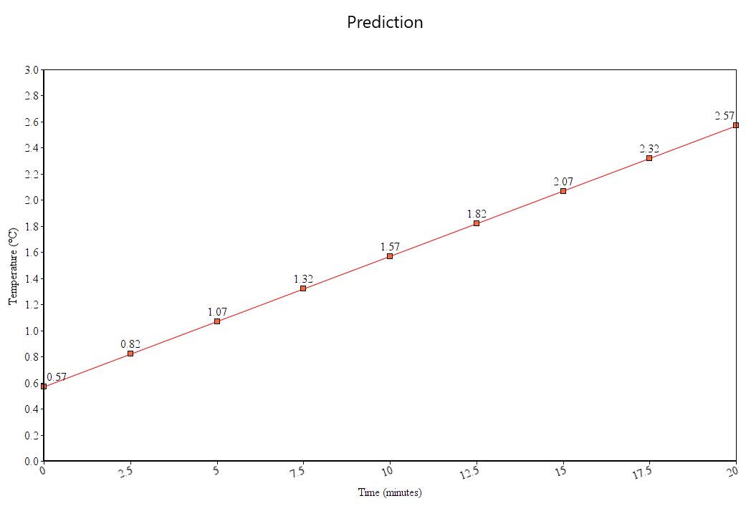
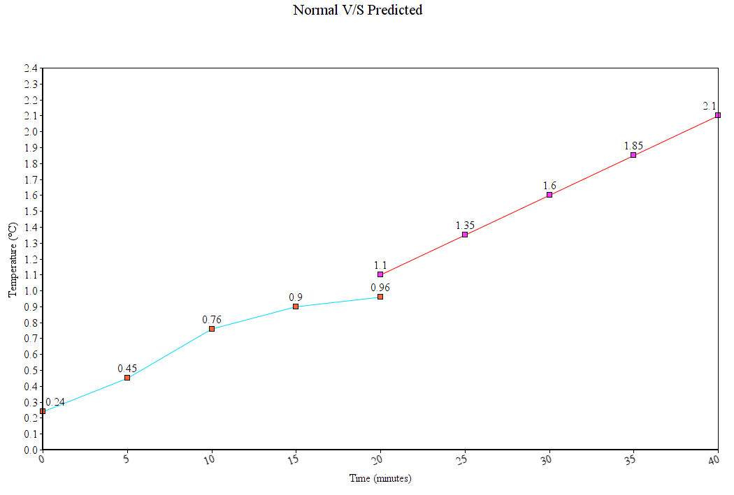
Data Visualization
Visual representation of the prediction made by ML algorithm
Comparison of Normal data and predicted data

Slide 15
Conclusion and Future work
This work is based on protection of vaccines, which are vital at the moment of time
The proposed system will maintain the temperature in the desired range and by doing that will prevent huge economic, life, property, money and time loss
Future scope of this work can be:
The system can be made fully independent by using solar power
A Web UI can be made from where one can see the real time data and can control system

Slide 16
References
T. H. Hafsiya and B. Rose, "An IoT-Cloud Based Health Monitoring Wearable Device For Covid Patients," 2021 7th International Conference on Advanced Computing and Communication Systems (ICACCS), 2021
H. K. Pendurthi, S. S. Kanneganti, J. Godavarthi, S. Kavitha and H. S. Gokarakonda, "Heart Pulse Monitoring and Notification System using Arduino," 2021 International Conference on Artificial Intelligence and Smart Systems (ICAIS), 2021
R. Saha et al., "Internet-of-Things Framework for Oxygen Saturation Monitoring in COVID-19 Environment," in IEEE Internet of Things Journal
R. Shinde, M. S. Alam, M. Choi and N. Kim, "Economical and Wearable Pulse Oximeter using IoT," 2021 16th International Conference on Computer Science & Education (ICCSE), 2021
J. C. Ordonez and C. Ordonez, "Thermoelectric insulation for cold temperature vaccine storage," 2021 IEEE Conference on Technologies for Sustainability (SusTech), 2021.

Slide 17
Thank You!
Questions?

