Slide 1
Identifying Locations for John’s Ice Cream and Pizza Shop
Capstone project

Slide 2
Background
John is planning to leave his fast-paced corporate career in NYC
He wishes to return to McLean County, Illinois to be near his family and start an ice cream and pizza shop there
John has decided to open his shop in McLean County, but wants to know which town in the County is most ideal for the business

Slide 3
Background (cont’d)
John has provided the following criteria for the shop location:
The town must be located in McLean County, Illinois
The town must not already have an ice cream shop.
The town must not already have a pizza restaurant.
The town has a substantial population to sustain the business.

Slide 4
Data required
List of towns in McLean County
Source: HomeTownLocator.com
List of populations and locations (latitudes and longitudes) for each town in McLean County
Source: Wikipedia
Existing venues for each town in McLean County
Source: Foursquare API

Slide 5
Data Processing & Tools Used
Pandas library will be imported to create and analyze data frames
Json library will be imported to process data in JSON files
Requests library will be imported to handle requests
Geolocation data (latitudes and longitudes) will be found with algorithm coding and Nominatim.
Folium mapping will be needed to generate maps of McLean County.

Slide 6
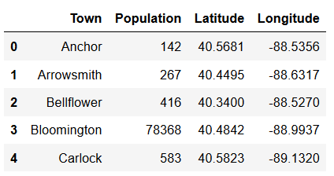
Analytical Methodology
Gather information from the Wikipedia page for each town in McLean County (including name, population, latitude, and longitude) and compiled it in a CSV file
Read the CSV file into a pandas data frame

Slide 7
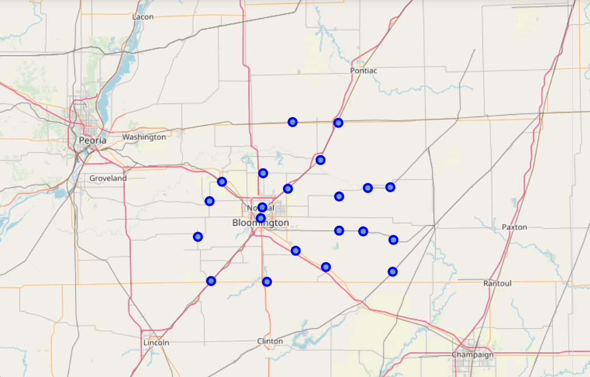
Analytical Methodology (cont’d)
c. Create a folium map for McLean county with all its towns superimposed on it

Slide 8
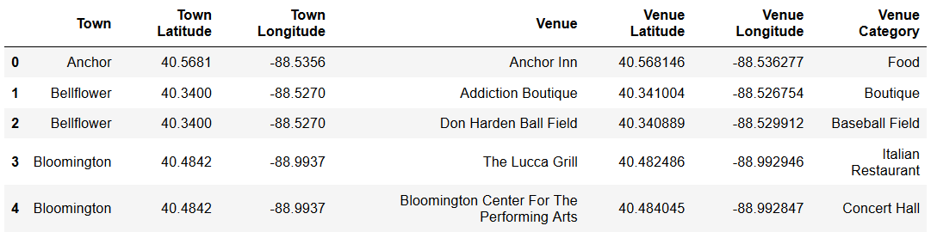
Analytical Methodology (cont’d)
d. Construct the GET request and send it to Foursquare to get JSON results for each town
e. Clean the JSON results and structure it into a data frame
f. Display all venues in all towns in McLean County

Slide 9
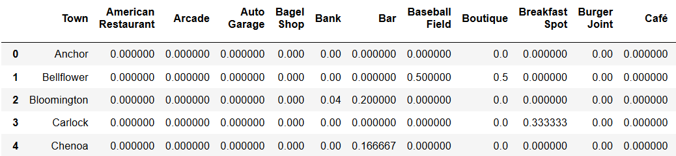
Analytical Methodology (cont’d)
g. Use the groupby method to calculate the total numbers of venues in each category for all towns

Slide 10
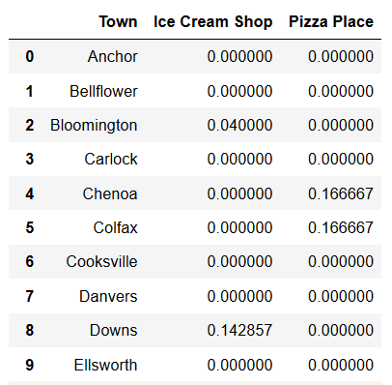
Analytical Methodology (cont’d)
h. Create a new data frame with three columns: town names, total number of ice cream shops, and total number of pizza places
i. Remove towns that already have ice cream shops and pizza restaurants
j. Sort the remaining towns by population and display the 3 towns with the largest populations

Slide 11
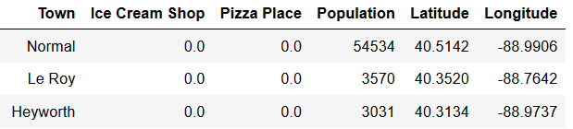
Results
Analyses has identified the three towns with the largest populations that currently do not have an ice cream shop nor a pizza restaurant
Normal, Le Roy, and Heyworth

Slide 12
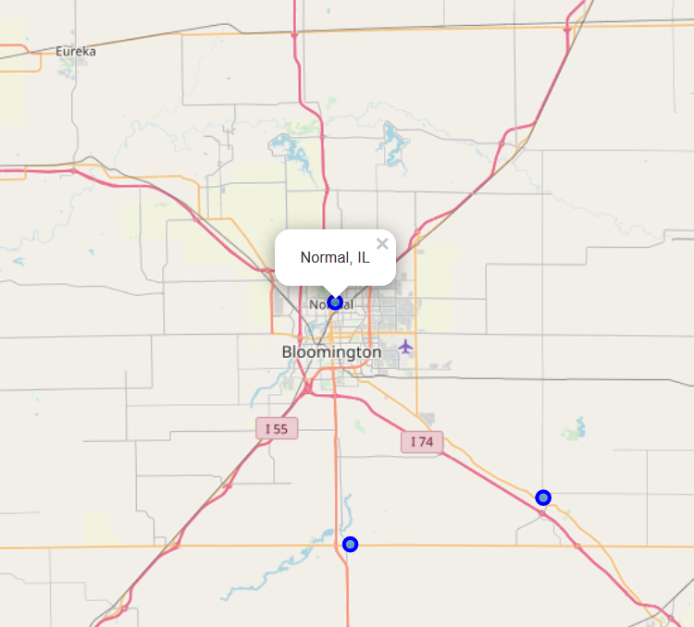
discussions
Le Roy and Heyworth are small towns with similar populations (3,000~ 4,000)
Normal is a much larger community (54,000+ residents) and is better positioned to sustain an ice cream and pizza shop.

Slide 13
Conclusion & Recommendation
Three towns meet John’s selection criteria: Normal, Le Roy, and Heyworth.
Normal is likely the most ideal location for his shop given its larger population. Thus, Normal is recommended as the top choice for his shop.
Le Roy is recommended as the second choice, and Heyworth the third.

