Slide 1

CST 391 BenchMark Milestone by Rebecca Johnson

Slide 2
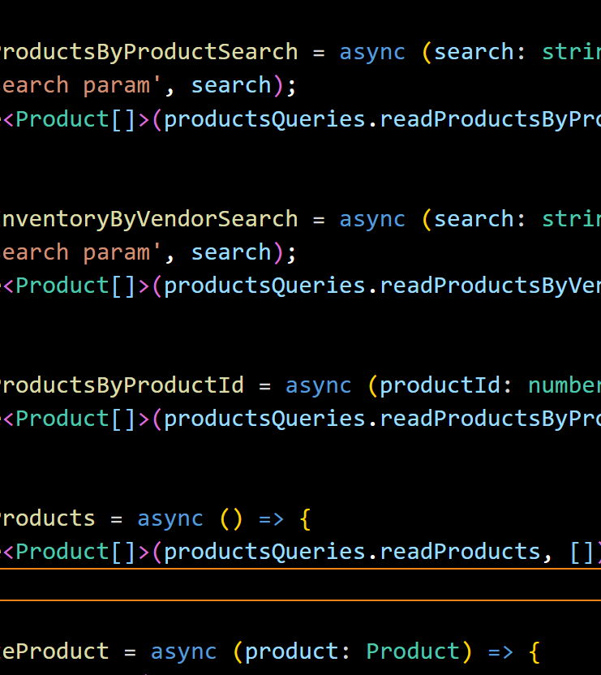
AGENDA
Challenges
Pending bugs or issues
Lessons learned

Slide 3
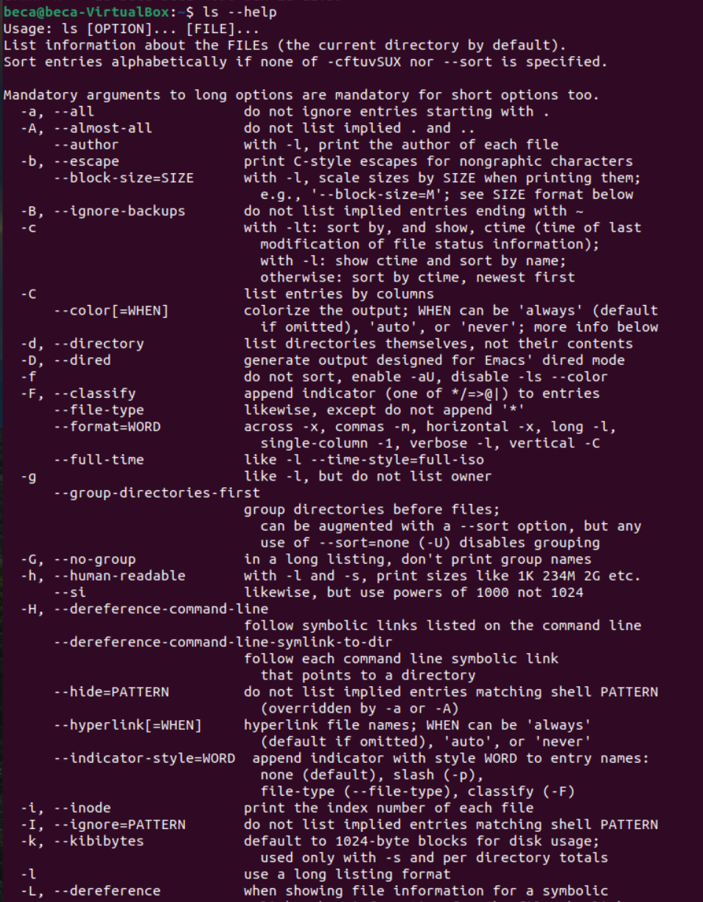
challenges
Getting it to work
Harder to understand
Debugging
SQL
Changes/Over Complicating

Slide 4
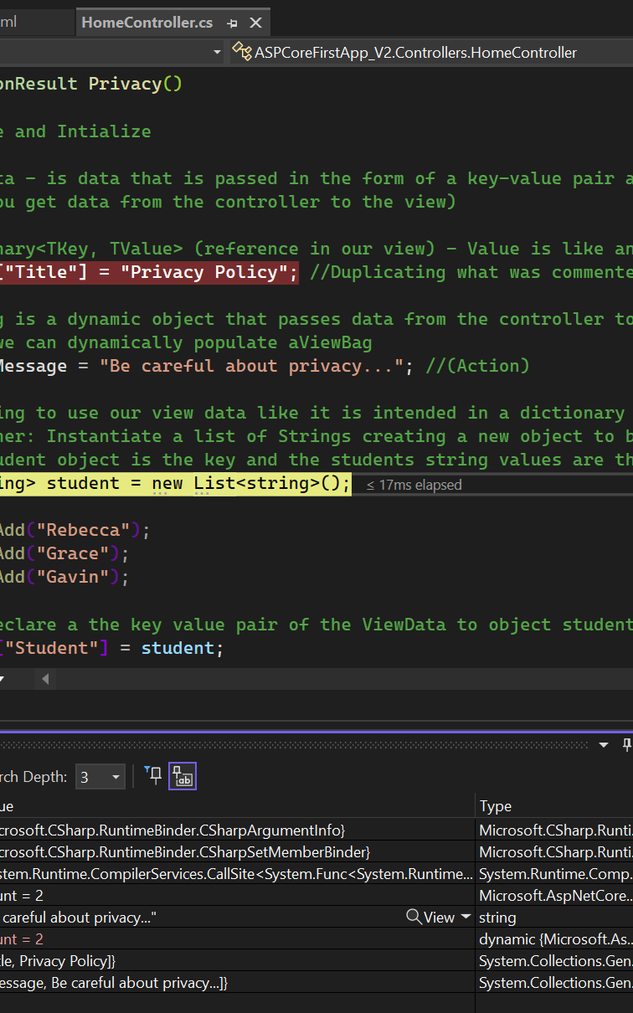
Pending bugs or issues
Unable to retrieve Json file from API
Unable to test CRUD operations besides view, create and list with hardcoded Data

Slide 5
Lessons Learned
K.I.S.S – keep it simple silly
Console statements helps debugging
Inspect Edge – Helps with breakpoints & debugging
Ask for help

Slide 6

THANK YOU
Screencast Link:
https://www.loom.com/share/af0539608453493a9f947870a70dd924?sid=bbf4469e-1931-4618-8f4c-74836d8a2a97
GIT Link:
rj404GCU/Milestone (github.com)

