Slide 1
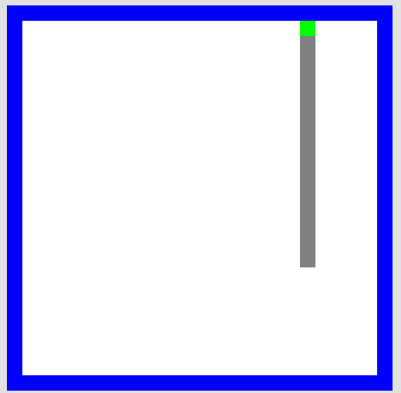
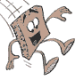
Picobot Challenge!
walls
Picobot
area not covered (yet!)
area already covered
Picobot
as envisioned by an HMC clinic
Goal: whole-environment coverage with only local sensing…
inspiration?

Slide 2
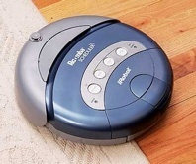
Picobot…
walls
Picobot
area not covered (yet!)
area already covered
Goal: whole-environment coverage with only local sensing…
iRobot's Roomba vacuum
inspiration!

Slide 3
Surroundings
N
Picobot can only sense things directly to the N, E, W, and S
W
E
S
For example, here its surroundings are
NxWx
Surroundings are always in NEWS order.
N E W S

Slide 4
Surroundings
N
How many distinct surroundings are there?
W
E
S

Slide 5
Surroundings
N
How many distinct surroundings are there?
W
E
S
2⁴
== 16 possible …
xxxx
Nxxx
xExx
xxWx
xxxS
NExx
NxWx
NxxS
xEWx
xExS
xxWS
NEWx
NExS
NxWS
xEWS
NEWS
(won’t happen)

Slide 6
State
I am in state 0.
My surroundings
are xxWS.
Picobot's memory is a single number, called its state.
State is the internal context of computation.
Picobot always starts in state 0.
State and surroundings represent everything the robot knows about the world

Slide 7
Rules
I am in state 0.
My surroundings
are xxWS.
Aha!
I should move N.
I should enter state 0.
Picobot moves according to a set of rules:
state
surroundings
direction
new state
0
xxWS
N
0
If I'm in state 0 seeing xxWS,
Then I move North, and change to state 0.

Slide 8
Wildcards
I am in state 0.
My surroundings
are xxWS.
Aha! This matches x***
Asterisks * are wild cards. They match walls or empty space:
state
surroundings
direction
new state
0
x***
N
0
and EWS may be wall or empty space
N must be empty

Slide 9
What will this set of rules do to Picobot?
state
surroundings
direction
new state
0
x***
->
N
0
0
N***
->
X
0
how can we get back down the screen?
Picobot checks its rules from the top each time.
When it finds a matching rule, that rule runs.
Only one rule is allowed per state and surroundings.

Slide 10
What will this set of rules do to Picobot?
state
surroundings
direction
new state
0
x***
->
N
0
0
N***
->
X
0
how can we get back down the screen?
Picobot checks its rules from the top each time.
When it finds a matching rule, that rule runs.
Only one rule is allowed per state and surroundings.

Slide 11
What will this set of rules do to Picobot?
state
surroundings
direction
new state
0
x***
->
N
0
0
N***
->
X
1
1
***x
->
S
1
1
***S
->
X
0
Picobot checks its rules from the top each time.
When it finds a matching rule, that rule runs.
Only one rule is allowed per state and surroundings.

Slide 12

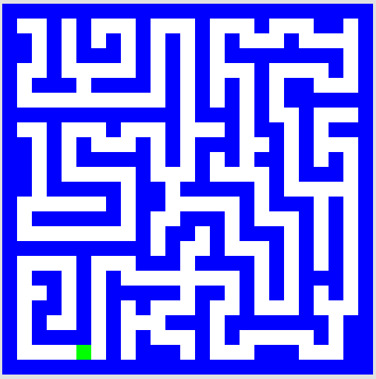
To do
Write rules that will always cover these two rooms.
(separate sets of rules are encouraged…)
Challenge #1
Challenge #2
but your rules should work regardless of Picobot's starting location

Slide 13
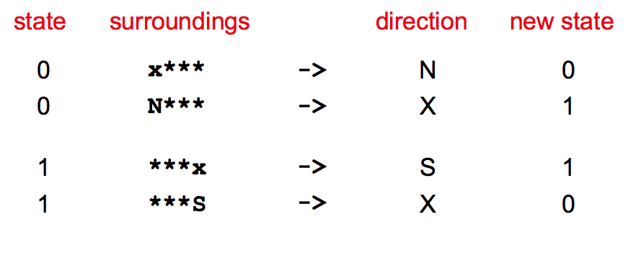
Alter these "up & down" rules so that Picobot will traverse the empty room…
"Quiz"
add E or W somewhere…
the empty room
Hints:
watch out for dead ends!

Slide 14
Ideas for the maze?
the maze
Hint: use the "right-hand-rule" !

Slide 15
Computer Science
Information is intrinsic to every system…
How can we benefit from this information?
“create with”
Representing it … Applying it … Measuring it
Efficiently? Effectively? Possibly?
Notes:
ZACH:
fundamentally creative

Slide 16
Computer Science
Information is intrinsic to every system…
How can we benefit from this information?
“create with”
Representing it … Applying it … Measuring it
Efficiently? Effectively? Possibly?
How to measure these rooms' complexity?
Notes:
ZACH:
fundamentally creative

Slide 17
Computer Science
Information is intrinsic to every system…
How can we benefit from this information?
“create with”
Representing it … Applying it … Measuring it
Efficiently? Effectively? Possibly?
How to measure these rooms' complexity?
How many states and rules are really necessary ?
How much information does each system contain ?
our best: 3 states, 6 rules
our best: 4 states, 8 rules
Notes:
ZACH:
information isn't just something that has appeared in the last 50 years as computers have become ubiquitous…
despite its name, computer science doesn't require a computer at all

Slide 18
Computer Science
Information is intrinsic to every system…
How can we benefit from this information?
“create with”
Representing it … Applying it … Measuring it
Efficiently? Effectively? Possibly?
How to measure these rooms' complexity?
How many states and rules are really necessary ?
How much information does each system contain ?
This image: 5 kilobytes
This image: 20 kilobytes!
Notes:
ZACH:
information isn't just something that has appeared in the last 50 years as computers have become ubiquitous…
despite its name, computer science doesn't require a computer at all

Slide 19
Happy Picobotting!

