Slide 1
2026 WNBA Draft &
Salary Analysis
Player Archetypes · Draft Probability Model · Salary Projections
UMD Sports Analytics Case Competition · April 2026

Slide 2
Agenda
01
Player Archetypes — cluster WNBA players into 5 roles using on-court stats
02
CBA Salary Curve — convert old-CBA salaries to new 2026 CBA values
03
Draft Model — predict which 2025-26 college seniors get drafted
04
2026 Predictions — top prospects, archetype fit, and salary projections

Slide 3
01 Player Archetypes
Clustering the WNBA player pool into 5 distinct roles

Slide 4
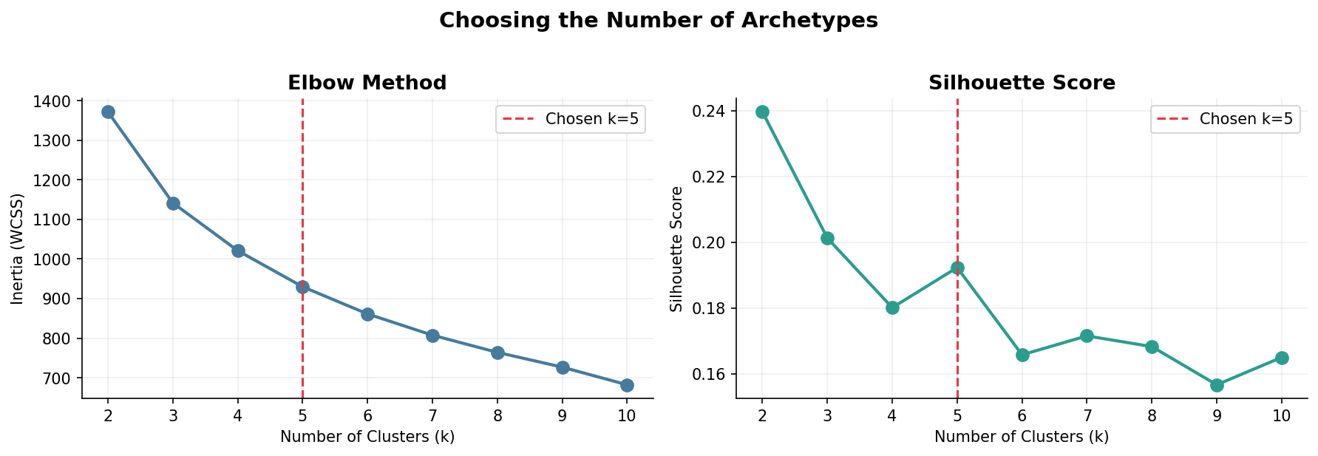
Choosing the Number of Archetypes
Elbow method + silhouette score both support k = 5

Slide 5
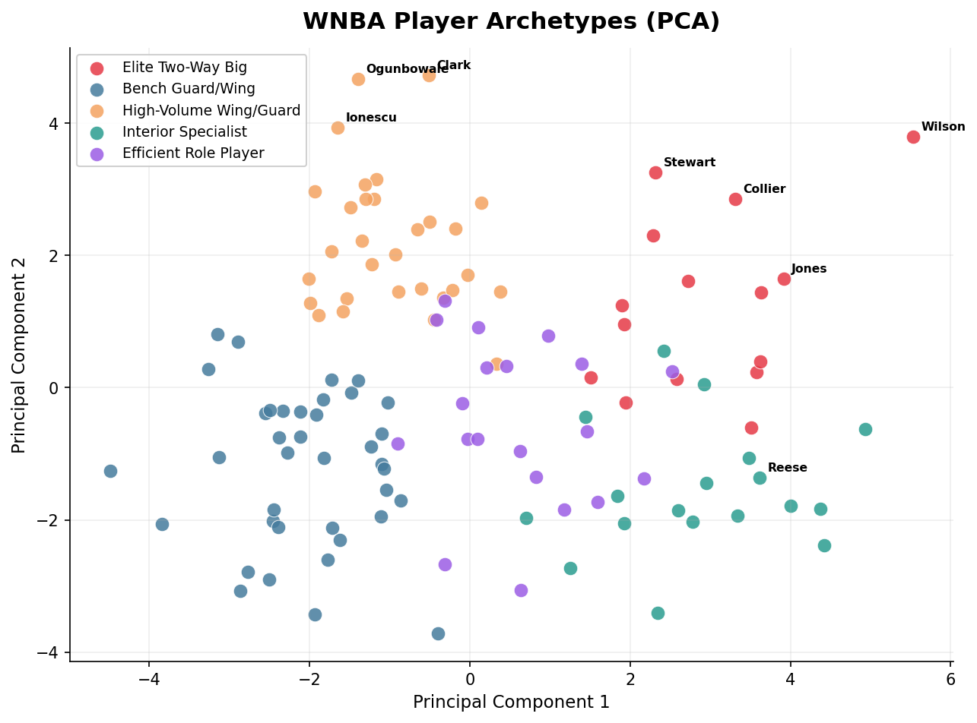
WNBA Player Archetypes (PCA Visualization)
KMeans clustering on 15 shared stats — each dot is a WNBA player

Slide 6
The 5 Archetypes
Defined on WNBA players; applied to NCAA prospects
Elite Two-Way Big
High PTS + BLK, dominant on both ends (Stewart, Collier, Howard)
High-Volume Wing/Guard
High usage, high scoring, perimeter-heavy (Mitchell, Ogunbowale, Loyd)
Interior Specialist
Paint-focused, strong rebounding, low 3PA (Thomas, McCowan)
Efficient Role Player
High TS%, controlled usage, complementary scorer (Hayes, Clark)
Bench Guard/Wing
Low minutes, reserve role, developing player (Wheeler, Powers)

Slide 7
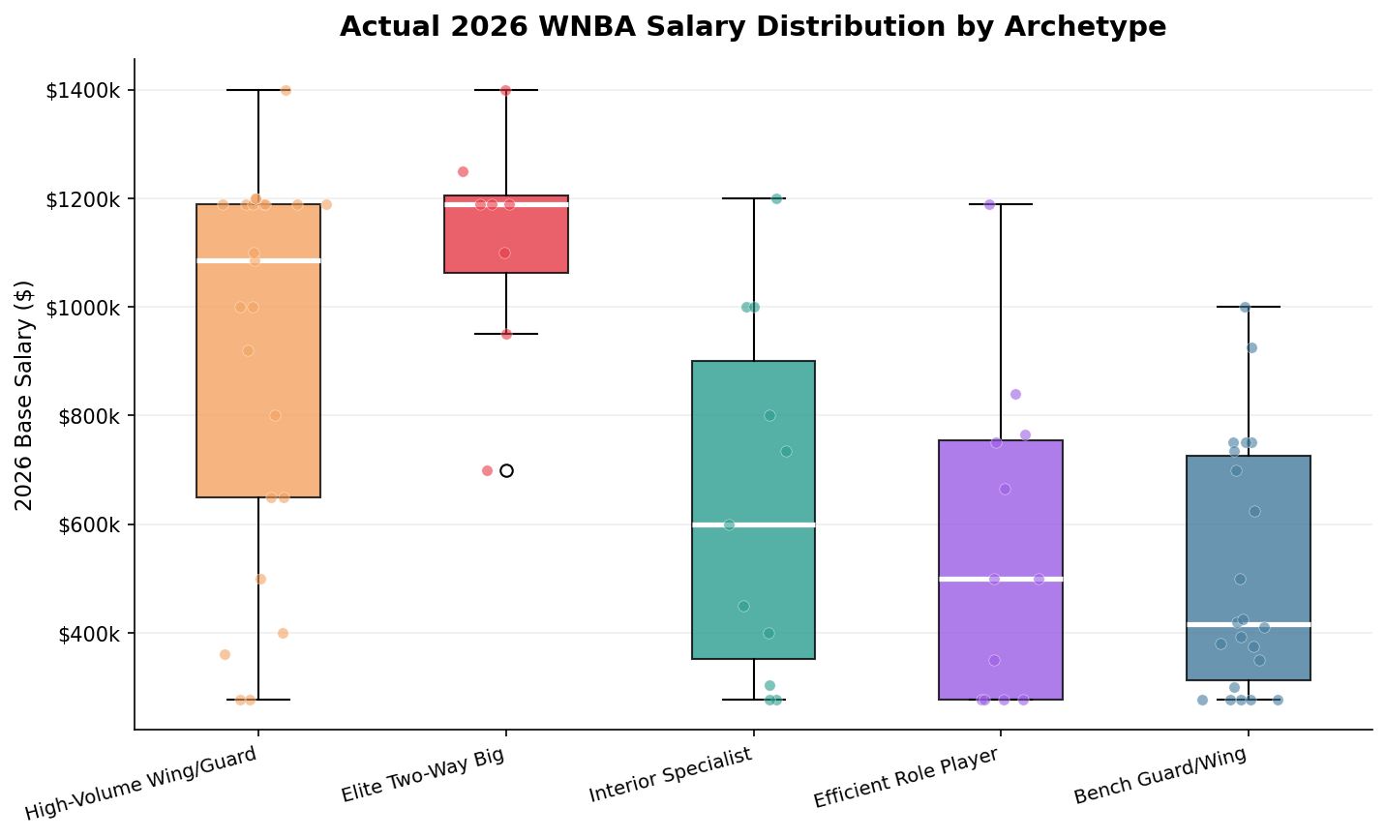
2026 WNBA Salary by Archetype
Actual 2026 base salaries from the new CBA — High-Volume Wings earn the most

Slide 8
02 CBA Salary Curve
Translating old-CBA contracts to new 2026 values

Slide 9
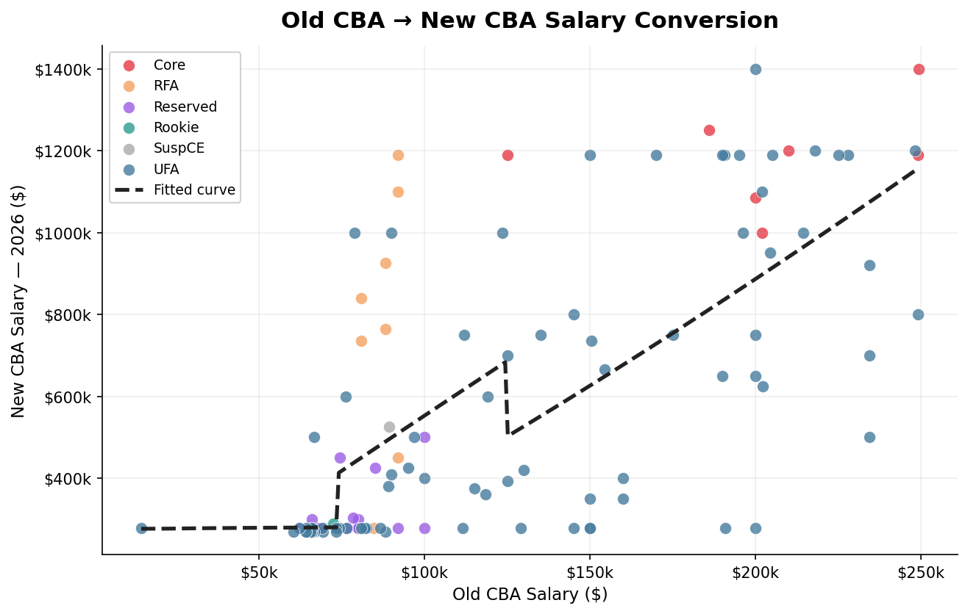
Old CBA → New CBA Salary Conversion
Power-law fit per signing type (UFA, Rookie, RFA, Core) — 14.8% median error

Slide 10
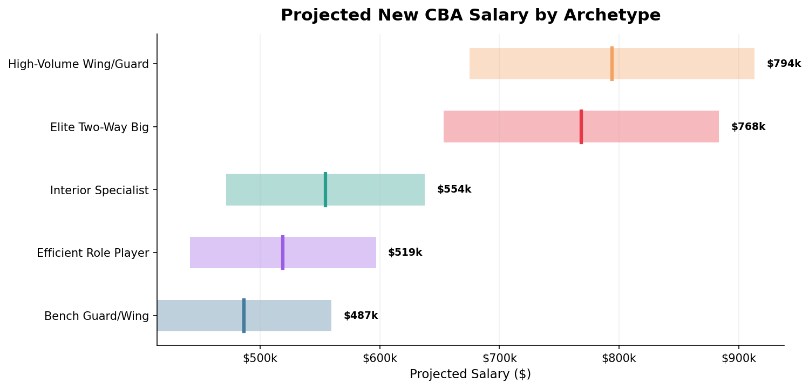
Projected New CBA Salary by Archetype
±15% band around median projection — Elite Two-Way Bigs projected highest

Slide 11
03 Draft Probability Model
Predicting which 2025-26 NCAA seniors will be selected in the 2026 WNBA Draft

Slide 12
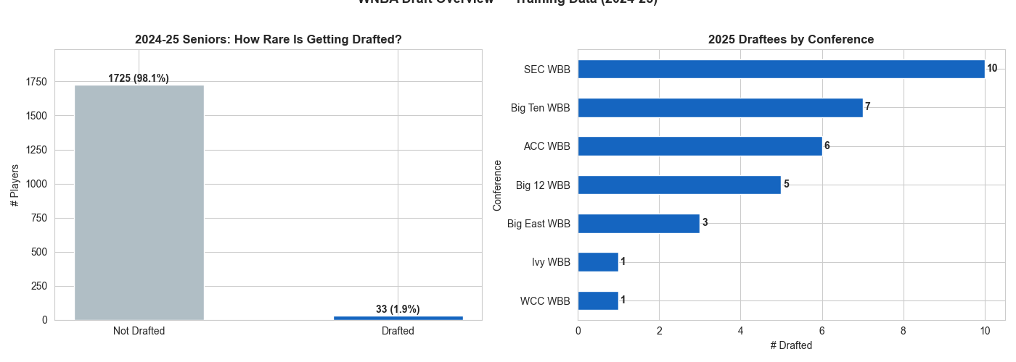
The Challenge: Getting Drafted Is Extremely Rare
~1.9% of college seniors get drafted — a 25:1 class imbalance requiring special handling

Slide 13
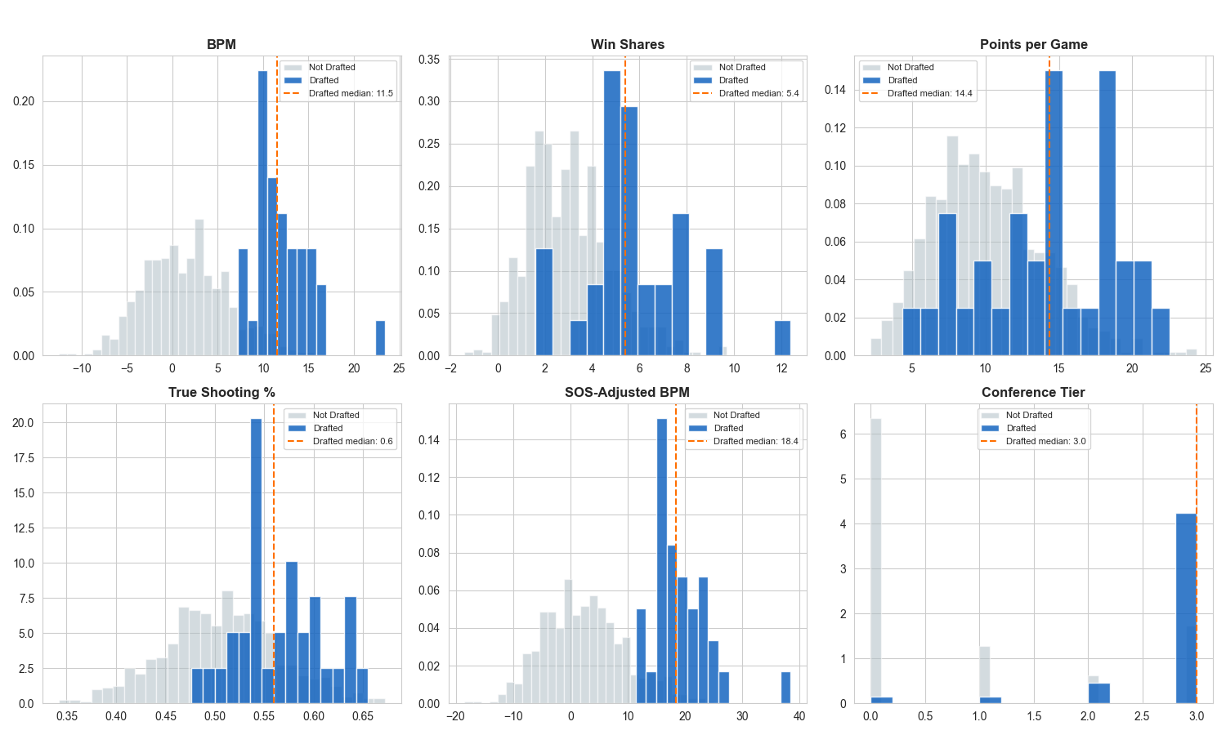
What Separates Drafted from Undrafted Players?
Drafted players sit in the top percentiles across BPM, Win Shares, and schedule-adjusted metrics

Slide 14
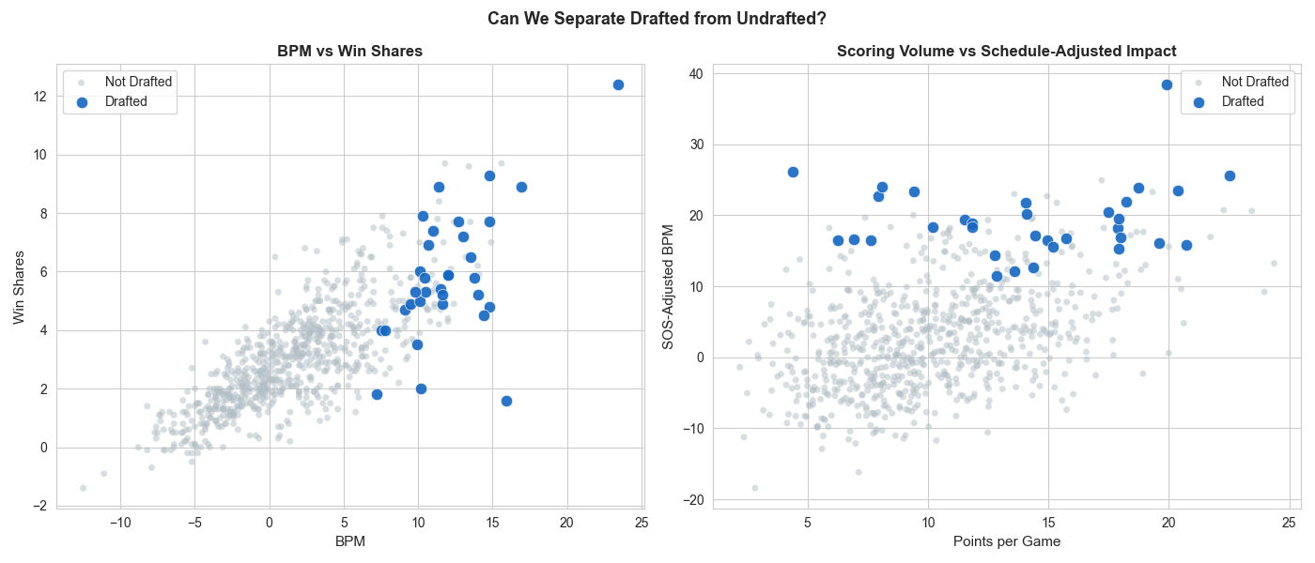
Feature Space: Drafted Players Cluster at the Top
BPM + Win Shares provide strong separation; SOS-adjusted BPM captures conference quality

Slide 15
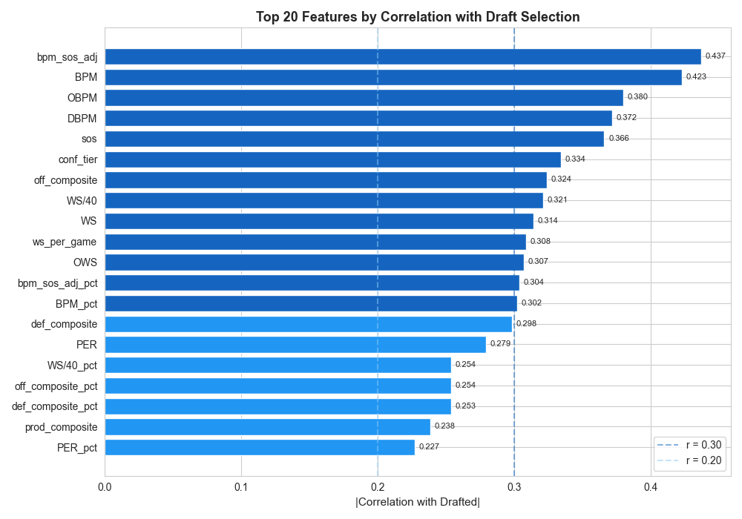
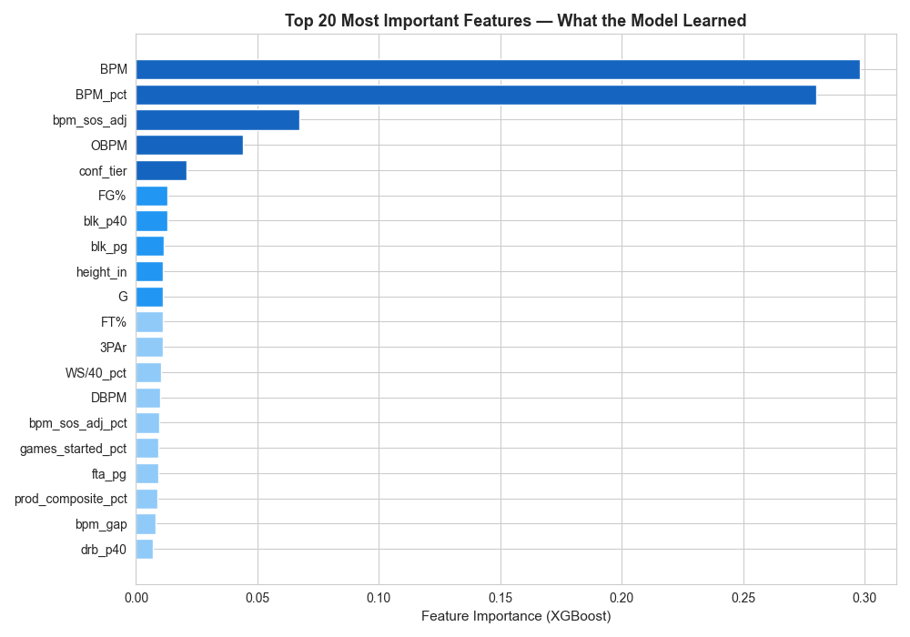
Model: What Predicts Draft Selection?
Left: correlation with drafted label · Right: XGBoost feature importance (gain)

Slide 16
Model Architecture & Performance
Trained on 2024-25 seniors → applied to 2025-26 seniors for 2026 draft predictions
▸
Ensemble of 3 models: XGBoost, LightGBM, Random Forest — average of all three probabilities
▸
Class imbalance handled with scale_pos_weight (25:1 ratio) — prevents model from ignoring rare class
▸
5-fold cross-validation for reliable performance estimates with only 29 positive examples
▸
Training: 2024-25 NCAA seniors labeled against 2025 WNBA draft picks (29 draftees / 753 total)
▸
XGBoost: ROC AUC = 0.982 | PR AUC = 0.693 — strong precision-recall on the minority class

Slide 17
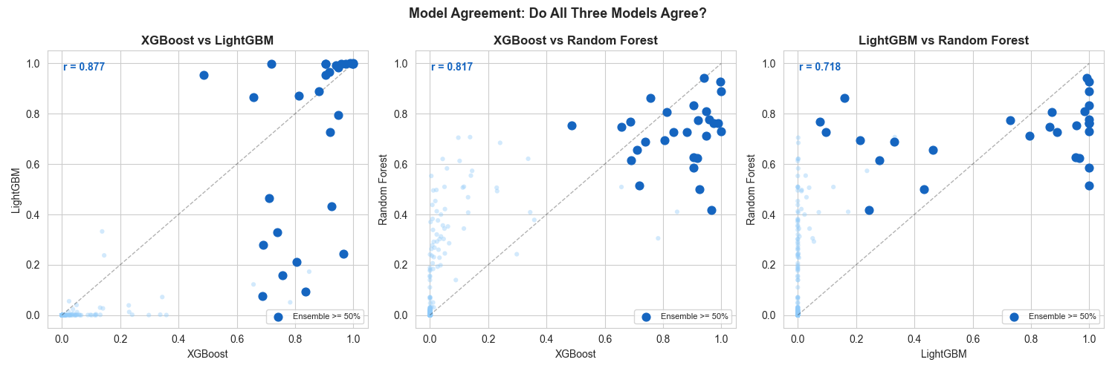
All Three Models Agree on Top Prospects
High correlation between models (r > 0.95) confirms predictions are robust, not model-specific

Slide 18
04 2026 Predictions
Top prospects, archetype fit & projected salaries

Slide 19
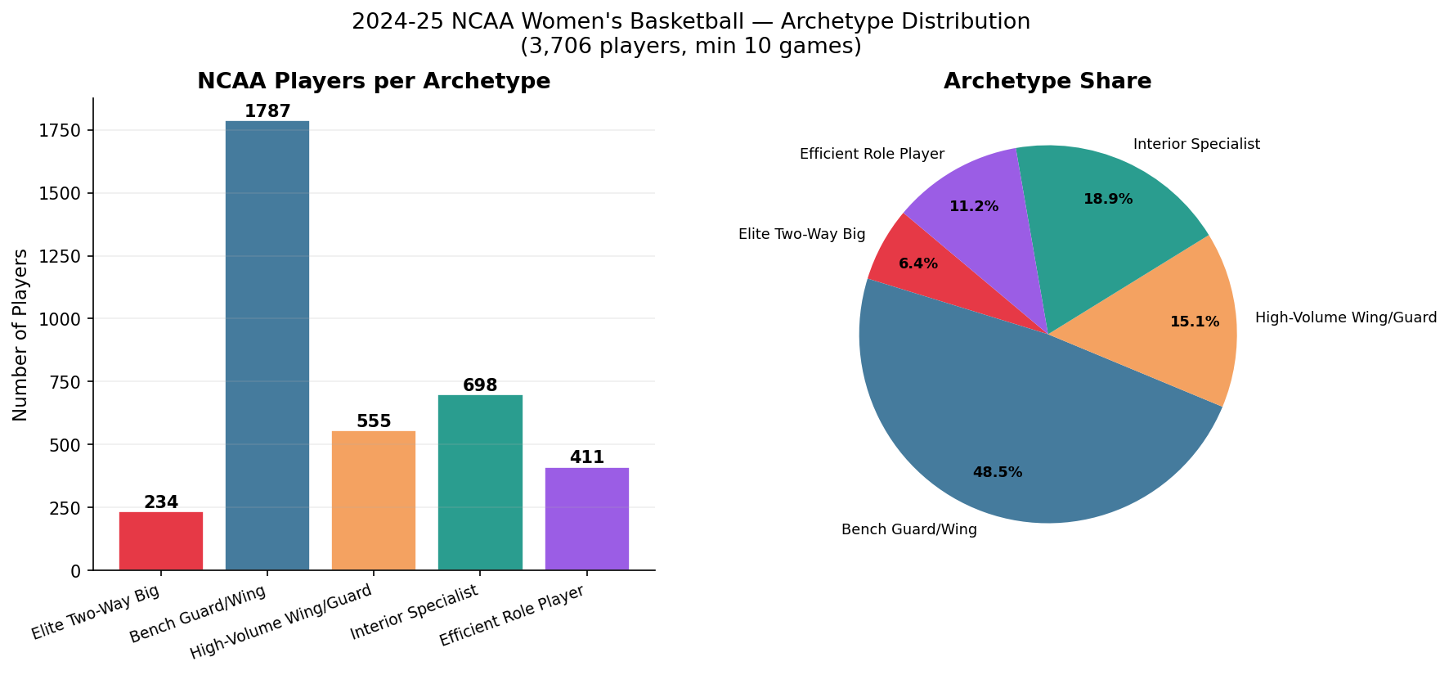
2025-26 NCAA Player Archetype Distribution
3,685 eligible players classified — Bench Guard/Wing is the largest group by far

Slide 20
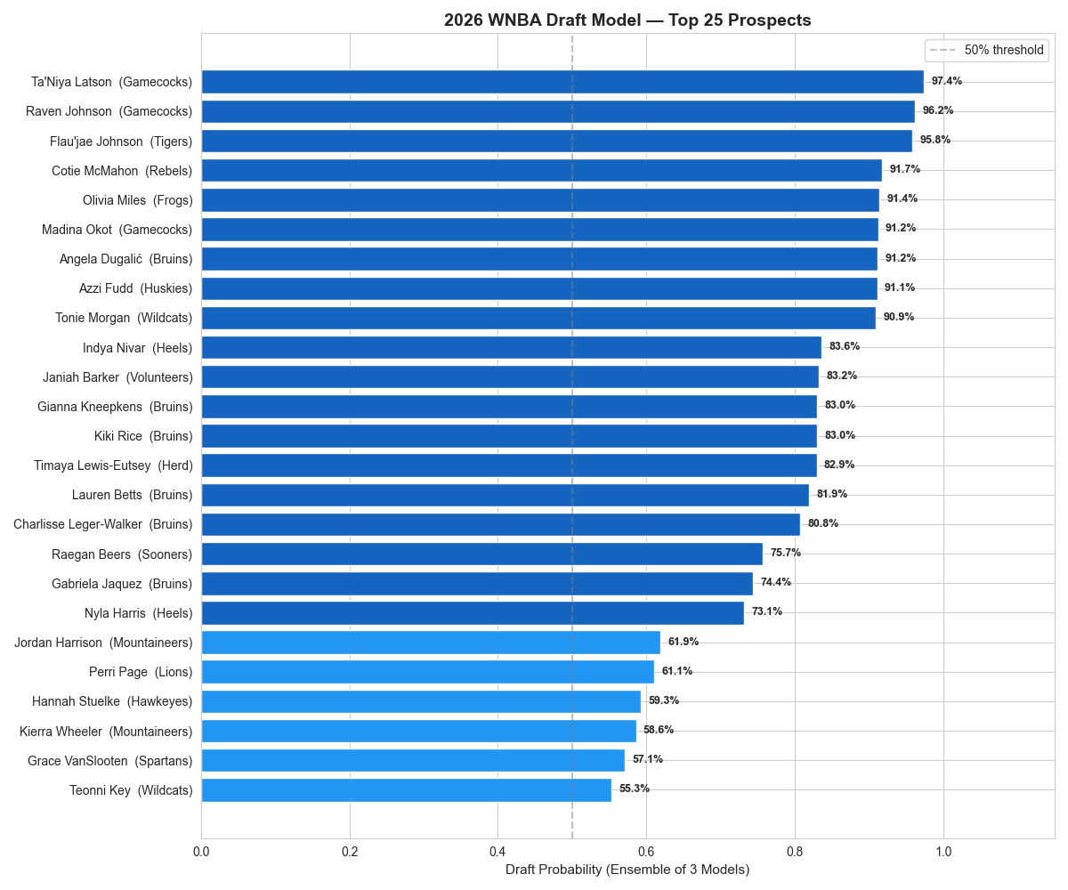
2026 WNBA Draft Model — Top 25 Prospects
Ensemble probability averaged across XGBoost, LightGBM, and Random Forest

Slide 21
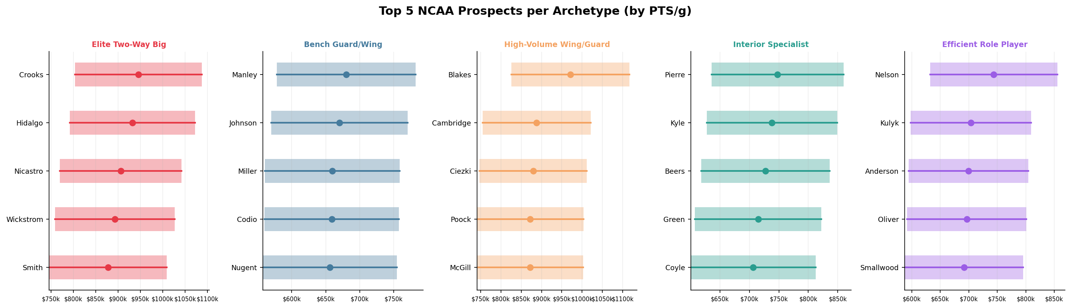
Top Prospects per Archetype + Salary Projections
Each player's projected new-CBA salary range based on their archetype and stats

Slide 22
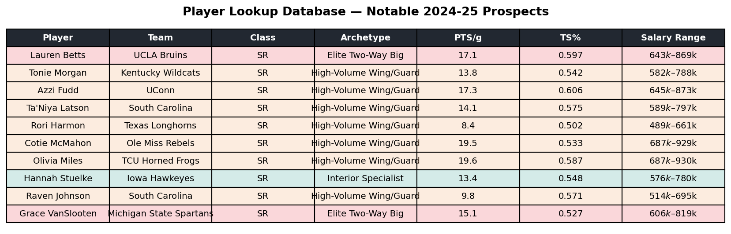
Player Lookup Database
Every 2025-26 senior gets an archetype, draft probability, and salary band — 3,672 players total

Slide 23
Key Takeaways
A complete framework: archetype → draft probability → salary projection
01
5 distinct player archetypes exist in the WNBA — the model maps NCAA players into these same roles
02
The new CBA raises salaries substantially — especially for high-usage wings and elite two-way bigs
03
BPM, Win Shares, and schedule-adjusted metrics are the strongest predictors of draft selection
04
Lauren Betts, Tonie Morgan, Azzi Fudd, and Ta'Niya Latson are the model's top 2026 picks
05
Every D-I senior has a salary projection — teams can use this for pre-draft roster planning

