Slide 1
Contrast Limited Adaptive Histogram Equalization (CLAHE)
Group 6 members:
Timothy Chan Randall Pajaro Ryhle Nodnylson Guinto Raphael Laguda

Slide 2
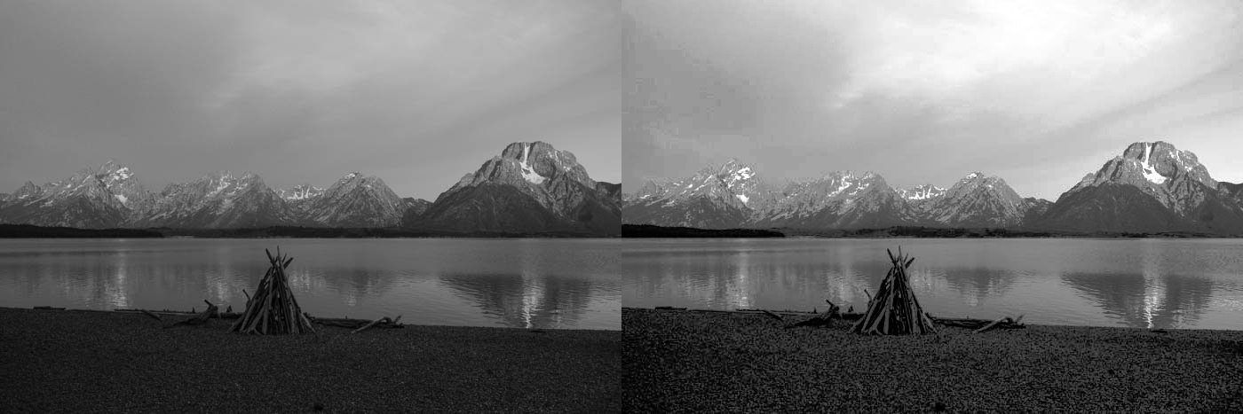
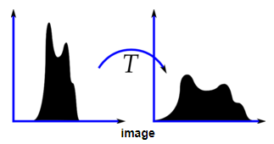
What is Histogram Equalization?
This is a method of adjusting an image’s contrast by using the image’s histogram.
This is possible by pulling the image’s histogram to either ends.

Slide 3
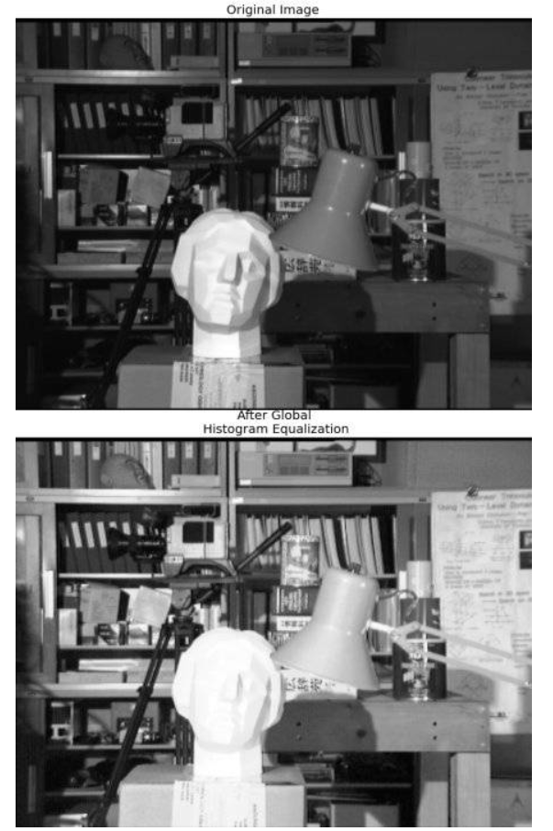
Problem with Histogram Equalization
Whenever an image has areas that have different contrasts, such as an image having a foreground object being brighter than its background, applying histogram equalization globally could result in a contrast enhancement problem that over-amplifies the contrast of certain region/s of an image.

Slide 4
What is Adaptive Histogram Equalization?
This is a histogram equalization that operates on small regions in the image called tiles.
Using OpenCV in Python, the default size of the regions would be 8x8 px.
By using this, all regions of the image will have contrast enhancement according to their pixels’ intensity value.

Slide 5
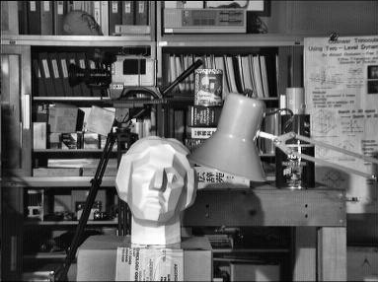
What is Contrast Limited Adaptive Histogram Equalization (CLAHE)?
CLAHE is a histogram equalization that uses adaptive histogram equalization and contrast limiting in order to enhance the contrast of an image, while reducing noise being amplified.
By doing so, contrast enhancement on images with areas that have different contrasts will result in equal contrast enhancement.
The tiles close by will merge using bilinear interpolation to remove the artificial boundaries/ tile grid.

Slide 6
Applications of CLAHE
Improves the contrast of images.
Enhancement method for improving the video quality in real time system.
Can be applied to colored images.

Slide 7
Why was CLAHE created?
Some images are not quite visible due to several factors.
Fog, haze, and smoke can significantly degrade an image’s visibility.
For removing this problem we introduced a novel algorithm which works over real time video surveillance system. This algorithm is based on Contrast adaptive histogram equalization enhancement technique which works for real time video system. This method is used to overcome the drawback of adaptive histogram equalization

Slide 8
How does CLAHE work?
Step 1: Acquisition process of a desired image.
Step 2: Get all input values which is used in enhancement process like number of regions in row and Column direction separately, dynamic range (number of bins used in histogram transform function), cliplimit, distribution parameter type.
Step 3: Original image divide into some region any preprocess these inputs.
Step 4: Process applied over tile (contextual region).
Step 5: Generate gray level mapping and clipped histogram. In contextual region numbers of pixels are equally divided in each gray level so, average number of pixels is gray level is described as follow:

Slide 9
How does CLAHE work?
Step 3: Original image divide into some region any preprocess these inputs.
Step 4: Process applied over tile (contextual region).
Step 5: Generate gray level mapping and clipped histogram. In contextual region numbers of pixels are equally divided in each gray level.
Step 6: Interpolate gray level mapping in order to create enhanced image. In this process use four pixel cluster and applied mapping process then each of mapping tiles will partly overlap in the image region after that a single pixel will be extracted and then apply four mapping to that pixel. Interpolate between that results and get enhance pixel, repeat over an image.

