Slide 1
EGOCENTRIC VIDEOS CSCI 576 Project
Timothy Fong
Roeil Jacob DEN

Slide 2
CSCI 576 Multimedia System Design Spring 2016 Term Project
Professor Parag Havaldar

Slide 3
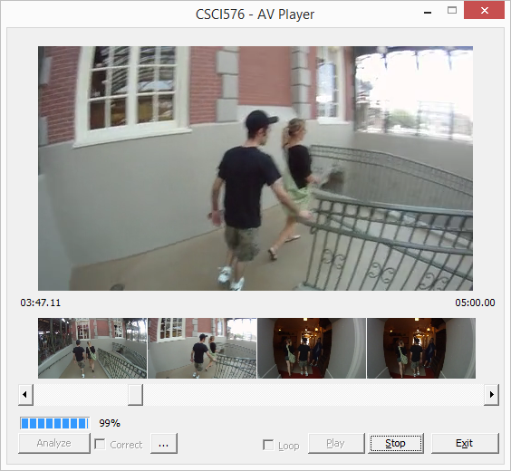
AUDIO/VIDEO PLAYER GUI Design
Playback Frame
Time Code: Duration
Time Code: Current
Analysis Progress Bar
Stop
Analysis Button
Corrected Video Playback
Analysis Progress %
Browse Index Frame
Play/Pause Button

Slide 4
AUDIO/VIDEO PLAYER Algorithm Design
Multi Threaded
Decoupling of “Disk Read” and “Display Buffer Writer”
Buffered
Timer discrepancies
Overflows or Underflows
Audio Sync
Drift due to playback timer discrepancies

Slide 5
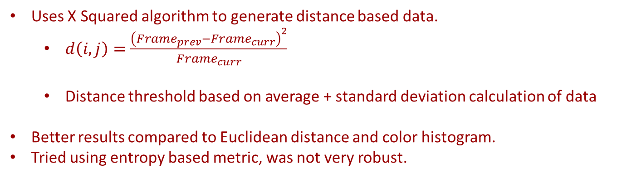
VIDEO Summarization Algorithm Design
Uses X Squared algorithm to generate distance based data.
$d\left(i,j\right)=\frac{{\left(Frame_{prev}−Frame_{curr}\right)}^{2}}{Frame_{curr}}$
Distance threshold based on average + standard deviation calculation of data
Better results compared to Euclidean distance and color histogram.
Tried using entropy based metric, was not very robust.

Slide 6
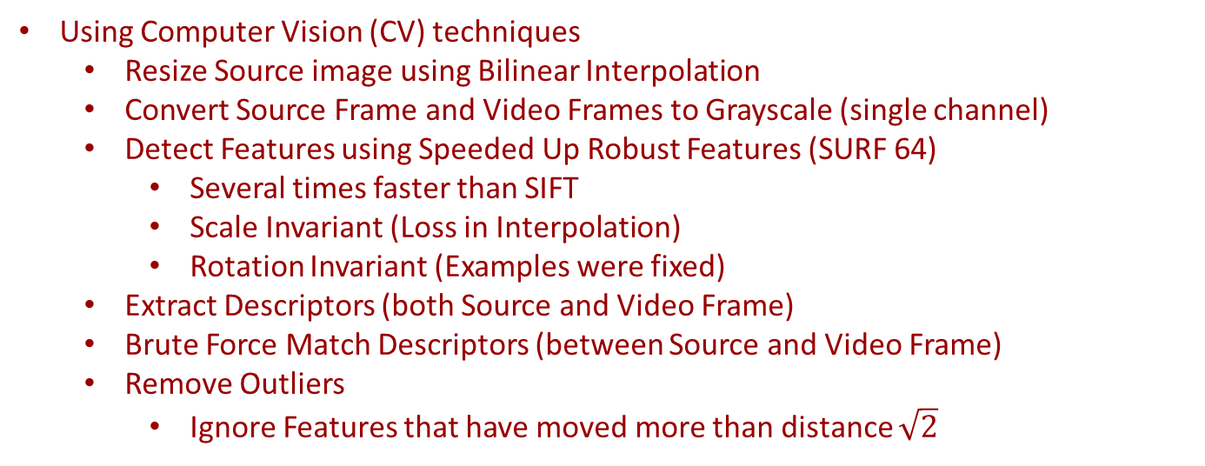
VIDEO INDEXING Design
Using Computer Vision (CV) techniques
Resize Source image using Bilinear Interpolation
Convert Source Frame and Video Frames to Grayscale (single channel)
Detect Features using Speeded Up Robust Features (SURF 64)
Several times faster than SIFT
Scale Invariant (Loss in Interpolation)
Rotation Invariant (Examples were fixed)
Extract Descriptors (both Source and Video Frame)
Brute Force Match Descriptors (between Source and Video Frame)
Remove Outliers
Ignore Features that have moved more than distance $\sqrt{2}$

Slide 7
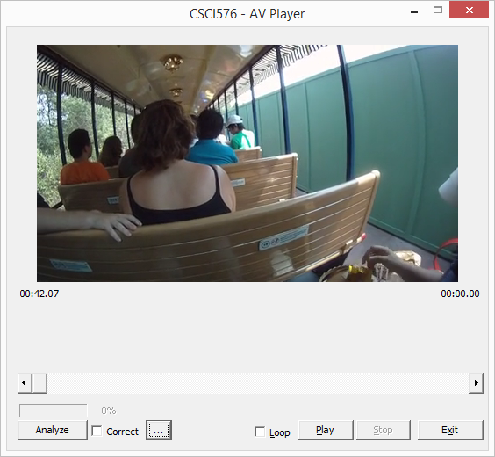
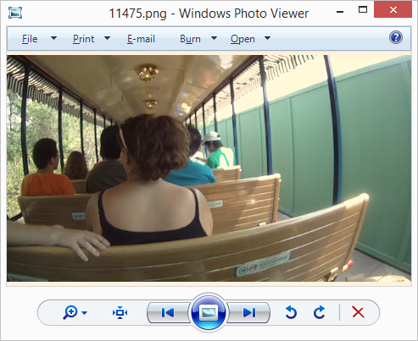
VIDEO INDEXING Results Alin_Day1_002\11475.png
Frame: 636 (15 Matches)

Slide 8
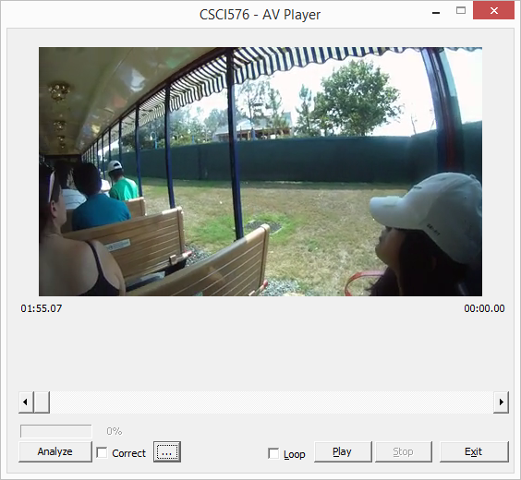
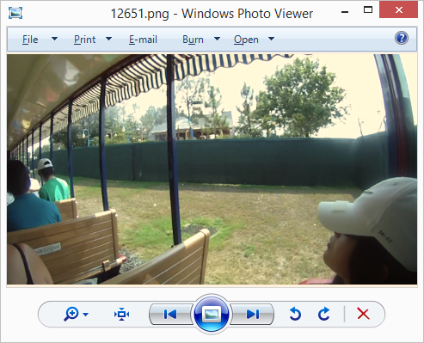
VIDEO INDEXING Results Alin_Day1_002\12651.png
Frame: 1731(9 Matches)

Slide 9
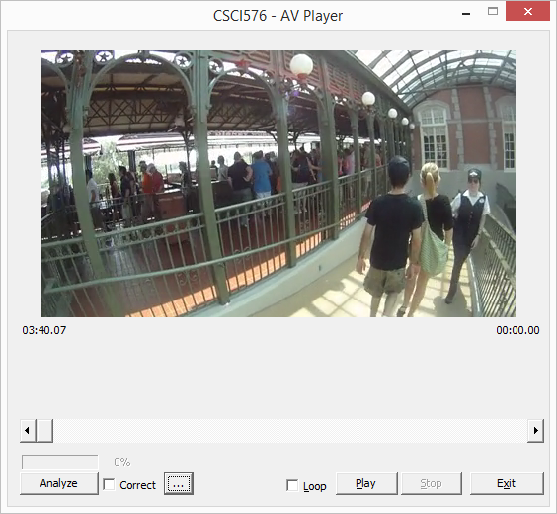
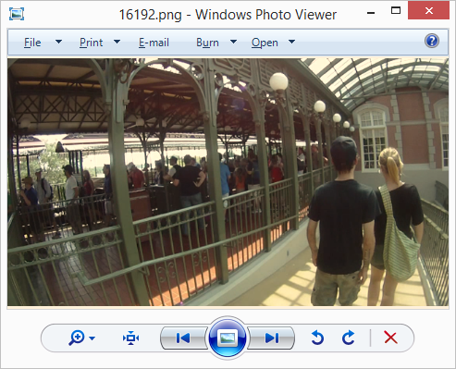
VIDEO INDEXING Results Alin_Day1_002\16700.png
Frame: 3306 (34 Matches)

Slide 10
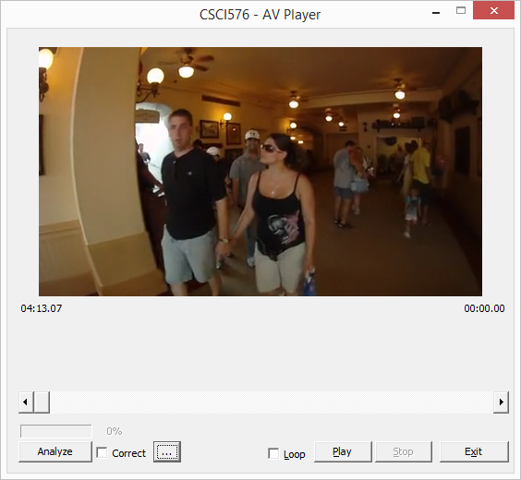
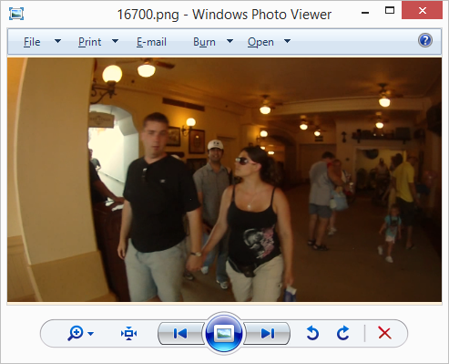
VIDEO INDEXING Results Alin_Day1_002\16700.png
Frame: 3801 (7 Matches)

Slide 11
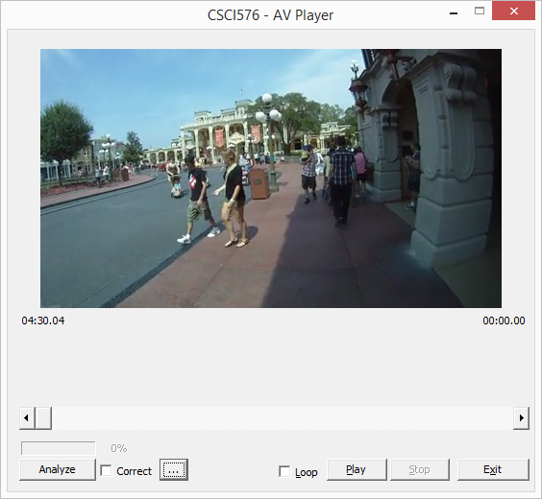
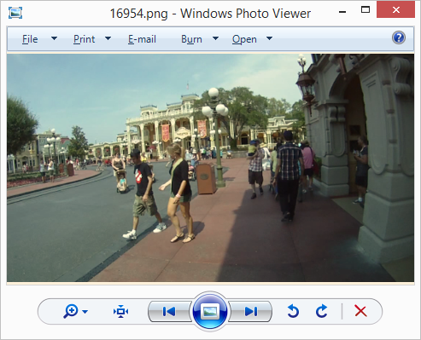
VIDEO INDEXING Results Alin_Day1_002\16954.png
Frame: 4053 (15 Matches)

Slide 12
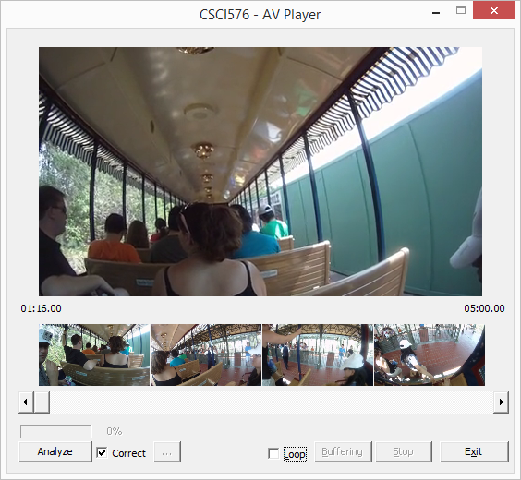
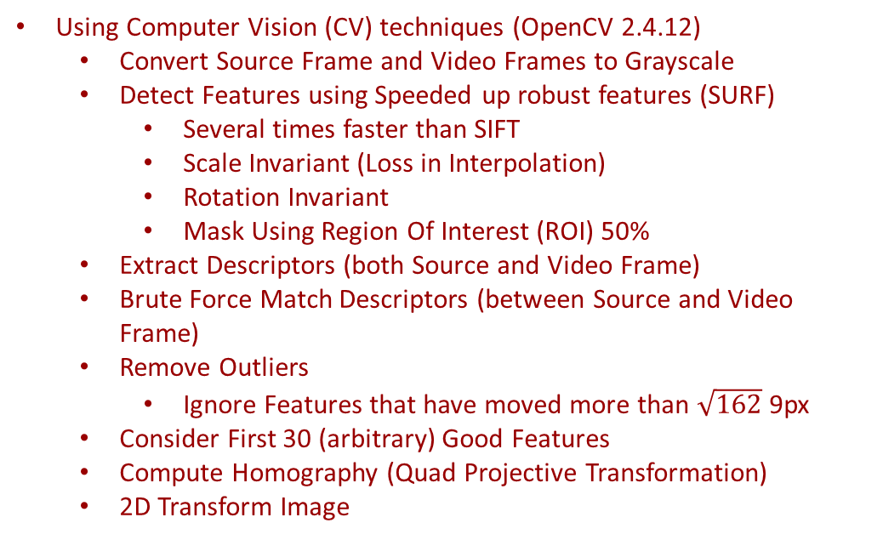
VIDEO CORRECTIONS Attempt Motion Stabilization
Using Computer Vision (CV) techniques (OpenCV 2.4.12)
Convert Source Frame and Video Frames to Grayscale
Detect Features using Speeded up robust features (SURF)
Several times faster than SIFT
Scale Invariant (Loss in Interpolation)
Rotation Invariant
Mask Using Region Of Interest (ROI) 50%
Extract Descriptors (both Source and Video Frame)
Brute Force Match Descriptors (between Source and Video Frame)
Remove Outliers
Ignore Features that have moved more than $\sqrt{162}$9px
Consider First 30 (arbitrary) Good Features
Compute Homography (Quad Projective Transformation)
2D Transform Image

Slide 13
AREAS FOR IMPROVEMENT
Audio Video Player
Attempts were made to analyze audio to outlie regions where there were no human voice (imperceptible to viewer).
Rendering Timer unreliable (use of deterministic clock instead to guarantee 15 Hz)
Summarization
Consolidate analysis to determine inliers.
X-squared, Color Histogram, Entropy, Euclidean Distance
Segment image for higher key point resolution.
Reference
Speed up computation.
Memory leaks produced from usage of CV libraries. (SURF is not free!)
Stabilization
Extract Head-Motion vs general object tracking (Improve outlier methods)
To reduce additional outliers focus ROI to only the 4 corners
General Bugs
Bugs related to Integration

Slide 14
REFERENCES
Havaldar, P., Medioni, G.: Multimedia Systems, Algorithms, Standards, and Industry Practices
Laganiere, R.: OpenCV 2 Computer Vision, Application Programming Cookbook
Szeliski, R.: Computer Vision, Algorithms and Applications
Bay H., Tuytelaars T., Van Gool, L.: SURF: Speeded Up Robust Features
Jiang, H., Helal, A., Elmagarmid, A., Joshi, A.: Scene Change Detection for Video Database Management Systems-A Survey
Aye, Y.: Speech Recognition Using Zero-Crossing Features
https://github.com/rjacob/ProjectCSCI576
Roeil Jacob
roeiljac@usc.edu
Timothy Fong,
timothwf@usc.edu

