Slide 1
EGOCENTRIC VIDEOS CSCI 576 Project
Timothy Fong
Roeil Jacob DEN

Slide 2
CSCI 576 Multimedia System Design Spring 2016 Term Project
Professor Parag Havaldar

Slide 3
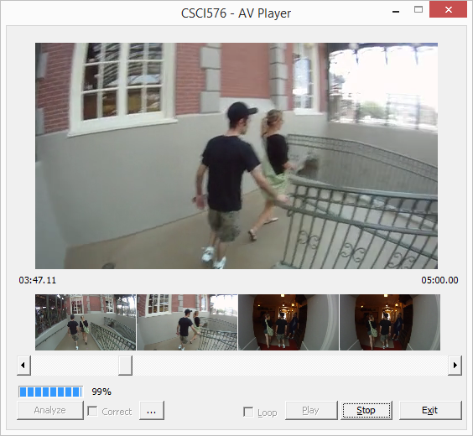
AUDIO/VIDEO PLAYER GUI Design
Time Code: Duration
Time Code: Current
Analysis Progress Bar
Corrected Video Playback
Analysis Progress %
Browse Index Frame

Slide 4
AUDIO/VIDEO PLAYER Algorithm Design
Multi Threaded
Decoupling
Buffered
Timer invariance
Audio Sync
Drift due to playback frequencies

Slide 5
VIDEO CORRECTIONS Presentation Subtitle

Slide 6
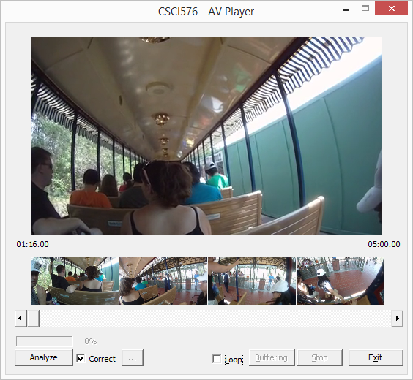
VIDEO CORRECTIONS Motion Stabilization
Using Computer Vision (CV) techniques (OpenCV 2.4.12)
Convert Source Frame and Video Frames to Grayscale (single channel)
Detect Features using Speeded up robust features (SURF)
Several times faster than SIFT
Scale Invariant (Loss in Interpolation)
Rotation Invariant
Using Region Of Interest (ROI) mask
Extract Descriptors (both Source and Video Frame)
Brute Force Match Descriptors (between Source and Video Frame)
Remove Outliers
Ignore Features that have moved more than 9px
Consider First 30 Good Features
Compute Homography (Quad Projective Transformation)
2D Transform Image

Slide 7
VIDEO INDEXING Design
Using Computer Vision (CV) techniques
Resize Source image using Bilinear Interpolation
Convert Source Frame and Video Frames to Grayscale (single channel)
Color Invariant
Detect Features using Speeded up robust features (SURF)
Several times faster than SIFT
Scale Invariant (Loss in Interpolation)
Rotation Invariant
Extract Descriptors (both Source and Video Frame)
Brute Force Match Descriptors (between Source and Video Frame)
Remove Outliers
Ignore Features that have moved more than 1px

Slide 8
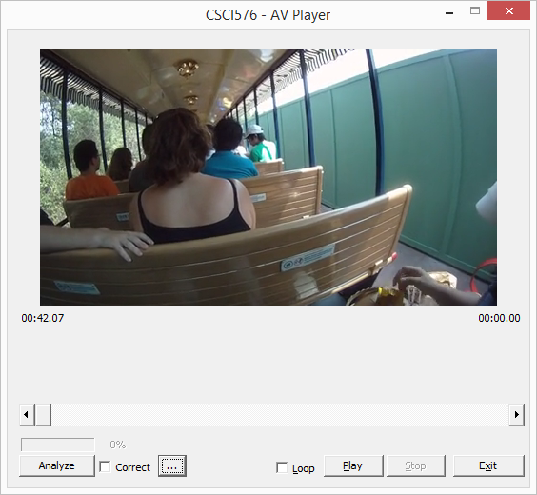
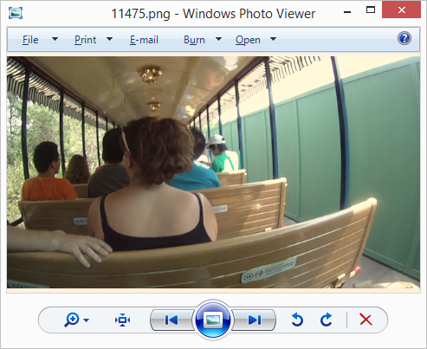
VIDEO INDEXING Results Alin_Day1_002\11475.png
Frame: 636 (15 Matches)

Slide 9
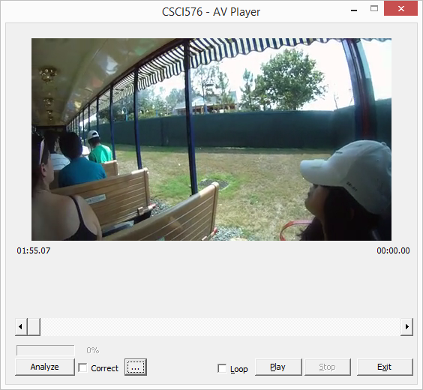
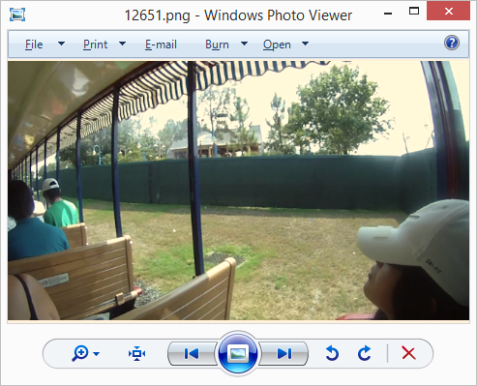
VIDEO INDEXING Results Alin_Day1_002\12651.png
Frame: 1731(9 Matches)

Slide 10
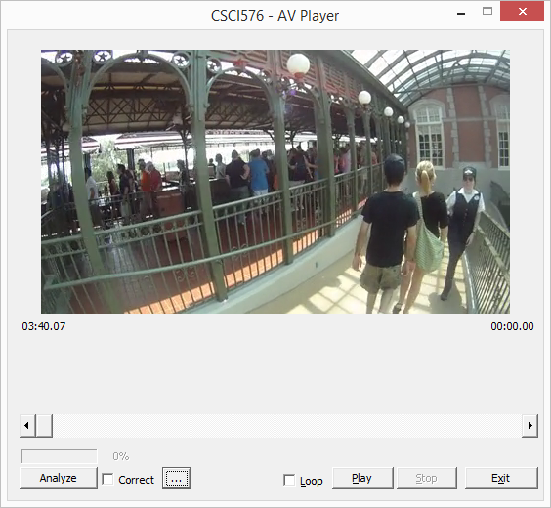
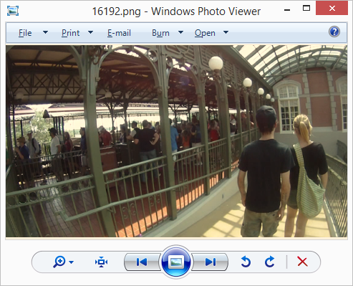
VIDEO INDEXING Results Alin_Day1_002\16700.png
Frame: 3306 (34 Matches)

Slide 11
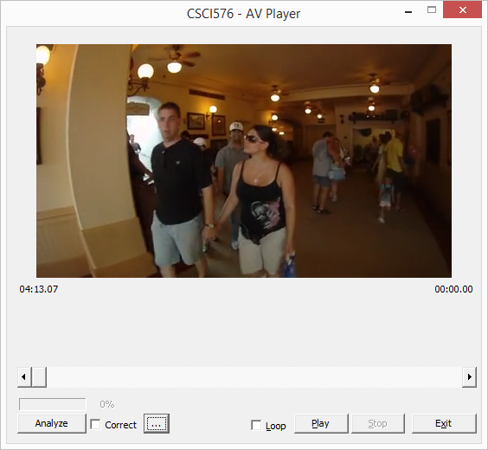
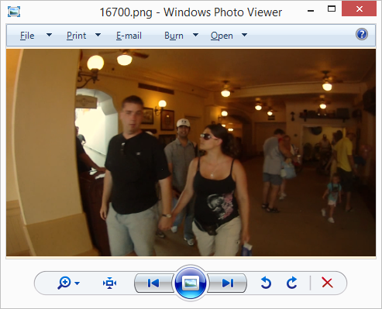
VIDEO INDEXING Results Alin_Day1_002\16700.png
Frame: 3801 (7 Matches)

Slide 12
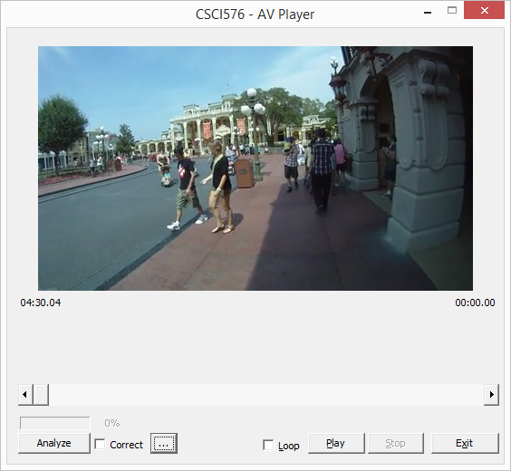
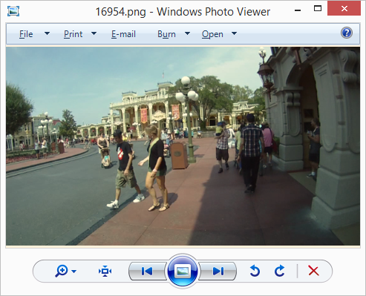
VIDEO INDEXING Results Alin_Day1_002\16954.png
Frame: 4053 (15 Matches)

Slide 13
AREAS FOR IMPROVEMENT Presentation Subtitle

Slide 14
REFERENCES
Havaldar, P., Medioni, G.: Multimedia Systems, Algorithms, Standards, and Industry Practices
Laganiere, R.: OpenCV 2 Computer Vision, Application Programming Cookbook
Szeliski, R.: Computer Vision, Algorithms and Applications
Bay H., Tuytelaars T., Van Gool, L.: SURF: Speeded Up Robust Features
https://github.com/rjacob/ProjectCSCI576
Roeil Jacob
roeiljac@usc.edu
Timothy Fong,
timothwf@usc.edu

