Slide 1
The fifteen year struggle of decentralizing privacy-enhancing technology
Rolf Jagerman, Wendo Sabée, Laurens Versluis and Martijn de Vos

Slide 2
Today
An introduction to Tor
Problems with Tor
Problems with decentralization
Decentralized privacy-enhancing systems
Our contribution to a better internet
Conclusion

Slide 3
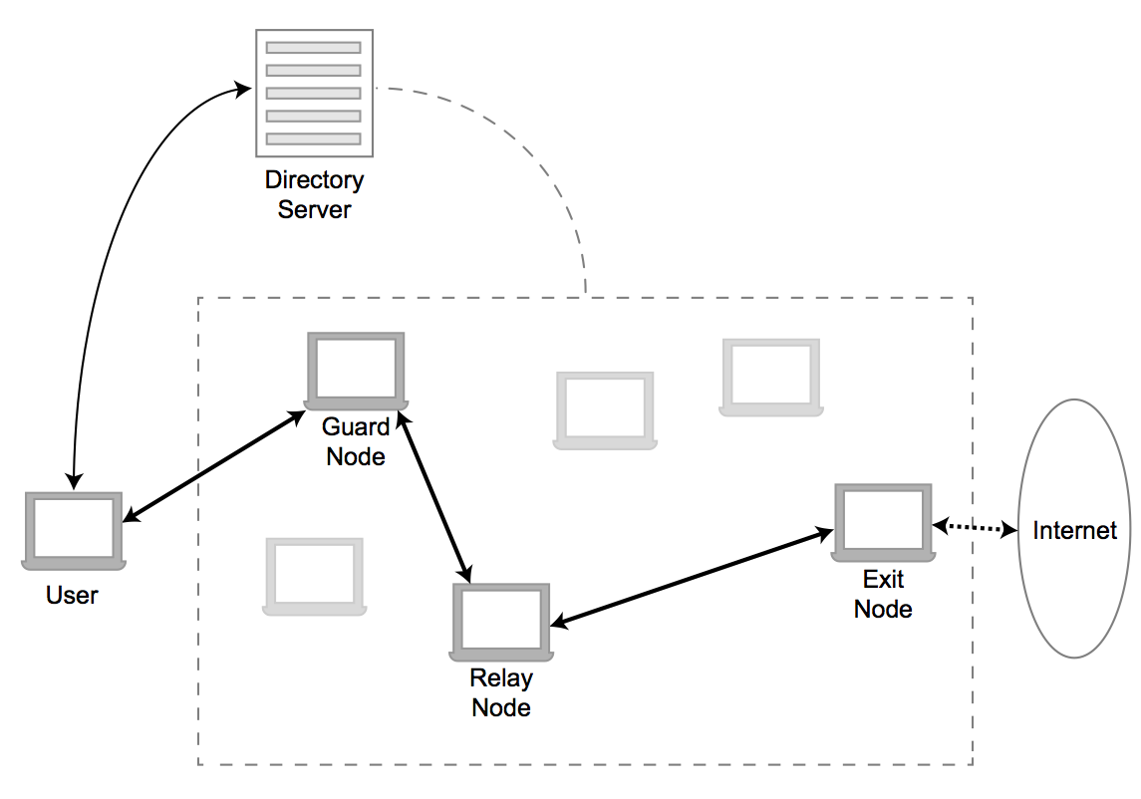
An introduction to Tor

Slide 4
Problems with Tor
Scalability
  Directory servers
  Freeriders
Attacks and vulnerabilities
  Browser based attacks
  Low-resource routing attacks
  Sybil attacks
  Replay attacks
Moral issues
  Silk road
  Illicit pornography

Slide 5
Problems with decentralization
Incentives in decentralized systems
NAT traversal
Bootstrapping new nodes

Slide 6
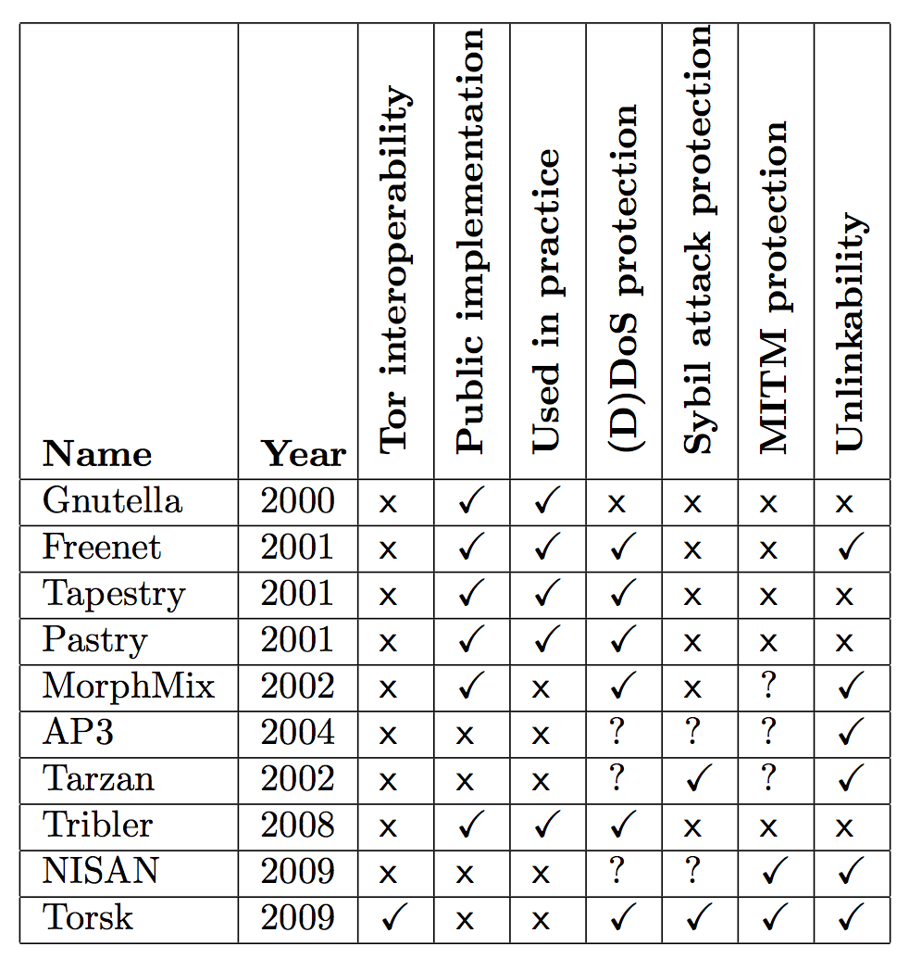
Decentralized privacy-enhancing systems

Slide 7
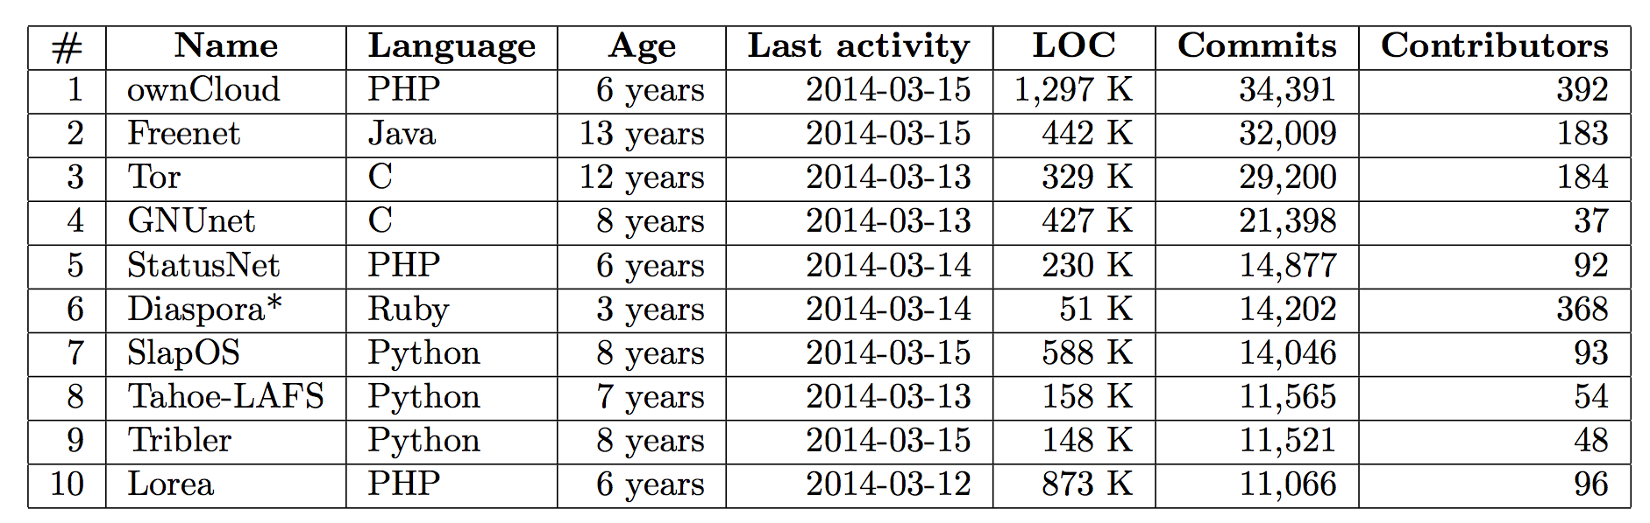
Our contribution to a better internet
Redecentalized.org
Data from Ohloh
Table is sorted by number of commits, as of 2014-03-15

Slide 8
Conclusion
Tor has room for improvement
There are no fully decentralized privacy-enhancing networks
Decentralization is difficult, hence the 15 year struggle

