Slide 1

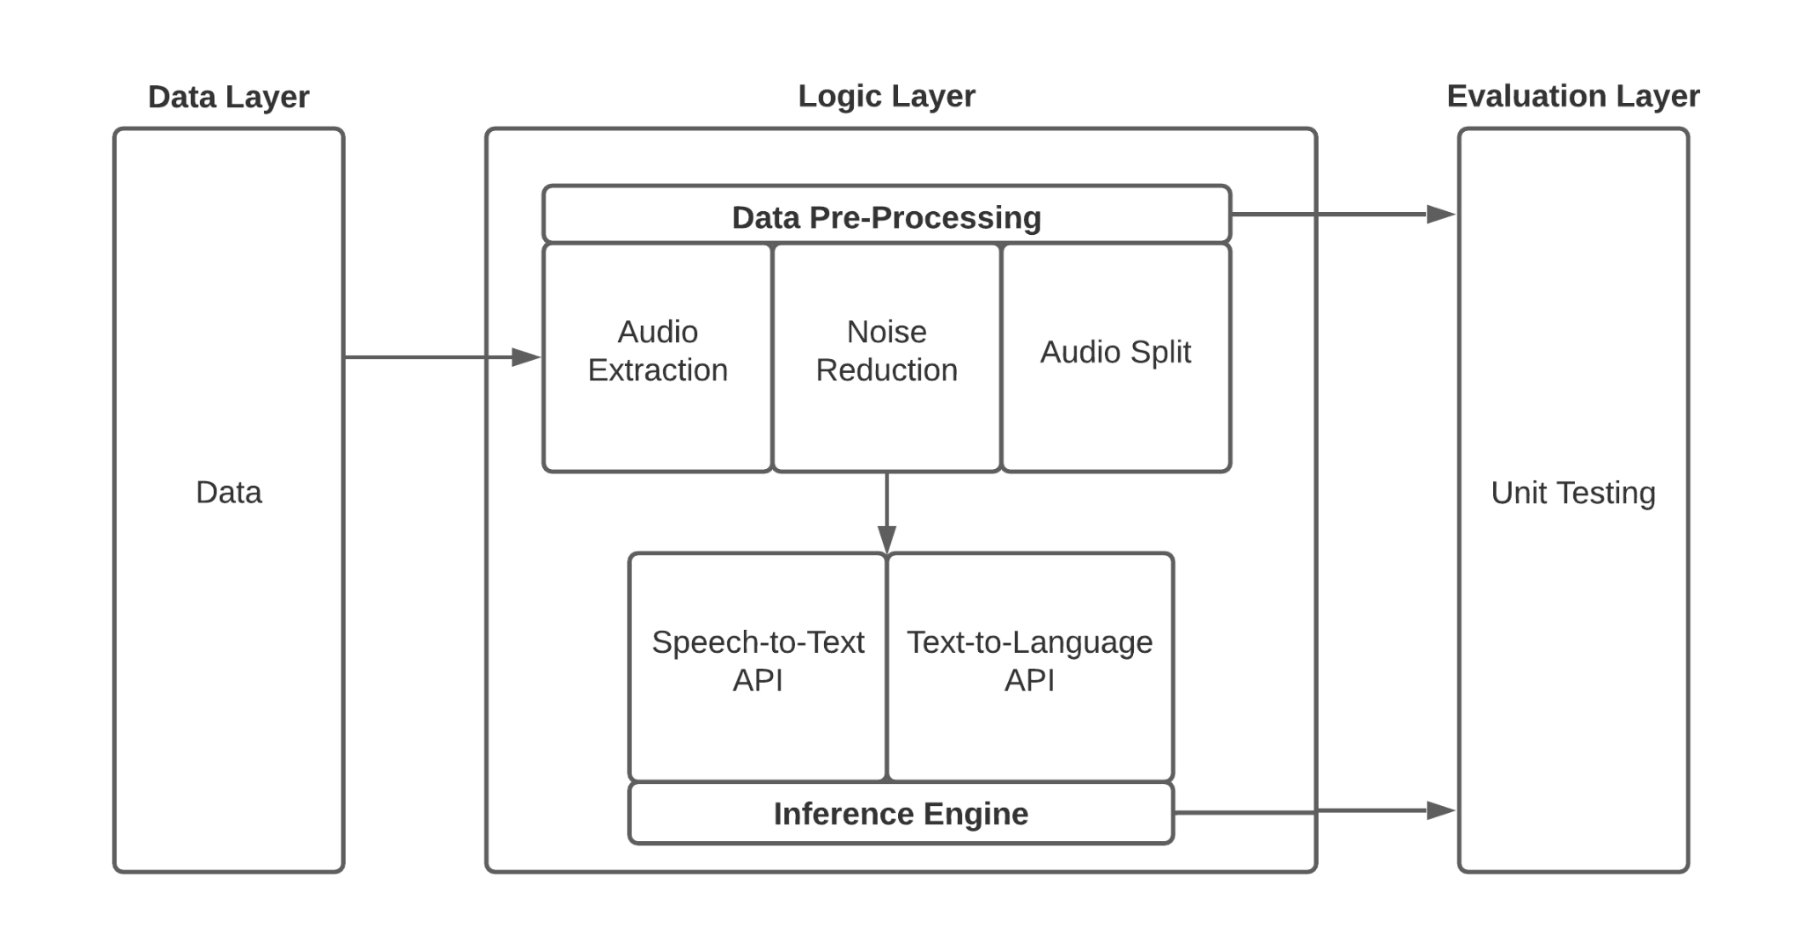
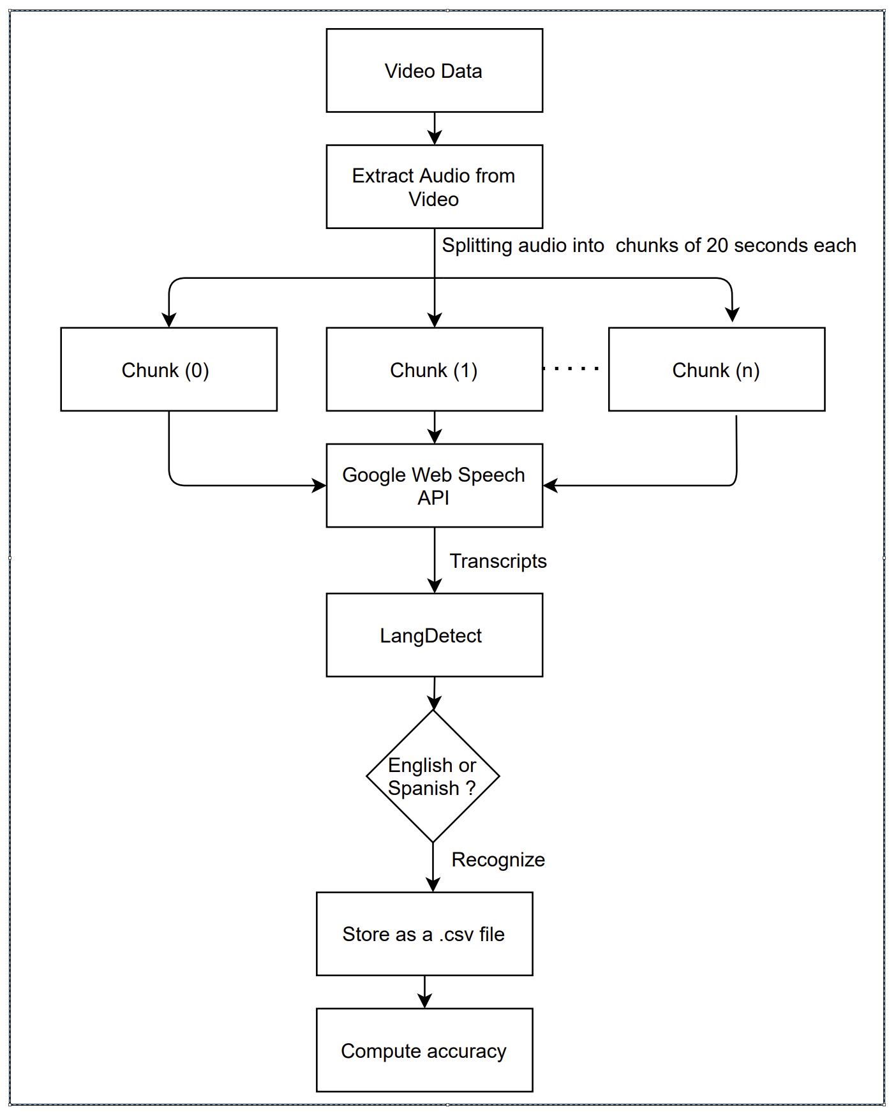
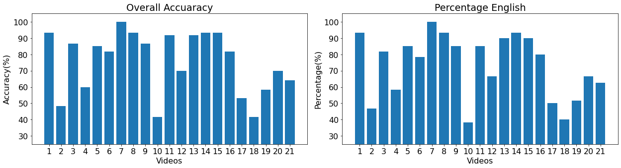
Team Codezilla - Automating Transitional Bilingual Observation Protocol
Rohan Jagiasi, Aishwarya Teegulla, Sunil Komadam, Sanjiti Bhargava, Spoorthy Kanduri, Zaid Bhat, Samiksha Marne
Dept. of Computer Science & Engineering
Introduction
System Design
The education department at TAMU has been assigned the task of improving the schools around the state of Texas. In order to understand the quality of lectures which have been recorded by various schools, they survey the video for certain cues and classify the video into different categories. For a language lecture where Spanish is being taught to students, they classify the video based on how much Spanish / English is being spoken and being used in conversation. This helps them identify the mistakes in the lecture and accordingly guide the professor in order to improve it. This specific task, of identifying language, we try to emulate using software. We create a system which extracts audio from these videos, processes it and identifies the language spoken.
Overall Flow of Code
Figure 2. Layerwise workflow
The Data Layer presents data to the logic layer. Logic layer has a pre-processing unit and Inference engine. Inference Engine has a model developed using Speech-to-Text API (Google Recognise API) and Text-to-language API (LangDetect).
Extract Audio from Video This code was implemented using the MoviePy library. It takes in a video file as input and extracts the audio stream from it and stores in the ‘.wav’ format. We can optionally choose to specify the format of the desired audio file. The code was tested on the sample video files provided by the client. Additionally, a sample video file has been included in the GitHub repository along with the command in Readme to test the working of the code.
Split into 20 seconds
This code was implemented using pydub from Audiosegment. It divides the audio file of wav. Format into small chunks of specified length. Pydub calculated in milliseconds. Thus a sample video of 1 minute was split into 3 chunks of 20 seconds each. The code was tried and tested on various audio files to determine its reliability
Remove Noise
There are two ways to remove noise. One is by using the integrated features of Google API and mentioning an extra parameter in the next step.
The other is a command utility called SoX (Sound Exchange). In SoX, we can apply a low pass filter to reduce all the background noise below a certain threshold. Silent parts of the audio can also be clipped by specifying a certain energy level below which the audio will be removed. You can visually see the difference by plotting a spectrogram.
Use Audio to text API
The audio to text feature is implemented using the ‘Speech Recognition’ library. It provides us with a Recognizer class and each instance of this class offers us with seven methods for recognizing speech from an audio source (which is previously extracted from the classroom video recordings in our project). We are using Google Web Speech API for speech-to-text. The audio file is provided to the API in the wav format and the output is obtained in the form of text.
Use Text to Language API
The implementation to predict the language of the text is done using Python language detection library - Langdetect. It has better accuracy and also the inference time is very fast. This library returns the detected language of longer sentences.
To determine both english and spanish in the output text, we split each sentence and detect the language.
Figure 1. Overall Flow Diagram
Integration / Testing
Integration:
Independent modules were created for extracting the audio, splitting into a required number of audio files and decision model which makes API calls to Speech-To-Text Google API and Text-To-Lang library. These were then integrated to form a cohesive pipeline which takes in the input video file and calls the functionality while maintaining formats; then encodes videoname, timestamp and output language to save in a CSV format output.
Testing:
Unit Testing - Independent functions have been written within each module for unit testing.
Integration testing - Integration testing is done by executing the pipeline for the videos provided by the client
Model Validation - Based on the output obtained by executing the software for each video, a CSV file with predictions is generated. This file is then compared with the file given by the client in order to calculate accuracy.
Experimentation Results
Challenges / Future Works
The model has been tested on label files provided by the client. The processing times vary anywhere from 1 to 2 minutes. We have compared the output of the code against the language of instruction data and have observed the following accuracy percentages:
As we see, the accuracy of the language prediction is decent enough for the most of the videos. An interesting observation is that the accuracy closely follows with the percentage of english in the video. It recognizes English really well but struggles in identifying Spanish, though it does recognize that Spanish parts are non English
For further analysis: We took a sample video completely in Spanish from Youtube to analyze the performance of the model on a Spanish video and we found it to be 78% accurate. Since it works decent on the Youtube video, we assume the quality of recorded audio is an issue here.
The biggest challenge faced while the execution of the project was to remove the noise and improve the quality of the video. For further research, special audio boosting and noise removal mechanisms can be used which are generally used in signal analysis. In order to improve the model, a model designed with a smaller subset of languages can be chosen so as to better identify the audio.
We can take a step ahead and also explore tensorflow/scikit learn to understand and develop the deep learning approaches to analyse audio data and language recognition. Specific Natural Language Processing models can be used extensively in order to classify other sections of TBOP sheet as well.
Acknowledgement
We would like to thank Dr Walker and Dr Beverly to give an opportunity to work on such an exciting project. The vision of the education department is to give realtime feedback to the professor teaching in the class, which would greatly improve the quality of students. This also gave us an insight about how the education team is striving to benefit and improve the life of students and teachers. This is a small contribution in the journey towards achieving it.
Conclusion / Lessons Learnt
The client expected a proof of concept application to evaluate languages in lecture videos and the same has been successfully implemented. We learnt that the English language works well with the existing model but the Spanish language needs some future work in the preprocessing phase. We learnt about the various libraries and frameworks used to process videos and audios. We also learnt about the various phases in Software Engineering and the importance of them in order to create a successful project. This project can be a good starting point for the eventual aim of education department to automate evaluation of recorded lectures.

