Slide 1
Web development
Ramana Jaladurgam

Slide 2
Web development
Enterprise Application Architecture
Skill sets for web development
Tools for web development - Core Java, Java EE, Angular Spring framework
Hugo framework for static website development – An idea
Q&A

Slide 3
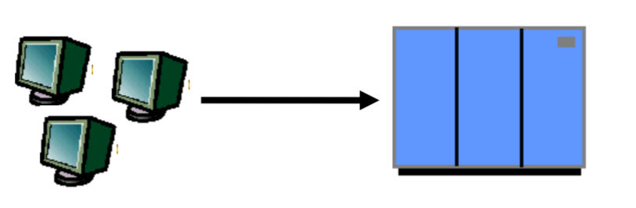
Enterprise Application Architecture – Single Tier
Mainframe Era
Dumb terminals are directly connected to mainframeTools for web development
Presentation, business logic, and data access are intertwined in one monolithic mainframe application

Slide 4
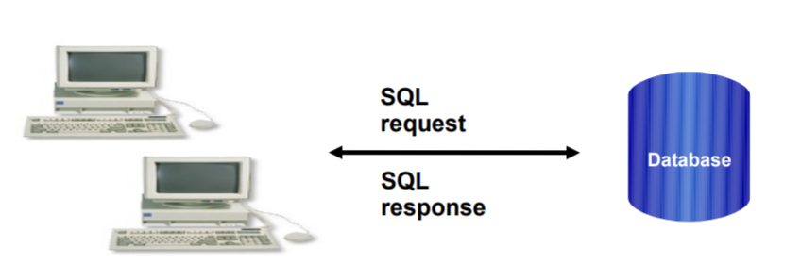
Enterprise Application Architecture – Two Tier
Thick clients talking to back end database. SQL queries sent, raw data returned
Presentation, Business logic and Data Model processing logic in client application

Slide 5
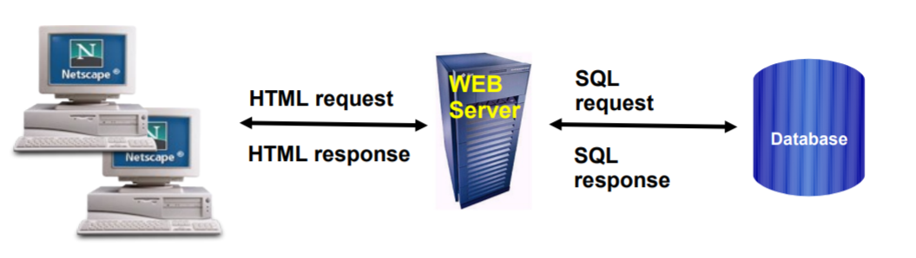
Enterprise Application Architecture – Three Tier
Browser handles presentation logic
Browser talks Web server via HTTP protocol
Business logic and data model are handled by “dynamic contents generation” technologies (Servlet/JSP/REST)

Slide 6
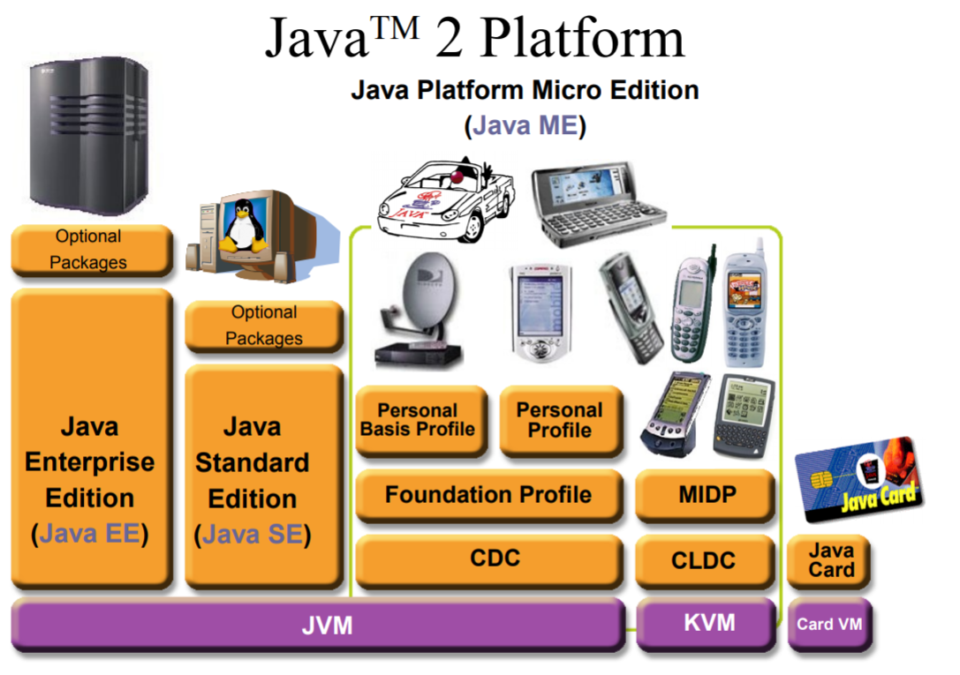
Java 2 Platform

Slide 7
Skill sets for web development
Java script, Angular JS, Node JS
REST API building
Frameworks like Spring
Database like Oracle, MySQL, SQLite
Application Servers like Tomcat, WebSphere
Basic Linux knowledge
IDE like Eclipse

Slide 8
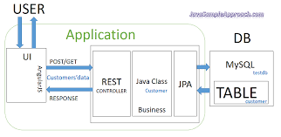
Tools for web development - Core Java, Java EE, Angular, Spring framework

Slide 9
Hugo framework for static website development
Fastest framework for building static websites
Hugo is one of the most popular open-source static site generators
Flexible framework and provides for templating
Building of your department website ?
Refer to https://gohugo.io/

