Slide 1
CSM151B
Spring 2003
Mid-Term Review
Mid-Term: Monday 5/05/03
Test Location: Math Science 4000A
Open Book / Open Lecture Notes & Class Example
NO HOMEWORK & SOLUTION ALLOWED
Extra Office Hours: Friday 4:30 – 8:30 p.m.
Location (tentative): TA Room BH4428

Slide 2
Areas to Study
What is computer architecture?
  What is the difference between RISC and CISC?
  What are their rationales?
How to evaluate computer performance
  Execution time calculation
  MIPS calculation and pitfalls of MIPS
  Concept of Spec Marks
Number Representation
  Floating point number representation and IEEE 754
  Floating point operations with IEEE 754
MIPS instruction set
  Able to write simple assembly code with MIPS instruction set
  Understanding of procedure calls and stack management
How to implement to single cycle data path and control unit
  RTL representation and minimum data path implementation of the instruction
  Combining data paths for different instructions
  Add control points
  Implementing the control unit with logic equation

Slide 3
Areas for Study (continued)
How to add instructions to multi cycle data path
  Converting a single cycle data path to multi-cycle data path and what to watch out
  Multi-cycle RTL representation of the data path for the instruction
  Combining the instruction data path to the main data path
How to design the multi cycle control unit with Explicit Next State Function for an instruction
  Finite state diagram for the instruction with control signal values
  Combining the instruction finite state diagram to the main finite state diagram
  How does the control logic block diagram look like (including inputs & outputs)
  Translating finite state diagram into state transition table
  Translating state transition table into truth table
  Translating the truth table into logic equations
How to design the multi cycle control unit with Micro Sequencer for an instruction
  How does the control logic block diagram look like (including inputs & outputs)
  How to translate the finite state diagram into the sequence control field
  How to generate the dispatch ROMs
  Basic idea of micro programming

Slide 4
What is Computer Architecture?
Coordination of many levels of abstraction
Under a rapidly changing set of forces
Design, Measurement, and Evaluation
Application
Software
Operating System
Compiler
Firmware
Instruction Set
Architecture
Instr. Set Proc.
I/O system
Datapath & Control
Control
I Reg
ALU
Mem
Digital Design
I2
O2
Hardware
I1
O1
Circuit Design
Bottom Up
view
Vdd
I1
O1
Physical Design
Vdd
I1
O1
Courtesy D. Patterson

Slide 5
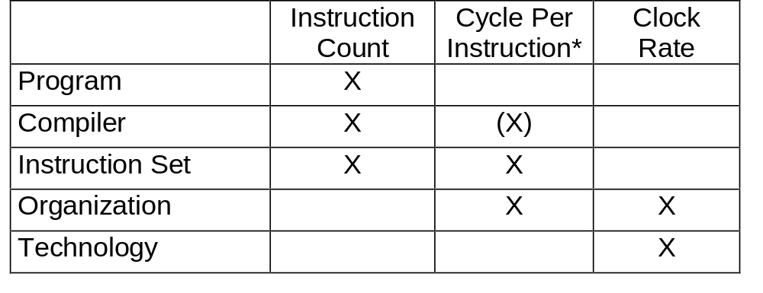
Performance Analysis
Basic Performance Equation:
Seconds
Instructions
Cycles
Seconds
CPU time
(execution time)
=
=
×
×
Program
Program
Instructions
Cycles
*Note: Different instructions may take different number of clock cycles. Cycle Per Instruction (CPI) is only an average and can be affected by application.
Courtesy D. Patterson

Slide 6
Traditional Performance Metrics
Million Instructions Per Second (MIPS)
MIPS = Instruction Count / (Time × 10⁶)
Relative MIPS
Million Floating Point Operation Per Second (MFLOPS)
MFLOPS = Floating Point Operations / (Time × 10⁶)
Million Operation Per Second (MOPS)
MFLOPS = Operations / (Time × 10⁶)
Ex Time _{reference machine}
×
Relative MIPS =
MIPS _{reference machine}
Ex Time _{target machine}

Slide 7
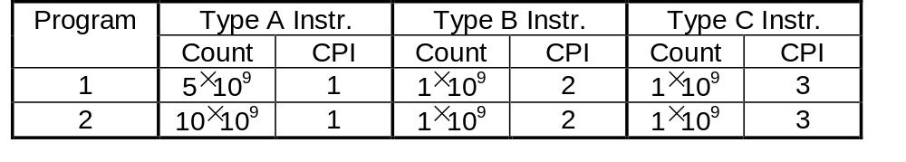
Million Instruction Per Second (MIPS)
Advantage: Intuitively simple (until you look under the cover)
Disadvantages:
  Doesn’t account for differences in instruction capabilities
  Doesn’t account for differences in instruction mix
  Can vary inversely with performance
Example: For a 500 MHz machine
(5×1+1×2+1×3) ×10⁹
(5+1+1) ×10⁹
CPU Time₁ =
=
20 sec;
MIPS₁ =
= 350
500 ×10⁶
20 ×10⁶
(10×1+1×2+1×3) ×10⁹
(10+1+1) ×10⁹
CPU Time₂ =
=
30 sec;
MIPS₂ =
= 400
500 ×10⁶
30 ×10⁶

Slide 8
1989 SPEC Benchmark
10 Programs
  4 Logical and Fixed Point Intensive Programs
  6 Floating Point Intensive Programs
  Representation of Typical Technical Applications
Evolution since 1989
  1992: SpecInt92 (6 Integer Programs),
  SpecFP92 (14 Floating Point Programs)
  1995: New Program Set, “Benchmarks Useful for 3 Years”
Exec. Time on Test System
Spec Ratio for Each Program =
Exec Time on Vax–11/ 780
Specmark = Geometric Mean of all 10 SPEC ratios
=
n
√ Π
10
SPEC Ratio (i)
i = 1

Slide 9
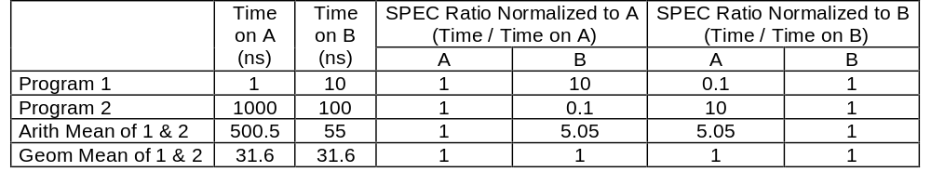
Why Geometric Mean?
Reason for SPEC to use geometric mean:
  SPEC has to combine the normalized execution time of 10 programs. Geometric means is able to summarize normalized performance of multiple programs more consistently
Disadvantage: Not intuitive, cannot easily relate to actual execution time
Example: Compare speedup on Machine A and Machine B
B is 10 times faster than A running Program 1, but A is 10 times faster than B running Program 2. Therefore, two computers should have same speedup. This is indicated by the geometric mean but not by the arithmetic mean (in fact, the arithmetic mean will be affected by the choice of reference machine)

Slide 10
IEEE 754 Standard for Floating Point Numbers
Two formats: single precision (32-bit) and double precision (64-bit). Single precision format:
sign
Exponent (biased)
Significand only (leading 1 is implicit)
Maximize precision of representation with fix number of bits
  Gain 1 bit by making leading 1 of mantissa implicit. Therefore,
  F = 1 + significand, Value = (−1)^{s} × (1 + significand) × 2 ^{E}
Easy for comparing numbers
  Put sign bit at MSB
  Use bias instead of sign bit for exponent field
  Real exponent value = exponent - bias, bias = 127 for single precision
  Examples: IEEE 754 value Floating Point Number Value
  Exponent A = -126 00000001 (−1)^{s} × F × 2 ⁽¹⁻¹²⁷⁾ = (−1)^{s} × F × 2⁻¹²⁶
  Exponent B = 127 11111110 (−1)^{s} × F × 2 ⁽²⁵⁴⁻¹²⁷⁾ = (−1)^{s} × F × 2¹²⁷
  This is much easier to compare than having A = −126₁₀ = 10000010₂ and
  B = 127₁₀ = 01111111₂
Need to take care special cases (by convention)
  Value = 0 E = 0 f = 0 i.e., f = significand
  Value = (−1)^{s} ∞ E = 255 f = 0
  Value = (−1)^{s}(0.f)2⁻¹²⁶ E = 0 f ≠ 0 Value has been denormalized

Slide 11
IEEE 754 Computation Example
A) 40 = (–1)⁰ × 1. 25 × 2⁵ = (–1)⁰ × 1.01₂ × 2^{(132 – 127)} = [0][10000100][101000000000000000000]
B) –80 = (–1)¹ × 1. 25 × 2⁶ = (–1)¹ × 1. 01₂ × 2^{(133 – 127)} = [1][10000101][111101000000000000000]
C) By the extended format of the standard, non-normalized significand can be used to align the exponents:
40 = (–1)⁰ × 0. 3125 × 2⁷ = (–1)⁰ × 0.0101₂ × 2 ^{(134 – 127)} = [0][10000110][010100000000000000000]
–80 = (–1)¹ × 0. 6250 × 2⁷ = (–1)¹ × 0.1010₂ × 2 ^{(134 – 127)} = [1][10000110][101000000000000000000]
D) Need to convert the IEEE 754 significand of –80 into 2’s complement before the subtraction:
–80 = [1][10000110][101000000000000000000] ➔ [1][10000110][011000000000000000000]
40 – 80 = [0][10000110][010100000000000000000] + [1][10000110][011000000000000000000]
= [0][10000110][101100000000000000000]
E) Convert the result in 2’s complement into IEEE 754 = [1][10000110][010100000000000000000]
F) Renormalize:
[1][10000110][010100000000000000000] = [1][10000100][010000000000000000000]
= (–1)¹ × 1.01₂ × 2⁵
Check: 40 – 80 = – 40 = (–1)¹ × 1.25 × 2⁵ = (–1)¹ × 1.01₂ × 2⁵

Slide 12
What is RISC and Why?
RISC is an architecture design concept based on the principle that simpler hardware runs faster (e.g. MIPS). It uses smaller and regular instruction set to achieve performance, while relying on compiler technology to achieve functions used to done by complex instructions.
Opposite to RISC is Complex Instruction Set Computer (CISC) (e.g. Intel x86). CISC believes complex instructions implemented in hardware can reduce the number of memory access and thus achieve higher performance. Language directed architecture such as Burroughs’ B5500 (Algol) or B4500 (Cobol) are extreme cases.
350
300
250
RISC
200
Performance
150
Intel x86
100
RISC
introduction
50
0
1982
1984
1986
1988
Year
1990
1992
1994
Courtesy D. Patterson

Slide 13
The MIPS Instruction Set
MIPS is a Reduced Instruction Set Computer (RISC),
Characterized By:
It is a Load- Store Machine: Computation Is Done On Data In Registers
i. e., Operands of Arithmetic And Logical Operations Do Not Reside In Memory. Data Is Moved Between Memory And Registers Before Being Used and Back To Memory After Computation Is Finished By Load and Store Instructions
A Relatively Small Number Of Instructions and Data Types
All Instructions Are Of The Same Length
There Are A Very Small Number Of Instruction Formats (3)
There Are A Small Number Of Addressing Modes - Three For Accessing Operands (Register- Direct, Based, Immediate) and One For Computing Jump Addresses (PC- Relative)
Courtesy M. Louie

Slide 14
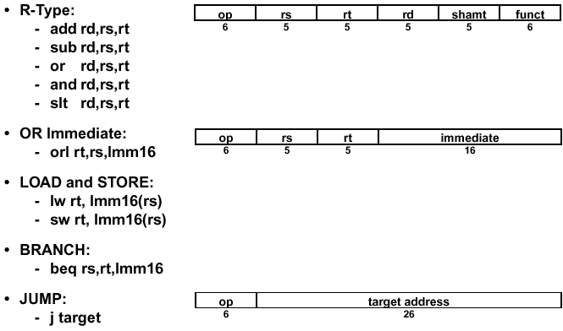
A Subset of MIPS Instruction Set Architecture

Slide 15
MIPS Instruction Addressing Modes
Register (Direct)
E.g., add $1, $2, $3
$1←$2+$3
OP
RS=$2
RT=$3
RD=$1
Register
Immediate
E.g., addi $1, $2, 100
$1←$2 +100
OP
RS
RT
Immediate=100
Base + Index
E.g., lw $1, 100($2)
$1←Mem[$2+100]
OP
RS=$2
RT
Immediate=100
Register
+
Memory
PC-Relative
E.g., bne $1, $2, 100
Goto Mem[PC+100] if $1=$2
OP
RS
RT
Immediate = 100
PC
+
Memory
Psuedo-Direct
E.g., J 1000
Goto Mem[PC(31:30):1000]
OP
Address = 1000
PC
Memory

Slide 16
Procedure Calls
Procedure call is used by programmers to structure programs, for easier to understand and reusuability. Example:
main() /* This is the calling procedure (caller) */
{
funct(100); /* procedure call */
}
int funct(arg) /* This is the called procedure (callee) */
{
…
}
In order to execute procedure call
  Step 1:The calling program has to put parameters in a place where procedure can access
  Step 2: The calling procedure transfers control to the called procedure while saving the return address at the same time
  Step 3: The called procedure executes the desired task
  Step 4: The called procedure puts return value in a place where the calling program can access
  Step 5: The called procedure returns control to the calling program at the point of origin

Slide 17
MIPS Software Convention for Registers
0 zero constant 0
1 at reserved for assembler
2 v0 expression evaluation &
3 v1 function results
4 a0 arguments
5 a1 (calling procedure uses these
6 a2 registers to pass arguments
7 a3 to the called procedure)
8 t0 temporary: caller saves
  do not need to be preserved across procedure calls
. . . (called procedure can clobber)
15 t7
16 s0 callee saves
  need to be preserved across procedure calls
. . . (calling procedure can clobber)
23 s7
24 t8 temporary (cont’d)
25 t9
26 k0 reserved for OS kernel
27 k1
28 gp Pointer to global area
holding a program’s static data
29 sp Stack pointer
30 fp frame pointer
31 ra Return Address (HW)
Stack frame -- A block of memory allocated on the stack for the subroutine call environment.
  Purpose:
  hold values passed as subroutine arguments
  save register values that the calling subroutine needs to use after the callee returns
  provide space for local variables since there are only a limited number of registers

Slide 18
An Overly Simplified Example
Addr
main() /* Caller */
{
x = y + z;
funct(arg); /* procedure call */
…
}
$v0
w
($2)
1
$a0
arg
($4)
funct addr
1
2
main addr
2
main addr
3
1
2
PC
3
3
x
3
$t0
w
($8)
y
$t1
v
($9)
$ra
main addr3
($31)
$t2
z
($10)
Addr
int funct( arg ) /* Callee */
{
w = arg – v;
return (w);
}
1
arg
2
3
But!
What if there are more than 4 arguments?
What if there are some register values need to be preserved across procedure call (e.g., if you want to preserve the value x)?
What if another procedure call happens before the current procedure is completed?

Slide 19
Call-Return Linkage: Stack Frames
Solution:
Save the needed information (e.g., arguments, return address) onto a stack in memory
Information needed by the called procedure are grouped into a stack frame
Many variations on stacks possible (up/down, last pushed / next )
High Mem
FP
ARGS
Reference Arguments
and Local Variables at
Fixed (negative)
Offset From FP
(frame pointer points to 1st word of frame)
Callee Save Registers
(old $fp, $ra, $s0,etc)
Stack Frame or
Activation Record
Local Variables
SP
(stack pointer points to last word of frame)
Grows and shrinks during expression evaluation
Low Mem

Slide 20
MIPS Instructions for Procedure Call
MIPS uses a jump and link instruction for procedure calls
  Jumps to the address specified in the lower bits of the instruction
  Simultaneously save the address of next instruction (i.e. PC+ 4) in the Return Address (RA) register (R31)
  Use jump register (jr RA) for return
Category | Instruction | Example | Meaning | Comments
Unconditional Jump | jump | j L | goto L | Jump to target address
 | jump register | jr $31 | goto $31 | For switch & call return
 | jump and link | jal L | $31 = PC + 4 goto L | For procedure call

Slide 21
Five Classic Components of a Computer
Processor
(CPU)
Input
Control
Memory
Datapath
Output

Slide 22
Steps to Design a Processor
5 steps to design a processor
  1. Analyze instruction set => datapath requirements
  2. Select set of datapath components & establish clock methodology
  3. Assemble datapath meeting the requirements
  4. Analyze implementation of each instruction to determine setting of control points that effects the register transfer.
  5. Assemble the control logic
MIPS makes it easier
  Instructions same size
  Source registers always in same place
  Immediates same size, location
  Operations always on registers/immediates
Datapath Design
Cpntrol Logic Design

Slide 23
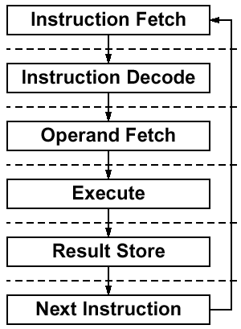
Step 1: Analyze the Instruction Set
Specify Requirements for the Data Path
Where and how to fetch the instruction?
  Where are the instructions stored?
Instruction format or encoding
  how is it decoded?
Location of operands
  where to find the operations?
  how many explicit operands?
Data type and Size
Type of Operations
Location of results
  where to store the results?
Successor instruction
  How to determine the next instruction?
  (next address logic for jumps, conditions branches)
fetch-decode-execute next address is implicit!

Slide 24
Specifying Datapath Implementation with Register Transfer Languages (RTL)
Specify what state elements (registers, memories, flip-flops) are needed to implement the instructions
Describe how signals are transferred among state elements
There are many types of RTLs. Examples: VDHL and Verilog
An informal RTL is used in this class:
Syntax: variable ← expression
Where variable is either a register or a signal or signal group
(Note: Use the following convention in this class.
Variable is a register if it is all caps or in form of array[address]. Otherwise it is a signal or signal group)
Expression is a function of input signals and the output of other state elements
Example: RTL for R-Type Instruction
instr ← mem[PC] Instruction Fetch
rs ← instr<25:21> Define Signals (Fields) of Instr
rt ← instr<20:16>
rd ← instr<15:11>
R[rd] ← R[rs] + R[rt] Add Register Contents
PC ← PC + 4 Update Program Counter

Slide 25
Register Transfer Language and Clocking
Register transfer in RTL:
R2 ⬅ f(R1)
What Really Happens Physically
R1
R2
1
0
1
1
.
.
.
.
.
.
.
.
.
.
.
.
0
0
1
1
1
1
Clk
Setup
Hold
Setup
Hold
Don’t Care
Setup (Hold) - Short time before (after) clocking that inputs can’t change or they might mess up the output
Two possible clocking methodologies: positively triggered or negatively triggered. This class uses the negatively-triggered.

Slide 26
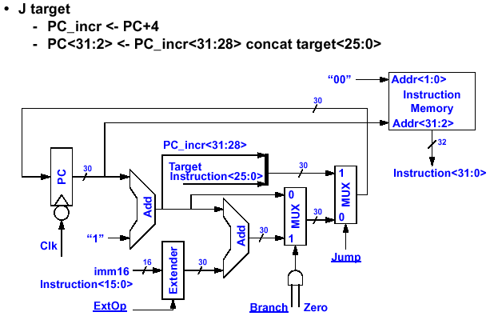
Step 3: Assemble the Datapath
The Instruction Fetch Unit

Slide 27
Step 3: Assemble the Datapath for Load Operations
lw rt, immed16(rs)
Instr <- mem[PC] Instruction Fetch
rs <- Instr<25:21> Define Signals (Fields) of Instr
rt <- Instr<20:16>
imm16 <- Instr<15:0>
Addr <- R[rs] + SignExtend(imm16) Calculate Memory Address
R[rt] <- Mem[Addr] Load Data into Register
PC <- PC + 4 Update Program Counter
PC+4
Next Address Logic
PC
Instruction Memory
Register
File
Rd addr1
ALU
Data
Memory
addr
Wr addr
Wr data
mux
ext
data in
data out

Slide 28
A Complete Single Cycle Data Path and Load Instruction Operations
Inst
Memory
Instruction<31:0>
<21:25>
<16:20>
<11:15>
<0:15>
We Have Everything Except Control Signals (underline)
Adr
Rs
Rt
Rd
Imm16
nPC_sel
RegDst
Equal
ALUctr
MemWr
MemtoReg
Rd
Rt
MUX
1
0
Rs
Rt
4
RegWr
5
5
5
Adder
busA
0
Rw
Ra
Rb
00
busW
rs
32
=
32 32-bit
Registers
rt
MUX
32
busB
Adder
32
0
PC
PC+4
32
0
PC+4
Clk
MUX
MUX
Adder
1
32
WrEn
Adr
1
Data In
Clk
Extender
Data
Memory
PC Ext
imm16
32
data for rt
1
imm16
16
Clk
ExtOp
ALUSrc

Slide 29
Required Control Signals for the Given Data Path
Instruction<31:0>
Instruction
Memory
<21:25>
<21:25>
<16:20>
<11:15>
<0:15>
Adr
Op
Fun
Rt
Rs
Rd
Imm16
Control
Branch
Jump
RegWr
RegDst
ExtOp
ALUSrc
ALUctr
MemWr
MemtoReg
Zero
DATA PATH

Slide 30
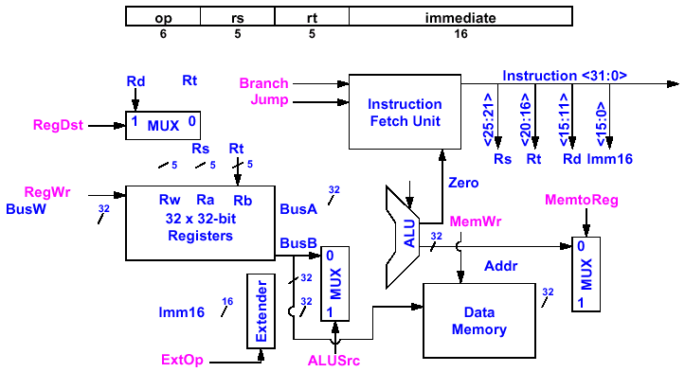
Step 4: Determine Control Points for the Single Cycle Data Path — Control Signals for Load
R[ rt] ← Data Memory [R[ rs] + SignExt( imm16)]
Branch = 0
Jump = 0
RegDst =
0
ALUctr =
ALUctr
add
RegWr =
1
MemtoReg =
1
MemWr =
MemWr = 0
0
Mem Data
ExtOP =
1
ALUSrc =
1

Slide 31
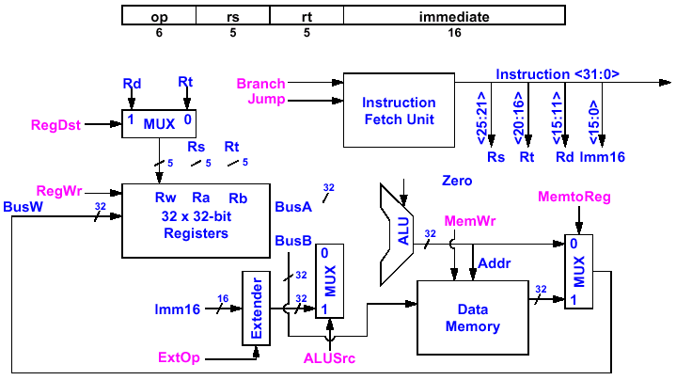
Single Cycle Data Path
Control Signals for Branch
If (R[rs] - R[rt] == 0 ) Then Zero ← 1 ; else Zero ← 0
Branch = 0
Jump = 0
RegDst = x
ALUctr
ALUctr =
sub
Zero
RegWr = 0
MemtoReg = x
MemWr = 0
ExtOP = x
ALUSrc =
0

Slide 32
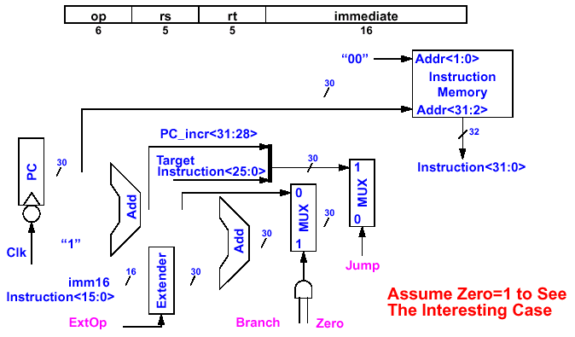
Instruction Fetch Unit at the End of Branch
If ( Zero == 1 ) Then PC = PC + 4 + SignExt( imm16) * 4 ; Else PC = PC + 4
Jump =
0
ExtOP =
1
Branch =
1
Zero =
1

Slide 33
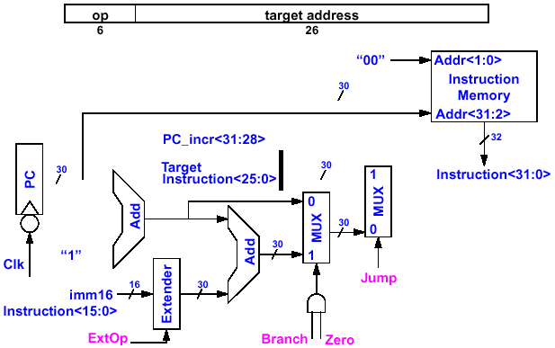
Instruction Fetch Unit at the End of Jump
PC ← PC_incr< 31: 28> concat target< 25: 0> concat “00”
Jump =
1
ExtOP = X
Branch = 0
Zero = x
The data path has nothing to do! Make sure all Write Enable signals are disabled!

Slide 34
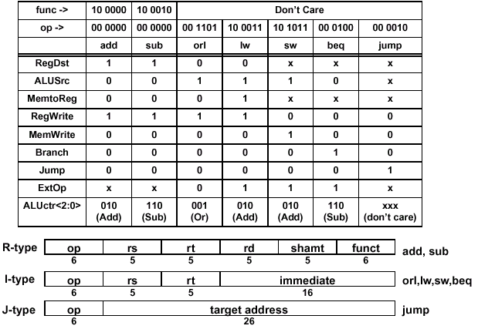
Step 5: Assemble the Control Logic
A Summary of the Control Signals
These signals can easily be expressed as functions of the opcodes
See following discussions

Slide 35
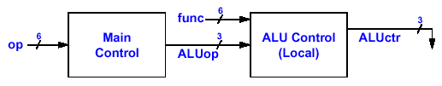
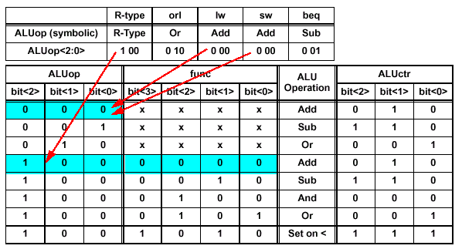
Truth Table for ALUctr
2⁶ = 64 words
2⁹ = 512 words
op
I-type uses the opcodes but not the func field
R-type has only 1 opcode but uses the func field for encoding
• ALUop = f (opcode) ; as shown in the previous slide
• ALUctr = f (ALUop, func)

Slide 36
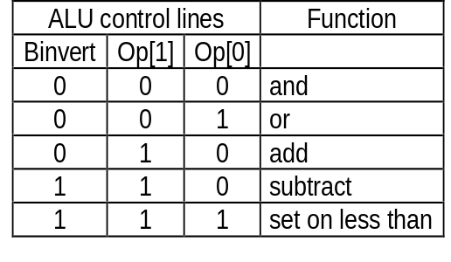
Data Path Element: ALU
Binvert
op[1:0]
Binvert
op[1:0]
c_{in}
C_{in}
a₀
ALU₀
a
b₀
result₀
0
Less
C_{out}
1
C_{in}
b
0
+
sum
2
result
a₁
ALU₁
c_{in}
sum
b₁
result₁
1
a
0
Less
Less
3
b
C_{out}
c_{out}
c_{out}
Binvert
op[1:0]
zero
c_{in}
a
0
C_{in}
1
a₃₁
ALU₃₁
result₃₁
b₃₁
overflow
0
Less
b
0
+
sum
2
result
set
1
Less
3
set
Overflow detection
overflow

Slide 37
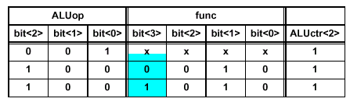
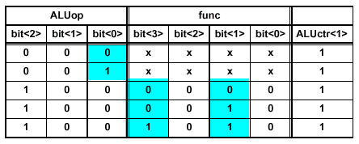
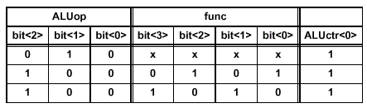
Logic Equations for the ALUctr Signals
This makes func< 3> a don’t care
ALUctr<2>:
ALUctr<2> = !ALUop<2> & !ALUop<1> & ALUop<0> + ALUop<2> & !ALUop<1> & !ALUop<0> & !func<2> & func<1> & ! func<0>
ALUctr<1>:
ALUctr<1> = !ALUop<2> & !ALUop<1> + ALUop<2> & !ALUop<1> & !ALUop<0> & !func< 2>
ALUctr<0>:
ALUctr<0> = !ALUop<2> & ALUop<1> & !ALUop< 0>+ ALUop<2> & !ALUop<1> & !ALUop<0> & !func<3> & func<2> & !func<1> & func<0>+ ALUop<2> & !ALUop<1> & !ALUop<0> & func<3> & !func< 2> & func< 1> & ! func< 0>

Slide 38
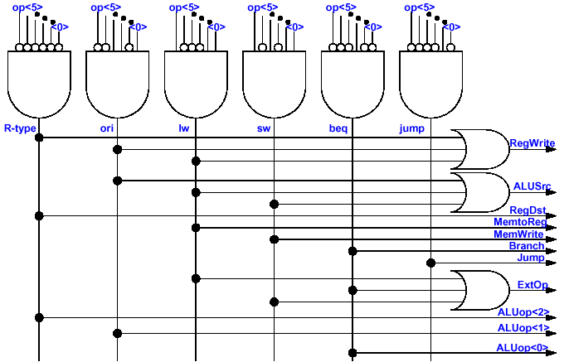
Implementation of the Entire Main Control

Slide 39
Problem with Single Cycle Processor Design
The Root of the Single Cycle Processor’s Problem:
  The Cycle Time has to be Long Enough for the Slowest Instruction. Time is wasted in short instructions.
  This is a serious problem because short instructions occur much more often.
Solution:
  Break the Instruction into Smaller Steps
  Execute Each Step (Instead of the Entire Instruction) in One Cycle
    Cycle Time: Time it Takes to Execute the Longest Step
    Keep All the Steps to a Similar Length
Jump
R-Type
Load
Instr
Fetch
Instr decode
PC write
Instr
Fetch
Instr decode R read
ALU delay
Reg write
Instr
Fetch
Instr decode R read
ALU delay
Mem read
Reg write
Time wasted
Clock
Time wasted
Clock
Time wasted
Clock
Clock
Jump
R-Type
Load
Instr
Fetch
Instr decode
PC write
Instr
Fetch
Instr decode R read
ALU delay
Reg write
Instr
Fetch
Instr decode R read
ALU delay
Mem read
Reg write
Clocks

Slide 40
Basic Idea of Multi Cycle Data Path
Control
R-type
4 cycles
Load
5 cycles
Jump
3 cycles
nPC_sel
PC_Wr
ALUctr
MemtoReg
MemWr
IR_Wr
ALUSrc
MemWr
RegDst
ExtOp
RegWr
Reg File
A
R
mux
Instruction
Fetch
Operand
Fetch
Exec
Next PC
IR
Result Store
PC
B
Mem
Access
M
Data
Mem

Slide 41

Reuse of Function Units in Multi Cycle Data Path
Since intermediate results are stored in intermediate registers, function units can be doing different things at different time
Examples:
  Memory can be used to store both instructions and data
  ALU can be used to do arithmetic and calculate branch address
    Price to pay: extra registers (IR, ALUout) and multiplexors
IR
Load Instruction:
PC
Mem
Mem Data Reg
Instruction Fetch
mux
ALUout
Calculate Address
mux
Read Memory Data
Data
address
PC
Reg A
PC
PC
4
Reg A
4
mux
Reg file or mem
Reg File
Shift 2
ALUout
Shift 2 bits
for branch
Reg B
Reg B
mux
Instr
IR
Need to hold the output so ALU can be reused
Instruction (15:0)
(15:0)
Single Cycle Data Path
Multi Cycle Data Path

Slide 42
General Steps to Design Multi Cycle Datapath
Step 1: Start with a single cycle data path that is capable to perform all execution steps
Step 2: Insert registers after each step in the instruction execution sequence
Step 3: Combine components if possible and add multiplexors
Step 4: Work out clock by clock control signal sequence
Note: Make sure IR is not changed before end of instruction

Slide 43
Step-by-Step Analysis of Multi Cycle Data Path
Instruction Execution Sequence
Step 1: Instruction Fetch
Step 2: Instruction Decode and Register Fetch
Step 3: Execution, Memory Address Computation, or
Branch Completion
Step 4: R-Type Completion or Memory Access for
Load/Store Instructions
Step 5: Memory Read and Load Completion

Slide 44

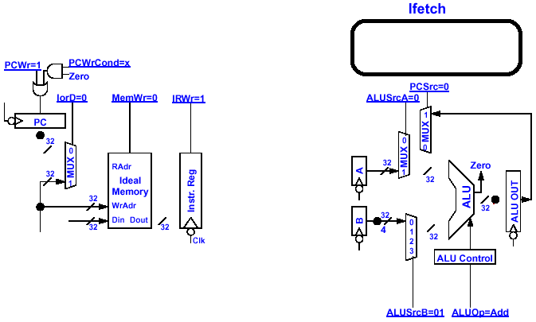
Instruction Fetch Step
Cycle Begins Right AFTER the Clock Tick
  Instr Reg ← mem[PC]; PC<31: 0> + 4
Cycle Ends AT the Next Clock Tick
  IR←mem[PC]; PC<31: 0> ← PC<31: 0> + 4
One Clock Cycle
ALUOp= Add, ALUSrcB= 01
x: PCWrCond, RegDst, MemtoReg,
ExtOp
1: PCWr, IRWr; Others: 0
PC+12
PC+4
PC+8
PC+8
PC+4

Slide 45
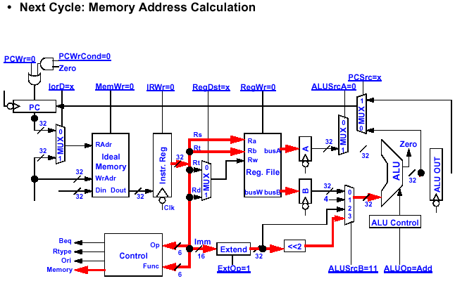
Load Instruction Decode Step
OpFetch/Decode
ALUOp= Add, ALUSrcB= 11
x: RegDst, PCSrc, IorD, MemtoReg
1: ExtOp Others: 0

Slide 46
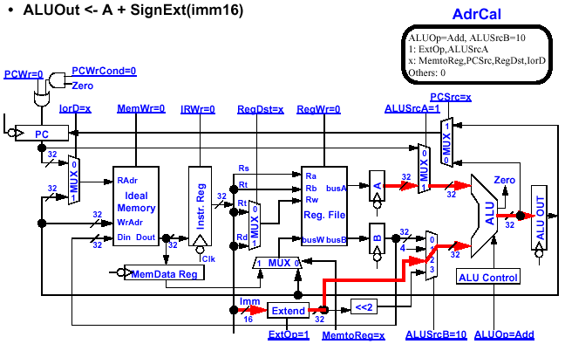
Load Instruction Execution Step
(Memory Address Calculation)

Slide 47
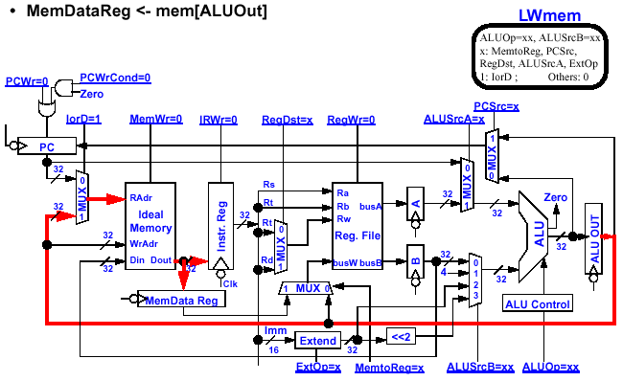
Load Instruction Execution Step
(Memory Access)

Slide 48
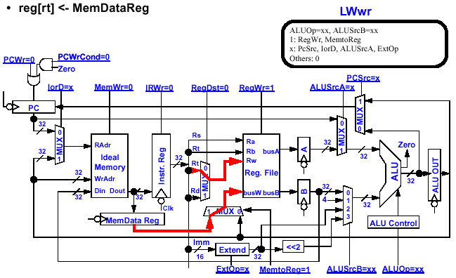
Load Instruction Completion Steps
Skip Forward

Slide 49
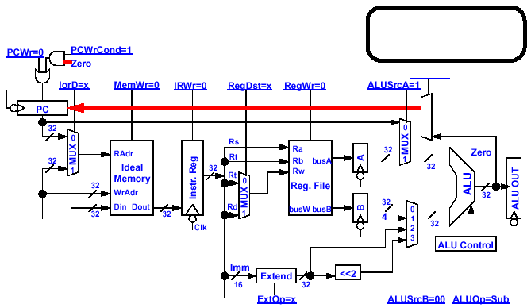

Jump Instruction Decode and Complete Steps
• PC_ incr ← PC + 4
PC<31: 2> ← PC_ incr<31: 28> concat target<25: 0>
JComplete
1: PCWrite
PCsrc = 10
x: others
PCWr=1
PCsrc=2
2
1
0
J
PC<31:28>
Instr<25:0>
4
26

Slide 50
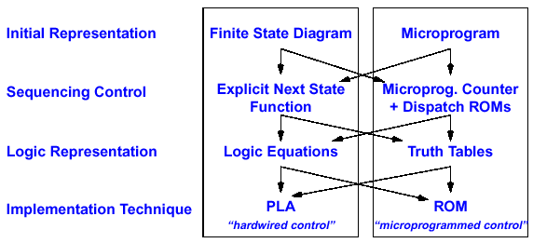
Overview of Control Hardware Development
Control may be designed using one of several initial representations. The choice of sequence control, and how logic is represented, can then be determined independently; the control can then be implemented with one of several methods using a structured logic technique.

Slide 51
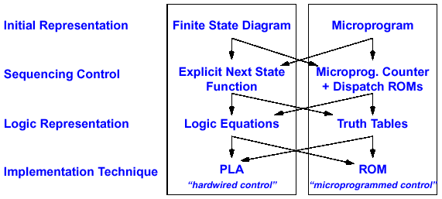
Hardwired Control Approach
Generates very compact design for small finite state machines

Slide 52
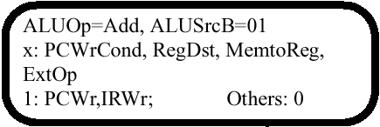



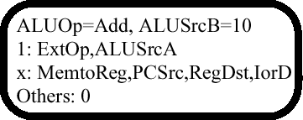
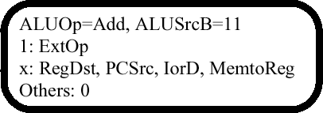
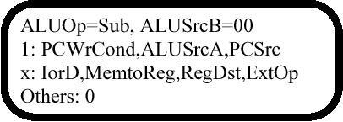


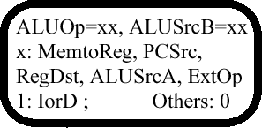
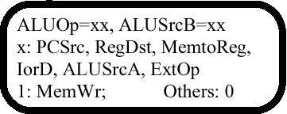
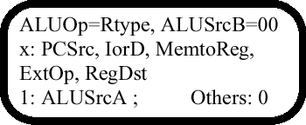
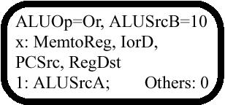

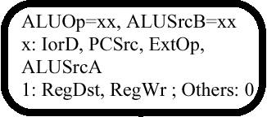
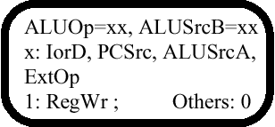
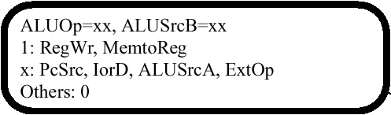
Initial Representation: Finite State Diagram
0
JComplete
9
1: PCWrite
PCsrc = 10
x: others
J
2
1
8
3
5
6
10
11
7
4

Slide 53
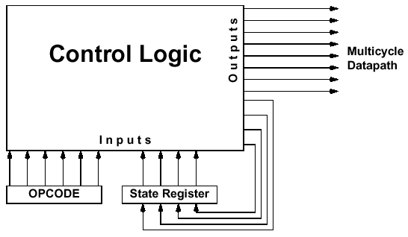
Sequencing Control #1: Logic Block Diagram of Explicit Next State Function
Current state number
Next state number
Each output line is a logical sum (i.e., OR) of minterms (i.e., AND) of the input lines. Example:
NS3 = OP5·OP4·OP3·OP2·OP1·OP0·S3·S2·S1·S0 + OP5·OP4·OP3·OP2·OP1·OP0·S3·S2·S1·S0 +
OP5·OP4·OP3·OP2·OP1·OP0·S3·S2·S1·S0 + S3·S2·S1·S0

Slide 54
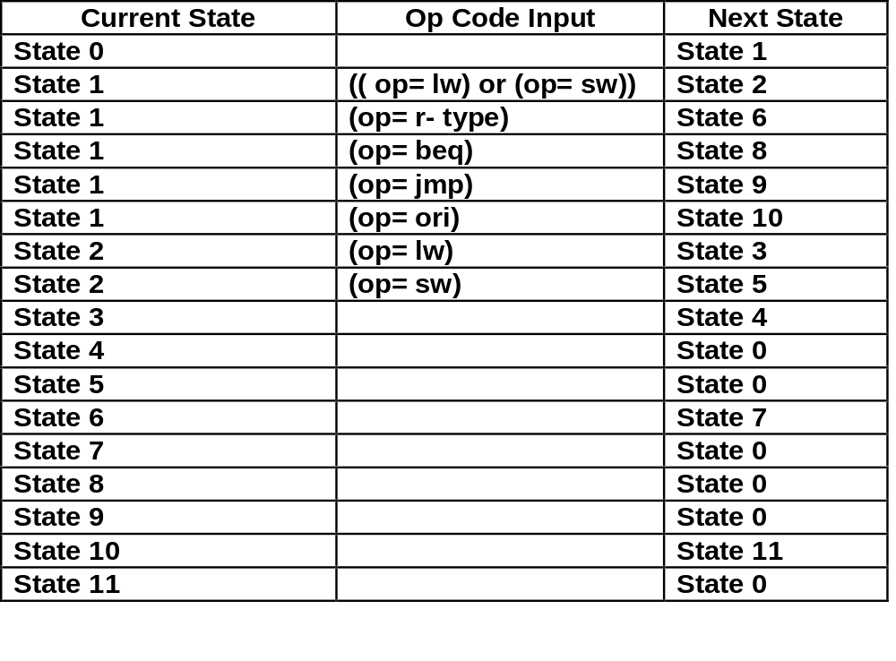
Logic Representation: State Transition Table
For Next State Output
Translating the State Diagram into State Transition Table

Slide 55
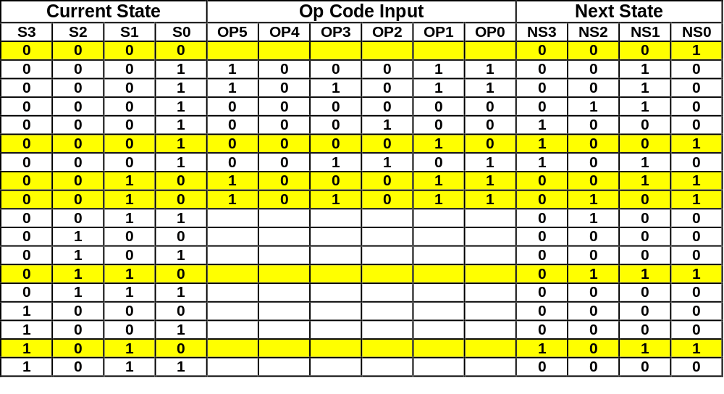
Logic Representation: Truth Table
For Next State Output
Translating the State Transition Table into Truth Table
See example below
Truth Table can be Translated into Logic Equations. Example:
NS0 = S3·S2·S1·S0 + S3·S2·S1·S0·OP5·OP4·OP3·OP2·OP1·OP0 +
S3·S2·S1·S0·OP5·OP4·OP3·OP2·OP1·OP0 + S3·S2·S1·S0 +
S3·S2·S1·S0·OP5·OP4·OP3·OP2·OP1·OP0 + S3·S2·S1·S0

Slide 56
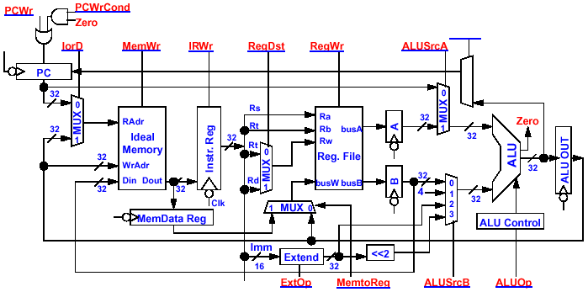
Control Signals
PCsrc
2
1
0
MUX

Slide 57
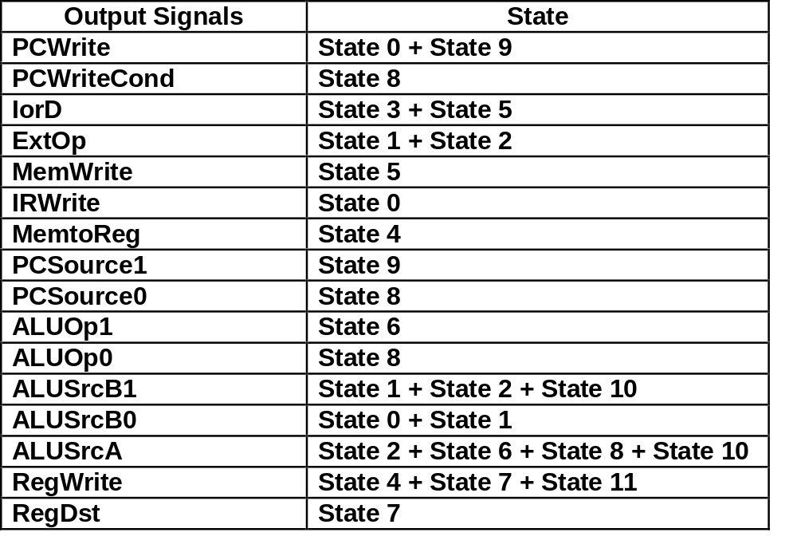
Logic Representation: Logic Equations
For Control Signal Output
Translating the State Diagram into Output Signals

Slide 58
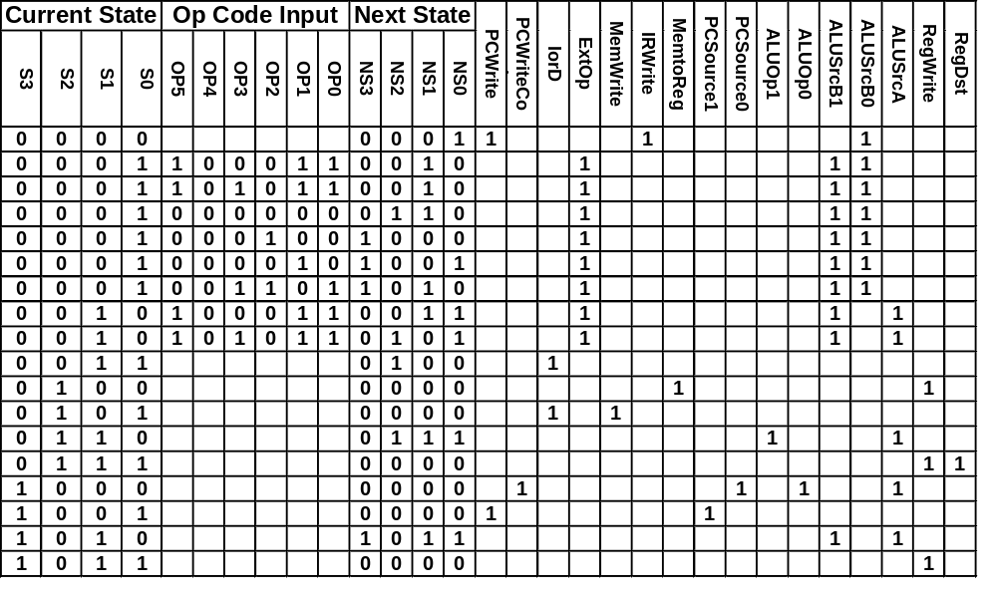
Logic Representation: Logic Equations
For Control Signal Output
For clarity, zeros are not shown in these columns

Slide 59
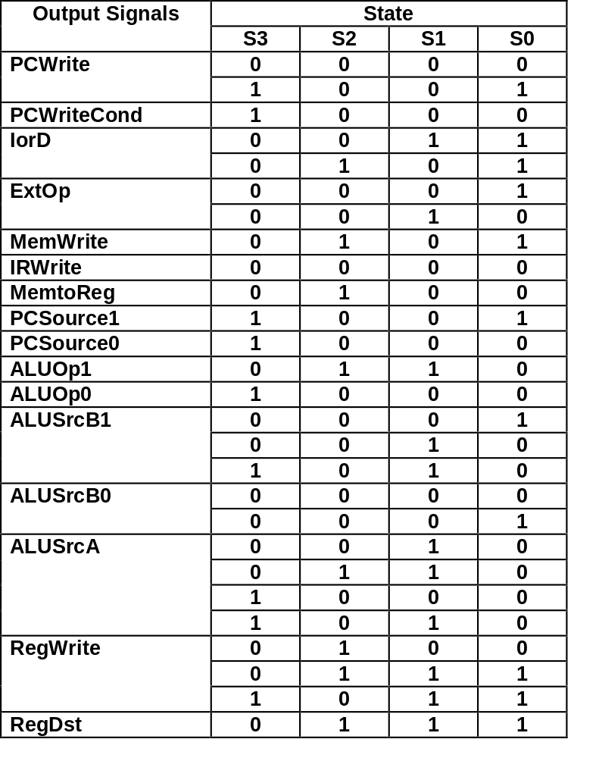
Logic Representation: Logic Equations
For Control Signal Output
Truth Table of Output Signals:
RegWrite = !S3 & S2 & !S1 & !S0 + !S3 & S2 & S1 & S0 + S3 & !S2 & S1 & S0

Slide 60
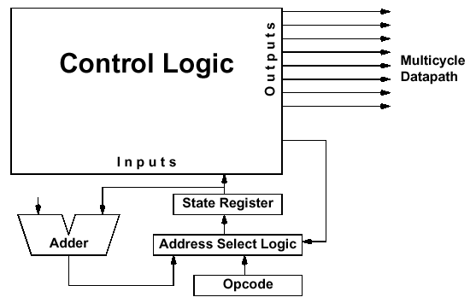
Sequence Control #2: Logic Block Diagram of Sequencer-Based Control Unit
AddrCtl
For sequential state transitions, next state is automatically increased by the counter rather than explicitly supplied by the Next State output

Slide 61
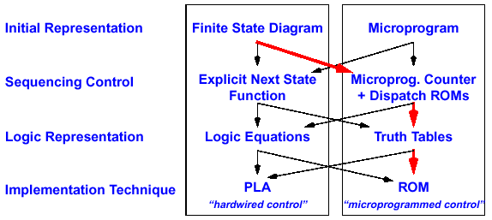
Using Sequencer for Next State
For complex control functions, it is more efficient to use a sequencer to supply the sequential next state because the it requires less number of bits than encoding the next state explicitly

Slide 62
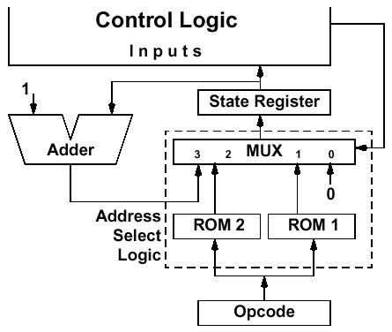
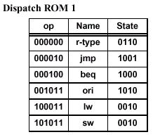
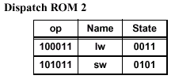
Example: Micro Sequencer Operations for Load
State No. | Control Word Bits 18 – 2 (page C-27) | Ctrl Word Bits 1-0
0 | 10010100000001000 | 11
1 | 00000000010011000 | 01
2 | 00000000000010100 | 10
3 | 00110000000010100 | 11
4 | 00110000000010110 | 00
5 | 00101000000010100 | 00
6 | 00000000001000100 | 11
7 | 00000000001000111 | 00
8 | 01000000100100100 | 00
9 | 10000001000000000 | 00
10 | ... | 11
11 | ... | 00
Bits 18 - 2
Bits 1-0
I Fetch
Decode
0
Adr Cal
Rd Mem
1
Wr Reg
11
0011
0010
100011

Slide 63
Microprogram Implementation
ROM can be Thought of as a Sequence of Control Words
Control Word can be Thought of as an Instruction: “Microinstruction”
Rather Than Program in Binary, Use Symbolic Language Which Can Be Translated Into Input and Output Signals by a Microcode Assembler
Microprogramming: A Particular Strategy for Implementing the Control Unit of a Processor by “Programming” at the Level of Register Transfer Operations
MicroArchitecture: Logical Structure and Functional Capabilities of the Hardware as Seen by the Microprogrammer

Slide 64
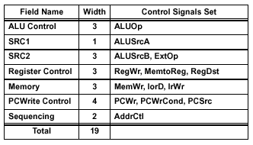
Designing a Microinstruction Set
Start with List of Control Signals
Group Signals Together That Make Sense: Called “Fields”
Places Fields In Some Logical Order (ALU operation & ALU Operands First and MicroInstruction Sequencing Last)
Create a Symbolic Legend for the MicroInstruction Format, Showing Name of Field Values and How They Set the Control Signals. Example:
To Minimize the Width, Encode Operations that Will Never be Used at the Same Time
ALU Control
SRC1
SRC2
Reg Control
Memory
PC Write Control
Sequencing

Slide 65

Details of Microinstruction Fields

Slide 66

MIPS Multicycle Microprogram for States 0,1,2,3,4,5
Label (State #) | ALU Control | Src 1 | Src2 | Register Control | Memory | PC Write Control | Sequence
000 | 00 | 0 | 01 | xxx | 001 | 011 | 11
001 | 00 | 0 | 11 | xxx | xxx | xxx | 01
010 | 00 | 1 | 10 | xxx | xxx | xxx | 10
011 | xxx | xxx | xxx | xxx | 100 | xxx | 11
100 | xxx | xxx | xxx | 001 | xxx | xxx | 00
101 | xxx | xxx | xxx | xxx | 110 | xxx | 00
Note: Usually it is safe to set all don’t cares to 0 or disabled

Slide 67
Microprogramming Pros and Cons
Flexibility
  Easy to Adapt to Changes in Organization, Timing, Technology
  Can make Changes Late in Design Cycle, or Even in the Field
Can Implement Very Powerful Instruction Sets (just more control memory)
Generality
  Can Implement Multiple Instruction Sets on Same Machine (Emulation)
  Can Tailor Instruction Set to Application
Compatibility
  Many Organizations, Same Instruction Set
Costly to Implement
  Need sequencer and ROM (mostly external)
Slow
  Need to read external ROM to ge microinstructions
Microprogramming is suitable for processor designs on a circuit board, while PLA is suitable for processor designs on a chip

