Slide 1
CS151B
Computer System Architecture
Instructor: Savio Chau, Ph.D.
Office: BH4531N
Class Location:
Class: Mon & Wed 4:00 - 6:00 p.m.
Office Hour: Mon & Wed 6:00 - 7:00 p.m.
TA1:

Slide 2
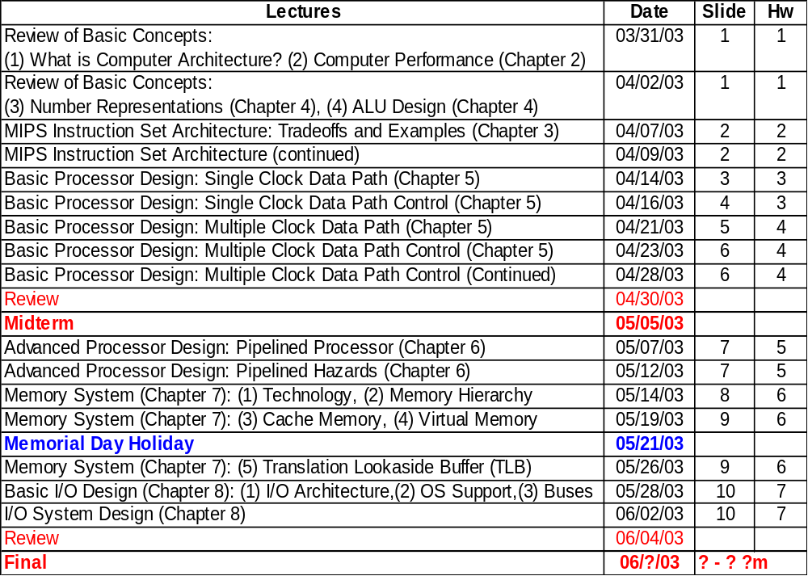
Syllabus

Slide 3
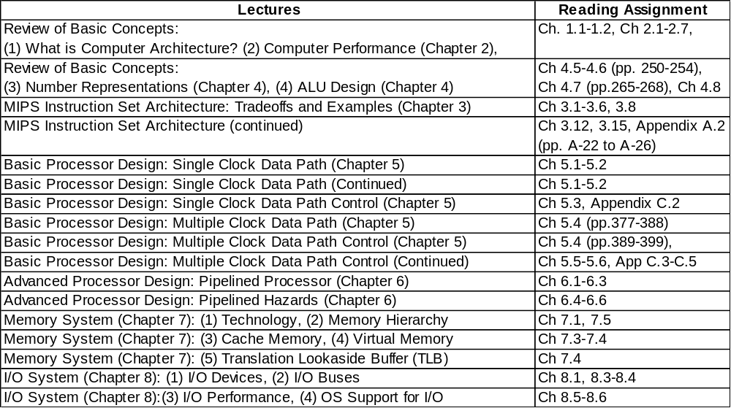
Reading Assignments
Note: Two sets of advanced topic slide are provided for reference

Slide 4
Administrative Information
Text:
  Patterson and Hennessy “Computer Organization and Design: The Hardware/Software Interface,” 2 ed. Morgan Kaufman, 1998
Lecture Slides
  Web Site: http://www.cs.ucla.edu/classes/spring03/csM151B/l1
Grades
  Homework 10%
  Midterm 30%
  Project 20%
  Final 40%
  General grading guideline:
  A ≥ 80%, 80% > B ≥ 70%, 70% > C ≥ 60%, 60% > D ≥ 50%, 50% < F
  May change as we go along
References
  Hennessy and Patterson, “Computer Architecture A Quantitative Approach,” 2nd Ed. Morgan Kaufman 1996
  Tanenbaum, “Structured Computer Organization,” 3d Ed., Prentice Hall 1990

Slide 5
Administrative Information
Contact Information
Instructor: Savio Chau
Email: savio.chau@jpl.nasa.gov
TA: Donald Lam Office: BH4428 Tel: 310 479 6553
Email: donaldl@cs.ucla.edu
Homework:
Turn in the original of your homework to the following drop boxes on or before due day:
  Discussion Class 2A: BH 4428, Box C-10
Make a copy of your homework and turn it in to me on due day. The copy will be kept by me for record. (Too many students complained about TA losing their homework in the past.)

Slide 6
Homework Grading Policy
Unless consented by the instructor, homework that is up to 2 calendar days late will receive half credit. Homework more than 2 days late will receive no credit.
Homework must be reasonably tidy. Unreadable homework will not be graded
Unaided work on homework problems will be graded mainly based on effort. However, you must answer every part of the question, and the answer must address that part of the question. Always show your work, and make your answer as clear as possible.
Group work is OK. However:
  Each member of the group MUST turn in his/her homework separately.
  If you worked with other students on a question, you must state the names of all students in the group. Homework that have identical answers without this information may be investigated for violating the academic integrity policy, so please record any cooperation.
  Group work on a homework problem will be graded on accuracy, and there will be deductions for mistakes. Each student should first attempt to answer every question on his or her own prior to meeting with the group or asking another student for help. After meeting with the group or seeking help, each student should verify the correctness of the answer

Slide 7
Start of Lectures

Slide 8
What You Will Learn In This Course
A Typical Computing Scenario
You will Learn:
How to design processor to run programs
Processor
Processor
Processor
Execution
Execution
The memory hierarchy to supply instructions and data to the processor as quickly as possible
cache
?
loaded
Memory Array
Computer Bus
?
The input and output of a computer system
Hard Drive
HD Controller
Hard Drive
HD Controller
HD Controller
In-depth understanding of trade-offs at hardware-software boundary
Experience with the design process of a complex (hardware) design
Display Controller
Power
Supply
Display Controller
Keyboard Controller
Keyboard Controller
Printer Controller
Network Controller

Slide 9
What You Will Learn in This Lecture
What is Computer Architecture
Forces on Evolution of Computer Architecture
Measurement and Evaluation of Computer Performance
Number Representation
Brief Review of Logic Design

Slide 10
What is Computer Architecture?
Coordination of many levels of abstraction
Under a rapidly changing set of forces
Design, Measurement, and Evaluation
Application
Software
Operating System
Compiler
Firmware
Instruction Set
Architecture
Instr. Set Proc.
I/O system
Datapath & Control
Control
I Reg
ALU
Mem
Digital Design
I2
O2
Hardware
I1
O1
Circuit Design
Bottom Up
view
Vdd
I1
O1
Physical Design
Vdd
I1
O1
Courtesy D. Patterson

Slide 11
Layer of Representations
Program:
temp = v[k];
v[k] = v[k+1];
v[k+1] = temp;
High Level Language Program
Top down
view
Compiler
Assembly Program:
Assembly Language Program
lw $15, 0($2)
lw $16, 4($2)
sw $16, 0($2)
sw $15, 4($2)
Assembler
Machine Language Program in Memory
Object machine code
Linker
Machine Language Program:
Executable machine code
0000 1001 1100 0110 1010 1111 0101 1000
1010 1111 0101 1000 0000 1001 1100 0110
1100 0110 1010 1111 0101 1000 0000 1001
0101 1000 0000 1001 1100 0110 1010 1111
Loader
Instruction
Set Architecture
Machine Interpretation
Control Signal Specification
ALUOP[0:3] ⬅ InstReg[9:11] & MASK
Courtesy D. Patterson

Slide 12
Computer Architecture (Our Perspective)
Computer Architecture =
Instruction Set Architecture + Machine Organization
Instruction Set Architecture: the attributes of a [computing] system as seen by the programmer, i.e. the conceptual structure and functional behavior
  Instruction Set
  Instruction Formats
  Data Types & Data Structures: Encodings & Representations
  Modes of Addressing and Accessing Data Items and Instructions
  Organization of Programmable Storage
  Exceptional Conditions
Machine Organization: organization of the data flows and controls, the logic design, and the physical implementation.
  Capabilities & Performance Characteristics of Principal Functional Unit (e.g., ALU)
  Ways in which these components are interconnected
  Information flows between components
  Logic and means by which such information flow is controlled.
  Choreography of Functional Units to realize the ISA
  Register Transfer Level (RTL) Description

Slide 13
Forces on Computer Architecture
Technology
Programming Languages
Applications
Computer
Architecture
Operating Systems
History
Courtesy D. Patterson

Slide 14
Processor Technology
logic capacity: about 30% per year
clock rate: about 20% per year
100000000
10000000
Pentium
R10000
i80486
R4400
1000000
i80386
Transistors
i80286
100000
R3010
i8086
SU MIPS
i80x86
10000
M68K
i4004
MIPS
Alpha
1000
1965
1970
1975
1980
1985
1990
1995
2000
2005
1000
R4400
R10000
100
Pentium
Clock (MHz)
R3010
i80486
10
i80x86
1
M68K
MIPS
Alpha
0.1
1965
1970
1975
1980
1985
1990
1995
2000
Courtesy D. Patterson

Slide 15
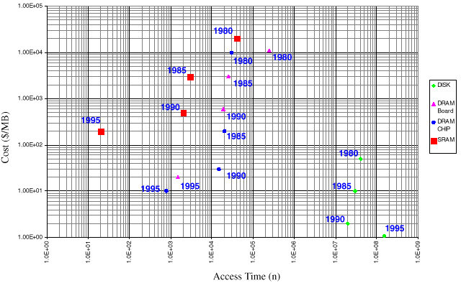
Memory Technology
DRAM capacity: about 60% per year (2x every 18 months)
DRAM speed: about 10% per year
DRAM Cost/bit: about 25% per year
Disk capacity: about 60% per year
Courtesy D. Patterson

Slide 16
How Technology Impacts Computer Architecture
Higher level of integration enables more complex architectures. Examples:
  On-chip memory
  Super scaler processors
Higher level of integration enables more application specific architectures (e.g., a variety of microcontrollers and DSPs)
Larger logic capacity and higher performance allow more freedom in architecture trade-offs. Computer architects can focus more on what should be done rather than worrying about physical constraints
Lower cost generates a wider market. Profitability and competition stimulates architecture innovations

Slide 17
Measurement and Evaluation
Architecture is an iterative process
-- searching the space of possible designs
-- at all levels of computer systems
Design
Analysis
Creativity
Cost /
Performance
Analysis
Good Ideas
Mediocre Ideas
Bad Ideas
Courtesy D. Patterson

Slide 18
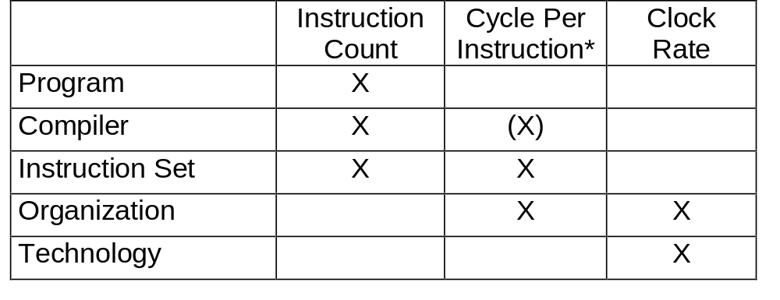
Performance Analysis
Basic Performance Equation:
Seconds
Instructions
Cycles
Seconds
CPU time
(execution time)
=
=
×
×
Program
Program
Instructions
Cycles
*Note: Different instructions may take different number of clock cycles. Cycle Per Instruction (CPI) is only an average and can be affected by application.
Courtesy D. Patterson

Slide 19
Other Useful Performance Metrics
CPI = CPU Clock Cycles per Program / Instructions per Program
= Average Number of Clock Cycles per Instruction
CPU Clock Cycles per Program
= Instrs per Program × Average Clocks Per Instr.
= Instructions / Program × CPI
= Σ C_{i} × CPI_{i} for multiple programs
Other ways to express CPU time:
CPU time
CPU Clock Cycles per Program
=
Clock Rate
Instructions / Program × CPI
=
Clock Rate
= CPU Clock Cycles per Program / Clock Rate
= CPU Clock Cycles per Program × Cycle Time
See Class Example #1

Slide 20
Traditional Performance Metrics
Million Instructions Per Second (MIPS)
MIPS = Instruction Count / (Time × 10⁶)
Relative MIPS
Million Floating Point Operation Per Second (MFLOPS)
MFLOPS = Floating Point Operations / (Time × 10⁶)
Million Operation Per Second (MOPS)
MFLOPS = Operations / (Time × 10⁶)
Ex Time _{reference machine}
×
Relative MIPS =
MIPS _{reference machine}
Ex Time _{target machine}

Slide 21
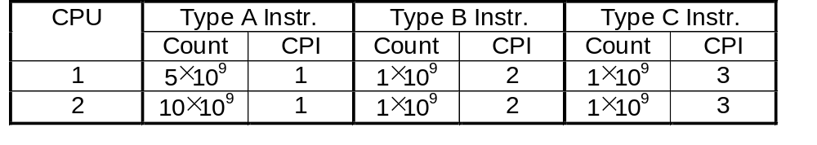
MIPS
Advantage: Intuitively simple (until you look under the cover)
Disadvantages:
  Doesn’t account for differences in instruction capabilities
  Doesn’t account for differences in instruction mix
  Can vary inversely with performance
Example: Two processors, both are 500 MHz, are running the same program. But the program is compiled into different number of machine instructions on the two processors due to their different instruction set architecture.
(5×1+1×2+1×3) ×10⁹
(5+1+1) ×10⁹
CPU Time₁ =
=
20 sec;
MIPS₁ =
= 350
500 ×10⁶
20 ×10⁶
(10×1+1×2+1×3) ×10⁹
(10+1+1) ×10⁹
CPU Time₂ =
=
30 sec;
MIPS₂ =
= 400
500 ×10⁶
30 ×10⁶

Slide 22
Benchmarks
Compare performance of two computers by running the same set of representative programs
Good benchmark provides good targets for development. Bad benchmark cannot identify speedup that helps real applications
Benchmark Programs
  (Toy) Benchmarks
    10 to 100 Line Programs
    e. g., Sieve, Puzzle, Quicksort
  Synthetic Benchmarks
    Attempt to Match Average Frequencies of Real Workloads
    e. g., Whetstone, dhrystone
  Kernels
    Time Critical Excerpts of Real Programs
    e. g., Livermore Loops
  Real Programs
    e. g., gcc, spice

Slide 23
Successful Benchmark: SPEC
1987 RISC Industry Mired in “benchmarking”:
(“ That is an 8-MIPS Machine, but they claim 10-MIPS!”)
EE Times + 5 Companies Band Together to Form
  Systems Performance Evaluation Committee (SPEC) in 1988: Sun, MIPS, HP, Apollo, DEC
Create Standard List of Programs, Inputs, Reporting:
  Some Real programs
  Includes OS Calls
  Some I /O

Slide 24
1989 SPEC Benchmark
10 Programs
  4 Logical and Fixed Point Intensive Programs
  6 Floating Point Intensive Programs
  Representation of Typical Technical Applications
Evolution since 1989
  1992: SpecInt92 (6 Integer Programs),
  SpecFP92 (14 Floating Point Programs)
  1995: New Program Set, “Benchmarks Useful for 3 Years”
Exec. Time on Test System
Spec Ratio for Each Program =
Exec Time on Vax–11/ 780
Specmark = Geometric Mean of all 10 SPEC ratios
=
n
√ Π
10
SPEC Ratio (i)
i = 1

Slide 25
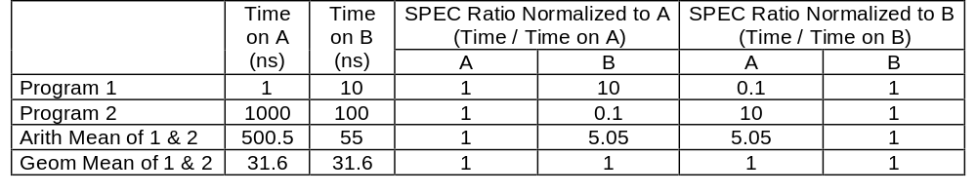
Why Geometric Mean?
Reason for SPEC to use geometric mean:
  SPEC has to combine the normalized execution time of 10 programs. Geometric means is able to summarize normalized performance of multiple programs more consistently
Disadvantage: Not intuitive, cannot easily relate to actual execution time
Example: Compare speedup on Machine A and Machine B
B is 10 times faster than A running Program 1, but A is 10 times faster than B running Program 2. Therefore, two computers should have same speedup. This is indicated by the geometric mean but not by the arithmetic mean (in fact, the arithmetic mean will be affected by the choice of reference machine)

Slide 26

Amdhal’s Law
Speedup Due to Enhancement E:
Ex time (without E)
Performance (with E)
Speedup(E)
=
=
Ex time (with E)
Performance (without E)
Suppose that Enhancement E accelerates a Fraction F of the task by a factor S and the remainder of the Task is unaffected then:
F
Ex time (with E) =
(1 - F) +
× Ex time (without E)
S
Ex time (without E)
Ex time (without E)
Speedup (with E) =
=
Ex time (with E)
F
(1 - F) +
× Ex time (without E)
S
Courtesy D. Patterson

Slide 27
Amdhal’s Law Example
A real case (modified):
  A project uses a computer which as a processor with performance of 20 ns/instruction (average) and a memory with 20 ns/access (average). A new project decides to use a new computer which has a processor with an advertised performance 10 times faster than the old processor. However, no improvement was made in memory. What is the expected performance and the real performance of the new computer?
Answer:
  Performance _{old computer} = 1 instructon / (20 ns + 20 ns) = 25 MIPS
  Since the new processor is 10 times faster, the expected performance of the new computer would have been 250 MIPS. However, since the memory speed has not been improved,
  Real Speedup = (20 ns + 20 ns) / (2 ns + 20 ns) = 1.8
  Actual Performance _{new computer} = 25 MIPS × 1.8 = 45 MIPS
  Less than 2 times of the old computer!

Slide 28
Number Representations
Unsigned: The N-bit word is interpreted as a non-negative integer
Value = b_{n-1}×2^{n-1} + b_{n-2}×2^{n-2} + … + b₁×2¹ + b₀×2⁰ + b₋₁×2⁻¹ + … + b_{m}×2^{-m}
Example: Represent value of 10110011₂ in decimal number
Value = 1×2⁷ + 0×2⁶ + 1×2⁵ + 1×2⁴ + 0×2³ + 0×2² + 1×2¹ + 1×2⁰ = 179₁₀
Example: Convert 28₁₀ to binary
Quotion Remainder
28 ÷ 2 0 (LSB)
14 ÷ 2 0
7 ÷ 2 1
3 ÷ 2 1
1 ÷ 2 1 (MSB)
28₁₀ = 11100₂
Example: Convert 0.8125₁₀ to binary
Decimal One’s
0.8125 × 2 = 1.625 1 (MSB)
0.625 × 2 = 1.25 1
0.25 × 2 = 0.5 0
0.5 × 2 = 1 1 (LSB)
0.8125₁₀ = 0.1101₂

Slide 29
Number Representations
Negative Integers: Two’s complement
Value = −s×2^{n} + b_{n-1}×2^{n-1} + b_{n-2}×2^{n-2} + … + b₁×2¹ + b₀×2⁰; s = sign bit
  Simple sign detection because there is only 1 representation of zero (as oppose to 1’s complement)
  Negation: bitwise toggle and add 1 (i.e., 1’s complement + 1)
  Visual shortcut for negation
    Find least significant non-zero bit
    Toggle all bits more significant than the least significant non-zero bit
    Example 8-bit word: 88 = [0][1011000]
    −88 = [1][0101000]
Two’s complement Operations
  Add: X+Y=Z, set Carry-In = 0, Overflow if signs of X and Y are the same but the sign of Z is different: (X_{n-1}= Y_{n-1}) and (X_{n-1}!= Z_{n-1})
  Right Shift [1]00100₂ ➔ [1]10010₂ ➔ [1]11001₂
  Left Shift [1]10100₂ ⬅ [1]01010₂ ⬅ [1]00101₂
  Sign Extension [1]00100₂ ➔ [1]1111111111100100₂
For fixed point number only, normalized floating point number is more complicate
5 bits
16 bits

Slide 30
Number Representations
Floating Point Numbers
Three parts: sign(s), mantissa (F), exponent (E)
Value = (−1)^{s} × F × 2 ^{E}
Example 1: Represent −364₁₀ as a floating point number:
If s =1 bit, F = 7 bits, E = 2 bits; range = ±127 × 2²²⁻¹ = ±1016
−364₁₀ = −1 × 91₁₀ × 2 ² = [1][1011011][10]₂
If s =1 bit, F = 6 bits, E = 3 bits; range = ±63 × 2²³⁻¹ = ±8064
−364₁₀ = −1 × 45₁₀ × 2 ³ = [1][101101][011]₂
Example 2: s = 1, F = 1011011₂ = 91₁₀, E = 01101001₂ = 105₁₀
[1][1011011][01101001]₂ = −91₁₀ × 2¹⁰⁵¹⁰ = −3.69₁₀ × 10³³
Normalized Floating Point Numbers:
F = 1.DDD···, where D = 1 or 0, decimal part = significand
Example: s = 1, F = 1.011011₂ , E = 01101001₂
[1][1011011][01101001]₂ = −1.421875₁₀ × 2¹⁰⁵¹⁰ = −1.71₁₀ × 10³¹
Losing precision but gaining range

Slide 31
Floating Point Operations (Base 10)
Addition (Subtraction)
  Step 1: Align decimal point of the number with smaller exponent
  A = 9.999₁₀ × 10 ¹, B = 1.610₁₀ × 10 ⁻ ¹ ➔ 0.016₁₀ × 10 ¹
  Step 2: Add (subtract) mantissas
  C = A + B = (9.999₁₀ + 0.016₁₀) × 10 ¹ = 10.015₁₀ × 10 ¹
  Step 3: Renormalize the sum (difference)
  C = 10.015₁₀ × 10 ¹ ➔ 1.0015₁₀ × 10 ²
  Step 4: Round the sum (difference)
  C = 1.0015₁₀ × 10 ² ➔ 1.002₁₀ × 10 ²
Multiplication (Division)
  Step 1: Add (subtract) exponents
  A = 1.110₁₀ × 10 ¹⁰, B = 9.200₁₀ × 10 ⁻ ⁵, New exponent = 10 + (− 5) = 5
  Step 2: Multiply (divide) mantissas
  1.110₁₀ × 9.200₁₀ = 10.212₁₀
  Step 3: Renormalize the product (quotion)
  10.212₁₀ × 10 ⁵ ➔ 1.0212₁₀ × 10 ⁶
  Step 4: Round the product (quotion)
    10.212₁₀ × 10 ⁶ ➔ 1.021₁₀ × 10 ⁶
  Step 5: Determine the sign
  Both signs are + ➔ Sign of produce is +

Slide 32
Overflow in Normalized Floating Point Numbers
If two normalized floating point numbers have opposite signs, their sum will never overflow. Example
Sign
Mantissa
Exponent
-1.5 = (-1)¹ x 1.101 x 2²
1
1.
1
0
1
1
0
7 = (-1)⁰ x 1.110 x 2²
+
0
1.
1
1
0
1
0
Check: 7 – 1.5 = 5.5 = (-1)⁰ x 1.011 x 2²
1
0
1.
0
1
1
1
0
Drop this bit because overflow cannot happen
carry
If two normalized floating point numbers have the same sign, their sum may overflow (sign A = sign B ≠ sign of sum). But in floating point, the overflow can be removed by re-normalization, unless the exponent is already maximum. Example:
Sign
Mantissa
Exponent
6.5 = (-1)⁰ x 1.101 x 2²
0
1.
1
0
1
1
0
7 = (-1)⁰ x 1.110 x 2²
+
0
1.
1
1
0
1
0
Check: 7 + 6.5 = 13.5 = (-1)⁰ x 1.1011 x 2²
0
1.
0
1
1
1
0
0
1.
1
0
1
1
1
If this bit is carried to the sign bit, it will cause overflow. But the overflow can be removed by normalization
1
carry
Re-normalize

Slide 33
IEEE 754 Standard for Floating Point Numbers
Single precision format:
sign
Exponent (biased)
Significand only (leading 1 is implicit)
Other formats: Double (64 bits), Double Extended (>80 bits), Quadruple (128 bits)
Maximize precision of representation with fix number of bits
  Gain 1 bit by making leading 1 of mantissa implicit. Therefore,
  F = 1 + significand, Value = (−1)^{s} × (1 + significand) × 2 ^{E}
Easy for comparing numbers
  Put sign bit at MSB
  Use bias instead of sign bit for exponent field
  Real exponent value = exponent – bias. Bias = 127 for single precision
  Examples: IEEE 754 Floating Point Number Value
  Exponent A = -126 00000001 (−1)^{s} × F × 2 ⁽¹⁻¹²⁷⁾ = (−1)^{s} × F × 2⁻¹²⁶
  Exponent B = 127 11111110 (−1)^{s} × F × 2 ⁽²⁵⁴⁻¹²⁷⁾ = (−1)^{s} × F × 2¹²⁷
  This is much easier to compare than having A = −126₁₀ = 10000010₂ and B = 127₁₀ = 01111111₂
See Class Example

Slide 34
IEEE 754 Computation Example
A) 40 = (–1)⁰ × 1. 25 × 2⁵ = (–1)⁰ × 1.01₂ × 2^{(132 – 127)} = [0][10000100][101000000000000000000]
B) –80 = (–1)¹ × 1. 25 × 2⁶ = (–1)¹ × 1. 01₂ × 2^{(133 – 127)} = [1][10000101][111101000000000000000]
C) Remove normalization of one of the significands so that the exponents can be aligned:
40 = (–1)⁰ × 0. 3125 × 2⁷ = (–1)⁰ × 0.0101₂ × 2 ^{(134 – 127)} = [0][10000110][010100000000000000000]
–80 = (–1)¹ × 0. 6250 × 2⁷ = (–1)¹ × 0.1010₂ × 2 ^{(134 – 127)} = [1][10000110][101000000000000000000]
D) Need to convert the IEEE 754 significand of –80 into 2’s complement before the subtraction:
–80 = [1][10000110][101000000000000000000] ➔ [1][10000110][011000000000000000000]
40 – 80 = [0][10000110][010100000000000000000] + [1][10000110][011000000000000000000]
= [0][10000110][101100000000000000000]
E) Convert the result in 2’s complement into IEEE 754 = [1][10000110][010100000000000000000]
F) Renormalize:
[1][10000110][010100000000000000000] = [1][10000100][010000000000000000000]
= (–1)¹ × 1.01₂ × 2⁵
Check: 40 – 80 = – 40 = (–1)¹ × 1.25 × 2⁵ = (–1)¹ × 1.01₂ × 2⁵

Slide 35
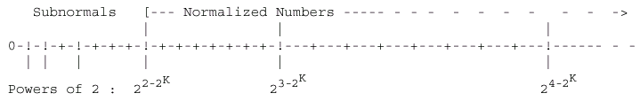
Special Numbers in IEEE 754 Standard
Number Type
Sign Bit
Exponent
Nth bit
(Hidden)
Significand
NaNs
(Not a Number)
X
111...111
1
1xxx...xxx
SNaNs
(Signaling Not a Number)
X
111...111
1
Non-zero
0xxx...xxx
Infinities
±
111...111
1
0
Subnormals
(Very small numbers)
±
0
0
(denormalized)
positive n < 2^{N-1}
N=size of significand+1
Zeros
±
0
0
0
Note: NaNs is used to indicate invalid data and SNaNs is used to indicate invalid operations

Slide 36
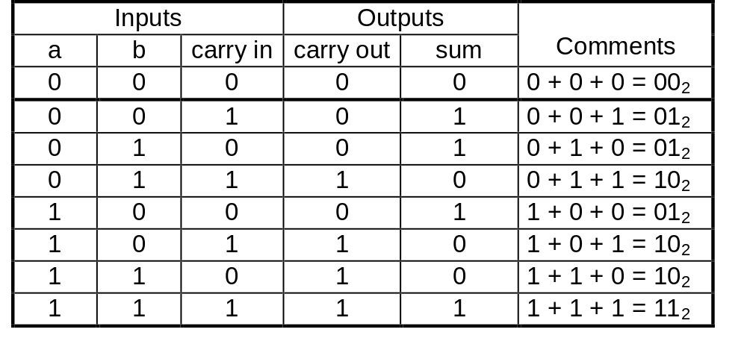
1-Bit ALU Design
A 1-bit adder
c_{in}
sum
a
b
c_{out}
sum = a ⊕ b ⊕ carry-in, carry-out = (a · b) + (a · carry-in) + (b · carry-in)
A 1-bit ALU with AND, OR, XOR
op code
c_{in}
sum
0
a
a ⊕ b
1
b
a + b
2
output
c_{out}
a · b
3
next cell

Slide 37
Multiple-Bit ALU Design
Ripple Carry ALU: Too slow. Not used in real machines
A₃
B₃
A₂
B₂
A₁
B₁
A₀
B₀
C₀
1-bit
ALU
1-bit
ALU
1-bit
ALU
1-bit
ALU
Op Code
C₄
C₃
C₂
C₁
Out₃
Out₂
Out₁
Out₀
Carry Look Ahead ALU
A₃
B₃
A₂
B₂
A₁
B₁
A₀
B₀
C₀
1-bit
ALU
1-bit
ALU
1-bit
ALU
1-bit
ALU
Op Code
C₄
Carry Look Ahead Logic
P₃
G₃
C₃
P₂
G₂
C₂
P₁
G₁
C₁
P₀
G₀
Out₃
Out₂
Out₁
Out₀

