Slide 1
What You Will Learn in this Set of Lectures
What is Reduced Instruction Set Computer (RISC) and Why
Instruction Set Architecture of MIPS, a RISC Machine
Alternatives to RISC (e.g. Complex Instruction Set Computers (CISC))
Preparation for Learning How to Design a Data Path that Executes the MIPS Instruction Set in Next Lecture Set

Slide 2
What is RISC and Why?
RISC is an architecture design concept based on the principle that simpler hardware runs faster (e.g. MIPS). It uses smaller and regular instruction set to achieve performance, while relying on compiler technology to achieve functions used to done by complex instructions.
Opposite to RISC is Complex Instruction Set Computer (CISC) (e.g. Intel x86). CISC believes complex instructions implemented in hardware can achieve higher performance. Language directed architecture such as Burroughs’ B5500 (Algol) or B4500 (Cobol) are extreme cases.
350
300
250
RISC
200
Performance
150
Intel x86
100
RISC
introduction
50
0
1982
1984
1986
1988
Year
1990
1992
1994
Courtesy D. Patterson

Slide 3
The MIPS Instruction Set
MIPS is a Reduced Instruction Set Computer (RISC),
Characterized By:
A Relatively Small Number Of Instructions and Data Types
All Instructions Are Of The Same Length
There Are A Very Small Number Of Instruction Formats (3)
It is a Load- Store Machine: Computation Is Done On Data In Registers
i. e., Operands of Arithmetic And Logical Operations Do Not Reside In Memory. Data Is Moved Between Memory And Registers Before Being Used and Back To Memory After Computation Is Finished By Load and Store Instructions
There Are A Small Number Of Addressing Modes - Three For Accessing Operands (Register- Direct, Based, Immediate) and One For Computing Jump Addresses (PC- Relative)
Courtesy M. Louie

Slide 4
Instruction Set Architecture Design Principles
Four things need to be considered
  What operations will be performed by this instruction set?
    Op code
  What kind of data this instruction set will operate on?
    Data type
  Where can you store the data?
    Memory and register architecture
  How to access those data?
    Address modes
Four design principles (that lead to reduced instruction set architectures)
  Simplicity favors regularity
  Smaller is faster
  Good design demands good compromises
  Make the common case fast

Slide 5
What Operations Performed by MIPS ISA?
Basic Functions
  Arithmetic and Logic Operations
    Need 2 source data and 1 destination to store result
  Data transfer to and from the memory
    Load a data from a memory address (+ offset) and put it in a register
    Store a data in a register into a memory address (+ offset)
  Conditional branches
    Need a way to determine a condition
    Need a target memory address to branch to if condition is met (or not met), go to next instruction otherwise
  Jump and subroutine linkage (procedure call)
    Need a large range of target memory address to branch
    Procedure call needs a return address
Additional functions: Examples
  Move data between registers, to I/O, or to co-processor
  Exception and Interrupt Instructions

Slide 6
What Data will be Operated on by MIPS ISA?
Data Types
  Signed: Numbers that can be either positive or negative
    Integers
    Floating Point Numbers
    Relative Address
  Unsigned: just positive
    Absolute Address
    Logical data
Data Sizes
  Word (32 bits)
  Half-word (16 bits)
  Byte (8 bits)

Slide 7
Where the MIPS ISA Stores Data?
In Registers — used by R-Type instructions)
Within the instruction — used by I-Type instructions
In Memory — always transferred to/from a register by a load/store (also I-Type) instruction first
  The memory address is in a register
  The memory address in a constant in the instruction
  The memory address is sum of a register and a constant in the instruction
  The memory address is relative to the PC (i.e., sum of the PC and a constant in the instruction)

Slide 8
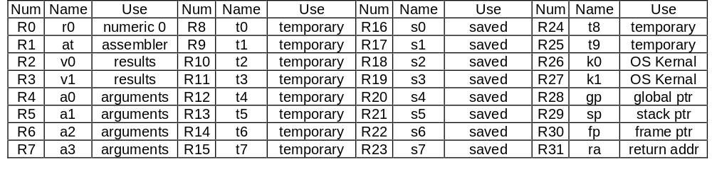
MIPS R2000 / R3000 Programmable Storage
Memory:
  2³² Addresses (32-bit Address)
  2³⁰ Memory Words; 1 Word = 4 Bytes
  Byte Addressable
Registers:
  31 32-Bit General Purpose Registers
  R1 - R31 General Purpose
  Register 0 = Constant Value 0
Note: The indicated register usage is by convention only, not restricted by the MIPS architecture

Slide 9
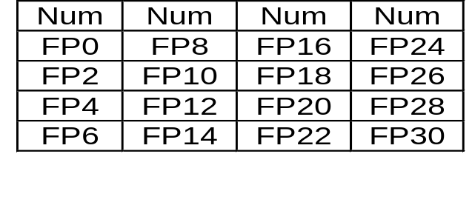
MIPS R2000 / R3000 Programmable Storage
Registers (Continued)
  32 Floating Point Registers (F0-F31)
    Double Precision = 16 FP Register Pairs
    Single Precision = 16 FP Registers (Even Addresses)
Other Registers
  PC = Program Counter Register
  HI and LO: for 64- Bit Integer Arithmetic Results
    (Multiplication) HI, LO = 64- Bit Integer Product
    (Division) LO= Quotient, HI= Remainder
  Exception Registers
    EPC (Execption Program Counter): Address of instruction causing exception
    Cause: Exception type and pending interrupt bits
    BadVaddr (Bad Value Address): Address of data causing exceptions
    Status: Interrupt mask and enable bits

Slide 10
How Does MIPS ISA Access the Data?
Register (Direct)
E.g., add $1, $2, $3
$1←$2+$3
OP
RS=$2
RT=$3
RD=$1
Register
Immediate
E.g., addi $1, $2, 100
$1←$2 +100
OP
RS
RT
Immediate=100
Base + Index
E.g., lw $1, 100($2)
$1←Mem[$2+100]
OP
RS=$2
RT
Immediate=100
Register
+
Memory
PC-Relative
E.g., bne $1, $2, 100
Goto Mem[PC+100] if $1=$2
OP
RS
RT
Immediate = 100
PC
+
Memory
Psuedo-Direct
E.g., J 1000
Goto Mem[PC(31:30):1000]
OP
Address = 1000
PC
Memory

Slide 11
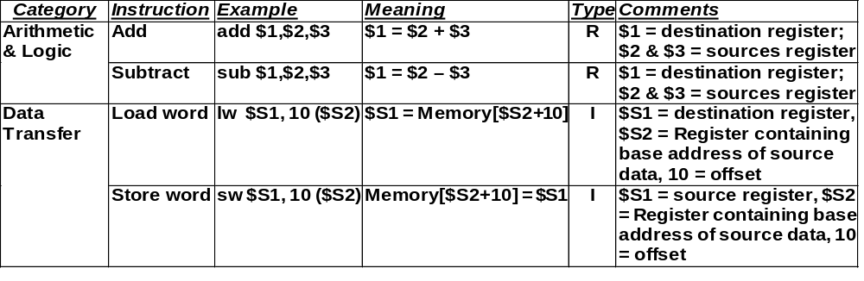
The Most Basic Four MIPS Instructions
You will learn other instructions later. Download the following files from the web or see text Page A-55 to A-75 for more MIPS instruction formats:
CSM151B_MIPS_opcodes
CSM151B_MIPS_opcodes_by_name
CSM151B_MIPS_opcodes_by_number
CSM151B_MIPS_opcodes_pseudo

Slide 12

MIPS Instruction Formats
R- Type Instructions
General Format: op RD, RS, RT Meaning: RD ⬅ RS op RT
Example: add $8,$17,$18 Meaning: $8 ⬅ $17 + $18
Machine Code Format of the Instuction:
Format:
Example:
The Meaning of Each Name of The Fields in MIPS Instructions:
  OP: Operation of Instruction
  RS: The First Register Source Operand
  RT: The Second Register Source Operand
  RD: The Destination Register Operand; It Gets The Result of the Operation
  SHAMT: Shift Amount for shift left logical or shift right logical instructions
  Funct (Function Field): Selects the Variant of the Operation in the OP Field Example: the OP field for all R-Type instructions is 0, but Funct field for add is 32₁₀ (100000₂), subtract is 34₁₀ (100010₂), and is 36₁₀ (100100₂), etc.

Slide 13
MIPS Instruction Formats
I- Type Instructions
General Format: op RT, RS, Const Meaning: RT ⬅ RS op Const
Example: addi $1,$2,100 Meaning: $1 ⬅ $2 + 100
Alternative Format: op RT, offset(RS) Meaning: RT Mem[RS+offset]
Example: sw $1, 100($2) Meaning: $1 ➔ Mem[$2+100]
⬅
➔
Machine Code Format of the Instuction:
Format:
OP
RS
RT
Immediate
6 Bits
5 Bits
5 Bits
16 Bits
Example:
101011
00010
00001
0000000001100010
43
2
1
100
Meaning of Each Name of The Fields in MIPS Instructions:
  OP: Operation of Instruction (including information about the instruction type)
  RS: The First Register Source Operand
  RT: The Destination Register Operand; It Gets The Result of the Operation
  Immediate: Constant
Applications of I-Type Instructions
  Immediate Addressing Format (e.g., addi, ori, andi. Immediate = constant)
  Data Transfer Instructions (e.g., lw, sw. Immediate = address)
  Conditional Branch (e.g. beq, bne. Immediate = displacement from PC)

Slide 14
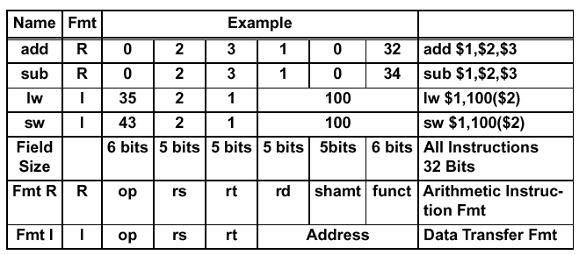
MIPS Machine Language Examples
See text Page 153 for more machine codes

Slide 15
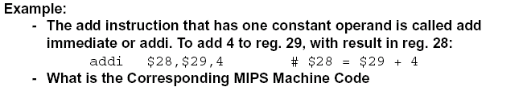
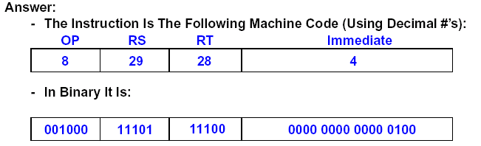
Assembly and Machine Language Exercise

Slide 16
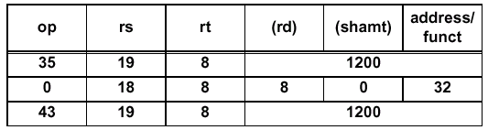

C, Assembly, and Machine Language Example
Register is assigned by compiler, which usually follows MIPS convention ($8 = $t0)
A[ i] = h + A[ i];
is compiled into:
lw $8, Astart($ 19) # Temporary reg $8 gets A[ i], Astart is a const.
add $8,$ 18,$ 8 # Temporary reg $8 gets h + A[ i]
sw $8, Astart($ 19) # Stores h + A[ i] back into A[ i], Astart is a const.
How to select registers?
Machine Code (in decimal value)
lw
add
sw
Machine Code (in binary value)
lw
add
sw

Slide 17
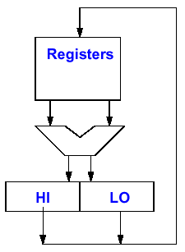
Multily and Divide Instructions
(Psuedo-Instructions)
Psuedo-Instructions are commonly used instructions that are not directly implemented in hardware but translated into one or more of the basic set of instructions
Multiply, Divide
  MULT rs, rt # Multiply
  MULTU rs, rt # Unsigned Multiply
  DIV rs, rt # Divide
  DIVU rs, rt # Unsigned Divide
Move Result From Multiply, Divide
  MFHI rd # Move Hi reg to RD
  MFLO rd # Move Lo reg to RD
Move To HI or LO
  MTHI rd
  MTLO rd
Multiply instruction is accomplished by a series of shift and add instructions and the results are accumulated in the HI and LO registers

Slide 18
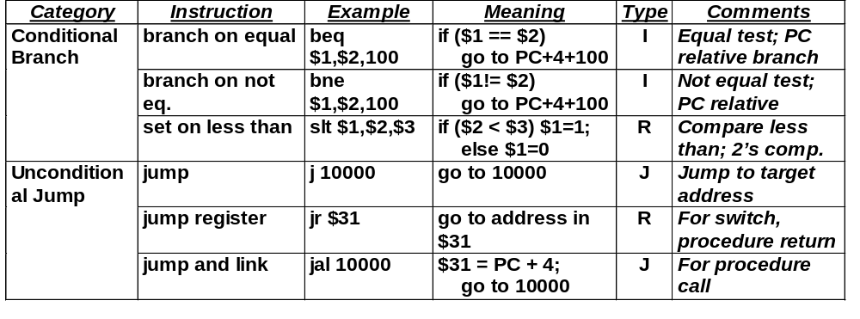
Adding Conditional Branch & Jump Instructions
See backup slides at the end of this presentation for more MIPS instructions
Question: What is $31?
Answer: By MIPS convention, $31 is the return address register after procedure call

Slide 19
MIPS Instruction Formats
J - Type Instructions (e.g., j 10000)
OP
Address
6 Bits
26 Bits
J-Type Instructions uses pseudodirect addressing, where the jump address is the 26 lower bits (i.e., the address bits) of the instruction, left shifted by 2 bits (i.e., word addressable only), and then concatenated with the upper 4 bits of the PC
OP
Address
Memory
Program Counter
unchange
Address
0
0
PC[31:28]
(PC[27:0]+4) replaced by Address×4
What about branch instructions?
Ans: Branch instruction is an I-type instruction using PC-relative addressing
Example:
bne
$t0
$s1
1000
Memory
Program Counter
If $t0 ≠ $s1, then New PC = Old PC + 4 + 4×1000
0
0

Slide 20
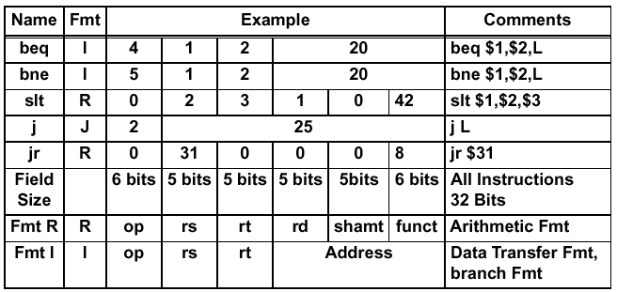
Branches/Jump Machine Language
Branches:
  The target address is in PC: PC ← PC + 4 + (16-bit Address Field) × 4
Jumps:
  The target address = instruction bits <25:0> × 4 (i.e., left shift 2 bits and fill the 2 LSB bits with 0) concatenate with PC bits <31:28>
L=20
L=20
L=25

Slide 21
A Coding Example with Conditional Branches
Example:
  In the following C code segment, f, g, h, i, and j are variables:
  if (i == j) goto L1;
  f = g + h;
  L1: f = f - i;
  Assuming the 5 variables correspond to 5 registers $16 through $20
  i.e. f in $16; g in $17; h in $18; i in $19; j in $20
  what is the compiled MIPS code?
Answer:
  The Compiled Program (Assembly Code) is:
  beq $19,$20, L1 # goto L1 if i equals j
  add $16,$17,$18 # f = g + h
  L1: sub $16,$ 16,$19 # f = f - i
What would the machine code look like for this?

Slide 22
Another C Compilation Example with Loops
Aaddr
Array A
C Code:
  Loop: g = g + A[i];
  i = i+ j;
  if (i != h) goto Loop;
Assuming the Following Register Assignments
f in $16; g in $17; h in $18; i in $19; j in $20; and a constant 4 in $10
A[i] is an array in memory with starting address at Aaddr[0]
Assembly Code:
  Loop: mult $19,$10 # (HI, LO) regs = i * 4
  mflo $9 # reg $9 ← least sig. 32 product bits
  lw $8, Aaddr($9) # Temporary reg $8 = A[i*4]
  add $17,$17,$8 # g = g + A[ i]
  add $19,$19,$20 # i = i + j
  bne $19,$ 18, Loop # goto Loop if i != h
Word 0
B0
B1
B2
B3
Word 1
B4
B5
B6
B7
Word 2
B8
B9
B10
B11
Word 3
B12
B13
B14
B15
32 bits
Need to compute BYTE address from i, which is word address (1 word = 4 bytes)
Why do this?

Slide 23
An Example Using a Case Statement
C Code:
switch (k)
{ case 0: f = i + j; break;
  case 1: f = g + h; break;
  case 2: f = g - h; break;
  case 3; f = i - j; break;
  }
The following MIPS assembly language will work, provided four words in memory, starting at location JumpTable, have addresses corresponding to the labels L0, L1,L2, and L3 respectively. Since we are using the variable k to index into this array of words, we must first multiply by 4 to turn k into its byte address equivalent..
  Switch: mult $10, $ 21 # (HI, LO) regs = k * 4
  mflo $9 # Temp reg $9 = least sig. 32 bits of product
  lw $8, JumpTable($ 9) # Temp reg $8 = Jumptable[k]
  jr $8 # Jump based on register $8
  L0: add $16,$ 19,$ 20 # k= 0 so f gets i+ j
  j Exit
  L1: add $16,$ 17,$ 18 # k= 1 so f gets g+ h
  j Exit
  L2: sub $16,$ 17,$ 18 # k= 2 so f gets g- h
  j Exit
  L3: sub $16,$ 19,$ 20 # k= 3 so f gets i- j
  Exit:
Register Assignments:
f in $16; g in $17;
h in $18; i in $19;
j in $20; k in $21
Constant 4 in $10
Word
Addr
Byte
Addr
Memory
JumpTable
0
0
L0
e.g., k=2
1
4
L1
jr
2
8
L2
lw
3
12
L3
Reg $8
L2

Slide 24
Procedure Calls
Procedure call is used by programmers to structure programs, for easier to understand and reusuability. Example:
main() /* This is the calling procedure (caller) */
{
funct(100); /* procedure call */
}
int funct(arg) /* This is the called procedure (callee) */
{
…
}
In order to execute procedure call
  The calling procedure (caller) has to put parameters in a place where procedure can access
  The calling procedure (caller) has to transfer control to the called procedure while saving the return address at the same time
  The called procedure (callee) has to put return value in a place where the calling program can access
  The called procedure (callee) has return control to the calling program at the point of origin

Slide 25
MIPS Software Convention for Registers
0 zero constant 0
1 at reserved for assembler
2 v0 expression evaluation &
3 v1 function results (return value)
4 a0 arguments
5 a1 (calling procedure uses these
6 a2 registers to pass arguments
7 a3 to the called procedure)
8 t0 temporary: caller saves
  do not need to be preserved across procedure calls
. . . (called procedure can clobber)
15 t7
16 s0 callee saves
  need to be preserved across procedure calls
. . . (calling procedure can clobber)
23 s7
24 t8 temporary (cont’d)
25 t9
26 k0 reserved for OS kernel
27 k1
28 gp Pointer to global area
holding a program’s static data
29 sp Stack pointer
30 fp frame pointer
31 ra Return Address (HW)
Stack frame -- A block of memory allocated on the stack for the subroutine call environment.
  Purpose:
  hold values passed as subroutine arguments
  save register values that the calling subroutine needs to use after the callee returns
  provide space for local variables since there are only a limited number of registers

Slide 26
An Overly Simplified Example
Addr
main() /* Caller */
{
x = y + z;
funct(arg); /* procedure call */
…
}
$v0
w
($2)
1
$a0
arg
($4)
funct addr
1
2
main addr
2
main addr
3
1
2
PC
3
3
x
3
$t0
w
($8)
y
$t1
v
($9)
$ra
main addr3
($31)
$t2
z
($10)
Addr
int funct( arg ) /* Callee */
{
w = arg – v;
return (w);
}
1
arg
2
3
But!
What if there are more than 4 arguments?
What if there are some register values need to be preserved across procedure call (e.g., if you want to preserve the value x)?
What if another procedure call happens before the current procedure is completed?

Slide 27
Call-Return Linkage: Stack Frames
Solution:
Save the needed information (e.g., arguments, return address) onto a stack in memory
Information needed by the called procedure are grouped into a stack frame
Many variations on stacks possible (up/down, last pushed / next )
High Mem
FP
ARGS
Reference Arguments
and Local Variables at
Fixed (negative)
Offset From FP
(frame pointer points to 1st word of frame)
Callee Save Registers
(old $fp, $ra, $s0,etc)
Stack Frame or
Activation Record
Local Variables
SP
(stack pointer points to last word of frame)
Grows and shrinks during expression evaluation
Low Mem

Slide 28
Nested Procedure Call Using Stack Frames
FP
PC
main()
{
…
funct1(arg0 … argN);
…
}
FP
Stack frame of caller of main
SP
FP
FP
arg4 … argN for funct1
(pushed by main)
PC
SP
Return address to main
(pushed by funct1)
PC
funct1(arg0 … argN)
{
…
funct2(arg0 … argM);
return(w);
}
main’s saved register $s0 … $s7, $fp
(pushed by funct1)
PC
Other local variables needed by funct1
(pushed by funct1)
FP
SP
arg4 … argM for funct2
(pushed by funct1)
SP
Return address to funct1
(pushed by funct2)
PC
funct1(arg0 … argM)
{
…
y = x + z;
return(y);
}
funct1’s saved register $s0 … $s7, $fp
(pushed by funct2)
Other local variables needed by funct2
(pushed by funct2)
SP

Slide 29
Return From Nested Procedure Call
main()
{
…
funct1(arg0 … argN);
…
}
FP
Stack frame for main
FP
SP
arg4 … argN for funct1
(popped by funct1 and trashed)
PC
Return address to main
(popped by funct1 and put back to $ra)
funct1(arg0 … argN)
{
…
funct2(arg0 … argM);
return(w);
}
main’s saved register $s0 … $s7, $fp
(popped by funct1 and put back to $s’s)
PC
Other local variables needed by funct1
(popped by funct1 and trashed)
FP
SP
arg4 … argM for funct2
(popped by funct2 and trashed)
Return address to funct1
(popped by funct2 and put back to $ra)
PC
funct2(arg0 … argM)
{
…
y = x + z;
return(y);
}
funct1’s saved register $s0 … $s7, $fp
(popped by funct2 and put back to $s’s)
Other local variables needed by funct2
(popped by funct2 and trashed)
SP

Slide 30
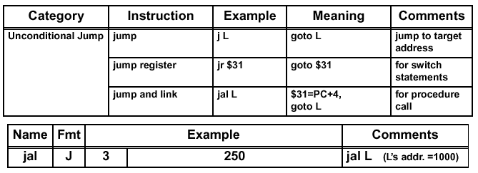
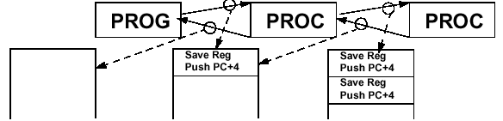
MIPS Instructions for Procedure Call
MIPS uses a jump and link instruction for procedure calls
  Jumps to the address specified in the lower 26 bits of the instruction
  Simultaneously save the address of next instruction (i.e. PC+ 4) in the Return Address (RA) register (R31)

Slide 31
MIPS Procedure Call: Put Everything Together
Step 1: Before the caller makes the subroutine call, the caller:
  1.1 Pushes onto the stack those values in caller-saved registers ($s regs) that the caller wants to use after the callee returns
  1.2 Stores subroutine call arguments in registers 4-7 ($a regs) and pushes any remaining arguments onto the stack for the callee stack frame
Step 2: When the subroutine is invoked, the callee then:
  2.1 Allocates memory on the stack for its stack frame
  2.2 Saves environment registers (e.g., return addr.($31), old frame pointer($30)) and callee-saved registers ($s regs) onto the stack so that the callee can alter them and then restore them before returning (Note: Need to store the $a and $s registers before they are modified)
  2.3 Updates the frame pointer ($fp) to point to the callee stack frame
Step 3: Just before the callee returns, the callee:
  3.1 Puts return values in registers 2-3 ($v regs)
  3.2 Restores registers saved in Step 2.2 (above) and pops the stack frame

Slide 32
Procedure Call Coding Example
main:
...
104 addi $a0, $0, 10 # save arg1 to $a0
108 addi $a1, $0, 11 # save arg2 to $a1
112 addi $a2, $0, 12 # save arg3 to $a2
116 addi $a3, $0, 13 # save arg4 to $a3
120 addi $t0, $0, 14 # save arg5 to $t0
124 sw $t0, 0($sp) # save (not push) arg5 to stack
128 jal funct1 # jump to called procedure
132 …
funct1:
500 subu $sp, $sp, 32 # allocate 32 bytes to new frame
504 sw $ra, 20($sp) # save return address to main
508 sw $fp, 16($sp) # save old frame pointer
512 addi $fp, $sp, 32 # new frame pointer = old sp
516 add $v0, $0, $0 # initialize w
520 add $v0, $v0, $a0 # calculate w from arguments
524 add $v0, $v0, $a1
528 add $v0, $v0, $a2
532 add $v0, $v0, $a3
536 lw $t0, 0($fp) # retrieve the 5th argument
540 add $v0, $v0, $t0 # add to w (already in $v0)
544 lw $ra, 20($sp) # pop return address to $ra
548 lw $fp, 16($sp) # pop old frame pointer
552 addi $sp, $sp, 32 # pop stack
556 jr $ra # jump back to main
main()
{
…
funct1(10,11,12,13,14);
…
}
funct1(arg1 … arg5)
{
w = arg1 + arg2 + arg3
+ arg4 + arg5;
return(w);
}
Register Assignments:
$a0 … $a4: arguments
$fp: frame pointer
$sp: stack pointer
$v0: return value
$ra: return address
$t0: temporary register

Slide 33
Procedure Call Coding Example (Animated)
main()
{
…
funct1(10,11,12,13,14);
…
}
fp
1000
1000
1000
968
996
Arguments
992
104
988
Return Addr
984
Frame Ptr
980
976
Saved Reg
& Local Var
funct1(arg1 … arg5)
{
w = arg1 + arg2 + arg3
+ arg4 + arg5;
return(w);
}
972
500
968
14 (not a stack push)
sp
936
968
968
964
Arguments
960
956
132
Return Addr
952
1000
Frame Ptr
10
a0
10
ra
PC
132
556
104
116
120
124
128
500
504
508
512
532
536
540
544
548
132
552
948
132
a1
11
944
Saved Reg
& Local Var
a2
12
v0
46
60
940
a3
13
936
t0
14
14
This approach can be modified to allow arbitrary number of arguments to be passed. How?
See Example

Slide 34
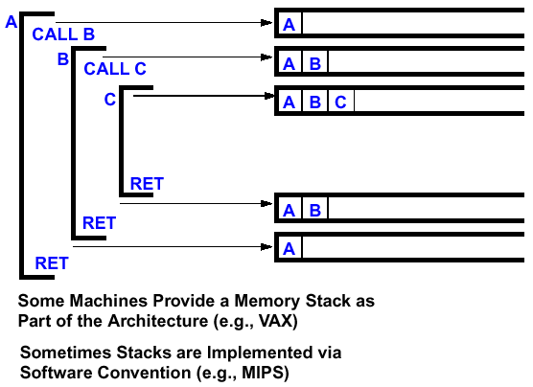
Stacking of Procedure Call/Return Environments

Slide 35
Additional Details of the MIPS Instruction Set
Register Zero always has the value Zero (even if you try to write to it)
Jump/ Link instr. puts the Return Addr PC+ 4 into the Link Register
All instructions change entire 32- bits of the destination register (including lui, lb, lh) and all read entire 32- bits of sources (add, sub, and, or,...)
Immediate Arithmetic and Logical Instructions are Extended as Follows:
  Logical Immediates are Zero Extended to 32 Bits
  Arithmetic Immediates are Sign Extended to 32 Bits
The data loaded by the instruction lb and lh are extended as follows:
  lbu, lhu are Zero Extended
  lb, lh are Sign Extended
Overflow can occur in these Arithmetic instructions:
  add, sub, addl
  It cannot occur in addu, subu, addiu, and, or, xor, nor, shifts, mult, multu, div, divu

Slide 36
Other Forms of Instruction Set Architecture
What Variations an Instruction Set Architecture Can Have?
  Data Path Architecture
  Instruction Types
  Instruction Lengths
  Register and Memory Architecture
  Address Modes
  Data Types
  Order of Bits and Bytes (Endians)

Slide 37
Other Forms of Data Path Architecture
Stack Architecture
Accumulator Architecture
Register
Add
Push(A)
Stack
Push(B)
Accumulator
A
B
A
A
B
C
A
A+B
ALU
ALU
0
C=A+B
General Purpose Register
Architecture
Load/Store Architecture
Register
Load
A
A
Store
ALU
A + B
A B
ALU
C
C
B
B
Register
Memory
Memory or Register
Memory
Registers
Memory

Slide 38
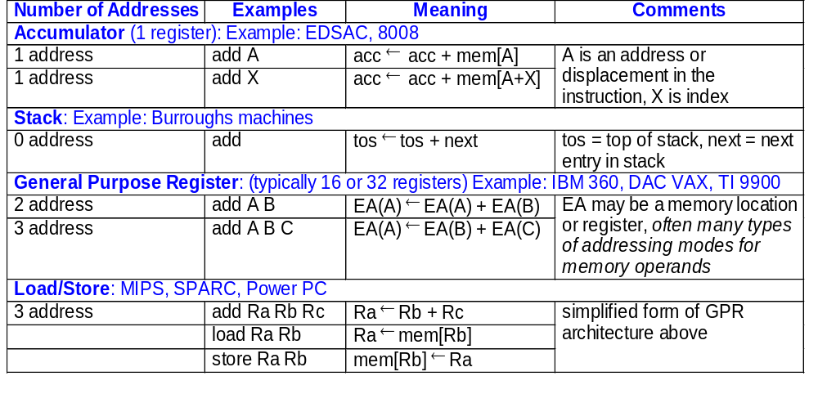
Instruction Examples of Various Path Architectures

Slide 39
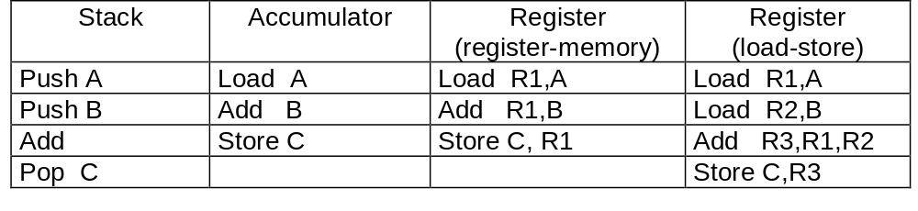
Comparing Number of Instructions
Code sequence for C = A + B for four classes of instruction sets:
Load/store requires more instructions but has better overall performance because:
  Registers are Faster than Memory
  Registers are Easier for a Compiler to Use
    e. g., (A* B) - (C* D) - (E* F) can do Multiplies In Any Order vs. Stack
  Registers can Hold Variables
    Memory Traffic is Reduced, so Program Is Sped Up
    (Since Registers Are Faster Than Memory)
  Code Density Improves
    (Since Register Named With Fewer Bits Than Memory Location)

Slide 40
Variations in Instruction Types (Examples)
Data Transfers
  Move:
    Reg–to–Reg, Reg–to–Mem, Mem–to–Mem, or with Immediate
  Explicit push and pop of stack
Control Operations
  Explicit return instruction (e.g., RET)
  Explicit loop instruction
Arithmetic and Logical Operations
  Rotate
  Test by non-destruction AND
String Operations
  Copy string
  Load a byte / word of a string into a register

Slide 41
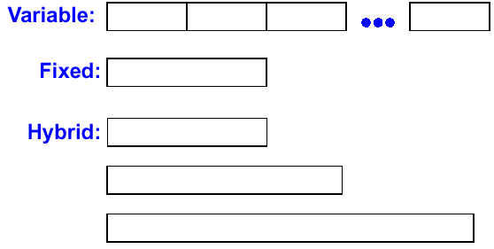
Variations in Instruction Length
• If Code Size is Most Important, Use Variable Length Instructions
• If Performance is Most Important, Use Fixed Length Instructions

Slide 42
Variations in Register & Memory Architecture
Intel 8086 | 2²⁰ x 8- bit Bytes AX, BX, CX, DX SP, BP, SI, DI CS, SS, DS, IP, Flags | acc, index, count, quot stack, string code, stack, data segment
VAX- 11 | 2³² x 8- bit Bytes 16 x 32- bit GPRs | r15 - program counter r14 - stack pointer r13 - frame pointer r12 - argument ptr
MC68000 | 2²⁴ x 8- bit Bytes 8 x 32- bit GPRs | 7 x 32- bit addr reg 1 x 32- bit SP 1 x 32- bit PC
MIPS | 2³² x 8- bit bytes 32 x 32- bit GPRs 32 x 32- bit FPRs HI, LO, PC

Slide 43
Variations in Addressing Modes (Examples)
Addressing mode
Example
Meaning
Register
Add R4,R3
R4
←
R4+R3
Add R4,R3, R2
R4
←
R3+R2
Immediate
Add R4,#3
R4
←
R4+3
Base + Index
lw R4,n(R3)
R4
←
Mem[R3+n]
PC Relative
beq R4,R3,100
Goto Mem[PC+100]
Pseudo-Direct
J 100
Goto Mem[PC<31:28>:100]
Displacement
Add R4,100(R1)
R4
←
R4+Mem[100+R1]
Register indirect
Add R4,(R1)
R4
←
R4+Mem[R1]
Indexed / Base
Add R3,(R1+R2)
R3
←
R3+Mem[R1+R2]
Direct or absolute
Add R1,(1001)
R1
←
R1+Mem[1001]
Memory indirect
Add R1,@(R3)
R1
←
R1+Mem[Mem[R3]]
Auto-increment
Add R1,(R2)+
R1
←
R1+Mem[R2]; R2
←
R2+d
Auto-decrement
Add R1,–(R2)
R2
←
R2–d; R1
←
R1+Mem[R2]
Scaled
Add R1,100(R2)[R3]
R1
←
R1+Mem[100+R2+R3*d]

Slide 44
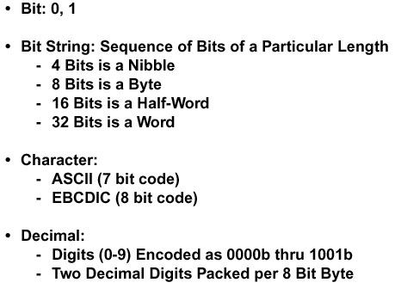
Variations in Data Type

Slide 45
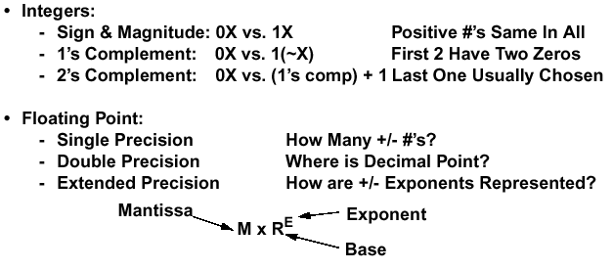
Variations in Data Type (continued)

Slide 46
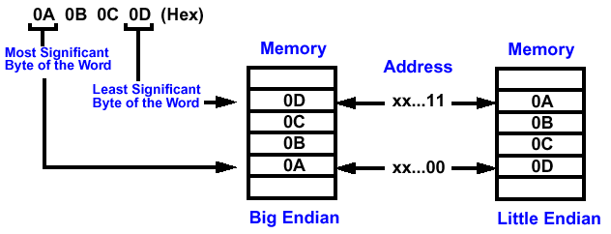
Variations in Order of Bits and Bytes: Endian
Given: Byte addressable system
Big Endian: Address of Most Significant Byte = Word Address
Little Endian: Address of Least Significant Byte = Word Address
Example: 4 Bytes per Word (xx... 00 = Word Address)

Slide 47
Byte Swap Problem with Endians
Big Endian Processors:
  MIPS, SPARC, IBM 360/ 370, Motorola 68000, HP PA
Little Endian Processors:
  Intel 80x86, DEC Alpha
When words are transferred between Big Endian and Little Endian machines, you must permute the bytes to successfully copy the data
Each system is self- consistent, but causes problems when they need to communicate!

Slide 48
Complex Instruction Set Computers (CISC)
General Characteristics of CISC
  Multiple Length Instruction Formats
  More Addressing Modes
  Typically Memory Operands can be used in Arithmetic and Logical operations
  An instruction may do several things (e. g., Test, Decrement, and Branch)
The Reasons for this are Historic
  There were few registers in early machines, so a Load- Store Architecture would be Inefficient (Why?)
  Memory was Expensive and Slow - Making special hardware instructions reduces memory bandwidth (fewer instruction accesses)
  Each instruction took several clock cycles including fetch cycles. Compound instructions has lower overhead in clock cycles.
Modern Technology caused the switch to RISC machines:
  More registers in the processor
  Pipelining to execute one instruction every clock cycle
  Cheaper Faster Memory

Slide 49
CISC Example: 8086 Family
8080 - Straightforward Accumulator Machine (8-bit)
1978: 8086 - Additional Registers
  Segments for 20- bit Address Space in 64KB fragments
1980: 80186 – 16-bit Extensions to the 8086 Architecture
1982: 80286 - Address space extended to 24- bits
  Elaborate Memory Mapping and Protection Scheme
  Real Addressing Mode to look like 8086
1985: 80386 - 32- bit Machine
  Real Addressing Mode for 8086 Compatibility
  Virutal 8086 Mode for Multiple 20- bit Partitions
  New Addressing Modes and Operations
  Most Operations can use any Register as an Operand
  Memory Paging
1989: 80486
  A few new instructions, substantial performance increases (e.g. pipelining)
1992: Pentium
  Super scalar architecture, multiple instructions per clock
1995: Pentium Pro
  Use micro instructions to achieve very high clock rates
1997: Pentium Pro MMX
  Special instructions for graphics support

Slide 50
8086 Instruction Set
Data Transfer Type
  14 instructions with a total number of 27 varients (e.g, MOV has 7 varients, PUSH has 3 varients etc.)
Arithmetic Type
  20 instructions with a total number of 32 varients
Logic Type
  12 instructions with a total number of 20 varients
String Manipulation Type
  6 instructions
Control Transfer Type (e.g., jump, branch etc.)
  26 instructions with a total number of 36 varients
Processor Control Type (e.g., halt, clear interrupt etc.)
  11 instructions
A total of 132 instructions and variants! (MIPS has 66)

Slide 51
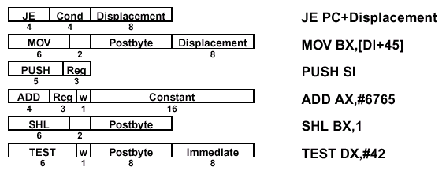
8086 Instruction Format
Instruction format: 1 to 6 bytes in length
Opcode is basically 8-bits, may use last 1 or 2 bits for indicators
  W Bit: Indicating this is a byte (W=0: half register) or word (W=1: full register) operation
  D Bit: Indicating direction (D=1: from mem, D=0: to mem) for instructions such as MOV
  V Bit: Indicating 1-bit shift or variable-length shift (V=0: count=1, V=1: count = Reg[CL])
  S Bit: Indicating if the 8-bit immediate operand should be sign-extended (S=1: sign extend)
  Note: the D, V, and S bits have the same location, before the W bit
Some instructions has Postbyte to encoding addressing mode
Example formats:
D
W
8
V
W
8

Slide 52
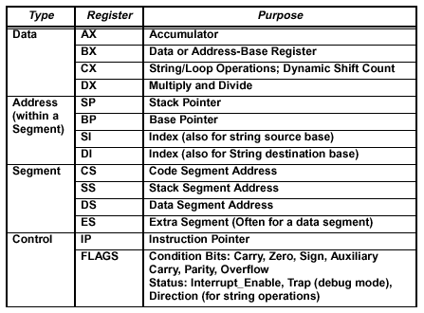
8086 Registers
14 16-bit Registers, some registers (AX, BX, CX, DX) can be used either as a full register or a half register, depending on the W bit
General registers with special purposes in some instructions
Special purposes registers

Slide 53
Addressing modes
2 Operand Arithmetic, Logical, and Data Transfer Instructions
  Register- Register, Register- Immediate, Register- Memory, Memory- Register, Memory- Immediate
Memory Addressing Modes
  16- Bit Absolute, Register Indirect
  Based (Base Register + Displacement)
  Indexed (Index Register + Displacement)
  Base Indexed with Displacement (Base + Index + Displacement)
Register Used in Addressing Modes
  Register Indirect: BX, SI, DI
  Based with 8- bit or 16- bit Displacement: BP, BX, SI, DI
  Based Indexed: BX+ SI, BX+ DI, BP+ SI, BP+ DI
  Based Indexed with 8- bit or 16- bit Displacement

Slide 54
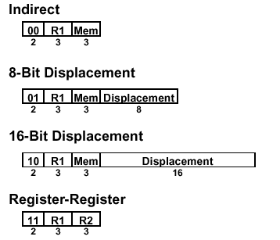

Postbyte Encoding
Postbyte: Use a Byte to Indicate Addressing Modes
Source/Destination Effective Addr
Example
Direction depends on D bit
Destination/Source
8 or 16 bits
Exercise: what is the machine code for moving 8-bit word from memory address (SI)+(DISP=11001100₂) to register AL? (op code for MOV from memory to register is 100010, d=1 for memory to register, w=0 for 8-bit op)
Answer:[100010 1 0][01 000 100][1100 1100]
Register Code assignments (dest / source):
Code 16 bit mode 8 bit mode
000 AX AL
001 CX CL
010 DX DL
011 BX BL
100 SP AH
101 BP CH
110 SI DH
111 DI BH
Mem Address Code assignments (source):
Code Effective Address (EA)
000 (BX)+(SI)+DISP
001 (BX)+(DI)+DISP
010 (BP)+(SI)+DISP
011 (BP)+(DI)+DISP
100 (SI)+DISP
101 (DI)+DISP
110 (BP)+DISP
111 (BX)+DISP

Slide 55
8086 Memory Architecture
The memory has 2²⁰ bytes (20-bit address) and is divided into 16 segments. Each segment has 64KBytes of Contiguous Memory.
Separate segments may be Adjacent, Disjoint, Partially Overlapped or Fully Overlapped.
All Segments fall on 16-byte boundary (i.e., last address byte = 0000)
Up to 4 segments are simultaneously active. The addresses of active segments are stored in the Segment Registers. The active segments are:
  Current Code Segment (CS)
  Current Stack Segment (SS)
  Current Data Segment (DS)
  Current Extra Data Segment (ES)
Address Calculation:
≈
≈
FFFFFh
64 KB
Code Segment
≈
≈
XXXX0h
Segment register
offset
Stack Segment
Segment address
0000
CS
≈
≈
SS
Data Segment
offset
DS
≈
≈
ES
+
Extra Data Segment
≈
≈
Physical address
Offset = Effective Address
00000h

Slide 56
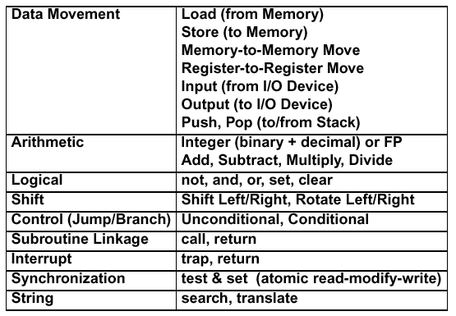
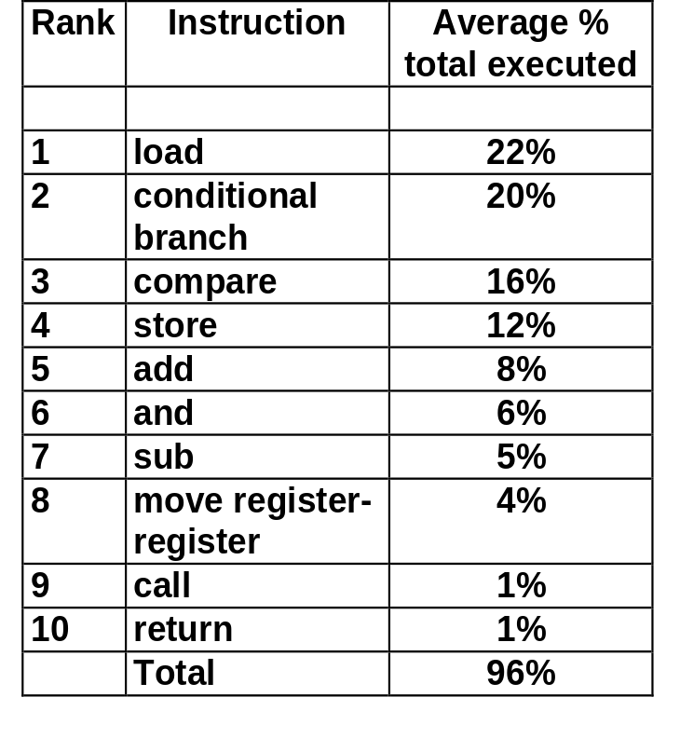
Is CISC Worthwhile?
Instruction Usage
Designed versus actually used operations
Typical Instructions Provided by CISC
Top 10 80X86 Instructions
Simple instructions dominate instruction frequency and most of the instructions in CISC are not used

Slide 57
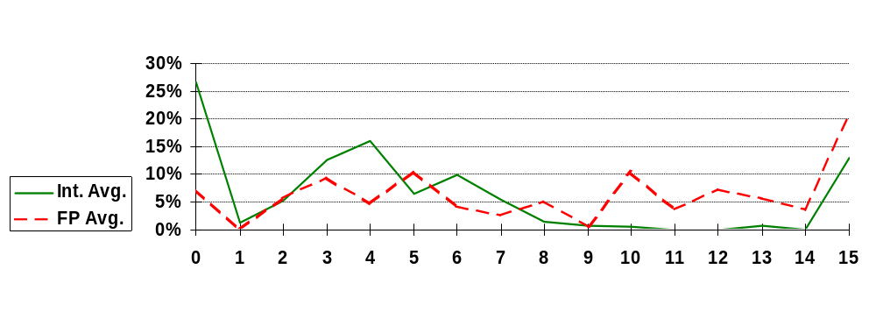
SPEC Program Analysis Results
Analysis of 5 Programs From SPECint92 and 5 Programs From SPECfp92Assist in MIPS Instruction Format Design
Results:
  Instructions Using Immediate Type Operands
  50% - 60% of Immediate Values Fit in 8 Bits
  75% - 80% of Immediate Values Fit in 16 Bits
  Displacement Addressing
  99% of Addresses <= 16 Bits
  Conditional Branches
  Most Branches Are Close to the Current PC Address
  Use at Least 8- Bits for PC- Relative Addresses
  Equal / Not Equal Comparison Most Important for Integer Programs
Address bits

Slide 58
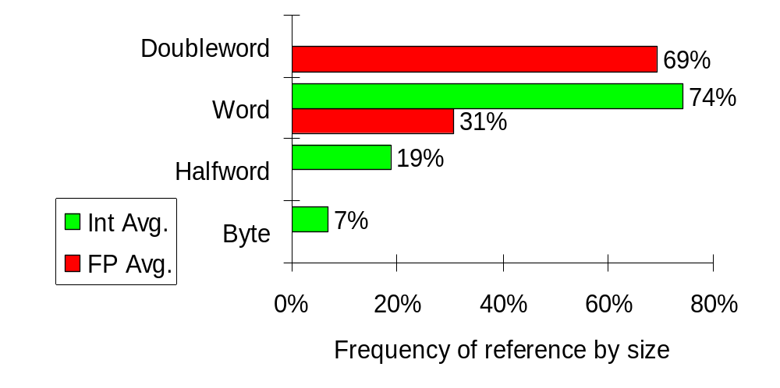
Operand Size Usage
Support these data sizes and types:
8-bit, 16-bit, 32-bit integers and
32-bit and 64-bit IEEE 754 floating point numbers

Slide 59
Summary of ISA Design
Use General Purpose Register with a Load- Store Architecture
Support These Addressing Modes: Displacement (with an Address Offset Size of 12 to 16 Bits), Immediate (Size 8 to 16 Bits), and Register Direct
Support These Instructions, Since They Will Dominate the Number of Instructions Executed: Load, Store, Add, Subtract, Move Register- Register, and, Shift, Compare Equal, Compare Not Equal, Branch (with a PC- relative Address at Least 8- Bits Long), Jump, Call, and Return
Support These Data Sizes and Types: 8- bit, 16- bit, 32- bit Integers and 64-Bit IEEE 754 Floating Point Numbers
Use Fixed instruction Encoding If Interested in Performance and Use Variable Instruction Encoding If Interested in Code Size
Provide at Least 16 General Purpose Registers Plus Separate Floating Point Registers, Be Sure All Addressing Modes Apply to All Data Transfer Instructions, and Aim for a Minimalist Instruction Set.

Slide 60
Backup Slides
MIPS Instructions

Slide 61
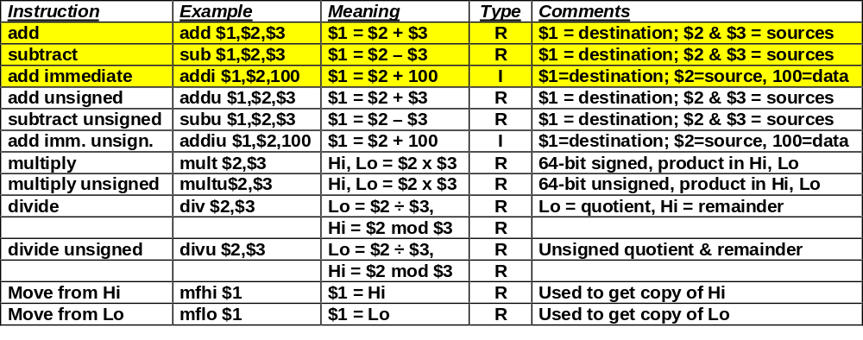
MIPS Arithmetic Instructions
Highlighted instructions are described in Chapter 3

Slide 62
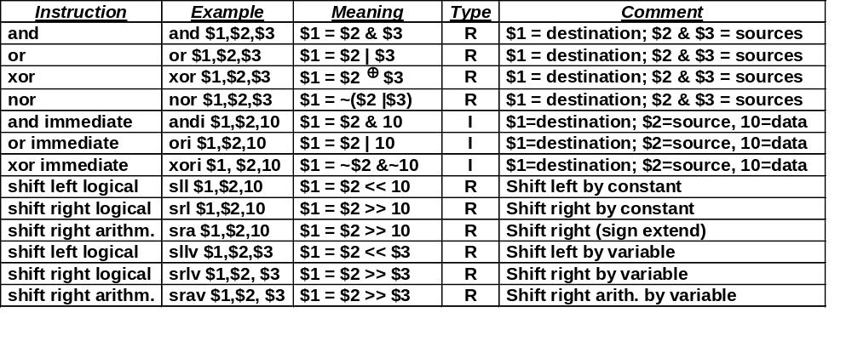
MIPS Logical Instructions

Slide 63
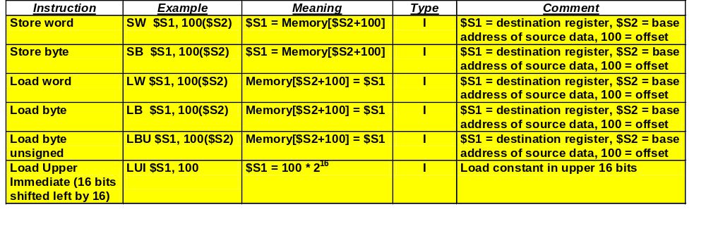
MIPS data transfer instructions
Highlighted instructions are described in Chapter 3

Slide 64
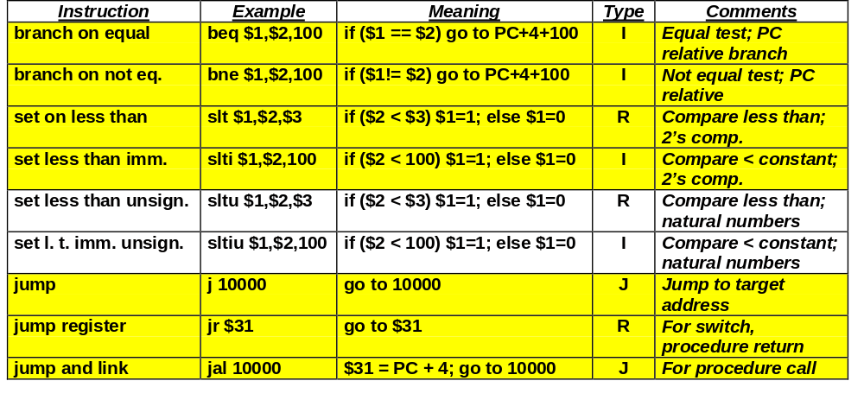
MIPS jump, branch, compare instructions
Highlighted instructions are described in Chapter 3

