Slide 1

What You Will Learn In Next Few Sets of Lectures
Basic CPU Architecture
Single Cycle Data Path Design
Single Cycle Controller Design
Multiple Cycle Data Path Design
Multiple Cycle Controller Design
Savio Chau

Slide 2
Five Classic Components of a Computer
Processor
(CPU)
Input
Control
Memory
Datapath
Output
Today’s Topic: Designing a Single Cycle Datapath

Slide 3
The Processor
Processor Executes The Program Instructions
2 Major Components
  Datapath
    Hardware to Execute Each Machine Instruction
    Consists of a cascade of combinational and state elements (e.g., Arithmetic Logic Unit (ALU), Shifters, Registers, Multipliers, etc.)
  Control
    Generates the Signals Telling the Datapath What To Do At Each Clock Cycle
    Generates the Signals to Execute an Instruction in a Single Cycle or as a Series of Small Steps Over Multiple Cycles

Slide 4
A Simplified Processor Model
Memory
I/O
Simplified Execution Cycle:
Instruction Fetch
Instruction Decode
Operand Fetch
Execute
Result Store
Next Instruction
Data
Address
Control
Program Counter
Control
Instruction Register
Register File
ALU
Data Path

Slide 5
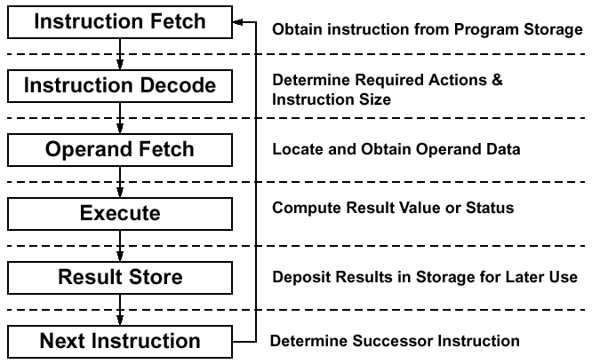
Execution Cycle

Slide 6
Steps to Design a Processor
5 steps to design a processor
  1. Analyze instruction set
    Define the instruction set to be implemented
    Specify the requirements for the data path
    Specify the physical implementation
  2. Select set of datapath components & establish clock methodology
  3. Assemble data path meeting the requirements
  4. Analyze implementation of each instruction to determine setting of control points that effects the register transfer.
  5. Assemble the control logic
MIPS makes it easier
  Instructions same size
  Source registers always in same place
  Immediates have same size, location
  Operations always on registers/immediates
Datapath Design
Cpntrol Logic Design

Slide 7
Step 1: Analyze the Instruction Set a) Defining the Instruction Set Architecture
Define the Functions of Each Instructions for the Basic Classes:
  Data Movement: load, store
  Arithmetic and Logic: add, sub, ori, and, or, slt
  Program Control: beq, jump
For Each Instruction, Specify:
  Instruction Mnemonics (Assembly Language)
  Instruction Format and Op Codes (Machine Language)

Slide 8
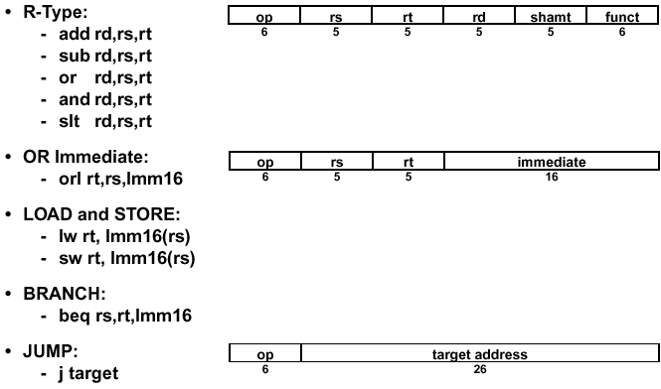
Example: Subset of MIPS ISA to be Implemented

Slide 9
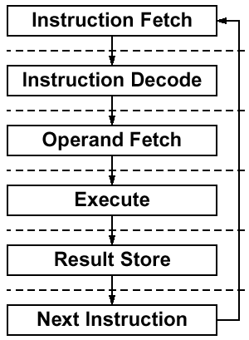
Step 1: Analyze the Instruction Set b) Specify Requirements for the Data Path
Where and how to fetch the instruction?
  Where are the instructions stored?
Instruction format or encoding
  how is it decoded?
Location of operands
  where to find the operations?
  how many explicit operands?
Data type and Size
Type of Operations
Location of results
  where to store the results?
Successor instruction
  How to determine the next instruction?
  (next address logic for jumps, conditions branches)
fetch-decode-execute next address is implicit!

Slide 10
Step 1: Analyze the Instruction Set c) Specify the Physical Implementation
Write Register Transfer Language (RTL) for the ISA:
Specify what state elements (registers, memories, flip-flops) are needed to implement the instructions
Describe how signals are transferred among state elements
There are many types of RTLs. Examples: VDHL and Verilog
An informal RTL is used in this class:
Syntax:
variable ← expression
Where variable is either a register or a signal or signal group
(Note: Use the following convention in this class.
Variable is a register if it is all caps or in form of array[address]. Otherwise it is a signal or signal group)
Expression is a function of input signals and the output of other state elements

Slide 11
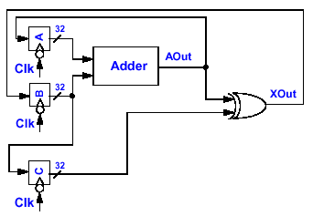
Register Transfer in RTL
• RTL: B can also be written as:
A ← A + B aout ← A + B
B ← (A + B) xor C xout ← aout xor C
C ← B B ← xout
Note: for single cycle data path, all register transfers are assumed taking place in one clock

Slide 12
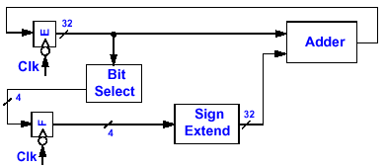
RTL: Bit Level Description
• Use pointed bracket to denote the bits in a register or signal group,
e.g., A< 31: 0> means bit 31 to bit 0 of register A
F ← E<26: 23>
E ← E + SignExtend( F)
Another way of expressing: Alternatively:
F<3> ← E<26> F<3: 0> ← E<26: 23>
F<2> ← E<25>
F<1> ← E<24>
F<0> ← E<23>

Slide 13
RTL: Memory Description
• Memory is described as an array
• General purpose registers are described as an array
e. g.,
Mem[100] Contents of address 100 in memory
R[6] Contents of Register 6
R[rs] Contents of the register whose
register number is specified by
the signal rs

Slide 14
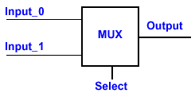
RTL: Conditionals
• Conditionals can also be used in RTL
e. g.,
RTL:
if (Select = 0) then
Output ← Input_0
else if (Select = 1) then
Output ← Input_1

Slide 15
Register Transfer Language and Clocking
Register transfer in RTL:
R2 ⬅ f(R1)
What Really Happens Physically
R1
R2
1
0
1
1
.
.
.
.
.
.
.
.
.
.
.
.
0
0
1
1
1
1
Clk
Setup
Hold
Setup
Hold
Don’t Care
Setup (Hold) - Short time before (after) clocking that inputs can’t change or they might mess up the output
Two possible clocking methodologies: positively triggered or negatively triggered. This class uses the negatively-triggered.

Slide 16


Instructions and RTL for the MIPS Subset
RTL:
instr ← mem[PC] Instruction Fetch
rs ← instr<25:21> Define Signals (Fields) of Instr
rt ← instr<20:16>
rd ← instr<15:11>
R[rd] ← R[rs] + R[rt] Add Register Contents
PC ← PC + 4 Update Program Counter
RTL:
Instr ← mem[PC] Instruction Fetch
rs ← instr<25: 21> Define Signals (Fields) of Instr
rt ← instr<20: 16>
rd ← instr<15: 11>
R[rd] ← R[rs] - R[rt] Subtract Register Contents
PC ← PC + 4 Update Program Counter

Slide 17

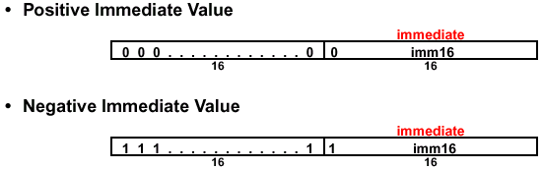
Instructions and RTL for the MIPS Subset (continued)
RTL:
instr ← mem[PC] Instruction Fetch
rs ← instr<25:21> Define Signals (Fields) of Instr
rt ← instr<20:16>
imm16 ← instr<15:0>
addr ← R[rs] + sign_extend(imm16) Calculate Memory Address
R[rt] ← Mem[addr] Load Data into Register
PC ← PC + 4 Update Program Counter

Slide 18


Instructions and RTL for the MIPS Subset (continued)
RTL:
instr ← mem[PC] Instruction Fetch
rs ← instr<25:21> Define Signals (Fields) of Instr
rt ← instr<20:16>
imm16 ← instr<15:0>
addr ← R[rs] + sign_ext(imm16) Calculate Memory Address
Mem[addr] ← R[rt] Store Register data Into Memory
PC ← PC + 4
RTL:
instr ← mem[PC] Instruction Fetch
rs ← instr<25:21> Define Signals (Fields) of Instr
rt ← instr<20:16>
imm16 ← instr< 15: 0>
R[rt] ← R[rs] or zero_ext(imm16) Logical OR
PC ← PC + 4 Update Program Counter

Slide 19


Instructions and RTL for the MIPS Subset (continued)
RTL:
instr ← mem[PC] Instruction Fetch
rs ← instr<25:21> Define Signals (Fields) of Instr
rt ← instr<20:16>
imm16 ← instr<15:0>
branch_ cond ← R[rs] - R[rt] Calculate Branch Condition
if (branch_cond eq 0) Calculate Next Instruction Address
then PC ← PC + 4 + (sign_ext(imm16)* 4)
else PC ← PC + 4
RTL:
instr ← mem[PC] Instruction Fetch
PC_incr ← PC + 4 Increment Program Counter
PC<31:2> ← PC_incr<31:28> concat target<25:0>
Calculate Next Instr. Addr.
Note: PC< 1: 0> is “00” for a word address so not necessary to implement PC< 1: 0>

Slide 20
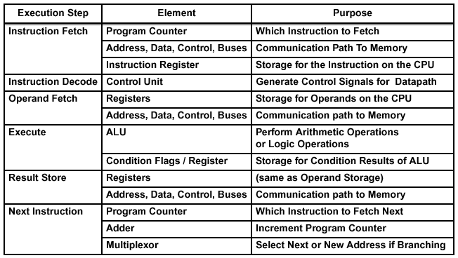
Step 2: Select Basic Processor Elements

Slide 21
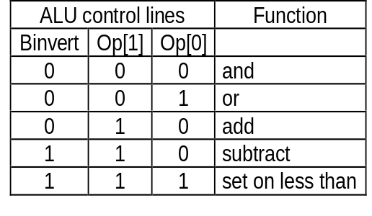
Data Path Element Example: ALU
Binvert
op[1:0]
Binvert
op[1:0]
c_{in}
C_{in}
a₀
ALU₀
a
b₀
result₀
0
Less
C_{out}
1
C_{in}
b
0
+
sum
2
result
a₁
ALU₁
c_{in}
sum
b₁
result₁
1
a
0
Less
Less
3
b
C_{out}
c_{out}
c_{out}
Binvert
op[1:0]
zero
c_{in}
a
0
C_{in}
1
a₃₁
ALU₃₁
result₃₁
b₃₁
overflow
0
Less
b
0
+
sum
2
result
set
1
Less
3
set
Overflow detection
overflow

Slide 22
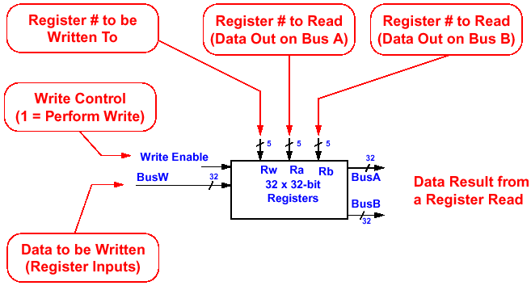
Data Path Element Example: Register File

Slide 23
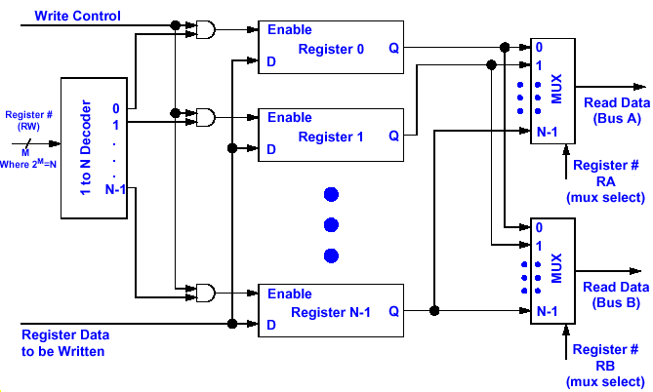
Implementation of Register File
clock

Slide 24
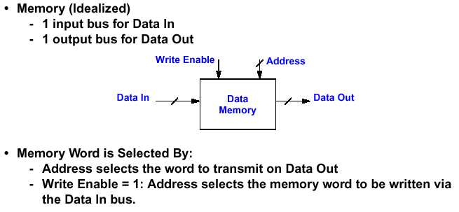
Data Path Element Example: An Idealized Memory

Slide 25
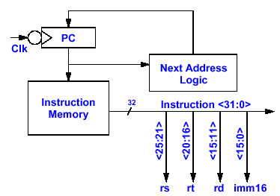
Step 3: Assemble the Datapath
Overview of the Instruction Fetch Unit
The Common RTL Operations:
  Fetch the Instruction and Define signal fields of the instruction:
    instr ← mem[ PC]; rs ← instr< 25: 21>; rt ← instr< 20: 16>;
    rd ← instr< 15: 11>; imm16 ← instr< 15: 0>
  Update the Program Counter:
    Sequential Code: PC ← PC+ 4
    Branch and Jump: PC ← “something else”
12
4
8
8
0
4
12
4
8
8
0
4
12
4
0
Instruction<31:0>
8
Instruction<31:0>
Instruction<31:0>
4
Instruction<31:0>
Instruction<31:0>
8
Instruction<31:0>

Slide 26
Step 3: Assemble the Datapath
Put Together a Datapath for R-Type Instruction
General format: Op rd, rs, rt
(e.g., add rd, rs, rt)
instr ← mem[PC] Instruction Fetch
rs ← instr<25:21> Define Signals (Fields) of Instr
rt ← instr<20:16>
rd ← instr<15:11>
R[rd] ← R[rs] + R[rt] Add Register Contents
PC ← PC + 4 Update Program Counter
PC+4
Next Address Logic
PC
Instruction Memory
rs
Register
File
rt
Rd addr1
rd
Rd addr2
ALU
Wr addr
Wr data
See Example Before Animating the Construction of the Data Path

Slide 27
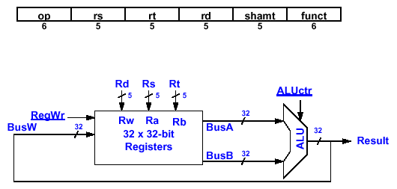
Operations of R-Type Instruction Datapath
• R[ rd] ← R[ rs] op R[ rt] Example: add rd, rs, rt
instr ← mem[PC] Instruction Fetch
rs ← instr<25:21> Define Signals (Fields) of Instr
rt ← instr<20:16>
rd ← instr<15:11>
R[rd] ← R[rs] + R[rt] Add Register Contents
PC ← PC + 4 Update Program Counter
  ALUctr and RegWr: Control Signals from Control Logic
Instruction Memory
PC
clock
clock
rs
rd
clock
clock
rt

Slide 28
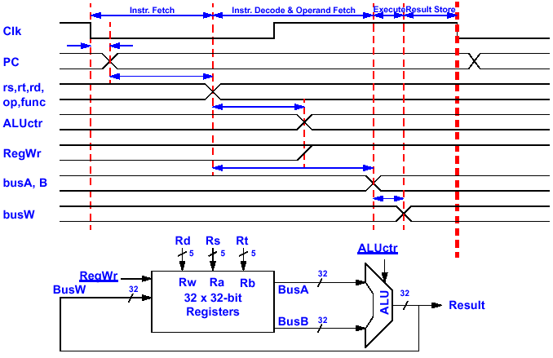
Details of R-Type Instruction Timing
Clk to-Q
Old Value
New Value
Instruction Memory Access Time
Old Value
New Value
Delay Through Control Logic
Old Value
New Value
Control decode
Old Value
New Value
Control decode
Register File Access Time
Old Value
New Value
ALU Delay
Old Value
New Value

Slide 29
Step 3: Assemble the Datapath (continue)
Put Together a Datapath for Load Instruction
lw rt, immed16(rs)
Instr <- mem[PC] Instruction Fetch
rs <- Instr<25:21> Define Signals (Fields) of Instr
rt <- Instr<20:16>
imm16 <- Instr<15:0>
Addr <- R[rs] + SignExtend(imm16) Calculate Memory Address
R[rt] <- Mem[Addr] Load Data into Register
PC <- PC + 4 Update Program Counter
PC+4
Next Address Logic
PC
Instruction Memory
rs
Register
File
rt
Rd addr1
ALU
Data
Memory
imm16
addr
Wr addr
Wr data
ext
data in
data out
See Example Before Animating the Construction of the Data Path

Slide 30
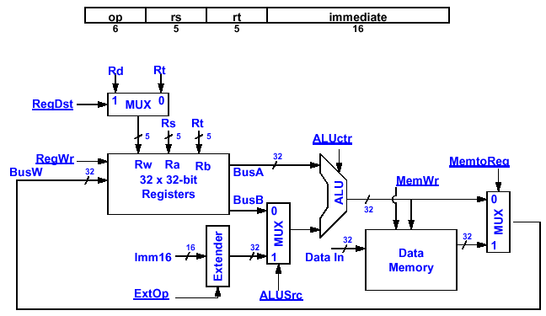
Operations of the Datapath for Load Instruction
• R[ rt] ← Mem[ R[ rs] + SignExt( imm16)] Example: lw rt, imm16( rs)
Instruction Memory
PC
clock
clock
rs
rt
clock
clock
data

Slide 31
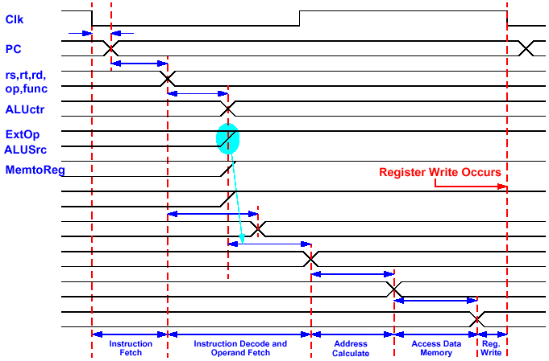
Timing of a Load Instruction
Clk to-Q
Old Value
New Value
Instruction Memory Access Time
Old Value
New Value
Delay Through Control Logic
Old Value
New Value
Old Value
New Value
Old Value
New Value
RegWr
busA
busB
Address
busW
Old Value
New Value
Register File Access Time
Old Value
New Value
Delay through Extender & Mux
Old Value
New Value
ALU Delay
Old Value
New Value
Data Memory Access & MUX Time
Old Value
New Value

Slide 32
Step 3: Assemble the Datapath (continue)
Put Together a Datapath for Store Instruction
sw rt, immed16($2)
Instr <- mem[PC] Instruction Fetch
rs <- Instr<25:21> Define Signals (Fields) of Instr
rt <- Instr<20:16>
imm16 <- Instr<15:0>
Addr <- R[rs] + SignExt(imm16) Calculate Memory Address
Mem[Addr] <- R[rt] Store Register data Into Memory
PC <- PC + 4
PC+4
Next Address Logic
PC
Instruction Memory
rs
Register
File
rt
Rd addr1
Rd addr2
ALU
Data
Memory
imm16
addr
ext
data in
data out

Slide 33
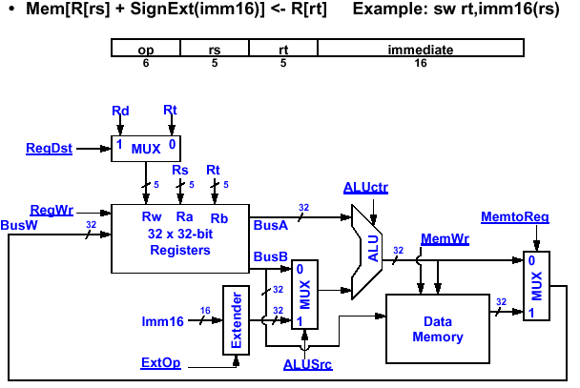
Operations of the Datapath for Store Instruction
Instruction Memory
PC
clock
rs
clock
rt
mem=rt

Slide 34
Step 3: Assemble the Datapath (continue)
Put Together a Datapath for I-Type Instruction
General format: Op rt, rs, immed16
(e.g., ori rt, rs, immed16)
Instr <- mem[PC] Instruction Fetch
rs <- Instr<25:21> Define Signals (Fields) of Instr
rt <- Instr<20:16>
imm16 <- Instr<15:0>
R[rt] <- R[rs] or ZeroExt(imm16) Logical OR
PC <- PC + 4 Update Program Counter
PC+4
Next Address Logic
PC
rs
Register
File
Instruction Memory
rt
Rd addr1
imm16
ALU
Wr addr
Wr data
ext

Slide 35
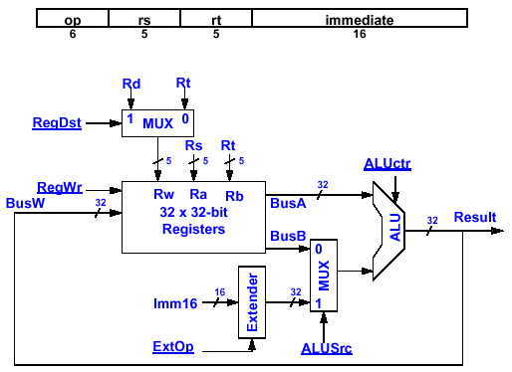
Operations of the I-Type Instruction Datapath
• R[rt] ← R[rs] op ZeroExt(lmm16); op = +, -, and, or etc.
Example: ori rt, rs, Imm16
Instruction Memory
PC
clock
clock
rs
rt
clock
clock

Slide 36
Step 3: Assemble the Datapath (continue)
Put Together a Datapath for Branch Instruction
beq rs, rt, immed16
Instr <- mem[PC] Instruction Fetch
rs <- Instr<25:21> Define Signals (Fields) of Instr
rt <- Instr<20:16>
imm16 <- Instr<15:0>
branch_ cond <- R[rs] - R[rt] Calculate Branch Condition
if (branch_ cond eq 0) Calculate Next Instruction Address
then PC <- PC + 4 + (SignExt(immd16)* 4)
else PC <- PC + 4
PC+4+immd16*4
branch_cond
Next Address Logic
PC
Instruction Memory
rs
Register
File
rt
Rd addr1
imm16
Rd addr2
ALU
ext

Slide 37
Step 3: Assemble the Datapath (continue)
Combining Datapaths for Different Instructions
Example: Combining Data Paths for add and lw
Data Path for Add
Data Path for lw
Combined Data Path
PC+4
PC+4
PC+4
Next Address Logic
Next Address Logic
PC
Next Address Logic
PC
PC
R[rs]
R[rs]
rs
R[rs]
rs
Instruction Memory
rs
Instruction Memory
Instruction Memory
Rd addr1
Rd addr1
Rd addr1
Data Memory
rt
Data Memory
rt
rt
Rd addr2
Rd addr2
Rd addr2
ALU
ALU
ALU
Register File
Register File
rd
Register File
rd
mux
Wr addr
Wr addr
Wr addr
R[rt]
R[rt]
imm16
imm16
Wr data
Wr data
Wr data
mux
ext
ext
mux
Wr Data = ALU output or Mem[addr]
See Example Before Animating the Construction of the Data Path

Slide 38
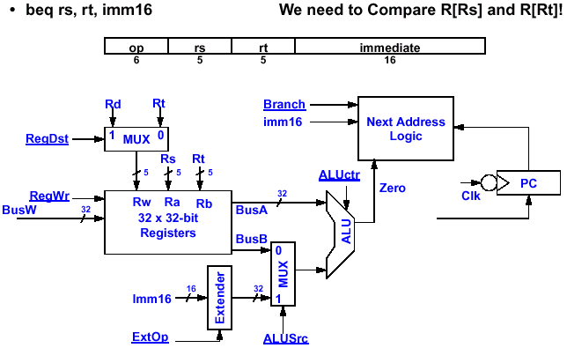
Operations of the Datapath for Branch Instruction
Instruction Memory
imm16
PC+4
clock
rs
clock
clock
clock
rt

Slide 39
Binary Arithmetic for the Next Address
In Theory, the PC is a 32- bit byte Address Into the Instruction Memory
  Sequential Operation: PC< 31: 0> = PC< 31: 0> + 4
  Branch Operation: PC< 31: 0> = PC< 31: 0> + 4 + SignExt( Imm16)* 4
The Magic Number “4” Always Comes Up Because:
  The 32- Bit PC is a Byte Address
  And All Our Instructions are 4 Bytes (32- bits) Long
In Other Words:
  The 2 LSBs of the 32- bit PC are Always Zeros
  There is No Reason to Have Hardware to Keep the 2 LSBs
In Practice, We Can Simplify the Hardware by Using a 30- bit PC< 31: 2>
  Sequential Operation: PC< 31: 2> = PC< 31: 2> + 1
  Branch Operation: PC< 31: 2> = PC< 31: 2> + 1 + SignExt( imm16)
  In Either Case, Instruction Memory Address = PC< 31: 2> concat “00”

Slide 40
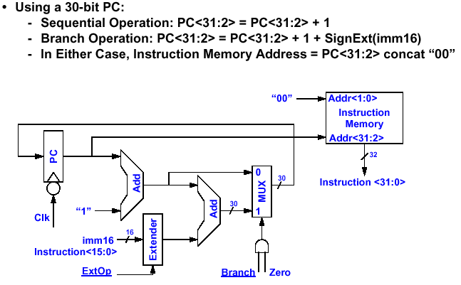
Next Address Logic

Slide 41
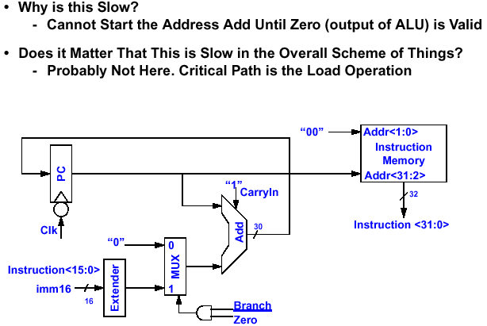
Next Address Logic: Cheaper Solution

Slide 42
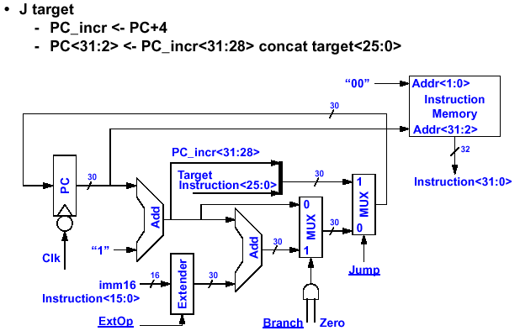
A Complete Instruction Fetch Unit

Slide 43
Putting It All Together: A Single Cycle Datapath
Inst
Memory
Instruction<31:0>
<16:20>
<11:15>
<0:15>
We Have Everything Except Control Signals (underline)
Adr
Rs
Rt
Rd
Imm16
nPC_sel
RegDst
Equal
ALUctr
MemWr
MemtoReg
Rd
Rt
MUX
1
0
Rs
Rt
4
RegWr
5
5
5
Adder
busA
0
Rw
Ra
Rb
=
00
busW
32 32-bit
Registers
32
MUX
32
busB
Adder
32
0
PC
0
32
Clk
MUX
32
MUX
Adder
1
WrEn
Adr
1
Data In
PC Ext
Clk
imm16
Extender
Data
Memory
16
32
1
imm16
Clk
ExtOp
ALUSrc

Slide 44
Load Instruction in the Complete Data Path
Inst
Memory
Instruction<31:0>
<16:20>
<11:15>
<0:15>
We Have Everything Except Control Signals (underline)
Adr
Rs
Rt
Rd
Imm16
nPC_sel
RegDst
Equal
ALUctr
MemWr
MemtoReg
Rd
Rt
MUX
1
0
Rs
Rt
4
RegWr
5
5
5
Adder
busA
0
Rw
Ra
Rb
00
busW
rs
32
=
32 32-bit
Registers
rt
MUX
32
busB
Adder
32
0
PC
PC+4
32
0
PC+4
Clk
MUX
MUX
Adder
1
32
WrEn
Adr
1
Data In
Clk
Extender
Data
Memory
PC Ext
imm16
32
data for rt
1
imm16
16
Clk
ExtOp
ALUSrc

