Slide 1
Single Cycle Controller Design
Last Time: Discussed the Designing of a Single Cycle Datapath
Processor
(CPU)
Input
Control
Memory
Datapath
Output
Today’s Topic: Designing the Control Unit for the Single Cycle Datapath

Slide 2
Steps to Design a Processor
5 steps to design a processor
  1. Analyze instruction set => datapath requirements
    Define the instruction set to be implemented
    Specify the implementation requirements for the datapath
    Specify the physical implementation
  2. Select set of datapath components & establish clock methodology
  3. Assemble datapath meeting the requirements
  4. Analyze implementation of each instruction to determine setting of control points that effects the register transfer.
  5. Assemble the control logic
MIPS makes it easier
  Instructions same size
  Source registers always in same place
  Immediates same size, location
  Operations always on registers/immediates
Datapath Design
Cpntrol Logic Design
See Example

Slide 3
Step 4: Determine Control Points of the Data Path
General Ideas
Where to find the control points? Common Places are:
  Read / Write Enable Signals for State Elements (Memory, Register File)
  Enable Signals for Combinational Logic (e.g., SignExtender)
  Control Signals that Determine ALU Operations
  Select Signals for Multiplexors
  Control Signals in Any Data Path Components
How to Determine the Setting of the Control Signals
  Need to Understand the Operations of the Components in Different Control Signal Setting
  Need to Understand How the Data is Supposed to Flow Through the Data Path for Each Instruction

Slide 4
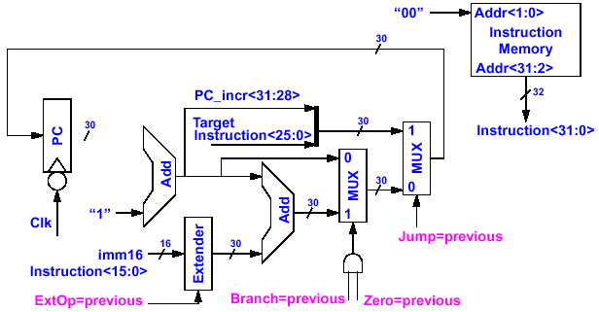
Step 4: Determine Control Points of the Data Path
Control Signal for Instruction Fetch
Fetch the Instruction from Instruction Memory: Instruction ← mem[ PC]
  For single cycle data paths, there is no control signal for the PC because it is updated every clock. This is true for all instructions

Slide 5
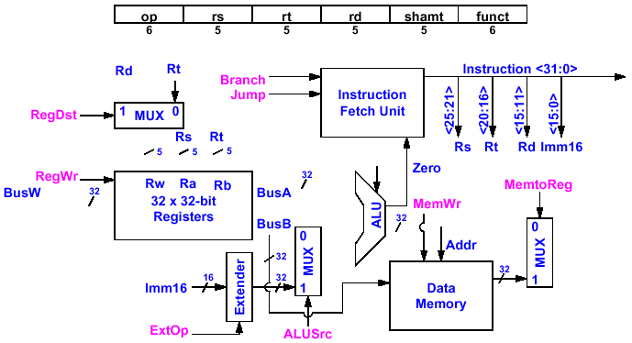
Step 4: Determine Control Points of the Datapath
Control Signals for Add Instruction
• R[ rd] ← R[ rs] + R[ rt]
Branch = 0
Jump = 0
RegDst = ?
RegDst = 1
ALUctr = ?
ALUctr
ALUctr = add
RegWr = ?
RegWr = 1
MemtoReg = ?
MemtoReg = 0
MemWr = 0
ExtOP = x
ALUSrc = ?
ALUSrc = 0

Slide 6
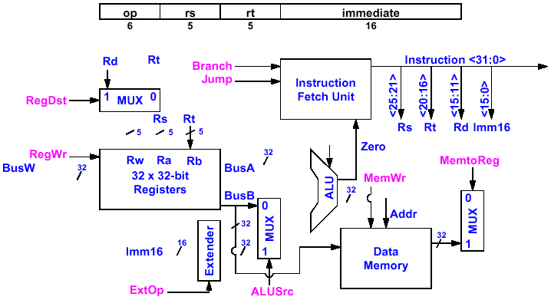
Step 4: Determine Control Points of the Datapath
Control Signals for Or Immediate
• R[ rt] ← R[ rs] or ZeroExt( imm16)
Branch = 0
Jump = 0
RegDst = 0
RegDst = ?
ALUctr = ?
ALUctr = or
ALUctr
RegWr = 1
RegWr = ?
MemtoReg = 0
MemtoReg = ?
MemWr = 0
ExtOP = 0
ExtOP = ?
ALUSrc = ?
ALUSrc = 1

Slide 7
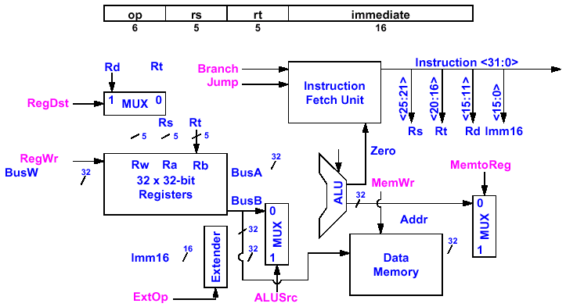
Step 4: Determine Control Points of the Datapath
Control Signals for Load
R[ rt] ← Data Memory [R[ rs] + SignExt( imm16)]
Branch = 0
Jump = 0
RegDst = 0
RegDst = ?
ALUctr = ?
ALUctr = add
ALUctr
RegWr = 1
RegWr = ?
MemtoReg = 1
MemtoReg = ?
MemWr = 0
ExtOP = 1
ExtOP = ?
ALUSrc = 1
ALUSrc = ?

Slide 8
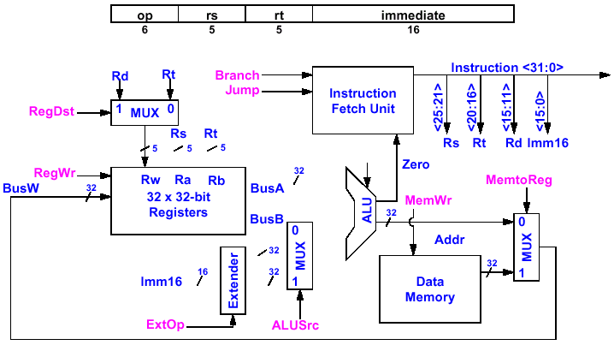
Step 4: Determine Control Points of the Datapath
Control Signals for Store
Data Memory [R[rs] + SignExt(imm16) ] ← R[rt]
Branch = 0
Jump = 0
RegDst = x
ALUctr = ?
ALUctr = add
ALUctr
RegWr = 0
MemtoReg = x
MemWr = 1
MemWr = ?
R[rt]
ExtOP = 1
ExtOP = ?
ALUSrc = 1
ALUSrc = ?

Slide 9
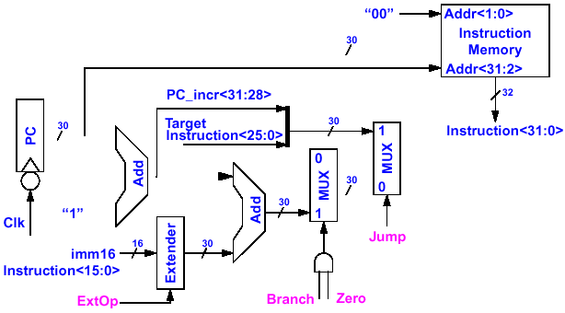
Instruction Fetch Unit at the End of Instructions Except for Branch and Jump
PC ← PC + 4
  This is the Same for all Instructions Except: Branch and Jump
Jump = 0
ExtOP = x
Branch = 0
Zero = x

Slide 10
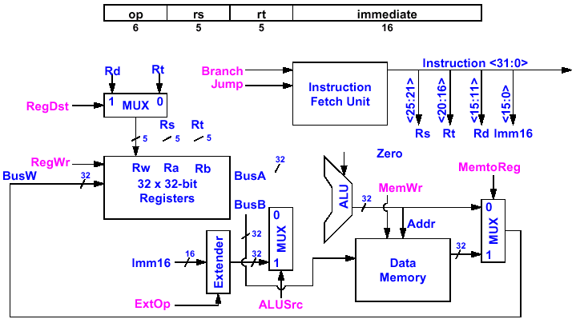
Step 4: Determine Control Points of the Datapath
Control Signals for Branch
If (R[rs] - R[rt] == 0 ) Then Zero ← 1 ; else Zero ← 0
Branch = ?
Jump = ?
RegDst = x
ALUctr
ALUctr = ?
ALUctr = sub
RegWr = 0
Zero
See next page
MemtoReg = x
MemWr = 0
ExtOP = x
ALUSrc = 0
ALUSrc = ?

Slide 11
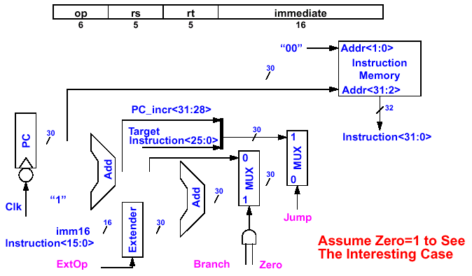
Instruction Fetch Unit at the End of Branch
If ( Zero == 1 ) Then PC = PC + 4 + SignExt( imm16) * 4 ; Else PC = PC + 4
Jump = 0
ExtOP = 1
Branch = 1
Zero = 1

Slide 12
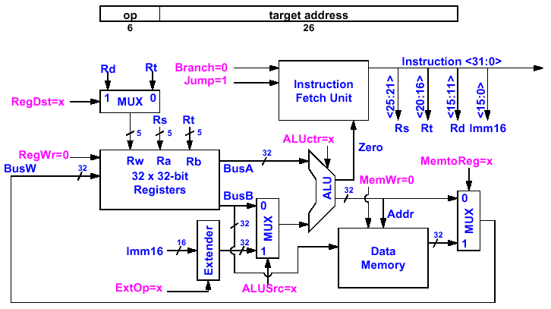
Step 4: Determine Control Points of the Datapath
Control Signals for Jump
The data path has nothing to do! Make sure control signals are set correctly!

Slide 13
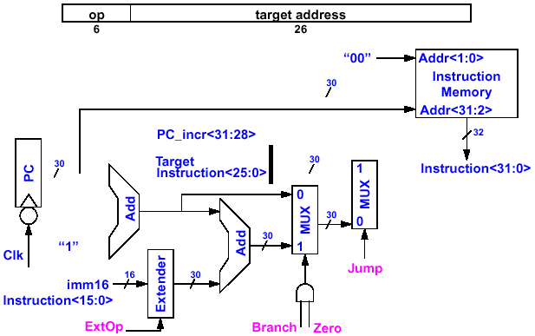
Instruction Fetch Unit at the End of Jump
PC ← PC_incr< 31: 28> concat target< 25: 0> concat “00”
Jump = 1
ExtOP = X
Branch = 0
Zero = x

Slide 14
Step 4: Determine Control Points of the Datapath
All Required Control Signals for the Given Data Path
Instruction<31:0>
Instruction
Memory
<21:25>
<21:25>
<16:20>
<11:15>
<0:15>
Adr
Op
Fun
Rt
Rs
Rd
Imm16
Control
Branch
Jump
RegWr
RegDst
ExtOp
ALUSrc
ALUctr
MemWr
MemtoReg
Zero
DATA PATH

Slide 15
Step 5: Assemble the Control Logic
Example: Control signals for a combined data path for add and lw instructions
Questions: (1) How to make sure the control signals have correct values for different instructions?
Ans: Need a control unit to generate control signals for instructions
(2) How does the control unit look like?
For single cycle data path, this is just a big decoder!
Next Addr Logic
PC+4
Control Unit
0
1
1
1
1
+
lw
1
1
X
0
0
+
add
PC
Op Code
RegDst
RegWr
ExtOP
ALUsrc
ALUctr
Instruction Memory
MemtoReg
rs
R[rs]
rt
RA1
Register File
Data Memory
RA2
ALU
rd
0
mux
WA
R[rt]
imm16
1
Wr data
0
mux
ext
1
0
mux
See Control Unit Design Example
1

Slide 16
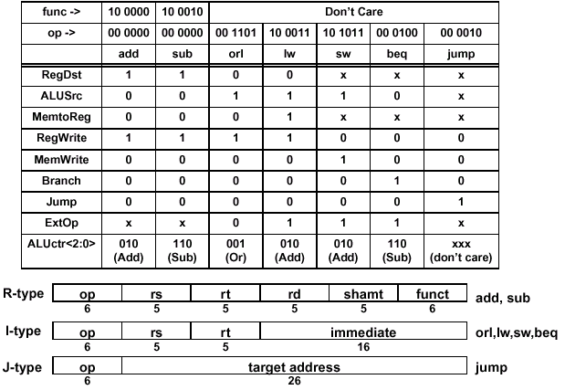
Step 5: Assemble the Control Logic
Control Signals for a Full Control Unit
These signals can easily be expressed as functions of the opcodes
See following discussions

Slide 17
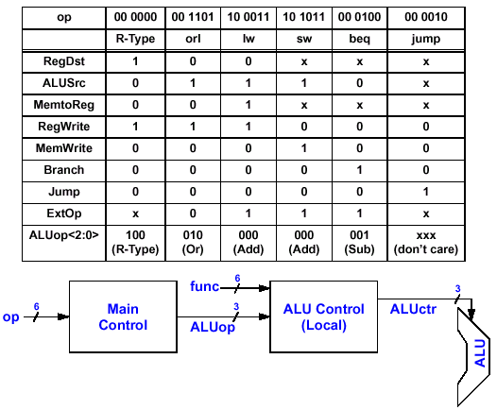
The Concept of Local Decoding
See next slide
func
6
Without local decoding, Main Control has to include func input and will have 2⁶⁺⁶ = 4K minterms
With local decoding, Main Control has only 2⁶ = 64 minterms and local control has only 2⁹ = 512 minterms

Slide 18
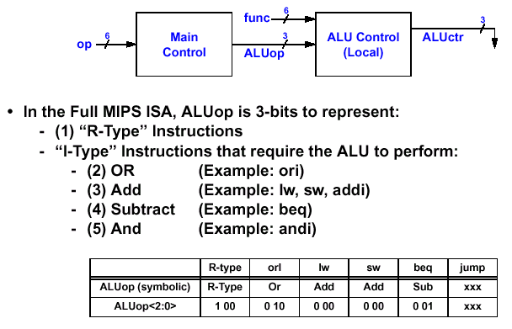
Encoding ALUop
Address concatenation do not need ALU
I-type
op
For R-type, actual operation is determined by the func field (see text p. 153 for func encoding)
Add offset to address for lw and sw
Subtract to compare

Slide 19
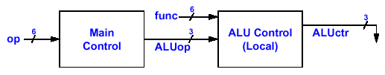
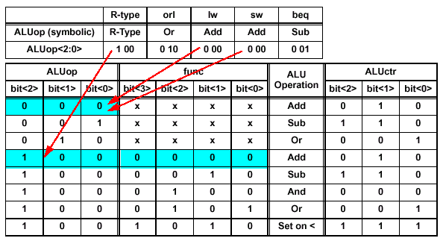
Truth Table for ALUctr
op
I-type uses the opcodes but not the func field
R-type has only 1 opcode but uses the func field for encoding
• ALUop = f (opcode) ; as shown in the previous slide
• ALUctr = f (ALUop, func)

Slide 20
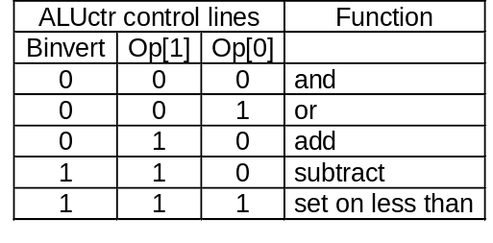
ALUctr Signals
Binvert
op[1:0]
Binvert
op[1:0]
c_{in}
C_{in}
a₀
ALU₀
a
b₀
result₀
0
Less
C_{out}
1
C_{in}
b
0
+
sum
2
result
a₁
ALU₁
c_{in}
sum
b₁
result₁
1
a
0
Less
Less
3
b
C_{out}
c_{out}
c_{out}
Binvert
op[1:0]
zero
c_{in}
a
0
C_{in}
1
a₃₁
ALU₃₁
result₃₁
b₃₁
overflow
0
Less
b
0
+
sum
2
result
set
1
Less
3
set
Overflow detection
overflow

Slide 21
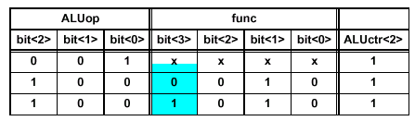
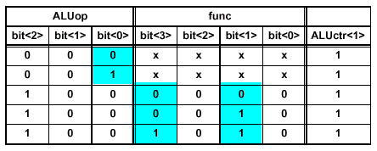
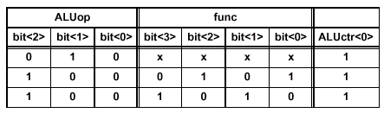
Logic Equations for the ALUctr Signals
This makes func< 3> a don’t care
ALUctr<2>:
ALUctr<2> = !ALUop<2> & !ALUop<1> & ALUop<0> + ALUop<2> & !ALUop<1> & !ALUop<0> & !func<2> & func<1> & ! func<0>
ALUctr<1>:
ALUctr<1> = !ALUop<2> & !ALUop<1> + ALUop<2> & !ALUop<1> & !ALUop<0> & !func< 2>
ALUctr<0>:
ALUctr<0> = !ALUop<2> & ALUop<1> & !ALUop< 0>+ ALUop<2> & !ALUop<1> & !ALUop<0> & !func<3> & func<2> & !func<1> & func<0>+ ALUop<2> & !ALUop<1> & !ALUop<0> & func<3> & !func< 2> & func< 1> & ! func< 0>

Slide 22
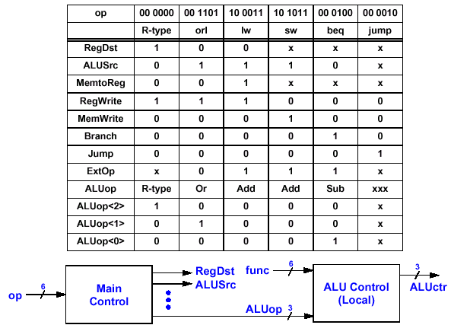
The “Truth Table” for the Main Control
See last 4 slides

Slide 23

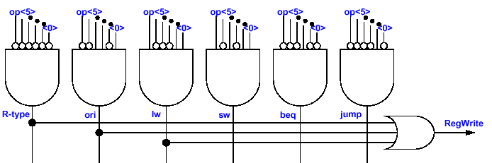
Implementation of the Main Control Unit
Example: the RegWrite Control Signal
RegWrite = R- type + ori + lw
= !op<5> & !op<4> & !op<3> & !op<2> & !op<1> & !op<0> (i.e., R- type)
+ !op<5> & !op<4> & op<3> & op<2> & !op<1> & op<0> (i.e., ori)
+ op<5> & !op<4> & !op<3> & ! op<2> & op<1> & op<0> (i.e., lw)
Key Idea: Any controller output signal can be expressed as a logical sum (i.e., or) of logical products (i.e., and terms)

Slide 24
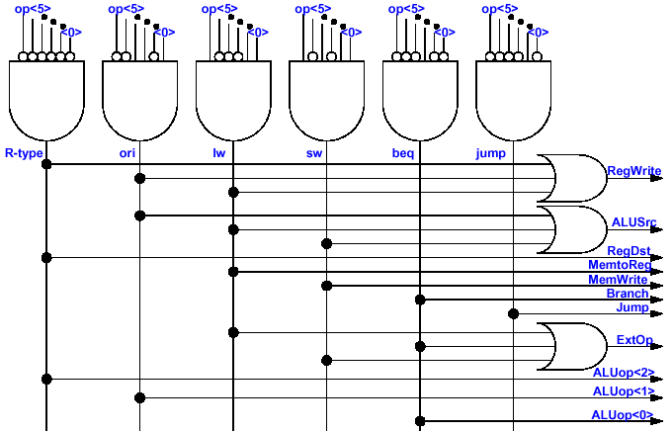
Step 5: Assemble the Control Logic (Summary) Implementation of the Entire Main Control

Slide 25
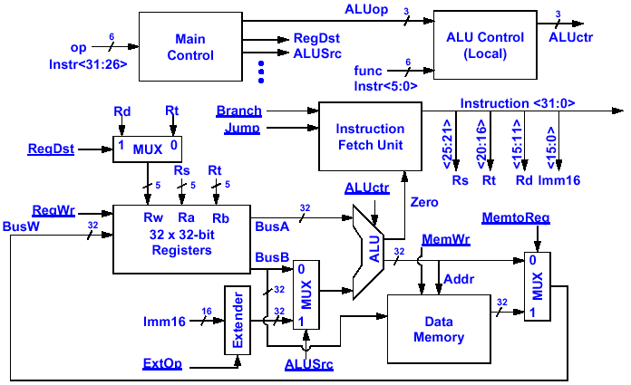
Putting It All Together: A Single Cycle Processor
clock
clock
clock

Slide 26
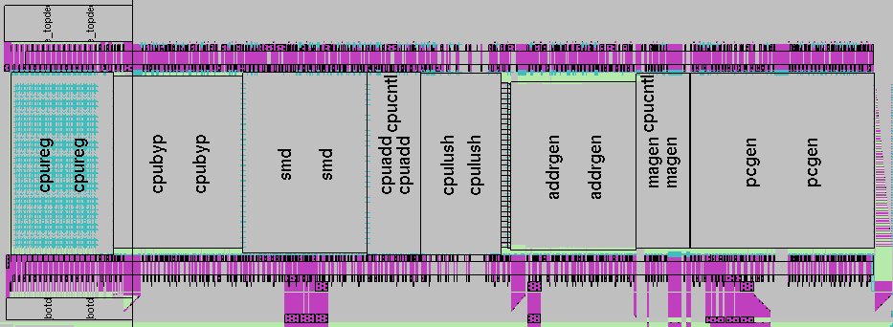
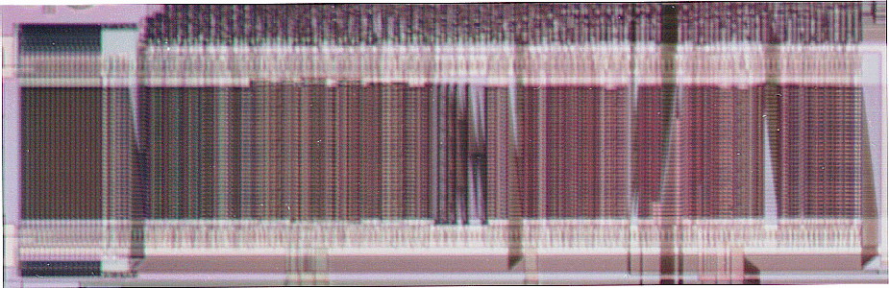
A Real MIPS Data Path

Slide 27
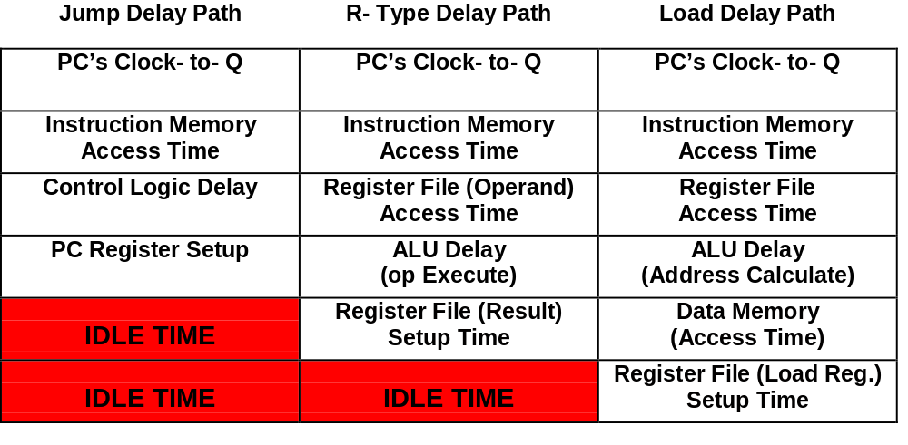
Single Cycle Processor
Delay Path Comparisons for Three Instruction Types
Clock
(T₁)
1 Clock Cycle
Clock
(T₂)

Slide 28
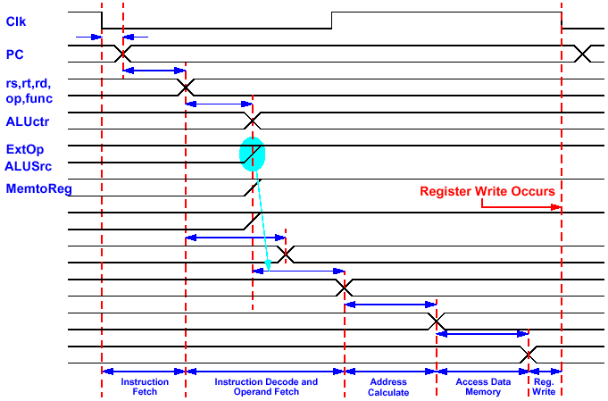
Worst Case Timing: Load Instruction
Clk to-Q
Old Value
New Value
Instruction Memory Access Time
Old Value
New Value
Delay Through Control Logic
Old Value
New Value
Old Value
New Value
Old Value
New Value
RegWr
busA
busB
Address
busW
Old Value
New Value
Register File Access Time
Old Value
New Value
Delay through Extender & Mux
Old Value
New Value
ALU Delay
Old Value
New Value
Data Memory Access & MUX Time
Old Value
New Value

Slide 29
Drawback of the Single Cycle Processor
Long Cycle Time:
  Cycle Time Must be Long Enough for the Load Instruction=
    + PC’s Clock- to- Q
    + Instruction Memory Access Time
    + Register File Access Time
    + ALU Delay (address calculation)
    + Data Memory Access Time
    + Register File Setup Time
Cycle Time is Much Longer than Needed for all Other Instructions

