Slide 1
Problem with Single Cycle Processor Design
The Root of the Single Cycle Processor’s Problem:
  The Cycle Time has to be Long Enough for the Slowest Instruction. Time is wasted in short instructions.
  This is a serious problem because short instructions occur much more often.
Solution:
  Break the Instruction into Smaller Steps
  Execute Each Step (Instead of the Entire Instruction) in One Cycle
    Cycle Time: Time it Takes to Execute the Longest Step
    Keep All the Steps to a Similar Length
Jump
R-Type
Load
Instr
Fetch
Instr decode
PC write
Instr
Fetch
Instr decode R read
ALU delay
Reg write
Instr
Fetch
Instr decode R read
ALU delay
Mem read
Reg write
Time wasted
Clock
Time wasted
Clock
Time wasted
Clock
Clock
Jump
R-Type
Load
Instr
Fetch
Instr decode
PC write
Instr
Fetch
Instr decode R read
ALU delay
Reg write
Instr
Fetch
Instr decode R read
ALU delay
Mem read
Reg write
Clocks

Slide 2
Advantages and Complications of
Multi Cycle Data Path
Advantages
  Cycle time is much faster
  Allows different instructions take different number of cycles to complete
    Load takes five cycles
    Jump only takes three cycles
  Allows a functional unit to be used more than once per instruction
Complications
  Need to add intermediate registers to hold data between steps
    To Make Sure Intermediate Values Are Captured Before Next Clock
  Need more complicate controller
  Need to add more multiplexors for sharing function units

Slide 3
Purpose of Intermediate Registers
Slow Clock
R1
R2
0
1
1
X
X
1
.
.
.
.
.
.
X
.
.
.
.
.
.
1
0
X
0
X
1
X
1
1
X
Clk
Fast Clock
R1
R2
X
X
X
.
.
.
.
.
.
X
.
.
.
.
.
.
1
0
X
0
X
1
X
1
1
X
Clk
Intermediate
Register
R1
R2
0
1
1
1
X
X
.
.
.
.
.
.
X
.
.
.
.
.
.
1
1
0
X
0
X
1
X
1
1
X
Clk

Slide 4
But Where to Put the Intermediate Registers?
To Start With, Add the Intermediate Registers at the End of Each Step in the Instruction Execution Sequence
Instruction Fetch
Decode/Operand Fetch
Possible places to put intermediate registers
Execute
Access Memory
Store Results
Next Instruction
Warning: Make Sure All Paths Between Intermediate Registers Have Similar Delays. Otherwise, the Overall Performance Can Be Worse Than Single Cycle Data Path!

Slide 5
Basic Idea of Multi Cycle Data Path
Control
R-type
4 cycles
Load
5 cycles
Jump
3 cycles
nPC_sel
PC_Wr
Op Code
ALUctr
MemtoReg
IR_Wr
ALUSrc
MemWr
RegDst
ExtOp
RegWr
Store Result
A
R
mux
Instruction
Fetch
Operand
Fetch
Exec
Next PC
IR
PC
B
Memory
Access
M

Slide 6

Reuse of Function Units in Multi Cycle Data Path
Since intermediate results are stored in intermediate registers, function units can be doing different things at different time
Examples:
  Memory can be used to store both instructions and data
  ALU can be used to do arithmetic and calculate branch address
    Price to pay: extra registers (IR, ALUout) and multiplexors
Instr Reg
Load Instruction:
Additional logic
PC
Mem
Mem Data Reg
Instruction Fetch
mux
Calculate Address
ALU
mux
Read Memory Data
Data
address
PC
Next address calculation
Both
Reg A
PC
PC
Arithmetic
Additional Logic
4
Reg A
4
mux
Reg file or mem
Reg File
Shift 2
ALUout
Shift 2 bits
for branch
Reg B
Reg B
mux
Instr
IR
Need to hold the output so ALU can be reused
Instruction (15:0)
(15:0)
Single Cycle Data Path
Multi Cycle Data Path

Slide 7
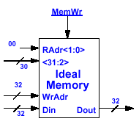
Dual- Port Ideal Memory
Dual Port Ideal Memory
  Independent Read (RAdr, Dout) and Write (WAdr, Din) Ports
  Read and Write (to Different Location) Can Occur at the Same Cycle
Read Port is a Combinational Path:
  Read Address Valid →
  Memory Read Access Delay →
  Data Out Valid
Write Port is Falling Edge Triggered
  MemWrite = 1
  Data In is Written Into Location[ WrAdr] at the Falling Clock Edge

Slide 8
General Steps to Design Multi Cycle Datapath
Step 1: Start with a single cycle data path that is capable to perform all execution steps
Step 2: Insert registers after each step in the instruction execution sequence. Make sure the delays in all steps are balanced.
Step 3: Combine components if possible and add multiplexors
Step 4: Work out clock by clock control signal sequence
Note: Make sure IR is not changed before end of instruction
See Example Questions 1 and 2

Slide 9
Step 1: Start with a Single Cycle Data Path Example: A Single Cycle Data Path for add and lw
PC+4
PC
Next Address Logic
10 ns
20 ns
Instruction Memory
20 ns
rs
Rd add1
R[rs]
Data Memory
rt
Rd add2
ALU
0
Reg File
rd
mux
Wr add
R[rt]
imm16
1
Wr data
0
5 ns
mux
Read = 50 ns
Write = 50 ns
50 ns
Read = 30 ns
Write = 30 ns
1
ext
5 ns
20 ns
0
mux
1
Critical Delay Path for add = 120 ns
5 ns
Critical Delay Path for lw = 170 ns
Assume all control signals arrive before data:
Delay for add: 10 + 50 + 30 + 5 + 20 + 5 = 120 ns
Delay for lw: 10 + 50 + 30 + 5 + 20 + 50 + 5 = 170 ns
Clock Cycle of Data Path = 170 ns
Execution Time for add = 1 clock × 170 ns/clock = 170 ns
Execution Time for lw = 1 clock × 170 ns/clock = 170 ns

Slide 10
Step 2: Insert Intermediate Registers
Example: Insert Registers Without Considering Delays
PC+4
PC
Next Address Logic
10 ns
20 ns
Instruction Memory
20 ns
rs
Rd add1
A
R[rs]
Data Memory
rt
Rd add2
ALU
0
Reg File
10 ns
ALU Out Reg
Mem Data Reg
Instr Reg
mux
Wr add
rd
B
R[rt]
imm16
1
Wr data
0
5 ns
mux
10 ns
Read = 50 ns
Write = 50 ns
50 ns
Read = 30 ns
Write = 30 ns
10 ns
1
10 ns
10 ns
ext
5 ns
20 ns
0
mux
1
5 ns
For add: PC → Instr Mem out = 10 + 50 = 60 ns
Instr Reg → B reg = 10 + 30 = 40 ns (mux not in critical path since not writing yet)
B reg → ALU output = 10 + 5 + 20 = 35 ns
ALUOut Reg → Reg File Written = 10 + 5 + 30 = 45 ns (IR can’t be updated till Reg File is written)
For lw: PC → Instr Mem out = 10 + 50 = 60 ns
Instr Reg → B reg = 10 + 5 + 30 = 45 ns
B Reg → ALU output = 10 + 5 + 20 = 35 ns
ALU Out Reg → Memory output = 10 + 50 = 60 ns
Mem Data Reg → Reg File Written = 10 + 5 + 30 = 45 ns (IR can’t be updated till Reg File is written)
Clock cycle = longest stage = 60 ns
Execution time for add = 4 clocks x 60 ns/clock = 240 ns PC updated during last instruct execution
Execution time for lw = 5 clocks x 60 ns/clock = 300 ns PC updated during last instruct execution

Slide 11
Step 2: Insert Intermediate Registers
A More Balanced Multi-Cycle Data Path
PC+4
PC
Next Address Logic
10 ns
20 ns
Instruction Memory
20 ns
rs
Rd add1
R[rs]
Data Memory
rt
Rd add2
ALU
0
Reg File
ALU Out Reg
Mem Data Reg
Instr Reg
mux
Wr add
rd
R[rt]
imm16
1
Wr data
0
5 ns
mux
10 ns
Read = 50 ns
Write = 50 ns
50 ns
Read = 30 ns
Write = 30 ns
1
10 ns
10 ns
ext
5 ns
20 ns
0
mux
1
5 ns
For add: PC → Instr Mem out = 10 + 50 = 60 ns
Instr Reg → ALU output = 10 + 30 + 5 + 20 = 65 ns
ALUOut Reg → Reg File Written = 10 + 5 + 30 = 45 ns (IR can’t be updated till Reg File is written)
For lw: PC → Instr Mem out = 10 + 50 = 60 ns
Instr Reg → ALU output = 10 + 30 + 5 + 20 = 45 ns
ALU Out Reg → Memory output = 10 + 50 = 60 ns
Mem Data Reg → Reg File Written = 10 + 5 + 30 = 45 ns (IR can’t be updated till Reg File is written)
Clock cycle = longest stage = 65 ns
Execution time for add = 3 clocks x 65 ns/clock = 195 ns PC updated during last instruct execution
Execution time for lw = 4 clocks x 65 ns/clock = 260 ns PC updated during last instruct execution
Note: The add instruction is faster than the single cycle data path but lw is slower

Slide 12
Step 2: Insert Intermediate Registers
Effect of Register Locations
PC+4
PC
Next Address Logic
10 ns
20 ns
Instruction Memory
20 ns
rs
Rd add1
R[rs]
Data Memory
rt
Rd add2
ALU
ALU Out Reg
Mem Data Reg
0
Reg File
Instr Reg
mux
Wr add
rd
R[rt]
imm16
1
Wr data
0
5 ns
mux
10 ns
Read = 50 ns
Write = 50 ns
50 ns
Read = 30 ns
Write = 30 ns
1
10 ns
10 ns
ext
5 ns
20 ns
0
mux
1
5 ns
For add: PC → Instr Mem out = 10 + 50 = 60 ns
Instr Reg → Reg File Written = 10 + 30 + 5 + 20 + 5 + 30 = 100 ns
For lw: PC → Instr Mem out = 10 + 50 = 60 ns
Instr Reg → ALU output = 10 + 30 + 5 + 20 = 45 ns
ALU Out Reg → Memory output = 10 + 50 = 60 ns
Mem Data Reg → Reg File Written = 10 + 5 + 30 = 45 ns
Clock cycle = longest stage = 100 ns
Execution time for add = 2 clocks x 100 ns/clock = 200 ns PC updated during last instruct execution
Execution time for lw = 4 clocks x 100 ns/clock = 400 ns PC updated during last instruct execution
Note: The add instruction is faster than last design but lw is much slower

Slide 13
Observation
For single cycle data path
  Execution Time for add = 1 clock × 170 ns/clock = 170 ns
  Execution Time for lw = 1 clock × 170 ns/clock = 170 ns
For multi-cycle data path
Case 1: 4 levels of intermediate registers
  Execution time for add = 4 clocks x 60 ns/clock = 240 ns
  Execution time for lw = 5 clocks x 60 ns/clock = 300 ns
Case 2: 3 levels of intermediate registers
  Execution time for add = 3 clocks x 65 ns/clock = 195 ns
  Execution time for lw = 4 clocks x 65 ns/clock = 260 ns
Case 3: 3 levels of intermediate registers, new location for ALUout Reg
  Execution time for add = 2 clocks x 100 ns/clock = 200 ns
  Execution time for lw = 4 clocks x 100 ns/clock = 400 ns
Observations:
1. All multi-cycle data paths are slower than the single cycle data path!
Reason: The lw path length is not much longer than the path length for add. In order for a multi-cycle data to have significant performance over single cycle data path, the path length of long instructions has to be much longer than short instructions. (In fact, if all instructions have the same path length, the multi-cycle data path is always worse than a single cycle data path.)
Case 2 has the best performance among the multi-cycle data path.
Reason: it has the most balanced data path among the multi-cycle data path.

Slide 14
Step 3: Combining Components
PC+4
PC
Next Address Logic
Instruction Memory
rs
Rd add1
A
R[rs]
Data Memory
rt
Rd add2
ALU
0
Reg File
ALU Out Reg
Mem Data Reg
Instr Reg
mux
Wr add
rd
B
R[rt]
imm16
1
Wr data
0
mux
1
ext
0
mux
1

Slide 15
Step 3: Combining Components
PC+4
PC
Next Address Logic
mux
Instruction Memory
Instruction and data Memory
rs
Rd add1
A
R[rs]
rt
Rd add2
ALU
0
Reg File
ALU Out Reg
Instr Reg
mux
Wr add
rd
B
R[rt]
imm16
1
Wr data
0
mux
1
ext
0
mux
1
Mem Data Reg

Slide 16
Describing Multi-Cycel Data Path with
Multi Cycle RTL
Group all RTL statements by clock
All register transfers in the same clock occur simultaneously
Example: Multi Cycle RTL for the add Instruction
Execution Sequence Clock RTL
Instruction Fetch: 1 IR ← Mem[PC]
PC ← PC + 4
Operand Fetch: 2 rs ← IR<25:21>
rt ← IR<20:16>
rd ← IR<15:11>
RA ← R[rs]
RB ← R[rt]
Execute: 3 ALUOUT ← RA + RB
Store Result: 4 R[rd] ← ALUOUT
Compare to Single Cycle RTL for the add Instruction
instr ← mem[PC]
rs ← instr<25:21>
rt ← instr<20:16>
rd ← instr<15:11>
R[rd] ← R[rs] + R[rt]
PC ← PC + 4

Slide 17
Operation Details of Multi Cycle Data Path
Will Look at the Details of Each Step in the Instruction Execution Sequence:
Step 1: Instruction Fetch
Step 2: Instruction Decode and Register Fetch
Step 3: Execution, Memory Address Computation, or
Branch Completion
Step 4: R-Type Completion or Memory Access for
Load/Store Instructions
Step 5: Memory Read and Load Completion

Slide 18

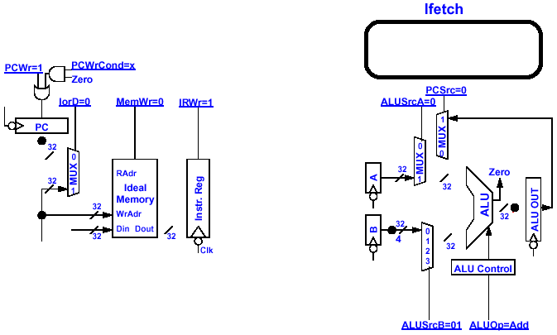
Instruction Fetch Step
Cycle Begins Right AFTER the Clock Tick
  Instr Reg ← mem[PC]; PC<31: 0> + 4
Cycle Ends AT the Next Clock Tick
  IR←mem[PC]; PC<31: 0> ← PC<31: 0> + 4
One Clock Cycle
ALUOp= Add, ALUSrcB= 01
x: PCWrCond, RegDst, MemtoReg,
ExtOp
1: PCWr, IRWr; Others: 0
PC+12
PC+4
PC+8
PC+8
PC+4

Slide 19
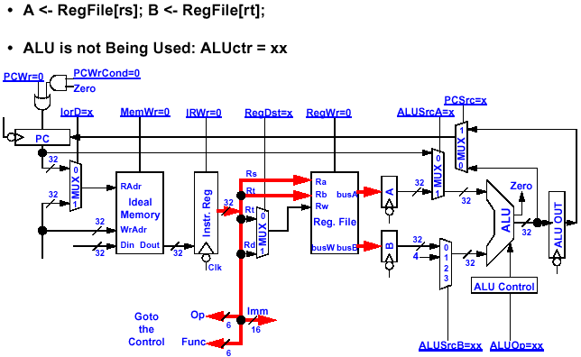

Minimal Functionality Required for
Instruction Decode and Register Fetch Step
Idle

Slide 20
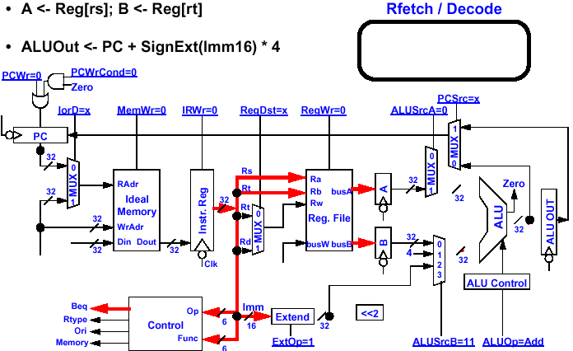
Decoding of Branch-if-Equal (beq) Instruction: Simultaneously Preparing for Branch Address
ALUOp= Add, ALUSrcB= 11
1: ExtOp
x: RegDst, PCSrc, IorD, MemtoReg
Others: 0
Use the idle components to do something useful: branch address calculation
Motivation: To take advantage of the idle components while decoding instruction to save one more cycle if the instruction happens to be a branch

Slide 21
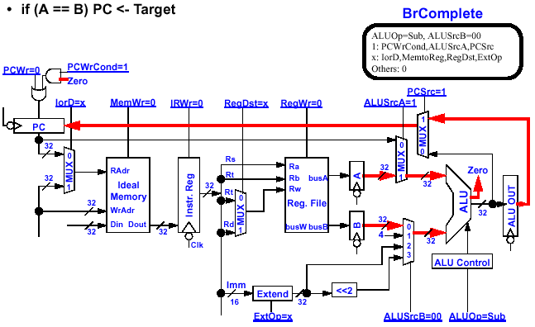
If Branch Actually Occurs in Execution Step
Registers holding operand when execution step begins
Holding branch address computed during instruction decode

Slide 22
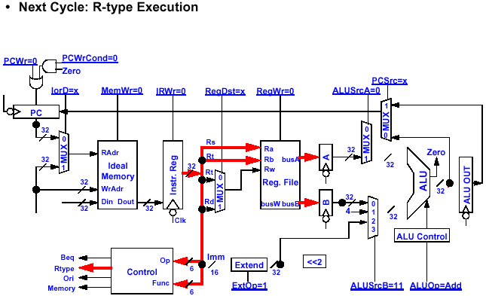
R-Type Instruction Decode Step
Branch address preparation as discussed before (result may not be used but it is harmless if ALUout is not written to other state elements)

Slide 23
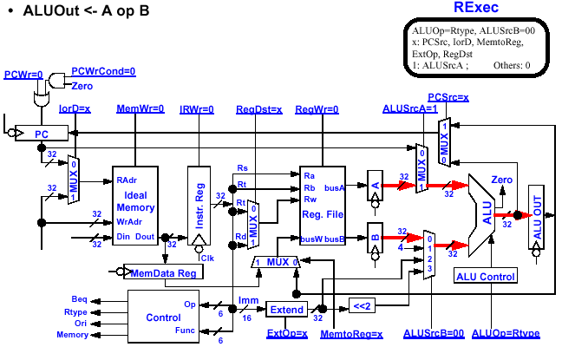
R-Type Execution Step

Slide 24
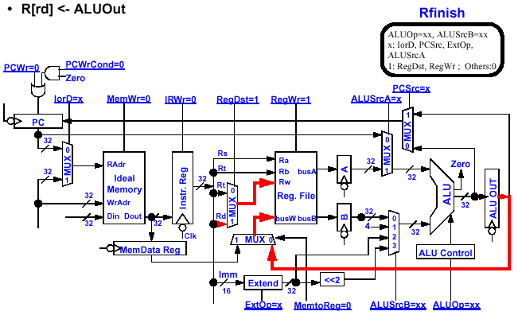
R- Type Completion Step
instruction is not a branch, pre-calculated branch address is overwritten by the add instruction

Slide 25
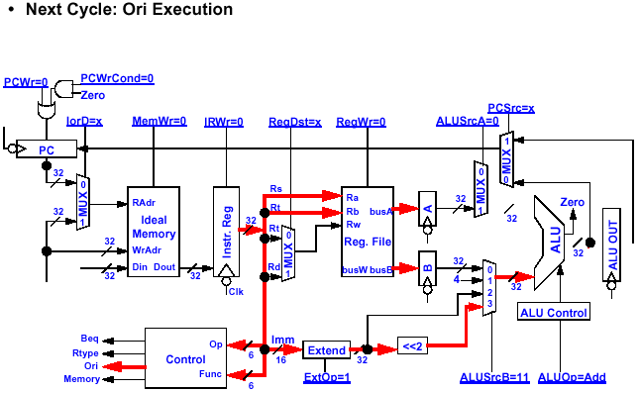
I-Type Instruction Decode Step (Ori)

Slide 26
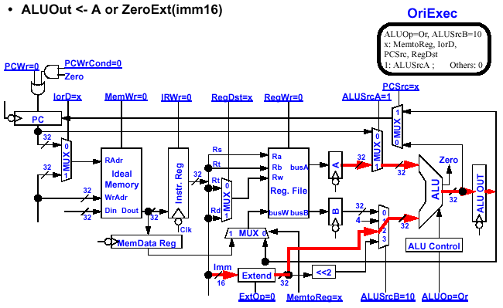
I-Type (Ori) Execution Step

Slide 27
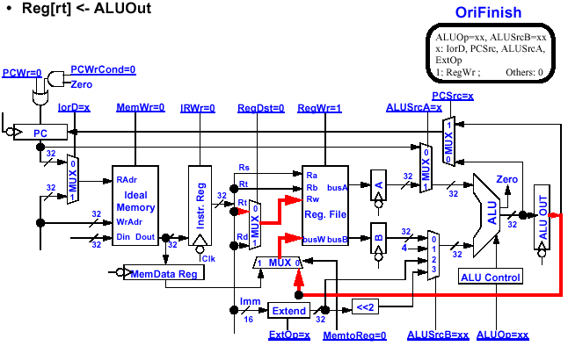
I-Type Completion Step

Slide 28
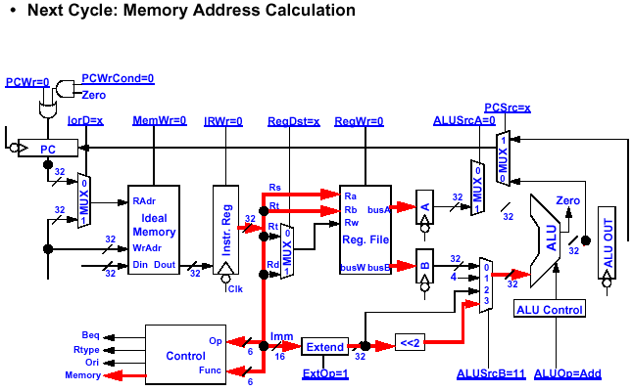
Store Instruction Decode Step

Slide 29
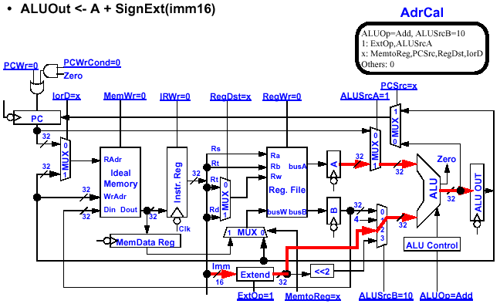
Store Instruction Execution Step
(Memory Address Calculation)

Slide 30
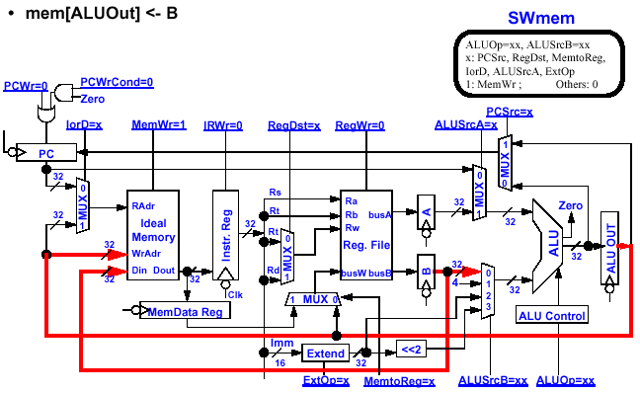
Store Instruction Completion Steps

Slide 31
Load Instruction Decode Step

Slide 32
Load Instruction Execution Step
(Memory Address Calculation)

Slide 33
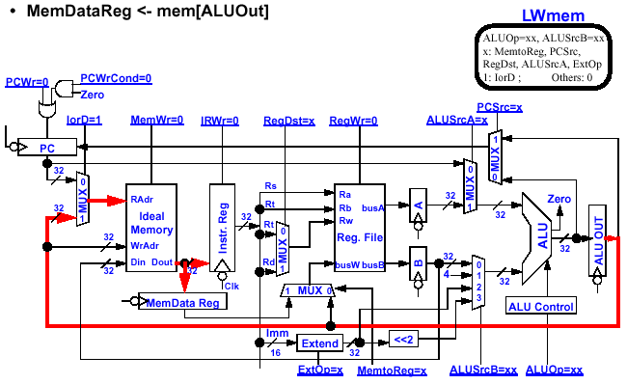
Load Instruction Execution Step
(Memory Access)

Slide 34
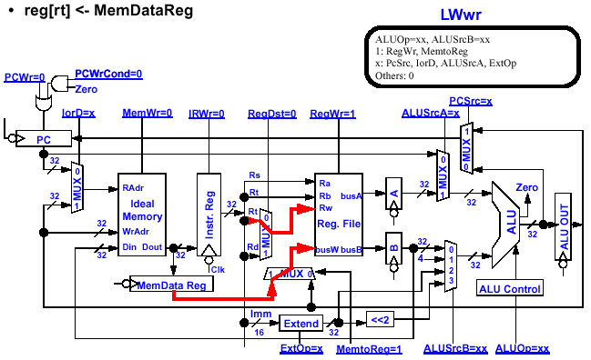
Load Instruction Completion Steps

Slide 35
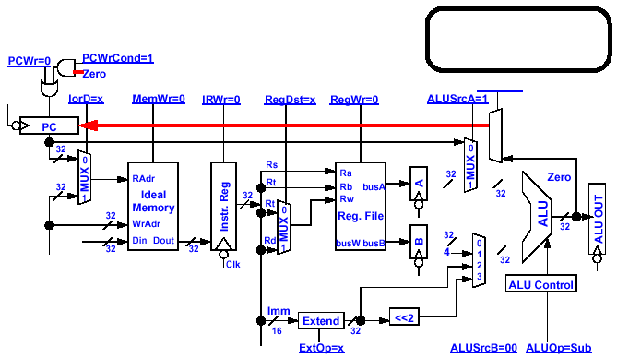

Jump Instruction Decode and Complete Steps
• PC_ incr ← PC + 4
PC<31: 2> ← PC_ incr<31: 28> concat target<25: 0>
JComplete
1: PCWrite
PCsrc = 10
x: others
PCwr = 1
PCWr=1
PCsrc=2
PCsrc = 2
2
1
0
J
PC<31:28>
Instr<25:0>
4
26

Slide 36
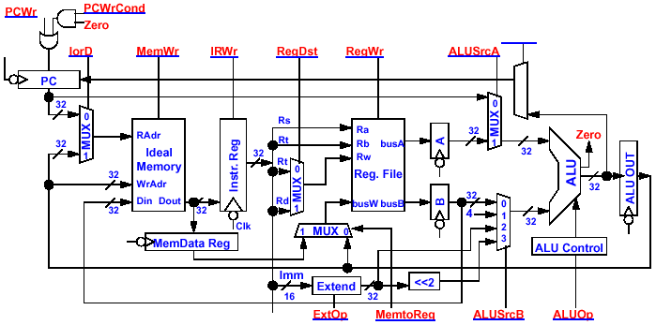
Putting it all Together: Multiple Cycle Datapath
PCsrc
2
1
0
MUX

Slide 37
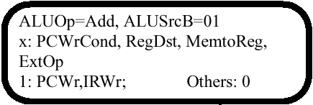



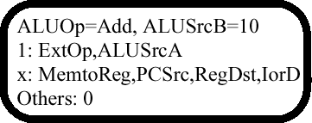
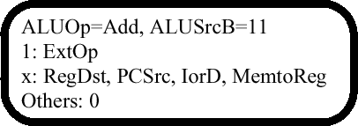
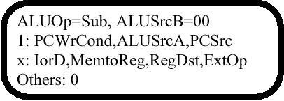


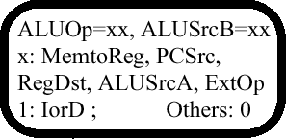
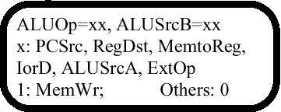
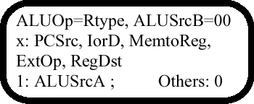
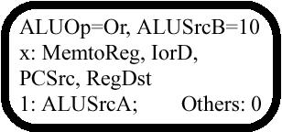

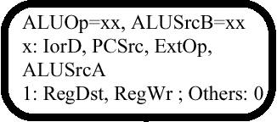
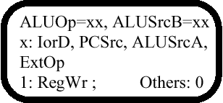
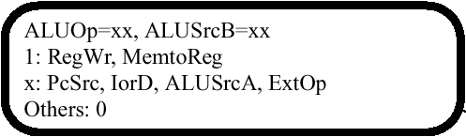
Multiple Cycle Datapath Control Diagram
JComplete
1: PCWrite
PCsrc = 10
x: others
J

Slide 38
Register File & Memory Write Timing: Ideal vs. Reality
Our Ideal Register File and Memory are Simplified
  Write Happens at the Falling Clock Edge
  Address, Data, and Write Enable Must be Stable One “Set- up” Time Before the Falling Clock Edge
In Real Life:
  Neither Register File nor Ideal Memory Has Clock Edge Triggered Writes
  The Write Path is a Combinational Logic Delay Path:
    Write Enable Goes to 1 and Din Settles Down
    Memory Write Access Delay
    Din is Written Into mem[ address]
  Important: Address and Data must be Stable one “Set- up” Time BEFORE Write Enable Goes High (1)
Ideal
Memory
WrEn
32
Adr
32
Din
Dout
32
Real
Memory
WrEn
32
Adr
32
Din
Dout
32

Slide 39
Race Condition Between Address and Write Enable
This “Real” (no clock input) Register File may not Work Reliably in our Design Because:
  We cannot Guarantee Rw will be Stable one “Set- up” Time BEFORE RegWr= 1
  There is a “race” between Rw (address) and RegWr (write enable)
The “Real” (no clock input) Memory may not Work Reliably in our Design Because:
  We cannot Guarantee Address will be Stable one “Set- up” Time BEFORE WrEn = 1
  There is a race between Addr and WrEn
Reg File
Ra
RegWr
5
Ra
busA
5
32
5
Rw
busW
busB
32
32
Memory
WrEn
32
Adr
32
Din
Dout
32

Slide 40
How to Avoid this Race Condition?
A Possible Solution:
  Have A Register Attached Directly to the Address and Data Inputs
  Store Address and Data info at the End of Cycle N
  Assert Write Enable Signal with Combinational Logic Delay into Cycle (N+ 1) where:
      Delay into Cycle N+1 ≥ clock- to- Q + setup
Disadvantage:
  Extra Register Delay
  Extra Logic Circuit
Delay
WrEn
Memory
Addr reg
WrEn
32
Adr
Clock
Data reg
32
Din
Dout
32

