Slide 1
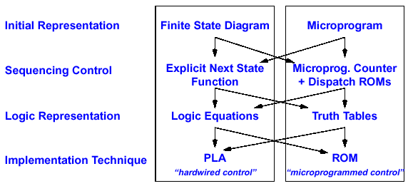
Overview of Control Hardware Development
Control may be designed using one of several initial representations. The choice of sequence control, and how logic is represented, can then be determined independently; the control can then be implemented with one of several methods using a structured logic technique.

Slide 2
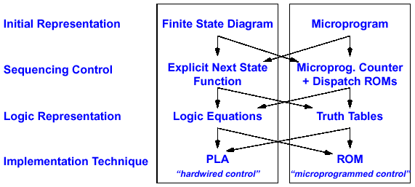
Hardwired Control Approach
Simple to Implement
See class example for drawing a finite state diagram for the multi-cycle add data path

Slide 3
Example of State Transition and Control Signals
Simple Multi-Cycle Data Path of add Instruction
State # 0
(Instr Fetch)
PC+4
PCwr = 1, IRwr = 1
RegWr = 0,
ALUctr = X
Next Address Logic
PC
Clk
Control Unit
Instruction Memory
State # 1
(Decode/Operand Fetch)
Opcode
PCWr
IRWr
RegWr
ALUctr
1
1
0
X
0
0
1
add
0
0
0
X
PCwr = 0, IRwr = 0 RegWr = 0,
ALUctr = X
rs
Register
File
A
Rd addr1
rt
Instr Reg
Rd addr2
Clk
ALU
rd
Wr addr
B
Wr data
State # 2
(Exec & Write Back)
Clk
Clk
PCwr = 0, IRwr = 0
RegWr = 1,
ALUctr = add
See class example for designing the simple state machine for the multi-cycle add data path

Slide 4
A Slightly More Complicate Example: Add & Lw
State diagram
#0
Instruction Fetch
#1
Decode/Operand Fetch
add
#2
lw
#3
Address Calculation
Add Exec
PC+4
PC
Next Address Logic
#4
Mem Read & Write Back
0
1
0
0
0
1
0
Control Unit
PCWr
IRWr
RegDst
RegWr
ExtOP
ALUSrc
ALUctr
MemtoReg
0
X
0
X
X
X
X
1
0
X
1
0
1
X
X
X
0
X
+
X
0
0
1
X
1
+
0
0
1
0
X
1
+
1
1
X
0
X
X
X
0
0
X
0
X
X
X
X
add
X
lw
lw
Instruction Memory
Op Code
rs
Rd add1
A
Data Memory
rt
Rd add2
ALU
Instr Reg
Reg File
0
ALU Out Reg
rd
mux
Wr add
0
imm16
1
Wr data
B
mux
ext
1
0
mux
1

Slide 5
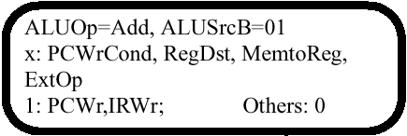



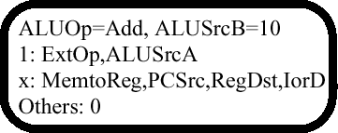
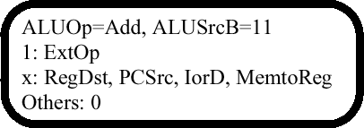
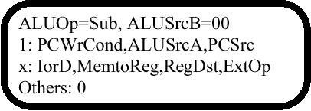


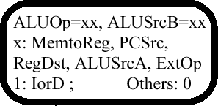
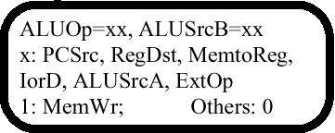
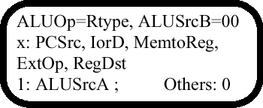
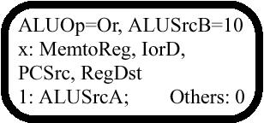

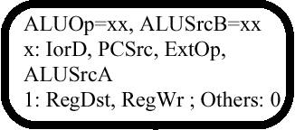
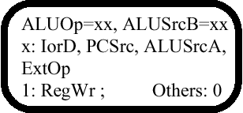
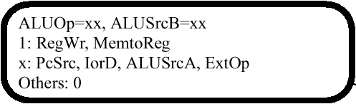
Initial Representation: Finite State Diagram
0
JComplete
9
1: PCWrite
PCsrc = 10
x: others
J
2
1
8
3
5
6
10
11
7
4

Slide 6
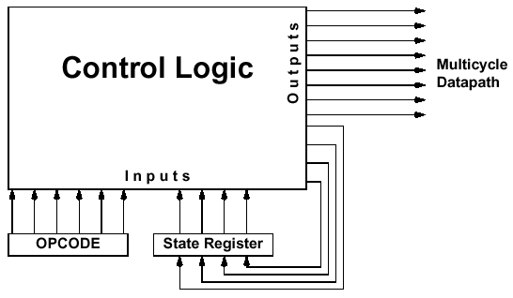
Sequencing Control: Explicit Next State Function
Control Signals
State N+1
State N+3
Opcode 1
State N+1
State N+2
State N
State N+2
See class examples for a simpler data path and control unit
Current state number
Next state number
Each output line is a logical sum (i.e., OR) of minterms (i.e., AND) of the input lines. Example:
NS3 = OP5·OP4·OP3·OP2·OP1·OP0·S3·S2·S1·S0 + OP5·OP4·OP3·OP2·OP1·OP0·S3·S2·S1·S0 +
OP5·OP4·OP3·OP2·OP1·OP0·S3·S2·S1·S0 + S3·S2·S1·S0

Slide 7
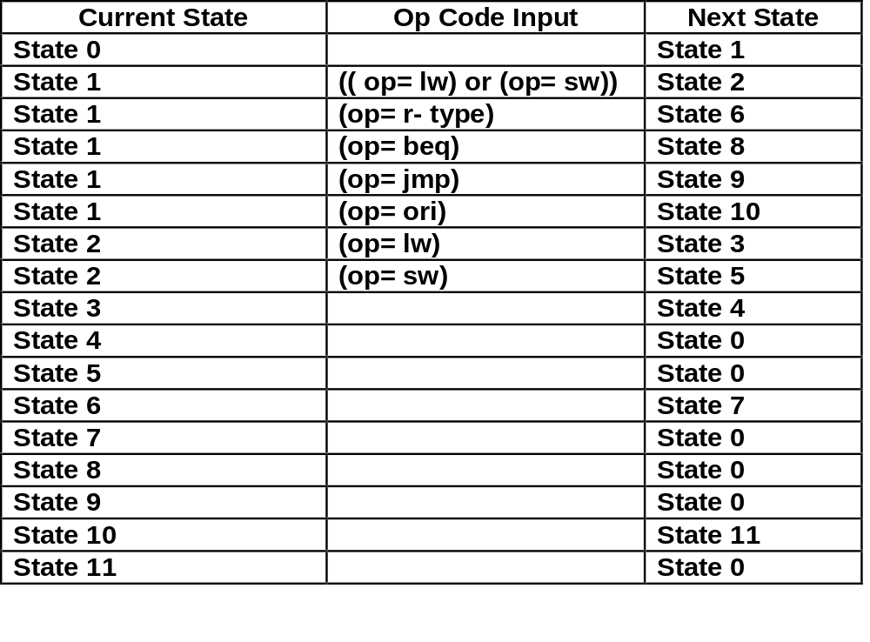
Logic Representation: State Transition Table
For Next State Output
Translating the State Diagram into State Transition Table
See class example 2 for translating finite state diagram to state transition table

Slide 8
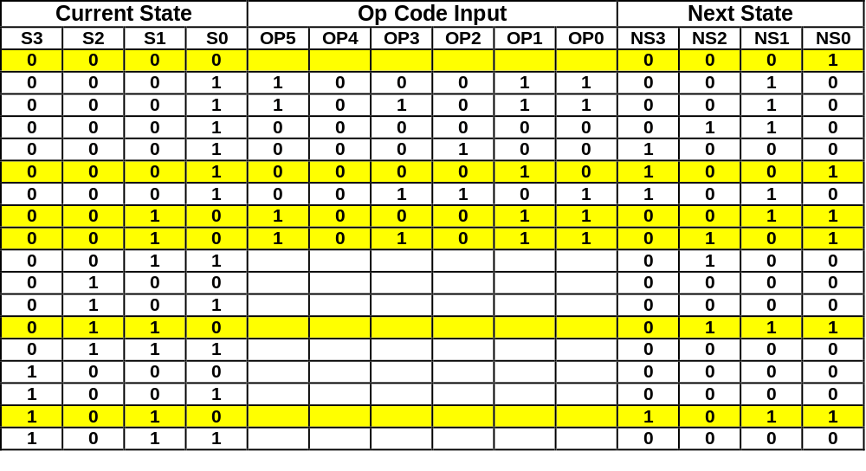
Logic Representation: Truth Table
For Next State Output
Translating the State Transition Table into Truth Table
See logic equation below
Truth Table can be Translated into Logic Equations. Example:
NS0 = S3·S2·S1·S0 + S3·S2·S1·S0·OP5·OP4·OP3·OP2·OP1·OP0 +
S3·S2·S1·S0·OP5·OP4·OP2·OP1·OP0 + S3·S2·S1·S0 +
+ S3·S2·S1·S0

Slide 9
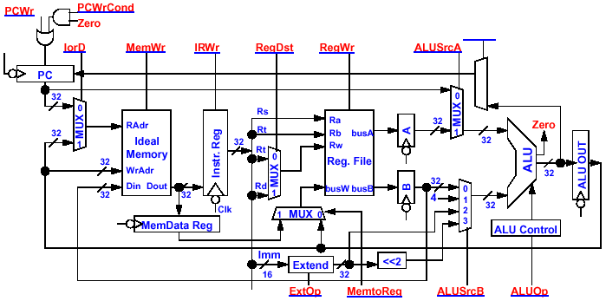
What About the Control Signals?
PCsrc
2
1
0
MUX

Slide 10
Control Signals and States
0
JComplete
9
1: PCWrite
PCsrc = 10
x: others
J
2
1
8
3
5
6
10
11
7
4

Slide 11
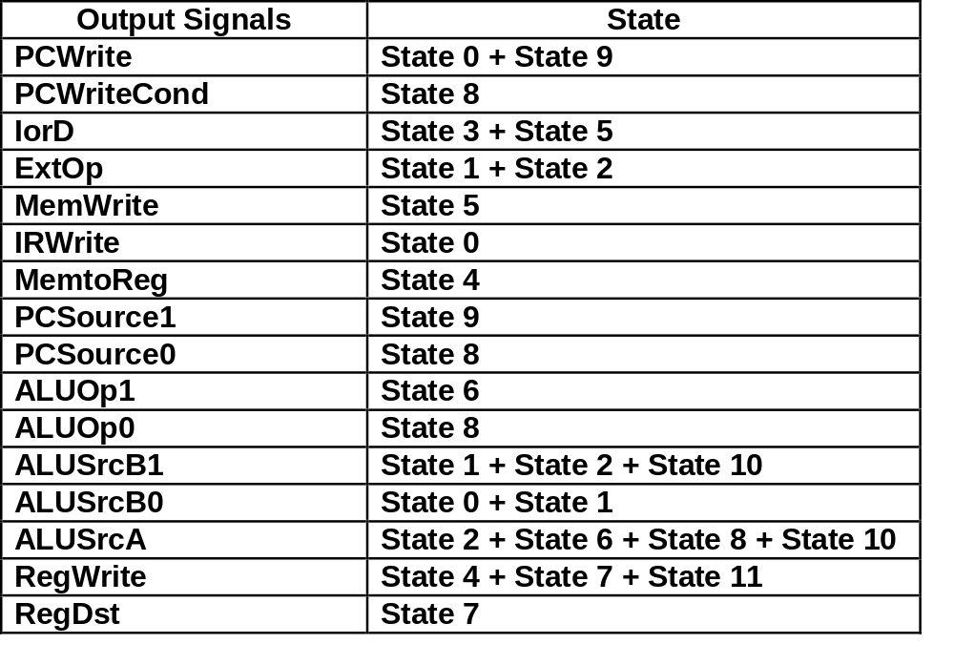
Logic Representation: Logic Equations
For Control Signal Output
Translating the State Diagram into Control Output Table
See class example 2 for translating finite state diagram to control output table

Slide 12
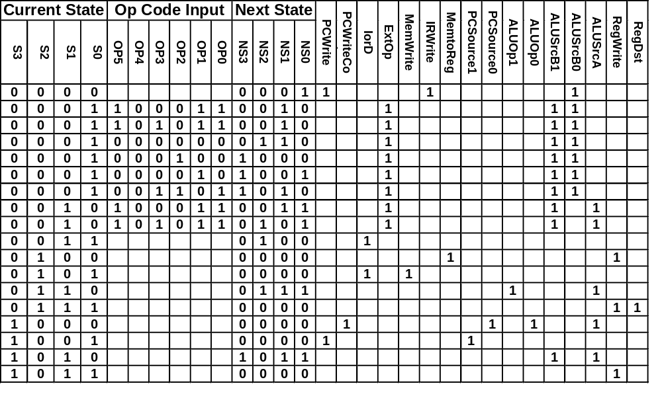
Logic Representation: Logic Equations
For Control Signal Output
For clarity, zeros are not shown in these columns
See the simpler state machine in class example 2

Slide 13
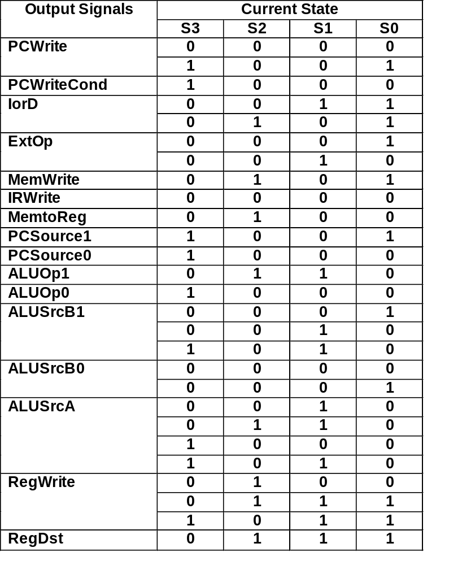
Logic Representation: Logic Equations
For Control Signal Output
Truth Table of Output Signals:
RegWrite = !S3 & S2 & !S1 & !S0 + !S3 & S2 & S1 & S0 + S3 & !S2 & S1 & S0

Slide 14
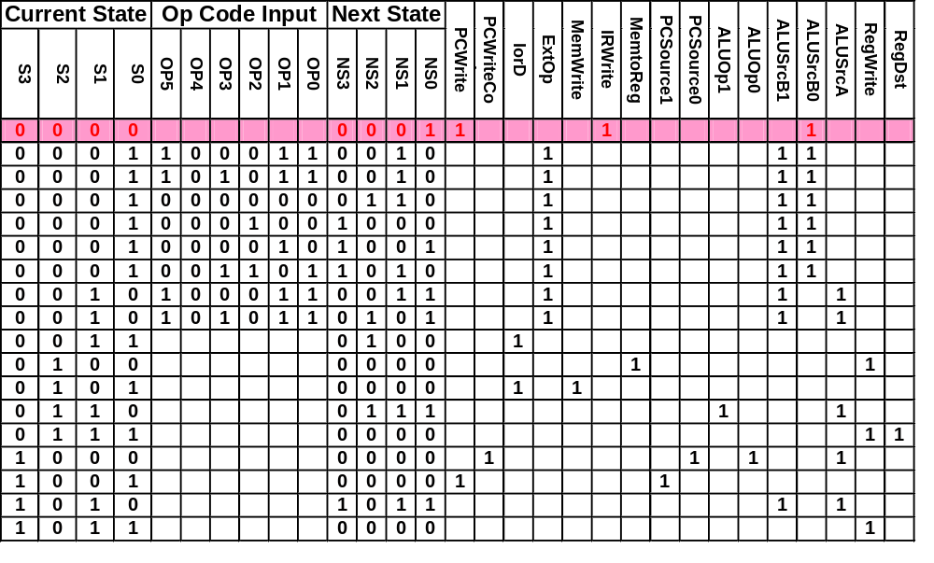
Example of Control Sequence: R-Type
0
0
0
0
0
0
0
1
0
0
0
0
0
0
1
0
0
0
0
1
0
0
0
0
0
0
1
0
0
0

Slide 15
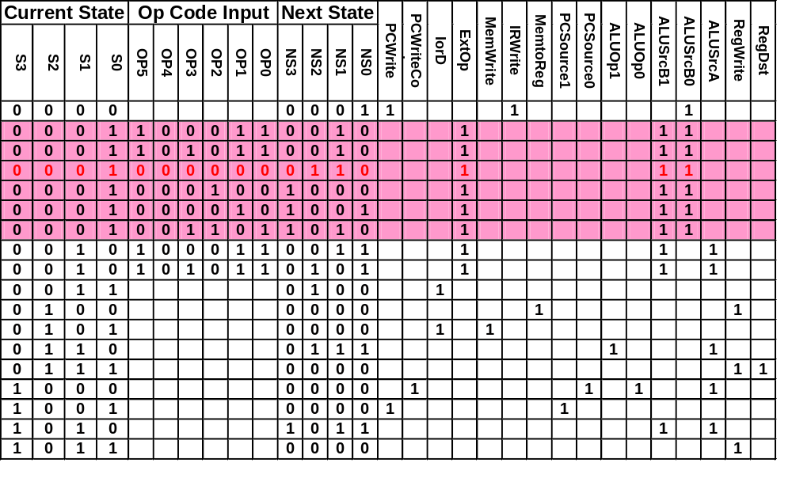
Example of Control Sequence: R-Type
0
0
0
1
0
1
1
0
0
0
0
0
0
0
0
0
0
1
0
0
0
0
0
0
0
1
1
0
0
0

Slide 16
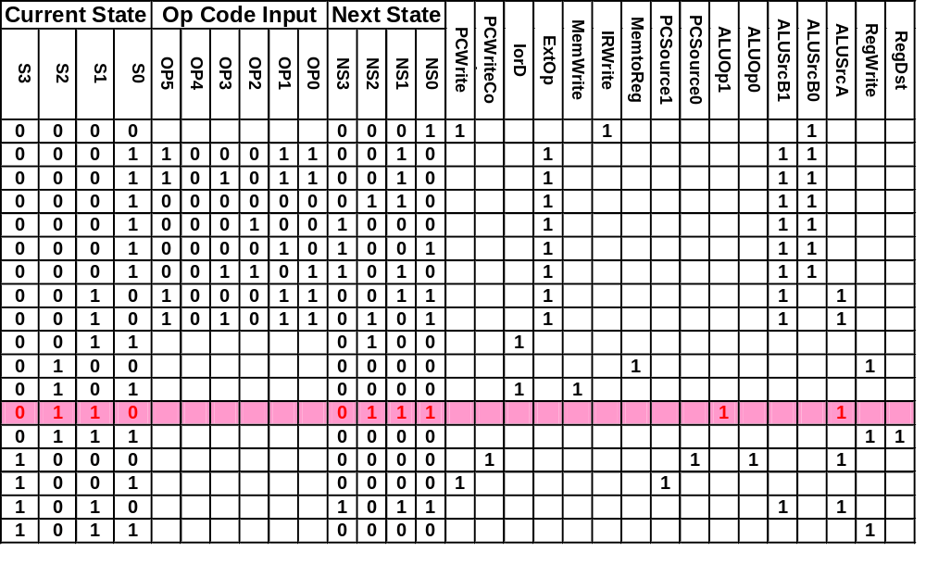
Example of Control Sequence: R-Type
0
1
1
0
0
1
1
1
0
0
0
0
0
0
0
0
0
0
0
0
0
0
0
1
0
0
0
1
0
0

Slide 17
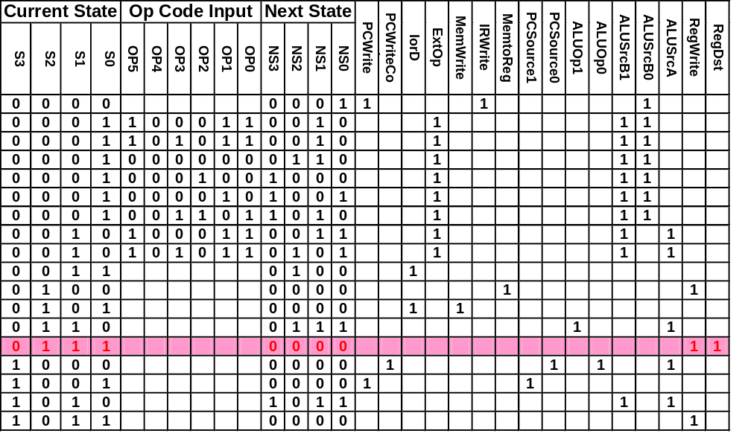
Example of Control Sequence: R-Type
0
1
1
1
0
0
0
0
0
0
0
0
0
0
0
0
0
0
0
0
0
0
0
0
0
0
0
0
1
1

Slide 18
Example of Control Sequence: R-Type
0
0
0
0
0
0
0
1
0
0
0
0
0
0
1
0
0
0
0
1
0
0
0
0
0
0
1
0
0
0

Slide 19
Implementation Technique:
Programmable Logic Array
AND Plane
OR Plane
X
1
1
0
0
States that have mutliple next-states need multiple minterms
NS0
NS1
NS2
NS3
IorD
ExtOp
IRWrite
RegDst
PCWrite
ALUOp1
ALUOp0
ALUSrcA
MemWrite
ALUSrcB1
RegWrite
MemtoReg
ALUSrcB0
PCSource1
OP5
OP4
OP3
OP2
OP1
OP0
S3
S2
S1
S0
PCWriteCond
PCSource0

Slide 20
Programmable Logic Array Circuit Design
AND Plane
OR Plane
Don’t
care
0
1
1
selected
on
off
0
off
Don’t
care
on
0
0
1
1
1
0

Slide 21
Summary of PLA Implemention of
Multi Cycle Data Path Control
Step 1: Develop the state diagram and assign a number to each state
Step 2: Translate the state diagram into state transition table, in which each entry is consisted of the current state number and transition conditions (op code) as inputs, and the next state number and control signal as outputs
Step 3: Translate the state transition table into truth table with all the bits shown explicitly
Step 4: Translate the truth table into PLA diagram. Use the following convention in this class
Step 5: Check the truth table and PLA diagram and make sure only one minterm is selected at any time (Note: some styles of PLA design allows multiple minterms selected, but it is more difficult because extreme care has to be used to make sure all output signals are correct in any state)
Truth table entry
1
0
X
1
0
PLA representation
Inputs (AND Plane)
Outputs (OR Plane)
Note: Step 1 is the most important. Many modern design tools have automated the other steps

Slide 22
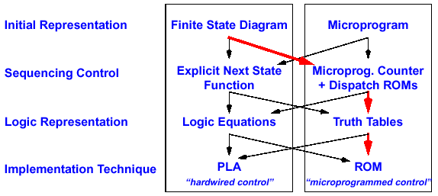
Using Sequencer for Next State
For complex control functions, it is more efficient to use a sequencer to supply the sequential next state because the it requires less number of bits than encoding the next state explicitly

Slide 23
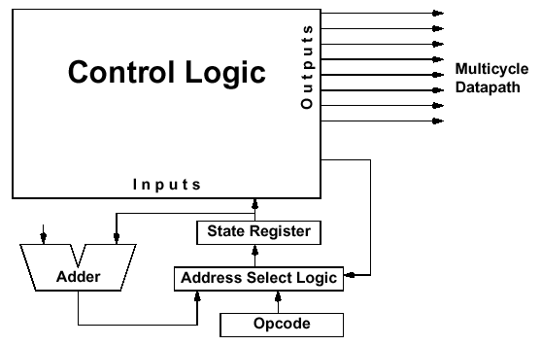
Sequencer-Based Control Unit
AddrCtl
For sequential state transitions, next state is automatically increased by the counter rather than explicitly supplied by the Next State output

Slide 24
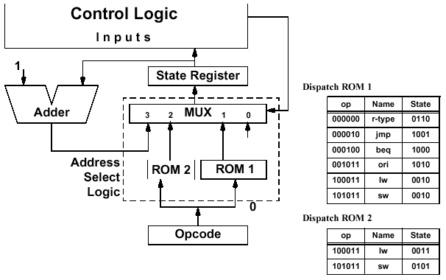
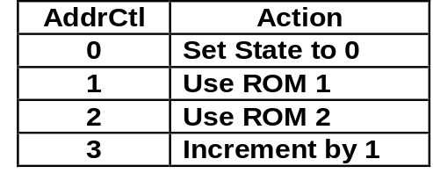
Logic for Non-Sequential State Transitions
AddrCtl
AddrCtl
Supplying an op code to the sequencer will force the finite state machine to the first state of the instruction

Slide 25
Implementing Control with a ROM
Since next-state address is supplied externally, a ROM can be used and needs only one word per state (“ Control word”).
  In comparison, in the Explicit Next State Function approach, State 1 has 6 control words and State 2 has 2 control words.
State Number (Control Word Address) | Output Signals (Control Word 18:2) | Address Control (Control Word 1:0)
0 | 10010100000001000 | 11
1 | 00000000010011000 | 01
2 | 00000000000010100 | 10
3 | 00110000000010100 | 11
4 | 00110000000010110 | 00
5 | 00101000000010100 | 00
6 | 00000000001000100 | 11
7 | 00000000001000111 | 00
8 | 01000000100100100 | 00
9 | 10000001000000000 | 00
10 | ... | 11
11 | ... | 00
These are the same control signals as in the explicit next state discussion

Slide 26
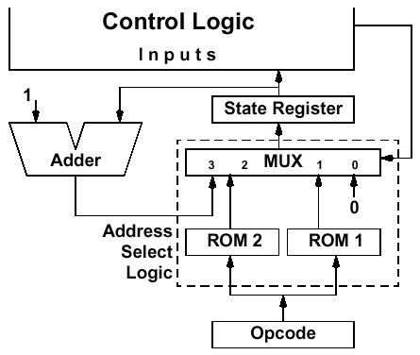
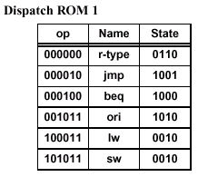
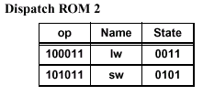
Example: Micro Sequencer Operations for Load
State No. | Control Word Bits 18 – 2 (page C-27) | Ctrl Word Bits 1-0
0 | 10010100000001000 | 11
1 | 00000000010011000 | 01
2 | 00000000000010100 | 10
3 | 00110000000010100 | 11
4 | 00110000000010110 | 00
5 | 00101000000010100 | 00
6 | 00000000001000100 | 11
7 | 00000000001000111 | 00
8 | 01000000100100100 | 00
9 | 10000001000000000 | 00
10 | ... | 11
11 | ... | 00
Bits 18 - 2
Bits 1-0
I Fetch
Decode
0
Adr Cal
Rd Mem
1
Wr Reg
11
100011

Slide 27
Example: Micro Sequencer Operations for Load
State No. | Control Word Bits 18 – 2 (page C-27) | Ctrl Word Bits 1-0
0 | 10010100000001000 | 11
1 | 00000000010011000 | 01
2 | 00000000000010100 | 10
3 | 00110000000010100 | 11
4 | 00110000000010110 | 00
5 | 00101000000010100 | 00
6 | 00000000001000100 | 11
7 | 00000000001000111 | 00
8 | 01000000100100100 | 00
9 | 10000001000000000 | 00
10 | ... | 11
11 | ... | 00
Bits 18 - 2
Bits 1-0
I Fetch
Decode
1
Adr Cal
Rd Mem
2
Wr Reg
01
0011
0010
100011
100011

Slide 28
Example: Micro Sequencer Operations for lw
State No. | Control Word Bits 18 – 2 (page C-27) | Ctrl Word Bits 1-0
0 | 10010100000001000 | 11
1 | 00000000010011000 | 01
2 | 00000000000010100 | 10
3 | 00110000000010100 | 11
4 | 00110000000010110 | 00
5 | 00101000000010100 | 00
6 | 00000000001000100 | 11
7 | 00000000001000111 | 00
8 | 01000000100100100 | 00
9 | 10000001000000000 | 00
10 | ... | 11
11 | ... | 00
Bits 18 - 2
Bits 1-0
I Fetch
Bits 1-0
Decode
2
Adr Cal
Rd Mem
3
Wr Reg
10
0011
0010
0011
0010
100011
100011

Slide 29
Example: Micro Sequencer Operations for lw
State No. | Control Word Bits 18 – 2 (page C-27) | Ctrl Word Bits 1-0
0 | 10010100000001000 | 11
1 | 00000000010011000 | 01
2 | 00000000000010100 | 10
3 | 00110000000010100 | 11
4 | 00110000000010110 | 00
5 | 00101000000010100 | 00
6 | 00000000001000100 | 11
7 | 00000000001000111 | 00
8 | 01000000100100100 | 00
9 | 10000001000000000 | 00
10 | ... | 11
11 | ... | 00
Bits 18 - 2
Bits 1-0
I Fetch
Bits 1-0
Bits 1-0
Decode
3
Adr Cal
Rd Mem
4
Wr Reg
11
100011

Slide 30
Example: Micro Sequencer Operations for lw
State No. | Control Word Bits 18 – 2 (page C-27) | Ctrl Word Bits 1-0
0 | 10010100000001000 | 11
1 | 00000000010011000 | 01
2 | 00000000000010100 | 10
3 | 00110000000010100 | 11
4 | 00110000000010110 | 00
5 | 00101000000010100 | 00
6 | 00000000001000100 | 11
7 | 00000000001000111 | 00
8 | 01000000100100100 | 00
9 | 10000001000000000 | 00
10 | ... | 11
11 | ... | 00
Bits 18 - 2
Bits 1-0
I Fetch
Bits 1-0
Bits 1-0
Bits 1-0
Decode
4
Adr Cal
Rd Mem
0
Wr Reg
00
100011

Slide 31
Example: Micro Sequencer Operations for lw
State No. | Control Word Bits 18 – 2 (page C-27) | Ctrl Word Bits 1-0
0 | 10010100000001000 | 11
1 | 00000000010011000 | 01
2 | 00000000000010100 | 10
3 | 00110000000010100 | 11
4 | 00110000000010110 | 00
5 | 00101000000010100 | 00
6 | 00000000001000100 | 11
7 | 00000000001000111 | 00
8 | 01000000100100100 | 00
9 | 10000001000000000 | 00
10 | ... | 11
11 | ... | 00
Bits 18 - 2
Bits 1-0
I Fetch
Bits 1-0
Decode
0
Adr Cal
Rd Mem
Wr Reg
11
100011

Slide 32
Microprogram Implementation
ROM can be Thought of as a Sequence of Control Words
Control Word can be Thought of as an Instruction: “Microinstruction”
Rather Than Program in Binary, Use Symbolic Language Which Can Be Translated Into Input and Output Signals by a Microcode Assembler
Microprogramming: A Particular Strategy for Implementing the Control Unit of a Processor by “Programming” at the Level of Register Transfer Operations
MicroArchitecture: Logical Structure and Functional Capabilities of the Hardware as Seen by the Microprogrammer

Slide 33
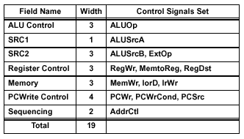
Designing a Microinstruction Set
Start with List of Control Signals
Group Signals Together That Make Sense: Called “Fields”
Places Fields In Some Logical Order (ALU operation & ALU Operands First and MicroInstruction Sequencing Last)
Create a Symbolic Legend for the Microinstruction Format, Showing Name of Field Values and How They Set the Control Signals. Example:
To Minimize the Width, Encode Operations that Will Never be Used at the Same Time
ALU Control
SRC1
SRC2
Reg Control
Memory
PC Write Control
Sequencing

Slide 34
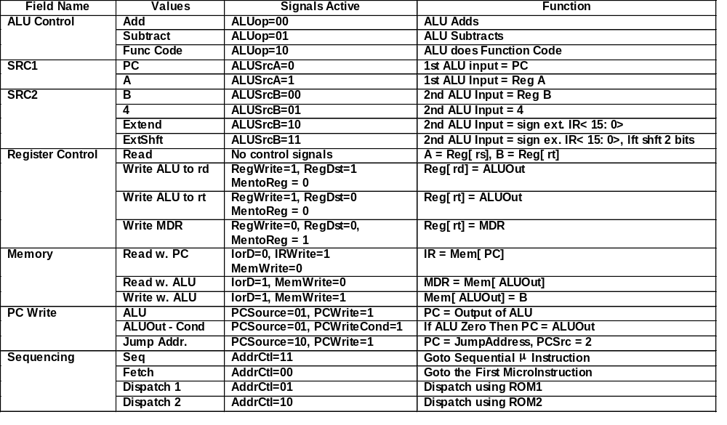
Details of Microinstruction Fields

Slide 35
MIPS Multicycle Microprogram for lw and sw
Label (State #) | ALU Control | Src 1 | Src2 | Register Control | Memory | PC Write Control | Sequence
Fetch | Add | PC | 4 |  | Read w. PC | ALU | Seq
Reg/Dec | Add | PC | ExtShift | Read |  |  | Dispatch1
AdrCal1 | Add | A | Extend |  |  |  | Dispatch2
LWMem2 |  |  |  |  | Read w. ALU |  | Seq
LwWr |  |  |  | WriteMDR |  |  | Fetch
SwMem2 |  |  |  | xxx | Write w. ALU |  | Fetch
Label (State #) | ALU Control | Src 1 | Src2 | Register Control | Memory | PC Write Control | Sequence
000 | 00 | 0 | 01 | xxx | 001 | 011 | 11
001 | 00 | 0 | 11 | xxx | xxx | xxx | 01
010 | 00 | 1 | 10 | xxx | xxx | xxx | 10
011 | xxx | xxx | xxx | xxx | 100 | xxx | 11
100 | xxx | xxx | xxx | 001 | xxx | xxx | 00
101 | xxx | xxx | xxx | xxx | 110 | xxx | 00
Note: Usually it is safe to set all don’t cares to 0 or disabled

Slide 36
Two Styles of Microprogramming
Most Microprogramming- based Controllers Vary Between:
  Horizontal Organization
    1 Control Bit Per Control Point
  Vertical Organization
    Grouping of Related Control Points into Encoded Fields
    Need Additional Level of Decoding between the Control Word and the Actual Control Signals
Horizontal
  + More Control Over the Potential Parallelism of Operations in the Data-path
  - Uses up Lots of Control Store
Vertical
  + Compact Microinstruction Format
  + Easier to Program, Not Very Different from Programming a RISC Machine in Assembly Language
  - Extra Level of Decoding May Slow the Machine Down

Slide 37
Microprogramming Pros and Cons
Flexibility
  Easy to Adapt to Changes in Organization, Timing, Technology
  Can make Changes Late in Design Cycle, or Even in the Field
Can Implement Very Powerful Instruction Sets (just more control memory)
Generality
  Can Implement Multiple Instruction Sets on Same Machine (Emulation)
  Can Tailor Instruction Set to Application
Compatibility
  Many Organizations, Same Instruction Set
Costly to Implement
  Need sequencer and ROM (mostly external)
Slow
  Need to read external ROM to get microinstructions
Microprogramming is suitable for processor designs on a circuit board, while PLA is suitable for processor designs on a chip

