Slide 1
Multiple Cycle Processor Summary
Essence of the Multiple Cycle Processor
  Break each Instruction into Smaller Steps
  Execute Each Step (Instead of the Entire Instruction) in One Cycle
  Cycle Time: Time It Takes to Execute the Longest Step
  Keep all the Steps to a Similar Length
The Advantages of the Multiple Cycle Processor:
  Cycle Time is Much Shorter
  Different Instructions Take Different Number of Cycles to Complete
    Load Takes Five Cycles
    Jump Only Takes Three Cycles
  Allows a Functional Unit to be Used More than Once per Instruction
The Disadvantages of the Multiple Cycle Processor:
  Each Instruction Needs Multiple Clock Cycles (although each cycle is much shorter than that of a single cycle data path)
  Only a Small Number of Function Units in The Data Path Are Active in Each Clock Cycle; Resources Are Wasted
How to do better than multi-Cycle Processor? ➔Pipelining

Slide 2
Key Ideas Behind Pipelining
Example: Made- to- Order Hamburger Assembly Line:
  Assembly Line Stages: (1) Take the order, (2) Prepare the bun and sauce, (3) Prepare the meat and place it on the bun, (4) Layer the vegetables, (5) Package the product
  One Person for Each Stage
  Pass the Hamburger and Order to the Next person as Soon as One Finishes His Part
  Assume Each Stage Takes 3 minutes to Complete
  Each Individual Order Still Takes 15 minutes to Complete
  But with 5 People, All Orders can be Completed Much Faster
Each Instruction has Multiple Stages
  The Functional Units in Each Stage are Independent
  Each Functional Unit Is Used Only Once in Each Instruction
  The Next Instruction can Start as Soon as an Instruction Finishes Its Instruction Fetch Stage
  Each Instruction Still Takes The Same Number of Cycles to Complete
  The Throughput, However, is Much Higher

Slide 3
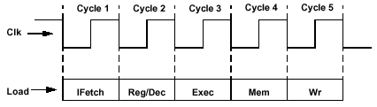
Example: The 5 Stages of Load
Without Pipelining:
  Latency = 5 cycles
  Throughput = 0.2 instructions/cycle (or cycles/instruction = 5)
IFetch: Instruction Fetch
  Fetch the Instruction from the Instruction Memory
Reg/ Dec: Registers (Operand) Fetch and Instruction Decode
Exec: Calculate the Memory Address
Mem: Read the Data from the Data Memory
Wr: Write the Data Back to the Register File

Slide 4
Pipelining The Load Instructions
Cycle 1
Cycle 2
Cycle 3
Cycle 4
Cycle 5
Cycle 6
Cycle 7
Clk
1st lw
IFetch
Reg/Dec
Exec
Mem
WrBack
2nd lw
IFetch
Reg/Dec
Exec
Mem
WrBack
3rd lw
IFetch
Reg/Dec
Exec
Mem
WrBack
Question: How can we stack the execution of the instructions?
Answer: By inserting “Pipeline Registers”
The Five Independent Functional Units In the Pipeline Datapath are:
  Instruction Memory for the IFetch Stage
  Register File’s Read Ports (busA and busB) for the Reg/ Dec Stage
  ALU for the Exec Stage
  Data Memory for the Mem Stage
  Register File’s Write Port (busW) for the Wr Stage
One Instruction Enters the Pipeline Every Cycle
  One Instruction Comes Out of the Pipeline (Complete) Every Cycle
  The “Effective” Cycles per Instruction (CPI) is 1

Slide 5
Performance of An Ideal Pipeline
Latency of Pipeline = Latency of a Single Task
Potential Throughput Improvement = Number of Pipeline Stages Under The Ideal Situations That All Instructions Are Independent and No Branch Instructions
Pipeline Rate is Limited by the Slowest Pipeline Stage
Cycle 1
Cycle 2
Cycle 3
Cycle 4
Cycle 5
Cycle 6
Cycle 7
Clk
1st lw
IFetch
Reg/Dec
Exec
Mem
WrBack
2nd lw
IFetch
Reg/Dec
Exec
Mem
WrBack
3rd lw
IFetch
Reg/Dec
Exec
Mem
WrBack

Slide 6
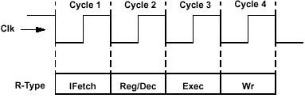
Mixing Different Types of Instructions in a Pipeline
Load and R-Type Instructions in Multi Cycle Data Path
Load Instruction
IFetch: Instruction Fetch
Reg/ Dec: Registers (Operand) Fetch and Instruction Decode
Exec: Calculate the Memory Address
Mem: Read the Data from the Data Memory
Wr: Write the Data Back to the Register File
R-Type Instruction
IFetch: Instruction Fetch
Reg/ Dec: Registers (Operand) Fetch and Instruction Decode
Exec: ALU Operates on the Two Register Operands
Wr: Write the Data Back to the Register File

Slide 7
Pipelining an R- type and a Load Instruction
Cycle 1
Cycle 2
Cycle 3
Cycle 4
Cycle 5
Cycle 6
Cycle 7
Cycle 8
Clk
R Type
IFetch
Reg/Dec
Exec
WrBack
R Type
IFetch
Reg/Dec
Exec
WrBack
Oops! We Get a Problem!
lw
IFetch
Reg/Dec
Exec
Mem
WrBack
R Type
IFetch
Reg/Dec
Exec
WrBack
R Type
IFetch
Reg/Dec
Exec
WrBack
Both the Load and R-Type Instructions Try to Write to the Register File at the Same Time!

Slide 8
Solution: Delay R- Type’s Write by One Cycle
Cycle 1
Cycle 2
Cycle 3
Cycle 4
Cycle 5
Cycle 6
Cycle 7
Cycle 8
Clk
R Type
IFetch
Reg/Dec
Exec
Mem/Nop
WrBack
R Type
IFetch
Reg/Dec
Exec
Mem/Nop
WrBack
lw
IFetch
Reg/Dec
Exec
Mem
WrBack
R Type
IFetch
Reg/Dec
Exec
Mem/Nop
WrBack
R Type
IFetch
Reg/Dec
Exec
Mem/Nop
WrBack
This actually can easily be done. Just make sure all instructions pass through the same number of pipeline stages and set the control signals of the unused stages to NOP (i.e., all control signals set to 0)
  Now R- Type Instructions Also Use Reg File’s Write Port at Stage 5
  Mem Stage is a NOP Stage: Nothing is Being Done
R Type
IFetch
Reg/Dec
Exec
Mem/Nop
WrBack

Slide 9
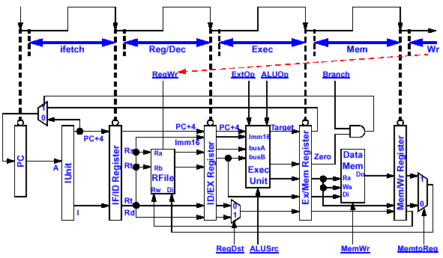
A Pipelined Datapath
Notice how the pipeline registers are labeled

Slide 10
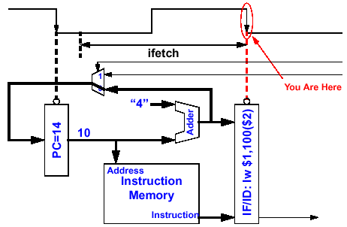
Details of the Instruction Fetch Unit

Slide 11
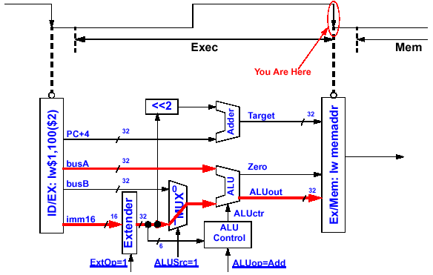
Details of the Execution Unit
lw instruction

Slide 12
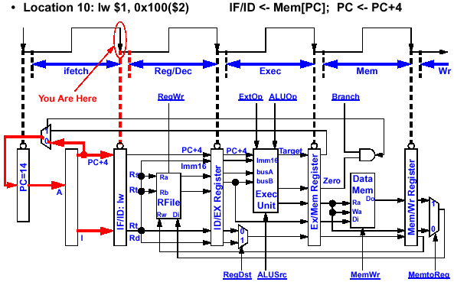
The Instruction Fetch Stage
Instruct Fetch Unit
lw instruction

Slide 13
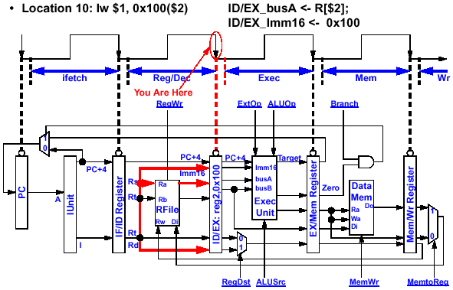
The Decode / Register Fetch Stage
Instruct Fetch Unit
The 2nd (R-type) instruction can start instruction fetch
lw instruction

Slide 14
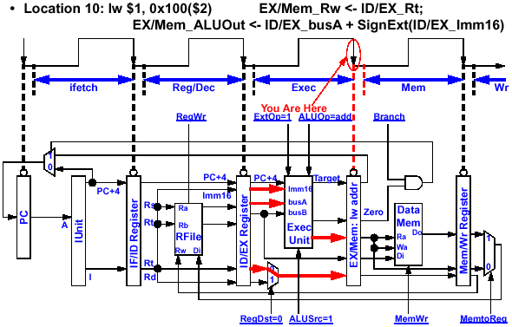
Load’s Address Calculation Stage
Instruct Fetch Unit
The 3rd (R-type) instruction can start instruction fetch
The 2nd (R-type) instruction can start decode/reg fetch
lw instruction

Slide 15
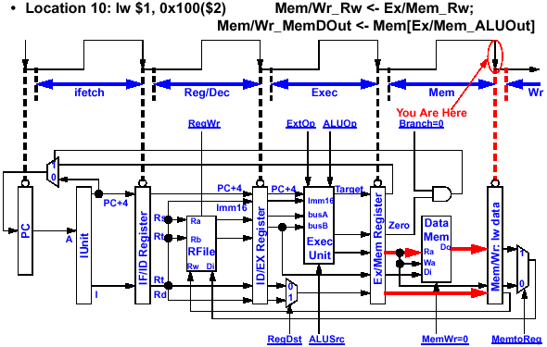
Load’s Memory Access Stage
Instruct Fetch Unit
The 4th (R-type) instruction can start instruction fetch
The 3rd (R-type) instruction can start decode/reg fetch
The 2nd (R-type) instruction can start Execution
lw instruction

Slide 16
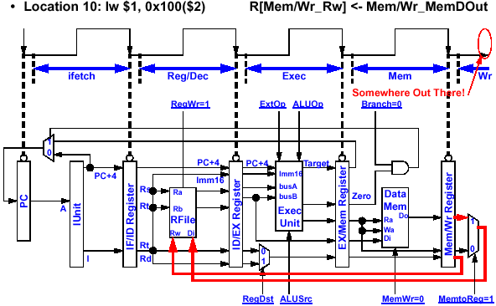
Load’s Write Back Stage
Instruct Fetch Unit
The 5th (R-type) instruction can start instruction fetch
The 4th (R-type) instruction can start decode/reg fetch
The 3rd (R-type) instruction can start Execution
The 2nd (R-type) instruction is no-op in memory access
lw
instruction

Slide 17
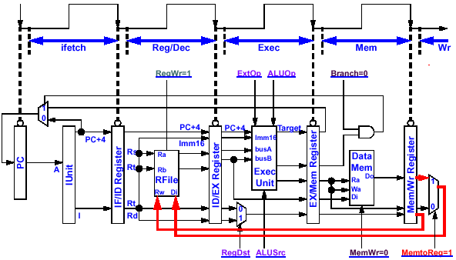
How About Control Signals?
Key Observations
Control signal at stage N is the function of only the instruction at that stage
When an instruction is in stage N, only the control signals in that stage are relevant to the instruction
Instruct Fetch Unit

Slide 18
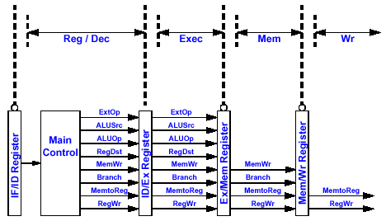
Pipelining the Control Signals
The above observations imply the control signals can be pipelined:
  The Main Control Generates the Control Signals During Reg/ Dec
  Control Signals for Exec (ExtOp, ALUSrc, ...) are Used 1 Cycle Later
  Control Signals for Mem (MemWr Branch) are Used 2 Cycles Later
  Control Signals for Wr (MemtoReg RegWr) are Used 3 Cycles Later

Slide 19
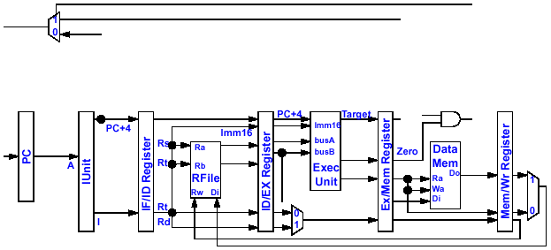
Putting It All Together
ExtOp
ALUSrc
ALUOp
RegDst
MemWr
Branch
MemtoReg
RegWr
Control Signals
Control Signals
Control Signals
Main Control
PC+4
Instruction Fetch Unit

Slide 20
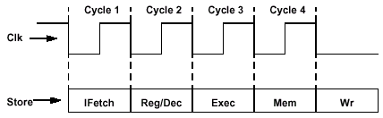
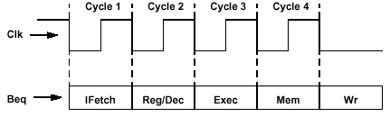
Mixing More Types of Instructions in a Pipeline
Store and Beq Instructions in Multi Cycle Data Path
Store Instruction
IFetch: Instruction Fetch from Instruction Memory
Reg/ Dec: Registers (Operand) Fetch and Instruction Decode
Exec: Calculate the Memory Address
Mem: Write the Data into the Data Memory
Wr: Not applicable. All control signals set to 0
Beq Instruction
IFetch: Instruction Fetch from the Instruction Memory
Reg/ Dec: Registers (Operand) Fetch and Instruction Decode
Exec: ALU compares the Two Register Operands
  Adder Calculates the Branch Target Address
Mem: If the Registers we Compared in the Exec Stage are the Same
  Write the Branch Target Address into the PC
Wr: Not applicable. All control signals set to 0

Slide 21
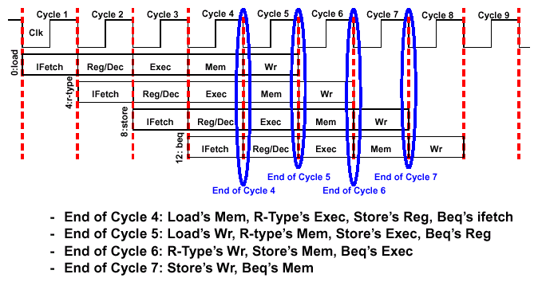
A More Extensive Pipelining Example

Slide 22
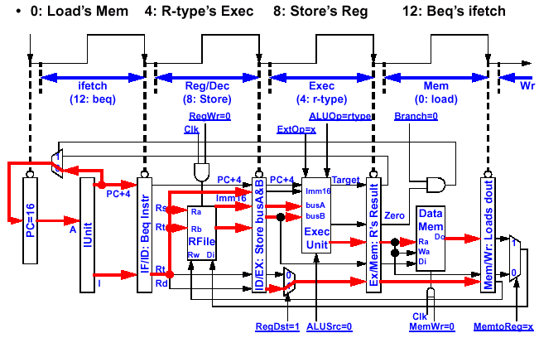
Pipelining Example: End of Cycle 4
12: Beq’s ifetch
8: Store’s Dec
4: R-types’ Exec
0: Load’s Mem
Instruct Fetch Unit

Slide 23
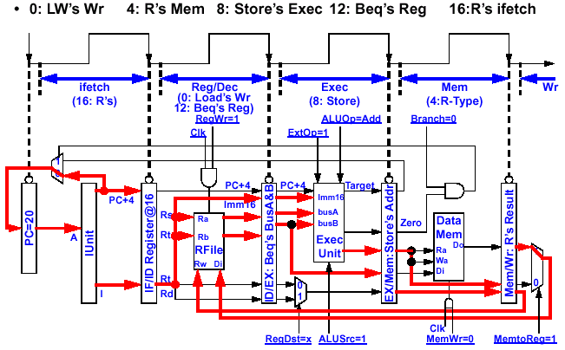
Pipelining Example: End of Cycle 5
16: R-type’s ifetch
12: Beq’s Dec
8: Store’s Exec
4: R-types’ Mem
0: Load’s Wr
Instruct Fetch Unit

Slide 24
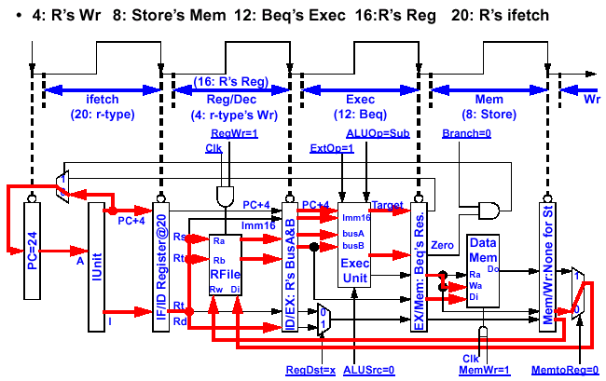
Pipelining Example: End of Cycle 6
20: R-type’s ifetch
16: R-type’s Dec
12: Beq’s Exec
8: Store’s Mem
4: R-types’ Wr
Instruct Fetch Unit

Slide 25
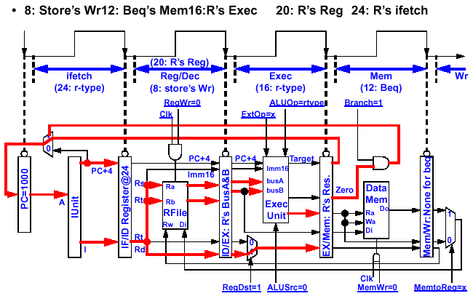
Pipelining Example: End of Cycle 7
24: R-type’s ifetch
20: R-type’s Dec
16: R-type’s Exec
12: Beq’s Mem
(select PC addr)
8: Store’s Wr
(No op)
Instruct Fetch Unit

Slide 26
Example of Detailed Pipeline Operations
--/IF
PCsrc
IF/ID
ID/EX
EX/MEM
MEM/WB
0
M
wb
wb
wb
1
u
x
<31:26>
Control
m
m
ex
ALUop
Add
Add
RegWrite
x4
Branch
MemWr
MemRd
MemtoR
4
<10:0>
ALU
rs
Control
Zero
PC
Addr
rt
Rd Reg1
ALUsrc
IF/ID
RdReg2
A
EX/MEM
MEM/WB
Instruction
Registers
ID/EX
ALUout
Addr
mdo
Memory
ALU
zero
Rd Data
Wr
Reg
B
0
M
out
Data
Wr Data
1
u
Memory
0
M
Clk PC
1 00 lw $2, 0($3)
2 04 add $4, $0, $5
3 08 sw $6, 4($3)
4 12 addi $7, $2, 100
5 16 add $8, $2, $5
6 20 add $9, $2, $4
7 24 sub $10, $4, $7
8 28 add $11, $7, $8
x
B
1
u
<15:0>
Ext
<31:0>
RegDst
Wr Data
x
rt
rt
0
M
rd
ALUout
rd
rd
rd
1
u
x
See MIPS Example in Class

Slide 27
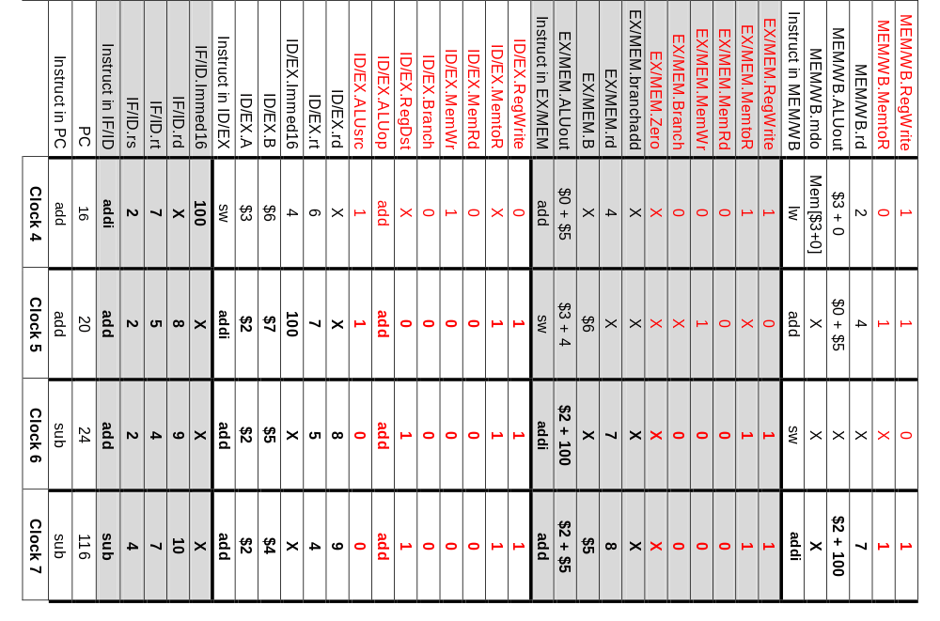
Signal Propagation through the Example Pipeline

Slide 28
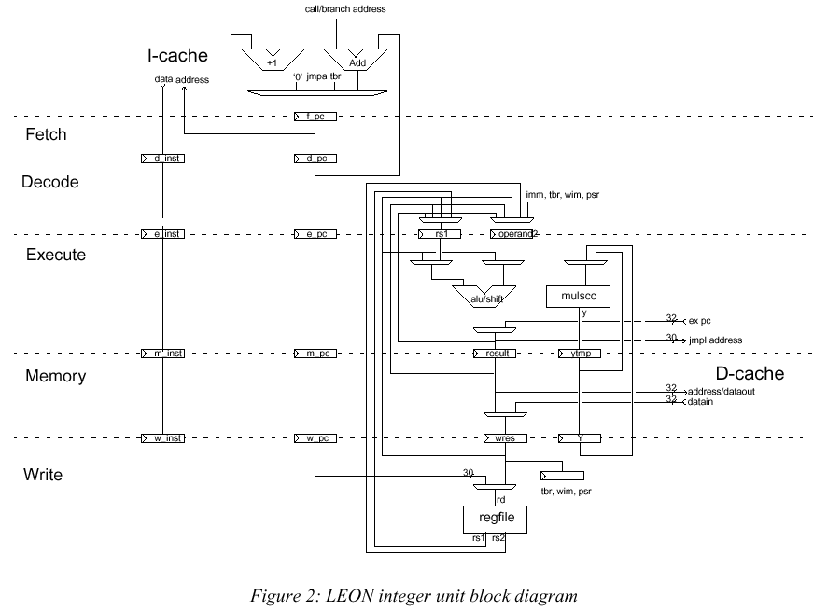
LEON: Another Pipeline Processor Example

Slide 29
Comparing Single Cycle, Multiple Cycle, & Pipeline
Disadvantages of the Single Cycle Processor
  Long cycle time
  Cycle time is too long for all instructions except the Load
Multiple Clock Cycle Processor
  Divide the instructions into smaller steps
  Execute each step (instead of the entire instruction) in one cycle
Pipeline Processor
  Natural enhancement of the multiple clock cycle processor
  Each functional unit can only be used once per instruction
  If an instruction is going to use a functional unit:
    It must use it at the same stage as all other instructions
  Pipeline Control:
    Each stage’s control signal depends ONLY on the instruction that is currently in that stage

Slide 30
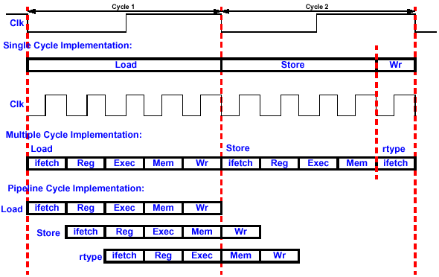
Single Cycle, Multiple Cycle, vs. Pipeline

Slide 31
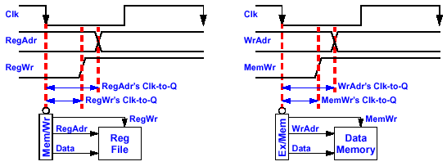
Write with Real Memory: A Real World Problem
At the Beginning of the Wr Stage, We Have a Problem If:
  RegAdr’s (Rd or Rt) Clk- to- Q > RegWr’s Clk- to- Q
Similarly, at the Beginning of the Mem Stage, We Have a Problem If:
  WrAdr’s Clk- to- Q > MemWr’s Clk- to- Q
Write signal happens too early and invalid data will be written. We Have a Race Condition Between Address and Write Enable!

Slide 32
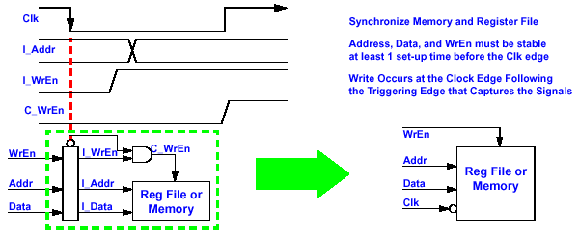
Synchronize Register File & Synchronize Memory
Solution: And the Write Enable Signal with the Clock
  This is the ONLY place where gating the clock is used
  MUST consult circuit expert to ensure no timing violation:
    Example: Clock High Time > Write Access Delay

