Slide 1
What We Have Learn About Pipeline So Far
Pipelining Helps the Throughput of the Entire Workload But Doesn’t Help the Latency of a Single Task
Pipeline Rate is Limited by the Slowest Pipeline Stage
Multiple Instructions are Operating Simultaneously
Potential Speedup = Number of Pipeline Stages Under The Ideal Situations That All Instructions Are Independent and No Branch Instructions
Soon, We Will Learn About Hazards That Degrade The Performance Of The Idea Pipeline

Slide 2
Pipeline Hazards
Pipelining Limitations: Hazards are Situations that Prevent the Next Instruction from Executing During its Designated Cycle
  Structural Hazard:
  Resource Conflict When Several Pipelined Instructions Need the Same Functional Unit Simultaneously
  Data Hazard:
  An Instruction Depends on the Result of a Prior Instruction that is Still in the Pipeline
  Control Hazard:
  Pipelining of Branches and Other Instructions that Change the PC
Common Solution:
Stall the Pipeline by Inserting “Bubbles” Until the Hazard is Resolved

Slide 3
Graphical Representation to Analyze Pipeline Hazards
Operations
Instruction
Mem
Reg
Mem
Reg
ALU
Bypass

Slide 4
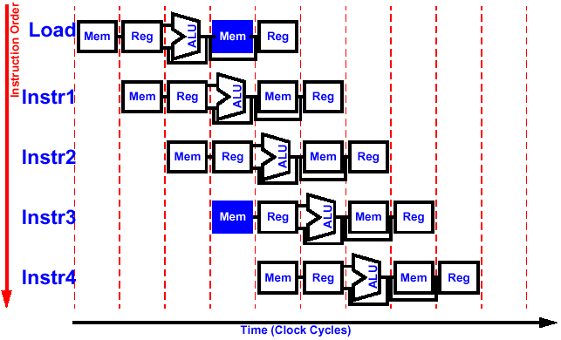
Structural Hazard:
Conflict in Resources
Example: Assuming Instructions and Data Share the Same Memory
Load reading data from memory
Instruction 3 fetching instruction from the same memory

Slide 5
Resolution Option 1: Don’t Share the Memory
IM
DM
IM
DM
IM
DM
IM
DM
IM
DM

Slide 6
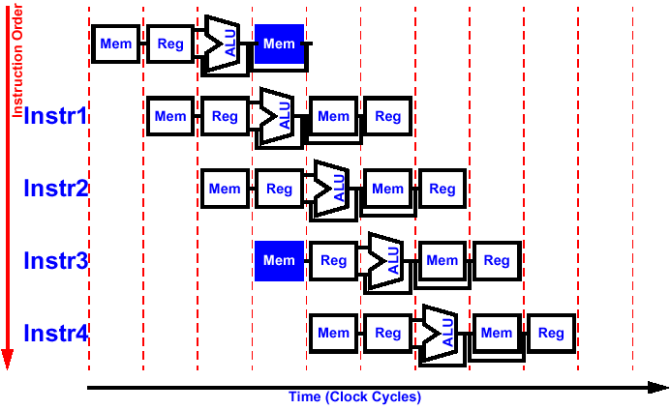
Resolution Option 2: Using a Two-Port Memory
Use a 2-port memory that can be read and written at the same time
Store writing data to memory
Store
Mem
Mem
Instruction 3 fetching instruction from the same memory

Slide 7
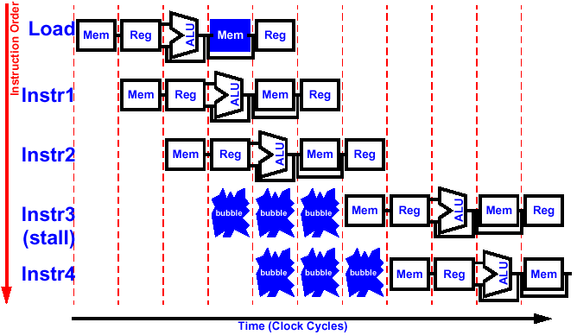
Resolution Option 3: Stall the Pipeline
Delay the start of conflicting successor instructions (i.e., for Load instructions, delay the 3rd succeeding instructions by 3 clocks)

Slide 8
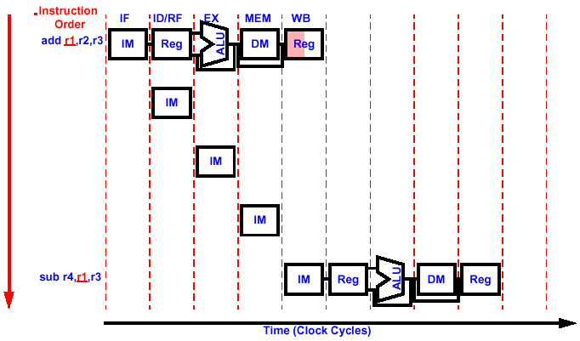

To Insert a Bubble
Don’t Change PC, Keeps Fetching Same Instruction, Sets All Control Signals in The ID/EX Pipeline Register to Benign Values (0)
Each refetch creates a bubble
All ctrl set to 0
All ctrl set to 0
All ctrl set to 0
All ctrl set to 0
sub r4, r1 ,r3
(I.e., do nothting)
sub r4, r1 ,r3
(refetch)
All ctrl set to 0
All ctrl set to 0
All ctrl set to 0
All ctrl set to 0
(I.e., do nothting)
sub r4, r1 ,r3
(refetch)
All ctrl set to 0
All ctrl set to 0
All ctrl set to 0
All ctrl set to 0
(I.e., do nothting)
Do not update PC
(execute)

Slide 9
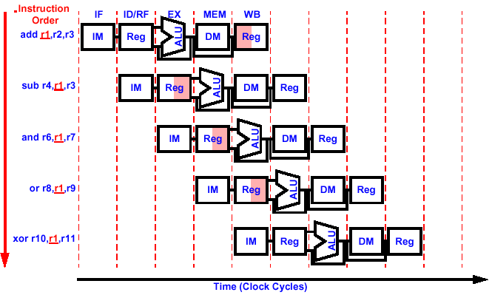
Data Hazard:
Dependencies Backwards in Time
Sub needs r1 2 clocks before add can supply it
And needs r1 1 clocks before add can supply it
Or gets the data in the same clock when add is done
Reg
R1 ready for xor
Note: The register file design allows date be written in first half of clock cycle and read in the second half of clock cycle

Slide 10
Data Hazard Example
Current Value
Correct Answer
r1
3
10
Add
IFetch
r2=4
r3=6
r1=10
10
6+4
r2
4
4
r3
6
6
r4
10
4
-3
sub
IFetch
r1=3
r3=6
r4=–3
r5
0
0
sub
r6
-37
3-6
0
-30
r7
40
40
r8
-50
0
-50
r9
60
60
sub
IFetch
r1=3
r7=40
r6=-37
r10
-70
sub
3-40
0
-70
r11
80
80
sub
sub
IFetch
r1=10
r9=60
10-60
r8=-50
sub
sub
IFetch
r1=10
r11=80
10-80
r10=-70

Slide 11
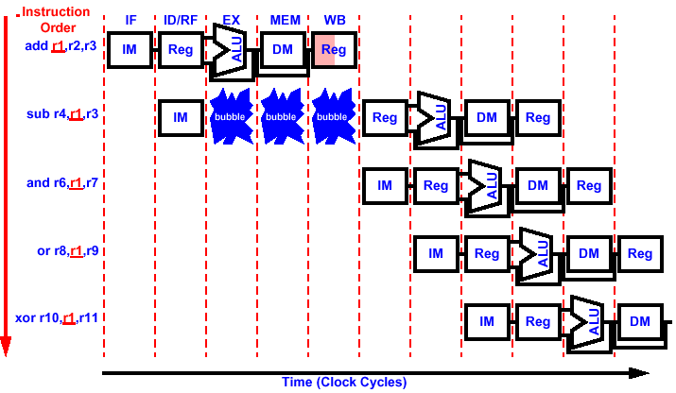
Resolution Option 1: HW Stalls
See structural hazard solution 2 for how to generate a bubble

Slide 12
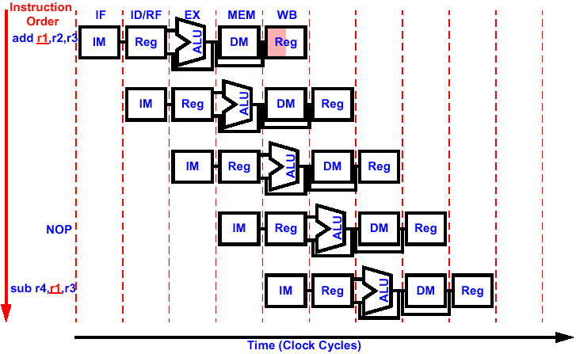
Resolution Option 2: Reordering of Instructions
Software inserts independent instructions instead of bubbles. May have to inserts NOP instructions if not independent instructions found.
add r5, r6, r7
sub r8, r9, r10

Slide 13
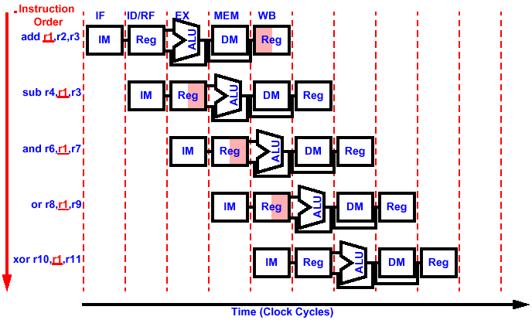
Resolution Option 3: Forwarding
Insight: The Needed Data is Actually Available! It is Contained in the Pipeline Registers.

Slide 14
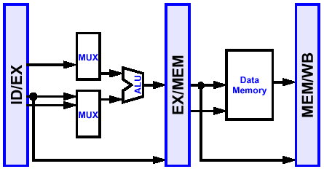
Hardware Change for Forwarding
Add Paths From Pipeline Registers to Stages That Need the Data
Add Multiplexors to Select The Pipeline Registers
Register File Forwarding: Register Read During Write Gets New Value (write in 1st half of the clock cycle and read in 2nd half)
Reg
File

Slide 15
Data Hazard Detection For Forwarding
4 types of instruction dependencies cause data hazard:
1a. Rd of instruction in execution = Rs of instruction in operand fetch
(EX/MEM.RegisterRd = ID/EX.RegisterRs)
1b. Rd of instruction in execution = Rt of instruction in operand fetch
(EX/MEM.RegisterRd = ID/EX.RegisterRt)
2a. Rd of instruction writing back = Rs of instruction in execution
(MEM/WB.RegisterRd = ID/EX.RegisterRs)
2b. Rd of instruction writing back = Rt of instruction in execution
(MEM/WB.RegisterRd = ID/EX.RegisterRt)
Type 1a
Type 2a
add r1 ,r2, r3
IM
Reg
ALU
DM
Reg
sub r4,r1 ,r3
IM
Reg
ALU
DM
Reg
r1 not valid yet
and r6,r1 ,r7
IM
Reg
ALU
DM
Reg
r1 not valid yet

Slide 16
Forwarding Control
Control
wb
wb
wb
m
m
ex
Fwd A
Reg
File
0
Mux A
1
Data Memory
2
EX/MEM
MEM/WB
0
ALU
Mux
ID/EX
1
Mux B
2
rd
Mux
rt
Fwd B
rd
rs
Forwarding
Unit
rd
Control Output of the Forwarding Unit
For Mux A
  Select ALU operands from previous ALU result in EX/MEM (Type 1a)
  if (EX/MEM.RegWrite and (EX/MEM.RegRd ≠ 0) and (EX/MEM.RegRd = ID/EX.RegRs))
  Select ALU operands from MEM/WB (Type 2a)
  if (MEM/WB.RegWrite and (MEM/WB.RegRd ≠ 0) and (MEM/WB.RegRd = ID/EX.RegRs))
For Mux B
  Same as Mux A except replacing Rs with Rt

Slide 17
Forwarding Example
add r1 ,r2, r3
sub r4, r1 ,r3
and r6, r7 ,r1
Control
wb
wb
wb
m
m
ex
01
Fwd A
A=R[rs]
A=R[rs]
Reg
File
A=R[rs]
Mux A
A+B
Data Memory
A • B
A - B
A+B
A-B
EX/MEM
MEM/WB
sub
add
add
B=R[rt]
ALU
B=R[rt]
B=R[rt]
Mux
ID/EX
add
and
sub
Mux B
r1
A+B
r6
rd
r4
r3
Mux
r1
rt
r3
rd
rd
10
r4
Fwd B
Forwarding
Unit
r1
r2
r1
r7
rs
r1
Type 1a Hazard
Type 2b Hazard

Slide 18
One More Problem
Control
wb
wb
wb
m
m
ex
Fwd A
Reg
File
0
Mux A
1
Data Memory
2
EX/MEM
MEM/WB
0
ALU
Mux
ID/EX
1
Mux B
2
rd
Mux
rt
Fwd B
rd
rs
Forwarding
Unit
rd
Question: If Rd is used Repeatedly such that rd in all three stages are the same (i.e., MEM/WB.RegRd = EX/MEM.RegRd = ID/EX.RegRs (or ID/EX.RegRt)). In that case, should EX/MEM or MEM/WB be forwarded?
Answer: Forward the EX/MEM because it is more update than MEM/WB. Therefore, MEM/WB is forwarded only if rd in all three stages are not the same. That is:
  For Mux A, Select ALU operands from MEM/WB (Type 2a):
  if (MEM/WB.RegWrite and (MEM/WB.RegRd ≠ 0) and
  (EX/MEM.RegRd ≠ ID/EX.RegRd) and (MEM/WB.RegRd = ID/EX.RegRs))
  For Mux B: Same as Mux A except replacing Rs with Rt (Type 2b)

Slide 19
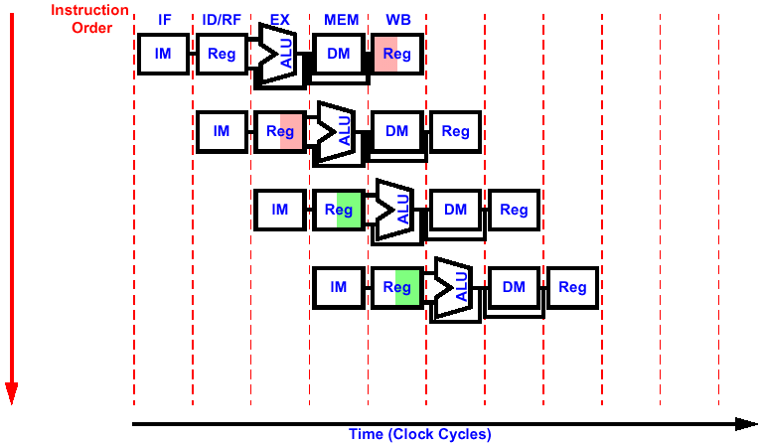
Forwarding Removes Data Hazard in Most Cases
add r1, r2, r3
add r4, r1, r3
add r5, r4, r1
sw r5, 0(r4)

Slide 20
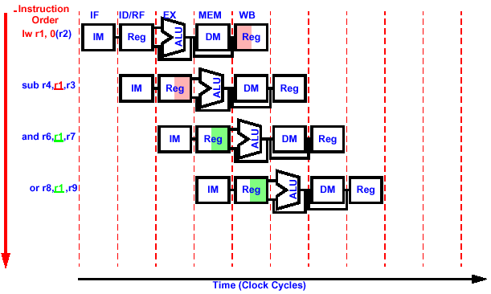
Except in One Case: lw Instruction
Problem: The lw instruction is still reading memory when the sub instruction needs the data for EX. Still need to handle the 1 hazard cycle

Slide 21
The Case Forwarding Can’t Avoid Stalling
lw r1 , 0(r2)
Problem: lw followed by R-type – the lw instruction is still reading memory when the sub instruction needs the data for EX. Need to stall 1 cycle
sub r4, r1 ,r3
and r6, r7 ,r1
Valid output for lw
Control
wb
wb
wb
m
m
ex
10
Fwd A
A=R[rs]
Reg
File
A=R[rs]
Mux A
addr
Data Memory
Mem[addr]
A+ B
addr
EX/MEM
lw
lw
MEM/WB
B=R[rt]
ALU
Mux
add
ID/EX
add
lw
Mux B
r1
rd
r4
r3
Mux
rt
r3
rd
rd
Fwd B
Forwarding
Unit
r1
r1
r2
Forwarded as Type 2a
rs
r1
Type 1a Hazard, but cannot forward EX/MEM output. It is not valid output of lw

Slide 22
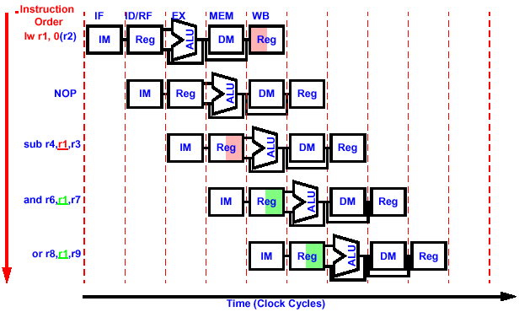
Option 1: Software Solution
Software inserts independent instructions worst case inserts NOP instructions

Slide 23
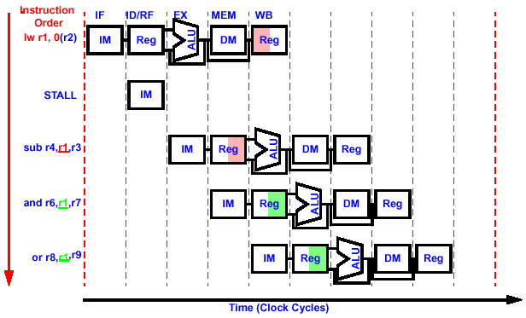
Option 2: Hardware Solution
Control logic checks for data hazard and stall one cycle (i.e., insert a bubble) if necessary
Already in reg file
Do nothing
Do nothing
Do nothing
Do nothing

Slide 24
Hardware to Stall The Pipeline
ID/EX.MemRead
Hazard Detect
ID/EX.rt
PCWr
IF/IDWr
0
IF/ID.opcode
IF/ID.rt
IF/ID.rs
Mux
wb
wb
wb
Control
m
m
ex
Fwd A
Reg
File
Mux A
Instr Mem
Data Memory
PC
EX/MEM
MEM/WB
IF/ID
ID/EX
ALU
Mux
Mux B
rd
rd
Mux
rt
rt
rt
rt
Fwd B
rd
rs
rs
Forwarding
Unit
rd
Step 1: Detecting the hazard (check if lw is being executed and if the memory data is loaded to one of the operands in the next instruction)
  Stall = if (ID/EX.MemRead and ((ID/EX.rt = IF/ID.rs) or (ID/EX.rt = IF/ID.rt)))
Step 2: If Stall is true
  Do not fetch the next instruction by disabling the writing to PC and IF/ID registers
  Disable all control signals of the current instruction

Slide 25
Stalling The Pipeline
ID/EX.MemRead = 1 ⇒ lw instrcution
ID/EX.MemRead
Hazard Detect
ID/EX.rt = R1
ID/EX.rt
PCWr
IF/IDWr
0
RegWr = 1
Sub
IF/ID.op
IF/ID.rt
IF/ID.rs = R1
IF/ID.rs
wb
wb
wb
Mux
lw
m
Control
m
MemRead = 1, MemWr = 0
ex
sub
Fwd A
Reg
File
Mux A
Instr Mem
Data Memory
PC
EX/MEM
MEM/WB
IF/ID
ID/EX
ALU
Mux
Mux B
rd
rd
Mux
rt
rt
rt
rt
Fwd B
rd
rs
rs
Forwarding
Unit
rd
lw r1, 0(r2)
sub r4, r1 ,r3
and r6, r7 ,r1
or r8, r1 ,r9

Slide 26
Stalling The Pipeline
ID/EX.MemRead = 1 ⇒ lw instrcution
ID/EX.MemRead
Hazard Detect
ID/EX.rt = R1
ID/EX.rt
PCWr
0
RegWr = 1
PCWr=0
IF/IDWr
Sub
IF/ID.op
IF/ID.rt
IF/IDWr = 0
IF/ID.rs = R1
IF/ID.rs
wb
wb
wb
Mux
lw
m
Control
m
MemRead = 1, MemWr = 0
ex
sub
Fwd A
Reg
File
Mux A
Instr Mem
Data Memory
PC
EX/MEM
MEM/WB
IF/ID
ID/EX
ALU
Mux
Mux B
rd
rd
Mux
rt
rt
rt
rt
Fwd B
rd
rs
rs
Forwarding
Unit
rd
lw r1, 0(r2)
sub r4, r1 ,r3
and r6, r7 ,r1
or r8, r1 ,r9

Slide 27
Stalling The Pipeline
ID/EX.MemRead
Hazard Detect
ID/EX.rt
PCWr
IF/IDWr
0
RegWr = 0
RegWr = 1
Sub
IF/ID.op
IF/ID.rt
IF/ID.rs = R1
IF/ID.rs
lw
Mux
wb
wb
wb
Control
m
MemRead = 0, MemWr = 0
m
ex
MemRead = 1
MemWr = 0
sub
sub
Fwd A
Reg
File
Mux A
Instr Mem
Data Memory
PC
EX/MEM
MEM/WB
IF/ID
ID/EX
ALU
Mux
Mux B
rd
rd
Mux
rt
rt
rt
rt
Fwd B
rd
rs
rs
Forwarding
Unit
rd
Re-Fetch
lw r1, 0(r2)
Not Doing Anything ➔bubble
sub r4, r1 ,r3
and r6, r7 ,r1
or r8, r1 ,r9

Slide 28
Stalling The Pipeline
ID/EX.MemRead
Hazard Detect
ID/EX.rt
PCWr
IF/IDWr
0
RegWr = 1
RegWr = 0
RegWr = 1
IF/ID.op
IF/ID.rt
IF/ID.rs
wb
lw
wb
wb
Mux
sub
Control
m
MemRead = 0, MemWr = 0
m
ex
sub
MemRead = 0
MemWr = 0
and
Fwd A
Reg
File
Mux A
Instr Mem
Data Memory
PC
EX/MEM
MEM/WB
IF/ID
ID/EX
ALU
Mux
Mux B
rd
rd
Mux
rt
rt
rt
rt
Fwd B
rd
rs
rs
Forwarding
Unit
rd
lw r1, 0(r2)
bubble
sub r4, r1 ,r3
and r6, r7 ,r1
or r8, r1 ,r9

Slide 29
Stalling The Pipeline
ID/EX.MemRead
Hazard Detect
ID/EX.rt
PCWr
IF/IDWr
0
RegWr = 1
RegWr = 1
RegWr = 0
IF/ID.op
IF/ID.rt
IF/ID.rs
wb
wb
wb
sub
Mux
and
m
Control
m
MemRead = 0, MemWr = 0
ex
MemRead = 0
MemWr = 0
or
Fwd A
sub
Reg
File
Mux A
Instr Mem
Data Memory
PC
lw data
EX/MEM
MEM/WB
IF/ID
ID/EX
ALU
Mux
Mux B
rd
rd
Mux
rt
rt
rt
rt
Fwd B
rd
rs
rs
Forwarding
Unit
rd
lw r1, 0(r2)
bubble
sub r4, r1 ,r3
and r6, r7 ,r1
or r8, r1 ,r9

Slide 30
Stalling The Pipeline
ID/EX.MemRead
Hazard Detect
ID/EX.rt
PCWr
IF/IDWr
0
RegWr = 1
RegWr = 1
RegWr = 1
IF/ID.op
IF/ID.rt
IF/ID.rs
wb
wb
wb
and
sub
Mux
or
m
Control
m
MemRead = 0, MemWr = 0
ex
MemRead = 0
MemWr = 0
Fwd A
Reg
File
Mux A
Instr Mem
Data Memory
PC
lw data
EX/MEM
MEM/WB
IF/ID
ID/EX
ALU
Mux
Mux B
rd
rd
Mux
rt
rt
rt
rt
Fwd B
rd
rs
rs
Forwarding
Unit
rd
lw r1, 0(r2)
The bubble has not changed any state of the pipeline
sub r4, r1 ,r3
and r6, r7 ,r1
or r8, r1 ,r9

Slide 31
Stalling The Pipeline
ID/EX.MemRead
Hazard Detect
ID/EX.rt
PCWr
IF/IDWr
0
RegWr = 1
RegWr = 1
IF/ID.op
IF/ID.rt
IF/ID.rs
wb
wb
wb
Mux
or
and
Control
m
m
ex
MemRead = 0
MemWr = 0
Fwd A
Reg
File
Mux A
Instr Mem
sub data
Data Memory
PC
lw data
EX/MEM
MEM/WB
IF/ID
ID/EX
ALU
Mux
Mux B
rd
rd
Mux
rt
rt
rt
rt
Fwd B
rd
rs
rs
Forwarding
Unit
rd
lw r1, 0(r2)
The bubble has not changed any state of the pipeline
sub r4, r1 ,r3
and r6, r7 ,r1
or r8, r1 ,r9

Slide 32
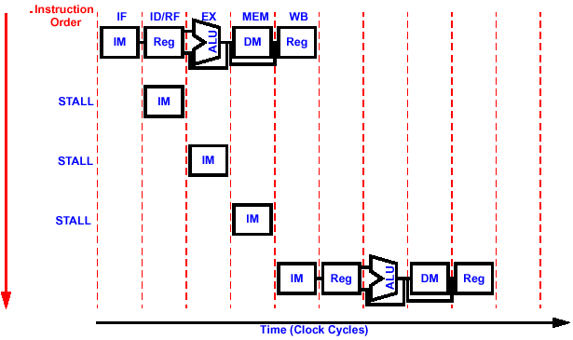
Control Hazard:
Change in Control Flow Due to Branching
beq $1,$ 3,36
All ctrl set to 0
All ctrl set to 0
All ctrl set to 0
All ctrl set to 0
Waiting for result of comparison
All ctrl set to 0
All ctrl set to 0
All ctrl set to 0
All ctrl set to 0
Waiting for result of comparison
All ctrl set to 0
All ctrl set to 0
All ctrl set to 0
All ctrl set to 0
Waiting for result of comparison
Result of comparison → branch to target
ld $4, $7, 100
Branch target
Have to stall 3 Cycles before branch decision is made

Slide 33
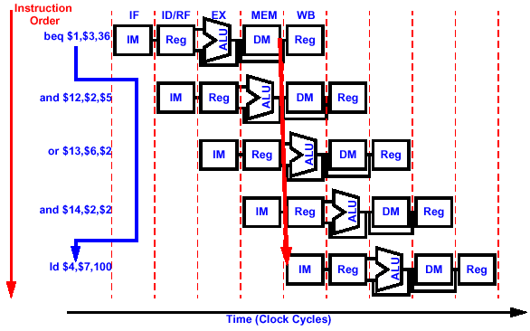
Option 1: Static Branch Prediction
Predict Branch Not Taken
PC=12
PC=16
Assume branch not taken
PC=20
Assume branch not taken
PC=24
Assume branch not taken
PC=28
or $15,$7,$3
Result of comparison → not to branch
Prediction is correct, branching does not cause any penalty

Slide 34
Penalty of Wrong Prediction
PC=12
PC=16
Assume branch not taken
PC=20
Assume branch not taken
PC=24
Assume branch not taken
PC=36
Result of comparison → branch taken
Branch target
Prediction is incorrect, need to flush pipe,
penalty = without branch prediction (3 cycles)

Slide 35
Detailed Example of Wrong Prediction Penalty
(Predict Branch Not Taken)
--/IF
PCsrc
IF/ID
ID/EX
EX/MEM
MEM/WB
0
M
reset
reset
reset
reset
u
wb
wb
wb
1
x
<31:26>
Control
m
m
ex
ALUop
Add
Add
RegWrite
x4
Branch
MemWr
MemRd
MemtoR
4
<10:0>
ALU
rs
Control
Zero
PC
Addr
rt
Rd Reg1
ALUsrc
IF/ID
RdReg2
A
EX/MEM
MEM/WB
Instruction
Registers
ID/EX
ALUout
Addr
mdo
Memory
ALU
zero
Rd Data
Wr
Reg
B
0
M
out
Data
Ck PC
1 00 lw $2, 0($3)
2 04 add $4, $0, $5
3 08 sw $6, 4($3)
4 12 beq $7, $2, 5
5 16 add $8, $2, $5
6 20 add $9, $2, $4
7 24 sub $10, $4, $7
8 28 add $11, $7, $8
9 32 j 11
8 36 sub $8, $2, $5
9 40 sub $9, $2, $4
Wr Data
1
u
0
x
Memory
M
B
1
u
<15:0>
Ext
<31:0>
RegDst
Wr Data
x
rt
rt
0
M
rd
ALUout
rd
rd
rd
1
u
x
Clock 1
Clock 2
Clock 3
Clock 4
Clock 5
See Set 8 Class Example

Slide 36
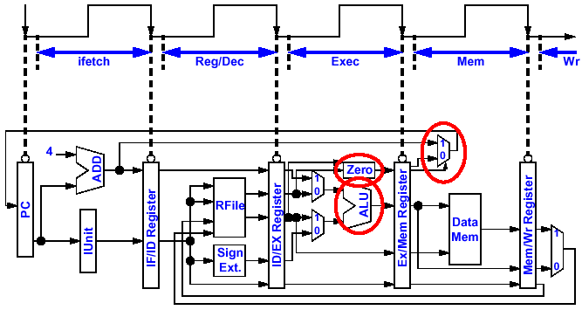
To Reduce Branch Penalty
Move Address Calculation Hardware Forward
3rd clock delay
1st clock delay
2nd clock delay

Slide 37
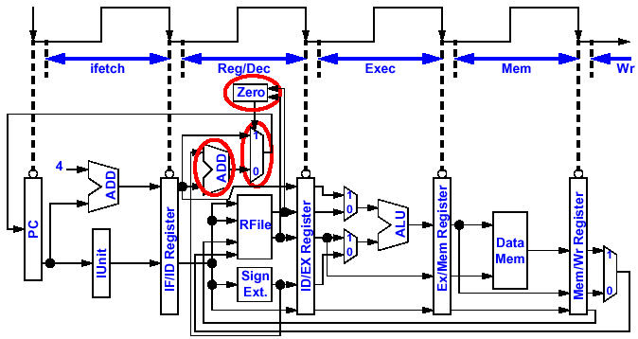
To Reduce Branch Panelty
Move Address Calculation Hardware Forward
1st clock delay

Slide 38
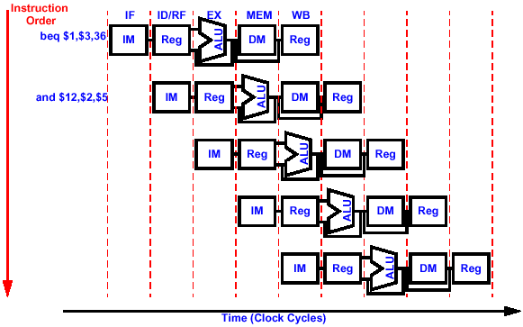
Pipeline After Branch Penalty Reduction
Branch Decision and Calculate Address Done in Decode Stage
All ctrl set to 0
All ctrl set to 0
All ctrl set to 0
All ctrl set to 0
Prediction is wrong. But need to flush IF/ID only
Predict branch not taken
ld $4,$7,100
Penalty = 1 cycle, instead of 3 cycles

Slide 39
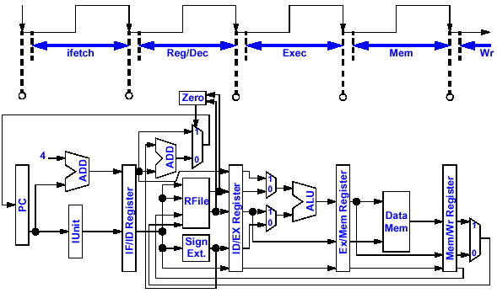
Flushing Pipe in the New Approach if Prediction is Wrong
Branch Hazard Detection
But beq decides that the branch should have taken (i.e. lw instead of and)
and fetched as if branch
not taken
Ctrl signals
Ctrl signals
Ctrl signals
Ctrl signals
Ctrl for add
Ctrl for lw
00…0
Ctrl for and
Ctrl for lw
00…0
Ctrl for and
Ctrl for beq
Ctrl for beq
Ctrl for beq
00…0
Ctrl for and
flush
Ctrl for beq

Slide 40
Option 2: Dynamic Branch Prediction
Rather than always assuming branch not taken, use a branch history table (also call branch prediction buffer) to achieve better prediction
The branch history table is implemented as a one or two bit register
Example: state transition of a 2-bit history table
taken
State 00
predict taken
not taken
State 01
predict taken
taken
taken
not taken
State 10
predict not taken
not taken
State 11
predict not taken
taken
If branch test is in Instruction N, then:
predict taken means PC set to the target address by default, and set to N+4 if wrong
predict not taken means PC set to N+4 by default, and set to target address if wrong

Slide 41
Option 3: Delayed Branch
Make use of the time while the branch decision is being made: Execute an unrelated instruction subsequent to the branch instruction
Where To Get Instructions to Fill Branch Delay Slot? Three Strategies:
Compiler Effectiveness for Single Branch Delay Slot:
  Fills About 60% of Branch Delay Slots
  About 80% of Instructions Executed in Branch Delay Slots Useful in Computation
  About 50% (60% x 80%) of Slots Usefully Filled
Worst Case, Compiler Inserts NOP into Branch Delay
Before Branch Instruction
(best if possible)
From Target
(good if always branch)
From Fall Through
(good if always don’t branch)
add $s1, $s2, $s3
sub $t4, $t5, $t6
add $s1, $s2, $s3
If $s2=0 then
add $s1, $s2, $s3
If $s1=0 then
Delay slot
add $s1, $s2, $s3
Delay slot
If $s1=0 then
sub $t4, $t5, $t6
Delay slot
sub $t4, $t5, $t6
sub $t4, $t5, $t6

