Slide 1
Five Classic Components of a Computer
Processor
(CPU)
Input
Control
Memory
Datapath
Output
Current Topic: Memory

Slide 2
What You Will Learn In This Set of Lectures
Memory Hierarchy
Memory Technologies
Cache Memory Design
Virtual Memory

Slide 3
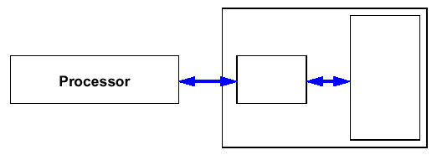
Memory Hierarchy
Memory is always a performance bottleneck in any computer
Observations:
  Technology for large memories (DRAM) are slow but inexpensive
  Technology for small memories (SRAM) are fast but higher cost
Goal:
  Present the user with a large memory at the lowest cost while providing access at a speed comparable to the fastest technology
Technique:
  User a hierarchy of memory technologies
Memory Hierarchy
Fast
Memory
(small)
Large
Memory
(slow)

Slide 4

Typical Memory Hierarchy
Performance:
CPU Registers: in 100’s of Bytes
<10’s of ns
Cache: in K Bytes
10-100 ns
$0.01 - 0.001/bit
Main Memory: in M Bytes
100ns - 1us
$0.01 - 0.001/bit
Disk: in G Bytes
ms
10⁻³ - 10⁻⁴ cents/bit
Tape : infinite capacity
sec-min
10⁻⁶ cents/bit
Registers
Cache
Memory
Disk
Tape

Slide 5
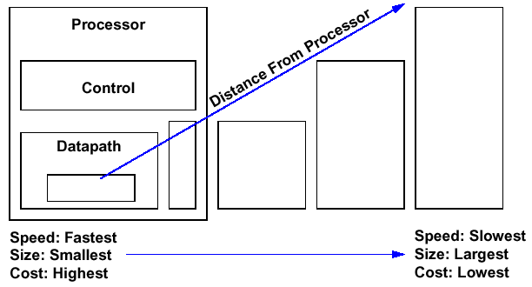
An Expanded View of the Memory Hierarchy
Memory
Secondary Storage
Disk
Memory
Main Memory
DRAM
Memory
Level 1 Cache
Memory
Level 2 Cache
SRAM
Memory
registers
Topics of this lecture set
Topics of next lecture set

Slide 6
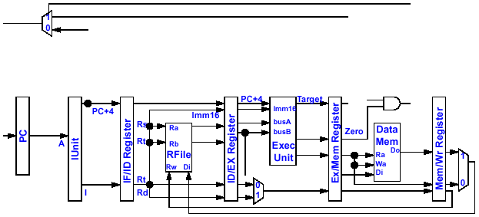

Memory Hierarchy and Data Path
ExtOp
ALUSrc
ALUOp
RegDst
MemWr
Branch
MemtoReg
RegWr
Control Signals
Control Signals
Control Signals
Main Control
4
4
Adder
PC+4
Inst
Mem
Instruction Memory
RA
Do
WA
Di
I-Cache
D-Cache
L2 Cache
Memory
L2 Cache
Mass Storage

Slide 7
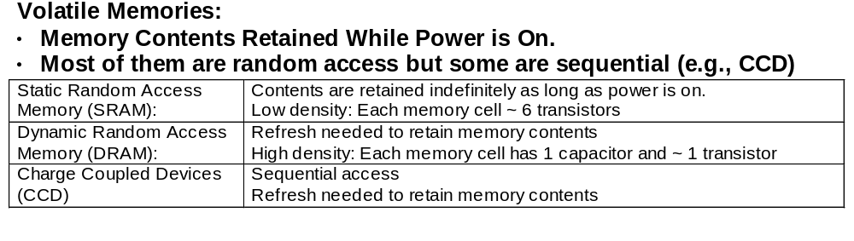
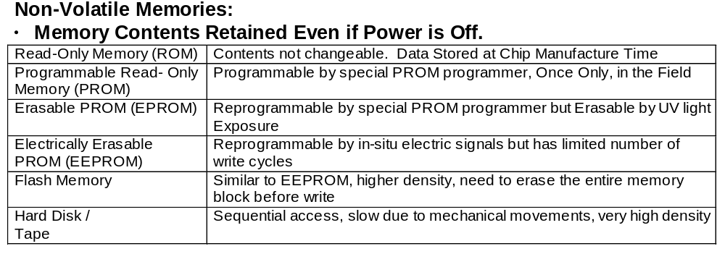
Memory Technologies Overview

Slide 8
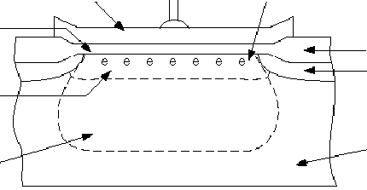
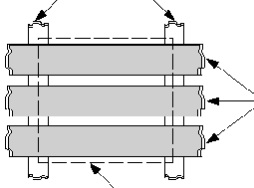
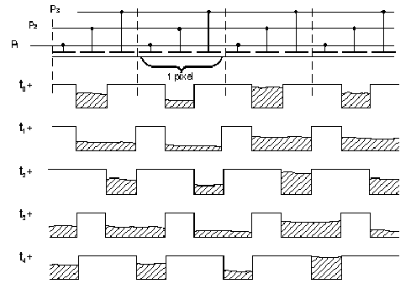
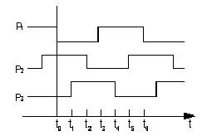
Charge Coupled Devices (CCD)
Basic CCD Cell
Gate
N-type Buried Channel
Channel Stops
Gate Oxide
Field Oxide
Signal Charges
Channel Stop
Polysilicon Gates
P-type Substrate
Depletion Region
Data Movement in CCD Memory for Reading/Writing
1-Pixel

Slide 9
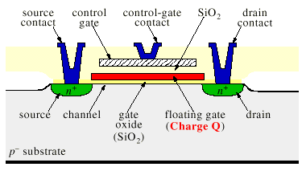
Floating Gate Technology for EEPROM and Flash Memories
Data represented by electrons stored in the floating gate
Data sensed by the shift of threshold voltage of the MOSFET
~10⁴ electrons to represent 1 bit

Slide 10
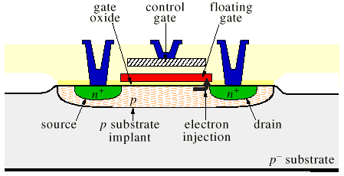
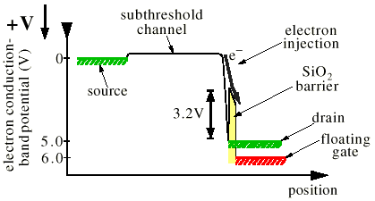
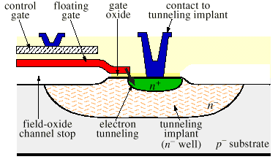
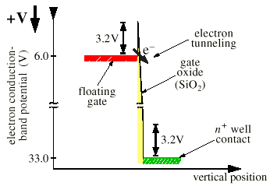
Programming Floating Gates Devices
Write a bit by electron injection
Erase a bit by electron tunneling

Slide 11
SRAM versus DRAM
Physical Differences:
Data Retention
  DRAM Requires Refreshing of Internal Storage Capacitors
  SRAM Does Not Need Refreshing
Density
  DRAM: Higher Density Than SRAM
  SRAM: Faster Access Time Than DRAM
Cost
  DRAM: Lower Cost per Bit Than SRAM
Select = 1
DRAM Cell
Row Select (Address)
SRAM Cell
P1
P2
Off
On
On
On
On
Off
Bit
(Data)
N1
N2
bit = 1
bit = 0
These differences have major impacts on their applications in the memory hierarchy

Slide 12
SRAM Organizations
WrEn
Precharge
Wr Driver &
Precharger
Wr Driver &
Precharger
Wr Driver &
Precharger
Wr Driver &
Precharger
-
+
-
+
-
+
-
+
Word 0
A0
SRAM
Cell
SRAM
Cell
SRAM
Cell
SRAM
Cell
A1
Word 1
A2
Address Decoder
SRAM
Cell
SRAM
Cell
SRAM
Cell
SRAM
Cell
A3
:
:
:
:
Word 15
SRAM
Cell
SRAM
Cell
SRAM
Cell
SRAM
Cell
-
+
-
+
-
+
-
+
Sense Amp
Sense Amp
Sense Amp
Sense Amp
Dout 3
Dout 2
Dout 1
Dout 0

Slide 13
DRAM Organization
bit (data) lines
Each intersection represents
a 1-T DRAM Cell
RAM Cell
Array
Row Decoder
word (row) select
row
address
Column Selector &
I/O Circuits
Column
Address
Conventional DRAM Designs Latch Row and Column Addresses Separately with row address strobe (RAS) and Column address strobe (CAS) signals
Row and Column Address Together Select 1 bit at a time
data

Slide 14
DRAM Technology
Conventional DRAM:
  Two dimensional organization, need Column Address Stroke (CAS) and Row Address Stroke (RAS) for each access
Fast Page Mode DRAM:
  Provide a DRAM row address first and then access any series of column addresses within the specified row
Extended- Data-Out (EDO) DRAM:
  The specified Row/Line of Data is Saved to a Register
  Easy Access to Localized Blocks of Data (within a row)
Synchronous DRAM:
  Clocked
  Random Access at Rates on the Order of 100 Mhz
Cached DRAM:
  DRAM Chips with Built- In Small SRAM Cache
RAMBUS DRAM
  Bandwidth on the Order of 600 MBytes per Second When Transferring Large Blocks of Data

Slide 15
Fast Page Mode Operation
Column
Address
N cols
Fast Page Mode DRAM
  N x M “SRAM” to save a row
After a row is read into the register
  Only CAS is needed to access other M-bit blocks on that row
  RAS_L remains asserted while CAS_L is toggled
DRAM
Row
Address
N rows
N x M “SRAM”
M bits
M-bit Output
1st M-bit Access
2nd M-bit
3rd M-bit
4th M-bit
RAS_L
CAS_L
A
Row Address
Col Address
Col Address
Col Address
Col Address

Slide 16
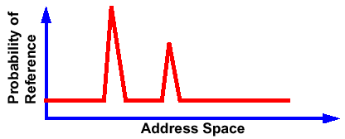
Why Memory Hierarchy Works?
The Principle of Locality:
  Program Accesses a Relatively Small Portion of the Address Space at Any Instant of Time. Example: 90% of Time in 10% of the Code
  Put All Data in Large Slow Memory and Put the Portion of Address Space Being Accessed into the Small Fast Memory.
Two Different Types of Locality:
  Temporal Locality (Locality in Time): If an Item is Referenced, It will Tend to be Referenced Again Soon
  Spatial Locality (Locality in Space): If an Item is Referenced, Items Whose Addresses are Close by Tend to be Referenced Soon.

Slide 17
Memory Hierarchy: Principles of Operation
At Any Given Time, Data is Copied Between only 2 Adjacent Levels:
  Upper Level (Cache): The One Closer to the Processor
    Smaller, Faster, and Uses More Expensive Technology
  Lower Level (Memory): The One Further Away From the Processor
    Bigger, Slower, and Uses Less Expensive Technology
Block:
  The Minimum Unit of Information that can either be present or not present in the two level hierarchy
Lower Level
Memory
To Processor
Upper Level
Memory
Blk X
From Processor
Blk Y

Slide 18
Factors Affecting Effectiveness of
Memory Hierarchy
Hit: Data Appears in Some Blocks in the Upper Level
  Hit Rate: The Fraction of Memory Accesses Found in the Upper Level
  Hit Time: Time to Access the Upper Level Which Consists of
  (( RAM Access Time) + (Time to Determine Hit/ Miss))
Miss: Data Needs to be Retrieved From a Block at a Lower Level (Block Y)
  Miss Rate = 1 - (Hit Rate)
  Miss Penalty: The Additional Time needed to Retrieve the Block from a Lower Level Memory After a Miss has Occurred
In order to have effective memory heirarchy:
  Hit Rate >> Miss Rate
  Hit Time << Miss Penalty

Slide 19
Analysis of Memory Hierarchy Performance
Simple Case: Single-Byte Block Read (No Replacement)
Average Mem Read Time = Hit Rate × Access Time + Miss Rate × Miss Penalty
Where in each level of the hierarchy
(1) Access Time = Look up time + transfer time to upper level
(2) Miss Penalty = Look up time + Look up time at lower level
+ Transfer time from lower level
+ Transfer time to upper level
Substituting (1):
Miss Penalty = Access time + Look up time at lower level
+ Transfer time from lower level
= Access time + Access time at lower level
Therefore:
Avg Mem Read Time = Hit Rate × Access Time
+ Miss Rate × (Access time + Access time at lower level)
Since Hit Rate + Miss Rate = 1,
Aveg Mem Read Time = Access Time + Miss Rate × Access time at lower level
Processor
Look up
Look up
Transfer
Transfer
Miss
Cache
Hit
Look up
Transfer
Main Memory

Slide 20
Analysis of Memory Hierarchy Performance
This formula can be applied recursively to multiple levels.
Aveg Mem Read Time = Access Time_{cache}+ Miss Rate_{cache}× Avg Access time_{mem}
Avg Access time_{mem} = Access Time_{mem} + Miss Rate_{mem} × Access time_{disk}
Therefore:
Aveg Mem Read Time
= Access Time_{cache} + Miss Rate_{cache} × Access Time_{mem}
+ Miss Rate_{cache} × Miss Rate_{mem} × Access time_{disk}
In general, let
  L_{n} refer to the upper level memory (e.g., a cache)
  L_{n-1} refer to the lower level memory (e.g., main memory)
  h_{Ln} = Hit rate at L_{n}
  t_{Ln} = Access time at L_{n}
Avg Mem Read Time = t_{Ln} + (1- h_{Ln}) × [t_{Ln-1} + (1- h_{Ln-1}) × t_{Ln-2}]
= t_{Ln} + (1- h_{Ln}) × t_{Ln-1} + (1- h_{Ln}) × (1- h_{Ln-1}) × t_{Ln-2}
Processor
Cache
Main Memory
Disk

Slide 21
Analysis of Memory Hierarchy Performance
Memory Hierarchies with Multiple word Blocks
Average Memory Read Time = Hit Rate × Hit Time + Miss Rate × Miss Penalty
  Let each block in L_{n} has m_{n} words, L_{n-1} has m_{n-1} words etc.:
  Hit Time = Look up time + time to transfer m_{n} words to upper level
Processor
Look up
Look up
Transfer m₁ words
Transfer m₁ words
Miss
Cache
Hit
Look up
Transfer m₂ words
Main Memory
  Miss Penalty = Look up time + Look up time at lower level
  + time to transfer m_{n-1} words from lower level
  + time to transfer m_{n} words to upper level
  = Hit time + Miss Rate × Hit time at lower level
  Same expression as the single block case, but now the hit time is a function of the block size

Slide 22
Analysis of Memory Hierarchy Performance
Average write time in memory hierarchy
Two ways to write to a memory hierarchy (just consider a cache and a main memory)
  Write through: Write to Cache and Memory at the Same Time
  Write back: Write to Cache Only. Write the Cache Block to Memory When that Cache Block is Being Replaced on a Cache Miss
Average write time for the Write Throught Cache
  Avg Mem Write Time = Hit Time of Main Memory
Average write time for the Write Back Cache
  Case 1: Cache blocks are single-word and assume the probability of replacement is negligible:
  Average Mem Write Time = Hit Time of the Cache
  Case 2: Cache blocks are multiple-word. In this case, the entire block has to be read from the main memory before the target word can be updated.

Slide 23
Analysis of Memory Hierarchy Performance
  Average Write Time for Multi-Word Write Back Cache
Assuming the read and write access time are symmetrical:
Avg Mem Write Time = Avg Mem Read Time for Multi-Word Block
  = t_{Ln} + (1- h_{Ln}) × t_{Ln-1} + (1- h_{Ln}) × (1- h_{Ln-1}) × t_{Ln-2}
Cache Block
Word 00
Word 01
Word 02
Word 03
Processor
Word to be modified
Look up
Look up
Write word
Transfer m₁ words
Miss
Cache
Hit
Look up
Transfer 4 words
Main Memory

Slide 24
Analysis of Memory Hierarchy Performance
If replacement is not negligible, a replaced block in the cache has to be written back to memory before the wanted block can be transferred to the cache
Processor
Look up
Write word
Miss
Cache
Write back replaced block
Look up address of replaced block
Transfer new Block
Look up address of new block
Main Memory
Let probability of replacement in cache be R_{c,} the miss penalty
= (1 – R_{c}) ×(Look up time in memory + time to transfer block from memory)
+ R_{c} × (time to look up the address of the replaced block
+ time to write back the replaced block to memory
+ time to look up for new block address
+ time to transfer new block to cache)

Slide 25
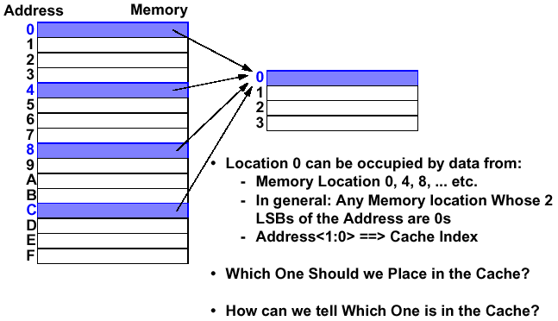
The Simplest Cache: Direct Mapping Cache
Answer: The block we need now
Answer: Use a cache tag

Slide 26
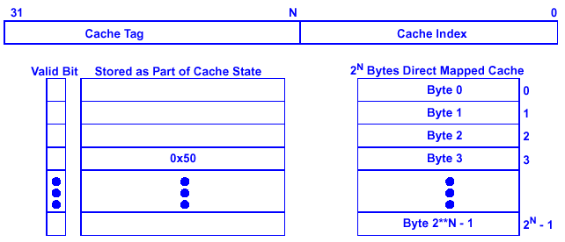
Cache Tag and Cache Index
Assume a 32- bit Memory (byte) Address:
  A 2^{N} Bytes Direct Mapping Cache:
  Cache Index: The Lower N Bits of the Memory Address
  Cache Tag: The Upper (32- N) Bits of the Memory Address
Example: Reading of Byte 0x5003 from cache
If N =4, other addresses eligible to be put in Byte 3 are:
0x0003, 0x0013, 0x0023, 0x0033, 0x0043, …
0x50
0x03
Hit
Byte 3

Slide 27
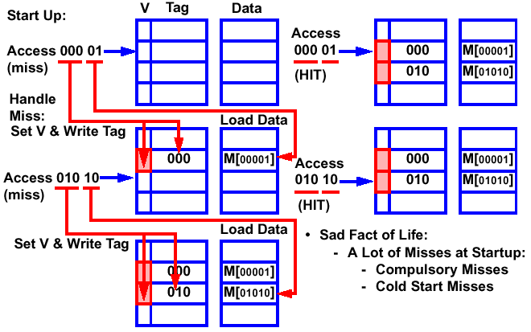
Cache Access Example

Slide 28
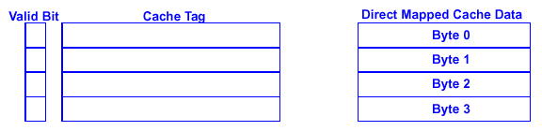
Cache Block
Cache Block: The Cache Data That is Referenced by a Single Cache Tag
Our Previous “Extreme” Example:
  4- Byte Direct Mapped Cache: Block Size = 1 word
  Take Advantage of Temporal Locality: If a Byte is Referenced, It will Tend to be referenced Soon
  Did not Take Advantage of Spatial Locality: If a Byte is Referenced, Its Adjacent Bytes will be Referenced Soon
In Order to Take Advantage of Spatial Locality: Increase Block Size (i.e., number of bytes in a block)

Slide 29
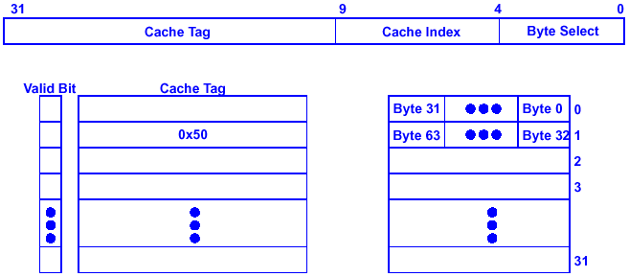
Example: 1KB Direct Mapped Cache with 32 Byte Blocks
For a 2^{N} Byte Cache:
  The Uppermost (32- N) Bits Are Always The Cache Tag
  The Lowest M Bits Are The Byte Select ( Block Size = 2^{M} )
  The Middle (32 - N - M) Bits Are The Cache Index
0x50
0x01
0x00
mux
Hit
Byte 32

Slide 30
Block Size Tradeoff
In General, Large Block Size Takes Advantage of Spatial Locality BUT:
  Larger Block Size Means Large Miss Penalty:
    Takes Longer Time to Fill Up the Block
  If Block Size is Big Relative to Cache Size, Miss Rate Goes Up
    Too few cache blocks
Average Access Time of a Single Level Cache:
= Hit Rate * HIT Time + Miss Rate * Miss Penalty
Miss
Penalty
Miss
Rate
Exploits Spatial
Locality
Average
Access Time
Increased Miss Penalty
& Miss Rate
Fewer blocks:
compromises
temporal locality
Block Size
Block Size
Block Size

Slide 31
Comparing Miss Rate of Large vs. Small Blocks
1-Word Block
PC
Addr
01000 main: add $t1, $t2, $t3
01001 add $t4, $t5, $t6
01010 add $t7, $t8, $t9
01011 add $a0, $t0, $0
01100 jal funct1
01101 j main
… …
10110 funct1: addi $v0, $a0, 100
10111 jr $ra
Index
V
Tag
Data
000
0
1
01
add $t1, $s3, $s3
001
0
1
01
add $t4, $s5, $s6
010
0
1
01
add $t7, $s8, $s9
011
0
1
01
add $a0, $t0, $0
100
1
01
jal funct1
0
101
1
01
j main
0
110
1
10
addi $v0, $a0, 100
0
111
1
10
jr $ra
0
8 Cold Misses but No more Misses After that!
4-Word Block
Index
V
Tag
Data Word 00
Data Word 01
Data Word 10
Data Word 11
0
0
1
01
add $t1, $s3, $s3
add $t4, $s5, $s6
add $t7, $s8, $s9
add $a0, $t0, $0
1
0
1
01
jal funct1
xxxxxxxxxxxxxxx
xxxxxxxxxxxxxxx
addi $v0, $a0, 100
jr $ra
1
10
j main
xxxxxxxxxxxxxxx
xxxxxxxxxxxxxxx
1
01
jal funct1
j main
xxxxxxxxxxxxxxx
xxxxxxxxxxxxxxx
address = [tag][word][index]
Only 2 Cold Misses but 2 more Misses after that!
Reason: The Temporal Locality is Compromised by the Inefficient Use of the Large Blocks!

Slide 32
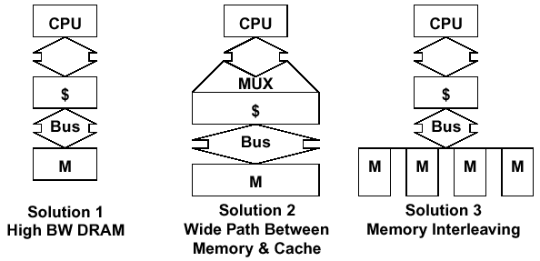
Reducing Miss Panelty
Miss Panelty = Time to Access Memory (i.e., Latency ) +
Time to Transfer All Data Bytes in Block
To Reduce Latency
  Use Faster Memory
  Use Second Level Cache
To Reduce Transfer Time
Other Ways to Reduce Transfer Time for Large Blocks with Multiple Bytes
  Early Restart: Processing resumes as soon as needed byte is loaded in cache
  Critical Word First: Transfer the needed byte first, then other bytes of the block

Slide 33
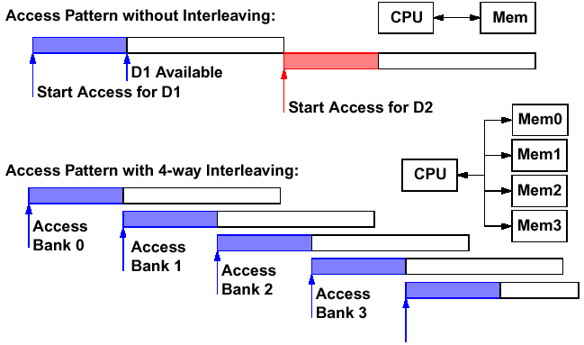
How Memory Interleaving Works?
Observation: Memory Access Time < Memory Cycle Time
  Memory Access Time: Time to send address and read request to memory
  Memory Cycle Time: From the time CPU sends address to data available at CPU
Memory Interleaving Divides the Memory Into Banks and Overlap the Memory Cycles of Accessing the Banks
Access Time
Memory Cycle
Access
Bank 0 Again

Slide 34
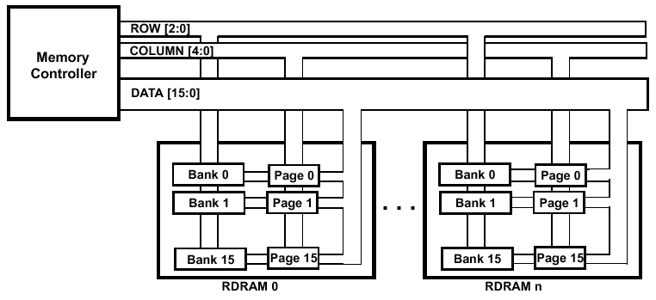
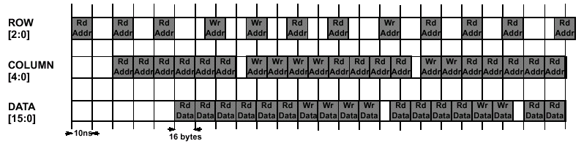
RAMBUS Example
Memory Architecture with RAMBUS
Interleaved Memory Requests

Slide 35
Other Ways to Reduce Transfer Time for Large Blocks with Multiple Bytes
Early Restart: Processing resumes as soon as needed byte is loaded in cache
Critical Word First: Transfer the needed byte first, then other bytes of the block
Access 010 100 01
Byte needed
Tag
Index
Byte 11
Byte 10
Byte 01
Byte 00
110
010
100
00110010
11000010
01110110
10000110
00010010
11110010
00001010
11010111
miss
To Processor
Access 010 100 01
Byte needed
Tag
Index
Byte 11
Byte 10
Byte 01
Byte 00
110
010
100
00110010
11000010
01110110
10000110
00010010
11110010
00001010
11010111
miss
To Processor

Slide 36
Another “Extreme” Example
Imagine a Cache: Size = 4 Bytes, Block Size = 4 Bytes
  Only ONE Entry in the Cache
By Principle of Temporal Locality, It is True that If a Cache Block is Accessed Once, it will Likely be Accessed Again Soon. Therefore, This One Block Cache Should Work in Principle.
  But Reality is That It is Unlikely the Same Block will be Accessed Again Immediately!
  Therefore, the Next Access will Likely to be a Miss Again
    Continually Loading Data Into the Cache But Discard (forced out) Them Before They are Used Again
    Worst Nightmare of a Cache Designer: Ping Pong Effect
Conflict Misses are Misses Caused by:
  Different Memory Locations Mapped to the Same Cache Index
    Solution 1: Make the Cache Size Bigger
    Solution 2: Multiple Entries for the Same Cache Index

Slide 37
The Concept of Associativity
Direct Mapping
A miss! Load cache.
Need to load cache again
PC
Addr
1000 Loop: add $t1, $s3, $s3
1001 lw $t0, 0($t1)
1010 bne $t0, $s5, Exit
1011 add $s3, $s3, $s4
1100 j Loop
1101 Exit
Index
V
Tag
Data
00
0
1
10
add $t1, $s3, $s3
1
11
j 1000
1
10
add $t1, $s3, $s3
01
0
1
10
lw $t0, 0($t1)
10
0
1
10
bne $t0, $s5, Exit
11
0
1
10
add $s3, $s3, $s4
Index
V
Tag
Data
2-Way Set Associative Cache
00
0
1
10
add $t1, $s3, $s3
PC
Addr
1000 Loop: add $t1, $s3, $s3
1001 lw $t0, 0($t1)
1010 bne $t0, $s5, Exit
1011 add $s3, $s3, $s4
1100 j Loop
1101 Exit
0
1
11
j 1000
1
01
0
10
lw $t0, 0($t1)
0
1
10
0
10
bne $t0, $s5, Exit
0
1
10
add $s3, $s3, $s4
Price to pay: either double cache size or reduce the number of blocks
11
0
0

Slide 38
Associativity: Multiple Entries for the Same Cache Index
Direct Mapped:
Memory Blocks (M mod N)
go only into a single block
0
1
2
3
4
0
5
1
6
2
7
3
8
9
Set Associative:
Memory Blocks (M mod N) can go anywhere in a set of blocks
0
1
2
3
0
4
1
Set 0
5
6
2
Set 1
7
3
8
9
Fully Associative:
Memory Blocks (M mod N) can go anywhere in the cache
0
1
2
3
0
4
1
Entire
Cache
5
2
6
3
7
8
9

Slide 39
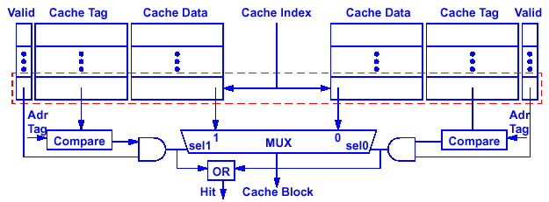
Implementation of Set Associative Cache
N- Way Set Associative: N Entries for Each Cache Index
  N Direct Mapped Caches Operates in Parallel
  Additional Logic to Examine the Tags to Decide Which Entry Is Accessed
Example: Two- Way Set Associative Cache
  Cache Index Selects a “set” from the Cache
  The Two Tags In the Set Are Compared In Parallel
  Data Is Selected Based On the Tag Result
Set
Tag #1
Entry #1
Entry #2
Tag #2
Tag
Index

Slide 40
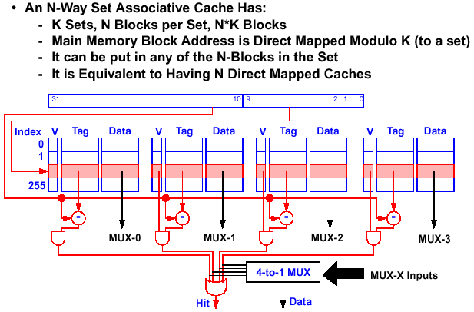
The Mapping for a 4- Way Set Associative Cache
Select block
Tag
Index
MUX-0
MUX-1
MUX-2
MUX-3

Slide 41
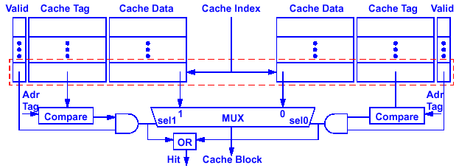
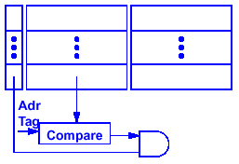
Disadvantages of Set Associative Cache
N- Way Set Associative Cache Versus Direct Mapped Cache:
  N Comparators Versus One
  Extra MUX Delay for the Data
  Data Comes AFTER Hit/ Miss
In a Direct Mapped Cache, Cache Block is Available BEFORE Hit/Miss
  Possible to Assume a Hit and Continue
  Recover Later if Miss
Valid
Cache Tag
Cache Data
Hit
Cache block

Slide 42
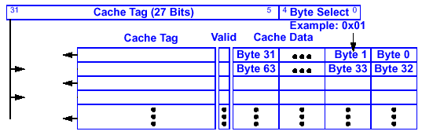
And Yet Another Extreme Example: Fully Associative
Fully Associative Cache — push the set associative idea to the limit!
  Forget about the Cache Index
  Compare the Cache Tags of All cache entries in parallel
  Example: Block Size = 32 Byte Blocks, we need N 27- Bit comparators
compare
compare
compare
compare
compare

Slide 43
Cache Organization Example
Given a cache memory has a fixed size of 64 Kbytes (2¹⁶ bytes) and the size of the main memory is 4 Gbytes (32-bit address), find the following overhead for the cache memory shown below:
  Number of memory bits for tag, valid bit, and dirty bits storage
  Number of comparators
  Number of 2:1 multiplexors
  Number of Miscellaneous gates
Tag
Index
Word select
V
D
Tag
Word #1
Word #2
V
D
Tag
Word #1
Word #2
…
…
…
…
…
…
=
32
=
32
32
32
Select
2-to-1 MUX
word 1
word 2
Hit
2-to-1 MUX
See Class Example

Slide 44
A Summary on Sources of Cache Misses
Compulsory (Cold Start, First Reference): First Access to a Block
  “Cold” Fact of Life: Not a Whole Lot You Can Do About It
Conflict (Collision):
  Multiple Memory Locations Mapped to Same Cache Location
  Solution 1: Increase Cache Size
  Solution 2: Increase Associativity
Capacity:
  Cache Cannot Contain All Blocks Accessed By the Program
  Solution: Increase Cache Size
Invalidation: Other Process (e. g., I/ O) Updates Memory
  This occurs more often in multiprocessor system in which each processor has its own cache, and any processor updates a data in its own cache may invalidate copies of the data in other caches

Slide 45
Cache Replacement
Issue: Since many memory blocks can go into a small number of cache blocks, when a new block is brought into the cache, an old block has to be thrown out to make room. Which block to be thrown out?
Direct Mapped Cache:
  Each Memory Location can only be Mapped to 1 Cache Location
  No Need to Make Any Decision :-)
  Current Item Replaced the Previous Item In that Cache Location
N- Way Set Associative Cache:
  Each Memory Location Have a Choice of N Cache Locations
  Need to Make a Decision on Which Block to Throw Out!
Fully Associative Cache:
  Each Memory Location Can Be Placed in ANY Cache Location
  Need to Make a Decision on Which Block to Throw Out!

Slide 46
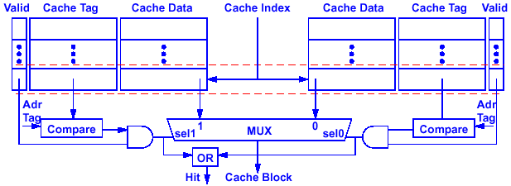
Cache Block Replacement Policy
Random Replacement
  Hardware Randomly Selects a Cache Item and Throw It Out
First- in First- out (FIFO)
Least Recently Used:
  Hardware Keeps Track of the Access History
  Replace the Entry that has not been used for the Longest Time
  Difficult to implement for high degree of associativity
Entry 3
Entry 0
Replacement Pointer
Entry 1
set
Entry 2
Entry 3
Entry 0
Used
Used
r
s
r
s
miss
s = set
r = reset
0
New Data
New Tag
1
1
1
0
1
0
r
s
r
s
0
reset
set
set
reset
read hit
read hit

Slide 47
Cache Write Policy: Write Through Versus Write Back
Cache Read is Much Easier to Handle than Cache Write:
  Instruction Cache is Much Easier to Design than Data Cache
Cache Write:
  How Do We Keep Data in the Cache and Memory Consistent?
Two Options
  Write Back: Write to Cache Only. Write the Cache Block to Memory When that Cache Block is Being Replaced on a Cache Miss.
    Need a “Dirty” bit for Each Cache Block
    Greatly Reduces the Memory Bandwidth Requirement
    Control can be Complex
  Write Through: Write to Cache and Memory at the Same Time
    Isn’t Memory Too Slow for this?
    Use a Write Buffer

Slide 48
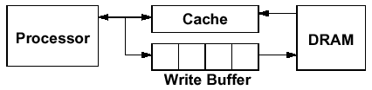
Write Buffer for Write Through
A Write Buffer is Needed Between the Cache and Memory
  Processor: Writes Data into the Cache and the Write Buffer
  Memory Controller: Write Contents of the Buffer to Memory
Write buffer is Just a FIFO:
  Typical Number of Entries: 4
  Works Fine If: Store Frequency << 1 / DRAM write cycle
  Additional Logic to Take Care Read Hit When Data Is in Write Buffer
Memory System Designer’s Nightmare:
  Store Frequency > 1 / DRAM Write Cycle
  Write Buffer Saturation

Slide 49
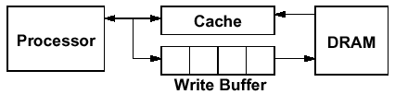
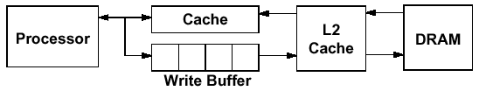
Write Buffer Saturation
Store Frequency > 1 / DRAM Write Cycle
  If this condition exists for a long period of time (CPU cycle time too quick and / or too many store instructions in a row):
    Store buffer will overflow no matter how big you make it
    The CPU Cycle Time << DRAM Write Cycle Time
Solution for Write Buffer Saturation
  Use a Write Back Cache
  Install a Second Level (L2) Cache

Slide 50
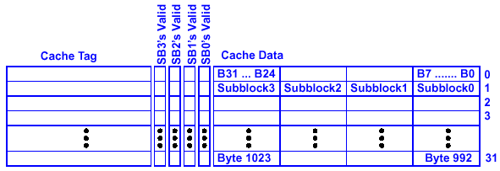
Misses in Write Back Cache
Upon Cache Misses, a Replaced Block Has to Be Written Back to Memory Before New Block Can Be Brought Into the Cache
Techniques to Reduce Panelty of Writing Back to Memory
  Write Back Buffer:
    The Replaced Block Is First Written to a Fast Buffer Rather Than Writing Back to Memory Directly
  Dirty Bit:
    Use Dirty Bit to Indicate If Any Changes Have Been Made to a Block. If the Block Has Not Been Changed, There Is No Need to Write It Back to Memory
  Sub-Block:
    A Unit within a block that has its own valid bit. When a miss occurs, only the bytes in that sub-block are brought in from memory

Slide 51
Summary
The Principle of Locality
  Program accesses a relatively small portion of the address space at any instant of time
  Temporal Locality: Locality in Time
  Spatial Locality: Locality in Space
Three Major Categories of Cache Misses:
  Compulsory Misses: Sad Facts of Life. Example: Cold Start Misses
  Conflict Misses: Increase Cache Size and / or Associativity
  Nightmare Scenario: Ping Pong Effect!
  Capacity Misses: Increase Cache Size
Write Policy:
  Write Through: Need a Write Buffer. Nightmare: WB Saturation
  Write Back: Control Can Be Complex

