Slide 1
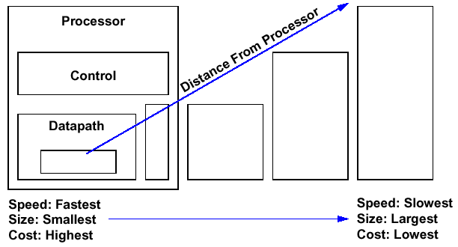
Continuing the Discussion of Memory Hierarchy
Memory
Secondary Storage
Disk
Memory
Main Memory
DRAM
Memory
Level 1 Cache
Memory
Level 2 Cache
SRAM
Memory
registers
Topics of this lecture set

Slide 2
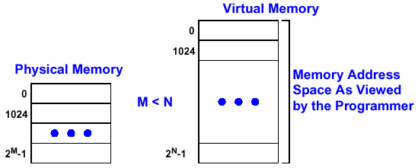
Virtual Memory
Illusion of Memory Size Much Greater Than Physical Memory Size
Exploits Memory Hierarchy to Keep Average Access Time Low
  At Least 2 Storage Levels: Main and Secondary
Virtual Address — Address Used By the Programmer
Memory Address — Address in Physical Memory
(Main Memory)
(Secondary Storage)

Slide 3
Similarities Between Cache and Virtual Memory
cache
Main memory
Secondary Storage
Cache Design
Virtual Memory Design
Both Use Two Levels of Memories
  Higher Level: Faster and Smaller
  Lower Level: Slower and Larger
Both Rely on the Principle of Locality
Both Use Associativity to Reduce Conflicts
Both Need to Decide Which Block in Higher Level has to be Replaced Upon Miss

Slide 4
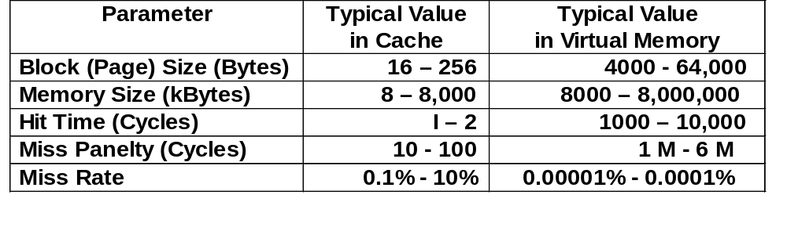
Differences Between Cache and Virtual Memory
Cache is several orders of magnitude faster than virtual memory, while virtual memory is several orders of magnitude larger than cache
Consequently
  Virtual memory can use software to track blocks in use while cache has to use hardware
  The cost to implement full associativity is low for Virtual memory and very high for cache
  Virtual memory can use more sophisticated block replacement algorithms
  Virtual memory has to use write-back while cache can use write-back or write-through

Slide 5
Issues in Virtual Memory Design
Mapping — How to Map the Blocks in Secondary Storage to the Main Memory
Fetch Policy — When to Find the Needed Data From Secondary Storage into Main Memory
Block Placement — Where to Put a Block in Main Memory and How to Find It
Block Replacement — How to Free a Region of Memory to Place the New Block
Write Policy — What to Do If a Block in Main Memory Has to Be Replaced

Slide 6

The Basic Unit of Transferring Data From Secondary Storage to Main Memory
Equal Size Blocks
  Paging: Block of Fixed Size in Virtual Memory
  Page Frame: Physical Address Space for Each Page
  Example: Alpha has 8KB, 64KB, 512KB, 4MB Page Sizes
Variable Sized Blocks
  Segmentation
  Example: Burroughs B4500
Multiple Page Blocks
  Segments Consist of Multiple Pages
Note: Paging is used in most modern machines due to its simplicity

Slide 7
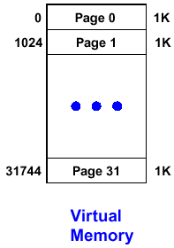
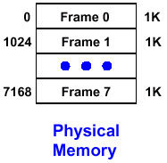
Example Paging Organization
Page Size = 1 Kbytes
Address Translation Map
Smaller
(Less Pages)
Larger
(More Pages)

Slide 8
Page Table
To keep track which page of the secondary store is in main memory and translate virtual memory address into physical address
Each entry has a valid bit, access right field, and a physical address of a page
The higher order bits of a virtual memory address (number of bits depending on page size) is used to index the entries. This is how the virtual memory address is translated into physical address
Usually each program has its own page table. The page table of the running program is pointed to by a Page Table Pointer Register
32 bits
1 bits
1 bits
24 bits
Virtual Page #
Valid
Access Right
Physical Page Address
Page Table Pointer ^{Note}
00001000
0
R/W
29B000
00002000
1
R
737000
...
...
...
...
000F000
1
X
C37000
Note: This register and the page table along with the program counter constitute the state of a program, also known as a process. The page table is loaded from disk to memory when the process is active. Operating System has to make sure no page is assigned to two active programs.

Slide 9
Protection of Pages by Page Frame Table
The Page Frame Table is Used by the operating system to know how the pages in main memory are allocated to different active jobs, and to provide the information to use in deciding what pages to replace.
Some frequently used pages such as critical OS functions can be “locked” into areas of main memory
Page Frame # in Main Memory | Used Bit | Dirty Bit | User | Virtual Page Address
0 (addr = 000000) | 1 | 1 | A | 0000029B
1 (addr = 001000) | 1 | 0 | B | 00000737
... | ... | ... | ... | ...
2^{n}- 1 (addr = FFF000) | 0 | 0 | A | 000C374
Set if page is accessed
User program name
Set if page is modified

Slide 10
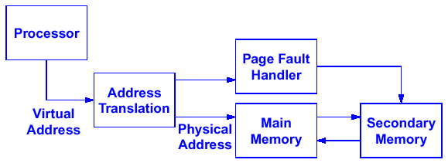
Address Mapping
Address Translation Determines If Main Memory Has the Requested Page by Examining the Valid Bit of the Page in the Page Table
If the Requested Page Is Not in Main Memory, Operating System Transfers Data from Secondary Memory to Main Memory and Then Set the Valid Bit. Write the old page back to memory if necessary (e.g., page modified but not saved).
Read Address
Write Address
V=1
V=0
V=1
Old Page
new phy addr
New Page
To Cache
To Cache

Slide 11
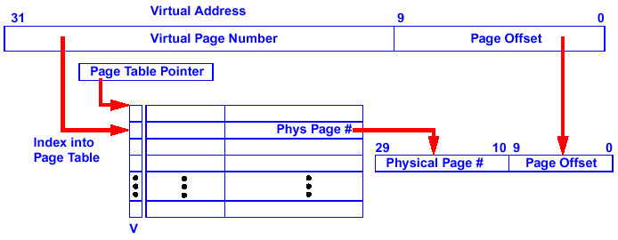
Example: Address Mapping with 1KB Pages
Page Table Located in Physical Memory
V = Valid Bit:
  V = 1: Page is in Main Memory
Access Rights: R = Read- Only, R/ W = Read/ Write, X = Execute Only
20
18
Physical Address
Access
Rights
Physical Page #
To Memory if V=1

Slide 12
Advantages and Disadvantages of Paging
Advantages
  Fixed page boundary (usually address = 2^{N}) significantly simplifies control logic (e.g., page number is just the upper bits of the address)
  Flexible: Pages of the same program do not have to be contiguous. Use the page table to locate individual pages
Disadvantages
  Fragmentation: Disjointed Areas of Unused Memory Space
  Internal Fragmentation: Program or Data Does not use an Integral Number of Pages so Part of the Last Page is Wasted:
Page Table for Program X
Page 1
Page 2
Page 3
Page 4
memory
Program X
Unused
Program X
Program X
Program Y
Program Y
Program X
memory
Wasted Memories
memory

Slide 13
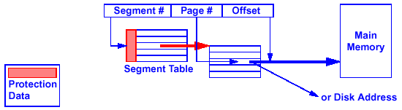
Segmentation and Paged Segments
Segmentation tries to remove the fragmentation by using vaiable block size, but it requires much more complex control logic (a segment pointer, an off-set pointer, and a boundary register)
Paged Segments
  Programs and Data Treated as Logical Entities (i.e., Segments of Differing Size)
  Each Segment Is then Broken into Fixed Sized Pages and Has Its Own Page Table
  Use of Segments is Invisible to the User
    Allows Protection to be Made on the Basis of Logical Entities (Bits Programs Set in Segment Table)
    More Complex Address Translation
Program Y
Segment pointer
Program X
Off-set
data
Boundary Reg
memory
Page table for segment

Slide 14
Trade-Offs Of Page Size
Large Page Size Increases Internal Fragmentation, but Decreases the Number of Pages and Page Table Size and Thus Simplifies the Management and Control of the Pages
Small Page Size Decreases Internal Fragmentation, but Increases Page Table Size and Complicates the Management and Control of the Pages
Trend Toward Large Page Sizes
  Large Memories as RAM Costs Drop
  Wider Gap Between Processor Speed and Disk Speed
  Programmers Want Larger Virtual Address Space
4KB Pages are Common

Slide 15
When to Fetch Secondary Storage?
Page Fault:
  Page Not In Main Memory (i.e., Valid Bit = 0 on Access)
  Current Process Suspended While a Page is Fetched From Secondary Storage (may switch to another process while waiting for data from disk)
Fetch Policies
  Demand Paging
    Pages Loaded Due to Page Faults Only
    If the Page to be Replaced Has Been Written to (i. e., Dirty), It Must be Written to Disk Before the New Page is Fetched.
  Prepaging
    Anticipate References and Load Pages Before Their Use
    Reduces Wait Time for a Page Transfer
    Difficult to Predict Future References
  Most Common Implementation is Demand Paging

Slide 16
Placing a Block in Main Memory
Since the secondary storage is so much slower than the CPU and main memory, software can be used to manage block placement in main memory without noticeable performance impact
Now, it is practical to use full associativity for block replacement to reduce page conflicts.
The full associativity is managed by the page table (as oppose to using tags and comparators in cache). The virtual page number serves as the “index”, and no “tag” is necessary because the index is a full address
Each program can have its own page table and a hardware page table register is used to point to the active page table.
Virtual Page #
in Virtual Address
V
Phy Page #
Main Memory
1
3
0
1
4
1
0
2
1
1
3
1
5
4
0
5
0
1
0
1
3
Disk
Page Table of Program

Slide 17
Page Table for Large Address Space
Two-level Page Tables
1K
PTEs
32-bit address:
4KB
10
10
12
P1 index
P2 index
page offest
4 bytes
Assuming 4 KB pages, a single-level page table, 4 GB virtual address space requires 1 M page table entries stored in memory
Assuming 4 KB pages, a two-level page table, 4 GB virtual address space requires 1 K entries in 1st level page table, 1000 2nd level page page of 1 K entries each. However, it is not necessary to load all 1000 2nd level page table in memory at the same time.
4 bytes

Slide 18
Finding Data in Main Memory
Using page table to find a data in memory has a problem; every memory access requires a 2-step process
  Step 1: Read page table in order to obtain a physical address
  Step 2: Use the physical address to get the data
The 2-step process doubles the miss panelty of cache misses
Why not cache the most recently used portion of the page table also? This cache is called the Table Look-Aside Buffer (TLB)
V
Tag
Phy Page #
Virtual Page #
in Virtual Addr
1
3
1
1
0
2
1
4
5
0
TLB
V
Phy Page #
Main Memory
0
1
2
0
1
1
4
1
2
0
2
3
1
1
3
4
1
5
4
5
0
5
6
0
7
1
0
8
1
3
Disk
Page Table

Slide 19
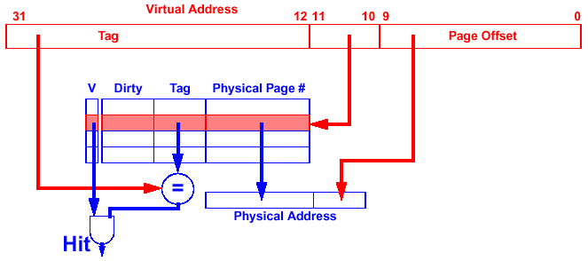
Translation Lookaside Buffer
Cache of Recently Used Page Table Entries
Can Be Fully Associative, Set Associative, or Direct Mapped
Direct Mapped TLB Example:
index
Note: Dirty bit indicates if the page in memory has been modified. If it has not been modified, it will be replaced without copying back to memory.

Slide 20
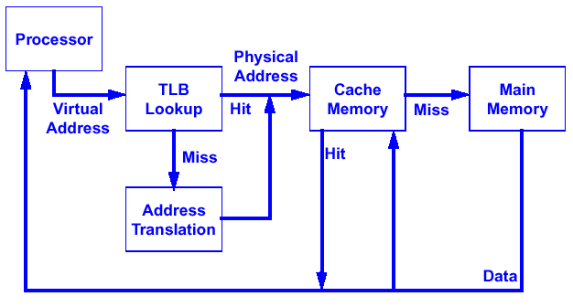
Translation with a TLB
(get physical address from page table in memory)
See Class Example

Slide 21
Virtual Memory and Cache Mappings
Example: Decstation 3100
31
Virtual Address
12
11
0
Virtual Page Number
Page Offset
Valid
Dirty
Tag
Physical Page #
12
20
TLB
mux
20
=
=
=
Physical Address
=
14
Valid
Tag
Data
2
Index
Byte Offset
Tag
TLB Hit
=
32
Cache Hit
Data
Note: Another important bookkeeping bit Write Access Bit for Write Protection Is Not Shown
See Class Example

Slide 22
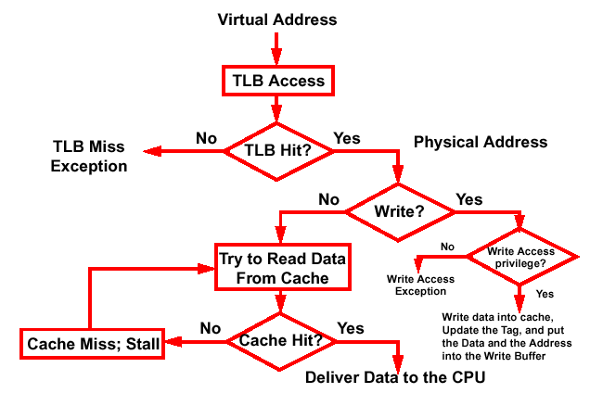
Decstation 3100 TLB and Cache (Continued)
Get Data from Disk
Write Data to Disk
Get Data from Memory

Slide 23
Page Replacement
Similar to Cache Block Replacement, Except that Software Can Be Used to Decide Which Block Should Be Replaced. Therefore, More Sophisticated Algorithms Can Be Used.
First-in-First-out
  Replace the Page that has been in Memory the Longest
  Replacement of Old but Frequently Used Page Can Happen
  Easy to Implement
Least Recently Used
  Replace the Least Recently Used Page
  Need Access History, It Is Easier in This Case Because It Can Be Implemented in Software Due to the Long Latency of Disk Access.
  Good Performance, Uses Principle of Locality
Page- Fault Frequency (PFF)
  Dynamically Assign Pages to Jobs Based on their Page Fault Rate
  Take Pages from Jobs that Seldom Fault and Give Pages to Jobs that Fault Frequently

Slide 24
Page Replacement (Continued)
During a Page Miss:
  A processor switches to another job whose pages are present
  Returns to the current job after the missing pages have been fetched (Hundreds of thousands of cycles later)
Working Set = the number of pages a job needs to achieve a “Reasonably Low” Miss Ratio.
  It varies from program to program, but with too few pages the job thrashes, and spends all of its time waiting for pages
Page allocation and replacement strategies should achieve good processing efficiency over the set of jobs in the machine
  Too Many Jobs and the whole system thrashes
  Too Few Pages for one job and that job gets nothing done

Slide 25
Example Implementation of LRU in Virtual Memory
Associated with each page is a used bit such that
used bit = 1 if the page has been referenced in recent past
= 0 otherwise
If replacement is necessary, choose any page frame such that its used bit is 0. This is a page that has not been referenced in the recent past.
If more than one page has used bit set to 0, choose a page whose dirty bit is also 0. This page has not been changed and therefore no need to write back to disk.
Question: How to update the used bits?

Slide 26
One Possible Way to Update the Used Bit
Add a Last Replaced Pointer (LRP) in Page Fault Handler:
  LRP points to the entry that have just been replaced
  If replacement is to take place, advance LRP to next entry until one with a 0 bit is found; this is the target for replacement; As a side effect, all examined page table entries have their reference bits set to zero.
Search for an unused entry, reset used bits of examined entries in the process
Page Frame Table
Assume the Program needs to replace a page again
Page #
used
Virtual Address
0
0x0200
  Last Replaced Pointer
Replace
0
1
0x1000
Read
1
0
0x0400
1
0
Write
1
0x0600
2
0
0
Read
1
0x0800
3
0
0
Replace
0
0x0A00
4
1
0x1200
5
0
0x0C00
  Control scheme is simple
  But this is only an approximation of LRU. No guarantee the replaced entries are the LEAST recently used

Slide 27
Write Policy
Due to long latency of disk access, only write-back is practical for virtual memory.
If accessed page in memory is valid, processor can write data to the page at memory speed rather than at the disk speed, which is several orders of magnitude slower. Set dirty bit after write.
Write memory data back to disk if the page is candidate for replacement and its dirty bit is set.
When data are written back, the system can make effective use of a high bandwidth transfer because the entire block is transferred. The latency is amortized over many bytes in the block.
While old page are written back to the disk, processor can switch to other tasks until the new page have been fetched into the memory.

Slide 28
Virtual Memory Summary
Virtual Memory is Another Level of the Memory Hierarchy
Creates the Illusion of a Very Large Memory
Page Tables, Possibly Multi-Level, Map a Virtual Address to a Physical Address
TLBs are Important for Fast Translation

