Slide 1
Five Classic Components of a Computer
Processor
Input
Control
Memory
Datapath
Output
Current Topic: Input and Output

Slide 2
What You Will Learn in This Set of Lectures
Basic Concepts of I/O Design from a Processor’s View Point
  I/O Architecture
  Design Example
  I/O Layers
  Standard I/O Bus Examples

Slide 3
Who Cares About I/O?
CPU Performance: 60% per year
I/O system performance limited by mechanical delays (disk I/O)
  < 10% per year (IO per sec or MB per sec)
Amdahl's Law: system speed-up limited by the slowest part!
  10% IO & 10x CPU ➔ 5x Performance (lose 50%)
  10% IO & 100x CPU ➔ 10x Performance (lose 90%)
I/O bottleneck:
  Diminishing fraction of time in CPU
  Diminishing value of faster CPUs

Slide 4
How is I/O Related to Processor
✓
1
Branch
Target
Address
0
ExtOp
ALUSrc
ALUOp
RegDst
MemWr
Branch
MemtoReg
RegWr
Control Signals
Control Signals
Control Signals
Main Control
4
Adder
PC+4
PC+4
Imm16
Imm16
Rs
BusA
Exec Unit
A
Ra
BusB
Zero
PC
Rt
Rb
Do
IF/ID Register
ID/EX Register
EX/Mem Register
Mem/Wr Register
RFile
RA
WA
1
Rw
Wr
Di
Rt
0
Di
0
I
Rd
1
I/O Controller
I/O Device
Memory Hierarchy

Slide 5
I/O Architecture Overview
I/O Architecture Usually is Divided into Layers. Typical Layers are:
System Interface
Operating System Support
Failure Handling
Logical
Protocol
Failure Handling
Physical
Protocol
Connectivity
Access Control
Performance
Expandability
Failure Handling

Slide 6
I/O Architecture Overview
✓
User Application
system call
System Interface
Software
Operating System
Device Driver
Device Driver
Protocol can be defined at all levels
Logical
I/O Controller
I/O Controller
Hardware
Media
Physical
I/O Device
I/O Device
Class example 1

Slide 7
I/O Architecture Design Example
Memory
I/O Controller
Read/Write#
I/O Device
Processor
Data
Clock
Memory Bus
Frame
Acknowledge
Write Operation
Read/Write#
(Controller → Device)
Data
(Controller → Device)
b0
b1
b2
b3
b4
b5
b6
b7
b0
b1
b2
b3
b4
b5
b6
b7
Clock
(Controller → Device)
Frame
(Controller → Device)
Acknowledge
(Device → Controller)

Slide 8
I/O Architecture Design Example
Memory
I/O Controller
Read/Write#
I/O Device
Processor
Data
Clock
Memory Bus
Frame
Acknowledge
Read Operation
Read/Write#
(Controller → Device)
Data
(Device → Controller)
b0
b1
b2
b3
b4
b5
b6
b7
b0
b1
b2
b3
b4
b5
b6
b7
Clock
(Controller → Device)
Frame
(Controller → Device)
Acknowledge
(Controller → Device)

Slide 9
Hardware Layer
The Design of the I/O Controller Design (RTL)
Note: (1) Upper cases are registers, low cases are signals
(2) All register transfers take 1 clock unless grouped by { }, which means all transfers are in parallel.
(3) CTRL_REG<0> = READ/WRITE#
(4) STATUS_REG<0> = data ready
If (SELECT = 1) then
  WORD_CNT ← mem_data_bus
  {CTRL_REG ← mem_data_bus
  rd_wr# ← CTRL_REG<0>
  If (CTRL_REG<0> = 1) then
    frame ← 1
    { }
    For (WORD_CNT > 0)
      For (BIT_CNT <= 7)
      {DATA_REG<BIT_CNT> ← data
      BIT_CNT ← BIT_CNT + 1}
      End_for
      While (mem_addr_bus != status_reg_addr)
      {ack ← 1
      STATUS_REG<0> ← 1}
      End_while
      {mem_data_bus ← DATA_REG
      STATUS_REG ← 0
      ack ← 0
      BIT_CNT ← 0
      WORD_CNT ← WORD_CNT – 1}
    End_for
    {CTRL_REG ← 0
    frame ← 0
  End_then
    Else
      {frame ← 1
      DATA_REG ← mem_data_bus}
      For (WORD_CNT > 1)
        For (BIT_CNT <= 7)
        {data ← DATA_REG<BIT_CNT>
      BIT_CNT ← BIT_CNT + 1}
        End_for
        {BIT_CNT ← 0
        WORD_CNT ← WORD_CNT – 1}
        While (ack = 0)
        End_while
        While (ack = 1)
        DATA_REG ← mem_data_bus End_while
      End_for
      {CTRL_REG ← 0
      frame ← 0
    End_ELSE
  End_if
  SELECT ← 0
End_if

Slide 10
Hardware Layer
The Design of the I/O Controller Design
I/O Controller
Control
Unit
Reset_select
Mem address bus
Decoder
SELECT
CTRL_REG
STATUS_REG
WORD_CNT
ack
frame
BIT_CNT
clock
Mem data bus
DATA_REG
read/write#
data
CTRL_REG address = SELECT address + 1
STATUS_REG address = SELECT address + 2
WORD_CNT address = SELECT address + 3
BIT_CNT address = SELECT address + 4
DATA_REG address = SELECT address + 5

Slide 11
Hardware Layer
State Diagram of the I/O Controller Control Unit
0
Controller_select = 0
No Op
1
Controller_select = 1
Word_cnt_wr_en = 1
2
Ctrl_reg_wr_en = 1
Rd_wr# = ctrl_reg<0>
8
3
Rd_wr# = 1
Rd_wr# = 0
Frame = 1
Data_reg_wr_en = 1
Frame = 1
4
Word_cnt > 0
Word_cnt > 0
Data_reg_shift_in = 1
Bit_cnt_increment = 1
Bit_cnt <=7
Data_reg_shift_in = 1
Bit_cnt_increment = 1
9
5
Bit_cnt >7
Bit_cnt <=7
Word_cnt > 0
Ack = 1
Reset_status_reg<0>=1
Mem_addr !=
status_reg_add
Bit_cnt >7
10
Reset_ bit_cnt = 1
Word_cnt_decrement = 1
6
Mem_addr = status_reg_add
Data_reg_rd_en = 1, Ack = 0
Reset_ status_reg_b0 = 1
Reset_bit_cnt = 1
Word_cnt_decrement = 1
Ack =0
11
No op
Ack =1
12
Ack = 0 & word_cnt > 0
Ack =1
Data_reg_wr_en = 1
7
Word_cnt = 0
Ack = 0 & word_cnt = 0
Ctrl_reg_reset = 1
Frame = 0, Reset_select = 1
13
Ctrl_reg_reset = 1
Frame = 0, Reset_select = 1

Slide 12
Software Layers
I/O Controller Driver Software
Read: Addi $s0, $0, select_addr #s1 = address of SELECT register
Addi $t1, $0, 1
Addi $t3, $0, cnt #word count
Sw $t1, 0($s0) #select the I/O controller by writing a 1 to SELECT
Sw $t3, 3($s0) #load word count to WORD_CNT register
Sw $t1, 1($s0) #write 1 to CTR_REG to tell I/O device this is a read
Wait_done: Lw $t4, 3($s0) #keep checking the WORD_CNT register
Beq $t4, $0, Exit #If word count = 0, done.
Wait_data: Lw $t4, 2($s0) #check STATUS_REG
Beq $t4, $t1, Xfer #If STATUS_REG =1, then data ready
j Wait_data
Xfer: lw $t5, 5($t0) #data ready, get DATA_REG
sw $t5, 0(buffer_memory) #store the read data into buffer memory
j Wait_done
This driver software can be called from a C program (via linker) as :
ReadIoDevice(select_addr, cnt, buffer_memory)

Slide 13
Software Layers
I/O Controller Driver Software
Write: Addi $s0, $0, select_addr #s1 = address of SELECT register
Addi $t1, $0, 1
Addi $t3, $0, cnt #word count
Sw $t1, 0($s0) #select the I/O controller by writing a 1 to SELECT
Sw $t3, 3($s0) #load word count to WORD_CNT register
Sw $t1, 1($s0) # write 0 to CTR_REG to tell I/O device this is a write
Lw $t5, 0(buffer_memory) #get data from memory buffer
Sw $t5, 5($s0) #move data to DATA_REG
Wait_done: Lw $t4, 3($s0) #keep checking the WORD_CNT
Beq $t4, $0, Exit #If word count = 0, done.
Wait_zero: Lw $t4, 4($s0) #check BIT_CNT
Bne $t4, $0, Wait_zeror #if BIT_CNT = 0, all bits in DATA_REG shifted out
Lw $t5, 0(buffer_memory) #get new data from memory buffer
Sw $t5, 5($s0) #move new data to DATA_REG
j Wait_done
This driver software can be called from a C program (via linker) as :
WriteIoDevice(select_addr, cnt, buffer_memory)

Slide 14
To Put Everything Together
Write: Addi $s0, $0, select_addr #s1 = address of SELECT register
Addi $t1, $0, 1
Addi $t3, $0, cnt #word count
Sw $t1, 0($s0) #select the I/O controller by writing a 1 to SELECT
Sw $t3, 3($s0) #load word count to WORD_CNT register
Sw $t1, 1($s0) # write 0 to CTR_REG to tell I/O device this is a write
Lw $t5, 0(buffer_memory) #get data from memory buffer
Sw $t5, 5($s0) #move data to DATA_REG
Wait_done: Lw $t4, 3($s0) #keep checking the WORD_CNT
Beq $t4, $0, Exit #If word count = 0, done.
Wait_zero: Lw $t4, 4($s0) #check BIT_CNT
Bne $t4, $0, Wait_zeror #if BIT_CNT = 0, all bits in DATA_REG shifted out
Lw $t5, 0(buffer_memory) #get new data from memory buffer
Sw $t5, 5($s0) #move new data to DATA_REG
j Wait_done
Control
Unit
Reset_select
Mem address bus
Decoder
SELECT
CTRL_REG
STATUS_REG
WORD_CNT
ack
frame
BIT_CNT
clock
Mem data bus
DATA_REG
read/write#
data

Slide 15
A Real I/O Controller: 80312
Local memory
(SDRAM, Flash)
80200 Processor
Memory Controller
Core Interface
I²C Bus Interface
Application Accelerator
Internal Arbitration
64-bit internal bus
Messaging Unit
2 DMA Channels
Address Translation
Performance Monitor
1 DMA Channel
Address Translation
PCI to PCI Bridge
64-bit/32-bit primary PCI bus
64-bit/32-bit secondary PCI bus
Secondary PCI Arbitration Unit

Slide 16
Hardware Aspect of I/O Design

Slide 17
Physical Level Protocol
Synchronous:
  Includes a clock in the control lines
  A fixed protocol for communication that is relative to the clock
  Advantage: involves very little logic and can run very fast
  Disadvantages:
    Every device on the bus must run at the same clock rate
    To avoid clock skew, they cannot be long if they are fast
Asynchronous:
  Has no clock signal
  Requires a handshaking protocol to synchronize the sender and receiver
  Advantage
    Can accommodate a wide range of device speed
    Can be lengthened without worrying about clock skew
  Disadvantage
    handshaking protocol reduces the effactive bandwidth significantly

Slide 18
Synchronous Physcial Level Protocol
✓
Clock
(master)
Valid
(master)
R/W
Address
(master)
Cmd+Addr
Wait
(slave)
Data
(master/slave)
Data1
Data1
Data2
Wait signal is optional: Slave can use this signal to indicate when it is prepared for data transfer
Actual transfer goes at bus rate

Slide 19
Asynchronous Physical Level Protocol (Handshaking)
✓
Write Transaction
Address
Data
Rd / Wr
(Master)
Req
(Master)
Ack
(Slave)
Master Asserts Address
Next Address
Master Asserts Data
t0 t1 t2 t3 t4 t5
t0 : Master has obtained control and asserts address, direction, data Waits a specified amount of time for slaves to decode target
t1: Master asserts request line
t2: Slave asserts ack, indicating data received
t3: Master releases req
t4: Slave releases ack

Slide 20
Asynchronous Physical Level Protocol (Handshaking)
✓
Read Transaction
Address
Data
(Slave)
Rd / Wr
(Master)
Req
(Master)
Ack
(Slave)
Master Asserts Address
Next Address
t0 t1 t2 t3 t4
t0 : Master has obtained control and asserts address and direction. Waits a specified amount of time for slaves to decode target
t1: Master asserts request line
t2: Slave asserts ack, indicating ready to transmit data
t3: Master releases req, data received
t4: Slave releases ack

Slide 21
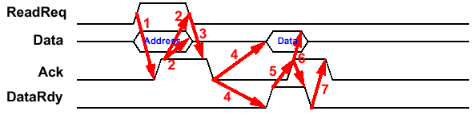
Asynchronous Protocol for Multiplexed Bus
✓
Read Example
(master)
(master)
(slave)
(master/slave)
(slave)
(master)
(slave/master)
(slave)
Three Control Lines
  ReadReq: Indicates a Read Request for Memory
    Address is Put on the Data Lines at the Same Time
  DataRdy: Indicates the Data Word is Now Ready on the Data Lines
    Data is put on the Data Lines at the Same Time
  Ack: Acknowledge the ReadReq or the DataRdy of the Other Party

Slide 22
State Diagram for Asynchronous Multiplexed Bus
I/O Devices (master)
Address Phase Done
Data Phase Done
Ack
DataRdy
DataRdy
Put
Address on
data lines;
Assert
ReadReq
2
Release data
lines; deassert
ReadReq
5
Read memory
data from
data lines
assert Ack
7
Deassert
Ack
Ack
DataRdy
DataRdy
Memory (slave)
ReadReq
ReadReq
Ack
1
Record address on
data lines and
assert Ack
3,4
Drop Ack; put
memory data
on data lines;
assert
DataRdy
6
Release data
lines and
DataRdy
Idle
Ack
ReadReq
ReadReq

Slide 23
Another Example of Signal Level Protocol:
PCI Bus Protocol (Read)
Initiator starts transaction by
asserting FRAME#, driviing
address onto AD bus
and command onto C/BE bus
1
2
3
4
5
6
7
8
9
CLK
Target begins to drive
data back to initiator
FRAME#
Initiator deasserts FRAME#
indicating that it is ready to
complete last data phase
Target latch and
decode address
and command
Addr
Data
1
Data
2
Data
3
AD
Turn-Around cycle. Initiator
stops driving AD bus
Bus
Cmd
Byte
Enable
Byte
Enable
Byte
Enable
C/BE#
Initiator stops drivint
command and starts
driving byte enables
Wait States
Initiator deasserts IRDY#,
returning bus to idle state
IRDY#
Target keeps TRDY#
deasserted to enforce
turn-around cycle
TRDY#
Target deasserts
TRDY# and DEVSEL#
Data Transfers
DEVSEL#
Target device
asserts DEVSEL#
GNT#

Slide 24
Packet (Link, Network) Level Protocol
✓
Packet is unit of information exchange in I/O system
Packet level protocol specifies the rules of communication with the contents of the packets
General format of a packet
  Header Fields
    Destination address
    Command
    Data length
    Source address (optional)
    Other auxiliary information
  Data Field
  Error Checking Code
Network usually requires multi-level headers
Packet Level Protocol

Slide 25
Example of Packet Level Protocol:
IEEE 1394 Protocol
✓
Cycle Structure
Subaction (long) gap
Isochronous Packets
Isochronous (short) gaps
Subaction (long) gaps
Asynchronous Packets
Cycle #m-1
Cycle #m
Cycle #m+1
Packet A
ack
Cycle start
data = x
Ch J
Ch K
Ch L
Ch N
Packet B
ack
Packet B
ack
Cycle start
data = y
Ch J
Acknowledge Packets
Cycle #m
start delay = x
ack (short) gaps
Cycle #m+1
start delay = x
Norminal cycle period = 125 μs
Cycle synch
Cycle synch
Physical Layer: Data-Strobe Encoding
1
0
1
1
0
0
0
1
Data Line
Strobe Line
Data xor Strobe
(Used for Clock)

Slide 26
IEEE 1394 Packet Examples
✓
Isochronous Packets (always multicasted)
Data_length
tag
Channel
tcode
sy
Header_CRC
Data Block
. . .
Last Data Block
Last Data Block (zero padded if necessary)
Data_CRC
Note: Broadcast and multi-cast packets does not require acknowledgement or response. Therefore, it usually does not have a source address
Asynchronous Packets
Read Request Packet
Read Response Packet
Destination_ID
tl
rt
tcode
pri
Destination_ID
tl
rt
tcode
pri
Source_ID
Destination_offset
Source_ID
rcode
Reserved
Destination_offset
Reserved
Data_length
Extended_tcode
Data_length
Extended_tcode
Header_CRC
Header_CRC
Data Block
Acknowledge Packet
. . .
Last Data Block
Last Data Block (zero padded if necessary)
Ack_code
Ack_parity
Data_CRC

Slide 27
Software Aspect of I/O Design

Slide 28
Processor Giving Commands to I/O Devices
✓
Two methods are used to address the device:
  Special I/O instructions
  Memory-mapped I/O
Special I/O instructions specify:
  Both the device number and the command word
    Device number: the processor communicates this via a set of wires normally included as part of the I/O bus
    Command word: this is usually send on the bus’s data lines
Memory-mapped I/O:
  Portions of the address space are assigned to I/O device
  Read and writes to those addresses are interpreted as commands to the I/O devices
  User programs are prevented from issuing I/O operations directly
    The I/O address space is protected by the address translation

Slide 29
I/O Device Communicating to the Processor
✓
The Operating System needs to know when:
  The I/O device has completed an operation
  The I/O operation has encountered an error
This can be accomplished in two different ways:
  Polling:
    The I/O device put information in a status register
    The Operating System periodically check the status register
  I/O Interrupt:
    Whenever an I/O device needs attention from the processor, it interrupts the processor from what it is currently doing.

Slide 30
Polling: Programmed I/O
✓
Processor
Bus
Poll #1
Poll #1
Poll #2
Poll #3
Poll #4
Device #1
Device #2
Device #3
Device #4
Has data
Has no data
Has no data
Has data
Advantage:
  Simple: the processor is totally in control and does all the work
Disadvantage:
  Polling can consume a lot of CPU time
  Processor cannot respond to I/O events in real time unless polling the I/O devices at very high speed

Slide 31
I/O Interrupt
I/O interrupt is just like the exceptions except:
  An I/O interrupt is asynchronous
  Further information needs to be conveyed
I/O interrupt is asynchronous with respect to instruction execution:
  I/O interrupt is not associated with any instruction
  I/O interrupt does not prevent any instruction from completion
    You can pick your own convenient point to take an interrupt
I/O interrupt is more complicated than exception:
  Needs to convey the identity of the device generating the interrupt
  Interrupt requests can have different urgencies:
    Interrupt request needs to be prioritized

Slide 32
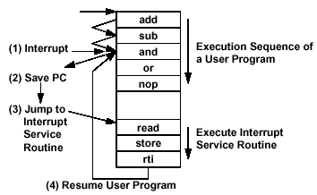
Interrupt Driven Data Transfer
✓
Processor
Device #1
Device #2
Device #3
Has data
Data served
Has no data
Has no data
Has data
Has no data
Data served
Advantage:
  User program progress is only halted during actual transfer
  “Immediate” response to I/O requests (most of the real time systems use interrupt driven approach)
Disadvantage, special hardware is needed to:
  Cause an interrupt (I/O device)
  Detect an interrupt (processor)
  Save the proper states to resume after the interrupt (processor)

Slide 33
Hardware Implementation of I/O Interrupt
✓
Address Bus (from Processor)
Address for Device 1
I/O Device 1
Decoder
Data Bus (to/from Processor)
Interrupt Register = 1000 means source 1
1
Interrupt Source 1
Q
0
D
Q
0
D
Interrupt Source 2
I/O Controller
Double Synchronizer
0
Interrupt Source 3
Q
D
Device 1
Interrupt Priority Logic
Q
D
Q
D
Interrupt Source 4
Q
0
D
Clk
Processor
Q
D
Q
D
Decoder
I/O Device 2
Interrupt Mask Reg
Q
0
D
Interrupt Source 1
Clk
Q
0
D
Interrupt Source 2
Q
0
D
Interrupt Source 3
Q
0
D
Interrupt Source 4
Clk

Slide 34
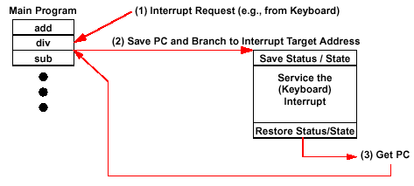
Programmer’s View of Interrupt
✓
Interrupt Target Address Options:
  General: Branch to a Common Address for all Interrupts; Software then Decodes the Cause and Figures Out What to do.
  Specific: Automatically Branch to Different Addresses Based on Interrupt Type and/ or Level — Known as Vectored Interrupt

Slide 35
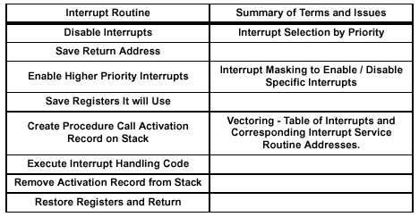
Issues in the Use of Interrupts
High Priority is Assigned to Devices that Require Rapid Response. Otherwise, They Lose Data (e. g. Hard Disk Controllers).
Low Priority Given to Slow Devices (e. g., Keyboard and Mouse)
Higher Priority Interrupts can Interrupt Lower Priority Interrupts, But all Interrupt Routines Should Disable All Interrupts While They Are Saving State — Otherwise the System May Fail

Slide 36
Disadvantages of Interrupt Driven I/O
✓
Large Overheads are Associated with Interrupt- Driven I/O
For Each Item Transferred Within a Block of Data
  Identify Interrupt
  Save State of Process
  Load State of Service Routine
  Access Address and Count In Memory
  Restore State of Process
Results in
  Inefficient use of CPU
  Slow Response to I/ O
Overhead can be Reduced by
  Including a “block transfer” Instruction in Architecture
  General Interrupt Used only at End of Block Transfer

Slide 37
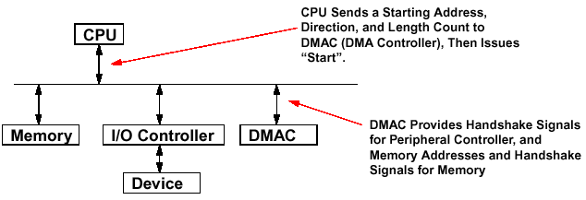
Delegating I/O Responsibility from CPU: DMA
✓
Direct Memory Access (DMA):
  External to the CPU
  Act as a Bus Master
  After Initial Set Up by the CPU, DMA Control Can Transfer Blocks of Data to or From Memory Without CPU Intervention
DMA Ack
DMA request
Set up DMA parameters
Data transfer directly to memory without processor’s help

Slide 38
Advantages of DMA
✓
Improves Response Time for Devices with Large Amounts of Data Transfers (Disks, Drums)
Reduces CPU Overhead
Data Transferred Directly to Memory
Memory Addresses / Counts Computed in DMA Controller
Cycle Stealing or Simultaneous Access (Multimodule Memory)
  Cycle Stealing: DMA controller has Priority Over CPU to Use Processor- Memory Bus. The CPU must Wait During the DMA Controller’s Infrequent Access to Memory

Slide 39
Delegating I/O Responsibility from CPU: IOP
✓
I/O Processor (IOP)
CPU
IOP
D1
main memory
bus
D2
Mem
. . .
I/O
bus
Dn
CPU - IOP Interactions
(1) CPU issues instruction to IOP
CPU
(4) IOP interrupts
CPU when done
I/O Instruction Format
OP
Device
Address
IOP
(2)
IOP looks in memory for commands
target device
(3)
Command Format in Memory
where cmnds are
IOP executes commands by transferring I/O device data to/from memory directly.
IOP steals memory cycles.
OP
Addr
Cnt
Other
what
to do
how
much
special
requests (e.g., next Instr addr)
Where to put data

Slide 40
Responsibilities of the Operating System
✓
The operating system acts as the interface between:
  The I/O hardware and the program that requests I/O
Three characteristics of the I/O systems in OS:
  The I/O system is shared by multiple program using the processor
  I/O systems often use interrupts (external generated exceptions) to communicate information about I/O operations.
    Interrupts must be handled by the OS because they cause a transfer to supervisor mode
  The low-level control of an I/O device is complex:
    Managing a set of concurrent events
    The requirements for correct device control are very detailed

Slide 41
Operating System Requirements
✓
Provides abstraction for accessing devices:
  Supply routines that handle low-level device operation
Handles the interrupts generated by I/O devices
Provide protection to shared I/O resources
  Guarantees that a user’s program can only access the
  portions of an I/O device to which the user has rights
Provide equitable access to the shared I/O resources
  All user programs must have equal access to the I/O resources
Schedule accesses in order to enhance system throughput

Slide 42
OS and I/O System Communication Requirements
✓
The Operating System must be able to prevent:
  The user program from communicating with the I/O device directly
If user programs could perform I/O directly:
  Protection to the shared I/O resources could not be provided
Three types of communication are required:
  The OS must be able to give commands to the I/O devices
  The I/O device must be able to notify the OS when the I/O device has completed an operation or has encountered an error
  Data must be transferred between memory and an I/O device

Slide 43
Basic I/O Design Summary
Discussed the basic I/O design concepts from a processor point of view
I/O architecture is usually divided into layers
  Hardware: signaling protocol and I/O controller
  Software: devicer driver, operating system interface, application interface
Hardware:
  Signaling protocols: synchronous and asynchronous
  Packet level protocol
Software
  Device drivers: handles details of hardware, can be called by operating system or linked to applications
  Operating System: provides abstraction of devices, handles communication between processor and I/O devices

Slide 44
Backup Slides
I/O Devices Examples

Slide 45
I/O Devices Examples
Device Behavior Partner Data Rate (KB/sec)
Keyboard Input Human 0.01
Mouse Input Human 0.02
Line Printer Output Human 1.00
Floppy disk Storage Machine 50.00
Laser Printer Output Human 100.00
Optical Disk Storage Machine 500.00
Magnetic Disk Storage Machine 5,000.00
Network-LAN Input/Output Machine 20 – 1,000.00
Graphics Display Output Human 30,000.00
See Backup Slides for More Detailed Information about Some of the I/O Devices

Slide 46
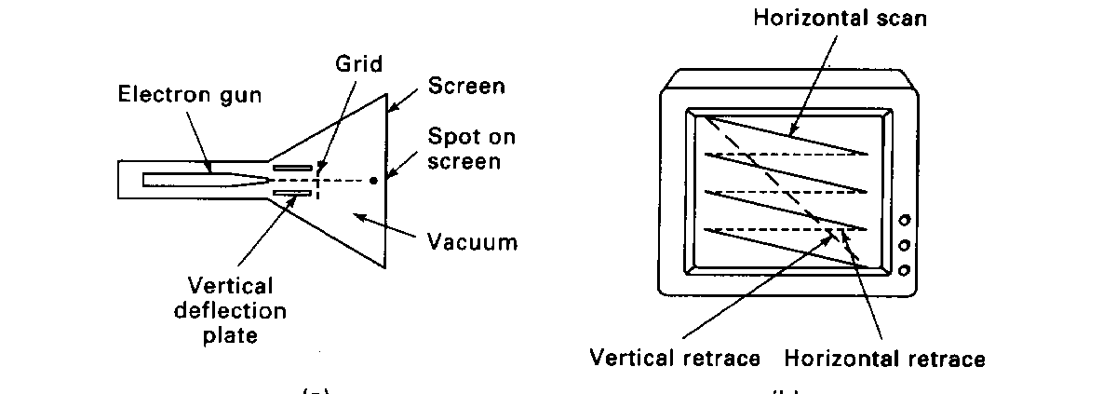
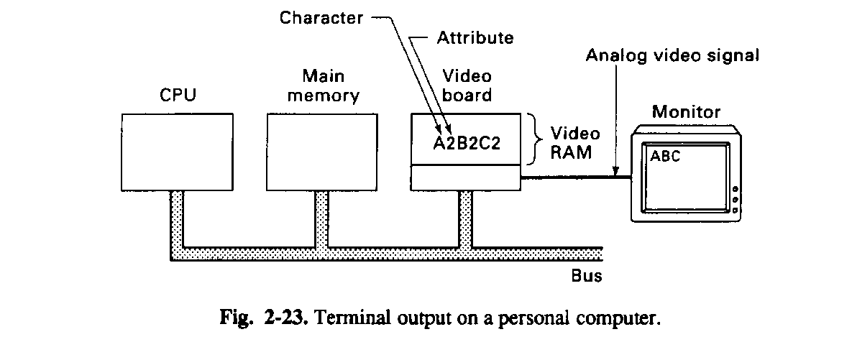
I/O Device Example: Display Monitor

Slide 47
Memory Requirements of a Display Monitor
Character graphics (Black and White)
  25 x 80 characters, 8 x 6 pixels/character, 1 bit/pixel, 30 frames/sec
  Video RAM requirement = 96 kbits, I/O bus bandwidth = 2.88 Mbits/sec
Bitmapped (pixel) graphics
  Different Graphics Resolutions:
  N= 640*480, 800x600, 1024x768, 1280x1024
  30 frames/sec
  Black and white 1*N bits per screen, I/O bus bandwidth = 30*N kbits/sec
  Sixteen intensity gray scale 4*N bits, I/O bus bandwidth = 120*N kbits/sec
  256 color display (RGB) 3*8*N bits, I/O bus bandwidth = 720*N kbits/sec
  True color (24 bits RGB) 3*24*N bits, I/O bus bandwidth = 2160*N kbits/sec
  Example: What is the video memory and I/O bus bandwidth requirements to play a movie on a monitor, resolution 1280 x 1024, true color, 30 frames/sec
  Video RAM = 1280 x 1024 pixels/frame x 9 bytes/pixel = 11.8 Mbytes
  I/O Bus Bandwidth = 1280 x 1024 pixels/frame x 72 bits/pixel x 30 frames/sec
  = 2.83 Gbits/sec
  This can be handled by a 66 MHz, 64-bit PCI bus (bandwidth = 4.2 Gbits/sec)

Slide 48
I/O Device Example: Magnetic Disks
Characteristics IBM 3090 IBM UltraStar Integral 1820
Disk diameter (inches) 10.88 3.50 1.80
Formatted data capacity (MB) 22,700 4,300 21
MTTF (hours) 50,000 1,000,000 100,000
Number of arms/box 12 1 1
Rotation speed (RPM) 3,600 7,200 3,800
Transfer rate (MB/sec) 4.2 9-12 1.9
Power/box (watts) 2,900 13 2
MB/watt 8 102 10.5
Volume (cubic feet) 97 0.13 0.02
MB/cubic feet 234 33000 1050

Slide 49
Organization of a Hard Magnetic Disk
Platters
Track
Sector
Typical numbers (depending on the disk size):
  500 to 2,000 tracks per surface
  32 to 128 sectors per track
    A sector is the smallest unit that can be read or written
Traditionally all tracks have the same number of sectors:
  Constant bit density: record more sectors on the outer tracks
  Recently relaxed: constant bit size, speed varies with track location

Slide 50
Magnetic Disk Characteristic
Cylinder: all the tacks under the head at a given point on all surface
Read/write data is a three-stage process:
  Seek time: position the arm over the proper track
  Rotational latency: wait for the desired sector to rotate under the read/write head
  Transfer time: transfer a block of bits (sector) under the read-write head
Track
Sector
Cylinder
Platter
Head
Average seek time as reported by the industry:
  Typically in the range of 8 ms to 12 ms
  (Sum of the time for all possible seek) / (total # of possible seeks)
Due to locality of disk reference, actual average seek time may:
  Only be 25% to 33% of the advertised number

Slide 51
Typical Numbers of a Magnetic Disk
Rotational Latency:
  Most disks rotate at 3,600 to 7200 RPM
  Approximately 16 ms to 8 ms per revolution
  An average latency to the desired information is halfway around the disk: 8 ms at 3600 RPM, 4 ms at 7200 RPM
Track
Sector
Cylinder
Platter
Head
Transfer Time is a function of :
  Transfer size (usually a sector): 1 KB / sector
  Rotation speed: 3600 RPM to 7200 RPM
  Recording density: bits per inch on a track
  Diameter typical diameter ranges from 2.5 to 5.25 in
  Typical values: 2 to 12 MB per second
  Indicate What Type of Information is on the Data Lines
A Bus Transaction Includes Two Parts:
  Sending the Address and Control
  Receiving or Sending the Data

