Slide 1
Five Classic Components of a Computer
✓
Network
Processor
Processor
Input
Input
Control
Control
Memory
Memory
Datapath
Output
Datapath
Output
Peripheral Devices
Current Topic: Input and Output

Slide 2
What You Will Learn in This Set of Lectures
✓
I/O Design from a System’s Point of View
  Overview of I/O Systems
  I/O System Design Considerations
  I/O System Design Parameters
  I/O Implementation Example

Slide 3
A Classificaiton of I/O According to the Targets of I/O Operation
✓
Processor to Memory
  Very low latency, very high throughput, very low protocol overhead
Processor to Peripheral
  Latency, throughput, and protocol overhead vary according to the I/O devices
Processor to Processors
  Tightly Coupled: all processors share a physical memory
  Low latency, high throughput, low overhead protocol, coherence problem
  Loosely Coupled: each processor has its own physical memory
  Medium latency, medium throughput, high protocol overhead, scalable
Processor to Network
  High latency, low throughput, high protocol overhead, very scalable

Slide 4
I/O System Example
✓
Processor
Processor
Main
Memory
Cache
Cache
Memory - I/O Bus
IEEE 1394 Bus Interface Contorller
I/O Controller
I/O Controller
Network Interface Controller
Disk
Disk
Graphics
Network
To Other Processors or Peripherals on the IEEE 1394 Bus

Slide 5
I/O System Design Process
✓
Establish Requirements: Understanding What You Need
Select the I/O System That Has the Required Capability: Understand What the I/O System being Considered Can Do
Integration: Understand How Everything Fits Together
Implementation
Device A?
Device B?
Device B?
Device C?
Device D?
Bus A?
Bus C?
Bus B?
Device A
Device B
?
?
Bus B
?
?
?
Device B
Device C
Device D

Slide 6
I/O System Design Example:
Establish Requirements
✓
Design an I/O architecture for a spacecraft that has the following equipment
Data Rate: 10 Kbps
1000 samples/sec
Latency < 1 ms
Data Rate: 400 bps
2 commands/sec
Latency < 0.5 sec
Data Rate: 5 Kbps
1transaction/sec
Latency < 1 sec
Data Rate: 8 Mbps
1000 samples/sec
Latency < 1 ms
Flight Computer (CDH)
Flight Computer (ACS)
Flight Computer (Payload)
Inertia Measurement Unit
Power Control Unit
Telecom Subsystem
Star Tracker
Inertia Measurement Unit
Power Control Unit
Telecom Subsystem
Star Tracker
I/O?
Thruster Control Unit
Wide Angle Camera
High Resolution Camera
Radar Sounder
Altimeter
Thruster Control Unit
Data Rate < 100 bps
10 commands/sec
Latency < 0.1 sec
Data Rate: 20 Mbps
2 frames/sec
Latency < 0.5 sec
Data Rate: 20 Mbps
2 frames/sec
Latency < 0.5 sec
Data Rate: 1 Mbps
1 transaction/sec
Latency < 1 sec
Data Rate: 5 Kbps
100 samples/sec
Latency < 0.01 sec
System Constraints (Prioritized):
Total power consumption of the avionics system < 100 W.
The I/O system power consumption should be less than 35% of the avionics system.
Each subsystem has to meet the latency and throughput requirements
System reliability should exceed 12 years (i.e., requires fault tolerance)
The system design should be scalable and distributed.
Maximum distance between subsystems is 5 meters. Average distance is 3 m.
Minimize the cable mass.

Slide 7
I/O System Design Example:
Candidate I/O Interface
✓
Metrics
IEEE 1394
(Cable version)
IEEE 1393
Fiber Channel
I2C
UART (Direct Interface)
Ethernet
(IEEE 802.3)
Raw Bandwidth
100, 200, 400 Mbps
200 to 1000 Mbps
1 Gbps
100, 400 Kbps
115 Kbps to 10 Mbps
10, 100 Mbps
Latency
125 μs max
196 bits × N nodes
196 bits × N (loop)
Undeterministic
< 100 ns
Undeterministic
Topology
Tree
Ring
Loop, Star, Switch network
Multi-Drop
Star
Multi-Drop
Signal Level Protocol
Async
Async
Async
Async
Async
Async
Cable Type
Electrical (Twisted pair)
Optical Fiber
Optical Fiber, Electrical (Twisted pair)
Electrical
(Single end)
Electrical
(Twisted pair)
Electrical
(Coaxial)
Power ^{Note 1}
1 W/node
8 W/node
8 W/node
5 mW/node
35 mW/node
150 mW/node
Multi-master
Yes
Yes
Yes
Yes
No
Yes
Max. # Nodes
64
127
127 for Loop
128
N/A
2⁴⁸
Max Bus Length ^{Note 1}
72 m
(4.5 m/hop)
10 km,
(100m/hop)
Fiber: 10 km
Electrical: 30m
Approx. 40 m (load<400 pf)
Approx. 10 m
500 m
Protocol Overhead
8 % for 278 byte data
3 bytes per 53-byte frame
25 % for 2168 byte data ^{Note 2}
1 byte address +Ack bit / byte
1 start + 1 stop bits/byte (25%)
64 bytes / msg (msg < 1500 B)

Slide 8
I/O System Design Example:
Selecting an I/O Interface
✓
There are 17 nodes in the system and the power allocation of the I/O system is 35 W. This eliminates the Fiber Channel and the IEEE 1393
The latency requirement eliminates the I2C and Ethernet
The total bandwidth requirement of the system ≈56 Mbps. This eliminates the UART
The system reliability requirement eliminates the IEEE 1394 bus because tree topology is not very fault tolerant
All interface options, except the UART, are buses and thus meet the scalability requirement. All bus options here support distributed processing.
The distance requirement prohibits the search for a parallel bus
All interface options, except the UART, are serial buses and thus meet the cable mass requirement
PROBLEM: WE DON’T HAVE AN OPTION THAT CAN MEET ALL REQUIREMENTS!
Resolution: Since power consumption and latency are technology dependent and difficult to improve, the next best option is to improve system reliability using fault tolerance design techniques. Therefore, the IEEE 1394 is the best choice in this case but need to be enhanced with fault tolerance design techniques. Use dual redundant buses.
Check: Since redundant buses have to be used, the number of interfaces of the IEEE 1394 bus is doubled. The power consumption will be 17 x 1 W x 2 = 34 W. This is OK since it is still within the 35 W power constraint.

Slide 9
Establish Requirements:
Understanding What You Need
✓
Application and Environments of the I/O System
  Home Computing
  Industrial Control
  Network
  Aerospace
Capability Required
  Number of I/O Devices
  Data Rate of the I/O Devices
  Required Throughput: How much data need to be transferred?
  Maximum Latency: How much delay the I/O devices can tolerate?
  Future Expansion
Constraints
  Cost Constraints: How much money do you have?
  Power Constraints: Do you have enough power?
  Electrical Interface Constraints Imposed by the I/O devices
  Mechanical Interface Constraints Imposed by the I/O devices
  Logical Interface Constraints: Protocol Imposed by the I/O devices

Slide 10
Select I/O System with Required Capability:
Understand the I/O System Being Considered
✓
Performance: How much data can be handled by I/O system being considered
  Throughput: function of Bit Rate, Bus Width, Block Size, Protocol Overhead
  Latency or Response Time
  Impact on Processor Performance
Expandability: How many devices can it handle
  Bus Length: Parallel Buses Are Shorter, Serial Buses Are Longer
  Drive Capability: Bus Loading, Transmission Line Effect
  Multi-Level Buses: Bridge Between Buses
Access Control: How to arbitrate I/O requests among nodes
  Master-Slave: One Master Controls All Transactions
    Passive Slaves, Active Slaves (interrupt)
  Multi-Master: Arbitration Required Among Masters (processors, controllers)
Failure Handling: What the I/O system can do in case of failures?
  Reliability vs. Availability
  Fault Tolerant: Fault Detection, Fault Isolation, Fault Recovery

Slide 11
Integration:
Understand How Everything Fits Together
✓
Physical Interface with the I/O Devices
  Electrical Interface
  Mechanical Interface
Topology
  Star, Multi-Drop, Ring, Tree, etc.
Protocol: Rules of Communication with the I/O Devices
  Signal Level Protocol
    Synchronization: Synchronous (Clocked), Asynchronous (handshake)
  Packet / Message Level Protocol
  Addressing Capability: Directed, Broadcast, Multi-Cast
  Transaction Types: Split, Unified
Operating System Support
  Software Device Driver
  Method of Addressing the Devices: I/O Address, Memory Mapped I/O:
  Processor & I/O Devices Interaction: Interrupt, Polling, DMA, I/O Processor
  Resource Management: Sharing of I/O Devices
  Protection: Ensure No Conflicts among I/O Devices

Slide 12
Implementation
✓
If Your I/O System Requirement Can be Met by Standard Interfaces
  It is easy! Just purchase commercial off-the-shelf (COTS) components, software, and test equipment and then integrate them
If Your I/O System Requirement Needs Custom Design, You Have to
  Specify the protocol and timing of the signals at the interface
  Design the logic required to implement the specification
  Realize the logic design in hardware
  Write the software driver to drive the hardware

Slide 13
Key Parameters for I/O System Design
✓
Connectivity
Protocol
Access Control
Performance
Expandability
Failure Handling

Slide 14
Connectivity

Slide 15
Connecting I/O to Processor: Direct Interface
✓
Ad Hoc
  No definite number of signals, protocol, electrical interface etc.
Standards
  RS232: Serial interface. Signals include Request-to-Send, Clear-to-Send, TxData, RxData
  UART (Universal Asynchronous Receiver Transmitter): Serial interface protocol, usually used with the RS232
  IEEE 1284: Parallel interface, commonly used for printer port on PCs
Processor
Input
Control
Input
Memory
Output
Datapath
Output

Slide 16
Connecting I/O to Processor: Buses
✓
A Bus is
  shared communication link
  single set of wires used to connect multiple subsystems
Bus is also a fundamental tool for composing large, complex systems
  systematic means of abstraction
Processor
Input
Control
Memory
Input
Datapath
Output
Output

Slide 17
Types of Buses
✓
Processor-Memory Bus (design specific)
  Used for Process-to-Memory I/O
  Usually is parallel, short, high speed and on the processor broad
  Match the processor and memory interfaces to maximize bandwidth
  Optimized for cache block transfers
I/O Bus (industry standard)
  Used for Process-to-Peripheral, loosely coupled Processor-to-Processor, and Processor-to-Network I/Os
  Usually is serial, lengthy, slower, and implemented by cables but flexible
  Need to match a wide range of I/O devices
  Connects to the processor-memory bus or backplane bus through bridges
Backplane Bus (standard or proprietary)
  Used for Process-to-Peripheral, tightly coupled Processor-to-Processor I/Os, and Processor-to-Network I/Os
  Backplane: an interconnection structure within the chassis
  Allow processors, memory, and I/O devices to coexist
  Usually is parallel, speed is between Processor and I/O Bus
  Cost advantage: one bus for all components
See Backup Slides for Bus Surveys

Slide 18
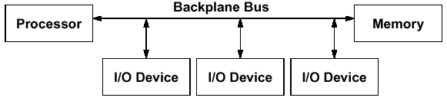
A Computer System with One Bus: Backplane Bus
A single bus (the backplane bus) is used for:
  Processor to memory communication
  Communication between I/O devices and memory
Advantages: Simple and low cost
Disadvantages: slow and the bus can become a major bottleneck
Example: IBM PC - AT

Slide 19
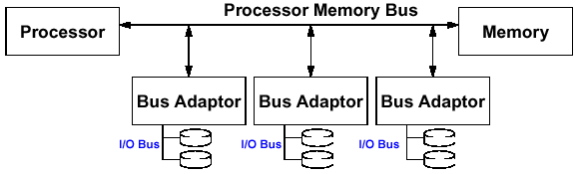
A Two-Level Bus System
I/O buses tap into the processor-memory bus via bus adaptors:
  Processor-memory bus: mainly for processor-memory traffic
  I/O buses: provide expansion slots for I/O devices
Examples:
  Apple Macintosh-II
  NuBus: Processor, memory, and a few selected I/O devices
  SCCI Bus: the rest of the I/O devices

Slide 20
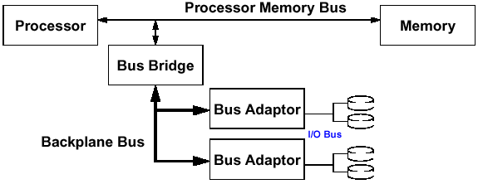
A Three-Level Bus System
✓
A small number of backplane buses tap into the processor-memory bus
  Processor-memory bus is used for processor memory traffic
  I/O buses are connected to the backplane bus
Advantage: loading on the processor bus is greatly reduced
Example: See PCI Bus Example

Slide 21
The General Organization of a Bus
✓
Control Lines
Data Lines
Data Lines Carry Information Between the Source and the Destination:
  Data and Addresses
  Complex Commands
Control Lines:
  Signal Requests and Acknowledgments

Slide 22
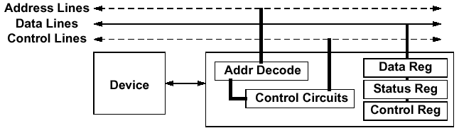
Typical Bus Operation and Interface Control
✓
I/O Operation Consists of
  Check if Device is Available (e.g., check busy signal)
  Send Operation Parameters (e.g., send read/write signals, address)
  Data Transfer (e.g., read or write to Data, Control, Status registers)
  Termination (e.g., send or receive acknowledge signal)
Methods are:
  Programmed I/O
  Interrupt- Driven
  Direct Memory Access (DMA)

Slide 23
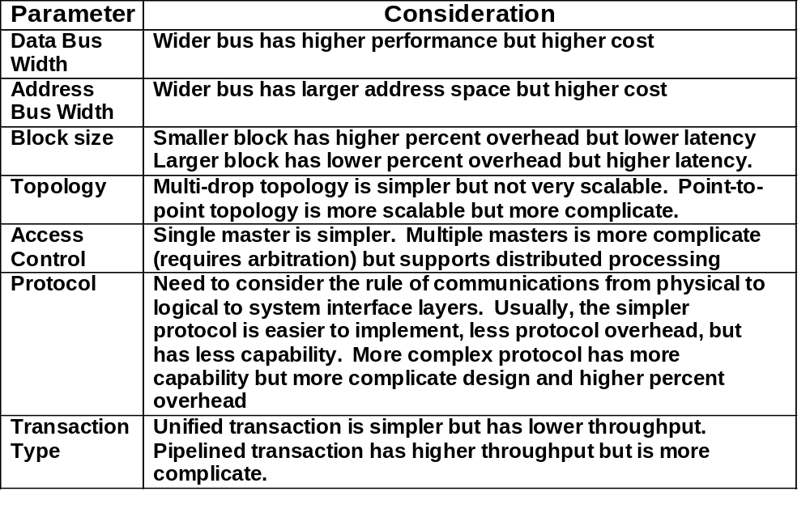
How to Specify a Bus
✓

Slide 24
Examples of Bus Topologies
✓
Multi-Drop Bus
  One media is shared by many devices
  If the media is a cable, each device needs a coupler to “tap” into the bus
  Need to consider short protection, electrical isolation, and termination
Device 1
Device 2
Device N
Short protection resistors
Data
Isolation (transformer, Optical etc.)
Termination Resistors
Command / Address
Bus couplers
Point-to-Point Buses
  One media between each pair of devices
  Many topologies are possible (e.g., ring, tree, star etc.)
  Short protection, electrical isolation, and termination are less critical
Ring (e.g. Token Ring)
Tree (e.g. IEEE 1394)
Star (e.g. Fiber Channel)
Device
Device
Device
Device
Device
Device
Device
Device
Device
Device
Device
Device
Device
Device

Slide 25
Examples of Bus Transaction Types
✓
Unified Transaction
  Request (address and read/write commands) is followed immediately by response (data)
Split Transaction
  Request is not followed immediately by response. Other requests can be issued in-between
R/W Address
(Requesting Node)
Rd Addr 1
Rd Addr 2
Data
(Responding Node)
Data1
Data2
R/W Address
(Requesting Node)
Rd Addr 1
Rd Addr 2
Data
(Responding Node)
Data1
Data2

Slide 26
Examples of Bus Protocols
Synchronous Bus:
  Includes a clock in the control lines
  A fixed protocol for communication that is relative to the clock
  Advantage: involves very little logic and can run very fast
  Disadvantages:
    Every device on the bus must run at the same clock rate
    To avoid clock skew, they cannot be long if they are fast
Asynchronous Bus:
  It is not clocked
  It can accommodate a wide range of devices (fast and slow)
  It can be lengthened without worrying about clock skew
  It requires a handshaking protocol which can significantly reduce the effactive bandwidth
Some more details in the Protocol discussion

Slide 27
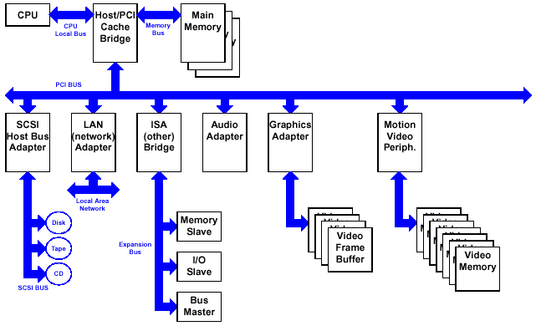
Backplane Bus Example: PCI
✓
Cache Memory
More details in the Protocol discussion

Slide 28
Key Features of PCI Bus
32-bit or 64-bit bus running at 33 MHz or 66 MHz, synchronized to host processor clock
Block oriented data transfer
Reconfigure bus nodes upon system startup or configuration changes (Plug-and-Play)
Multi-master, but only one master has bus arbitration capability
Sub-buses include
  Address and Data Bus (Multiplexed)
  Command and Byte Enable Bus
  Interface Control Signals
  Arbitration Signals
  Error Signals
Reflected wave signal switching
Device select and negative acknowlegment
More details in the Protocol discussion

Slide 29
Serial Bus Example: IEEE 1394 (Firewire)
✓
More details in the Protocol discussion
CPU
memory
I/O
CPU
Any Backplane Bus
nodes
IEEE 1394 Bus (backplane environment)
bridge
ports
IEEE 1394 Bus (Cable environment)
CPU
memory
I/O
CPU
I/O
I/O
I/O
Any Backplane Bus
IEEE 1394 Bus (backplane environment)
bridge
nodes
Note: IEEE 1394 Bus is a serial bus in both backplane and cable environments

Slide 30
Key Features of the IEEE 1394 Bus
A digital interface – there is no need to convert digital data into analog and tolerate a loss of data integrity
Physically small - the thin serial cable can replace larger and more expensive interfaces
Adopts a tree topology in cable environment and multi-drop topology in backplane enviroment
Easy to use - no need for terminators, device IDs, or elaborate setup
Hot pluggable - users can add or remove 1394 devices with the bus active
Inexpensive - priced for consumer products
Scalable architecture - may mix 100, 200, and 400 Mbps devices on a bus
Flexible topology - support of daisy chaining and branching for true peer-to-peer communication
Fast - even multimedia data can be guaranteed its bandwidth for just-in-time delivery
Non-proprietary
Mixed asynchronous and isochornous traffic
More details in the Protocol discussion

Slide 31
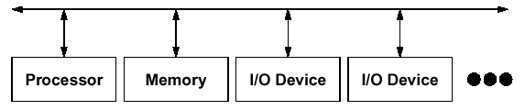
Advantages of Buses
✓
Versatility:
  New devices can be added easily
  Peripherals can be moved between computer systems that use the same bus standard
Low Cost:
  A single set of wires is shared in multiple ways
  Easy to maintain
Manage complexity by partitioning the design

Slide 32
Disadvantage of Buses
✓
It creates a communication bottleneck
  The bandwidth of that bus can limit the maximum I/O throughput
The maximum bus speed is largely limited by:
  The length of the bus
  The number of devices on the bus
  The need to support a range of devices with:
    Widely varying latencies
    Widely varying data transfer rates
A single point of failure: one bus failure (e.g., short to ground) can fail the entire system

Slide 33
Protocol: the Rules of Communication

Slide 34
Example of Protocol Stack: TCP/IP
✓
Source Node
Destination Node
Application
Application
TCP/IP has 5 Levels of Protocol
Transport
Transport
Internet
Internet
Network Interface
Network Interface
Physical
Physical
Network
Frame Header
IP Header
TCP Header
Data
VERS
H. Len
Service Type
Total Length
Source Port
Destination Port
Identification
Flags
Fragment Offset
Sequence Number
Time to Live
Type
Header Checksum
Acknowldegment Number
Source IP Address
H.Len
Unused
Code Bots
Window
Destination IP Address
Chechsum
Urgent Pointer
IP Options
Padding
Options

Slide 35
Physical Layer Protocol: Synchronous Signaling
✓
Clock
(master)
Valid
(master)
R/W
Address
(master)
Cmd+Addr
Wait
(slave)
Data
(master/slave)
Data1
Data1
Data2
Wait signal is optional: Slave can use this signal to indicate when it is prepared for data transfer
Actual transfer goes at bus rate

Slide 36
Physical Layer Protocol: Asynchronous Signaling (Handshaking)
✓
Write Transaction
Address
Data
Rd / Wr
(Master)
Req
(Master)
Ack
(Slave)
Master Asserts Address
Next Address
Master Asserts Data
t0 t1 t2 t3 t4 t5
t0 : Master has obtained control and asserts address, direction, data Waits a specified amount of time for slaves to decode target
t1: Master asserts request line
t2: Slave asserts ack, indicating data received
t3: Master releases req
t4: Slave releases ack

Slide 37
Physical Layer Protocol: Asynchronous Signaling (Handshaking)
✓
Read Transaction
Address
Data
(Slave)
Rd / Wr
(Master)
Req
(Master)
Ack
(Slave)
Master Asserts Address
Next Address
t0 t1 t2 t3 t4
t0 : Master has obtained control and asserts address and direction. Waits a specified amount of time for slaves to decode target
t1: Master asserts request line
t2: Slave asserts ack, indicating ready to transmit data
t3: Master releases req, data received
t4: Slave releases ack

Slide 38
Packet Level Protocol
✓
Packet is unit of information exchange in I/O system
Packet level protocol specifies the rules of communication with the contents of the packets
General format of a packet
  Header Fields
    Destination address
    Command
    Data length
    Source address (optional)
    Other auxiliary information
  Data Field
  Error Checking Code
Network usually requires multi-level headers
Packet Level Protocol

Slide 39
Example of Packet Level Protocol:
IEEE 1394 Protocol
✓
Cycle Structure
Subaction (long) gap
Isochronous Packets
Isochronous (short) gaps
Subaction (long) gaps
Asynchronous Packets
Cycle #m-1
Cycle #m
Cycle #m+1
Packet A
ack
Cycle start
data = x
Ch J
Ch K
Ch L
Ch N
Packet B
ack
Packet B
ack
Cycle start
data = y
Ch J
Acknowledge Packets
Cycle #m
start delay = x
ack (short) gaps
Cycle #m+1
start delay = x
Norminal cycle period = 125 μs
Cycle synch
Cycle synch
Physical Layer: Data-Strobe Encoding
1
0
1
1
0
0
0
1
Data Line
Strobe Line
Data xor Strobe
(Used for Clock)

Slide 40
IEEE 1394 Packet Examples
✓
Isochronous Packets (always multicasted)
Data_length
tag
Channel
tcode
sy
Header_CRC
Data Block
. . .
Last Data Block
Last Data Block (zero padded if necessary)
Data_CRC
Note: Broadcast and multi-cast packets does not require acknowledgement or response. Therefore, it usually does not have a source address
Asynchronous Packets
Read Request Packet
Read Response Packet
Destination_ID
tl
rt
tcode
pri
Destination_ID
tl
rt
tcode
pri
Source_ID
Destination_offset
Source_ID
rcode
Reserved
Destination_offset
Reserved
Data_length
Extended_tcode
Data_length
Extended_tcode
Header_CRC
Header_CRC
Data Block
Acknowledge Packet
. . .
Last Data Block
Last Data Block (zero padded if necessary)
Ack_code
Ack_parity
Data_CRC

Slide 41
Access Control

Slide 42
Obtaining Access to the Bus
✓
One of the most important issues in bus design:
  Since bus is a shared resource, how a device reserves the bus when it wishes to use the bus?
Chaos is avoided by a master-slave arrangement:
  Only the bus master can control access to the bus: It initiates and controls all bus requests
  A slave responds to read and write requests
The simplest system:
  Processor is the only bus master
  All bus requests must be controlled by the processor
  Major drawback: the processor is involved in every transaction
Master issues command & address
Bus
Master
Bus
Slave
Data can go either way
Selected
Bus
Slave
Not Selected

Slide 43
Bus Transaction in a Single Master Bus
✓
Master issues command & address
Bus
Master
Bus
Slave
Data can go either way
Selected
Bus
Slave
Not Selected
A bus transaction consists of two parts:
  Issuing the command (and address) – request
  Transferring the data – action
Master is the one who starts the bus transaction by:
  issuing the command (and address)
Slave is the one who responds to the address by:
  Sending data to the master if the master ask for data
  Receiving data from the master if the master wants to send data

Slide 44
Multiple Master Bus
✓
More than one device has the capability to become bus master and initiate bus transactions
The target device will respond whether it is master-capable or just a slave
Advantage: the workload can be shared among bus masters
Disadvantage: need to determine who has the right to use the bus - arbitration
Most modern buses are multi-master
Master issues command & address
Bus
Master
Arbitration
Bus
Master
Data can go either way
Bus
Slave

Slide 45
Arbitration in Multi-Master Bus
✓
Bus arbitration scheme:
  A bus master wanting to use the bus asserts the bus request
  A bus master cannot use the bus until its request is granted
  A bus master must signal to the arbiter after finish using the bus
Bus arbitration schemes usually try to balance two factors:
  Bus priority: the highest priority device should be serviced first
  Fairness: Even the lowest priority device should never
  be completely locked out from the bus
Bus arbitration schemes can be divided into four broad classes:
  Daisy chain arbitration: single device with all request lines.
  Centralized, parallel arbitration: see next-next slide
  Distributed arbitration by self-selection: each device wanting the bus places a code indicating its identity on the bus.
  Distributed arbitration by collision detection: Ethernet uses this.

Slide 46
Daisy Chain Bus Arbitration Scheme
✓
Device 1
Highest
Priority
Device 2
Device N
Lowest
Priority
Grant
Grant
Grant
Bus
Arbiter
Release
Request
wired-OR
Advantage: simple
Disadvantages:
  Cannot assure fairness:
  A low-priority device may be locked out indefinitely
  The use of the daisy chain grant signal also limits the bus speed

Slide 47
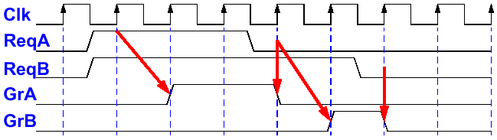
Centralized Parallel Arbitration
✓
Device
A
Device
B
Device
N
Grant A
Req A
Grant B
Bus
Arbiter
Req B
Grant N
Req N
Data Bus
Control Bus
Used in essentially all processor-memory buses and high-speed I/O buses
Disadvantage: Number of wires increases with devices

Slide 48
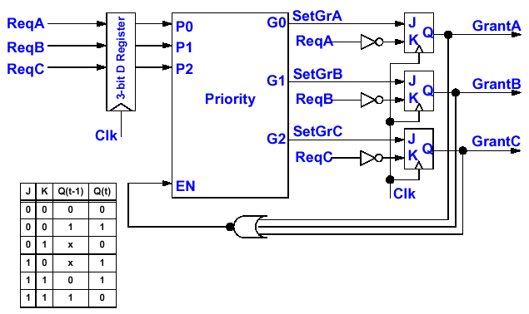
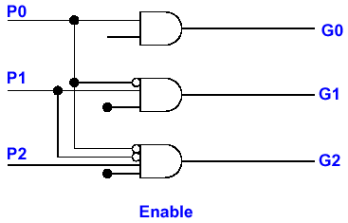
Simple Implementation of a Bus Arbiter
Priority Logic (Fixed Priority)

Slide 49
Increasing Transaction Rate on Multimaster Bus
Overlapped arbitration
  perform arbitration for next transaction during current transaction
Bus parking
  master can holds onto bus and performs multiple transactions as long as no other master makes request
Overlapped address / data phases (previous slide)
  requires one of the above techniques
Split-phase (or packet switched) bus
  completely separate address and data phases
  arbitrate separately for each
  address phase yield a tag which is matched with data phase
”All of the above” in most modern mem busses

Slide 50
Performance

Slide 51
I/O System Performance
✓
I/O System performance depends on many aspects of the system (“limited by weakest link in the chain”):
  The CPU speed
  The bandwidth and latency of underlying interconnection (buses)
  The speed of the I/O controller
  The speed of the I/O device
  The speed of the I/O software (Operating System)
  The efficiency of the software’s use of the I/O devices
  The speed of the memory system:
    Internal and external caches
    Main Memory
Two common performance metrics:
  Throughput: I/O bandwidth
  Response time: Latency

Slide 52
Performance Analysis Using Queueing Model Example: Disk I/O
✓
Request Rate
Service Rate
λ
μ
Disk
Disk
Controller
Queue
Processor
Disk
Controller
Disk
Queue
Disk Access Time = (Seek time + Rotational Latency + Transfer time + Controller Time) + Queueing Delay
  Seek time = time to look up directory
  Rotation latency = time to wait for data come under read head
Estimating Queue Length:
  Utilization: U = Request Rate / Service Rate
  Mean Queue Length = U / (1 - U)
  As Request Rate → Service Rate
    Mean Queue Length → Infinity

Slide 53
Disk Access Time Example
512 byte sector, rotate at 5400 RPM, advertised seeks is 12 ms, transfer rate is 4 BM/sec, controller overhead is 1 ms, queue idle so no service time
Disk Access Time = Seek time + Rotational Latency + Transfer time + Controller Time + Queueing Delay
= 12 ms + 0.5 / 5400 RPM + 0.5 KB / 4 MB/s + 1 ms + 0
= 12 ms + 0.5 / 90 RPS + 0.125 / 1024 s + 1 ms + 0
= 12 ms + 5.5 ms + 0.1 ms + 1 ms + 0 ms
= 18.6 ms
  Note: rotation latency is 0.5 rotation on the average
If real seeks are 1/3 advertised seeks, then its 10.6 ms, with rotation delay at 50% of the time!

Slide 54
Simple Producer-Server Model
Producer
Queue
Server
Throughput:
  The number of tasks completed by the server in unit time
  In order to get the highest possible throughput:
    The server should never be idle
    The queue should never be empty
Response time:
  Begins when a task is placed in the queue
  Ends when it is completed by the server
  In order to minimize the response time:
    The queue should be empty
    The server should be idle

Slide 55
Performance Enhancement
Server
Queue
Producer
Queue
Server
In general throughput can be improved by:
  Throwing more hardware at the problem
  Reducing load-related overhead
Response time is much harder to reduce:
  Function of technology

Slide 56
I/O Performance Enhancement Example: Increasing Bus Throughput
✓
Separate versus multiplexed address and data lines:
  Address and data can be transmitted in one bus cycle if separate address and data lines are available
  Cost: (a) more bus lines, (b) increased complexity
Data bus width:
  By increasing the width of the data bus, transfers of multiple words require fewer bus cycles
  Example: SPARCstation 20’s memory bus is 128 bit wide
  Cost: more bus lines
Block transfers:
  Allow the bus to transfer multiple words in back-to-back bus cycles
  Only one address needs to be sent at the beginning
  The bus is not released until the last word is transferred
  Cost: Increased complexity and slower response time
Pipelined Bus
  Initiate next address phase during current data phase
  Cost: Increased complexity in bus control logic

Slide 57
Expandibility

Slide 58
Expandability
✓
Depends on Many Factors
  Bus Length: Constrained by bit rate and cross-talk
  Bus Driver Capability: Constrained by how much current can source or sink by each node
  Topology
    The number of devices in star or point-to-point configuration must be determined ahead of time
    Multi-drop buses are more expandable. Devices can be added any time, but the shared bus media will eventually become a bottleneck
    Point-to-point buses is much more scalable
  Built-In Expandability: Some buses support expansion by using repeaters and bridges
  Bus Bandwidth: The higher bandwidth of the I/O system, the more nodes it can support
  Processor Performance: Faster processor can handle more I/O operations and thus more I/O devices

Slide 59
Failure Handling

Slide 60
Resilience in the face of failure
✓
Two terms that are often confused:
  Reliability: Is anything broken? There are two views:
    Is the system broken (e.g., your computer crashed)?
    Is the component (i.e., I/O devices) broken (e.g. printer not working)?
  Availability: Is the system available to the user?
System Reliability can be improved by:
  Component reliability
    Can only be improved by building more reliable components using better quality control or more advanced technology
  Fault tolerant design
    Adding fault detection logic and redundant components
  Building with fewer components
    This contradicts fault tolerant design. Careful trade-off is required.
  Better environmental conditions
Availability can be improved by:
  Have a good repair personnel
  Have sufficient spare components

Slide 61
Basic Ideas of Fault Tolerance Design
✓
Fault Detection:
  Hareware techniques
  Using duplicate-and-compare
  Using coding technique
  Software techniques
  Watchdog timer
Fault Isolation: to identify the location of the faulty component
  Usually done in softare
Fault Recovery
  Replace the faulty component with a backup component
  Sometimes fault recovery can be done by masking the fault with error correction code or voting

Slide 62
Error Checking Codes: Parity and Checksum
✓
Parity: Add a check bit to make the total number of 1’s even (odd) for even (odd) parity. For checking, XOR all bits should get a 0 if no error.
  Very simple
  Cannot detect even number of error bits
Checksum: Compute a check symbol by adding logically (i.e., xor) the bits of all data bytes in a block. For checking, XOR the bits of all data bytes and the check symbol should get a 0 if no error.
  Simple
  Cannot detect even number of error bits in the same position
Example: Even Parity 10001011
Checking: Syndrome = 1 ⊕ 0 ⊕ 0 ⊕ 0 ⊕ 1 ⊕ 0 ⊕ 1 ⊕ 1 = 0
Example: 11101011 Checking: 11101011
00110101 00110101
Check Symbol: 11011111 11011111
Syndrome = 00000000

Slide 63
Error Checking Code: Cyclic Redundancy Check
Capable to detect n error bits with a n-bit check symbol
Let’s Use the Following Definitions:
M - The original frame to be transmitted, before adding the check symbol. It is k bits long.
F - The resulting check symbol to be added to M. It is n bits long.
T - The cascading of M and F. This is the resulting frame that will be transmitted. It is k+n bits long.
P - The pre-defined CRC Polynomial. A pattern of n+1 bits. For the CRC to be effective, P should be a prime number.
The main idea behind the CRC algorithm is to find a value of F such that the reminder of T/P is zero. The process to create CRC is as follows:
1. Get the raw frame M and left shit it by n bits (I.e., M’ = M^{n})
2. Shift M^{n} into a linear feedback shift register (LFSR) constructed according to P
3. After all the bits of M^{n} shifted, the reminder in the LFSR is the check symbol F
4. Append F to the M. The result is the frame T to transmit
CRC check process: Upon receiving T, verify the remainder of T/P is still zero.
1. Receive the frame T
2. Divide T by P by shifting all the bits of T into the LFSR
3. Check the remainder in the LFSR. There is an error in the frame if it is not zero.

Slide 64
CRC Example
✓
CRC Creation: Lets assume the check symbol F is 5 bits in length (n=5).
M = 1010001101 (k=10) ⇒ M⁶ = 101000110100000 and,
P = 110101 (n+1=6)
F can be computed by shifing M⁶ into a linear feedback shift register (LFSR). The feedback connections of the LFSR correspond to the bits of P.
F = 01110 = content of LFSR after all bits of M⁶ shifted in
Then the transmitted frame will be:
T = 101000110101110
Check: Shift All Bits of T into the LFSR and Check the Remainder
Without Error: Remainder = 00000
If Error Introduced During Transmission: T’ = 101000110100110
With Error: Remainder = 01000
(Generate) 1010001101 01110
F/F
F/F
F/F
F/F
F/F
1010001101 00000
+
+
+
(Check) 1010001101 00000
1010001101 01110
X⁵
X⁴
X³
X²
X¹
X⁰
P(x) = X⁵ +
X⁴ +
X² +
1
1
1
0
1
0
1

Slide 65
I/O System Design Summary
✓
Overviewed I/O Systems
Discussed the I/O System Design Process
  Understand what you need
  Understand the capabilities of the candidates of the I/O systems
  Understand how things fits together
Discussed the Key Parameters of I/O System Design
  Connectivtiy: Ad hoc, point-to-point with standard, buses
  Protocol: Physcial, logical, system interface layers
  Access Control: Single master, multi-master with arbitration
  Performance: Througput vs. latency
  Expandability: Depends on many factors
  Failure Handling: Fault detection, isolation, and recovery

