Slide 1
Lecture 4
Impulse response of a linear system.
Special cases of the impulse response:
  Causal systems.
  Time invariant systems
Approximating signals by a train of impulses.
Input-output relation of a linear system.

Slide 2
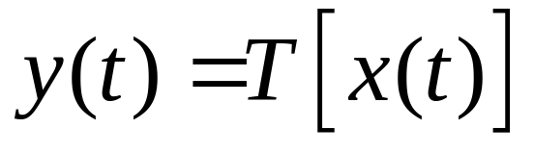
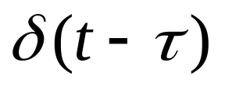
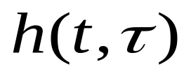
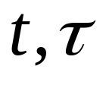


The impulse response of a linear system
x
y
Apply the input to the system. Denote the
corresponding output by . This function of the
variables is called the system impulse response.
t
t

Slide 3
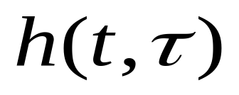

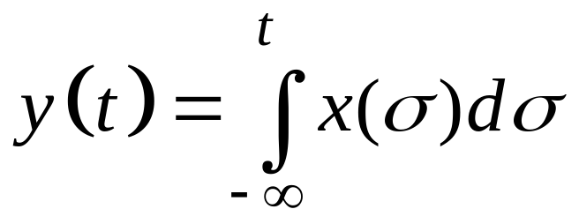
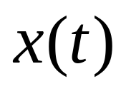
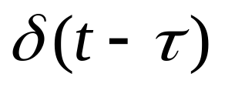
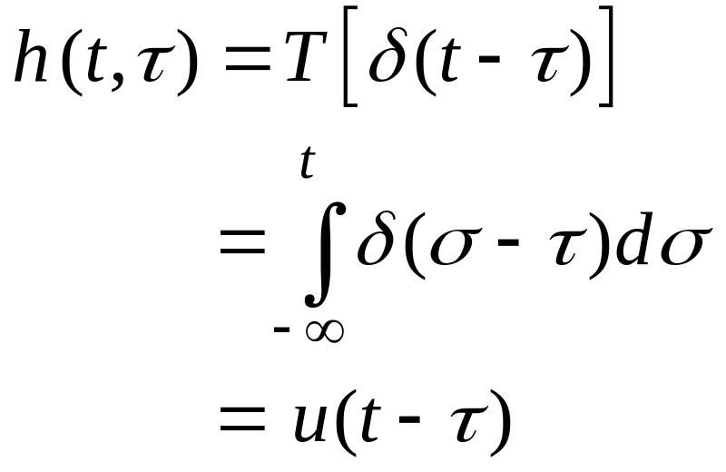
Impulse response function
Current
time
Time when
the impulse
is applied
Example: integrator
t
t

Slide 4
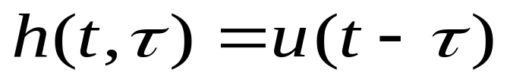

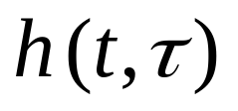

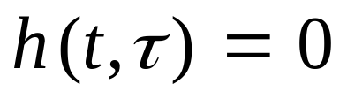

Integrator:
t
Note that in this example:
  depends only on the difference
  for
This is not a coincidence. In fact:
  a) is a general property of time invariant systems
  b) is a general property of causal systems.

Slide 5
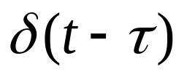
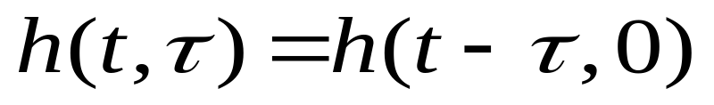
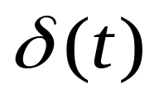

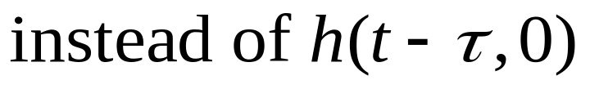
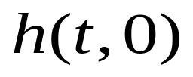

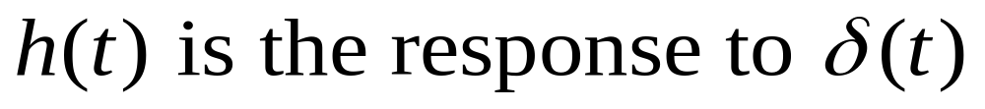
Impulse response for LTI systems
Property:
This follows directly
from time invariance
t
Notation:

Slide 6
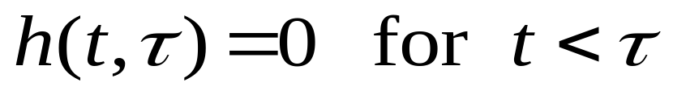
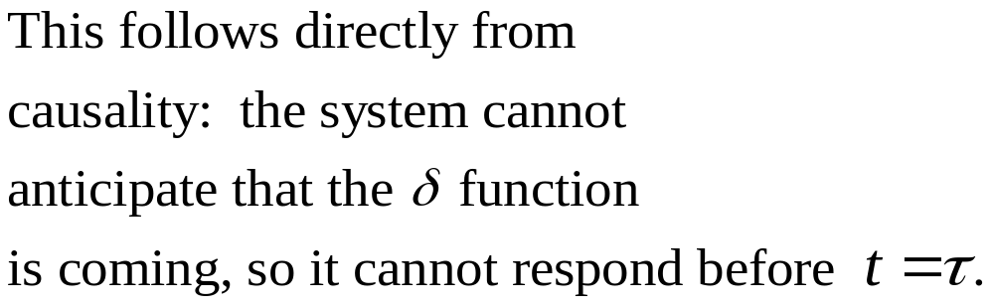
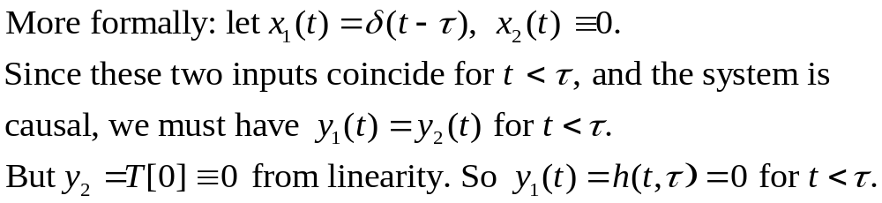
Impulse response for causal systems
Property:
t
t

Slide 7
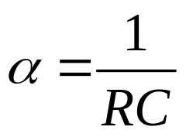
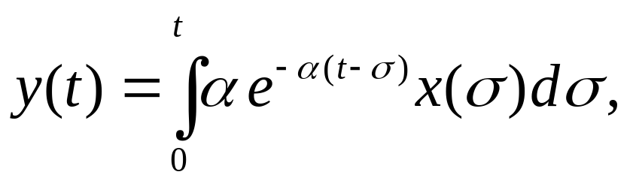
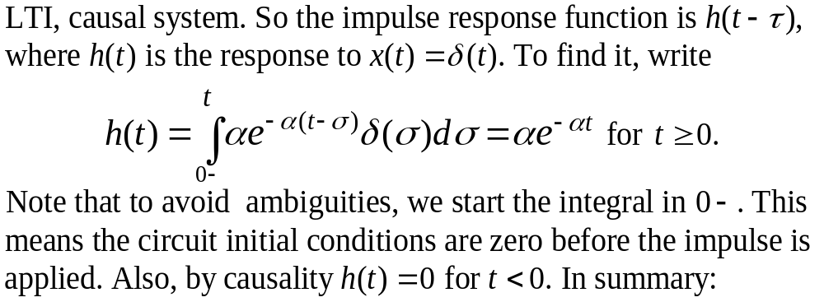
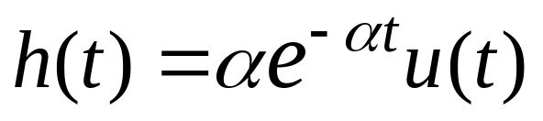
RC circuit example
+
+
R
x(t)
C
_
_

Slide 8
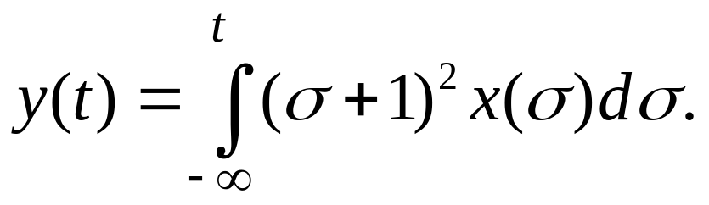
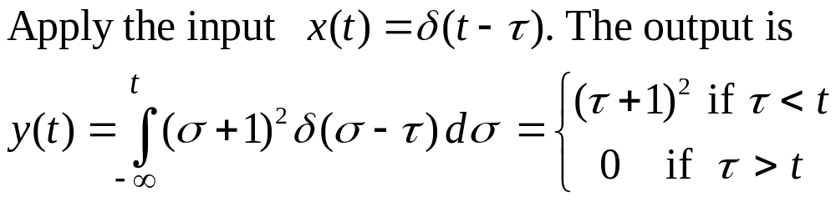
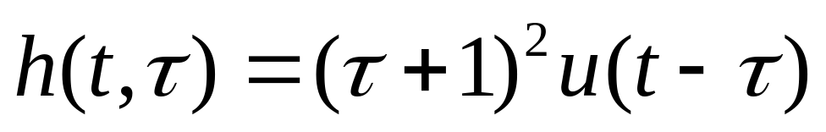
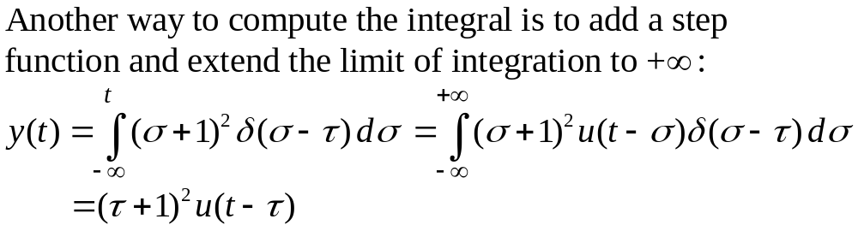
Another example:
Time varying, causal.

Slide 9
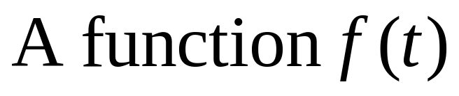
Why is the impulse response useful?
t
Idea: we can use impulses to approximate other functions

Slide 10
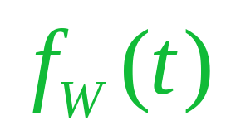
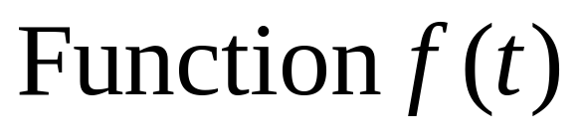

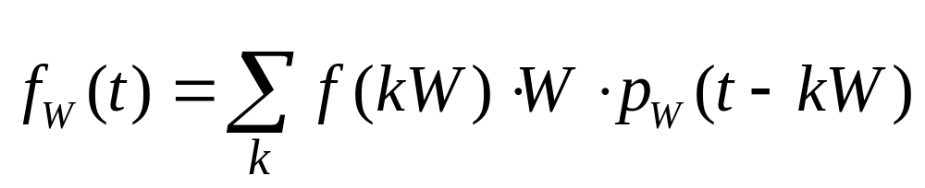
First, a “staircase approximation”
t

Slide 11

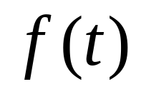

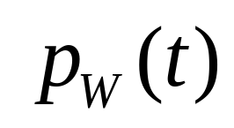
Deriving formula for
t

Slide 12



Deriving formula for
t

Slide 13

Deriving formula for
1
t

Slide 14

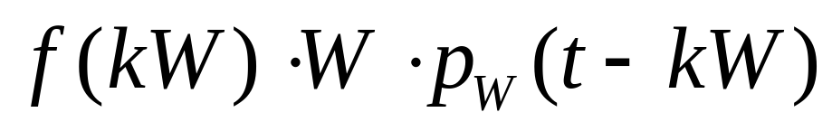
Deriving formula for
t

Slide 15

Deriving formula for
t

Slide 16

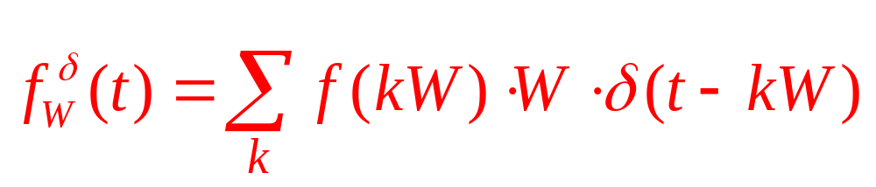
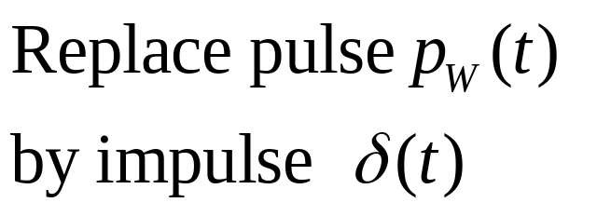
Now, an “impulse train” approximation
t

Slide 17
Are impulse trains physical?
In cart example: applying an impulse train as a force is like doing a periodic “hammering” instead of a smooth push.
Electrical example. The current i(t) flowing through a section of a cable is made up of discrete electrons going through. So i(t) is naturally modeled as an impulse train.
i(t)

Slide 18
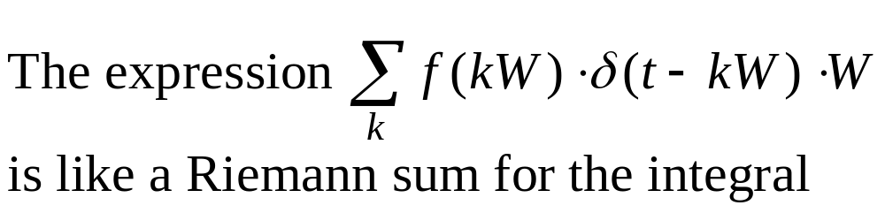
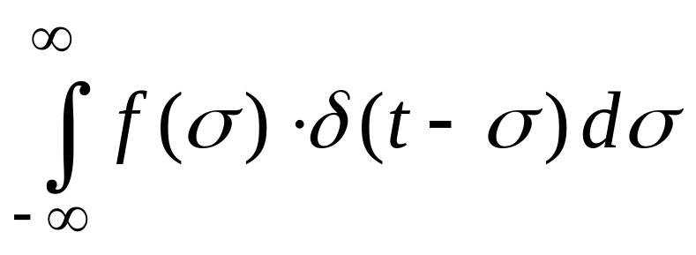
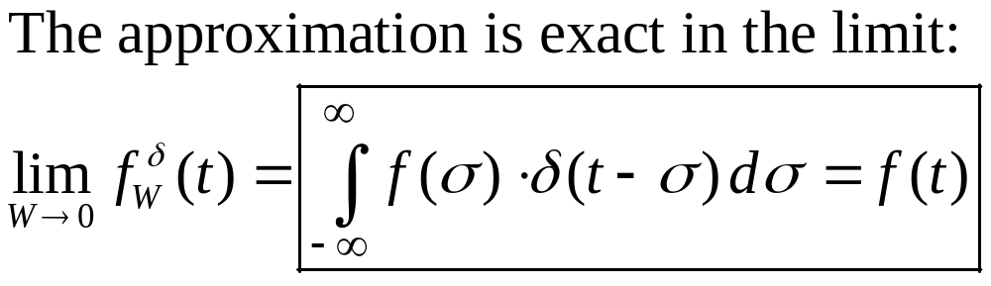
In the limit as step-size goes to 0
“Resolution” of a function as a superposition of delta’s

Slide 19
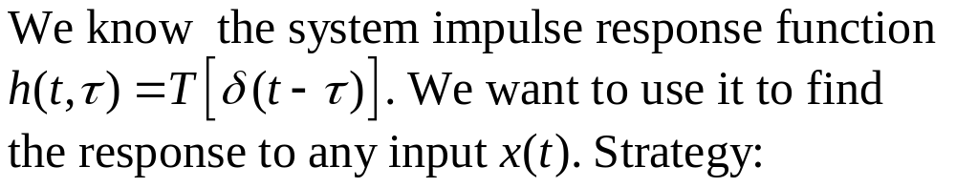
Input-output relation of a linear system
x
y
Approximate x(t) by a train of impulses.
Use linearity to obtain the output corresponding to this approximation.
Take the limit as W goes to zero.

Slide 20

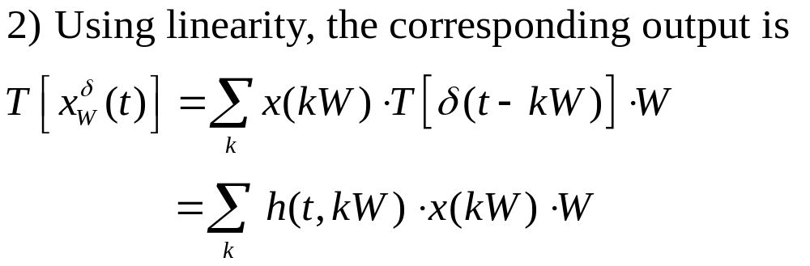
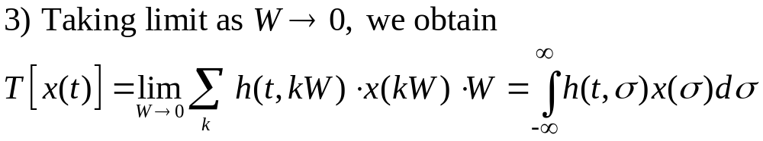

Slide 21

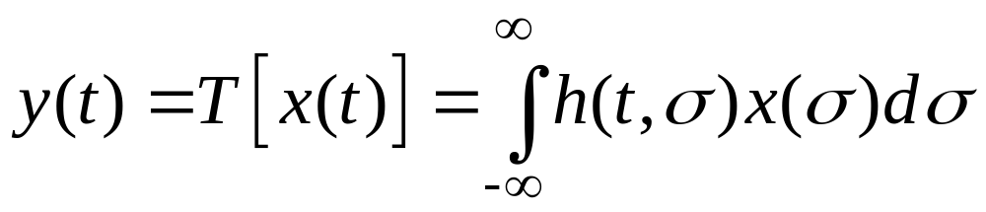
Input-output relation of a linear system
x
y
SUPERPOSITION INTEGRAL

Slide 22
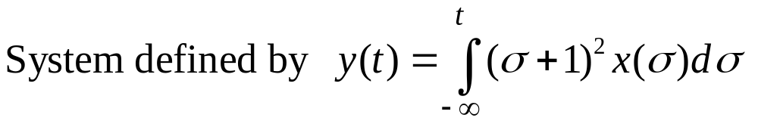
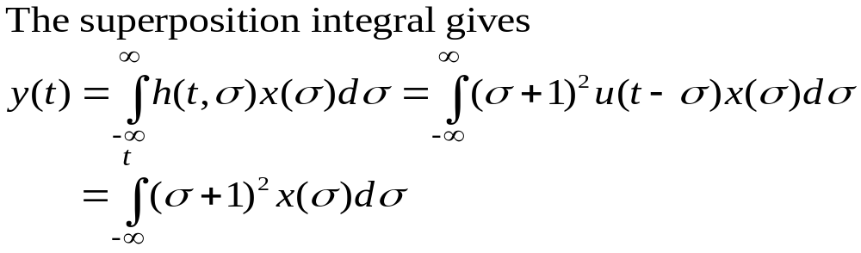
Back to earlier example:
Recover original definition. Having the impulse response
function is equivalent to having the complete definition.

