Slide 1
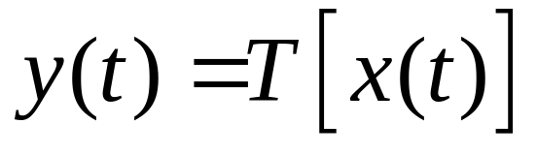
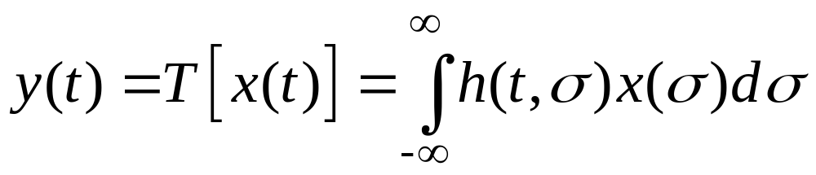
Recall: Input-output relation of a linear system
Lecture 5: Convolutions and Applications
x
y
SUPERPOSITION INTEGRAL

Slide 2
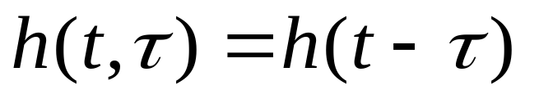
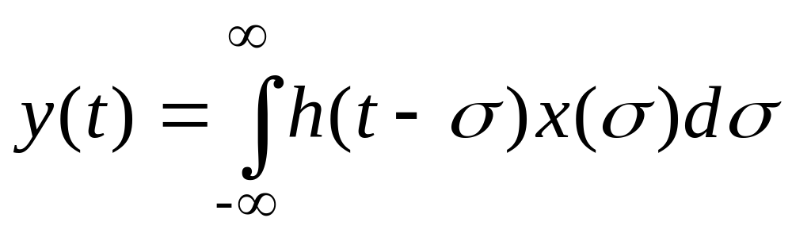
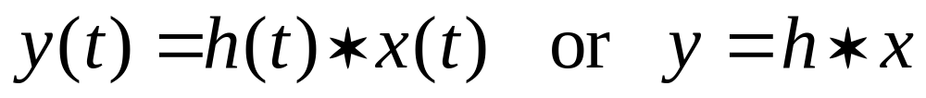
For the time invariant case:
This operation is called the convolution of the
functions h(t) and x(t). Notation:
Given two functions of one variable, the convolution
operation returns another function of one variable.

Slide 3



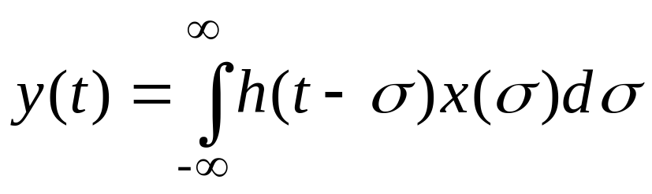
1
1
1
2

Slide 4
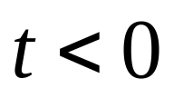





1
1
1
2

Slide 5
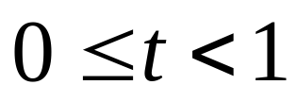


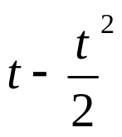
1
1
2
1
2
1

Slide 6
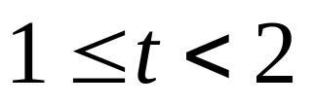

1
1
2
1
1
2

Slide 7
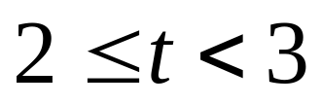

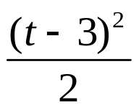
1
1
2
1
1
2
3

Slide 8
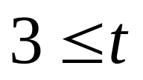
1
1
2
1
1
2
3

Slide 9


1
1
2
1
1
2
3

Slide 10
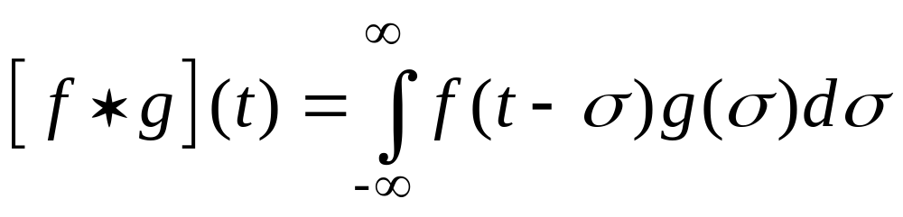
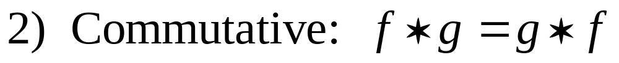
Properties of convolution.
Algebraic properties of a product!

Slide 11
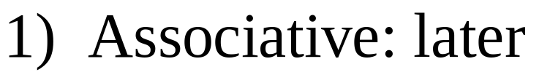
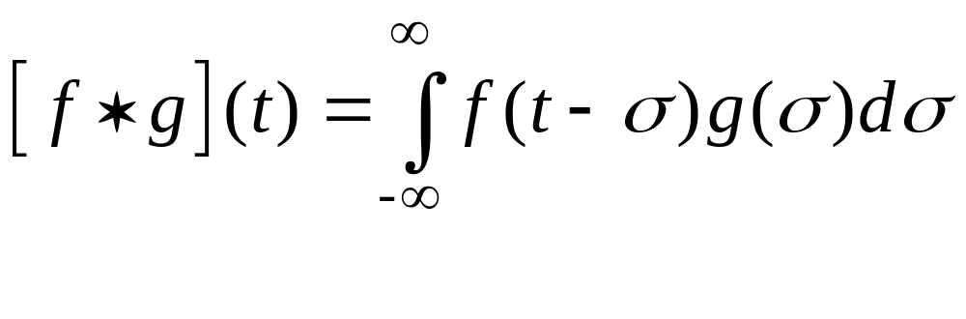
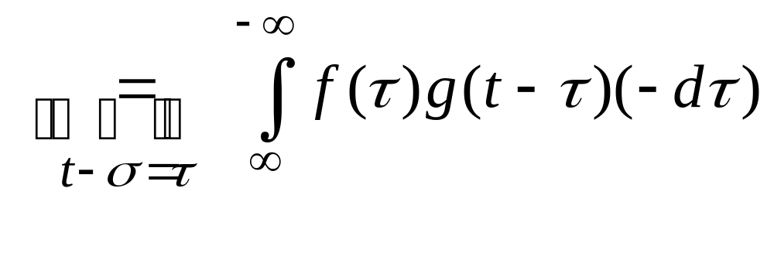
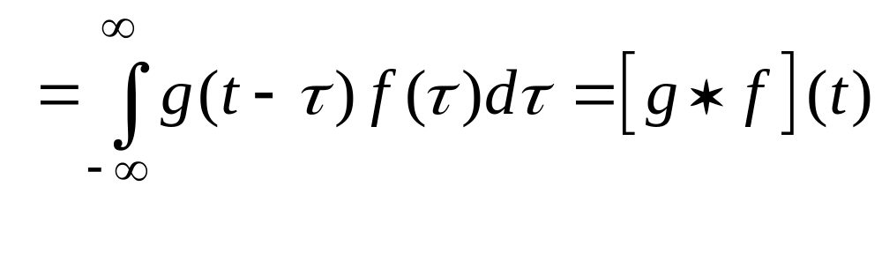
Properties of convolution → Proof
2) Commutative:

Slide 12
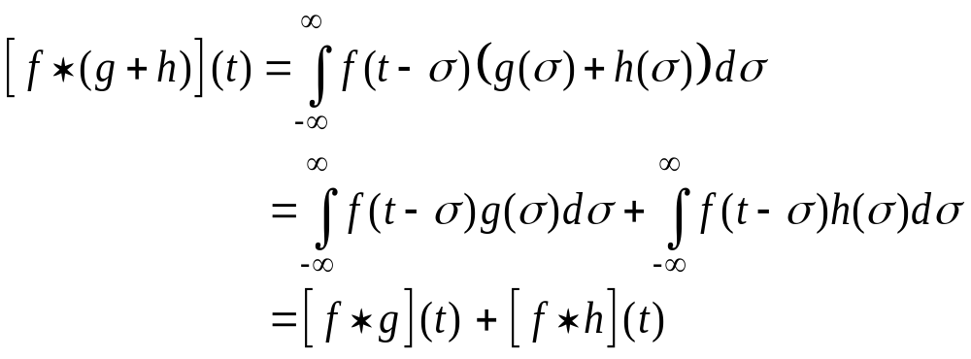
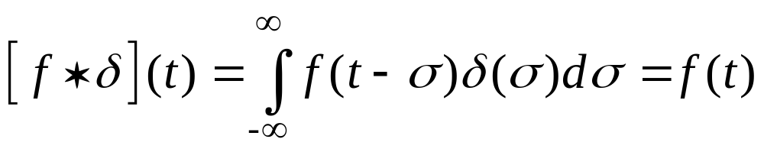
Properties of convolution → Proof
3) Distributive:
4) Unit of convolution: the Dirac delta function.

Slide 13
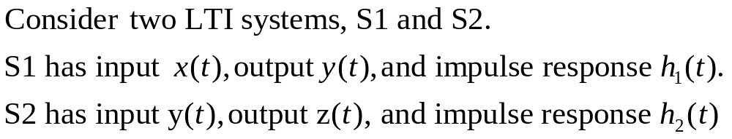

Impulse response of a cascaded system
y
x
S1
S2
z

Slide 14
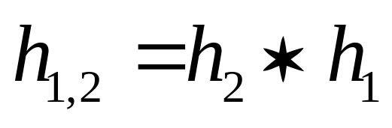
Impulse response of a cascaded system
y
x
S1
S2
z
Conclusion: The impulse response of the cascade is the
convolution of the impulse responses of each stage.

Slide 15

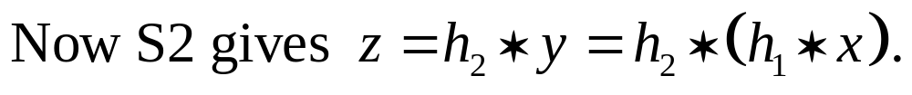
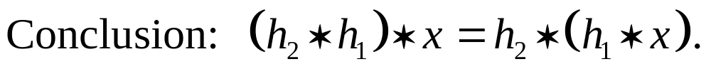
Associativity of convolution
y
x
S1
S2
z

Slide 16
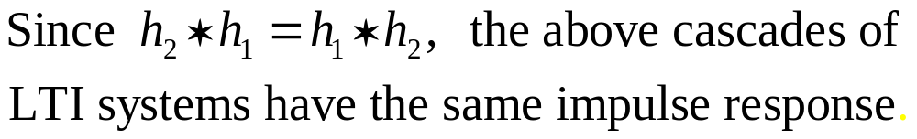
A consequence of commutativity
y
x
S1
S2
z
v
x
S2
S1
z
Therefore, they are equivalent: LTI systems commute.
Note: they are equivalent only as mappings from x to z.
The intermediate signals y and v will not be the same.

Slide 17
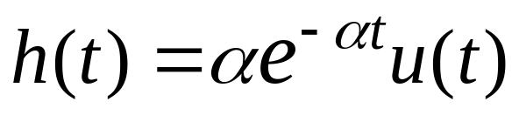
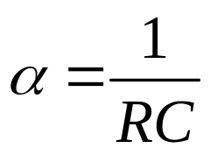
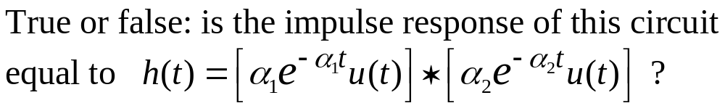
A cascaded circuit
+
Recall:
+
R
y(t)
x(t)
C
_
_
Now consider:
y(t)
+
+
+
R1
R2
z(t)
x(t)
C1
C2
_
_
_
Answer: False!

Slide 18
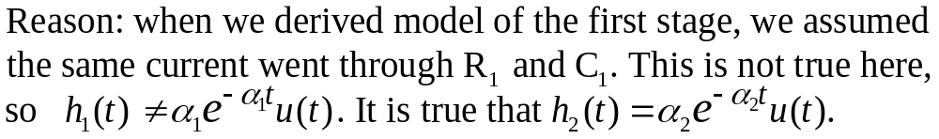
y(t)
+
+
+
R1
R2
z(t)
x(t)
C1
_
C2
_
_
Q: So what is the value of input-output system models if we can’t break complex systems into cascades of simpler parts?
A: We can, at least approximately, when some simplifying assumptions hold. e.g., when R2 >> R1 in the above circuit.
Complex engineering systems are designed so that such approximations hold, and we can understand them.
The decomposition strategy would not work for a “random” system, or one “designed” by nature. For example, complex biological or economic systems are much harder to study!

