Slide 1
Lecture 9
The CMOS Inverter
Energy & Power
EE 115C: Digital Electronic Circuits

Slide 2
Power and Energy Figures of Merit
Power consumption in Watts
  determines battery life in hours
Peak power
  determines power ground wiring designs
  sets packaging limits
  impacts signal noise margin and reliability analysis
Energy efficiency in Joules
  rate at which power is consumed over time
Energy = power * delay
  Joules = Watts * seconds
  lower energy number means less power to perform a computation at the same frequency
Notes:
power is the rate at which energy is delivered or exchanged; power dissipation is the rate at which energy is taken from the source (Vdd) and converted into heat (electrical energy is converted into heat energy during operation)
Hard to get large current into a chip (amps of current) – 30W at 3V is 10amps

Slide 3
Power versus Energy
Power is height of curve
Watts
Lower power design could simply be slower
Approach 1
Approach 2
time
Energy is area under curve
Watts
Two approaches require the same energy
Approach 1
Approach 2
time
Notes:
Energy – changing the operating frequency does not change the energy consumption!

Slide 4
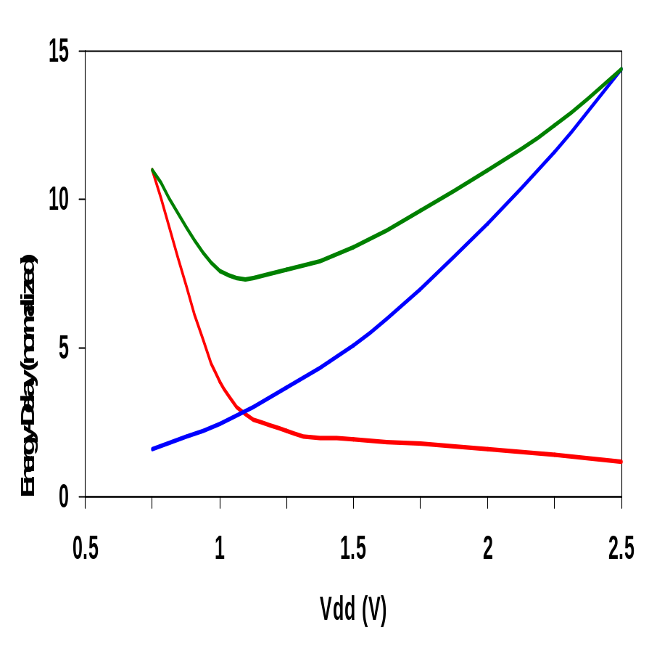
PDP and EDP
Power-delay product (PDP) = P_{av} * t_{p} = (C_{L}V_{DD}²)/2
  PDP is the average energy consumed per switching event (Watts * sec = Joule)
  lower power design could simply be a slower design
Energy-delay product
  (EDP) = PDP * tp = Pav * tp²
  EDP is the average energy consumed multiplied by the computation time required
  takes into account that one can trade increased delay for lower energy/operation (e.g., via supply voltage scaling that increases delay, but decreases energy consumption)
energy-delay
energy
delay
  allows one to understand tradeoffs better
Notes:
PDP stands for the average energy consumed per switching even – so its CL VDD**2 over 2
As each inverter cycle contains a 0->1 and a 1->0 transition, Eav is twice the PDP
For a given structure the PDP may be made arbitrarily low by reducing the supply voltage that comes at the expense of performance.
EDP is the preferred metric – since it takes performance into account
The optimum supply voltage can be derived (as in the book) as VDDopt = 3/2 VTE where VTE = VT + VDSAT/2.
This value of VDD optimizes both performance and energy simultaneously. For technologies with VT’s in the range of 0.5V, the optimum supply is around 1V as shown in the plot (for our generic parameters of 0.43 VTn and –0.4 VTp it is 1.2V)
Ignores standby power issues, and microarchitecture optimization issues (e.g., pipelining)

Slide 5
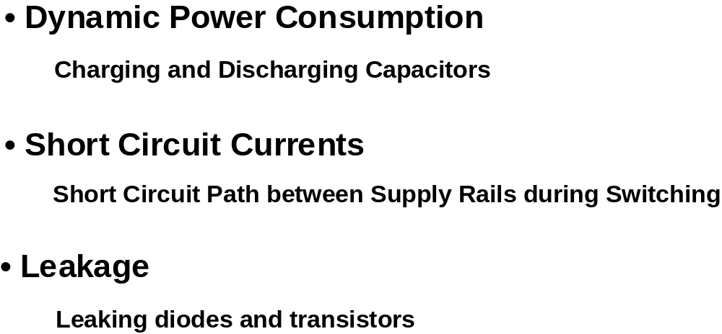
Where Does Power Go in CMOS?

Slide 6
CMOS Energy & Power Equations
E = C_{L} V_{DD}² P_{0→1} + t_{sc} V_{DD} I_{peak} P_{0→1} + V_{DD} I_{leakage}
P = C_{L} V_{DD}² f_{0→1} + t_{sc}V_{DD} I_{peak} f_{0→1} + V_{DD} I_{leakage}
f_{0→1} = P_{0→1} * f_{clock}
Dynamic power
Short-circuit power
Leakage power
Notes:
f0->1 represents the energy consuming transition

Slide 7
Dynamic Power Consumption
Vdd
Vin
Vout
C_{L}
f_{0→1}
Energy/transition = C_{L} * V_{DD}² * P_{0→1}
P_{dyn} = Energy/transition * f = C_{L} * V_{DD}² * P_{0→1} * f
P_{dyn} = C_{EFF} * V_{DD}² * f where C_{EFF} = P_{0→1} C_{L}
Not a function of transistor sizes!
Data dependent - a function of switching activity!
Note: for a L->H trancision C_{L}V_{DD}² is drawn from the supply but only 0.5C_{L}V_{DD}² is stored in CL. The rest is dissipated as energy in the device (text p. 214-15)
Notes:
Half of the energy is dissipated in the PMOS device, the remainder is stored on the load capacitor. Notice that this energy dissipation is independent of the size (and hence the resistance) of the PMOS device. During the high-to-low transition, this capacitor is discharged and the stored energy is dissipated in the NMOS transistor.
P0->1 is the transition probability - probability that the output is going to make the transition from 0 to 1 (the energy consuming transition). Ceff is the effective capacitance representing the average capacitance switched every clock cycle
Dynamic power accounts for 60 to 80% of the total power consumption of today’s parts.
Advances in technology result in ever higher values for f0->1 (as tp decreases). At the same time the total capacitance on the chip (CL) increases as more and more gates are placed on a single die.
With CL = 6fF, Edyn = 37.5 fJoules (for 2.5 V supply). If clocked at the maximum rate (T = 1/f = tpLH + tpHL = 2tp) then Pdyn = Edyn/(2tp) = 580 microWatts

Slide 8
Lowering Dynamic Power
Capacitance:
Function of fan-out, wire length, transistor sizes
Supply Voltage:
Has been dropping with successive generations
P_{dyn} = C_{L} V_{DD}² P_{0→1} f
Activity factor:
How often, on average, do wires switch?
Clock frequency:
Increasing…
Notes:
Lowering C_{L}
Improves performance as well
Keep transistors minimum size (keeps intrinsic capacitance (gate and diffusion) small)
Transistors should be sized only when C_{L} is dominated by extrinsic capacitance (fanout and wires)
Reducing V_{DD} has a quadratic effect!
But has a negative effect on performance especially as V_{DD} approaches 2V_{T}
Reducing the switching activity, f_{0→1} = P_{0→1} * f
A function of signal statistics and clock rate
Impacted by logic and architecture design decisions
One alternative is to lower the supply voltage as much as possible and to compensate for the loss in performance by increasing the transistor sizes. Yet this causes the capacitance to increase. At a low enough supply voltage, the capacitance (for speed) may start to dominate the power equation causing energy to increase with further drops in supply.

Slide 9
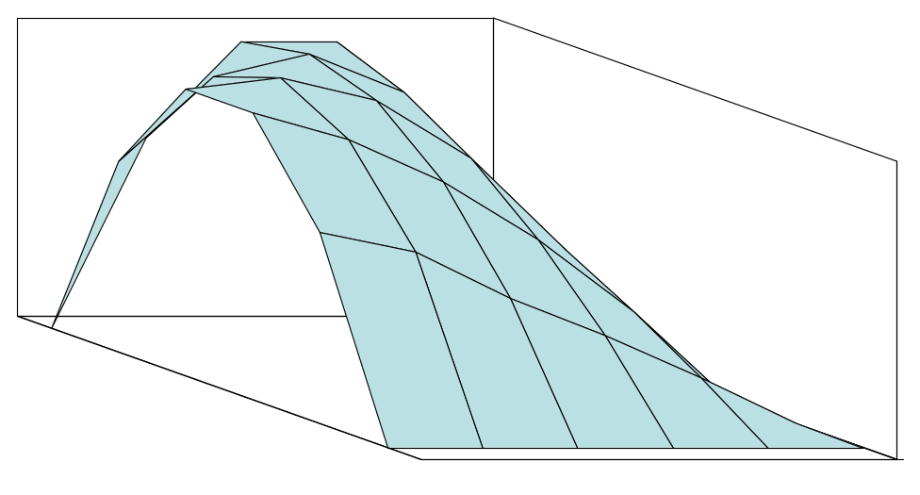
NOR Gate Transition Probabilities
Switching activity is a strong function of the input signal statistics
  P_{A} and P_{B} are the probabilities that inputs A and B are one
A
B
0
A
B
C_{L}
P_{A}
1
0
1
P_{B}
P_{0→1} = P₀ x P₁ = (1-(1-P_{A})(1-P_{B})) (1-P_{A})(1-P_{B})
Notes:
Understanding the signal statistics and their impact on switching events can be used to significantly impact the power dissipation.
Observe how the graph degrades into the simple inverter case when one of the input probabilities is set to 0

Slide 10
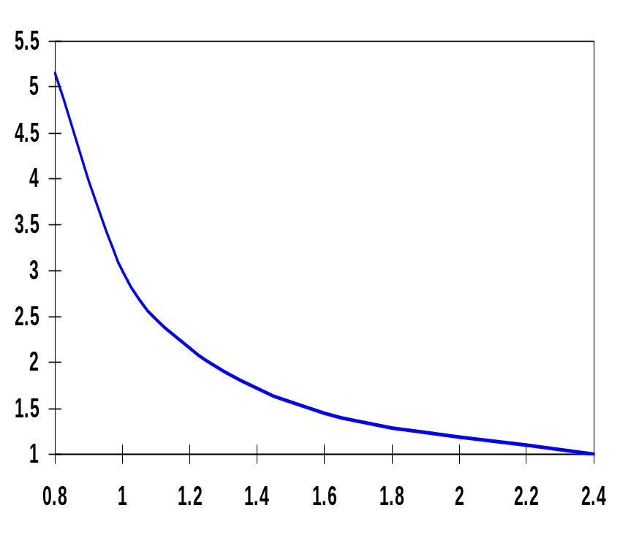
Dynamic Power as a Function of V_{DD}
Decreasing the V_{DD} decreases dynamic energy consumption (quadratically)
But, increases gate delay (decreases performance)
t_{p(normalized)}
V_{DD} (V)
Determine the critical path(s) at design time and use high V_{DD} for the transistors on those paths for speed. Use a lower V_{DD} on the other gates, especially those that drive large capacitances (as this yields the largest energy benefits).
Notes:
Propagation delay of a CMOS inverter as a function of supply voltage (normalized wrt delay at 2.5V supply). While the delay is relatively insensitive to supply variations for higher values of VDD, a sharp increase can be observed starting around 2VT. This operation regions should be avoided for high performance! Increasing VDD also has reliability concerns - oxide breakdown, hot-electron effects - that enforce firm upper bounds on the supply voltage in deep submicron processes. Lowering VDD slows down the gate!

Slide 11
Short Circuit Power Consumption
Vin
I_{sc}
Vout
C_{L}
Finite slope of the input signal causes a direct current path between V_{DD} and GND for a short period of time during switching when both the NMOS and PMOS transistors are conducting.
Notes:
Accounts for 20 to 40% of power of today’s technology

Slide 12
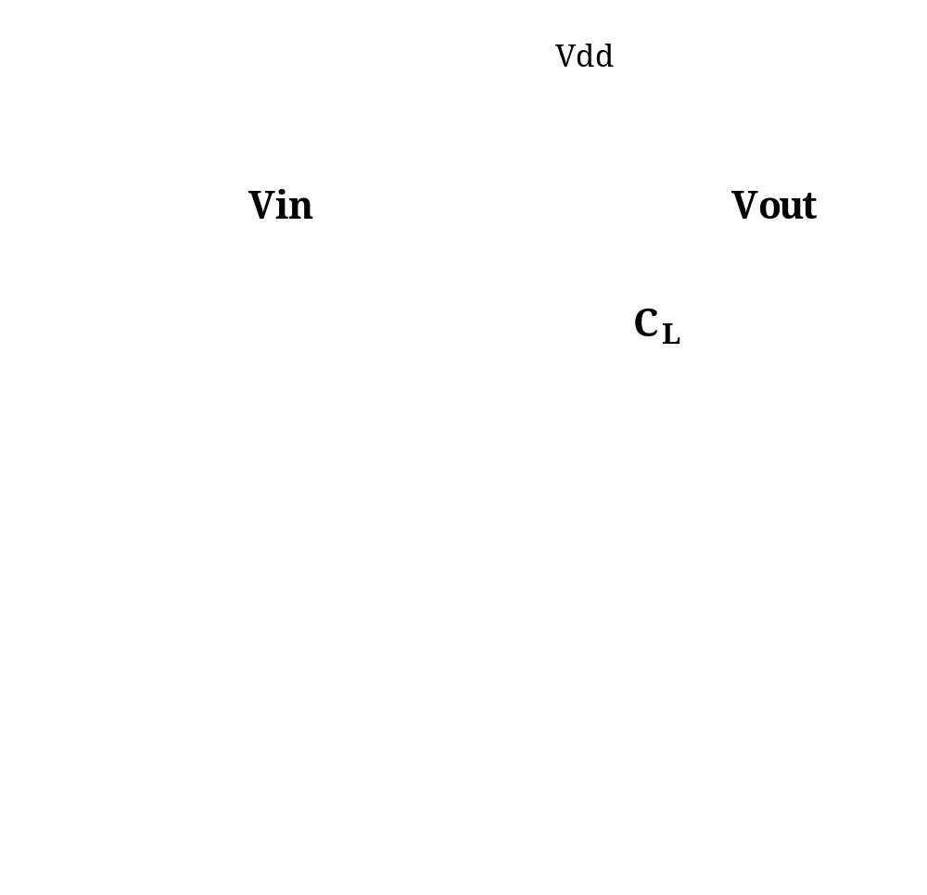
Short Circuit Currents

Slide 13
Short Circuit Currents Determinates
Probability of a ‘0’ to ‘1’ transition at the output
E_{sc} = t_{sc} V_{DD} I_{peak} P_{0→1}
P_{sc} = t_{sc} V_{DD} I_{peak} f_{0→1}
Frequency of a ‘0’ to ‘1’ transition at the output
Duration and slope of the input signal, t_{sc}
I_{peak} determined by
  the saturation current of the P and N transistors which depend on their sizes, process technology, temperature, etc.
  strong function of the ratio between input and output slopes
    a function of C_{L}
Notes:
Direct path currents
tsc is when both devices are conducting – peak and duration of Isc both increase as the input slope decreases

Slide 14
Impact of C_{L} on P_{sc}
I_{sc} ≈ 0
I_{sc} ≈ I_{max}
Vin
Vout
Vin
Vout
C_{L}
C_{L}
Large capacitive load
Output fall time significantly larger than input rise time.
Small capacitive load
Output fall time substantially smaller than the input rise time.
Notes:
Left case - input moves through the transient region before the output starts to change. As the source-drain voltage of the PMOS is approximately 0 during that period, the device shuts off without ever delivering any current, so Isc is close to zero.
Right case - Drain-source voltage of PMOS equals VDD for most of the transition period, giving maximum Isc

Slide 15
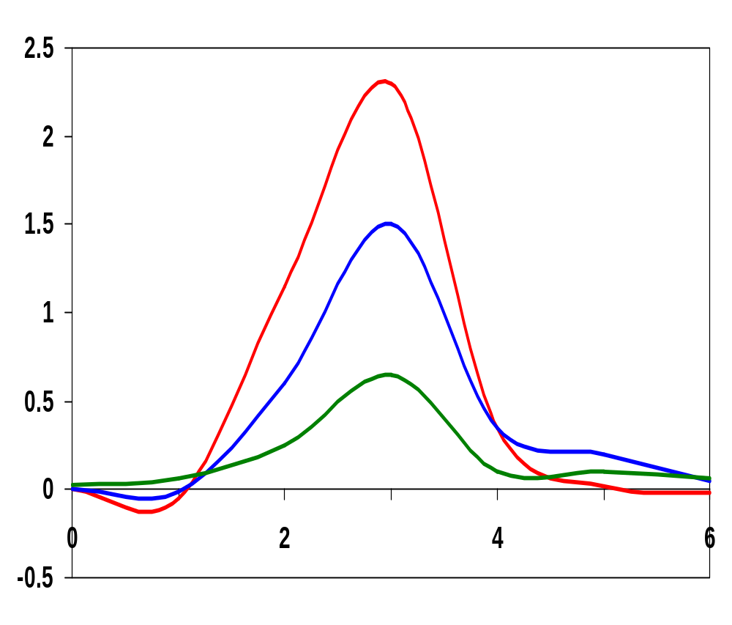
I_{peak} as a Function of C_{L}
When load capacitance is small, I_{peak} is large.
x 10⁻⁴
⇒ Use small input cap and large output cap
⇒ Gate delay is higher and the input rise time of the next gate (fanout gate) is higher
⇒ Higher I_{sc} in fanout gate !!
⇒ Local optimization is not good
C_{L} = 20 fF
I_{peak} (A)
C_{L} = 100 fF
C_{L} = 500 fF
Short circuit dissipation is minimized by matching the rise/fall times of the input and output signals - slope engineering.
x 10⁻¹⁰
time (sec)
500 psec input slope
Notes:
Making the output rise/fall time too large slows down the circuit and can cause short-circuit currents in the fan-out gates!
SLOPE ENGINEERING – is important for BOTH speed and power consumption
However, its not the optimum solution for a gate on its own (just keeps the overall short-circuit current within bounds). For a single inverter, see next slide . . .

Slide 16
Leakage (Static) Power Consumption
V_{DD} I_{leakage}
Vout
Drain junction leakage
Gate leakage
Sub-threshold current
Sub-threshold current is the dominant factor.
All increase exponentially with temperature!
Notes:
For drain junction: Leakage current per unit drain area typically ranges between 10 and 100 picoA/micron**2 at room temperature (25 degrees C) for 0.25 micron CMOS (1 million gates, each with drain area of 0.5 micron**2 = 0.125 milliW).
However, values increase with increasing junction temperature - exponentially! JS doubles for every 9 deg C! At 85 degrees C (commonly imposed upper bound for junction temperatures) the leakage currents increase by a factor of 60 over room temperature. As temperature is a strong function of the dissipated heat and its removal mechanisms – limit power heat and use chip packages that support efficient heat removal.
Have to be more concerned about sub-threshold current. The closer the threshold voltage is to zero, the larger the leakage current at VGS = 0 V. To offset this effect, threshold voltages are not scaled as aggressively as supply voltages (narrowing noise margins). Unfortunately, scaling the supply voltage and not scaling threshold hurts performance, esp as VDD approaches 2 VT.

Slide 17
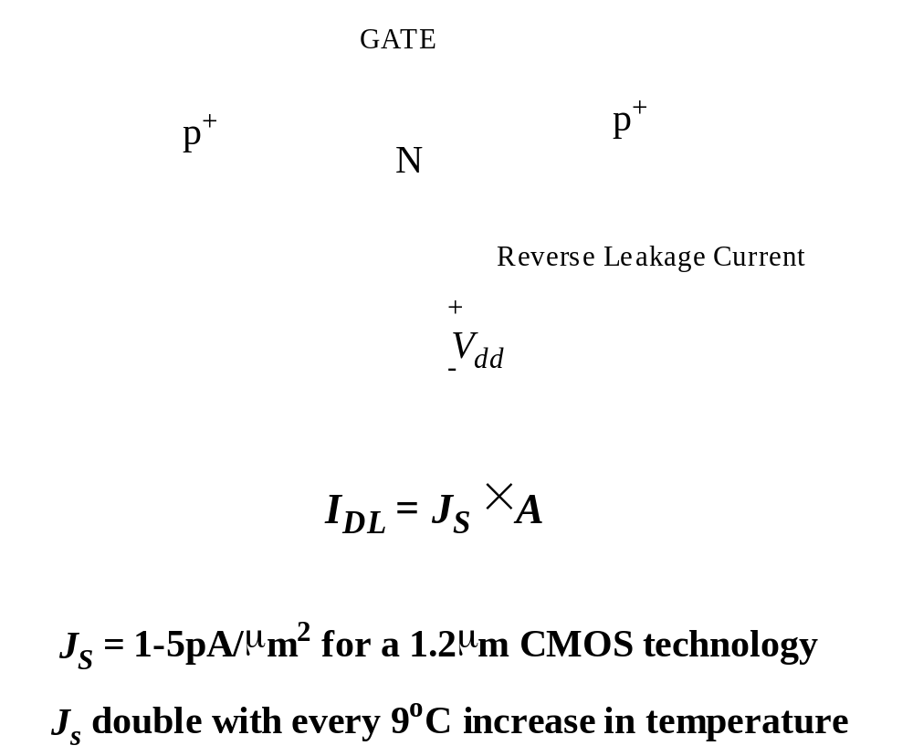
Reverse-Biased Diode Leakage
JS = 10-100 pA/μm2 at 25 deg C for 0.25μm CMOS
JS doubles for every 9 deg C!

Slide 18
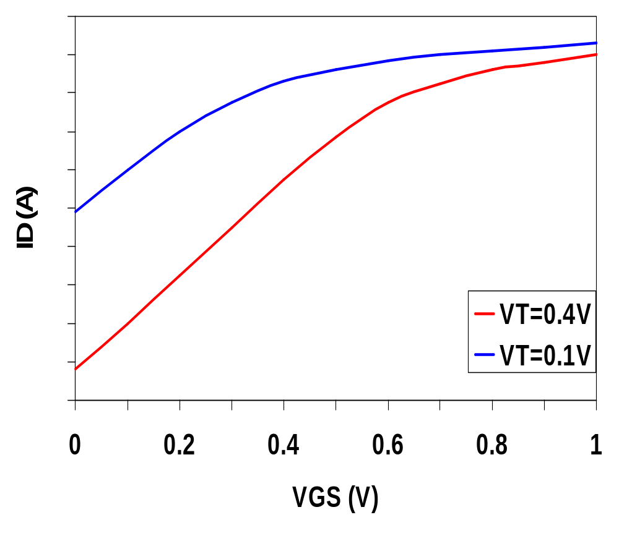
Leakage as a Function of V_{T}
Continued scaling of supply voltage and the subsequent scaling of threshold voltage will make subthreshold conduction a dominate component of power dissipation.
10⁻²
An 90mV/decade V_{T} roll-off - so each 255mV increase in V_{T} gives 3 orders of magnitude reduction in leakage (but adversely affects performance)
10⁻⁷
10⁻¹²
Notes:
The choice of VT represents a trade-off between performance and static power dissipation. Process technologies with sharper turn-off characteristics (like SOI with slope factors closer to the ideal 60mV/decade) will become more attractive. With sizable static power dissipation, it is essential that non-active modules are powered-down (put in standby) by disconnecting the unit from the supply rails or by lowering the supply voltage.
There are other leakage factors that we are ignoring here including: Drain-Induced Barrier Lowering (I₃)
Gate-Induced Drain Leakage (I₄)
Punchthrough (I₅)
Narrow Width Effect (I₆)
Gate Oxide Tunneling (I₇)
Hot Carrier(I₈)

Slide 19
TSMC Processes Leakage and V_{T}
CL018 G
CL018 LP
CL018 ULP
CL018 HS
CL015 HS
CL013 HS
V_{dd}
1.8 V
1.8 V
1.8 V
2 V
1.5 V
1.2 V
T_{ox} (effective)
42 Å
42 Å
42 Å
42 Å
29 Å
24 Å
L_{gate}
0.16 μm
0.16 μm
0.18 μm
0.13 μm
0.11 μm
0.08 μm
I_{DSat} (n/p) (μA/μm)
600/260
500/180
320/130
780/360
860/370
920/400
I_{off} (leakage) (ρA/μm)
20
1.60
0.15
300
1,800
13,000
V_{Tn}
0.42 V
0.63 V
0.73 V
0.40 V
0.29 V
0.25 V
FET Perf. (GHz)
30
22
14
43
52
80
From MPR, 2000
Notes:
From MPR, June 2000, pp. 19 – Performance of various TSMC processes (G generic, LP low power, ULP ultra low power, HS high speed)

Slide 20
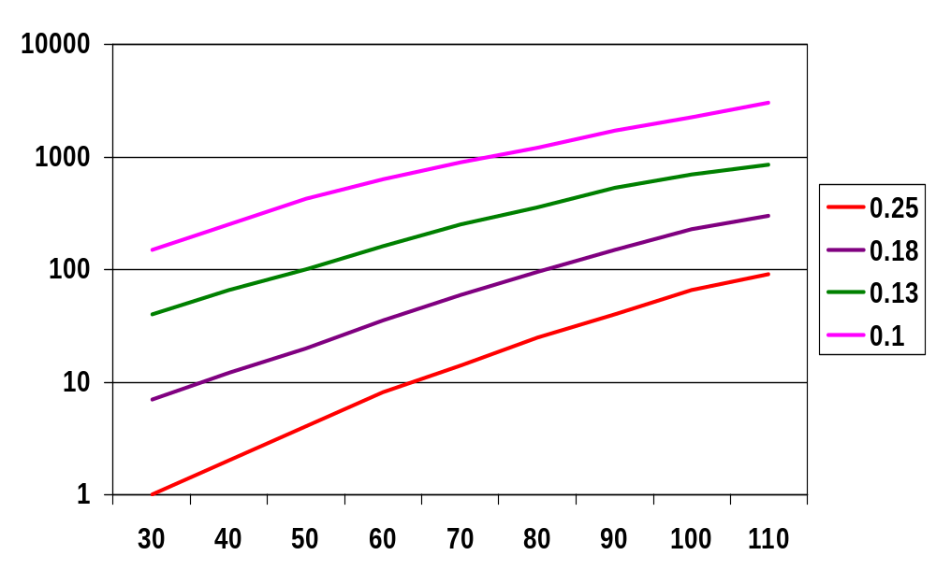
Exponential Increase in Leakage Currents
I_{leakage}(nA/μm)
Temp(C)
From De,1999
Notes:
Note y axis is log – doubles for every 10 degree increase in temperature
Will leakage power still be 6 orders of magnitude smaller (as it is today) than dynamic power for future technologies even at room temperature.
Example – the following configurations have the same power performance:
3V VDD, 0.7V VT and a 0.45V VDD, 0.1V VT
The dynamic power consumption of the latter is, however, 45 times smaller.

Slide 21
Principles for Power Reduction
Prime choice: Reduce voltage!
  Recent years have seen an acceleration in supply voltage reduction
  Design at very low voltages still open question (0.6 … 0.9 V by 2010!)
Reduce switching activity
Reduce physical capacitance
  Device Sizing: for F=20
    f_{opt}(energy)=3.53, f_{opt}(performance)=4.47

Slide 22
Review: Energy & Power Equations
E = C_{L} V_{DD}² P_{0→1} + t_{sc} V_{DD} I_{peak} P_{0→1} + V_{DD} I_{leakage}
P = C_{L} V_{DD}² f_{0→1} + t_{sc}V_{DD} I_{peak} f_{0→1} + V_{DD} I_{leakage}
f_{0→1} = P_{0→1} * f_{clock}
Dynamic power
(~90% today and decreasing relatively)
Short-circuit power
(~8% today and decreasing absolutely)
Leakage power
(~2% today and increasing)
Notes:
f0->1 represents the energy consuming transition

Slide 23
Backup slides

Slide 24
Dynamic Power as a Function of Device Size
Device sizing affects dynamic energy consumption
  gain is largest for networks with large overall effective fan-outs (F = C_{L}/C_{g,1})
The optimal gate sizing factor (f) for dynamic energy is smaller than the one for performance, especially for large F’s
  e.g., for F=20, f_{opt}(energy) = 3.53 while f_{opt}(performance) = 4.47
If energy is a concern avoid oversizing beyond the optimal
1.5
F=1
F=2
1
normalized energy
F=5
0.5
F=10
F=20
0
1
2
3
4
5
6
7
f
From Nikolic, UCB
Notes:
Device sizing COMBINED with supply voltage reduction is a very effective way to reduce the energy consumption of a logic network. Especially true for networks with large effective fanout (F) where energy reductions of a factor of 10 can be obtained (except when F=1 when minimum size should be used).
Oversizing comes at a hefty price in energy.
The optimal sizing factor for energy is smaller than the one for performance.

Slide 25
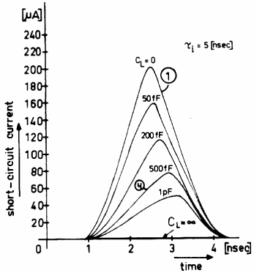
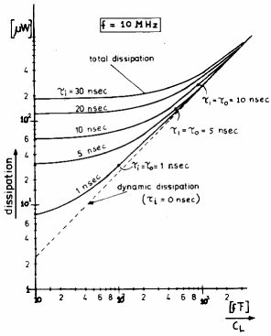
How to keep Short-Circuit Currents Low?
Short circuit current goes to zero if t_{fall} >> t_{rise},
but can’t do this for cascade logic, so ...

Slide 26
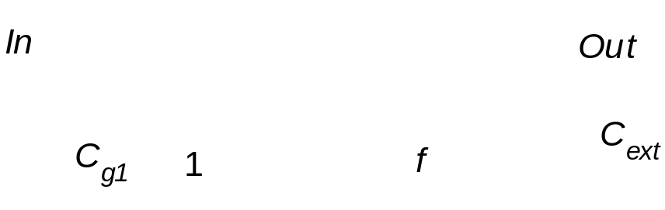
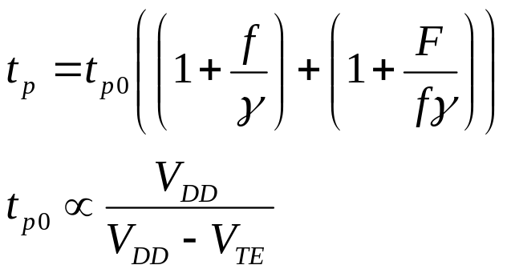
Transistor Sizing for Minimum Energy
Goal: Minimize Energy of whole circuit
  Design parameters: f and V_{DD}
  t_{p} ≤ t_{pref} of circuit with f=1 and V_{DD} =V_{ref}

Slide 27
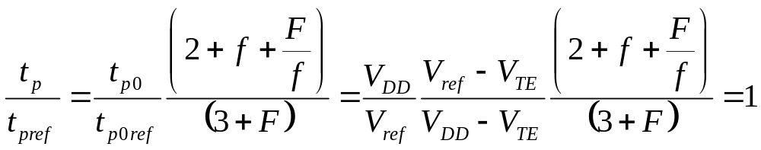
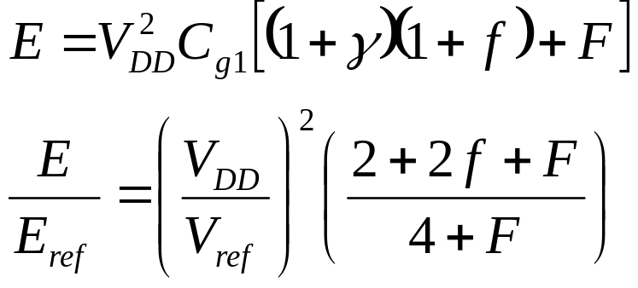
Transistor Sizing (2)
Performance Constraint (γ=1)
Energy for single Transition

