Slide 1
Lecture 10 & 11
Combinational Logic Gates
EE 115C: Digital Electronic Circuits

Slide 2
CMOS Circuit Styles
Static complementary CMOS - except during switching, output connected to either V_{DD} or GND via a low-resistance path
  high noise margins
    full rail to rail swing
    V_{OH} and V_{OL} are at V_{DD} and GND, respectively
  low output impedance, high input impedance
  no steady state path between V_{DD} and GND (no static power consumption)
  delay a function of load capacitance and transistor resistance
  comparable rise and fall times (under the appropriate transistor sizing conditions)
Dynamic CMOS - relies on temporary storage of signal values on the capacitance of high-impedance circuit nodes
  simpler, faster gates
  increased sensitivity to noise
Notes:
Focus on combinational logic – output of the circuit is related to its current input signals by some Boolean expression
static CMOS - most widely used logic style

Slide 3
Static Complementary CMOS
Pull-up network (PUN) and pull-down network (PDN)
V_{DD}
PMOS transistors only
In₁
pull-up: make a connection from V_{DD} to F when F(In₁,In₂,…In_{N}) = 1
In₂
…
PUN
In_{N}
F(In₁,In₂,…In_{N})
In₁
pull-down: make a connection from F to GND when F(In₁,In₂,…In_{N}) = 0
In₂
…
PDN
In_{N}
NMOS transistors only
PUN and PDN are dual logic networks
Notes:
One and only one of the networks (PUN or PDN) is conducting in steady state (output node is always a low-impedance node in steady state)
Why PUN of PMOSs only and PDN of NMOSs only ? (Next slide)

Slide 4
What Type of Trans for PUN & PDN?
V_{DD}
V_{DD}
PUN
V_{DD}
0 →
0 →
C_{L}
C_{L}
PDN
V_{DD} →
V_{DD} →
C_{L}
C_{L}
V_{DD}
Notes:
For class handout

Slide 5
What Type of Trans for PUN & PDN?
V_{DD}
V_{DD}
PUN
S
D
V_{DD}
D
0 → V_{DD}
S
0 → V_{DD} - V_{Tn}
V_{GS}
C_{L}
C_{L}
PDN
V_{DD} → 0
V_{DD} → |V_{Tp}|
V_{GS}
D
C_{L}
S
C_{L}
V_{DD}
S
D
Notes:
Why PMOS in PUN and NMOS in PDN … threshold drop
NMOS transistors produce strong zeros; PMOS transistors generate strong ones
Two circuits on the right cut-off before the ideal voltage level is reached (when VGS < VT)
Ask to think about two nfets in series, both with Vdd gates and a Vdd on the drain “input” – how many voltage drops?
Ask to think about two nfets, the output of the first driving the gate of the second, both the Vdd drain “inputs” – how many voltage drops?

Slide 6
Construction of PDN
NMOS devices in series implement a NAND function
NMOS devices in parallel implement a NOR function
A • B
A
B
A + B
A
B

Slide 7
Dual PUN and PDN
PUN and PDN are dual networks
  a parallel connection of transistors in the PUN corresponds to a series connection of the PDN
  DeMorgan’s theorems
    A + B = A • B [!(A + B) = !A • !B or !(A | B) = !A & !B]
    A • B = A + B [!(A • B) = !A + !B or !(A & B) = !A | !B]
    Parallel PMOS transistors conduct if A=0 OR B=0
      Conducts if !A + !B = !(AB)
    Series NMOS transistors conduct if A=1 AND B=1
      Conducts if AB
Complementary gate is naturally inverting (NAND, NOR, XNOR)
Number of transistors for an N-input logic gate is 2N

Slide 8
CMOS NAND
A | B | F
0 | 0 | 1
0 | 1 | 1
1 | 0 | 1
1 | 1 | 0
A
B
A • B
A
B
A
B

Slide 9
CMOS NOR
A | B | F
0 | 0 | 1
0 | 1 | 0
1 | 0 | 0
1 | 1 | 0
B
A
A + B
A
B
A
B

Slide 10
Complex CMOS Gate
OUT = !(D + A • (B + C))
A
D
B
C
Notes:
For class handout

Slide 11
Complex CMOS Gate
B
A
C
D
OUT = !(D + A • (B + C))
A
D
B
C
Notes:
Shown synthesis of pull up from pull down structure
Max of 3 transistors in series (in the PUN)

Slide 12
Example 1
A
j
C
B
X = !(C • (A + B))
C
i
A
B
A
B
C
Notes:
Systematic approach to derive order of input signal wires so gate can be laid out to minimize area
Note PUN and PDN are duals (parallel <-> series)
Vertices are nodes (signals) of circuit, VDD, X, GND and edges are transitions

Slide 13
Example 2
A
C
B
D
X = !((A+B)•(C+D))
C
D
A
B
A
B
C
D
Notes:
Consistent Euler paths
ABDC
BDCA
DCAB
CABD
BACD
ACDB
CDBA
DBAC
and NOT DACB, BCAD, etc.

Slide 14
XNOR/XOR Implementation
XNOR
XOR
A
A
A ⊕ B
B
B
A ⊕ B
A
A
B
B
A ⊕ B
A ⊕ B
How many transistors in each?
Notes:
12 and 10 transistor implementations of static XOR circuit

Slide 15
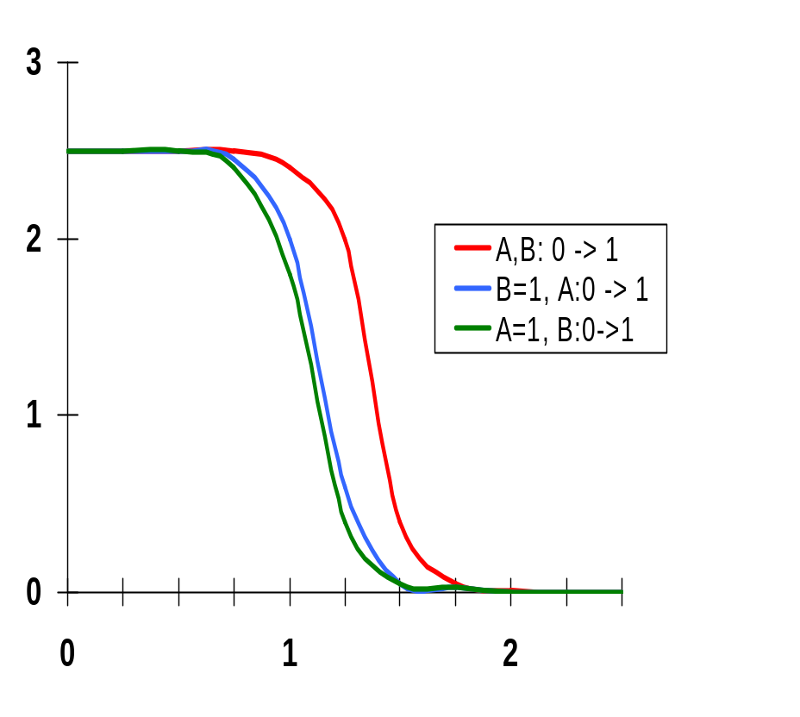
VTC is Data-Dependent
0.5μ/0.25μ NMOS
0.75μ /0.25μ PMOS
A
M₃
B
M₄
F= A • B
D
weaker
PUN or
Stronger
PDN
A
M₂
V_{GS2} = V_{A} –V_{DS1}
S
D
Cint
B
M₁
V_{GS1} = V_{B}
S
The threshold voltage of M₂ is higher than M₁ due to the body effect (γ)
V_{Tn1} = V_{Tn0}
V_{Tn2} = V_{Tn0} + γ(√(|2φ_{F}| + V_{int}) - √|2φ_{F}|)
since V_{SB} of M₂ is not zero (when V_{B} = 0) due to the presence of Cint
Notes:
VTC characteristics are dependent upon the data input patterns applied to the gate (so the noise margins are also data dependent!)
Threshold voltage of M2 will be higher than transistor M1 due to body effect
Case 1 – both transistors in the PUN are on simultaneously for A=B=0, representing a strong pull-up. In the other two cases only one of the pull-up devices is on. So the VTC is shifted left as a result of the weaker PUN for the second and third cases.
Case 2 – see Case 3, small difference can be attributed to the body effect of M2 and the drive voltage
Case 3 – M2 as resistor in series with M1, so only small effect on VTC; since pulldown is strong and pullup weaker than case 1, VTC shifted to the left
(also have to discharge both CL (on the output) and Cint (possibly) thru M1 so will also be slower!)

Slide 16
Static CMOS Full Adder Circuit
B
A
B
B
A
B
C_{in}
A
A
C_{in}
!C_{out}
!Sum
C_{in}
A
C_{in}
A
A
B
B
A
B
C_{in}
B
Notes:
24 + 4 (for C and Sum inverter) transistor Full Adder
No more than 3 transistors in series
Loads: A-8, B-8, Cin-6, !Cout-2
Number of “gate delays” to Sum – 3?

Slide 17
Derive the Logic from the transistor schematic for a Static CMOS Full Adder Circuit
!C_{out} = !C_{in} & (!A | !B) | (!A & !B)
!Sum = C_{out} & (!A | !B | !C_{in}) | (!A & !B & !C_{in})
B
A
B
B
A
B
C_{in}
A
A
C_{in}
!C_{out}
!Sum
C_{in}
A
C_{in}
A
A
B
B
A
B
C_{in}
B
C_{out} = C_{in} & (A | B) | (A & B)
Sum = !C_{out} & (A | B | C_{in}) | (A & B & C_{in})
Notes:
24 + 4 (for C and Sum inverter) transistor Full Adder
No more than 3 transistors in series
Loads: A-8, B-8, Cin-6, !Cout-2
Number of “gate delays” to Sum – 3?

Slide 18
Delay of Complex Gates

Slide 19
Review: CMOS Inverter: Dynamic
V_{DD}
t_{pHL} = f(R_{n}, C_{L})
t_{pHL} = 0.69 R_{eqn} C_{L}
t_{pHL} = 0.69 (3/4 (C_{L} V_{DD})/ I_{DSATn} )
= 0.52 C_{L} / (W/L_{n} k’_{n} V_{DSATn} )
V_{out}
C_{L}
R_{n}
V_{in} = V _{DD}
Notes:
So propagation delay is determined by the time to charge and discharge the load capacitor CL
SO, getting CL as small as possible is crucial to the realization of high-performance CMOS circuits
Today we look at dynamic inverter characteristics

Slide 20
Review: Designing Inverters for Performance
Reduce C_{L}
  internal diffusion capacitance of the gate itself
  interconnect capacitance
  fanout
Increase W/L ratio of the transistor
  the most powerful and effective performance optimization tool in the hands of the designer
  watch out for self-loading!
Increase V_{DD}
  only minimal improvement in performance at the cost of increased energy dissipation
Slope engineering - keeping signal rise and fall times smaller than or equal to the gate propagation delays and of approximately equal values
  good for performance
  good for power consumption
Notes:
Good design practice keeps drain diffusion areas as small as possible
Self-loading is when the intrinsic capacitance (diffusion capacitance) starts to dominate the extrinsic load formed by wiring and fanout.
Increasing VDD also has reliability concerns - oxide breakdown, hot-electron effects - that enforce firm upper bounds on the supply voltage in deep submicron processes.

Slide 21
Switch Delay Model
A
R_{eq}
A
R_{p}
R_{p}
R_{p}
B
A
B
R_{p}
R_{p}
A
R_{p}
A
C_{int}
R_{n}
C_{L}
A
A
R_{n}
C_{L}
A
R_{n}
R_{n}
C_{L}
R_{n}
C_{int}
A
B
B
INVERTER
NOR
NAND
Notes:
Logic is transformed into an equivalent RC network that includes the effect of internal node capacitances – due to the source grain of the two fets in series and the overlap gate capacitances of the two fets in series

Slide 22
Input Pattern Effects on Delay
Delay is dependent on the pattern of inputs
Low to high transition
  both inputs go low
    delay is 0.69 R_{p}/2 C_{L} since two p-resistors are on in parallel
  one input goes low
    delay is 0.69 R_{p} C_{L}
High to low transition
  both inputs go high
    delay is 0.69 2R_{n} C_{L}
Adding transistors in series (without sizing) slows down the circuit
R_{p}
R_{p}
A
B
R_{n}
C_{L}
A
R_{n}
C_{int}
B

Slide 23
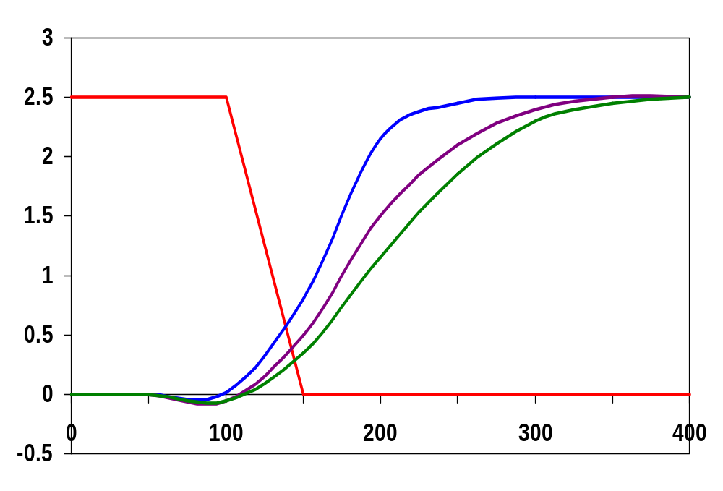
Delay Dependence on Input Patterns
2-input NAND with
NMOS = 0.5μm/0.25 μm
PMOS = 0.75μm/0.25 μm
C_{L} = 10 fF
A=B=1→0
Input Data Pattern | Delay (psec)
A=B=0→1 | 69
A=1, B=0→1 | 62
A= 0→1, B=1 | 50
A=B=1→0 | 35
A=1, B=1→0 | 76
A= 1→0, B=1 | 57
A=1 →0, B=1
Voltage, V
A=1, B=1→0
time, psec
Notes:
Gate sizing should result in approximately equal worst case rise and fall times.
Reason for difference in the last two delays is due to internal node capacitance of the pulldown stack. When B transitions to zero, the pullup only has to charge CL; when A=1 and B transitions to zero the pullup has to charge up both CL and Cint.
Note approx. equal rise and fall delays
For high to low transitions (first three cases), delay depends on the initial state of the internal nodes. E.g., when both inputs transition from 0 to 1, the worst case happens when the internal node has been initially charged (up to VDD-VTn).
Conclusions: Estimates of delay can be fairly complex – have to consider internal node capacitances and the data patterns.
NOTE A& B need to be flipped from previous figure for this to work !!!
Figures 6.8 (a) and (b) are reversed !!!!

Slide 24
Transistor Sizing
R_{p}
R_{p}
R_{p}
1
A
B
1
2
2
B
R_{n}
R_{p}
C_{int}
C_{L}
2
2
A
B
R_{n}
R_{n}
R_{n}
C_{L}
C_{int}
1
A
A
B
1
Objective: keep the worst case propagation delay equal to that of an Inverter with W_{p}=W_{n}=1
(as a first order approximation assume the same load capacitance)
Notes:
Assumes Rp = Rn (and ignores the extra diffusion capacitance introduced by widening the transistors)
In DSM, even larger increases in the width are needed due to velocity saturation. For 2-input NANDs, the nmos transistors should be made 2.5 times as wide.
NAND implementation is clearly preferred over a NOR implementation, since a pmos stack series is slower than an nmos stack due to lower carrier mobility

Slide 25
Transistor Sizing a Complex CMOS Gate
B
A
C
D
OUT = !(D + A • (B + C))
A
D
B
C
Notes:
For class handout.

Slide 26
Transistor Sizing a Complex CMOS Gate
B
4
12
A
2
6
C
4
12
D
2
6
OUT = !(D + A • (B + C))
A
2
D
1
B
2
C
2
First Objective: keep the worst case propagation delay equal to that of an Inverter with W_{p}=W_{n}=1
Second Objective: keep the worst case propagation delay equal to that of an Inverter with Wp=3Wn=1
(as a first order approximation assume the same load capacitance)
Notes:
For class lecture.
Red sizing assuming Rp = Rn
Follow short path first; note PMOS for C and B 4 rather than 3 – average in pull-up chain of three – (4+4+2)/3 = 3
Also note structure of pull-up and pull-down to minimize diffusion cap at output (e.g., single PMOS drain connected to output)
Green for symmetric response and for performance (where Rn = 3 Rp)
Sizing rules of thumb
PMOS = 3 * NMOS
1 in series = 1
2 in series = 2
3 in series = 3
etc.

Slide 27
Fan-In Considerations
A
B
C
D
A
C_{L}
B
C₃
Distributed RC model
(Elmore delay)
t_{pHL} = 0.69 R_{eqn}(C₁+2C₂+3C₃+4C_{L})
Propagation delay deteriorates rapidly as a function of fan-in – quadratically in the worst case.
C
C₂
D
C₁
Notes:
While output capacitance makes full swing transition (from VDD to 0), internal nodes only transition from VDD-VTn to GND
C1, C2, C3 (from junction capacitances as well as the gate-to-source and gate-to-drain capacitances (turned into capacitances to ground using the Miller effect)) on the order of 0.85 fF for W/L of 0.5/0.25 NMOS and 0.375/0.25 PMOS, CL of 3.47 fF with NO output load (all diffusion capacitance – intrinsic capacitance of the gate itself).
To give a 85 psec tpHL (simulated as 86 psec).
The simulated worst case low-to-high delay was 106 ps.

Slide 28
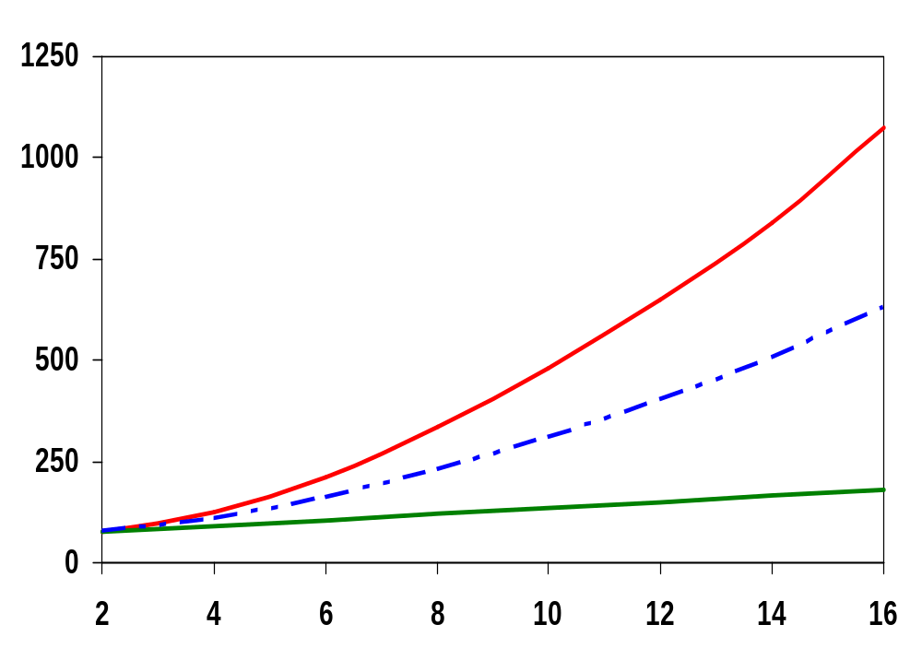
t_{p} as a Function of Fan-In (NAND Gate)
quadratic function of fan-in
t_{p} (psec)
t_{pHL}
t_{p}
t_{pLH}
linear function of fan-in
fan-in
Gates with a fan-in greater than 4 should be avoided.
Notes:
Fixed fan-out (NMOS 0.5 micron, PMOS 1.5 micron)
tpLH increases linearly due to the linearly increasing value of the diffusion capacitance of the pmos transistors (resistance remains unchanged)
tpHL increase quadratically due to the simultaneous increase in pull-down resistance and internal capacitance

Slide 29
Fast Complex Gates: Design Technique 1
Transistor sizing
  as long as fan-out capacitance dominates
Progressive sizing
Distributed RC line
M1 > M2 > M3 > … > MN
(the FET closest to the output should be the smallest)
In_{N}
MN
C_{L}
In₃
M3
C₃
In₂
M2
C₂
Can reduce delay by more than 20%; decreasing gains as technology shrinks
In₁
M1
C₁
Notes:
With transistor sizing, if the load capacitance is dominated by the intrinsic capacitance of the gate, widening the device only creates a “self loading” effect and the propagation delay is unaffected (and may even become worse).
For progressive sizing, M1 have to carry the discharge current from M2 (C1), M3 (C2), … MN and CL so make it the largest. MN only has to discharge the current from MN (CL)(no internal capacitances).
While progressive sizing is easy in a schematic, in a real layout it may not pay off due to design-rule considerations that force the designer to push the transistors apart, increasing internal capacitance.

Slide 30
Fast Complex Gates: Design Technique 2
Input re-ordering
  when not all inputs arrive at the same time
critical path
critical path
0→1
charged
In₃
1
charged
In₁
M3
C_{L}
M3
C_{L}
1
In₂
1
In₂
M2
C₂
M2
C₂
In₃
1
In₁
M1
C₁
M1
C₁
0→1
Notes:
For class handout

Slide 31
Fast Complex Gates: Design Technique 2
Input re-ordering
  when not all inputs arrive at the same time
critical path
critical path
charged
0→1
charged
In₃
1
C_{L}
In₁
M3
C_{L}
M3
1
In₂
1
In₂
M2
C₂
charged
M2
C₂
discharged
In₃
1
discharged
In₁
M1
C₁
charged
M1
C₁
0→1
delay determined by time to discharge C_{L}, C₁ and C₂
delay determined by time to discharge C_{L}
Notes:
For lecture.
Critical input is latest arriving signal – the path through the logic that determines the ultimate speed of the structure is called the critical path.
Place latest arriving signal (critical path) closest to the output can result in a speed up.

Slide 32
Sizing and Ordering Effects
A
3
B
3
C
3
D
3
A
4
4
C_{L}
= 100 fF
B
4
5
C₃
Progressive sizing in pull-down chain gives up to a 23% improvement.
C
4
6
C₂
D
4
7
C₁

Slide 33
Fast Complex Gates: Design Technique 3
Alternative logic structures
F = ABCDEFGH
Notes:
Reduced fan-in -> deeper logic depth
Reduction in fan-in offsets, by far, the extra delay incurred by the NOR gate (second configuration).
Only simulation will tell which of the last two configurations is faster, lower power
Need to run the simulations to get real timing numbers – and power

Slide 34
Fast Complex Gates: Design Technique 4
Isolating fan-in from fan-out using buffer insertion
C_{L}
C_{L}
Real lesson is that optimizing the propagation delay of a gate in isolation is misguided.
Notes:
Reduce CL on large fan-in gates, especially for large CL, and size the inverters progressively to handle the CL more effectively

Slide 35
Fast Networks: Design Technique 5 - Logical Effort
The optimum fan-out for a chain of N inverters driving a load C_{L} is
f = √(C_{L}/C_{in})
  so, if we can, keep the fan-out per stage around 4.
Can the same approach (logical effort) be used for any combinational circuit?
  For a complex gate, we expand the inverter equation
t_{p} = t_{p0} (1 + C_{ext}/ γC_{g}) = t_{p0} (1 + f/γ)
  to
t_{p} = t_{p0} (p + g f/γ)
    t_{p0} is the intrinsic delay of an inverter
    f is the effective fan-out (C_{ext}/C_{g}) – also called the electrical effort
    p is the ratio of the instrinsic (unloaded) delay of the complex gate and a simple inverter (a function of the gate topology and layout style)
    g is the logical effort
N
Notes:
Logical effort first defined by Sutherland and Sproull in 1999

Slide 36
Intrinsic Delay Term, p
The more involved the structure of the complex gate, the higher the intrinsic delay compared to an inverter
Gate Type | p
Inverter | 1
n-input NAND | n
n-input NOR | n
n-way mux | 2n
XOR, XNOR | n 2^{n-1}
Ignoring second order effects such as internal node capacitances

Slide 37
Logical Effort Term, g
g represents the fact that, for a given load, complex gates have to work harder than an inverter to produce a similar (speed) response
  the logical effort of a gate is a ratio of how much more input capacitance a gate presents to the previous stage in order to produce the same drive (output) current as a nominal inverter
  Following table assumes a PMOS/NMOS ratio of 2
Gate Type | g (for 1 to 4 input gates)
 | 1 | 2 | 3 | 4
Inverter | 1
NAND |  | 4/3 | 5/3 | (n+2)/3
NOR |  | 5/3 | 7/3 | (2n+1)/3
mux |  | 2 | 2 | 2
XOR |  | 4 | 12

Slide 38
Example of Logical Effort
Assuming a pmos/nmos ratio of 2, the input capacitance of a minimum-sized inverter is three times the gate capacitance of a minimum-sized nmos (C_{unit})
B
A
B
A
A
A
A • B
A + B
A
A
B
A
B
Notes:
For class handout

Slide 39
Example of Logical Effort
Assuming a pmos/nmos ratio of 2, the input capacitance of a minimum-sized inverter is three times the gate capacitance of a minimum-sized nmos (C_{unit})
B
4
A
2
B
2
A
2
A
4
A
A • B
1
A + B
A
A
2
B
2
A
1
B
1
C_{unit} = 3
C_{unit} = 4
C_{unit} = 5
Notes:
For lecture
So the input capacitance of a 2-input NAND is 4/3 the capacitance of an inverter and for a 2-input NOR is 5/3

Slide 40
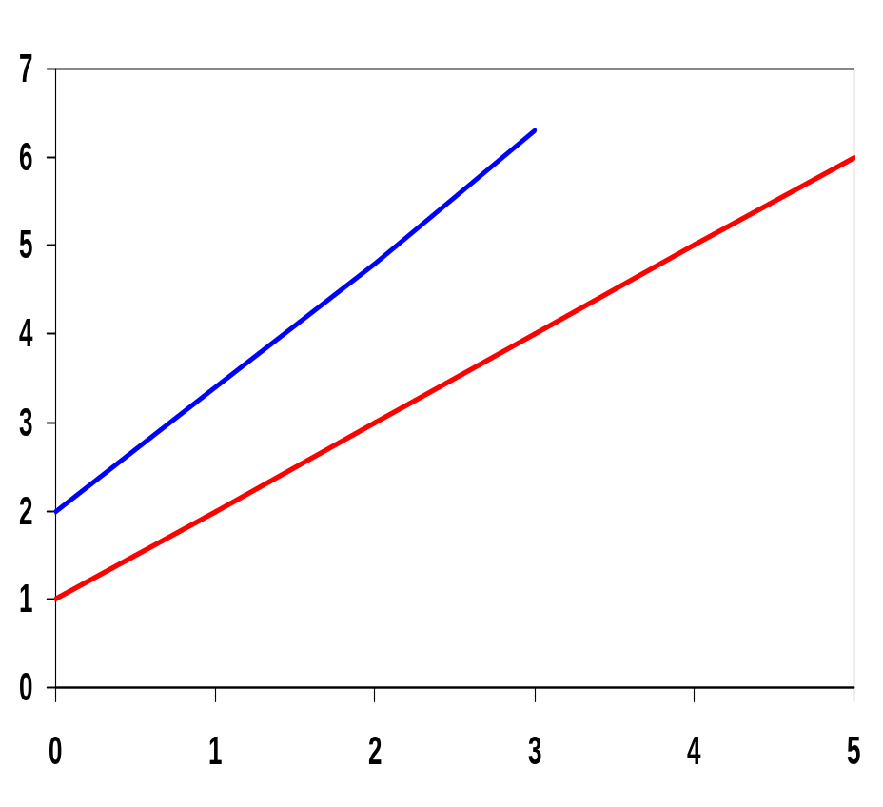
Aside: Delay as a Function of Fan-Out
The slope of the line is the logical effort of the gate
The y-axis intercept is the intrinsic delay
NAND2: g=4/3, p = 2
INV: g=1, p=1
normalized delay
effort delay
Can adjust the delay by adjusting the effective fan-out (by sizing) or by choosing a gate with a different logical effort
Gate effort: h = fg
intrinsic delay
fan-out f

Slide 41
Aside: Path Delay of Complex Logic Gate Network
Total path delay through a combinational logic block
t_{p} = ∑ t_{p,j} = t_{p0} ∑(p_{j} + (f_{j} g_{j})/γ )
So, the minimum delay through the path determines that each stage should bear the same gate effort
f₁g₁ = f₂g₂ = . . . = f_{N}g_{N}
Consider optimizing the delay through the logic network
how do we determine a, b, and c sizes?
1
c
a
b
C_{L}
5

