Slide 1
Lecture 13
Dynamic Logic Gates
EE 115C: Digital Electronic Circuits

Slide 2
Dynamic CMOS
In static circuits at every point in time (except when switching) the output is connected to either GND or V_{DD} via a low resistance path.
  fan-in of N requires 2N devices
Dynamic circuits rely on the temporary storage of signal values on the capacitance of high impedance nodes.
  requires only N + 2 transistors
  takes a sequence of precharge and conditional evaluation phases to realize logic functions

Slide 3
Dynamic Gate
CLK
M_{p}
CLK
M_{p}
Out
Out
In₁
C_{L}
A
In₂
PDN
C
In₃
B
CLK
M_{e}
CLK
M_{e}
Two phase operation
Precharge (CLK = 0)
Evaluate (CLK = 1)
Notes:
For class handout

Slide 4
Dynamic Gate
off
CLK
M_{p}
CLK
M_{p}
on
1
Out
Out
!((A&B)|C)
In₁
C_{L}
A
In₂
PDN
C
In₃
B
CLK
M_{e}
off
CLK
M_{e}
on
Two phase operation
Precharge (CLK = 0)
Evaluate (CLK = 1)
Notes:
For lecture
Evaluate transistor, Me, eliminates static power consumption

Slide 5
Conditions on Output
Once the output of a dynamic gate is discharged, it cannot be charged again until the next precharge operation.
Inputs to the gate can make at most one transition during evaluation.
Output can be in the high impedance state during and after evaluation (PDN off), state is stored on C_{L}
Notes:
This behavior is fundamentally different than the static counterpart that always has a low resistance path between the output and one of the power rails.

Slide 6
Properties of Dynamic Gates
Logic function is implemented by the PDN only
  number of transistors is N + 2 (versus 2N for static complementary CMOS)
  should be smaller in area than static complementary CMOS
Full swing outputs (V_{OL} = GND and V_{OH} = V_{DD})
Nonratioed - sizing of the devices is not important for proper functioning (only for performance)
Faster switching speeds
  reduced load capacitance due to lower number of transistors per gate (C_{int}) so a reduced logical effort
  reduced load capacitance due to smaller fan-out (C_{ext})
  no I_{sc}, so all the current provided by PDN goes into discharging C_{L}
  Ignoring the influence of precharge time on the switching speed of the gate, t_{pLH} = 0 but the presence of the evaluation transistor slows down the t_{pHL}
Notes:
CL being lower also contributes to power savings
The precharge time is determined by the time it takes to charge CL through the PMOS precharge transistor. Often, the overall digital system can be designed in such a way that the precharge time coincides with other system funcitons (e.g., precharge of a FU can coincide with instruction decode).

Slide 7
Properties of Dynamic Gates, con’t
Power dissipation should be better
  consumes only dynamic power – no short circuit power consumption since the pull-up path is not on when evaluating
  lower C_{L}- both C_{int} (since there are fewer transistors connected to the drain output) and C_{ext} (since there the output load is one per connected gate, not two)
  by construction can have at most one transition per cycle – no glitching
But power dissipation can be significantly higher due to
  higher transition probabilities
  extra load on CLK
PDN starts to work as soon as the input signals exceed V_{Tn}, so set V_{M}, V_{IH} and V_{IL} all equal to V_{Tn}
  low noise margin (NM_{L})
Needs a precharge clock

Slide 8
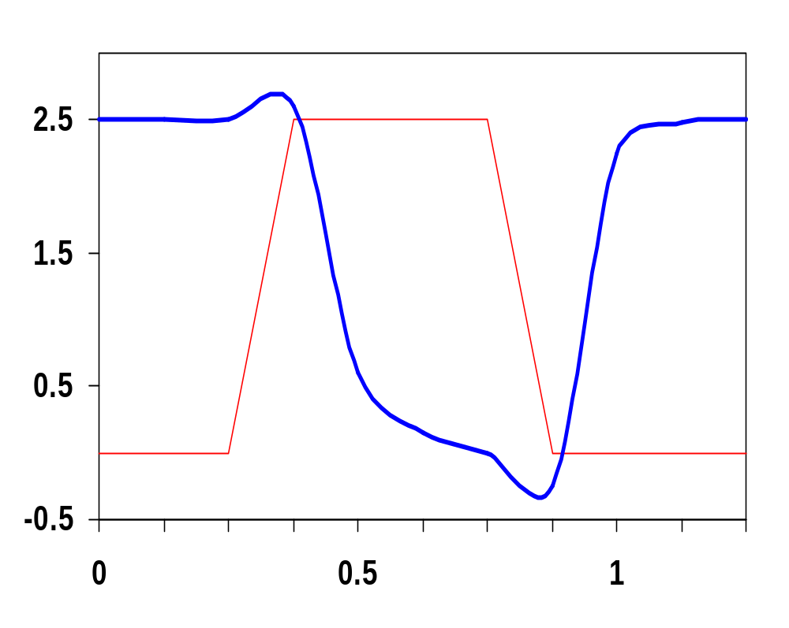
Dynamic Behavior
CLK
Out
Evaluate
In₁
In₂
Voltage
In₃
In &
CLK
In₄
Out
Precharge
CLK
Time, ns
#Trns | V_{OH} | V_{OL} | V_{M} | NM_{H} | NM_{L} | t_{pHL} | t_{pLH} | t_{p}
6 | 2.5V | 0V | V_{Tn} | 2.5-V_{Tn} | V_{Tn} | 110ps | 0ns | 83ps
Notes:
all data inputs set to 1.
The duration of the precharge cycle can be adjusted by changing the size of the PMOS precharge transistor. But making it too large increases the gate’s Cint as well as increasing the capacitive load on the clock.

Slide 9
Issues in Dynamic Design 1: Charge Leakage
CLK
4
CLK
M_{p}
3
Out
1
A=0
C_{L}
2
Evaluate
V_{Out}
CLK
M_{e}
Precharge
Leakage sources
Minimum clock rate of a few kHz
Notes:
leakage sources are reverse-biased diode (1) and the sub-threshold leakage (2) of the NMOS pulldown device.
Charge stored on CL will leak away with time (input in low state during evaluation)
Requires a minimum clock rate - so not good for low performance products such as watches (or when have conditional clocks)
PMOS precharge device also contributes some leakage due to reverse bias diode (3) and subthreshold conduction (4) that, to some extent, offsets the leakage due to the pull down paths.

Slide 10
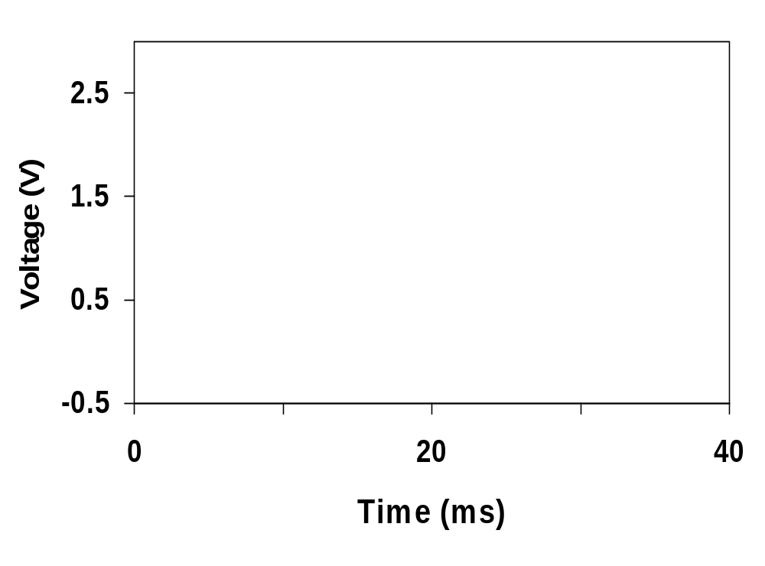
Impact of Charge Leakage
Output settles to an intermediate voltage determined by a resistive divider of the pull-up and pull-down networks
  Once the output drops below the switching threshold of the fan-out logic gate, the output is interpreted as a low voltage.
CLK
Out

Slide 11
A Solution to Charge Leakage
Keeper compensates for the charge lost due to the pull-down leakage paths.
Keeper
CLK
M_{p}
M_{kp}
!Out
A
C_{L}
B
CLK
M_{e}
Same approach as level restorer for pass transistor logic
Notes:
During precharge, Out is VDD and inverter out is GND, so keeper is on
During evaluation if PDN is off, the keeper compensates for drained charge due to leakage.
If PDN is on, there is a fight between the PDN and the PUN - circuit is ratioed so PDN wins, eventually
Note Psc during switching period when PDN and keeper are both on simultaneously

Slide 12
Issues in Dynamic Design 2: Charge Sharing
Charge stored originally on C_{L} is redistributed (shared) over C_{L} and C_{A} leading to static power consumption by downstream gates and possible circuit malfunction.
CLK
M_{p}
Out
A
C_{L}
B=0
C_{a}
CLK
M_{e}
C_{b}
When ΔV_{out} = - V_{DD} (C_{a} / (C_{a} + C_{L} )) the drop in V_{out} is large enough to be below the switching threshold of the gate it drives causing a malfunction.
Notes:
CA initially discharged and CL fully charged.

Slide 13
Charge Sharing Example
What is the worst case voltage drop on y? (Assume all inputs are low during precharge and that all internal nodes are initially at 0V.)
Load
inverter
CLK
y = A ⊕ B ⊕ C
A
!A
C_{y}=50fF
a
B
b
C_{a}=15fF
!B
B
!B
c
d
C_{b}=15fF
C_{c}=15fF
!C
C
C_{d}=10fF
CLK
Notes:
For class handout

Slide 14
Charge Sharing Example
What is the worst case voltage drop on y? (Assume all inputs are low during precharge and that all internal nodes are initially at 0V.)
Load
inverter
CLK
y = A ⊕ B ⊕ C
A
!A
C_{y}=50fF
a
B
b
C_{a}=15fF
!B
B
!B
c
d
C_{b}=15fF
C_{c}=15fF
!C
C
C_{d}=10fF
CLK
ΔV_{out} = - V_{DD} ((C_{a} + C_{c})/((C_{a} + C_{c}) + C_{y}))
= - 2.5V*(30/(30+50)) = -0.94V
Notes:
For lecture – should work up a different example than the one in the book (like just set the internal capacitances different)
Output stays high for 4 out of 8 cases (!A B C, !A !B !C, A !B C, and A B !C)
Worst case is obtained by exposing the maximum amount of internal capacitance to the output node during evaluation. This happens when !A B C or A !B C
30/(30+50) * 2.5 V = -0.94 V so the output drops to 2.5 - 0.94 = 1.56 V which is below the switching threshold of the Load inverter.

Slide 15
Solution to Charge Redistribution
CLK
M_{p}
M_{kp}
CLK
Out
A
B
CLK
M_{e}
Precharge internal nodes using a clock-driven transistor (at the cost of increased area and power)

Slide 16
Issues in Dynamic Design 4: Clock Feedthrough
A special case of capacitive coupling between the clock input of the precharge transistor and the dynamic output node
Coupling between Out and CLK input of the precharge device due to the gate- drain capacitance. So voltage of Out can rise above V_{DD}. The fast rising (and falling edges) of the clock couple to Out.
CLK
M_{p}
Out
A
C_{L}
B
CLK
M_{e}
Notes:
Danger is that signal levels can rise enough above VDD that the normally reverse-biased junction diodes become forward-biased causing electrons to be injected into the substrate.

Slide 17
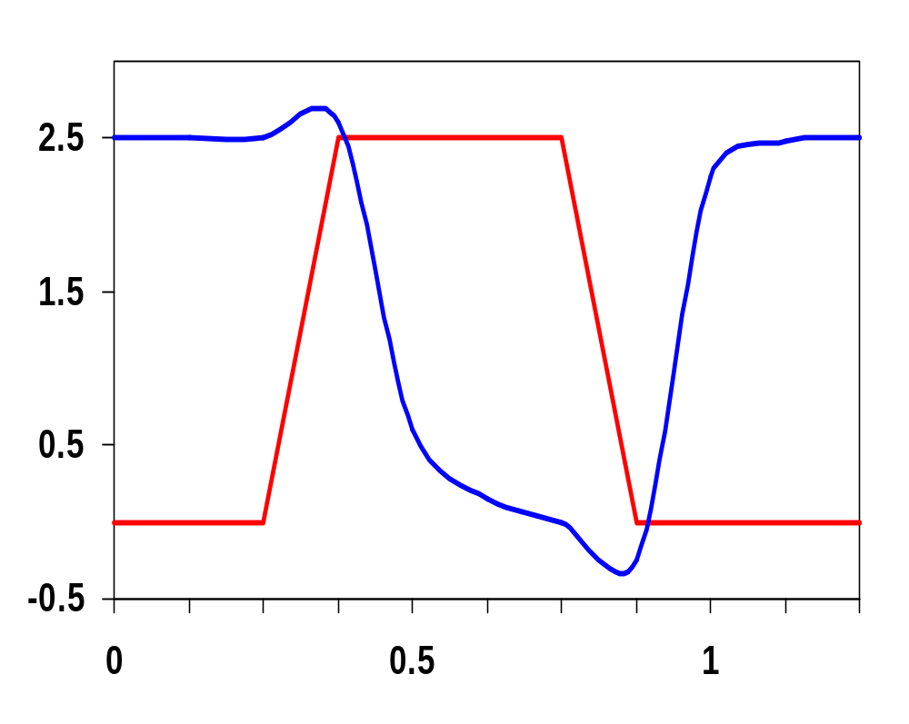
Clock Feedthrough
CLK
Clock feedthrough
Out
In₁
In₂
In₃
Voltage
In &
CLK
In₄
CLK
Out
Time, ns
Clock feedthrough

Slide 18
Cascading Dynamic Gates
V
CLK
CLK
CLK
M_{p}
M_{p}
Out2
Out1
In
In
V_{Tn}
Out1
CLK
M_{e}
CLK
M_{e}
ΔV
Out2
t
Only a single 0 → 1 transition allowed at the inputs during the evaluation period!
Notes:
Out2 should remain at VDD since Out1 transitions to 0 during evaluation. However, since there is a finite propagation delay for the input to discharge Out1 to GND, the second output also starts to discharge.
The second dynamic inverter turns off (PDN) when Out1 reaches VTn.
Setting all inputs of the second gate to 0 during precharge will fix it.
Correct operation is guaranteed (ignoring charge redistribution and leakage) as long as the inputs can only make a single 0 -> 1 transition during the evaluation period

Slide 19
Domino Logic
CLK
M_{p}
CLK
M_{p}
M_{kp}
Out1
Out2
1 → 1
1 → 0
0 → 0
0 → 1
In₁
In₂
PDN
In₄
PDN
In₃
In₅
CLK
M_{e}
CLK
M_{e}
Notes:
Ensures all inputs to the Domino gate are set to 0 at the end of the precharge period. Hence, the only possible transition during evaluation is 0 -> 1
Additional advantage is that the fan-out of the gate is driven by a static inverter with a low-impedance output that increases the noise immunity.
The buffer also reduces the capacitance of the dynamic output node by separating internal and load capacitances.
Finally, the inverter can be used to drive a bleeder to combat leakage and charge redistribution.

Slide 20
Why Call it Domino?
CLK
In₁
In_{i}
PDN
In_{i}
PDN
In_{i}
PDN
In_{i}
PDN
In_{j}
In_{j}
In_{j}
In_{j}
CLK
Like falling dominos!

Slide 21
Domino One Detector
In₇
In₆
In₅
In₄
In₃
In₂
In₁
In₀
not zero
CLK
Notes:
Slide hidden – to be used as the basis of a question for the final exam.
How would you build it in static CMOS? A 16-wide fan-in OR function using a tree composed of NAND and NOR gates
As opposed to one dynamic gate!

Slide 22
Domino Manchester Carry Chain
CLK
P₀
P₁
P₂
P₃
C_{i,4}
C_{i,0}
G₀
G₁
G₂
G₃
CLK
Notes:
For class handout.

Slide 23
Domino Manchester Carry Chain
CLK
3 3 3 3 3
P₀
P₁
P₂
P₃
4
3
2
1
C_{i,4}
C_{i,0}
5
6
G₀
4
5
G₁
3
4
G₂
2
3
G₃
1
2
CLK
!(G₀ + P₀ C_{i,0})
!(G₁ + P₁G₀ + P₁P₀ C_{i,0})
Notes:
For lecture.
Note four pass transistors in series (P3 P2 P1 P0) + Ci,0 and Me of first gate.
Automatically forms all the intermediate carries as well – as shown on animation
Sizing assumes only integer multiples allowed, should pfets all be 3?

Slide 24
Domino Comparator
A3
A2
A1
A0
CLK
Out
B3
B2
B1
B0
Notes:
4 bit comparator, out is miscompare (1 when they are not equal)
AND function in each NMOS pull-down stack.
AND-NOR structure appears in many interesting dynamic control circuits.
Don’t need isolation fet in the pull-down, since the bottom NMOS fet is forced off during precharge.

Slide 25
Properties of Domino Logic
Only non-inverting logic can be implemented, fixes include
  can reorganize the logic using Boolean transformations
  use differential logic (dual rail)
  use np-CMOS (zipper)
Very high speed
  t_{pHL} = 0
  static inverter can be optimized to match fan-out (separation of fan-in and fan-out capacitances)
Notes:
First 32 bit micro (BellMAC 32) was designed in Domino logic
Now a rather rare design style due to non-inverting logic only

