Slide 1
Lecture 15
Sequential Logic
EE 115C: Digital Electronic Circuits

Slide 2
Review: How to Choose a Logic Style
Must consider ease of design, robustness (noise immunity), area, speed, power, system clocking requirements, fan-out, functionality, ease of testing
4-input NAND
Style | # Trans | Ease | Ratioed? | Delay | Power
Comp Static | 8 | 1 | no | 3 | 1
CPL* | 12 + 2 | 2 | no | 4 | 3
domino | 6 + 2 | 4 | no | 2 | 2 + clk
DCVSL* | 10 | 3 | yes | 1 | 4
* Dual Rail
Current trend is towards an increased use of complementary static CMOS: design support through DA tools, robust, more amenable to voltage scaling.
Notes:
Current trend is towards an increased use of complementary static CMOS - tools driven that emphasis optimization at the logic level rather than the circuit level and that put a premium on robustness.
Static CMOS is also more amenable to voltage scaling than some of the other approaches.

Slide 3
Sequential Logic
Inputs
Outputs
Combinational
Logic
Current
State
Next
State
State
Registers
clock
Notes:
Output is a function of the inputs AND the current state
Have already discussed how to design the combinational logic part – now need to focus on designing the state registers
Mealy (both the input and the current state is used to determine the output) versus Moore state machines (output depends only on the current state). Moore machines have potential implementation advantages in speed and size – speed because the control outputs, which are needed early in the clock cycle, do not depend upon the inputs. Moore machine disadvantages are that they may require additional states.
The State Register shown is “edge-triggered” (can tell by the >). In fact, its positive edge triggered, i.e., changes output state when the clock edge goes from 0 to 1 (can tell by the absence of a o)

Slide 4
Timing Metrics
In
D
Q
Out
clock
clock
t_{su}
t_{hold}
time
In
data
stable
t_{c-q}
time
Out
output
stable
output
stable
time
Notes:
tsetup – time that the data inputs (D) must be valid before the clock transition (0 ti 1 transition for a positive edge-triggered device)
thold is the time that the data inputs must remain valid after the clock edge
Tc-q is the worst case propagation delay (with reference to the clock edge) – time to copy D to Q

Slide 5
System Timing Constraints
Inputs
Outputs
Combinational
Logic
Current
State
Next
State
State
Registers
T (clock period)
clock
t_{cdreg} + t_{cdlogic} ≥ t_{hold}
T ≥ t_{c-q} + t_{plogic} + t_{su}
Notes:
contamination delay - minimum delay of the combinational logic or register
Thus, it is important to minimize the values of the timing parameters associated with the register. In modern high-performance systems, the register propagation delay and set-up times account for a significant portion of the clock period. E.g., DEC Alpha EV6 has a maximum logic depth of 12 gates and the register overhead accounts for about 15% of the clock period.
Hold time becomes and issue then there is little logic between registers or when the clocks at different registers are somewhat out of phase due to clock skew.
Modern machines are characterized by a very-low logic depth and, in fact, the register propagation delay and setup times account for a significant portion of the clock period. E.g., DEC EV6 has a maximum logic depth of 12 gates and the register overhead accounts for approx. 15% of the clock period.

Slide 6
Static vs Dynamic Storage
Static storage
  preserve state as long as the power is on
  have positive feedback (regeneration) with an internal connection between the output and the input
  useful when updates are infrequent (clock gating)
Dynamic storage
  store state on parasitic capacitors
  only hold state for short periods of time (milliseconds)
  require periodic refresh
  usually simpler, so higher speed and lower power
Notes:
clock gating - conditional clocks - where the clock is turned off for unused modules to save on power

Slide 7
Latches vs Flipflops
Latches
  level sensitive circuit that passes inputs to Q when the clock is high (or low) - transparent mode
  input sampled on the falling edge of the clock is held stable when clock is low (or high) - hold mode
Flipflops (edge-triggered)
  edge sensitive circuits that sample the inputs on a clock transition
    positive edge-triggered: 0 → 1
    negative edge-triggered: 1 → 0
  built using latches (e.g., master-slave flipflops)
Notes:
Positive latch - can also have negative latch with flip definitions
Should insert a slide with figure 7.3 after this one?

Slide 8
Review: The Regenerative Property
V_{i1}
V_{o1}
V_{i2}
V_{o2}
cascaded inverters
A
If the gain in the transient region is larger than 1, only A and B are stable operation points. C is a metastable operation point.
V_{i2} = V_{o1}
C
B
V_{i1} = V_{o2}
Notes:
bistability principle - a circuit having two stable states that represent 0 and 1
Consider just two inverters - VTC of first inverter and second inverter (later plot is rotated to accentuate that Vi2 = Vo1). Resulting circuit has just three possible operation points (A, B and C). A small deviation from the bias point C (e.g., from noise) is amplified and regenerated around the circuit loop until either point A or B is reached.
A and B are stable operation points. At these points, the loop gain is much smaller than unity.

Slide 9
Bistable Circuits
The cross-coupling of two inverters results in a bistable circuit (a circuit with two stable states)
V_{i1}
V_{i2}
Have to be able to change the stored value by making A (or B) temporarily unstable by increasing the loop gain to a value larger than 1
  done by applying a trigger pulse at V_{i1} or V_{i2}
  the width of the trigger pulse need be only a little larger than the total propagation delay around the loop circuit (twice the delay of an inverter)
Two approaches used
  cutting the feedback loop (mux based latch)
  overpowering the feedback loop (as used in SRAMs)
Notes:
cutting the feedback loop is the most popular in today’s latches

Slide 10
Review SR Latch
S | R | Q | !Q
0 | 0 | Q | !Q | memory
1 | 0 | 1 | 0 | set
0 | 1 | 0 | 1 | reset
1 | 1 | 0 | 0 | disallowed
S
!Q
Q
R

Slide 11
Review: Clocked D Latch
D
!Q
Q
D
D Latch
Q
clock
transparent mode
clock
clock
hold mode

Slide 12
MUX Based Latches
Change the stored value by cutting the feedback loop
feedback
feedback
1
0
Q
Q
D
0
D
1
clk
clk
Negative Latch
Positive Latch
Q = clk & Q | !clk & D
Q = !clk & Q | clk & D
transparent when the clock is low
transparent when the clock is high
Notes:
Nonratioed latch – sizing of the devices affects performance and is not critical to functionality

Slide 13
TG MUX Based Latch Implementation
clk
Q
!clk
D
input sampled
(transparent mode)
clk
clk
D
D Latch
Q
!clk
feedback
(hold mode)
clk
Notes:
Positive latch – latch is transparent (D is copied to Q) when clk is high (bottom transmission gate is on)
clk load is two transistors (and two for !clk) = clock load of 4
Also have the problem of having to generate both clk and !clk (nonoverlapping clocks)

Slide 14
PT MUX Based Latch Implementation
clk
!Q
D
Q
input sampled
(transparent mode)
!clk
Reduced clock load, but threshold drop at output of pass transistors so reduced noise margins and performance
clk
!clk
feedback
(hold mode)
Notes:
Positive latch – latch is transparent (D is copied to Q) when clk is high
Have reduced clock load by replacing transmission gates with pass transistors, but that impacts both noise margin and switching performance and causes static power dissipation due to threshold drop.
clk load is one transistors (and one for !clk) = clock load of 2
Still have the problem of having to generate both clk and !clk

Slide 15
Latch Race Problem
Combinational
Logic
B
B
B’
State
Registers
clk
Which value of B is stored?
clk
Two-sided clock constraint
T ≥ t_{c-q} + t_{plogic} + t_{su}
T_{high} < t_{c-q} + t_{cdlogic}
Notes:
So, a solution to the latch race problem is to design with edge-triggered (master-slave) devices

Slide 16
Master Slave Based ET Flipflop
D
D FF
Q
0
0
1
clock
1
Q
Q
1
1
Q_{M}
D
Q_{M}
D
0
0
clk
clk
clk
Slave
Slave
D
Master
Master
clk = 0 transparent hold
Q_{M}
clk = 0→1 hold transparent
Q
Notes:
On low phase of clock, master is transparent and D input is passed to master stage output QM. Slave is in hold mode, keeping its previous value using feedback.
During the rising edge of the clock, the master stops sampling and goes into hold mode, the slave starts sampling coping QM to its output.
The value of Q is the value of D right before the rising edge of the clock achieving a POSITIVE EDGE TRIGGERED effect.
Can build a negative edge triggered by switching the order of master and slave (master positive, slave negative)

Slide 17
MS ET Implementation
Master
Slave
I₂
T₂
I₃
I₅
T₄
I₆
Q
Q_{M}
I₁
T₁
I₄
T₃
D
clk
clk
!clk
Notes:
For class handout

Slide 18
MS ET Implementation
Master
Slave
I₂
T₂
I₃
I₅
T₄
I₆
Q
Q_{M}
I₁
T₁
I₄
T₃
D
clk
master transparent
slave hold
master hold
slave transparent
clk
!clk
Notes:
For lecture
Note that !clk is generated locally
20 transistors (plus clock inverter) – 8 clock loads (4 on clk and 4 on !clk) (can ignore the buffer inverter overhead since it can be amortized over multiple register bits)

Slide 19
MS ET Timing Properties
Assume propagation delays are t_{pd_inv} and t_{pd_tx}, that the contamination delay is 0, and that the inverter delay to derive !clk is 0
Set-up time - time before rising edge of clk that D must be valid
Propagation delay - time for Q_{M} to reach Q
Hold time - time D must be stable after rising edge of clk -
Notes:
For class handout

Slide 20
MS ET Timing Properties
Assume propagation delays are t_{pd_inv} and t_{pd_tx}, that the contamination delay is 0, and that the inverter delay to derive !clk is 0
Set-up time - time before rising edge of clk that D must be valid
Propagation delay - time for Q_{M} to reach Q
Hold time - time D must be stable after rising edge of clk
3 * t_{pd_inv} + t_{pd_tx}
  t_{pd_inv} + t_{pd_tx}
  zero
Notes:
For lecture
set-up - how long before the rising edge does D have to be stable such that QM samples the value reliably? - D has to propagate through I1, T1, I3 and I2 before the rising edge to ensure that the node voltages on both terminals of T2 are the same value.
prop delay - since the delay of I2 is included in the set-up time, the output of I4 is valid before the rising edge of clk, so the delay is simply the delay through T3 and I6
hold time - since T1 turns off when the clock goes high, any changes in D after clk goes high are not seen, so hold time is 0

Slide 21
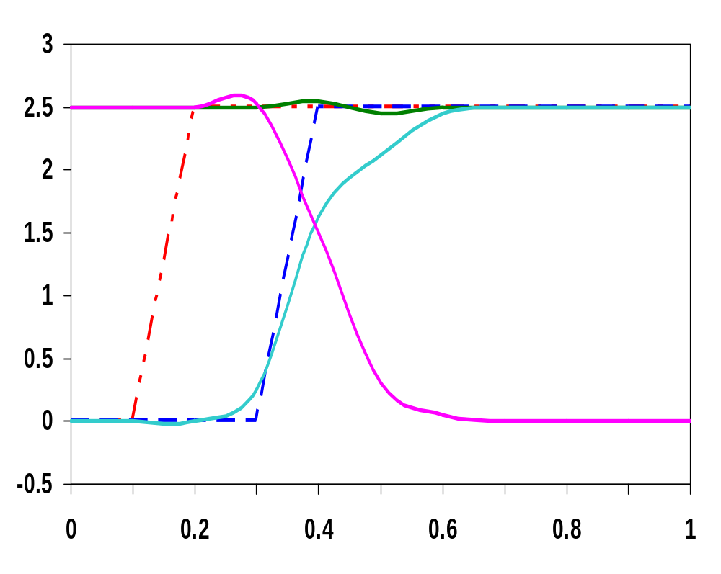
Set-up Time Simulation
Q
t_{setup} = 0.21 ns
Q_{M}
Volts
D
clk
I₂ out
works correctly
Time (ns)
Notes:
progressively skew the input wrt to the clock edge until the circuit fails.

Slide 22
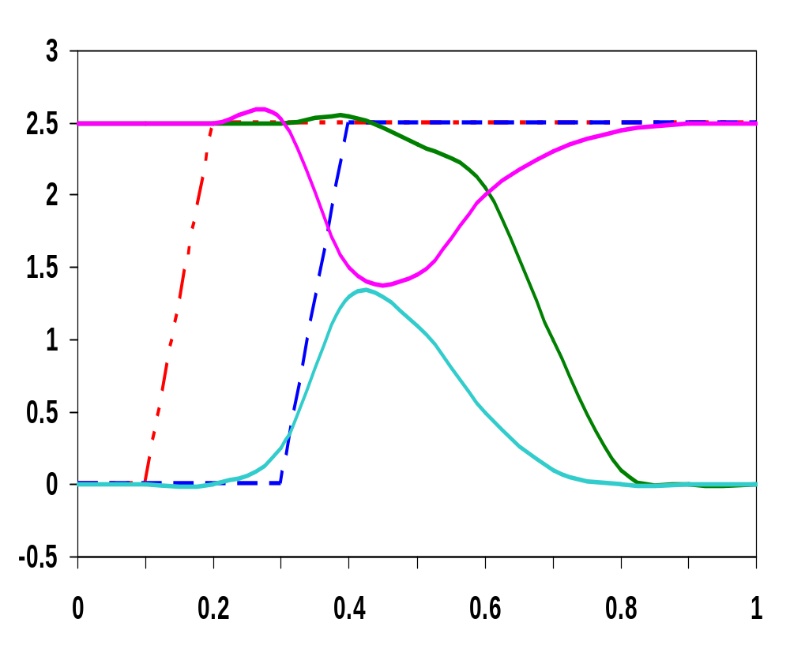
Set-up Time Simulation
Q
I₂ out
t_{setup} = 0.20 ns
Volts
D
clk
Q_{M}
fails
Time (ns)
Notes:
the clock is enabled before the nodes on both sides of the transmission gate T2 settle to the same value

Slide 23
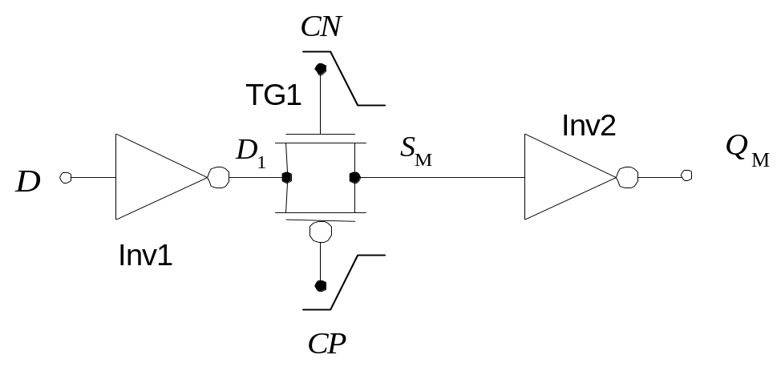
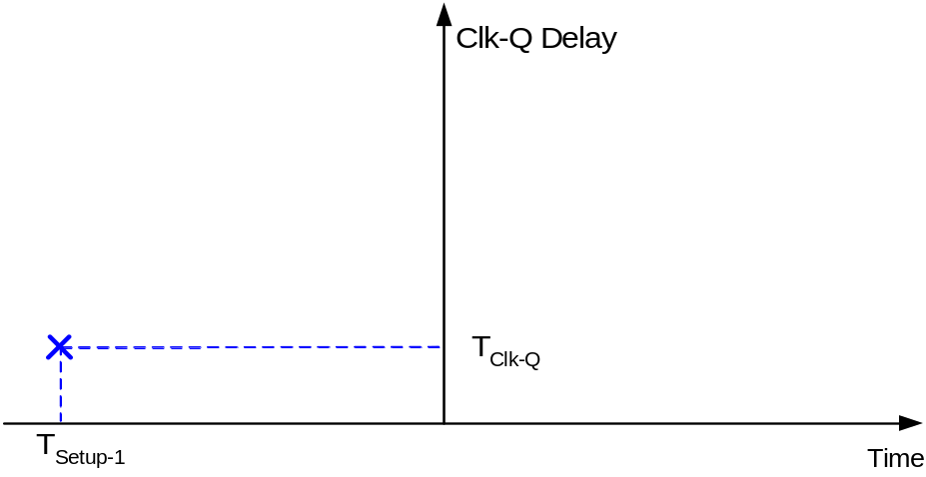
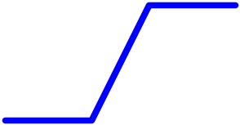
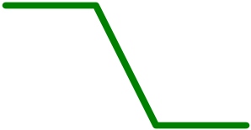
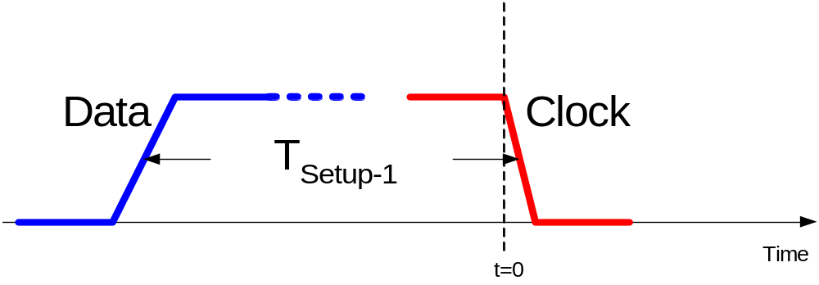
Setup/Hold Time Illustrations
Circuit before clock arrival (Setup-1 case)

Slide 24
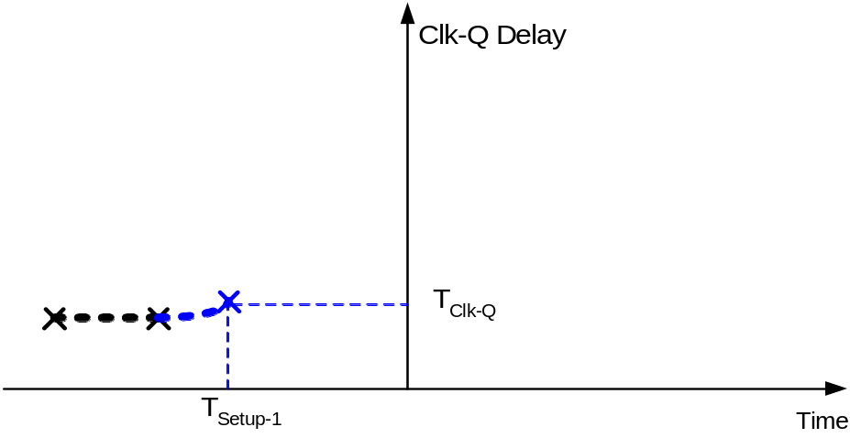
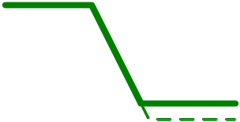
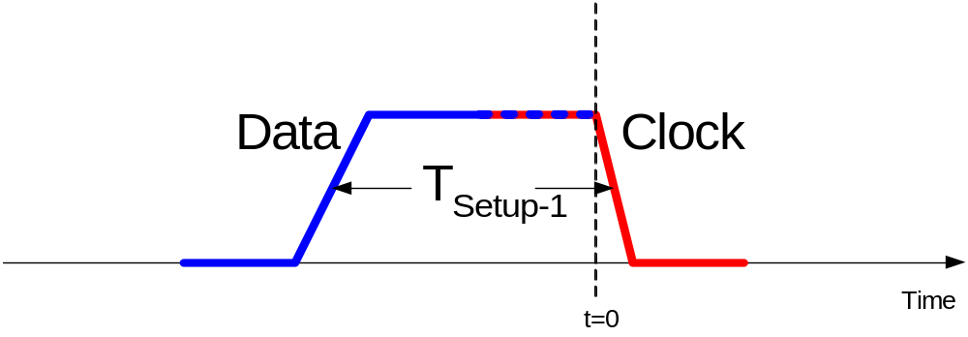
Setup/Hold Time Illustrations
Circuit before clock arrival (Setup-1 case)

Slide 25
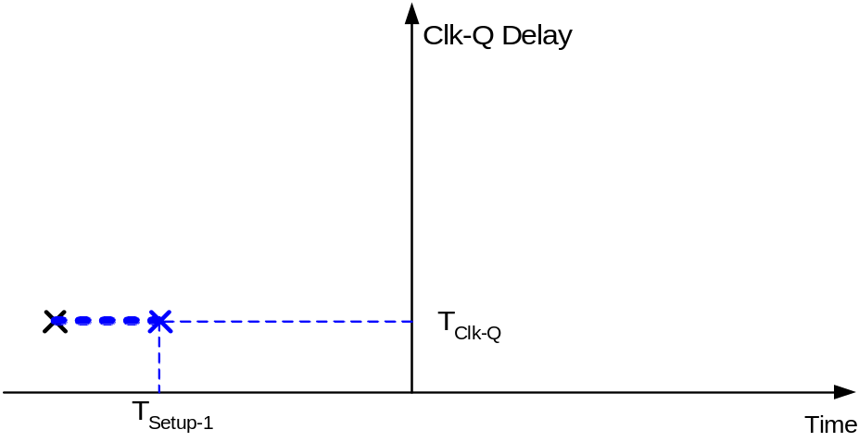
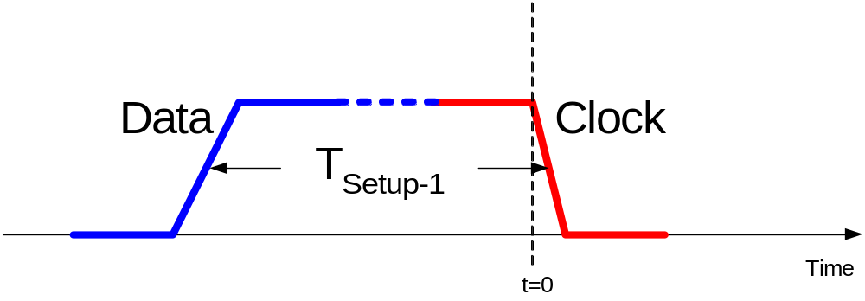
Setup/Hold Time Illustrations
Circuit before clock arrival (Setup-1 case)

Slide 26
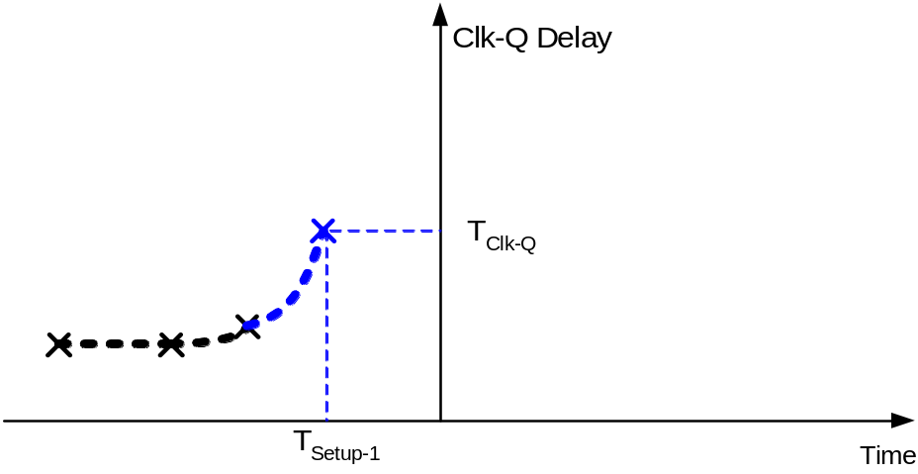
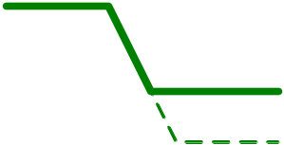
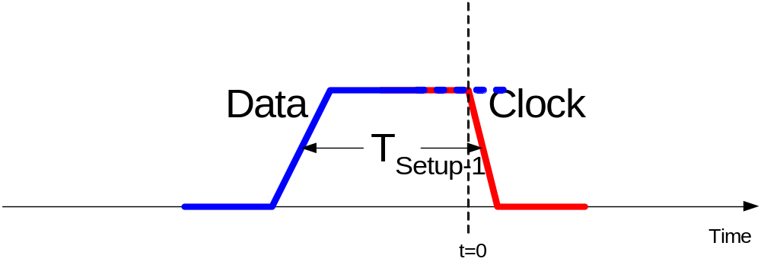
Setup/Hold Time Illustrations
Circuit before clock arrival (Setup-1 case)

Slide 27
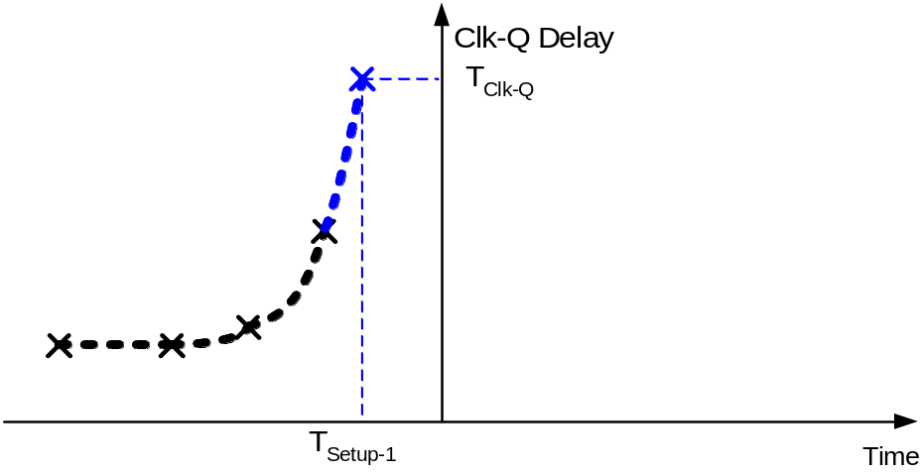
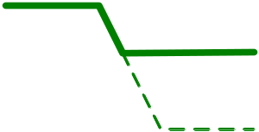
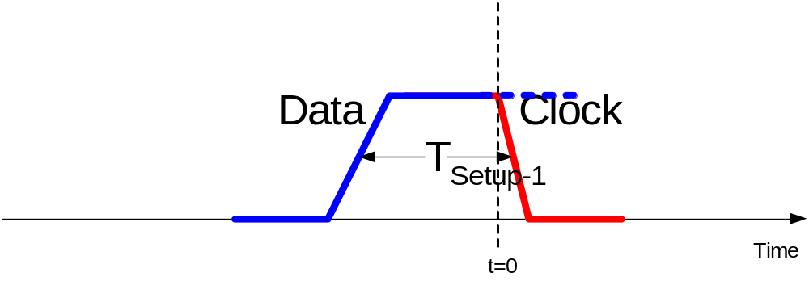
Setup/Hold Time Illustrations
Circuit before clock arrival (Setup-1 case)

Slide 28
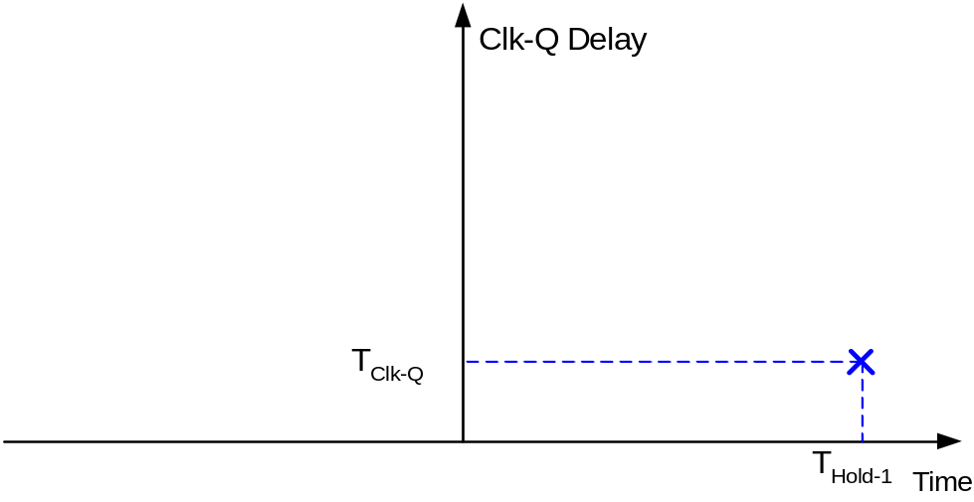
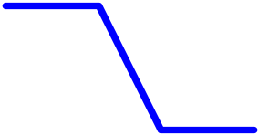
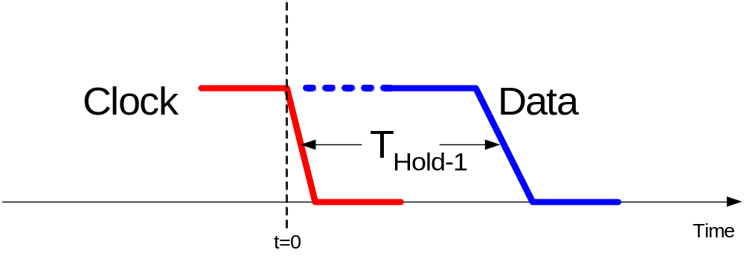
Setup/Hold Time Illustrations
Hold-1 case
0

Slide 29
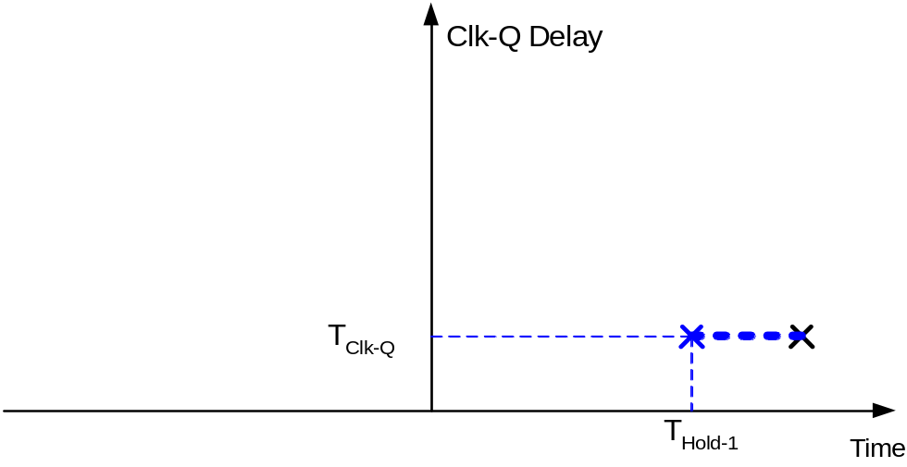
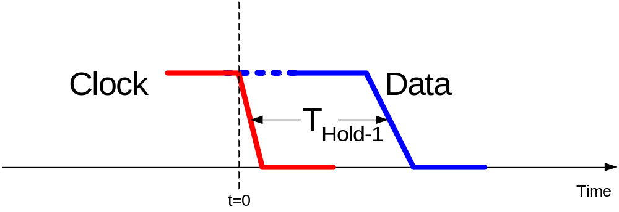
Setup/Hold Time Illustrations
Hold-1 case
0

Slide 30
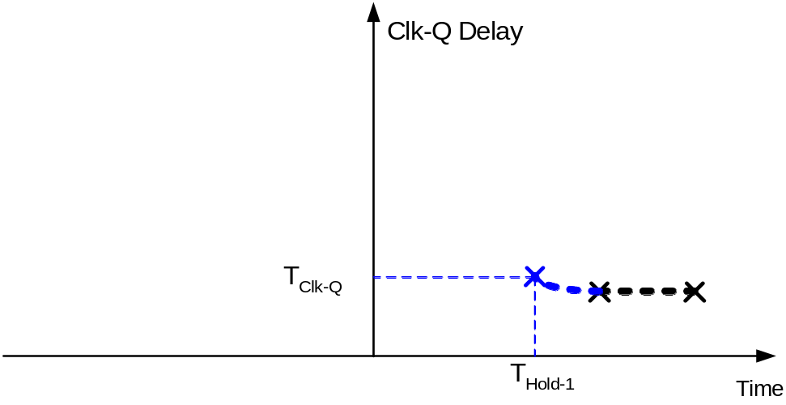
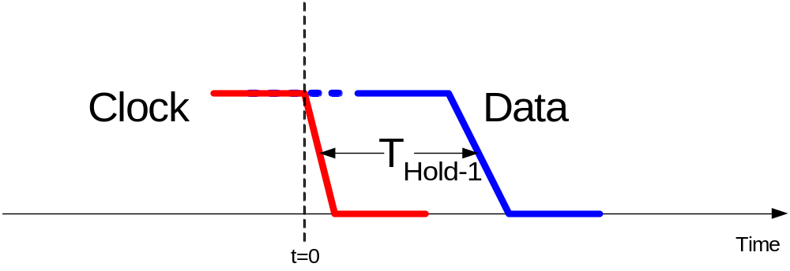
Setup/Hold Time Illustrations
Hold-1 case
0

Slide 31
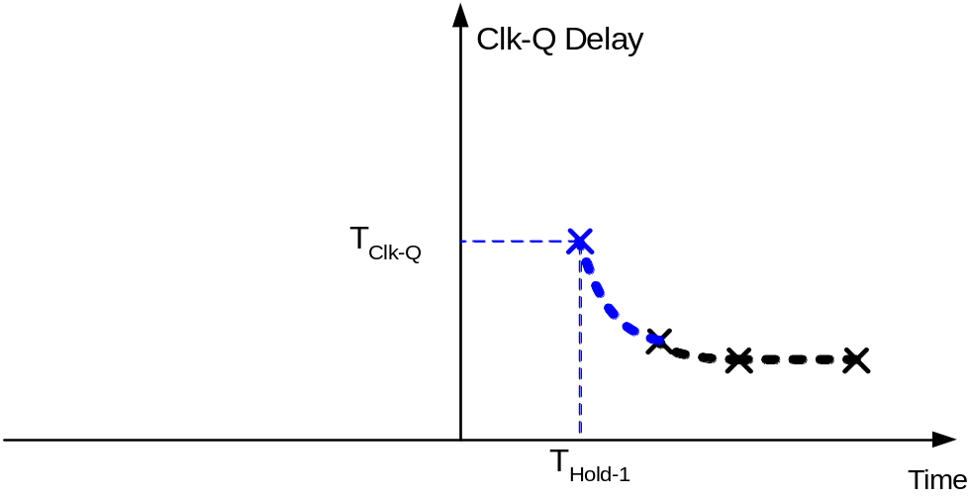

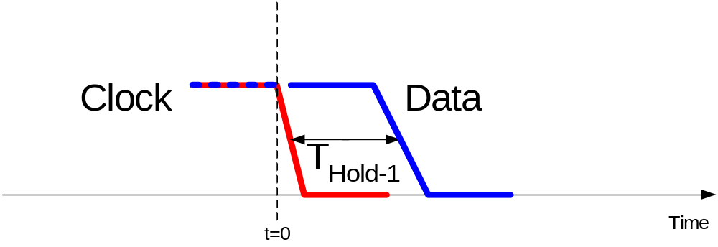
Setup/Hold Time Illustrations
Hold-1 case
0

Slide 32
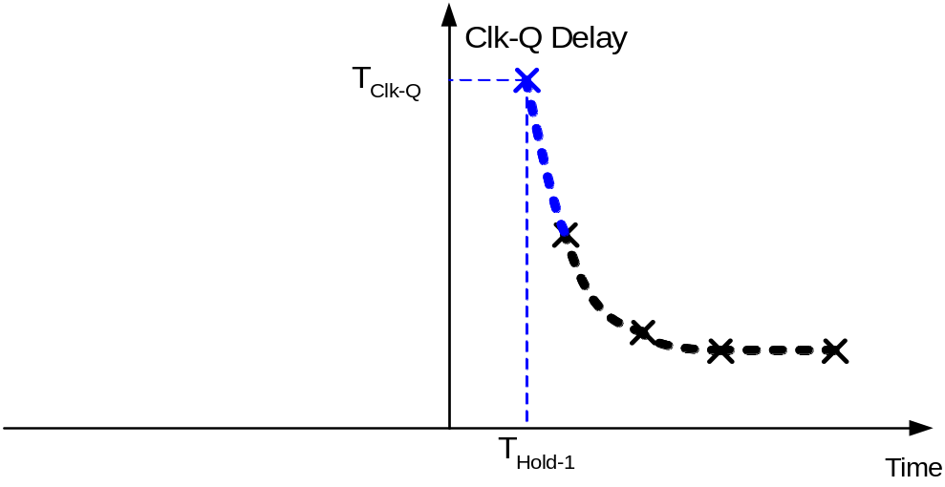

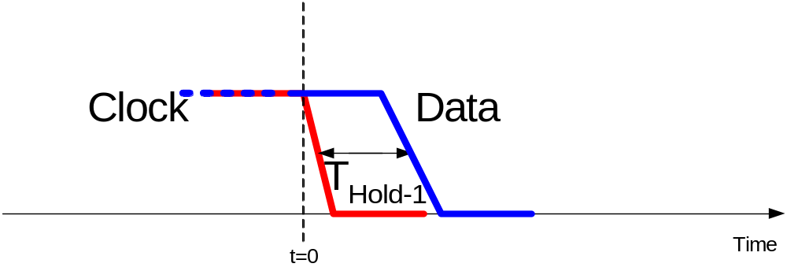

Setup/Hold Time Illustrations
Hold-1 case
0

Slide 33
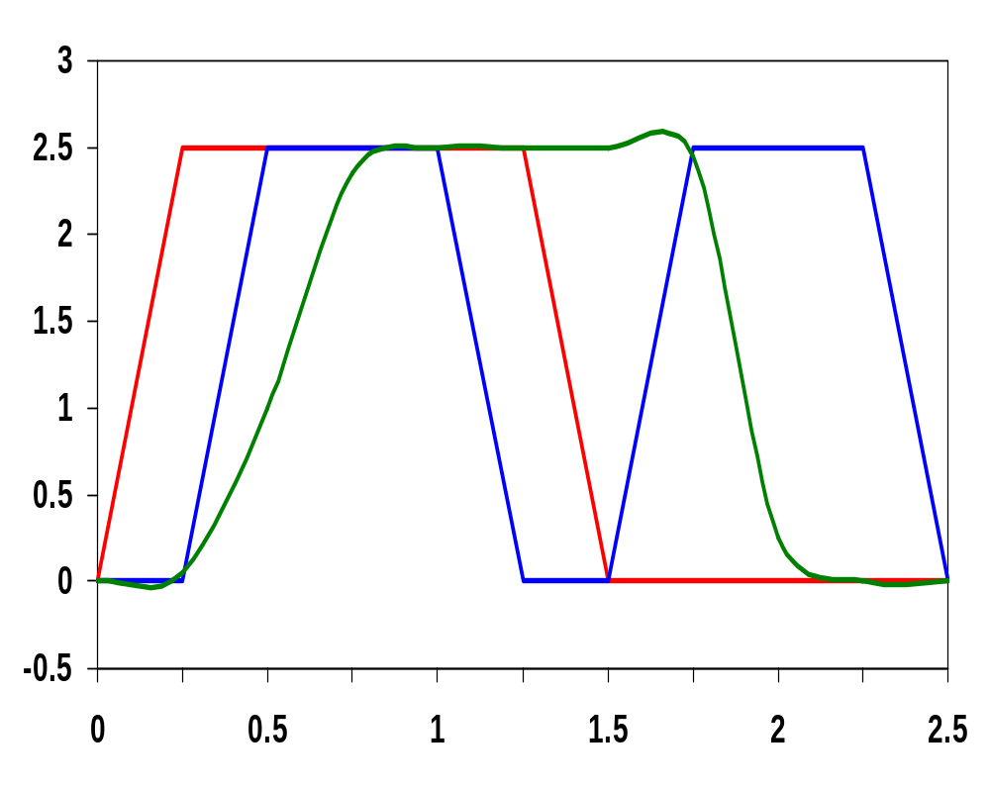
Propagation Delay Simulation
t_{c-q(LH)} = 160 psec
Volts
t_{c-q(LH)}
t_{c-q(HL)} = 180 psec
t_{c-q(HL)}
Time (ns)
Notes:
hold time - D input edge is skewed relative to the clock signal until the circuit fails
propagation delay – delay is measured from the 50% point of the clk edge to the 50% point of the Q output

Slide 34
Reduced Load MS ET FF
Clock load per register is important since it directly impacts the power dissipation of the clock network.
Can reduce the clock load (at the cost of robustness) by making the circuit ratioed
clk
!clk
I₁
I₃
T₁
Q_{M}
T₂
D
Q
I₂
I₄
!clk
clk
reverse conduction
  to switch the state of the master, T₁ must be sized to overpower I₂
  to avoid reverse conduction, I₄ must be weaker than I₁
Notes:
12 transistors with clock load of 4 (2 on clk and 2 on !clk) – but now ratioed design (and thus less robust)
T1 must overpower I2 to switch the state of the cross-coupled inverters I1 and I2. But want to use minimum (or close to it) transistors in T1 and T2 to keep clock load small (to reduce power dissipation in flipflops and in the clock distribution network). Thus, probably want to downsize the transistors in I1 (making them longer and thus weaker).
Another problem is reverse conduction is possible – second stage can affect the state of the first latch. When slave (second latch) is on, it is possible for a combination of T2 and I4 to influence the data stored in I1&I2. As long as I4 is a weak device, this is not a problem

Slide 35
Non-Ideal Clocks
clk
clk
!clk
!clk
Ideal clocks
Non-ideal clocks
clock skew
1-1 overlap
0-0 overlap
Notes:
Clk and !clk are never perfect inversions of one another – must generate !clk and route both signals (variations can exist in the wires used to route the two clock signals and load capacitances can vary)
Clock skew can result in clock overlap

Slide 36
Example of Clock Skew Problems
X
!clk
Q
clk
P₁
A
P₃
I₃
I₄
!Q
D
I₁
I₂
B
P₂
P₄
!clk
clk
Race condition – direct path from D to Q during the short time when both clk and !clk are high (1-1 overlap)
Undefined state – both B and D are driving A when clk and !clk are both high
Dynamic storage – when clk and !clk are both low (0-0 overlap)
Notes:
When clock goes high, slave should go into hold mode. But since clk and !clk are both high for a short period of time there is a direct path from D to Q. So data output could change on rising edge (not this is a negative et device!). Race condition where value of Q is a function of whether the input D arrives at node X before or after the falling edge of !clk.
Node A is driven by both D and B when clk and !clk are both high resulting in an undefined state

Slide 37
Pseudostatic Two-Phase ET FF
X
clk2
Q
clk1
P₁
A
P₃
I₃
I₄
!Q
D
I₁
I₂
B
P₂
P₄
clk2
clk1
dynamic
storage
master transparent
slave hold
clk1
master hold
slave transparent
t_{non_overlap}
clk2
Notes:
Keep clock nonoverlap time large enough that no overlap occurs even in the presence of clock skew
During the nonoverlap time, the ff is in the high-impedance state – the feedback loop is open (the loop gain is zero) and the input is disconnected. Leakage will destroy the state if this condition holds for too long – hence the name pseudostatic (the register employs a combination of static and dynamic storage approaches depending upon the state of the clock). Don’t want to stop the clocks when both are low!!

Slide 38
Two Phase Clock Generator
A
clk1
clk
B
clk2
clk
A
B
clk1
clk2

Slide 39
Review: Sequential Definitions
Static versus dynamic storage
  static uses a bistable element with feedback (regeneration) and thus preserves its state as long as the power is on
  static is preferred when updates are infrequent (clock gating)
  dynamic stores state on parasitic capacitors so only holds the state for a period of time (milliseconds) and requires periodic refresh
  dynamic is usually simpler (fewer transistors), higher speed, lower power
Latch versus flipflop
  latches are level sensitive with two modes: transparent - inputs are passed to Q and hold - output stable
  fliplflops are edge sensitive that only sample the inputs on a clock transition
Notes:
Dynamic storage requires periodic refresh of the value.
Reading the value of the stored signal from a capacitor without disrupting the charge requires the availability of a device with a high input impedance

Slide 40
Dynamic ET Flipflop
master
slave
!clk
clk
Q_{M}
D
T₁
I₁
T₂
I₂
Q
C₁
C₂
clk
!clk
t_{su} =
t_{hold} =
t_{c-q} =
clk
!clk
Notes:
For class handout

Slide 41
Dynamic ET Flipflop
master
slave
!clk
clk
Q_{M}
D
T₁
I₁
T₂
I₂
Q
C₁
C₂
clk
!clk
t_{su} =
t_{hold} =
t_{c-q} =
t_{pd_tx}
zero
master transparent
slave hold
2 t_{pd_inv} + t_{pd_tx}
clk
!clk
master hold
slave transparent
Notes:
C1 is the gate cap of I1, the junction cap of T1 and the overlap gate cap of T1
8 transistors, so very efficient
tsetup is delay of the transmission gate (time it takes C1 to sample D input)
hold time is zero since T1 is turned off on the clock edge so further input changes are ignored
tpFF is two inverter delays plus the delay of T2
Remember – dynamic nodes (C1 and C2) only hold their state so long, so ff has to be refreshed periodically to prevent state loss due to charge leakage

Slide 42
Dynamic ET FF Race Conditions
!clk
clk
Q_{M}
D
T₁
I₁
T₂
I₂
Q
C₁
C₂
clk
!clk
0-0 overlap race condition
t_{overlap0-0} < t_{T1} +t_{I1} + t_{T2}
clk
!clk
1-1 overlap race condition
t_{overlap1-1} < t_{hold}
Notes:
clock overlap leads to race conditions
1-1 race fixed by enforcing a hold time - data must be stable during the high-high overlap period
0-0 race fixed by making sure there is enough delay between D and C2 so that new data sampled by the master does not propagate to the slave (can be ensured by enforcing appropriate setup time)

Slide 43
Dynamic Two-Phase ET FF
clk1
clk2
Q_{M}
D
T₁
I₁
T₂
I₂
Q
C₁
C₂
!clk1
!clk2
master transparent
slave hold
clk1
t_{non_overlap}
clk2
master hold
slave transparent
Notes:
Keep clock nonoverlap time large enough that no overlap occurs even in the presence of clock skew
But now have 4 clock signals to route!

Slide 44
Pseudostatic Dynamic Latch
Robustness considerations limit the use of dynamic FF’s
  coupling between signal nets and internal storage nodes can inject significant noise and destroy the FF state
  leakage currents cause state to leak away with time
  internal dynamic nodes don’t track fluctuations in V_{DD} that reduces noise margins
A simple fix is to make the circuit pseudostatic
!clk
D
clk
Add above logic added to all dynamic latches
Notes:
adding a weak feedback inverter to each latch
comes at a slight cost in delay (adds to the capacitive load) and power consumption, but it improves noise immunity significantly

Slide 45
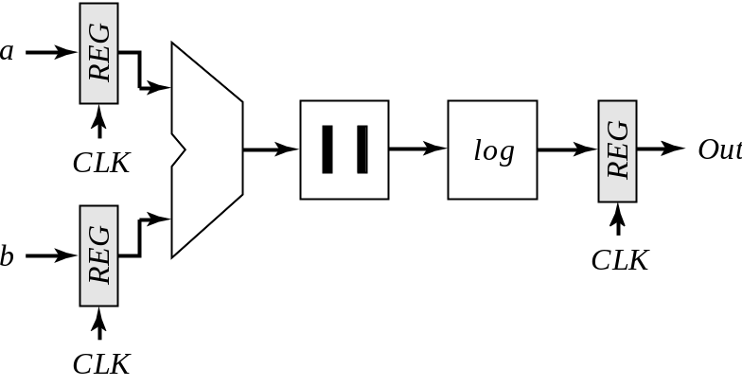
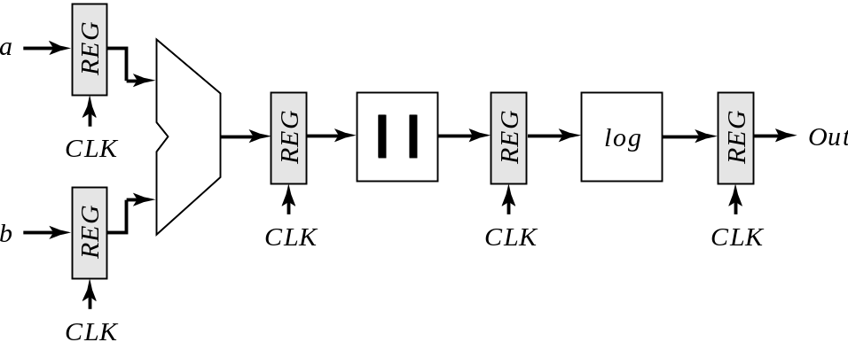
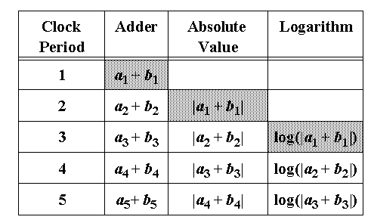
Pipelining
Reference
Pipelined

Slide 46
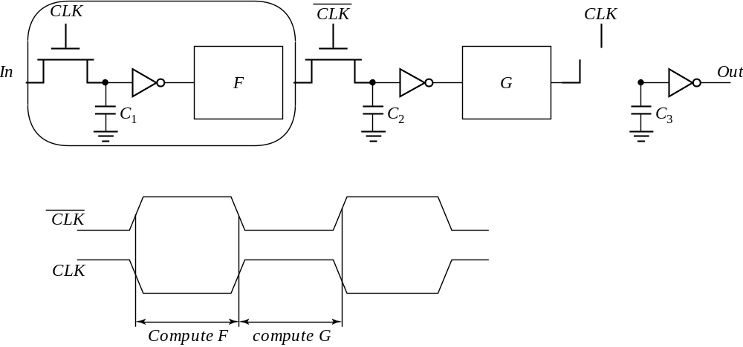
Latch-Based Pipeline

