Slide 1
Lecture 17
Adder Design
EE 115C: Digital Electronic Circuits

Slide 2
The 1-bit Binary Adder
C_{in}
A | B | C_{in} | C_{out} | S | carry status
0 | 0 | 0 | 0 | 0 | kill
0 | 0 | 1 | 0 | 1 | kill
0 | 1 | 0 | 0 | 1 | propagate
0 | 1 | 1 | 1 | 0 | propagate
1 | 0 | 0 | 0 | 1 | propagate
1 | 0 | 1 | 1 | 0 | propagate
1 | 1 | 0 | 1 | 0 | generate
1 | 1 | 1 | 1 | 1 | generate
A
1-bit Full Adder
(FA)
S
B
C_{out}
G = A&B
P = A ⊕ B
K = !A & !B
S = A ⊕ B ⊕ C_{in}
C_{out} = A&B | A&C_{in} | B&C_{in} (majority function)
= P ⊕ C_{in}
= G | P&C_{in}
How can we use it to build a 64-bit adder?
How can we modify it easily to build an adder/subtractor?
How can we make it better (faster, lower power, smaller)?
Notes:
A VERY common operation - so worth spending some time trying to optimize
And often in the critical path, so need to look at both
logic level optimizations
circuit level optimizations

Slide 3
A 64-bit Adder/Subtractor
add/subt
C₀=C_{in}
Ripple Carry Adder (RCA) built out of 64 FAs
Subtraction – complement all subtrahend bits (xor gates) and set the low order carry-in
RCA
  advantage: simple logic, so small (low cost)
  disadvantage: slow (O(N) for N bits) and lots of glitching (so lots of energy consumption)
A₀
1-bit FA
S₀
B₀
C₁
A₁
1-bit FA
S₁
B₁
C₂
A₂
1-bit FA
S₂
B₂
C₃
. . .
C₆₃
A₆₃
1-bit FA
S₆₃
B₆₃
C₆₄=C_{out}

Slide 4
Ripple Carry Adder (RCA)
A₃
B₃
A₂
B₂
A₁
B₁
A₀
B₀
C_{out}=C₄
FA
FA
FA
FA
C₀=C_{in}
S₃
S₂
S₁
S₀
T_{adder} ≈ T_{FA}(A,B→C_{out}) + (N-2)T_{FA}(C_{in}→C_{out}) + T_{FA}(C_{in}→S)
T = O(N) worst case delay
Real Goal: Make the fastest possible carry path
Notes:
worst case is when the carry ripples from the least to most significant end

Slide 5
Sizing the Mirror Adder Transistors for Speed
24+4 transistors
B
6
A
8
B
8
B
8
A
4
B
4
C_{in}
4
A
6
0-propagate
kill
8
A
8
4
C_{in}
6
C_{in}
!C_{out}
!S
4
A
4
2
C_{in}
3
1-propagate
generate
B
B
A
B
C_{in}
A
3
A
4
4
4
2
2
2
B
3
C_{out} = A&B | B&C_{in} | A&C_{in}
SUM = A&B&C_{in} | C_{OUT}&(A | B | C_{in})
Sizing: Each input in the carry circuit has a logical effort of 2 so the optimal fan-out for each is also 2. Since !C_{out} drives 2 internal and 2 inverter transistor gates (to form C_{in} for the nms bit adder) should oversize the carry circuit. PMOS/NMOS ratio of 2.
Notes:
24 + 4 (for C and Sum inverter) transistor Full Adder
No more than 3 transistors in series
Loads: A-8, B-8, Cin-6, !Cout-2
Number of “gate delays” to Sum – 3?

Slide 6
Mirror Adder Features
The NMOS and PMOS chains are completely symmetrical with a maximum of two series transistors in the carry circuitry, guaranteeing identical rise and fall transitions if the NMOS and PMOS devices are properly sized.
When laying out the cell, the most critical issue is the minimization of the capacitances at node !C_{out} (four diffusion capacitances, two internal gate capacitances, and two inverter gate capacitances). Shared diffusions can reduce the stack node capacitances.
The transistors connected to C_{in} are placed closest to the output.
Only the transistors in the carry stage have to be optimized for optimal speed. All transistors in the sum stage can be minimal size.
Notes:
Particularly the diffusion capacitances

Slide 7
Inversion Property
Inverting all inputs to a FA results in inverted values for all outputs
A
B
A
B
C_{out}
FA
C_{in}
≡
C_{out}
FA
C_{in}
S
S
!S (A, B, C_{in}) = S(!A, !B, !C_{in})
!C_{out} (A, B, C_{in}) = C_{out} (!A, !B, !C_{in})
Notes:
mod 2**n adder means 1111 + 1 = 0000 (ignoring high order carry out)
Note that high order bit (bit 3) is the sign bit – treated as are all other bits (magnitude bits)

Slide 8
Exploiting the Inversion Property for Speed
A₃
B₃
A₂
B₂
A₁
B₁
A₀
B₀
C_{out}=C₄
FA’
FA’
FA’
FA’
C₀=C_{in}
S₃
S₂
S₁
S₀
inverted cell
regular cell
Minimizes the critical path (the carry chain) by eliminating inverters between the FAs (will need to increase the transistor sizing on the carry chain portion of the mirror adder).
Now need two “flavors” of FAs
Notes:
eliminates inverters in the carry path
Notice that the mirror adder produces !cout and !sum out in its 28 transistor implementation, so adder for bit 0 is just the mirror adder. Adder bit 1 would be the other flavor of the mirror adder (once again without the inverter on the carry output). Then the two inverters between bit 0 and bit 1 cancel one another. This eliminates all of the inverters in the carry chain.

Slide 9
Fast Carry Chain Design
The key to fast addition is a low latency carry network
What matters is whether in a given position a carry is
  generated G_{i} = A_{i} & B_{i} = A_{i}B_{i}
  propagated P_{i} = A_{i} ⊕ B_{i} (sometimes use A_{i} | B_{i})
  annihilated (killed) K_{i} = !A_{i} & !B_{i}
Giving a carry recurrence of
C_{i+1} = G_{i} | P_{i}C_{i}
  C₁ =
  C₂ =
  C₃ =
  C₄ =
Notes:
For class handout

Slide 10
Fast Carry Chain Design
The key to fast addition is a low latency carry network
What matters is whether in a given position a carry is
  generated G_{i} = A_{i} & B_{i} = A_{i}B_{i}
  propagated P_{i} = A_{i} ⊕ B_{i} (sometimes use A_{i} | B_{i})
  annihilated (killed) K_{i} = !A_{i} & !B_{i}
Giving a carry recurrence of
C_{i+1} = G_{i} | P_{i}C_{i}
  C₁ = G₀ | P₀C₀
  C₂ = G₁ | P₁G₀ | P₁P₀ C₀
  C₃ = G₂ | P₂G₁ | P₂P₁G₀ | P₂P₁P₀ C₀
  C₄ = G₃ | P₃G₂ | P₃P₂G₁ | P₃P₂P₁G₀ | P₃P₂P₁P₀ C₀
Notes:
For lecture
Note that one and only one of the signals pi, gi, and ai is 1
Si = pi xor ci if we use the xor equation for pi

Slide 11
Manchester Carry Chain
Switches controlled by G_{i} and P_{i}
Total delay of
  time to form the switch control signals G_{i} and P_{i}
  setup time for the switches
  signal propagation delay through N switches in the worst case
!C_{i+1}
!C_{i}
G_{i}
P_{i}
clk
Notes:
when clock is low, the carry nodes precharge; when clock goes high if gi is high, ci+1 is asserted (goes low)
to prevent gi from affecting ci, the signal pi must be computed as the xor (rather than the or) of xi and yi which is not a problem since we need the xor of xi and yi for computing the sum anyway
delay is roughly proportional to n**2 (as n pass transistors are connected in series) so usually group 4 stages together and buffer the carry chain with an inverter between each stage

Slide 12
4-bit Sliced MCC Adder
A₃
B₃
A₂
B₂
A₁
B₁
A₀
B₀
clk
& ⊕
& ⊕
& ⊕
& ⊕
G
P
G
P
G
P
G
P
!C₄
!C₀
!C₃
!C₂
!C₁
⊕
⊕
⊕
⊕
S₃
S₂
S₁
S₀
Notes:
Dynamic circuit – impact on clock power and timing (have to allow for precharge time)
Limit of 4 transistors in a row for speed, then have to buffer carry chain

Slide 13
Domino Manchester Carry Chain Circuit
3 3 3 3 3
clk
P₃
P₂
P₁
P₀
C_{i,4}
1
2
3
4
1
2
G₃
2
3
G₂
3
4
G₁
4
5
G₀
5
6
C_{i,0}
clk
!(G₀ | P₀ C_{i,0})
!(G₂ | P₂G₁ | P₂P₁G₀ | P₂P₁P₀ C_{i,0})
!(G₁ | P₁G₀ | P₁P₀ C_{i,0})
!(G₃ | P₃G₂ | P₃P₂G₁ | P₃P₂P₁G₀ | P₃P₂P₁P₀ C_{i,0})
Notes:
Note four pass transistors in series (P3 P2 P1 P0) + Ci,0 and Me of first gate.
Automatically forms all the intermediate carries as well – as shown on animation
Sizing assumes only integer multiples allowed, should pfets all be 3?

Slide 14
Binary Adder Landscape
synchronous word parallel adders
ripple carry adders (RCA) carry prop min adders
signed-digit fast carry prop residue adders adders adders
Manchester carry parallel conditional carry carry chain select prefix sum skip
T = O(N), A = O(N)
T = O(1), A = O(N)
T = O(√N),
A = O(N)
T = O(N)
A = O(N)
T = O(log N)
A = O(N log N)
Notes:
speed versus complexity versus power consumption but have to worry about constants
also have bit (digit) serial adders and asynchronous adders

Slide 15
Carry-Skip (Carry-Bypass) Adder
A₃
B₃
A₂
B₂
A₁
B₁
A₀
B₀
C_{o,3}
FA
FA
FA
FA
C_{i,0}
C_{o,3}
S₃
S₂
S₁
S₀
BP = P₀ P₁ P₂ P₃ “Block Propagate”
If (P₀ & P₁ & P₂ & P₃ = 1) then C_{o,3} = C_{i,0} otherwise the block itself kills or generates the carry internally

Slide 16
Carry-Skip Chain Implementation
block carry-out
carry-out
BP
block carry-in
P₃
P₂
P₁
P₀
!C_{out}
C_{in}
G₃
G₂
G₁
G₀
BP
Notes:
Only 10% to 20% area overhead
Only 2 “gate delays” to produce cout if skip occurs

Slide 17
4-bit Block Carry-Skip Adder
bits 12 to 15
bits 8 to 11
bits 4 to 7
bits 0 to 3
Setup
Setup
Setup
Setup
Carry
Propagation
Carry
Propagation
Carry
Propagation
Carry
Propagation
C_{i,0}
Sum
Sum
Sum
Sum
Worst-case delay → carry from bit 0 to bit 15 = carry generated in bit 0, ripples through bits 1, 2, and 3, skips the middle two groups (B is the group size in bits), ripples in the last group from bit 12 to bit 15
T_{add} = t_{setup} + B t_{carry} + ((N/B) -1) t_{skip} +B t_{carry} + t_{sum}
Notes:
Set up is for forming p’s and g’s
For N bits and N/B chunks each containing B bits

Slide 18
Carry-Skip Adder Extensions
Variable block sizes
  A carry that is generated in, or absorbed by, one of the inner blocks travels a shorter distance through the skip blocks, so can have bigger blocks for the inner carries without increasing the overall delay
C_{out}
C_{in}
Multiple levels of skip logic
C_{out}
C_{in}
skip level 1
AND of the first level skip signals (BP’s)
skip level 2

Slide 19
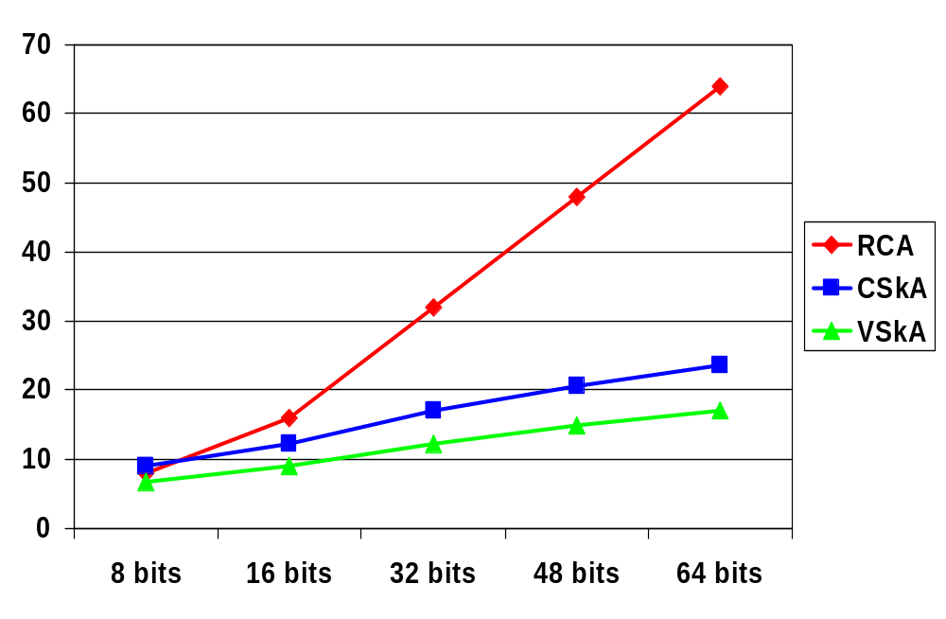
Carry-Skip Adder Comparisons
Carry Ripple Adder
Carry Skip Adder
B=6
B=5
B=4
B=2
B=3
Variable Size
Carry Skip Adder
Notes:
Need to redo numbers – just fill in for now!!!

Slide 20
Optimal Block Size and Time
Assuming one stage of ripple (t_{carry}) has the same delay as one skip logic stage (t_{skip}) and both are 1
T_{CSkA} = 1 + B + (N/B-1) + B + 1
t_{setup} ripple in skips ripple in t_{sum}
block 0 last block
= 2B + N/B + 1
So the optimal block size, B, is
dT_{CSkA}/dB = 0 ⇒ √(N/2) = B^{opt}
And the optimal time is
Optimal T_{CSkA} = 2(√(2N)) + 1
Notes:
so if n=32, bopt = 4 bits and Topt = 12.5 stages compared to a ripple-carry adder of 32 or more than 2.5 times faster
And pass chain to implement GP would also argue for no more than 4 bits in a group

Slide 21
Carry Select Adder
A’s
B’s
4-b Setup
Precompute the carry out of each block for both carry_in = 0 and carry_in = 1 (can be done for all blocks in parallel) and then select the correct one
P’s
G’s
“0” carry propagation
0
“1” carry propagation
1
C_{out}
multiplexer
C_{in}
C’s
Sum generation
S’s
Notes:
“Skip” the carry select adder in lecture – just refer students to the book
Compute both carry out with no carryin and carries with carryin and then select the right one when you know what the real carryin is

Slide 22
Carry Select Adder: Critical Path
bits 12 to 15
bits 8 to 1
bits 4 to 7
bits 0 to 3
A’s
B’s
A’s
B’s
A’s
B’s
A’s
B’s
Setup
Setup
Setup
Setup
P’s
G’s
P’s
G’s
P’s
G’s
P’s
G’s
“0” carry
“0” carry
“0” carry
“0” carry
0
“1” carry
“1” carry
“1” carry
“1” carry
1
mux
mux
mux
mux
C_{out}
C_{in}
C’s
C’s
C’s
C’s
Sum gen
Sum gen
Sum gen
Sum gen
S’s
S’s
S’s
S’s
Notes:
For class handout

Slide 23
Carry Select Adder: Critical Path
bits 12 to 15
bits 8 to 1
bits 4 to 7
bits 0 to 3
A’s
B’s
A’s
B’s
A’s
B’s
A’s
B’s
1
Setup
Setup
Setup
Setup
P’s
G’s
P’s
G’s
P’s
G’s
P’s
G’s
“0” carry
“0” carry
“0” carry
0
adder
Cin
+4
“1” carry
“1” carry
“1” carry
1
Carry bit
+1
+1
+1
C_{out}
mux
mux
mux
C’s
C’s
C’s
Sum bits
+1
Sum gen
Sum gen
Sum gen
Sum gen
S’s
S’s
S’s
S’s
T_{add} = t_{setup} + B t_{carry} + N/B t_{mux} + t_{sum}
Notes:
For lecture
N is number of bits in adder, B is number of bits in block, M is the number of blocks
According to the book, it is easy to show that the carry select adder is more cost effective than the ripple carry adder if n >16/(alpha-1) where alpha is cadd(n) = alpha n for RCAs
For alpha = 4 and tau = 2, the carry select approach is almost always preferable to ripple carry

Slide 24
Square Root Carry Select Adder
bits 14 to 19
bits 9 to 13
bits 5 to 8
bits 2 to 4
bits 0 to 1
A’s
B’s
A’s
B’s
A’s
B’s
A’s
B’s
A’s
B’s
Setup
Setup
Setup
Setup
Setup
P’s
G’s
P’s
G’s
P’s
G’s
P’s
G’s
P’s
G’s
Cin
“0” carry
“0” carry
“0” carry
“0” carry
“0” carry
“1” carry
“1” carry
“1” carry
“1” carry
“1” carry
1
C_{out}
mux
mux
mux
mux
mux
C_{in}
C’s
C’s
C’s
C’s
C’s
Sum gen
Sum gen
Sum gen
Sum gen
Sum gen
S’s
S’s
S’s
S’s
S’s
Notes:
For class handout

Slide 25
Square Root Carry Select Adder
bits 14 to 19
bits 9 to 13
bits 5 to 8
bits 2 to 4
bits 0 to 1
A’s
B’s
A’s
B’s
A’s
B’s
A’s
Bs
As
B’s
1
Setup
Setup
Setup
Setup
Setup
P’s
G’s
P’s
G’s
P’s
G’s
P’s
G’s
P’s
G’s
0
0
“0” carry
0
“0” carry
“0” carry
“0” carry
“0” carry
0
+6
+5
+4
+3
+2
“1” carry
1
“1” carry
“1” carry
1
“1” carry
“1” carry
1
1
+1
+1
+1
+1
+1
C_{out}
mux
mux
mux
mux
mux
C_{in}
C’s
C’s
C’s
C’s
C’s
+1
Sum gen
Sum gen
Sum gen
Sum gen
Sum gen
S’s
S’s
S’s
S’s
S’s
T_{add} = t_{setup} + 2 t_{carry} + √N t_{mux} + t_{sum}
Notes:
For lecture
Delay balancing – make the later blocks bigger
How about two level carry select as in book?

Slide 26
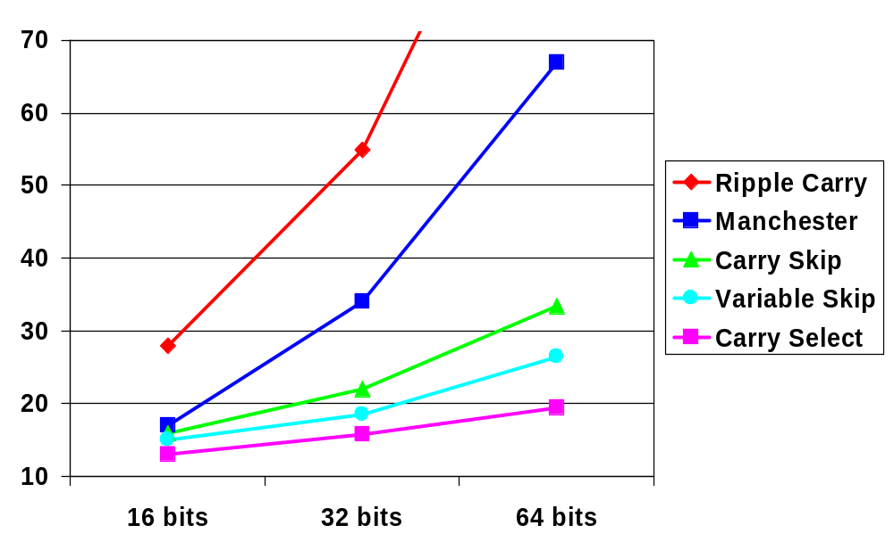
Adder Speed Comparisons

Slide 27
Carry Select Adder: Critical Path
bits 12 to 15
bits 8 to 1
bits 4 to 7
bits 0 to 3
A’s
B’s
A’s
B’s
A’s
B’s
A’s
B’s
1
Setup
Setup
Setup
Setup
P’s
G’s
P’s
G’s
P’s
G’s
P’s
G’s
“0” carry
“0” carry
“0” carry
“0” carry
0
+4
“1” carry
“1” carry
“1” carry
“1” carry
1
+1
+1
+1
+1
C_{out}
mux
mux
mux
mux
C_{in}
C’s
C’s
C’s
C’s
+1
Sum gen
Sum gen
Sum gen
Sum gen
S’s
S’s
S’s
S’s
T_{add} = t_{setup} + B t_{carry} + N/B t_{mux} + t_{sum}
Notes:
For lecture
N is number of bits in adder, B is number of bits in block, M is the number of blocks
According to the book, it is easy to show that the carry select adder is more cost effective than the ripple carry adder if n >16/(alpha-1) where alpha is cadd(n) = alpha n for RCAs
For alpha = 4 and tau = 2, the carry select approach is almost always preferable to ripple carry

