Slide 1
Lecture 2
Diodes
EE 115C
Digital Electronic Circuits

Slide 2
Physical Operation of Diodes
Intrinsic/Doped Silicon
Diffusion & Drift Current
Forward Bias & Reverse Bias
Depletion Capacitance
First & Second Order Model
Diodes do not appear explicitly in CMOS digital electronic circuits, but rather many reverse biased PN junctions exist in MOSFETs (Metal-Oxide Semiconductor Field-Effect Transistor).

Slide 3
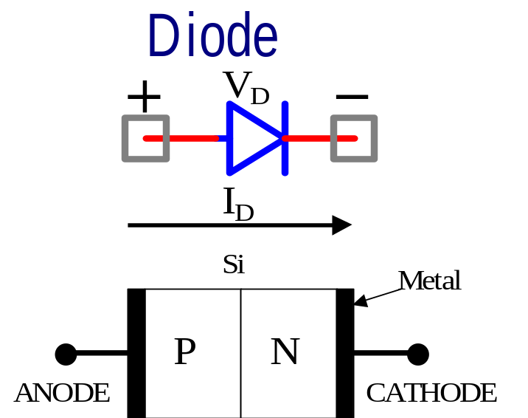
The PN-junction
Junction of P-type semiconductor material with N-type semiconductor material.
The diode is a PN-Junction.

Slide 4
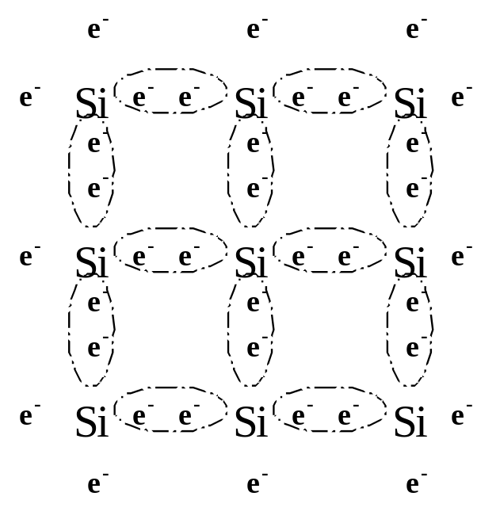
Intrinsic Silicon
Intrinsic or PURE Silicon consists of a regular lattice structure of Si atoms held together by 4 covalent bonds.
The core of each Si atom has a positive charge of +4 which is neutralized by its 4 valence electrons.
The electrons are tightly bonded to the nucleus by the covalent bonds and are not “free” to move around. Thus the electrical conductivity of intrinsic silicon is low.

Slide 5
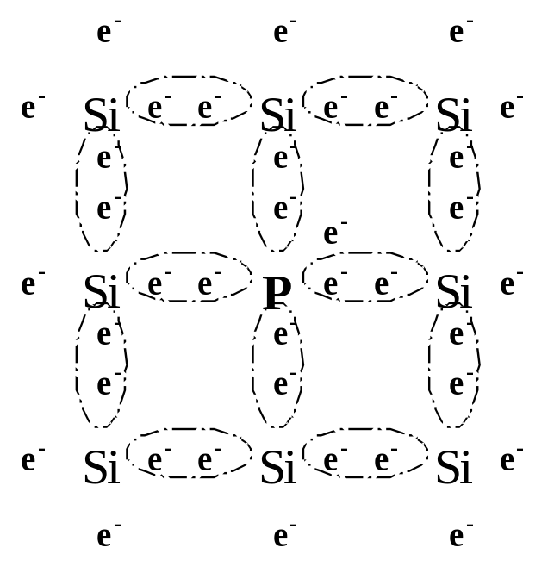
Doped Silicon (N-Type)
If we add a small amount of, for example, Phosphorus to pure silicon, the following structure results.
Phosphorus, has a core charge of +5 and has 5 valence electrons.
Thus one electron is relatively free to move around.
This type of silicon is referred to as N-type. It has an excess concentration of relatively free electrons which can “drift” when a potential drop is introduced across the material.
Electrical conductivity of N-type Si is much higher than intrinsic-Si.

Slide 6
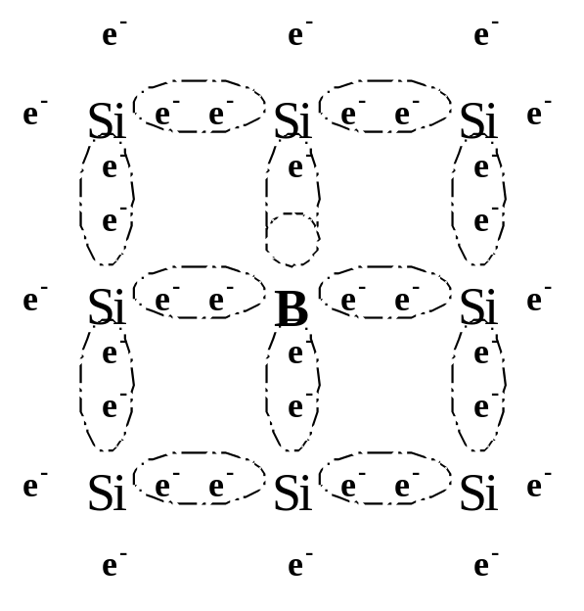
Doped Silicon (P-Type)
If we add Boron instead of Phosphorus the following lattice structure results.
Boron has a core charge of +3 and has 3-valence electrons.
The Boron atom strongly attracts electrons from neighboring atoms in order to fill its valence bands. A vacancy or “hole” is thus created (+ve charge) which moves around the lattice.
This is referred to as P-type Si and its electrical conductivity is much higher than pure Si, but lower than N-type Si.

Slide 7
The PN Junction:
Fundamental Element Of Electronic Circuits
Junction of an n-type and a p-type material:
N-type doped Si made using donor atoms (i.e. phosphorus)
P-type doped Si made using acceptor atoms (i.e. boron)

Slide 8
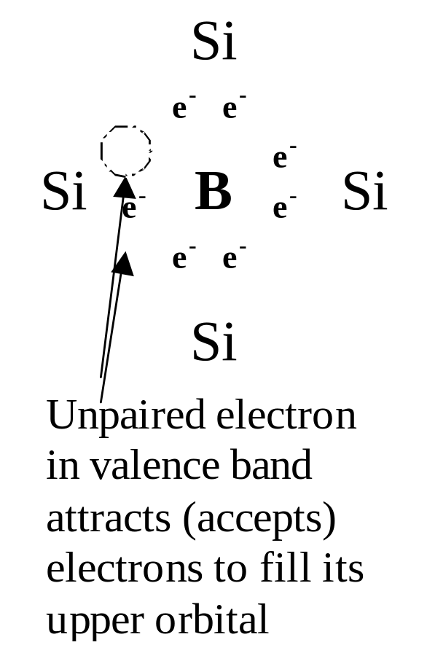
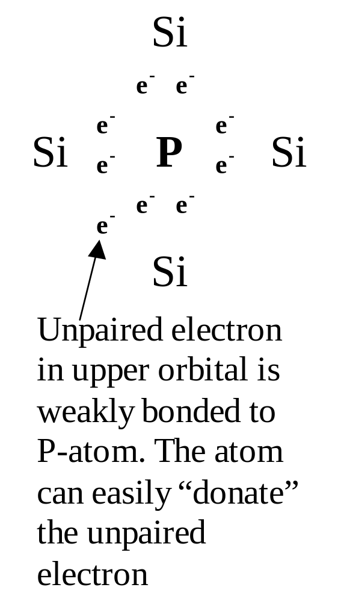
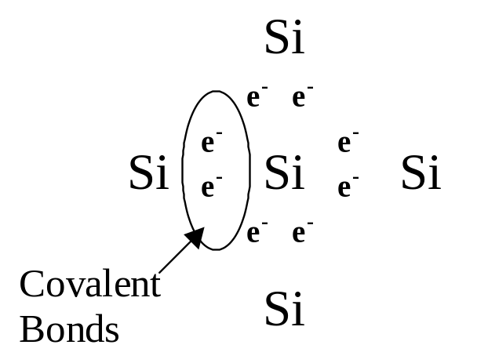
Neutral, N-, P- Type Si
Neutral Si Lattice
P-type Silicon
N-type Silicon

Slide 9
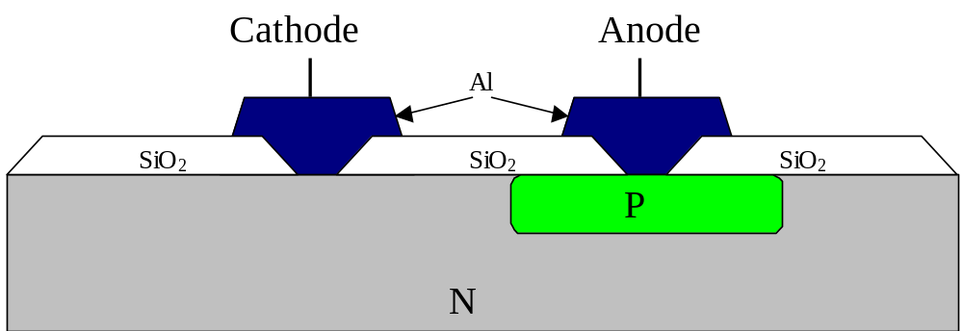
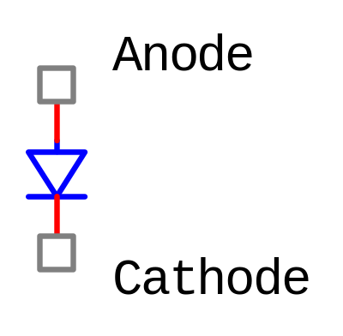
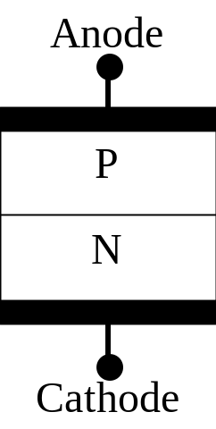
Physical Implementation of a Diode
Actual realization of PN-junction diode
One-Dimensional representation of Diode
Diode Symbol

Slide 10
Diffusion And Drift
At the junction, we have a concentration of electrons at the N-side and a deficiency on the P-side.
Electrons will diffuse from N-to-P
Holes will diffuse from P-to-N
Results in E-field in a direction opposed to that of electron flow

Slide 11
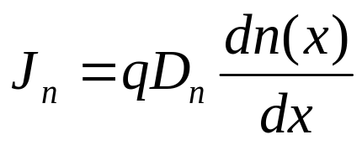
Diffusion And Drift
2 mechanisms by which holes and electrons move through a Si crystal.
Diffusion
Tendency of electrons (holes) to “diffuse” from areas with higher concentration to areas of lower concentration
J_{n} ~ current density (current per unit area) of electrons
D_{n} ~ diffusivity (constant ≈18cm²/Vs in p region)

Slide 12
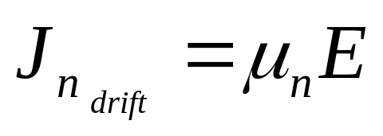
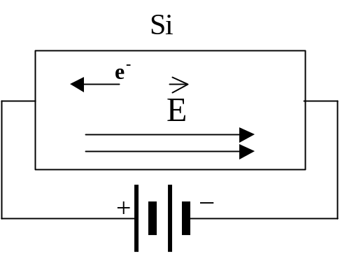
Drift
Movement of carriers due to applied electric field
Carriers acquire a drift velocity superimposed on the diffusion velocity
(velocity of electrons moving towards the +ve terminal)
µ_{n} ~ mobility (constant ≈1350 cm²/Vs)
µ_{p} ≈ µ_{n}/2.5

Slide 13
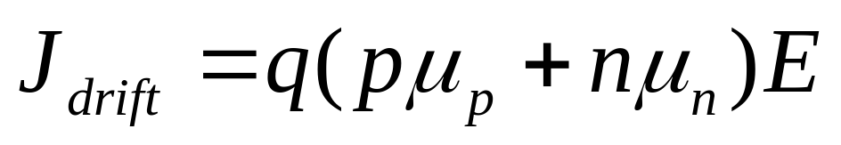
For the Silicon Crystal with hole density p & electron density n
Total drift current density

Slide 14
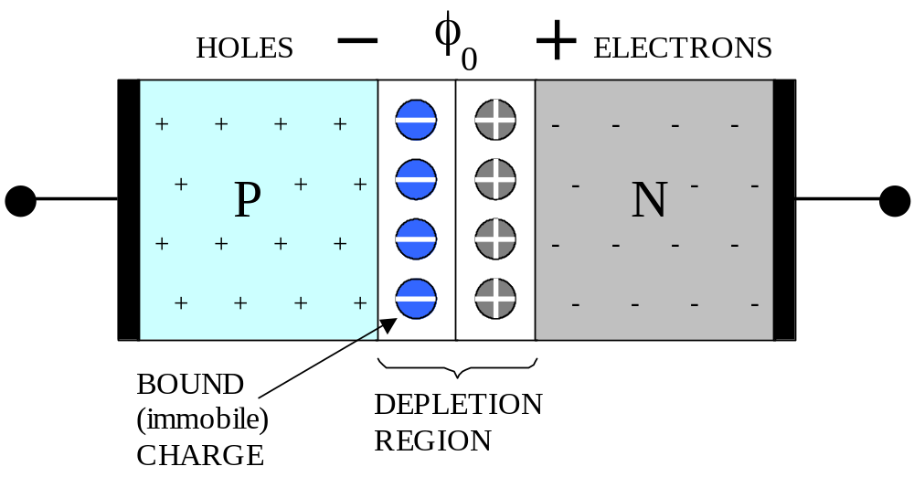
PN-junction Under Open Circuit Conditions
Initially when junction is formed, the excess electrons on the n-side diffuse into the p-side and fill the holes. They become trapped by the holes. This results in negatively charged atoms on the p-side & positively charged atoms on the N-side.

Slide 15
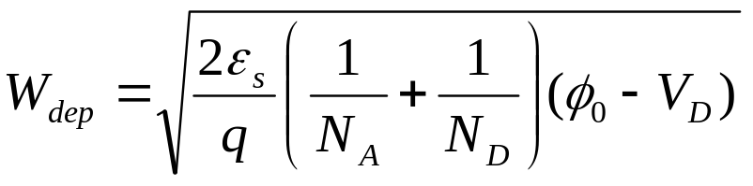
At the same time some thermally generated holes on the n side diffuse to the edge of the depletion region and are swept to the p-side by the E filed in the depletion region (reverse applies to electrons on the p-side)
This gives rise to a current Is in the opposite direction of the diffusion current
Eventually, a steady-state conditions reached where the drift current Is exactly balances the electron-hole diffusion.
The width of the depletion region is a function of the doping concentration in the N & P regions.
V_{D} is the external voltage
applied across the diode
from the P-side
to the n-side

Slide 16
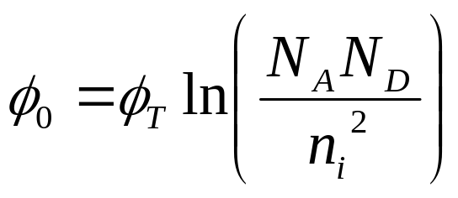
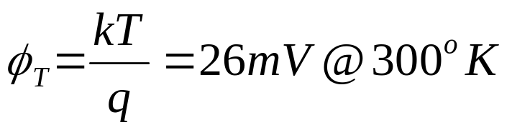
where φ₀ is the Junction built in voltage.
φ₀ ~ built in potential
N_{A}, N_{D} ~ Doping concentration of the p-side & n-side respectively
n_{i} ~ concentration of holes & electrons in intrinsic (undoped) Silicon (electrons that have left their atoms)
A region of immobile charge is formed at the junction which is referred to as the depletion region.
The charge built up across the depletion region is referred to as the built in potential.

Slide 17
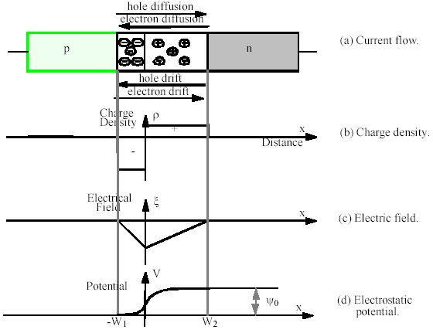
An abrupt PN-junction in Equilibrium

Slide 18
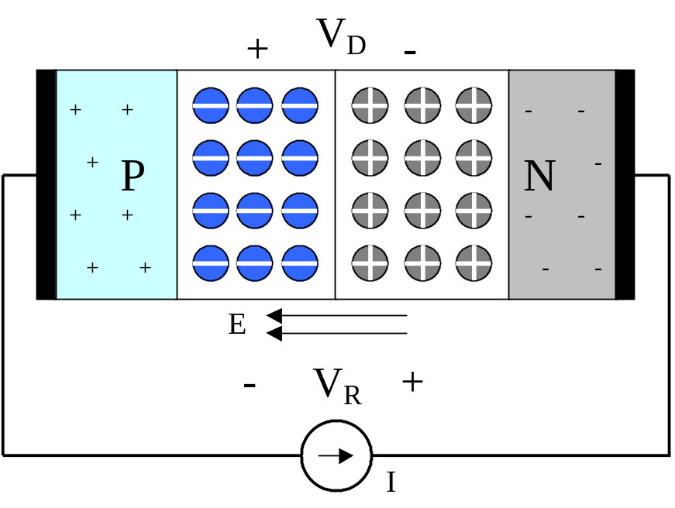
PN Junction Under Reverse-bias Conditions
The current I, forces electrons to leave the N-material
⇒ more trapped positive charge in N-type
⇒ wider depletion width.
Current I forces holes to leave the P-material
⇒ more trapped negative charge in P-type
⇒ wider depletion width.

Slide 19
Reverse Bias, cont’d
More charge in depletion region ⇒ Higher voltage in the depletion region (greater barrier voltage) ⇒ diffusion current I_{D}↓
The current Is however is independent of the barrier voltage and remains constant
Equilibrium is reached when I_{D} – I_{s} = I
E-field ⇒ Voltage drop V_{R} across depletion region above the built-in voltage – V_{R} appears across current source I. i.e. Reverse bias voltage.

Slide 20
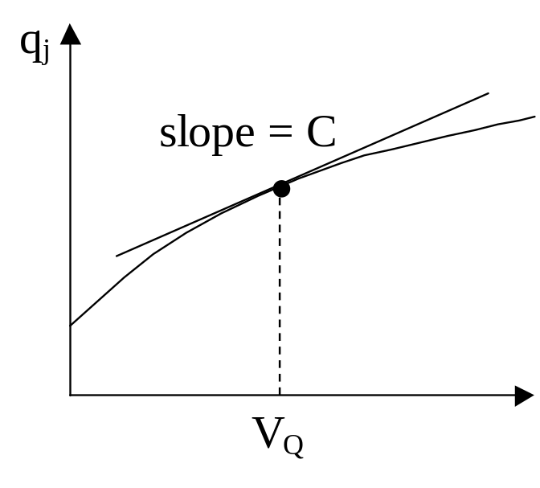
Depletion Capacitance
C_{j} (Junction Capacitance)
Note: charge is stored in depletion region for a given V_{R} ⇒ Depletion region acts as a charge storage device
(i.e. Capacitor)
q_{j} ~ charge stored in depletion layer

Slide 21
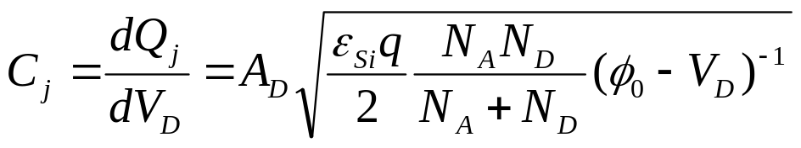
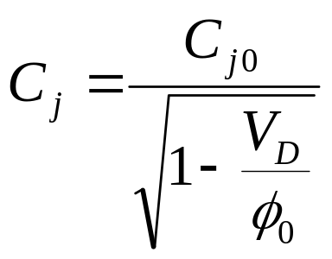

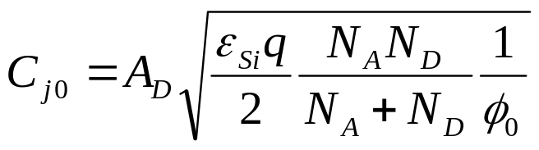
Depletion Capacitance
(Reverse Bias Junction Cap)
Depletion Region holds charge, similar to a capacitor
where
Above equation valid for an abrupt PN-junction and –V_{D}
Depletion Cap. dominates when the device is reverse biased.
C_{j0} ~ capacitance under zero bias conditions. Only a function of the physical parameters of the device

Slide 22
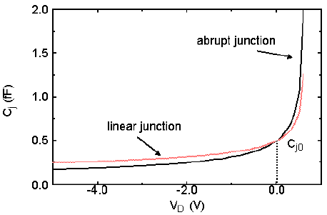


Slide 23
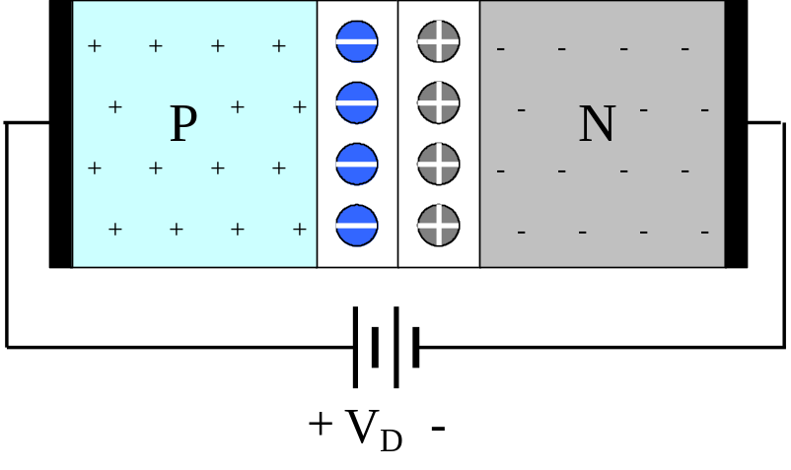
PN-junction Forward Bias
The externally applied voltage reduces the barrier potential in the depletion layer by V_{D} volts.
This allows majority carriers to cross the junction, creating a substantial forward current flow due to diffusion.
When these majority carriers cross the junction, they then become minority carriers and eventually disappear due to recombination.

Slide 24
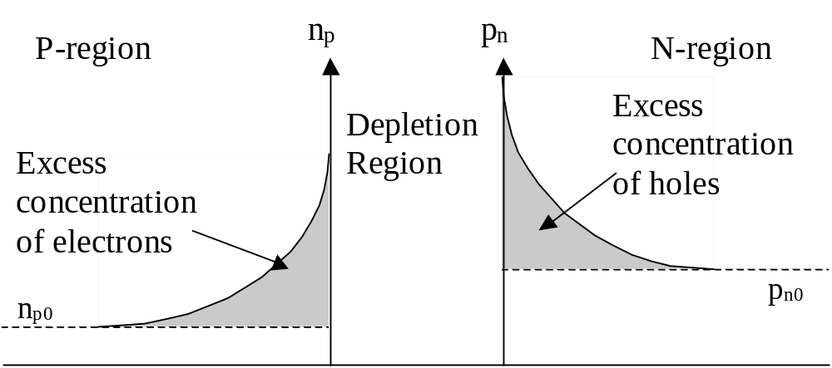
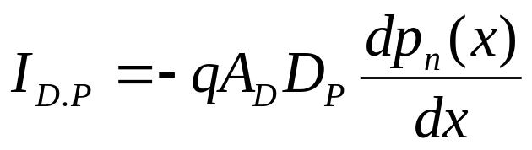
p_{n} ~ hole concentration in N-region
n_{p} ~ electron concentration in P-region
p_{n0}, n_{p0} ~ Thermal equilibrium value
The gradient causes diffusion current to flow

Slide 25
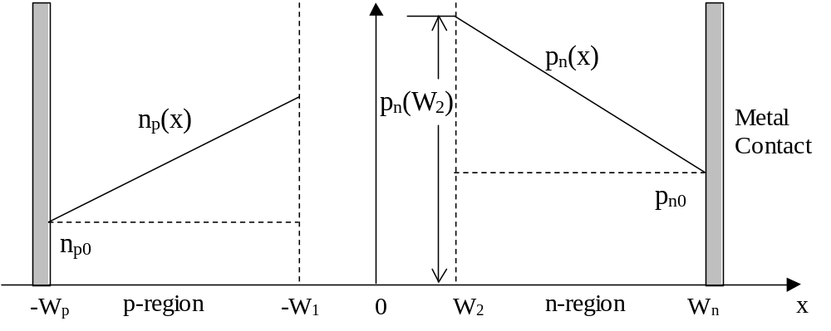
Assuming that we have short bare diodes
⇒ minority carriers do not have sufficient time to recombine & minority charge concentration is linear.

Slide 26
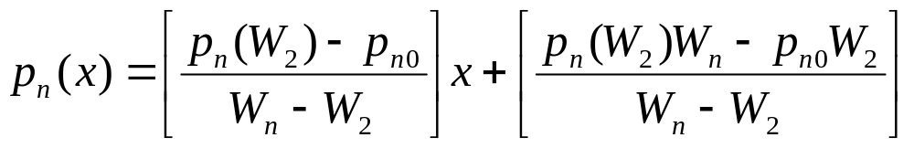
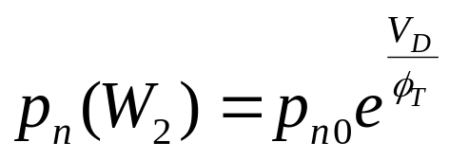
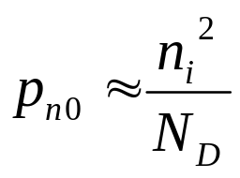
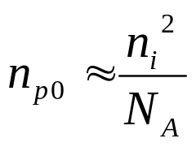
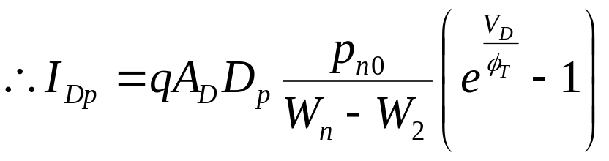
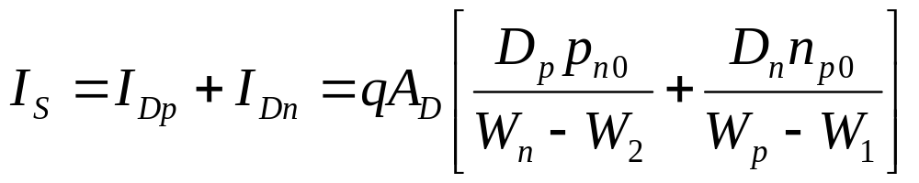

Slide 27
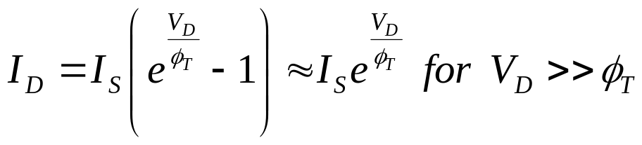
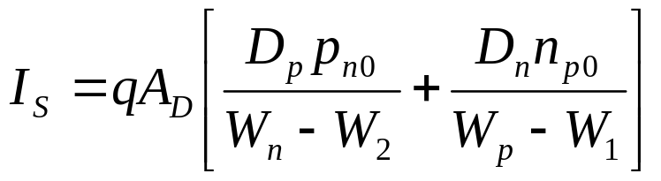
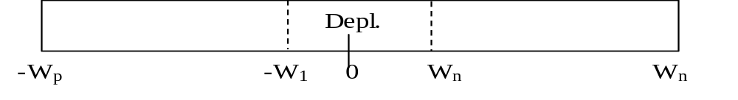
Note: current is due to the movement of minority carriers electrons in p-type & holes in n-type.
q ~ electronic charge
A_{D} ~ cross sectional area of the diode
D_{n}, D_{p} ~ diffusion constants
n_{p0}, (p_{no}) ~ equilibrium minority electron (hole) concentration in P-region (N-region).

Slide 28
Under Reverse Bias Condition
Trying to push electrons into n-side which is already full of electrons.
Very little current flows
I_{D} → -I_{S} for |V_{D}|>>φ_{T}

Slide 29
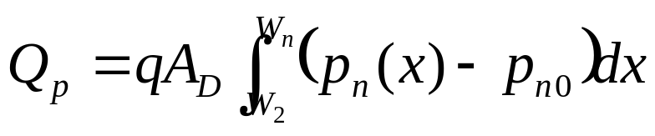
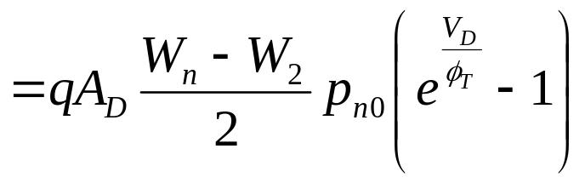
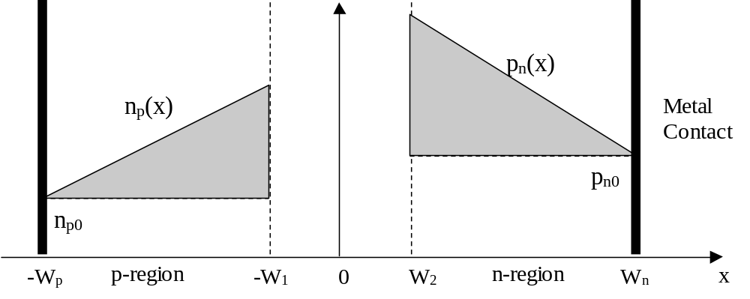
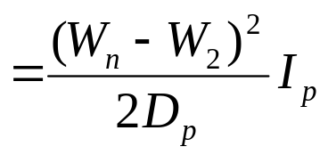
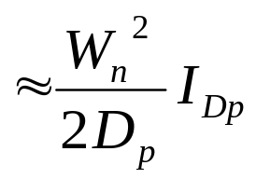
Diffusion Capacitance
Under forward bias conditions there is minority charge stored in the n & p regions
⇒ capacitance which is proportional to the current flow
Hole component of the diode current

Slide 30
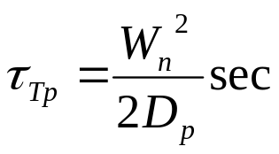
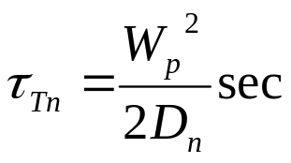
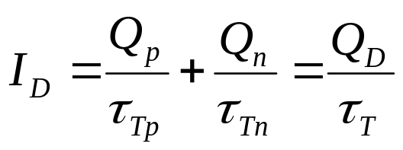
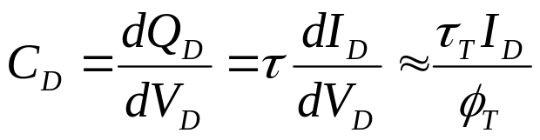
let
τ_{Tp}, τ_{Tn} ~ mean transit time
Note: linear dependence on I_{D}

Slide 31
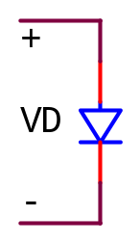
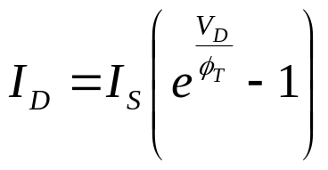
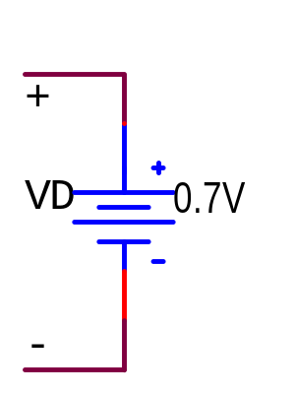

First Order Diode Models for Manual Analysis
Ideal diode model
↓
First order diode model
When V_{D} ≤ V_{DON}
I_{D} = 0
When V_{D} > V_{DON}??
I_{D} > 0 ⇒ V_{D} = V_{DON}

Slide 32

Second Order Diode Model
(Used for Computer Analysis)
Small series resistance representing the resistance seen by the electrons as they go through the neutral base regions.
Variable current source
Variable nonlinear caps

Slide 33

EXAMPLE 1
Using the simple Diode Model with V_{DON}=0.7V
Solve for I_{D}
(b) Find I_{D} & V_{D} using the ideal diode equation with I_{S}=10⁻¹⁴A, T=300K

Slide 34

EXAMPLE 2
A piecewise linear model for a non-abrupt diode is proposed as follows:
V
D0
R
D
Ideal Diode
For a non-abrupt diode, the current equation is given as

Slide 35


(A) Choose the parameters of the model s.t. it exactly matches the Diode’s current curves for
Assume T=290ºK⇔17ºC
(B) Calculate the error in milivolts in predicting V_{D} using the piecewise linear model at i_{D}=0.5, 5, and 15mA
 | i_{D} | v_{D} experimental | v_{D} model | Diff
 | 0.5mA
 | 5mA
 | 15mA

Slide 36

EXAMPLE 3a
Find I_{D1}, I_{D2}, I_{R1} & V. Assuming constant voltage drop model for diodes.

Slide 37

EXAMPLE 3b
Find I_{D1}, I_{D2}, I_{R1} & V. Assuming constant voltage drop model for diodes.

Slide 38
Example 4
Find the depletion (junction capacitance) for a diode with reverse biased voltage of 0.5V and 2.5V. Use the following diode device parameters:
    A_{D} = 0.5 μm²
    N_{A} = 10¹⁵ atoms/cm³
    N_{D} = 10¹⁶ atoms/cm³
    N_{i} = 1.5x10¹⁰ /cm³

