Slide 1
Lecture 3
The MOS Transistor
Long Channel Behavior
EE 115C: Digital Electronic Circuits

Slide 2
Metal-Oxide Semi-conductor Field Effect Transistor (MOSFET)
NMOS Cross section View
Source
Drain
Body
Gate
Poly Si
SiO₂
SiO₂
p+
n
n
P substrate

Slide 3
This is a 4 terminal Device
Source Drain Gate Body
Both NMOS and PMOS transistor are available
What’s the difference between NMOS and PMOS?
NMOS: current is carried by electrons moving through an n-type channel
PMOS: current is carried by holes moving through an p-type channel

Slide 4
NMOS
Source
Drain
Body
Gate
D
G
p+
n
n
P substrate
S
Analog Representation
From 115A, you learned Analog Representation already
In 115C, we used Digital Representation
D
G
S
Digital Representation

Slide 5
For PMOS we have a similar representation
PMOS
Source
Drain
Body
Gate
n+
p
p
N substrate
S
S
G
G
D
D
Digital Representation
Analog Representation

Slide 6
How can we determinate which is source or Drain??
B
A
C
If Va >Vc and the NMOS is on
  current flow from A to C ⇒ the electron flow from C to A
From Definition, “source” is the source of electron flow into the channel
Therefore, C is the “Source” while A is Drain
Alternatively: for an NMOS the source is the terminal with the lower potential.

Slide 7
MOSFET Operation
V_{s}
V_{g}
V_{d}
Body
Gate
Source
Drain
p+
n
n
P substrate
Consider V_{s}=V_{d} GND and V_{g} increase
V_{g} ↑ => V_{gate} ↑ => E-field across channel ↑
Electron are stripped away from atoms deep in the substrate and attracted to the channel. Simultaneously, holes are pushed away from the surface and into the substrate

Slide 8
Initially electrons fill the valence band of the acceptor (p-type) atom below the gate to form a depletion layer ( no mobile charge available)
As V_{g} increases further, more electrons are attracted below the gate, thus creating an “Inversion Layer” ( channel) consisting of “Mobile electron” ( electrons that will flow in response to an applied voltage between Drain and source)

Slide 9
Source
Drain
Body
Gate
p+
n
n
P substrate
The voltage V_{gs} = V_{g} – V_{s} at which the channel is initially formed is referred to as the threshold voltage, V_{t}

Slide 10
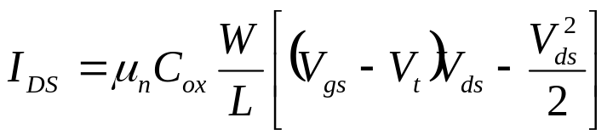
Linear (Triode) Operation
S
G
I
D
D
n
+
–
n
+
L
x
p
-substrate
B
Once the channel has been formed
The application of a potential between the source and the drain causes current to flow
The shape of the channel region changes (it becomes more tapered off)
Under the above set of conditions, the transistor is said to be in the triode (Active) mode. The inversion layer spans the channel and the current is given by:

Slide 11
Gate
Drain
Source
V_{gs}> V_{t}
V_{DS}> 0
V_{s}= 0
n
n
V_{gate} to channel
= V_{gs}= V_{g}
V_{gate} to channel
= V_{gs}- V_{ds}< V_{gs}
Attracts fewer electron
P substrate
Why is the inversion layer tapered as we go from source to drain???
We can consider the channel as a series of resistance.
Less potential drop across gate-channel at drain for Vg ~ fixed

Slide 12
V
GS
G
V
DS
> V
GS
- V
T
S
D
n+
-
V
- V
+
n+
GS
T
Pinch Off
As V_{ds} ↑ we reach a point at which V_{gs}- V_{ds}=V_{t} => no inversion layer near drain
The channel is said to be “pinched off”
as V_{ds} increase further, the pinch-off point starts moving toward the source.
For V_{ds} > V_{gs} – V_{t} the transistor is said to be operated in the saturation or pinch-off

Slide 13
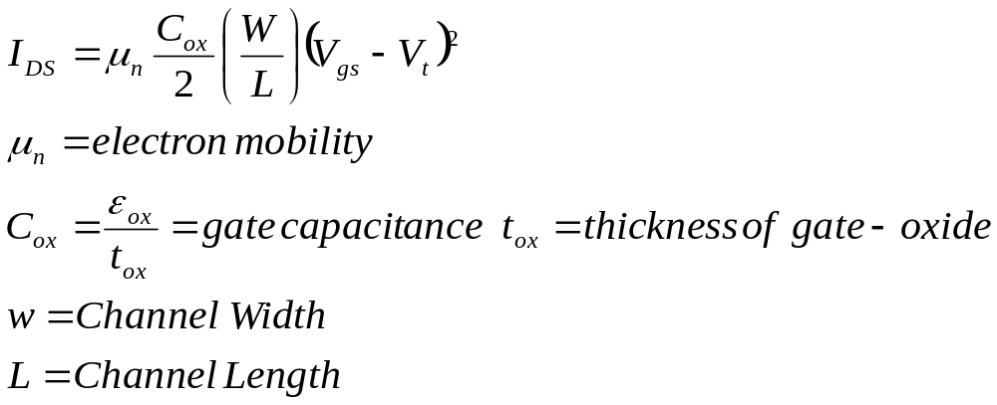
The current equation for a long-channel NMOS in saturation is the following:
W
t_{ox}
L

Slide 14
Long Channel NMOS I-V characteristic:
x 10
-4
6
VGS= 2.5 V
5
Linear
Saturation
4
VGS= 2.0 V
V_{gs}
V_{Ds}
(A)
3
I
D
V_{DS} = V_{GS} - V_{T}
2
VGS= 1.5 V
1
VGS= 1.0 V
0
0
0.5
1
1.5
2
2.5
V
DS
(V)

Slide 15
Current Determinates
For a fixed V_{DS} and V_{GS} (> V_{T}), I_{DS} is a function of
  the distance between the source and drain – L
  the channel width – W
  the threshold voltage – V_{T}
  the thickness of the SiO₂ – t_{ox}
  the dielectric of the gate insulator (SiO₂) – ε_{ox}
  the carrier mobility
    for nfets: μ_{n} = 500 cm²/V-sec
    for pfets: μ_{p} = 180 cm²/V-sec

Slide 16
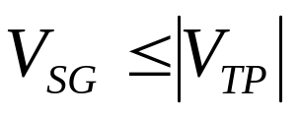
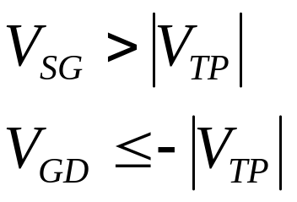
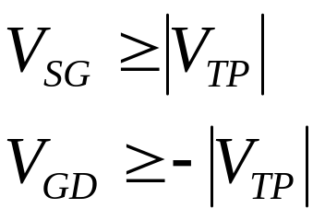
P-Channel Device Enhancement Mode (V_{t}<0)
Equation are the same as the NMOS if the following substitutions are made:
NMOS PMOS
V_{GS} V_{SG}
V_{DS} V_{SD}
V_{Tn} |V_{tp}|
μ_{n} μ_{p}
Cut off Triode Saturation

Slide 17
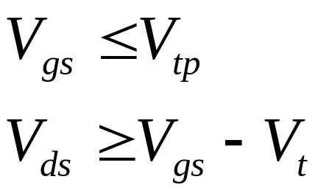

Alternatively for the PMOS use the same equation as for the NMOS
Keep in mind that V_{tp} < 0
Cut off Triode Pinch-off
V_{gs}> V_{tp}

Slide 18
Finite Output Resistance in Saturation
(Channel-length Modulation)
Due to channel length modulation:
The Pinch-off point moves as a function of V_{DS}
I_{d} changes as a function of V_{DS}
i_{d}
V_{dsat}
V_{drop}
V_{dsat}=V_{gs}-V_{t}
V_{drop}= V_{ds}-V_{dsat}
V_{ds}
-V_{A}= -1/λ

Slide 19
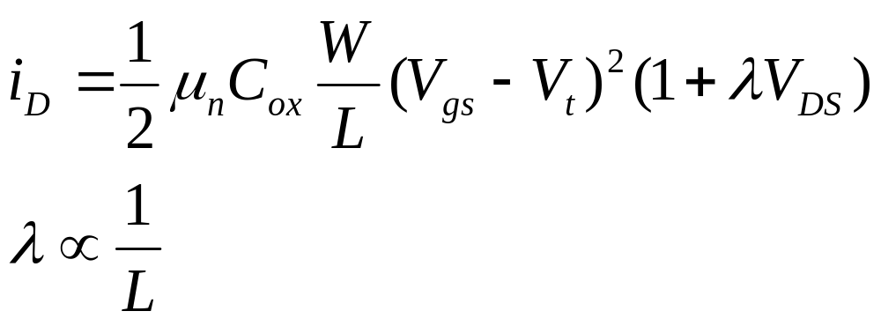
Modified Current equation in Saturation
λ- empirical constant referred to as the channel length
modulation

Slide 20
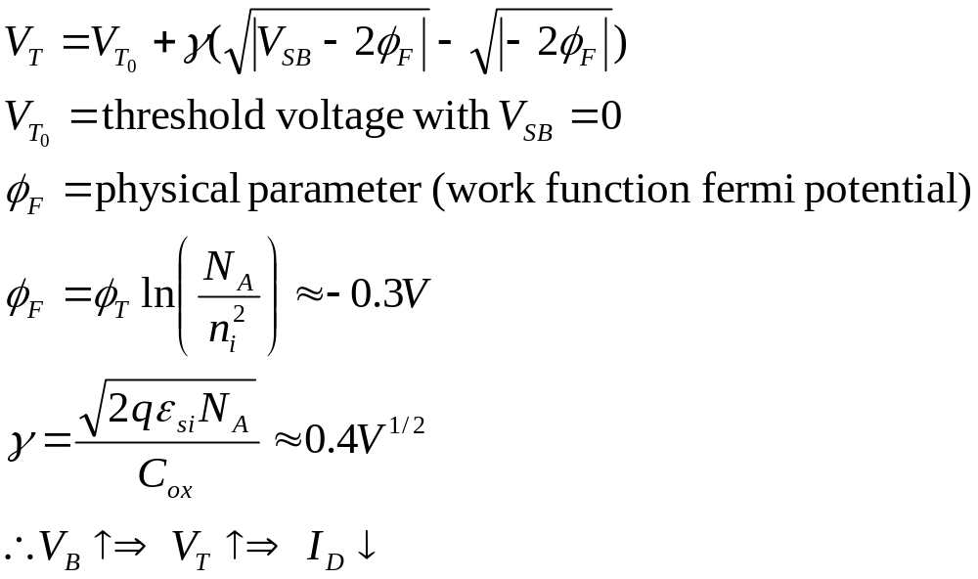
The Body Effect
For an NMOS
The substrate is usually connected to the most negative supply
The Substrate behaves like a second gate
i.e. The channel width can be controlled by the substrate voltage V_{B}
The Threshold Voltage was defined as the gate-source voltage required to induce a channel when V_{SB}=0. For V_{SB} not equal to zero we define:

Slide 21
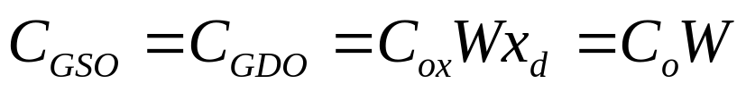
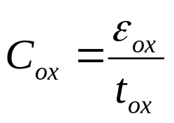
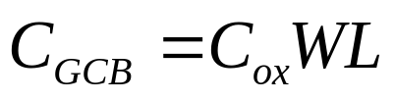
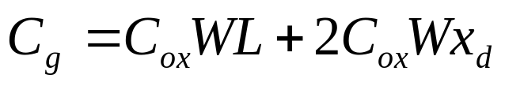
MOS Capacitance in Cutoff
Lateral diffusion (overlap) capacitance
C_{GSO}
C_{GDO}
where
C_{sb}
C_{gb}
C_{db}
Gate to Channel Capacitance
x_{d}
x_{d}
L
Total Gate Capacitance
W
L_{d}

Slide 22
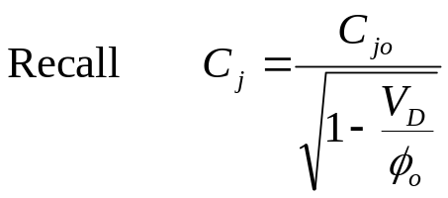

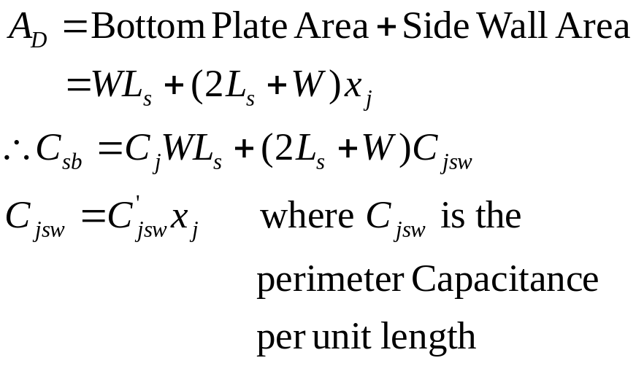
C_{sb} & C_{db} are reverse bias junction capacitance
Src/Drn
Diffusion
x_{j}
What is A_{D} for the source (drain)?
L_{s}
G
C_{gs}
C_{gd}
S
C_{gb}
D
C_{sb}
C_{db}

Slide 23
Linear (Active)
C_{GCB}=0 since a channel exists. However, we have a gate to channel capacitance of C_{ox}WL which is divided equally between C_{GCS} and C_{GCD}
Therefore: C_{GCS}=C_{GCD}=C_{ox}WL/2
Total gate capacitance C_{g} = C_{ox} W L + 2C_{ox} Wx_{d}
C_{sb}= C_{db}= C_{j}WL_{s}+(2L_{s}+W)C_{jsw}
G
C_{overlap}
C_{gc}
C_{gd}
C_{overlap}
C_{gs}
S
Inversion Layer
D
C_{sb}
C_{db}

Slide 24
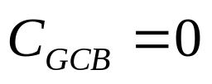
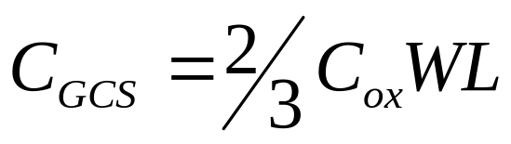
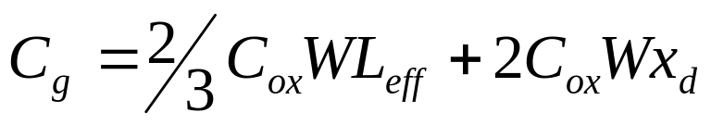
Saturation
Total Gate Capacitance

Slide 25
Average Distribution of Channel Capacitance
Operation Region | C_{GCB} | C_{GCS} | C_{GCD} | C_{GC} | C_{G}
Cutoff | C_{ox}WL | 0 | 0 | C_{ox}WL | C_{ox}WL + 2C_{o}W
Resistive | 0 | C_{ox}WL/2 | C_{ox}WL/2 | C_{ox}WL | C_{ox}WL + 2C_{o}W
Saturation | 0 | (2/3)C_{ox}WL | 0 | (2/3)C_{ox}WL | (2/3)C_{ox}WL + 2C_{o}W
Channel capacitance components are nonlinear and vary with operating voltage
Most important regions are cutoff and saturation since that is where the device spends most of its time
Notes:
In cutoff – all cap in gate to substrate since there is no channel
Linear – substrate is shielded from the gate by the channel, cap is shared equally between S and D
Saturation – Channel pinched off at drain end, cap between gate and drain is approx. zero and so is the gate-body, so all the cap is between the gate and the source.
The large fluctuation of the channel capacitance around VGS = VT is worth remembering (Figure 3.31 that is not included in these notes)
The total gate capacitance is getting smaller with an increased level of saturation

Slide 26
Transistor Capacitance Values for 0.25μ
C_{GSO} = C_{GDO} = C_{ox} x_{d} W = C_{o} W =
C_{GC} = C_{ox} WL =
so C_{gate_cap} = C_{ox}WL + 2C_{o}W =
C_{bp} = C_{j} L_{S} W =
C_{sw} = C_{jsw} (2L_{S} + W) =
so C_{diffusion_cap} =
 | C_{ox} (fF/μm²) | C_{o} (fF/μm) | C_{j} (fF/μm²) | m_{j} | φ_{b} (V) | C_{jsw} (fF/μm) | m_{jsw} | φ_{bsw} (V)
NMOS | 6 | 0.31 | 2 | 0.5 | 0.9 | 0.28 | 0.44 | 0.9
PMOS | 6 | 0.27 | 1.9 | 0.48 | 0.9 | 0.22 | 0.32 | 0.9
Notes:
for class handout

Slide 27
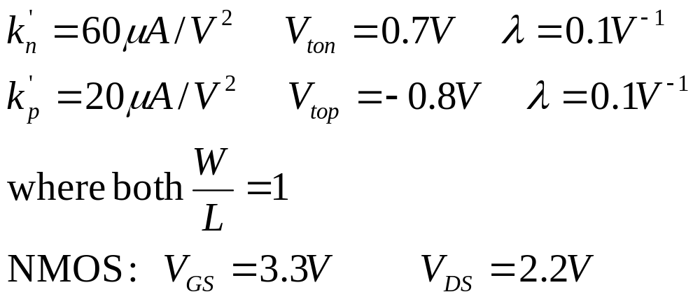
Example 1 (long channel devices)
Determinate the mode of operation and the drain current I_{d}

Slide 28
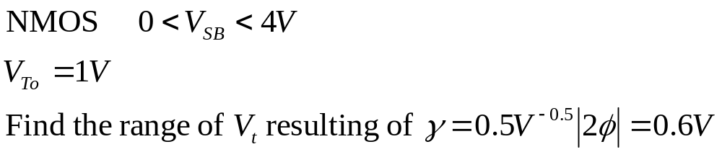
Example 2 (long channel)

Slide 29
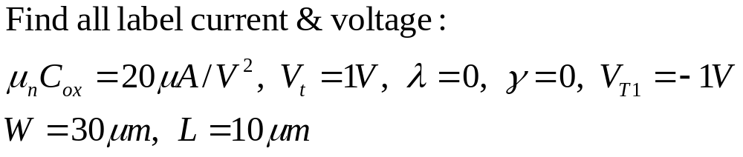
Example 3 (long channel)
3V
I₃
M3
V₃
I₄
M1
I₁
M2
Note: M1 is a depletion-type
NMOS Device with V_{t}=-1V

Slide 30
Example 4
Given an NMOS transistor with t_{ox}=6nm, L=0.24 μm, W=0.36 μm, L_{D}=L_{S}=0.625 μm, , Co=3x10⁻¹⁰ F/m, C_{jo}= 2x10⁻³ fF/m², C_{jswo}=2.75x10⁻¹⁰F/m, and φ_{o}=0.65V
Determine the value of all capacitances with the transistor is in the active region with Vg=3V and Vd=1.5V.

