Slide 1
Lecture 4
The MOS Transistor under
Deep Submicron Channel Conditions
EE 115C: Digital Electronic Circuits

Slide 2
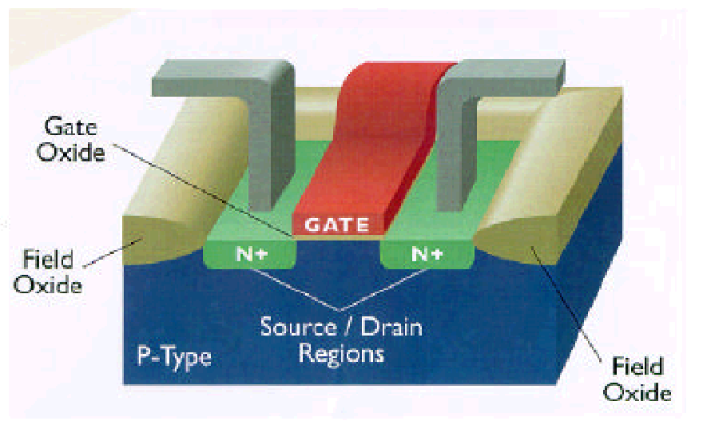
The MOS Transistor
Polysilicon
Aluminum

Slide 3
The NMOS Transistor Cross Section
n areas have been doped with donor ions (arsenic) of concentration N_{D} - electrons are the majority carriers
Gate oxide
Polysilicon Gate
W
Source
Drain
Field-Oxide
(SiO₂)
n+
n+
L
p substrate
p+ stopper
Bulk (Body)
p areas have been doped with acceptor ions (boron) of concentration N_{A} - holes are the majority carriers
Notes:
Starting at the bottom of the design abstraction chart
Gate Oxide – insulator
NMOS – since carriers are electrons (n type carriers)
M – metal; O – oxide; S – semiconductor
Field oxide isolates one device from neighboring devices
Base technology for the semester
0.25 micron transistor length L (drawn separation from source to drain) – 0.24 effective
1.0 micron transistor width W for minimum size transistor
2.5V supply voltage VDD
0.43 (-0.4) threshold voltage for NMOS (PMOS) devices
so
min W/L ratio in max for 250nm technology is 1/.24
View transistor as a switch with an infinite off-resistance and a finite on-resistance

Slide 4
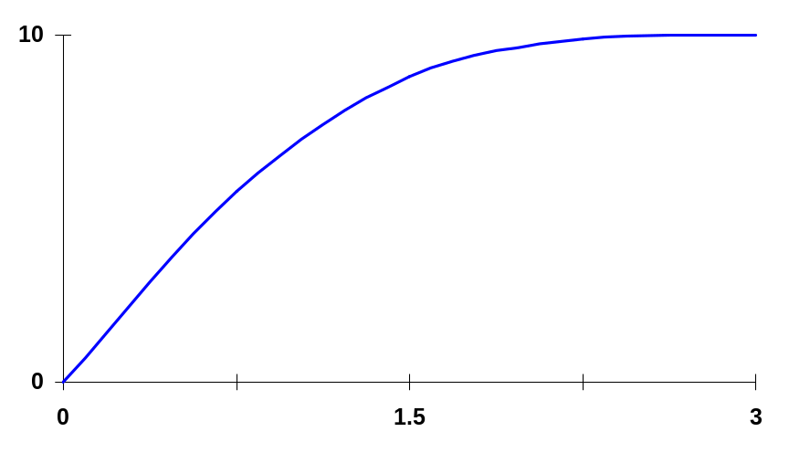
Deep Submicron Short Channel Effects
Behavior of short channel device mainly dominated by velocity saturation
5
υ_{sat} =10⁵
Constant velocity
Velocity saturation – the velocity of the carriers saturates due to scattering (collisions suffered by the carriers)
υ_{n} (m/s)
Constant mobility
(slope = μ)
ξ_{c}=
ξ(V/μm)
For an NMOS device with L of .25μm, only a couple of volts difference between D and S are needed to reach velocity saturation
Notes:
Normally, the velocity of the carriers is proportional to the electric field – carrier mobility is constant.
However, at high field strengths, carriers fail to follow this linear model.
For p-type silicon (nfets), the critical field at which electron saturation occurs is around 1.5 x10**6 V/m (1.5 V/um) and vsat ~ 10**5 m/s
Holes in a n-type silicon saturate at the same velocity, although a higher electric field is needed to achieve velocity saturation.
So velocity saturation effects are less pronounced in pfets.
For a 0.25 micron NMOS device are only about 2 volts between the drain and source are needed to reach velocity saturation

Slide 5
Voltage-Current Relation: Velocity Saturation
For short channel devices
Linear: When V_{DS} ≤ V_{GS} – V_{T}
I_{D} = κ(V_{DS}) k’_{n} W/L [(V_{GS} – V_{T})V_{DS} – V_{DS}²/2]
where
κ(V) = 1/(1 + (V/ξ_{c}L)) is a measure of the degree of velocity saturation
Saturation: When V_{DS} = V_{DSAT} ≥ V_{GS} – V_{T}
I_{DSat} = κ(V_{DSAT}) k’_{n} W/L [(V_{GS} – V_{T})V_{DSAT} – V_{DSAT}²/2]
Notes:
For large L or small VDS, K approaches 1.
For short channel devices, K is small than 1 which means that the delivered current, even in the linear region, is smaller than what would normally be expected!
VDSAT = k(VGT) VGT so further increasing VDS does not yield more current

Slide 6
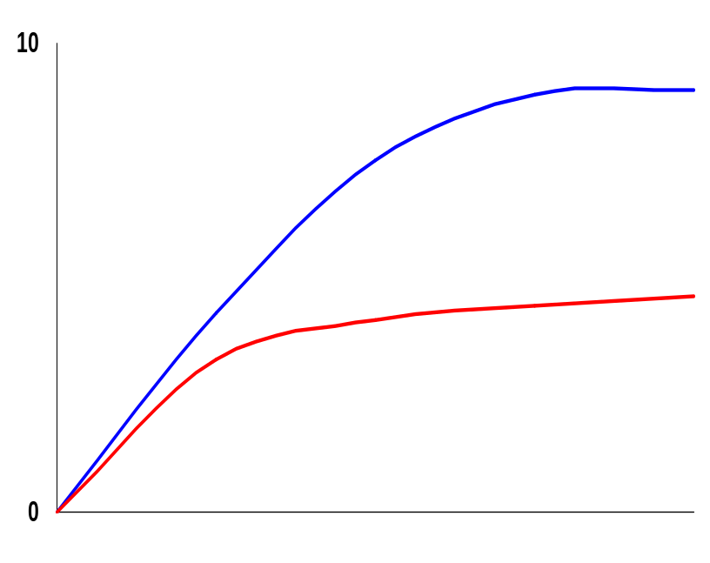
Velocity Saturation Effects
V_{GS} = V_{DD}
Long channel devices
For short channel devices and large enough V_{GS} – V_{T}
V_{DSAT} < V_{GS} – V_{T} so the device enters saturation before V_{DS} reaches V_{GS} – V_{T} and spends more time in the saturation region
Short channel devices
V_{DSAT}
V_{GS}-V_{T}
I_{DSAT} has a linear dependence wrt V_{GS} so a reduced amount of current is delivered for a given control voltage
Notes:
Other effects in play as well – like mobility degradation (that reduces the surface mobility of the carriers wrt bulk mobility)
On the other hand, reducing the supply voltage does not have as significant an effect (as it does in long-channel devices).

Slide 7
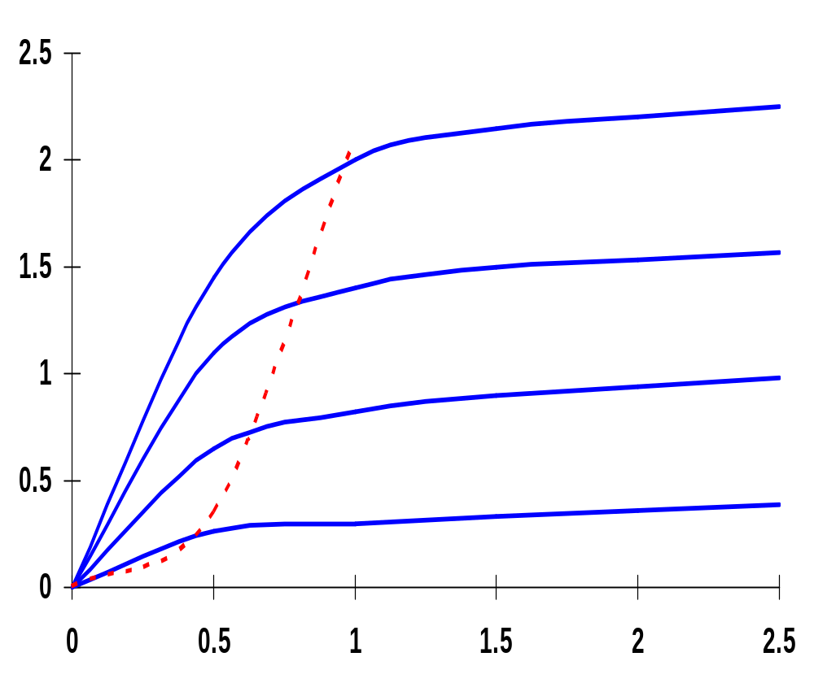
Deep Submicron Short Channel I-V Plot (NMOS)
X 10⁻⁴
Boundary for
Long Chan.
Device
Early Velocity
Saturation
V_{GS} = 2.5V
V_{GS} = 2.0V
I_{D} (A)
Linear
Saturation
V_{GS} = 1.5V
Linear dependence
V_{GS} = 1.0V
V_{DS} (V)
NMOS transistor, 0.25um, L_{d} = 0.25um, W/L = 1.5, V_{DD} = 2.5V, V_{T} = 0.4V
Notes:
Ld is drawn length
Linear dependence of saturation current wrt VGS
Velocity saturation causes device to saturate for substantially smaller values of VDS.
Results in a substantial drop in current drive for high voltage levels.
Eg at VGS = 2.5V and VDS = 2.5V, the drain current of the short channel device is only 40% of the corresponding value of the long channel device (220 uA versus 540 uA)

Slide 8
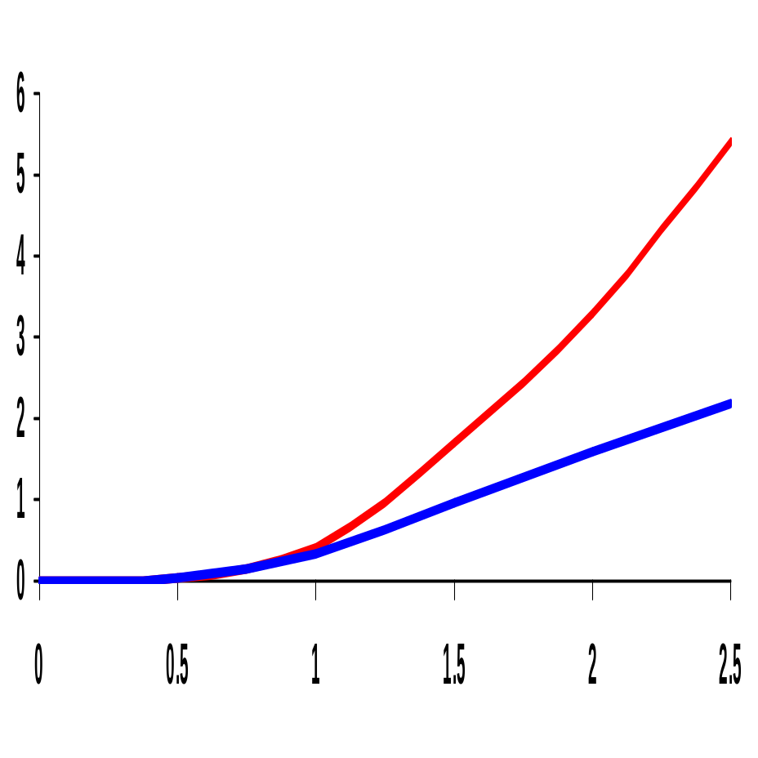
MOS I_{D}-V_{GS} Characteristics
X 10⁻⁴
Linear (short-channel) versus quadratic (long-channel) dependence of I_{D} on V_{GS} in saturation
Velocity-saturation causes the short-channel device to saturate at substantially smaller values of V_{DS} resulting in a substantial drop in current drive
long-channel quadratic
I_{D} (A)
short-channel linear
V_{GS} (V)
(for V_{DS} = 2.5V, W/L = 1.5)

Slide 9
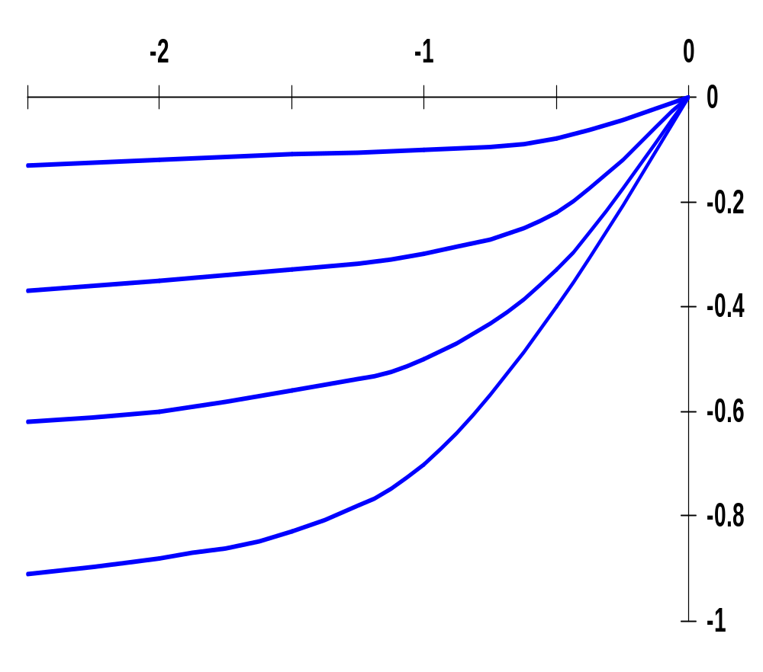
Deep Submicron Short Channel I-V Plot (PMOS)
All polarities of all voltages and currents are reversed
V_{DS} (V)
V_{GS} = -1.0V
V_{GS} = -1.5V
I_{D} (A)
V_{GS} = -2.0V
V_{GS} = -2.5V
X 10⁻⁴
PMOS transistor, 0.25um, L_{d} = 0.25um, W/L = 1.5, V_{DD} = 2.5V, V_{T} = -0.4V
Notes:
All the derived equations hold for PMOS – for PMOS devices the polarities of all voltages and currents are reversed
Due to lower mobility, the maximum current is only 42% of what is achieved by a similar NMOS transistor
Effects of velocity saturation are less pronounced than in NMOS (smaller mobility of holes act electrons)

Slide 10
The MOS Current-Source Model for Manual Analysis
G
I_{D} = 0 for V_{GS} – V_{T} ≤ 0
I_{D} = k’ W/L [(V_{GS} – V_{T})V_{min}–V_{min}²/2](1+λV_{DS}) for V_{GS} – V_{T} ≥ 0
with V_{min} = min(V_{GS} – V_{T}, V_{DS}, V_{DSAT})
and V_{GT} = V_{GS} - V_{T}
I_{D}
S
D
B
Determined by the voltages at the four terminals and a set of five device parameters
 | V_{T0}(V) | γ(V^{0.5}) | V_{DSAT}(V) | k’(A/V²) | λ(V⁻¹)
NMOS | 0.43 | 0.4 | 0.63 | 115 x 10⁻⁶ | 0.06
PMOS | -0.4 | -0.4 | -1 | -30 x 10⁻⁶ | -0.1
Notes:
For the generic 0.25 micron, minimum length device
.4 and -.4 are the body-effect coefficients

Slide 11
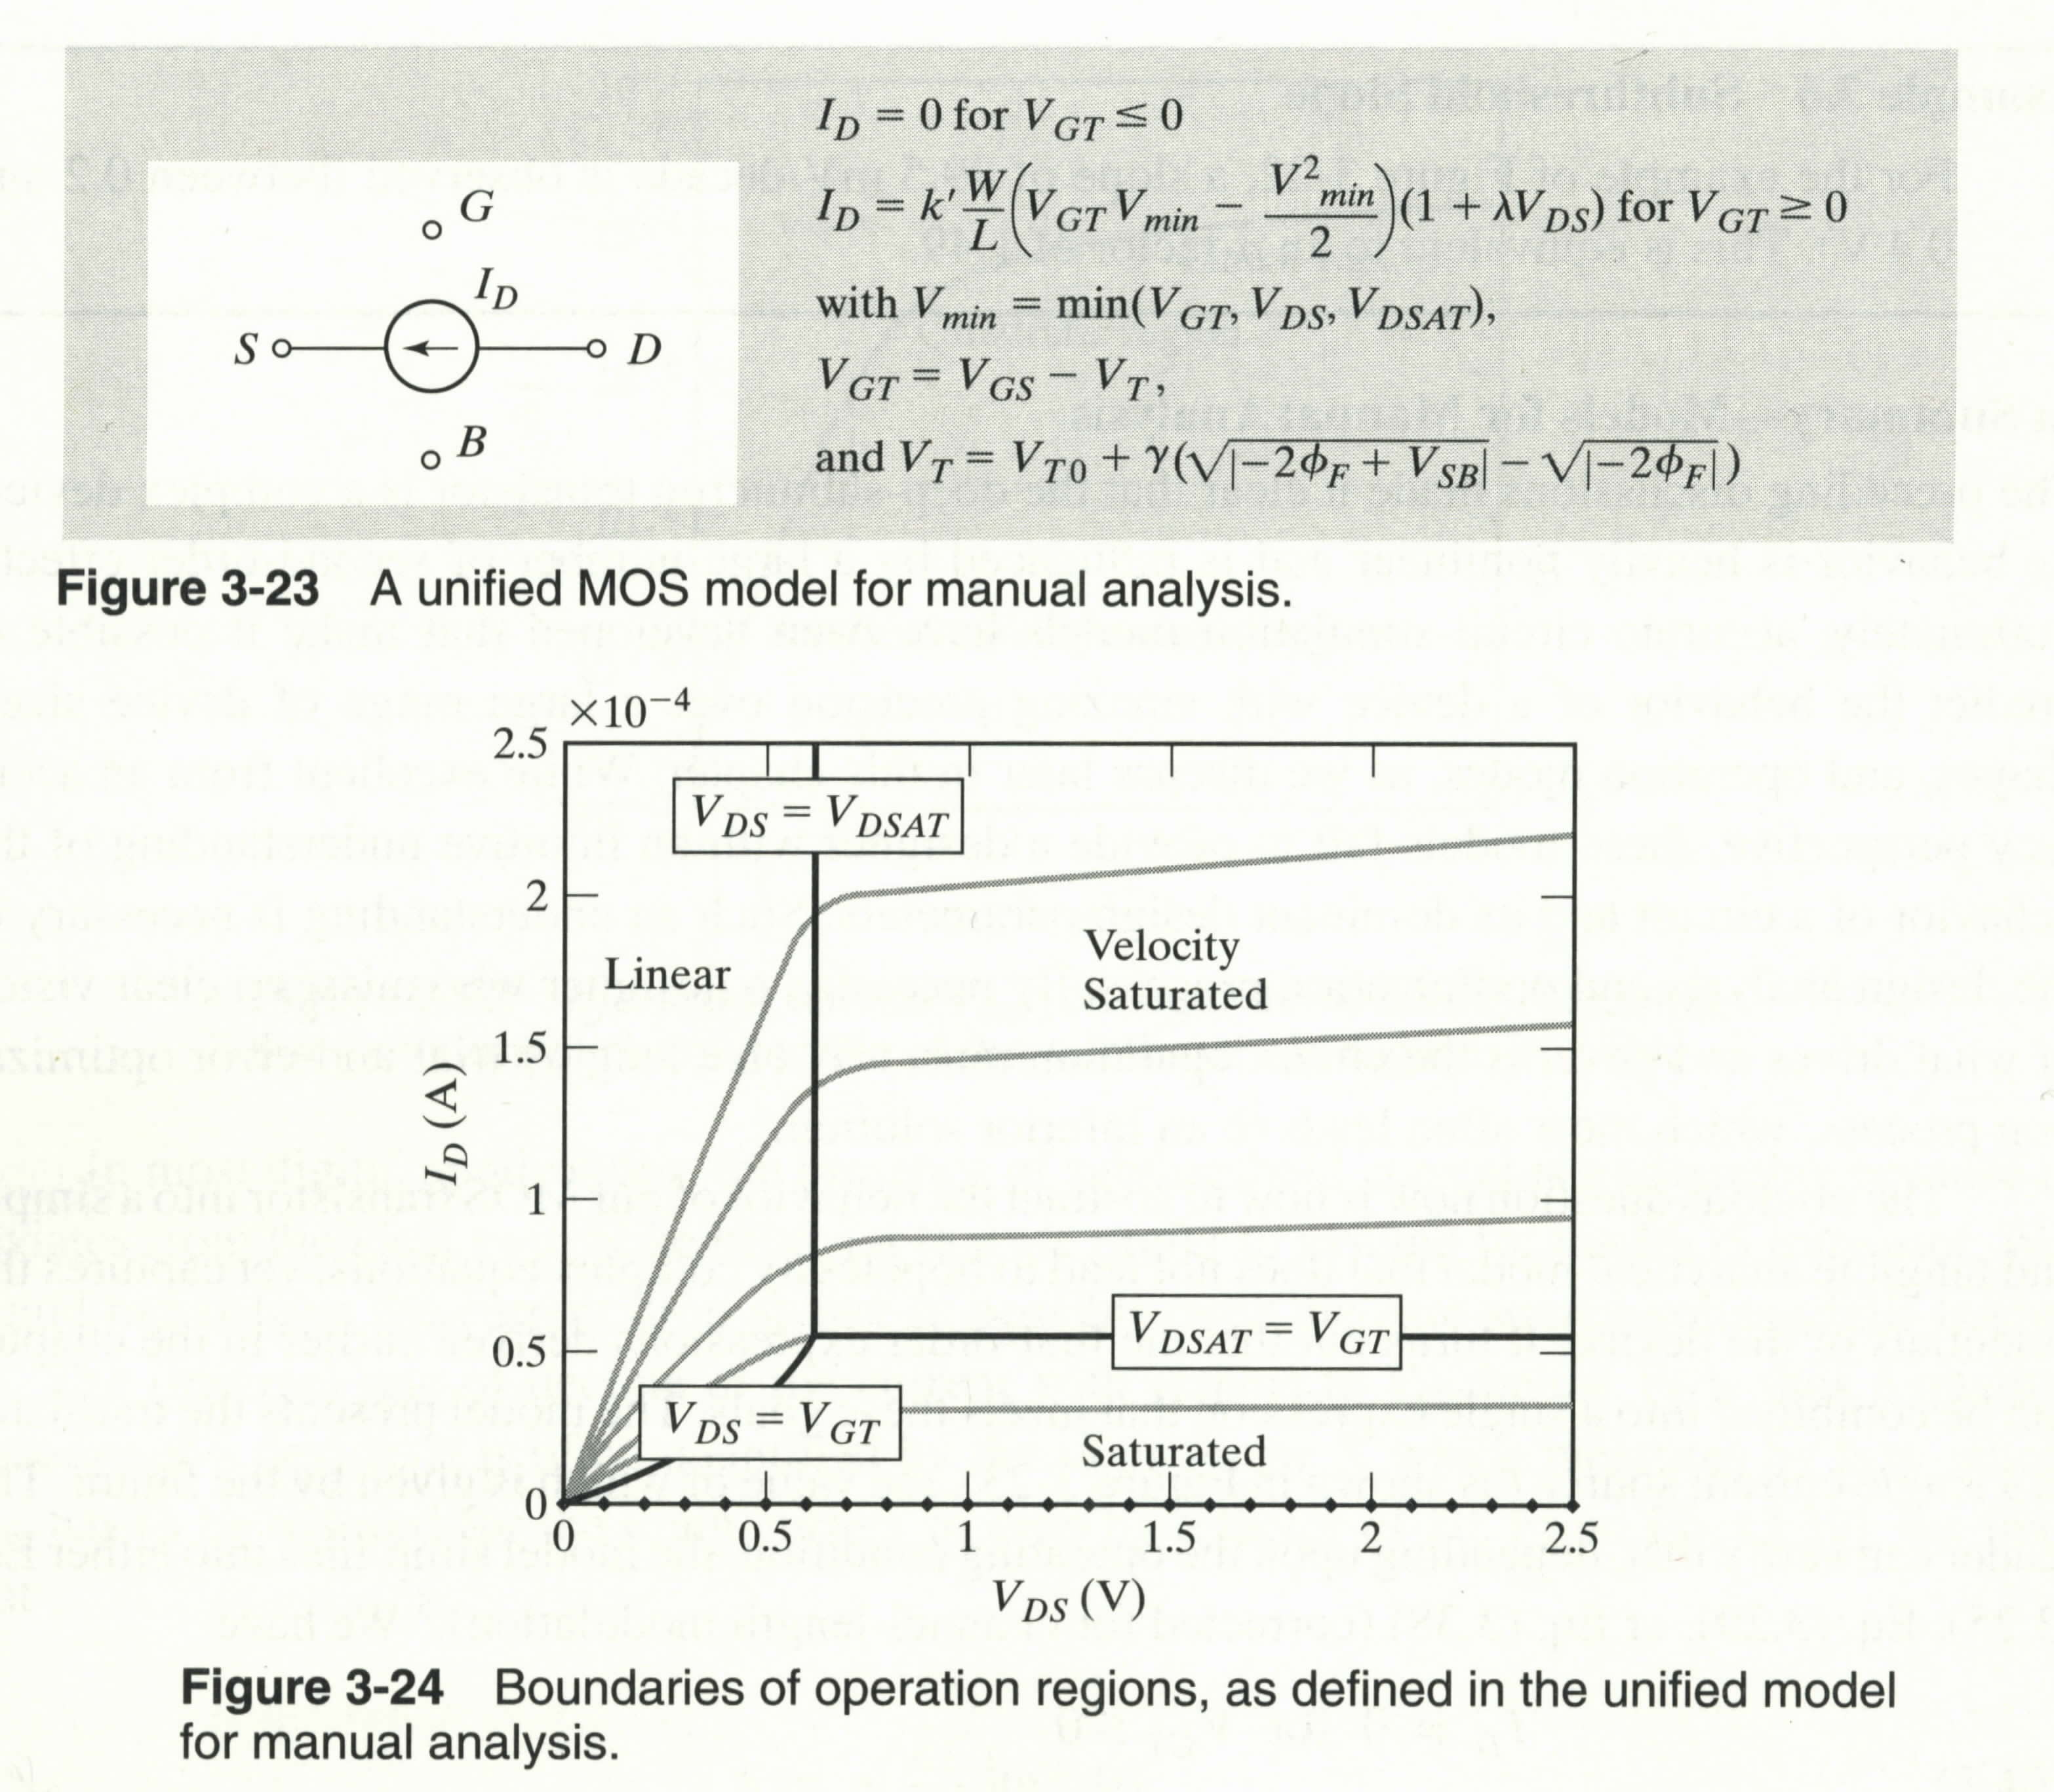
4 Regions of Operation

Slide 12
How to Determine the Region of Operation
If V_{GS}-V_{T} < V_{DSAT}
  The transistor is not sufficiently “turned on” to get into velocity saturation. It could be in one of two modes: linear or Saturation
    V_{DS} < V_{GS} – V_{T} ⇒ Linear
    V_{DS} > V_{GS} – V_{T} ⇒ Saturation
If V_{GS}-V_{T} > V_{DSAT}
    The transistor is either in Velocity Saturation or in linear. Note that Saturation is not possible here since if V_{DS} > VGT, then by default V_{DS} > V_{DSAT}
    V_{DS} > V_{DSAT} ⇒ Velocity Saturation
    V_{DS} < V_{DSAT} ⇒ Saturation

Slide 13
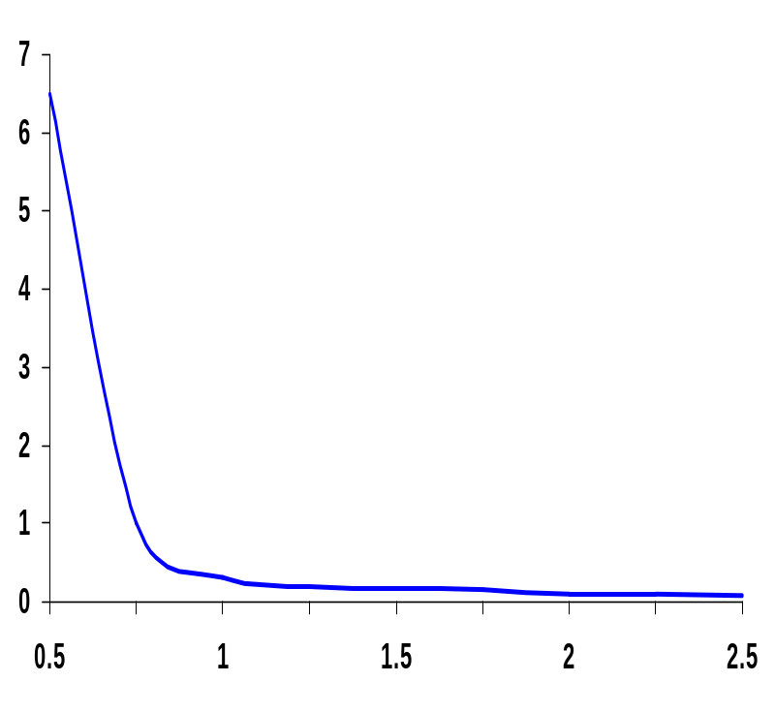
The Transistor Modeled as a Switch
x10⁵
Modeled as a switch with infinite off resistance and a finite on resistance, R_{on}
V_{GS} ≥ V_{T}
R_{on}
S
D
Resistance inversely proportional to W/L (doubling W halves R_{on})
For V_{DD}>>V_{T}+V_{DSAT}/2, R_{on} independent of V_{DD}
Once V_{DD} approaches V_{T}, R_{on} increases dramatically
R_{eq} (Ohm)
(for V_{GS} = V_{DD}, V_{DS} = V_{DD} →V_{DD}/2)
V_{DD} (V)
V_{DD}(V) | 1 | 1.5 | 2 | 2.5
NMOS(kΩ) | 35 | 19 | 15 | 13
PMOS (kΩ) | 115 | 55 | 38 | 31
R_{on} (for W/L = 1)
For larger devices divide R_{eq} by W/L
Notes:
Switch with an infinite off-resistance and a finite on-resistance
Unfortunately, Ron is time-variant, non-linear and depends on operating point
Once the supply voltage approaches VT, a dramatic increase in resistance is observed
Table gives equivalent resistance Req (W/L =1) in 0.25 micron CMOS process (with L = Lmin).
For larger devices, divide Req by W/L = doubling the transistor width halves the resistance

Slide 14
Equivalent Resistance When Charging a Cap.
Equivalent resistance when d is changing capacitance.
Assume that supply voltage is substantially greater than VDsat => Transistor stays in velocity saturation for the entire duration of the transition.
V_{DS}:V_{DD}->V_{DD}/2
V_{DD}
C

Slide 15
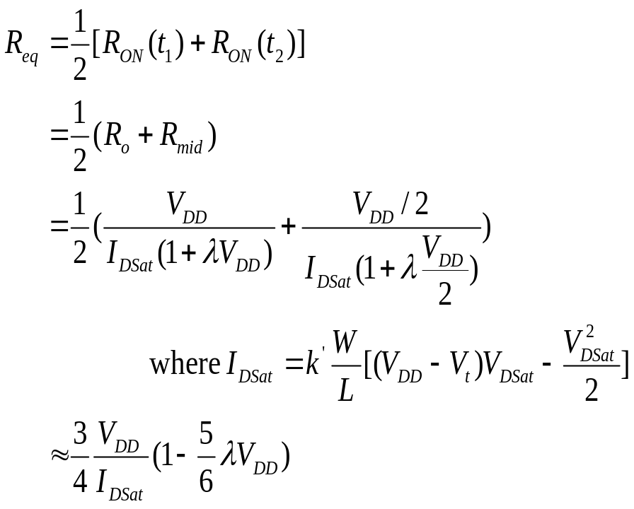
The transistor can be modeled with an equivalent resistance equal to the average resistance of the device over the interval
V_{GS}=V_{dd}
I_{d}
t₂
R_{mid}
R_{o}
V_{DD}/2
V_{DD}
Resistance inversely proportional to W/L
Resistance is independent of supply for V_{DD} >> V_{T}+V_{DSAT}

Slide 16
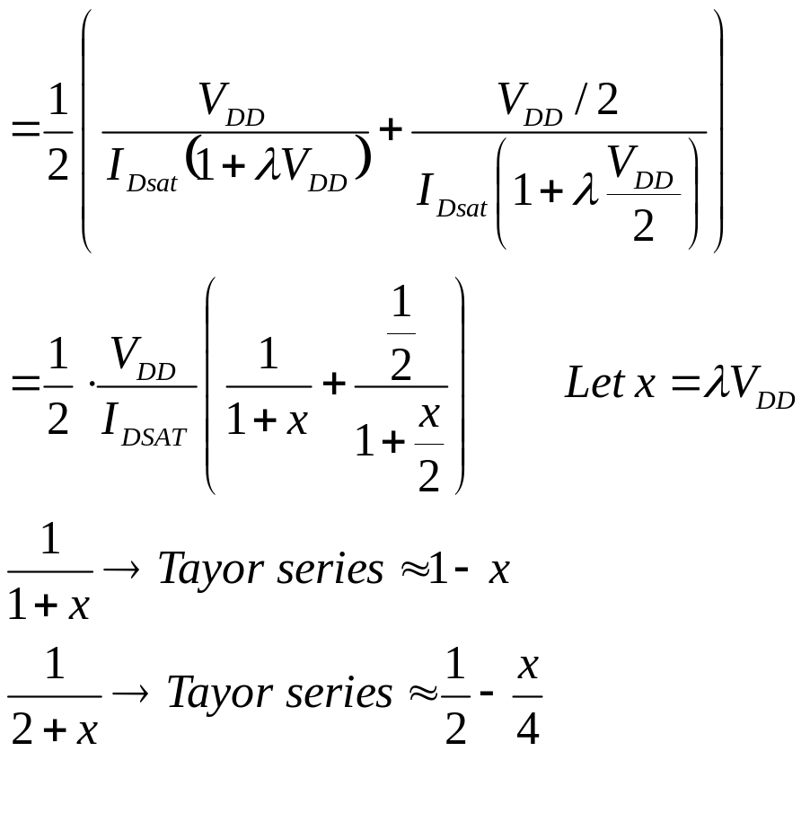
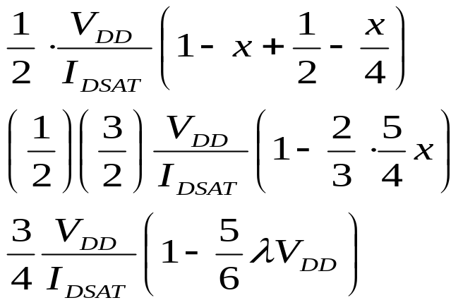
Aside
The following is the approximation made in the previous
VG to arrive at the final expression for Req

Slide 17
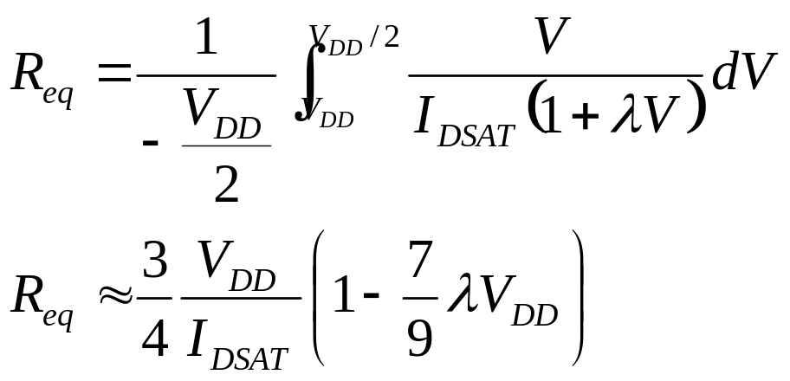
More Accurate Expression for R_{eq}
Average resistance as VDS goes from VDD to VDD/2
Why only integrate to VDD/2?
  Equivalent to the switching point of the following gate
  Delay of a gate is measured from the 50% point of the input transition to the 50% point of the output transition.

Slide 18
Other (Submicon) MOS Transistor Concerns
Velocity saturation
Subthreshold conduction
  Transistor is already partially conducting for voltages below V_{T}
Threshold variations
  In long-channel devices, the threshold is a function of the length (for low V_{DS})
  In short-channel devices, there is a drain-induced threshold barrier lowering at the upper end of the V_{DS} range (for low L)
Parasitic resistances
  resistances associated with the source and drain contacts
Latch-up
G
S
D
R_{S}
R_{D}
Notes:
Subthreshold conduction - the transition from on to off is not abrupt, but gradual

Slide 19
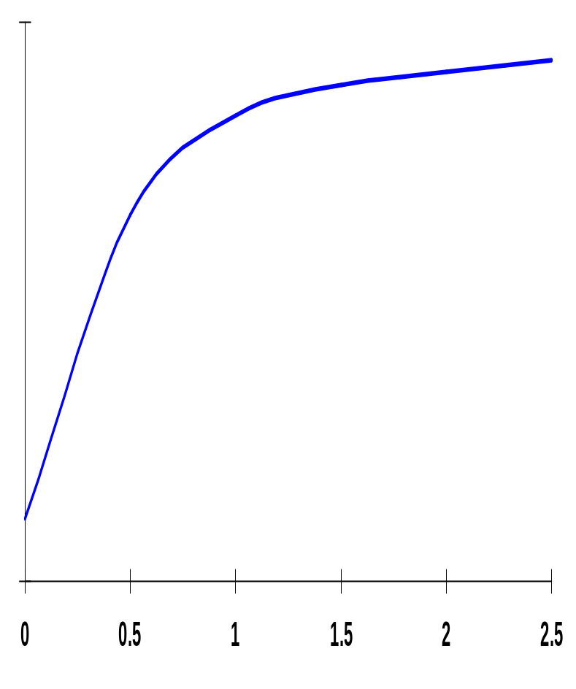
Subthreshold Conductance
10⁻²
Linear region
Transition from ON to OFF is gradual (decays exponentially)
Current roll-off (slope factor) is also affected by increase in temperature
S = n (kT/q) ln (10)
(typical values 60 to 100 mV/decade)
Has repercussions in dynamic circuits and for power consumption
Quadratic region
I_{D} (A)
Subthreshold exponential region
V_{T}
10⁻¹²
V_{GS} (V)
I_{D} ~ I_{S} e ^{(qV}GS^{/nkT)} where n ≥ 1
Notes:
Log scale
Presence of subthreshold current is undesirable because it deviates from the ideal switch-like behavior.
Slope factor – measures by how much VGS has to be reduced for the drain current to drop by a factor of 10.
IS and n are empirical parameters, with n >= 1 and typically ranging around 1.5. For an ideal transistor with the sharpest possible roll-off, n = 1 (where S = 60 mV/decade which means that the subthreshold current drops by a factor of 10 for a reduction in VGS of 60mV). Unfortunately, n is more like 1.5 for actual devices (so S = 90 mV/decade).. The current roll-off is further decreased by a rise in the operating temperature.
The value of n is determined by the intrinsic device topology and structure. Reducing its value requires a different processing technology (e.g., SOI).

Slide 20

Example 1
Given the table below and V_{DSAT}=-1V, -2φ_{F}=-0.6V. Determine the following:
  Type of transistor (NMOS or PMOS)?
  V_{to}, γ, λ, region of operation
Meas. No. | V_{GS} (V) | V_{DS} (V) | V_{SB} (V) | I_{D} (μA) | Region of Opn.
1 | -2.5 | -2.5 | 0 | -84.375
2 | 1 | 1 | 0 | 0.0
3 | -0.7 | -0.8 | 0 | -1.04
4 | -2.0 | -2.5 | 0 | -56.25
5 | -2.5 | -2.5 | -1 | -72.0
6 | -2.5 | -1.5 | 0 | -80.625
7 | -2.5 | -0.8 | 0 | -66.56

Slide 21
Example 2
For a deep submicron transistor with L=0.25 μm. Find W such that V_{x} = 1.5V. Use the PMOS parameters from table 3.2

