Slide 1
Lecture 5
Manufacturing Process
EE 115C: Digital Electronic Circuits

Slide 2
Review: CMOS Inverter
Full rail-to-rail swing ⇒ high noise margins
Low output impedance
High input impedance
No direct path steady-state between power and ground ⇒ no static power dissipation
Propagation delay a function of load capacitance and on resistance of transistors
V_{DD}
V_{in}
V_{out}
C_{L}
Notes:
Decreasing the on-resistance achieved by increasing the W/L ratio of the device

Slide 3
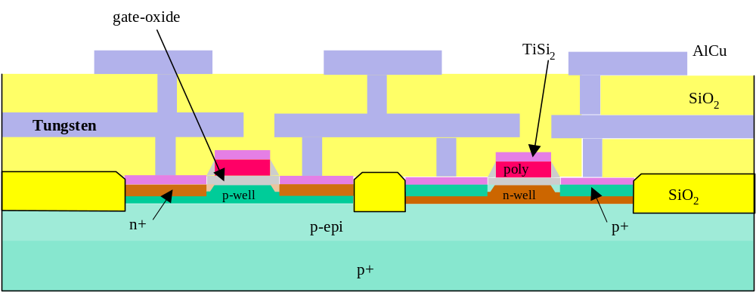
A Modern CMOS Process
Dual-Well Trench-Isolated CMOS Process

Slide 4
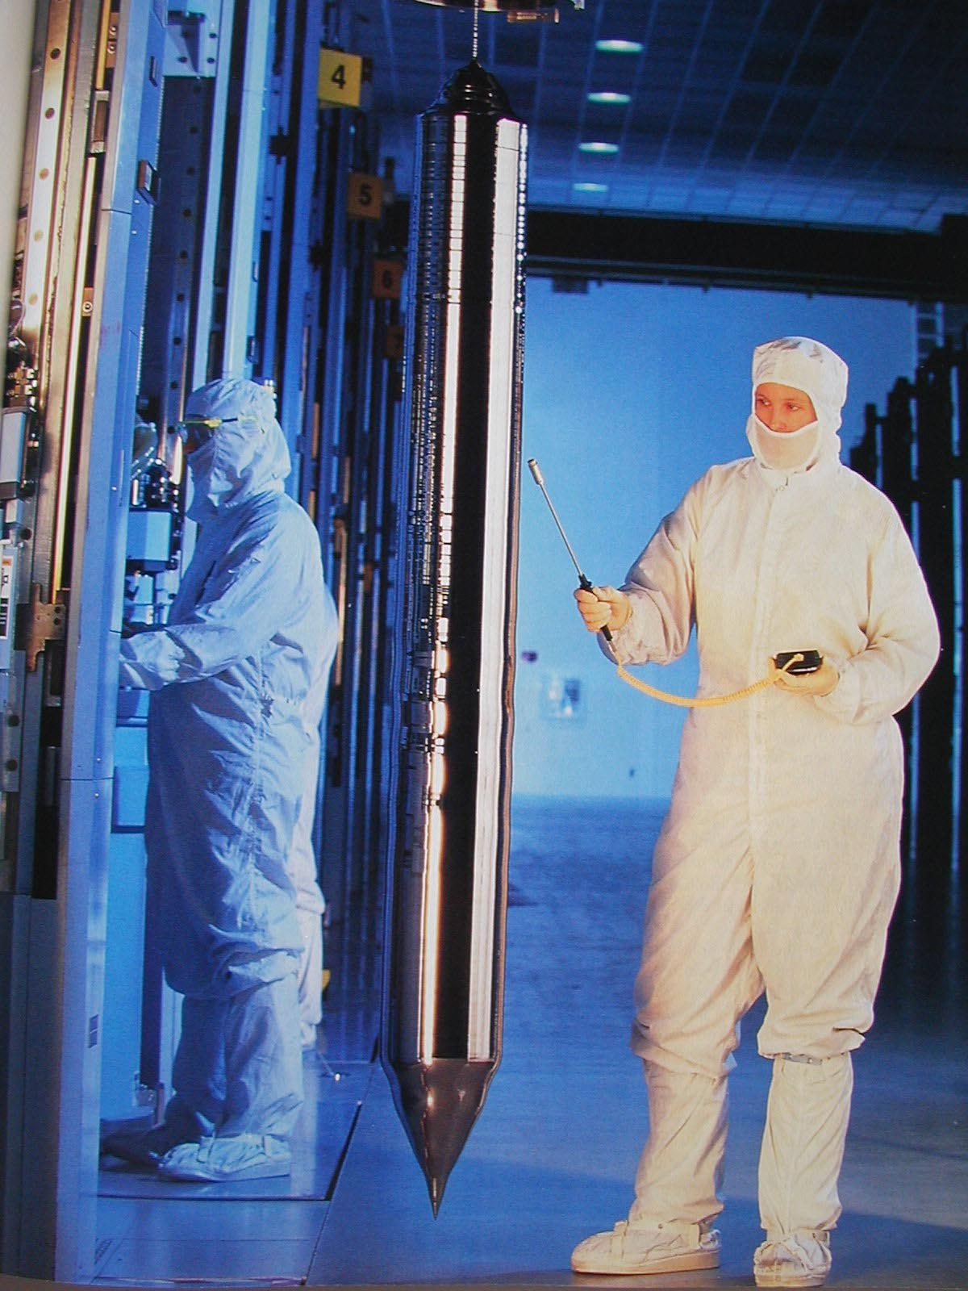
Growing the Silicon Ingot
Grown in diameter of 4”-12”
Sliced into wafers of maximum 1mm thickness
Wafers are processed to develop electronic circuits
From Smithsonian, 2000
Notes:
Base material is a single-crystalline, lightly doped wafer between 4 and 12 inches and a thickness of, at most, 1 mm – obtained from cutting a single-crystal ingot into thin slices. Starting wafer of p- type around 2 x 10**21 impurities/m**3.
The surface is then doped more heavily with a single crystal epitaxial layer grown over the surface before the wafer goes to the processing company.
Important metric – defect density

Slide 5
CMOS Process at a Glance
Define active areas
Etch and fill trenches
One full photolithography sequence per layer (mask)
Built (roughly) from the bottom up
  5 metal 2
  4 metal 1
  2 polysilicon
  3 source and drain diffusions
  1 tubs (aka wells, active areas)
Implant well regions
Deposit and pattern
polysilicon layer
Implant source and drain
exception!
regions and substrate contacts
Create contact and via windows
Deposit and pattern metal layers

Slide 6
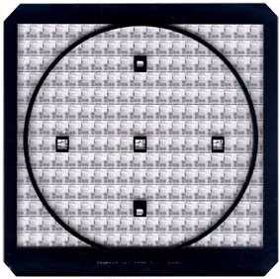
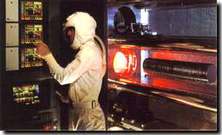
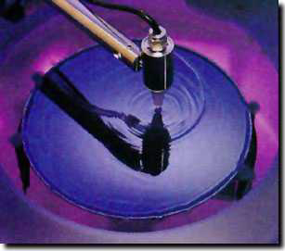
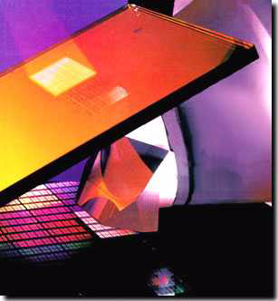
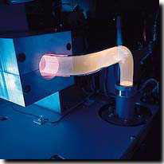
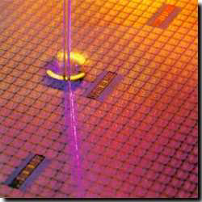
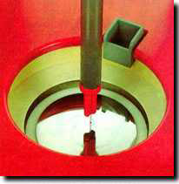
Photolithographic Process
1.Deposit SiO₂ to protect transistor
2.Photoresist positive & negative
(sometimes allows mask to be used twice)
3.Stepper exposure: expose photoresist to UV light through mask to harden/soften photoresist
optical mask
oxidation
stepper exposure
8. Remove exposed photoresist
photoresist removal (ashing)
photoresist coating
photoresist development
7. Diffusion implantation growth, deposition, etc.
process
step
4.Remove unexposed
photoresist
spin, rinse, dry
acid etch
5.Etch the SiO₂
Exposed by removed photoresist
6. Wipe it clean

Slide 7
Patterning - Photolithography
Oxidation
Photoresist (PR) coating
Stepper exposure
Photoresist development and bake
Acid etching Unexposed (negative PR) Exposed (positive PR)
Spin, rinse, and dry
Processing step Ion implantation Plasma etching Metal deposition
Photoresist removal (ashing)
UV light
mask
SiO₂
PR
Notes:
Same sequence patterns the complete surface of the wafer. Hence it is a very parallel process transferring hundreds of millions of patterns to the wafer surface simultaneously making cheap manufacturing of complex circuits possible.
1 – deposit thin layer of SiO2 by exposing it to a mixture of high-purity oxygen and hydrogen at 1000C
2 – light-sensitive polymer evenly applied while spinning the wafer to a thickness of 1 micron; polymers cross-link when exposed to light making the affected region insoluble (negative PR) or original insoluable, soluable after exposure (positive PR). COST OF MASKS IS INCREASING QUITE RAPIDLY WITH SCALING OF TECHNOLOGY – A REDUCTION OF MASKS IS OF HIGH PRIORITY!
3 – glass mask containing patter brought in close proximity to the wafer. Mask is transparent in regions we want to process and opaque elsewhere (positive PR). Combination exposed to UV light. Where mask is transparent, photoresist becomes soluable. Dimensions of features is approaching the wavelength of optical light sources (we’re good up to 0.1 micron). Will eventually move to X-ray or electron-beam (much less cost effective).
4 – Exposed photoresist is removed in a acid or base wash, then wafer is “soft-baked” to harden remaining PR
5 – Exposed material (SiO2) is removed via acid, base, and caustic solution wash.
6 – SRD – number of dust particles per cubic foot of air in clean room ranges between 1 and 10
8 – high-temperature plasma is used to selectively remove the remaining photoresist

Slide 8
Example of Patterning of SiO₂
Chemical or plasma
Si-substrate
etch
Hardened resist
Silicon base material
SiO
2
Photoresist
Si-substrate
SiO₂
Si-substrate
4. After development and etching of resist, chemical or plasma etch of SiO₂
1&2. After oxidation and deposition of negative photoresist become hard where light does shine (not covered by mask)
Hardened resist
SiO₂
Si-substrate
UV-light
Patterned
5. After etching
optical mask
Exposed resist
SiO₂
Si-substrate
Si-substrate
8. Final result after removal of resist
3. Stepper exposure

Slide 9
Diffusion and Ion Implantation
Area to be doped is exposed (photolithography)
Diffusion
or
Ion implantation
Notes:
Needed for well, source and drain regions, doping of polysilicon, adjustment of thresholds
Diffusion – wafer placed in quartz tube embedded in a furnace (900 to 1100 C). Gas containing dopant is introduced in the tub. Dopands diffused into the exposed surface both vertically and horizontally. Final dopant concentration is highest at surface and decreases in a gaussian profile deeper in the material
Ion implantation – Dopants are introduced as ions into the material by sweeping a beam of purified ions over the surface - acceleration determines how deep ions will penetrate and the beam current and exposure time determine dosage. Independent control of depth and dosage – ion implantation has largely displaced diffusion. However, has a side effect of causing lattice damage to substrate, so usually follow with an annealing step (wafer heated to 1000C for 15 to 30 minutes and allowed to cool slowly). Heating vibrates atoms and allows the bonds to reform.

Slide 10
Deposition and Etching
1. Pattern masking (photolithography)
2. Deposit material over entire wafer
CVD (Si₃N₄)
chemical deposition (polysilicon) sputtering (Al)
3. Etch away unwanted material wet etching
dry (plasma) etching
Notes:
Needed for insulating SiO2, silicon nitride (sacrificial buffer), polysilicon, metal interconnect
CVD – chemical vapor deposition uses a gas-phase reaction with energy supplied by heat at around 850C. Use for, eg, silicon nitride
Chemical deposition – used for polysilicon. flow silane gas over the heated wafer (coated with SiO2) at approx. 650C. Resulting reaction produces a non-crystaline material – polysilicon. Followed by an implant step to increase its conductivity.
Sputtering – used for aluminum. Al evaporated in a vacuum, heat for evaporation delivered by e-bam bombarding.
Etching is then used to selectively form patterns (wires, contact holes). Wet etching using acid or basic solutions – hydrofluoric acid buffered with fluoride is used to etch SiO2. Plasma etching becoming more common. Use plasma molecules in heated chamber to “sandblast” the surface. Gives well-defined directionality to the etching action, creating patterns with sharp vertical contours.

Slide 11
Self-Aligned Gates
Create thin oxide in the “active” regions, thick elsewhere
Deposit polysilicon
Etch thin oxide from active region (poly acts as a mask for the diffusion)
Implant dopant
Notes:
Polysilicon gate is patterned before source and drain are created – thereby actually defining the precise location of the channel region and the locations of the source and drain regions. This allows for very precise positioning of the source and drain relative to the gate.
Note that can’t completely stop lateral diffusion – accounts for difference between drawn transistor dimensions and actual ones

Slide 12
Simplified CMOS Inverter Process
cut line
P-Well process
N-substrate
There is no n-well in this process
N-substrate
P-well
Notes:
n type substrate - p well/tub

Slide 13
P-Well Mask
Mask: Defines the areas where a P-Well is to be placed
NMOS transistors will be in the P-well
SiO₂
Notes:
After p-well use implants to adjust VTn

Slide 14
Active Mask
SiO₂
Photoresist
Active Mask: Define the active transistor areas for both the PMOS and the NMOS transistors
Grow thick field oxide in areas outside the active regions
The active regions need thin gate-oxide
Notes:
Grown thick oxide. Then use active mask to create thin oxide layers over the active areas – where we are going to place the transistors (source, gate, and drain areas)

Slide 15
Poly Mask
SiO₂
Polysilicon
Gate Oxide is thinner due to active mask
Notes:
First used chemical deposition to deposit polysilicon on wafer.
Note thin oxide area for gate oxide - critical (helps determine Vth) doe 0.25 micron technology -> 6.5 to 5.5 microns thick

Slide 16
P+ Select Mask
Note: The etching process in the poly step exposed the substrate
The P+ Mask now selects the regions where PMOS transistors are to be formed
Notes:
Followed by diffusion (ion implant) to build pfets source and drain areas

Slide 17
N+ Select Mask
P+ diffusion of PMOS transistors has been created
N+ Mask defines areas of diffusion for NMOS transistors
Notes:
Followed by diffusion (ion implant) to build nfets source and drain areas

Slide 18
Contact Mask
SiO₂
Define contacts for connecting active areas to metal1 (holes through SiO₂ insulation)
Define contacts from Metal
NMOS diffusions
Notes:
After deposition of SiO2 insulator, then contact holes are etched (in this case to make contacts to source and drain regions)

Slide 19
Metal Mask
Notes:
62 processing steps for a double/twin tub CMOS process!!
tanqueray.eecs.berkeley.edu/~ehab/inv.html

Slide 20
A Modern CMOS Process
Dual-Well Trench-Isolated CMOS
gate oxide
field oxide
Al (Cu)
SiO₂
TiSi₂
tungsten
p well
n well
SiO₂
p-epi
n+
p+
p-
Notes:
dual-well approach uses both n- and p- wells grown on top of a epitaxial layer(using trench isolation areas of SiO2)

Slide 21
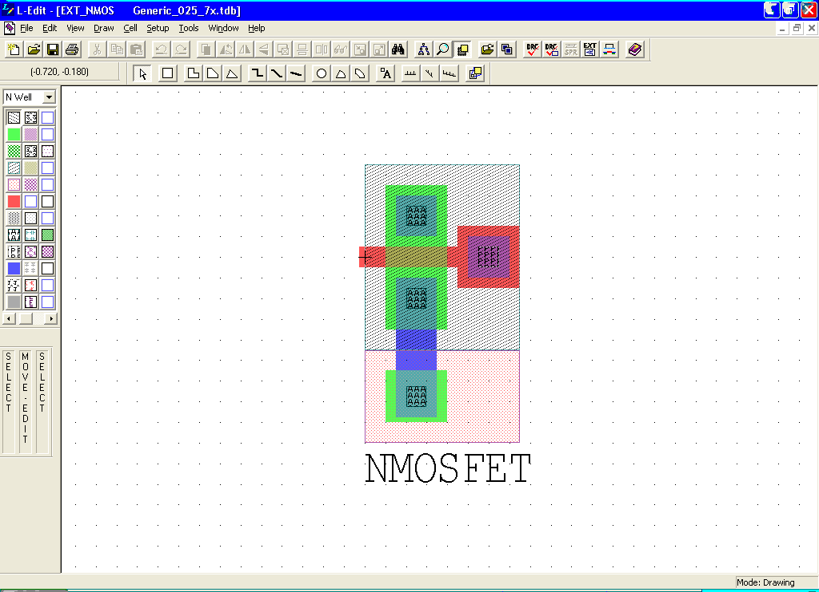
Layout Editor: L-Edit

Slide 22
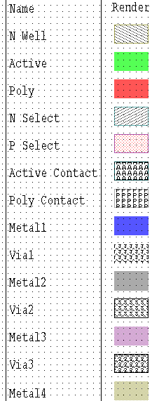
L-Edit Layer Representation
N-Well – for PMOS only
Active – active areas on/in substrate
  Poly (gates), transistor channels, source and drain diffusions
Poly – overlap with active to define the transistors (gate)
Select – overlap with active to define the n+ (for N-select) or the p+ (P-select) regions
Contacts
  Active Contact: Active to Metal1
  Poly Contact: Poly to Metal1
Metals and vias/contacts between the interconnect levels
  Note that Metal4 connects only to Metal3, Metal3 only to Metal2, Metal2 only to Metal1, and Metal1 only to Poly and Active
  Some technologies support “stacked vias”

Slide 23
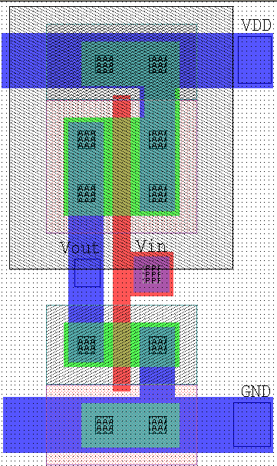
CMOS Inverter L-Edit Layout
metal1
V_{DD}
Body
polysilicon
N-well
P-select
D
S
PMOS (1.2/.24 = 4/1)
In
Out
G
metal1-poly contact
metal1-active
contact
G
NMOS (.6/.24 = 2/1)
G
S
D
S
IN
B
D
OUT
Body
N-select
D
G
B
S
GND

Slide 24
Design Rules
Interface between the circuit designer and process engineer
Guidelines for constructing process masks
Unit dimension: minimum line width
  scalable design rules: lambda parameter
  absolute dimensions: micron rules
Rules constructed to ensure that design works even when small misalignment of masks occur during the fabrication process
A complete set includes
  set of layers
  intra-layer: relations between objects in the same layer
  inter-layer: relations between objects on different layers

Slide 25
Why Have Design Rules?
To be able to tolerate some level of fabrication errors such as
Mask misalignment
Dust
Process parameters (e.g., lateral diffusion)
Rough surfaces
Notes:
Motivation for design rules – next slide

Slide 26
Intra-Layer Design Rule Origins
Minimum dimensions (e.g., widths) of objects on each layer to maintain that object after fabrication
  minimum line width is set by the resolution of the patterning process (photolithography)
Minimum spaces between objects (that are not related) on the same layer to ensure they will not short after fabrication
0.36 micron
0.18
0.36 micron
0.18
Notes:
why would the spacing of the active (n) area be different that drawn? - due to lateral diffusion

Slide 27
Intra-Layer Design Rules
N-Well
0.36
Well
0.72
Polysilicon
1.44
0.24
0.36
0.36
Active
Metal1
Contact
or Via
0.24
0.36
Hole
0.36
0.48
0.24
0.48
Metal2
Select
0.48
0.36
*All in micron (μm)

Slide 28
Inter-Layer Design Rule Origins
Transistor rules – transistor formed by overlap of active and poly layers
Transistors
Catastrophic error
Layout will result
in a functioning transistor
Incorrect: Resulting “thing”
will NOT be a Transistor
Unrelated
Poly & Diffusion
(not a transistor)
Thinner diffusion,
but still working
OK: A parallel Poly line with a diffusion.
They are not supposed to be related
and they are not
The poly will cause the diffusion
To be thinner.
In a self aligned process poly
Acts as a mask for diffusion

Slide 29
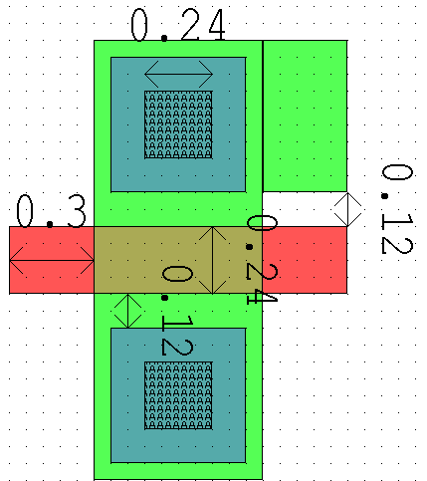
Transistor Layout
Transistor

Slide 30
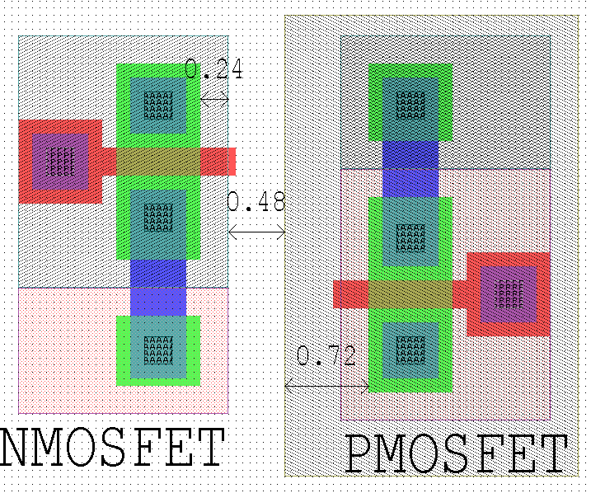
Select Layer
substrate
n-select
n-select
N-well
p-select
p-select

Slide 31
Inter-Layer Design Rule Origins, Con’t
Contact and via rules
M1 contact to p-diffusion
M1 contact to n-diffusion
Contact Mask
M1 contact to poly
Mx contact to My
Via Masks
0.24
mask misaligned
both materials
Contact: 0.24 x 0.24
0.18
Notes:
Note that the minimum area of a contact is 0.44 x 0.44 which is larger than the dimensions of a minimum size transistor!! Excessive changes between interconnect layers are thus to be avoided.

Slide 32
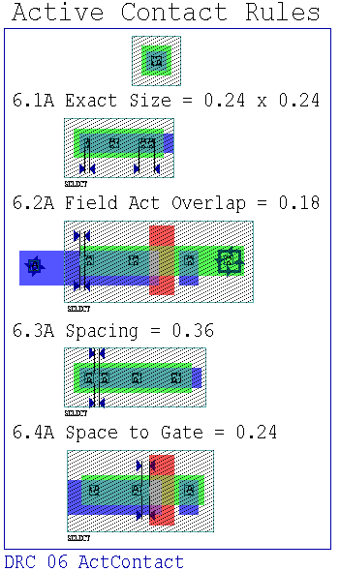
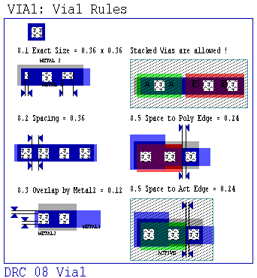
Vias and Contacts

Slide 33
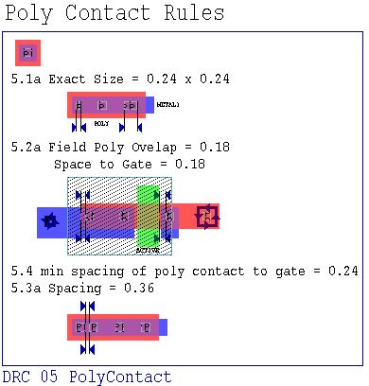
Vias and Contacts (con’t)

Slide 34
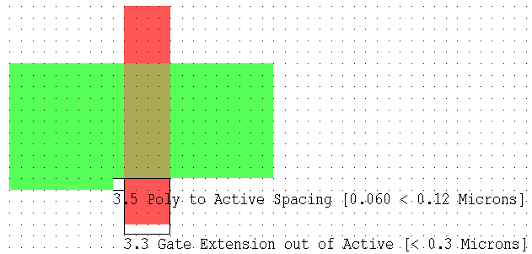
Design Rule Checker (DRC)

Slide 35
LEdit Steps for in Class Demo
Open the technology file with all the design rules
  File -> Open -> Generic_025_7x.tdb
Set the grid size so that the process minimum dimensions fall on integer grid positions
  Setup -> Design -> Grid
    change display grid to 0.06 micron
    change Mouse snap grid to 0.06 micron
Close the initial layout that came up
  since the layout file needs to be opened after the desired technology file has been opened
Open a new file
  File -> New
    Open a new layout
    On the same dialogue box choose the database (technology file) that you want to use
Zoom in and out until you see the grid points (use +, -)
Choose Box tool, select layer and have fun !!
  Use the middle mouse button to move and stretch selected items

Slide 36
Ledit cont’d
Run DRC
  Tools -> DRC, check “place error objects” box
  To view DRC errors, simply select an object or simply drag a box over an area to see all DRCs in that area
Run Extraction to get a Spice Netlist
  Tools -> Extract, on the output tab be sure to check the “write nodal parasitic capacitance” box and set the “ignore parasitic capacitance less than:” field to 0.005 fF

Slide 37
Ledit Fix 256 color problem
Right click on the Ledit icon and choose properties
Choose the “compatibility” tab
Under Display Settings, check the box labeled “Run in 256 colors”

