Slide 1
Lecture 6
The Wire
EE 115C: Digital Electronic Circuits

Slide 2
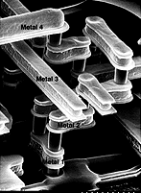
Modern Interconnect

Slide 3
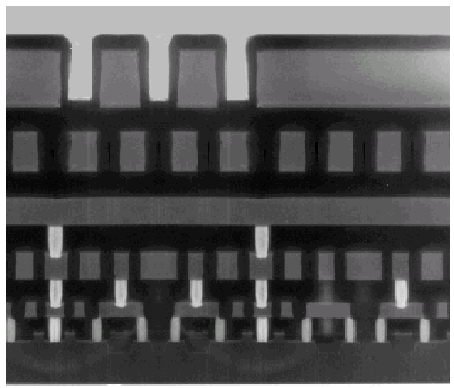
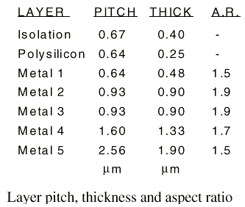
Example: Intel 0.25 micron Process
5 metal layers
Ti/Al - Cu/Ti/TiN
Polysilicon dielectric

Slide 4
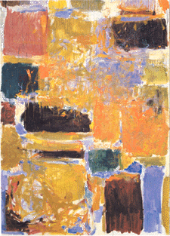
INTERCONNECT
Capacitance

Slide 5
Wiring Capacitance
The wiring capacitance depends upon the length and width of the connecting wires and is a function of the fan-out from the driving gate and the number of fan-out gates.
Wiring capacitance is growing in importance with the scaling of technology.

Slide 6
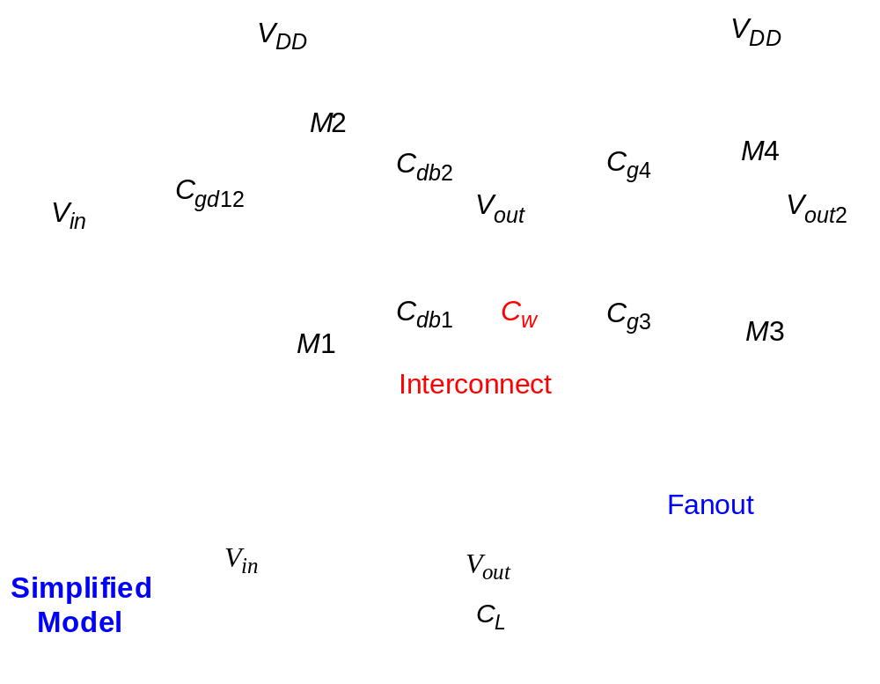
Capacitance of Wire Interconnect

Slide 7
Parallel Plate Wiring Capacitance
current flow
L
electrical field lines
W
H
t_{di}
dielectric (SiO₂)
substrate
permittivity
constant
(SiO₂= 3.9)
C_{pp} = (ε_{di}/t_{di}) WL
Notes:
Parallel plate model – the capacitance is proportional to the overlap between the conductors and inversely proportional to their separation.
Scaling technology shrinks W (L depends on circuit interconnect lengths) but scaling down H at the same time would negatively affect resistance. Thus, H is not scaled by the same ratio as W leading to a smaller W/H ratio (now approaching unity!)

Slide 8
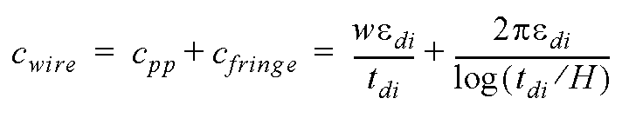
Fringing Capacitance
The model decomposes the capacitance
into two contributions:
-- a parallel plate capacitance
-- a fringing capacitance modeled by a cylindrical
wire with a diameter equal to the thickness of
the wire
W
H
(a)
H
w = W-H/2
+
where w = W-H/2
t_{di}
(b)

Slide 9
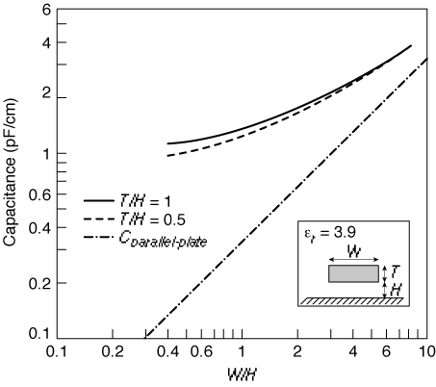

Impact of Fringe Capacitance
H/t_{di} = 1
H/t_{di} = 0.5
Fring Capacitance is the
dominant capacitance at
smaller dimensions
C_{pp}
W/t_{di}
Notes:
Assume SiO2 dielectric with relative permittivity of 3.9
For larger values of W/H (smaller values of H/tdi) the total capacitance approaches the parallel-plate model.
Note that the cap level levels off to a constant value of approx. 1 pF/cm for line widths smaller than the insulator thickness (i.e., is no longer a function of the width)

Slide 10
Permittivity Values of Some Dielectrics
Material | ε_{di}
Free space | 1
Teflon AF | 2.1
Aromatic thermosets (SiLK) | 2.6 – 2.8
Polyimides (organic) | 3.1 – 3.4
Fluorosilicate glass (FSG) | 3.2 – 4.0
Silicon dioxide | 3.9 – 4.5
Glass epoxy (PCBs) | 5
Silicon nitride | 7.5
Alumina (package) | 9.5
Silicon | 11.7
Notes:
But the capacitance of a wire is a function of its shape, its environment, its distance to the substrate, and the distance to the surrounding wires, so also have to consider . . .

Slide 11
Sources of Interwire Capacitance
C_{wire} = C_{pp} + C_{fringe} + C_{interwire}
= (ε_{di}/t_{di})wL
+ (2πε_{di})L/log(t_{di}/H)
+ (ε_{di}/t_{di})HL
fringe
interwire
pp
Notes:
Cfringe ~ ½ Cpp for 0.5 micron technology
Interwire capacitance is responsible for cross-talk
When W < 1.75 H the interwire capacitance starts to dominate

Slide 12
Wiring Capacitances
 | Field | Active | Poly | Al1 | Al2 | Al3 | Al4
Poly | 88
 | 54
Al1 | 30 | 41 | 57
 | 40 | 47 | 54
Al2 | 13 | 15 | 17 | 36
 | 25 | 27 | 29 | 45
Al3 | 8.9 | 9.4 | 10 | 15 | 41
 | 18 | 19 | 20 | 27 | 49
Al4 | 6.5 | 6.8 | 7 | 8.9 | 15 | 35
 | 14 | 15 | 15 | 18 | 27 | 45
Al5 | 5.2 | 5.4 | 5.4 | 6.6 | 9.1 | 14 | 38
 | 12 | 12 | 12 | 14 | 19 | 27 | 52
pp in aF/μm²
fringe in aF/μm
 | Poly | Al1 | Al2 | Al3 | Al4 | Al5
Interwire Cap | 40 | 95 | 85 | 85 | 85 | 115
per unit wire length in aF/μm for minimally-spaced wires
Notes:
Values for a typical 0.25 micron CMOS process; Rows are the top plates; columns are the bottom plate
Consider a wire of 10 cm and 1 micron wide routed in Al1 (e.g., a clock line) (over field) then the
pp cap = (0.1 x 10**6 micron **2) x 30 aF/micron**2 = 3pF
fringe cap – 2 x (0.1 x 10**6 micron) x 40 aF/micron = 8pF
Now, if a second wire is routed alongside the first wire with minimum separations
interwire cap = (0.1 x 10**6 micron) x 95 aF/micron = 9.5pF
If the wire were in Al4 (over field), pp = 0.65pF, fringe = 2.8pF, interwire = 8.5pF

Slide 13
Insights
For W/H < 1.5, the fringe component dominates the parallel-plate component. Fringing capacitance can increase the overall capacitance by a factor of 10 or more.
When W < 1.75H interwire capacitance starts to dominate
Interwire capacitance is more pronounced for wires in the higher interconnect layers (further from the substrate)
Rules of thumb
  Never run wires in diffusion
  Use poly only for short runs
  Shorter wires – lower R and C
  Thinner wires – lower C but higher R
Wire delay nearly proportional to L²

Slide 14
Dealing with Capacitance
Low capacitance (low-k) dielectrics (insulators) such as polymide or even air instead of SiO₂
  family of materials that are low-k dielectrics
  must also be suitable thermally and mechanically and
  compatible with (copper) interconnect
Copper interconnect allows wires to be thinner without increasing their resistance, thereby decreasing interwire capacitance
SOI (silicon on insulator) to reduce junction capacitance

Slide 15
INTERCONNECT
Resistance

Slide 16
Wire Resistance
ρ L
ρ L
R =
=
A
H W
Sheet Resistance R
L
R₁
=
R₂
H
=
W
Material | Sheet Res. (Ω/)
n, p well diffusion | 1000 to 1500
n+, p+ diffusion | 50 to 150
n+, p+ diffusion with silicide | 3 to 5
polysilicon | 150 to 200
polysilicon with silicide | 4 to 5
Aluminum | 0.05 to 0.1
Material | ρ(Ω-m)
Silver (Ag) | 1.6 x 10⁻⁸
Copper (Cu) | 1.7 x 10⁻⁸
Gold (Au) | 2.2 x 10⁻⁸
Aluminum (Al) | 2.7 x 10⁻⁸
Tungsten (W) | 5.5 x 10⁻⁸
Notes:
Resistance in ohms; sheet resistance is in ohms per square
rho is the resistivity of the material
Aluminum used due to low cost and compatibility with fab process; Top of the line processes (e.g., IBM) are now increasingly using Copper as the conductor of choice

Slide 17
Dealing with Resistance
Selective Technology Scaling
Use Better Interconnect Materials
  reduce average wire-length
  e.g. copper, silicides
More Interconnect Layers
  reduce average wire-length

Slide 18
Parasitic Simplifications
Inductive effects can be ignored
  if the resistance of the wire is substantial enough (as is the case for long Al wires with small cross section)
  if the rise and fall times of the applied signals are slow enough
When the wire is short, or the cross-section is large, or the interconnect material has low resistivity, a capacitance only model can be used
When the separation between neighboring wires is large, or when the wires run together for only a short distance, interwire capacitance can be ignored and all the parasitic capacitance can be modeled as capacitance to ground

Slide 19
Wire Delay Models
Ideal wire
  same voltage is present at every segment of the wire at every point in time - at equi-potential
  only holds for very short wires, i.e., interconnects between very nearest neighbor gates
Lumped C model
  when only a single parasitic component (C, R, or L) is dominant the different fractions are lumped into a single circuit element
    When the resistive component is small and the switching frequency is low to medium, can consider only C; the wire itself does not introduce any delay; the only impact on performance comes from wire capacitance
Driver
V_{out}
V_{out}
R_{Driver}
C_{lumped}
c_{wire}
capacitance per unit length
  good for short wires; pessimistic and inaccurate for long wires
Notes:
Model of choice for the analysis of most interconnect wires
However, wires over a few mm length have a significant resistance, so have to use the distributed (or lumped) RC model

Slide 20
Wire Delay Models, con’t
Lumped RC model
  total wire resistance is lumped into a single R and total capacitance into a single C
  good for short wires; pessimistic and inaccurate for long wires
Distributed RC model
  circuit parasitics are distributed along the length, L, of the wire
    c and r are the capacitance and resistance per unit length
rΔL
rΔL
rΔL
rΔL
rΔL
(r,c,L)
V_{in}
V_{N}
V_{in}
V_{N}
cΔL
cΔL
cΔL
cΔL
cΔL
N
  Delay is determined using the Elmore delay equation τ_{Di} = ∑ c_{k}r_{ik}
    Where τ_{Di} is the delay from the source (Vin) to node i
    The delay is the sum of “intermediate node” delays for each consecutive node, k, from the source to node i,
    The delay for each “intermediate node” is calculated as if for each intermediate node, k, there was only one capacitor c_{k} at that node, and a single lumped resistor equal to the total resistance from the source to node i
k=1
Notes:
Lumped model is, once again, only good for short wires – and give pessimistic results
Elmore delay is the equivalent to the first-order time constant of the network (a simple approx. of the actual delay between input node and node i)

Slide 21
Chain Network Elmore Delay
r₁
r₂
r_{i-1}
r_{i}
r_{N}
1
2
i-1
i
N
V_{in}
V_{N}
c₁
c₂
c_{i-1}
c_{i}
c_{N}
N
i
Elmore delay equation τ_{DN} = ∑ c_{i}r_{ii} = ∑ c_{i} ∑ r_{j}
Notes:
For class handout

Slide 22
Chain Network Elmore Delay
τ_{D1}=c₁r₁
τ_{D2}=c₁r₁ + c₂(r₁+r₂)
r₁
r₂
r_{i-1}
r_{i}
r_{N}
1
2
i-1
i
N
V_{in}
V_{N}
c₁
c₂
c_{i-1}
c_{i}
c_{N}
τ_{Di}=c₁r₁+ c₂(r₁+r₂)+…+c_{i}(r₁+r₂+…+r_{i})
N
i
Elmore delay equation τ_{DN} = ∑ c_{i}r_{ii} = ∑ c_{i} ∑ r_{j}
τ_{Di}=c₁r_{eq}+ 2c₂r_{eq}+ 3c₃r_{eq}+…+ ic_{i}r_{eq}
Notes:
For lecture
Why is chain model important – because its what most resistive-capacitive wires look like in a digital circuit (encountered most often)
Note - the shared-path resistance is replaced by the path resistance!
If all Resistances are equal size can replace R values by Req

Slide 23
RC Tree Definitions
2
RC tree characteristics
  A unique resistive path exists between the source node and any node of the network
    Single input (source) node, s
    All capacitors are between a node and GND
    No resistive loops
r₂
r₁
c₂
s
1
r₃
r₄
4
c₁
c₄
3
r_{i}
c₃
i
  Path resistance (sum of the resistances on the path from the input node to node i)
r_{ii} = ∑ r_{j} ⇒ (r_{j} ∈ [path(s → i)]
c_{i}
i
j=1
  Shared path resistance (resistance shared along the paths from the input node to nodes i and k)
r_{ik} = ∑ r_{j} ⇒ (r_{j} ∈ [path(s → i) ∩ path(s → k)])
N
j=1
N
A typical wire is a chain network with (simplified) Elmore delay of τ_{DN} = ∑ c_{i}r_{ii}
i=1
Notes:
Path resistance – Rii (from the input node to any node i of the network); e.g., R44 = R1 + R3 + R4
Shared path resistance – resistances shared along paths
Ask class - Ri4 = R1 + R3 (the resistors that are shared on all paths that go through 1 and 3 along the way) and Ri2 = R1
Ask class – what is the Elmore delay equation for node i of the RC tree?
tDi = R1C1 + R1C2 + (R1 + R3)C3 + (R1 + R3) C4 + (R1 + R3 + Ri) Ci
Once again, only good for short wires – and give pessimistic results

Slide 24
Elmore Delay Models Uses
Modeling the delay of a wire
Modeling the delay of a series of pass transistors
Modeling the delay of a pull-up and pull-down networks

