Slide 1
Lecture 7
The CMOS Inverter
EE 115C: Digital Electronic Circuits

Slide 2
CMOS Inverter: First Look
V_{DD}
V_{in}
V_{out}
C_{L}
Notes:
Inverter – the nucleus of all digital designs; foundation of more intricate gates
Design metrics – cost (area); integrity and robustness (static – steady-state behavior); performance (dynamic or transient behavior); energy efficiency

Slide 3
CMOS Inverter: Steady State Response
V_{OL} = 0
V_{OH} = V_{DD}
V_{M} = f(R_{n}, R_{p})
V_{DD}
V_{DD}
R_{p}
V_{out} = 1
V_{out} = 0
R_{n}
V_{in} = 0
V_{in} = V _{DD}

Slide 4
CMOS Properties
Full rail-to-rail swing ⇒ high noise margins
  Logic levels not dependent upon the relative device sizes ⇒ transistors can be minimum size ⇒ ratioless
Always a path to V_{dd} or GND in steady state ⇒ low output impedance (output resistance in kΩ range) ⇒ large fan-out (albeit with degraded performance)
Extremely high input resistance (gate of MOS transistor is near perfect insulator) ⇒ nearly zero steady-state input current
No direct path steady-state between power and ground ⇒ no static power dissipation
Propagation delay function of load capacitance and resistance of transistors
Notes:
rail-to-rail - Vdd to 0V giving good noise margins
power dissipation - no path between Vdd and Gnd in steady state (ignores leakage current)
ratioless - logic levels are not dependent upon relative device sizes (as in NMOS), so transistors can be minimum size
single inverter can theoretically drive an infinite number of gates and still be functionally operational; fan-out increases propagation delay
steady state path to Vdd or Gnd - low output impedance, so less sensitive to noise

Slide 5
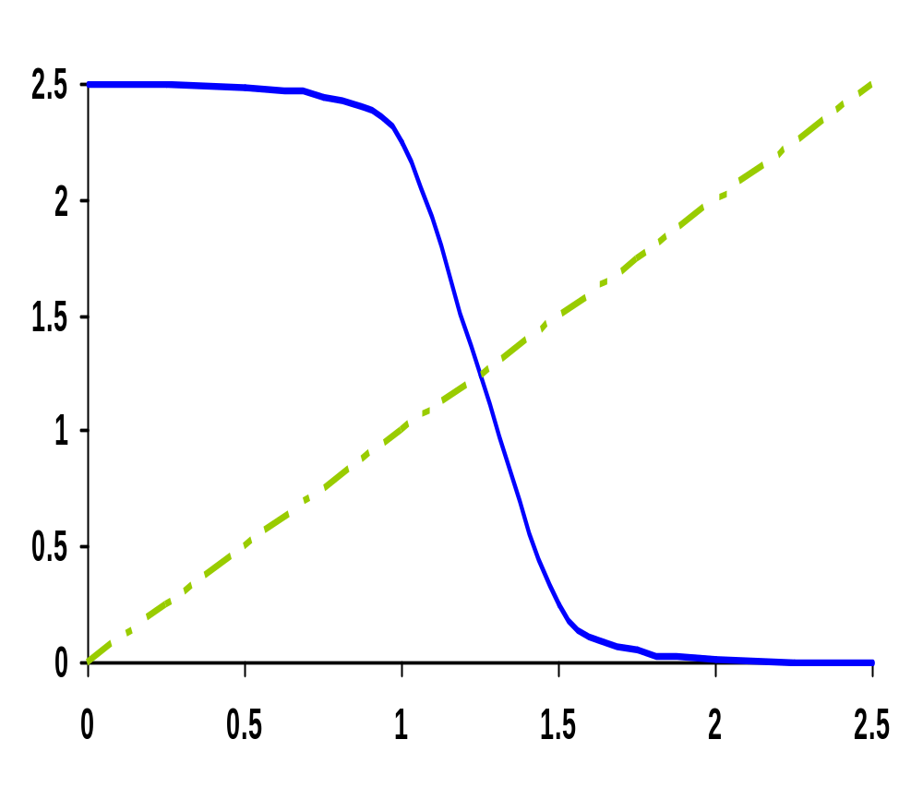
CMOS Inverter Voltage Transfer Curve (VTC)
V_{out} (V)
V_{in} (V)
Notes:
For class handout – hide for class

Slide 6
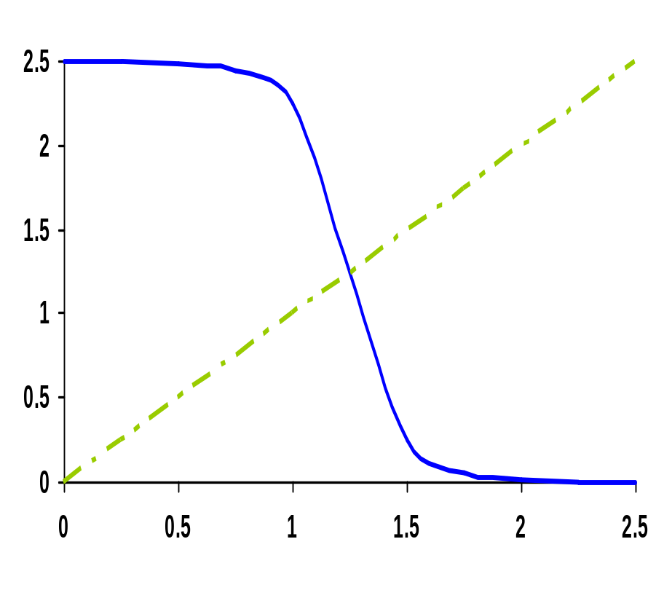
CMOS Inverter VTC
NMOS off
PMOS res
NMOS sat
PMOS res
The VTC is obtained by solving for Vout while I_{DN}=I_{DP} AND
V_{GS-NMOS} = V_{in}
V_{DS-NMOS} = V_{out}
V_{SG-PMOS} = V_{DD}-V_{in}
V_{SD-PMOS} = V_{DD}-V_{out}
NMOS sat
PMOS sat
V_{out} (V)
NMOS res
PMOS sat
NMOS res
PMOS off
V_{in} (V)
Notes:
For lecture
VTC of the inverter exhibits a very narrow transition zone; high gain during switching transient (when both PMOS and NMOS are simultaneously on and in saturation). In that region, a small change in input voltage results in a large output voltage variation.
Indicate on VTC plot where VTn and VTp lie

Slide 7
CMOS Inverter: Switch Model of Dynamic Behavior
V_{DD}
V_{DD}
R_{p}
V_{out}
V_{out}
C_{L}
C_{L}
R_{n}
V_{in} = 0
V_{in} = V _{DD}
Notes:
For handouts. Hide for class.

Slide 8
CMOS Inverter: Switch Model of Dynamic Behavior
V_{DD}
V_{DD}
R_{p}
V_{out}
V_{out}
C_{L}
C_{L}
R_{n}
V_{in} = 0
V_{in} = V _{DD}
Gate response time is determined by the time to charge C_{L} through R_{p} (discharge C_{L} through R_{n})
Notes:
For class.
response determined mainly by the output capacitance of the gate, CL - drain diffusion capacitance of the NMOS and PMOS transistors; the connecting wires, and the input capacitances of the fan-out gates
A fast gate is built either by keeping the output capacitance small or by decreasing the on-resistance or the transistor (or both)
Decreasing the on-resistance achieved by increasing the W/L ratio of the device
Be award that the on-resistance of the NMOS and PMOS transistors is not constant; rather it is a nonlinear function of the voltage across the transistor

Slide 9
Relative Transistor Sizing
When designing static CMOS circuits, balance the driving strengths of the transistors by making the PMOS section wider than the NMOS section to
  maximize the noise margins and
  obtain symmetrical characteristics

Slide 10
Switching Threshold
V_{M} where V_{in} = V_{out} (both PMOS and NMOS in saturation since V_{DS} = V_{GS})
V_{M} ≈ rV_{DD}/(1 + r) where r = k_{p}V_{DSATp}/k_{n}V_{DSATn}
Switching threshold set by the ratio r, which compares the relative driving strengths of the PMOS and NMOS transistors
Want V_{M} = V_{DD}/2 (to have comparable high and low noise margins), so want r ≈ 1
(W/L)_{p} k_{n}’V_{DSATn}(V_{M}-V_{Tn}-V_{DSATn}/2)
(W/L)_{n} k_{p}’V_{DSATp}(V_{DD}-V_{M}+V_{Tp}+V_{DSATp}/2)
=
Notes:
Assumes: The supply voltage is high enough so that the devices are velocity-saturated (VDSAT < VM – VT) and ignores channel length modulation.
Reminder:
k = k’W/L and k’ = mu Cox (mu is carrier mobility)
Larger r to move VM upwards means making the PMOS wider
Smaller r to move VM downwards means making the NMOS wider

Slide 11
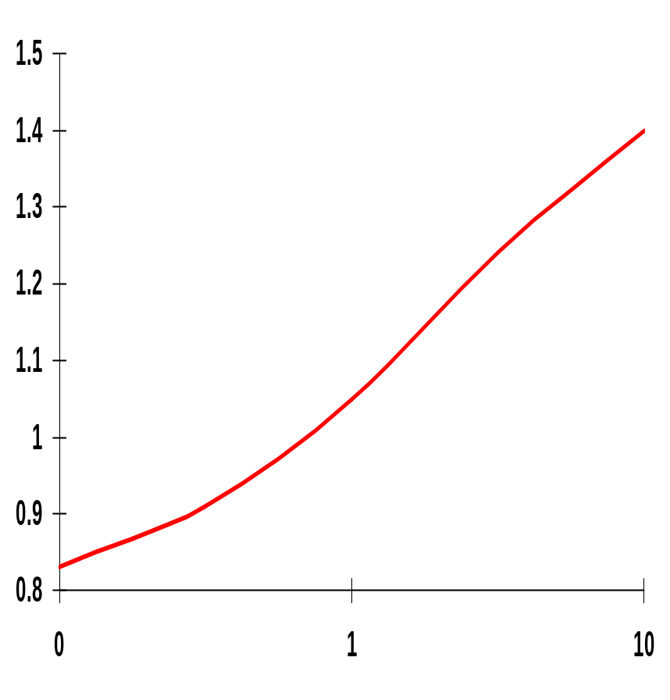
Simulated Inverter V_{M}
V_{M} is relatively insensitive to variations in device ratio
  setting the ratio to 3, 2.5 and 2 gives V_{M}’s of 1.22V, 1.18V, and 1.13V
Increasing the width of the PMOS moves V_{M} towards V_{DD}
Increasing the width of the NMOS moves V_{M} toward GND
V_{M} (V)
.1
~3.4
(W/L)_{p}/(W/L)_{n}
Note: x-axis is semilog
Notes:
Plot needs work – but it’s the best I could do with powerpoint graphing
Small variations in ratio don’t make a lot of difference
To move the VM to 1.5V requires a ratio of 11 !!!
Note that the x axis is semilog

Slide 12
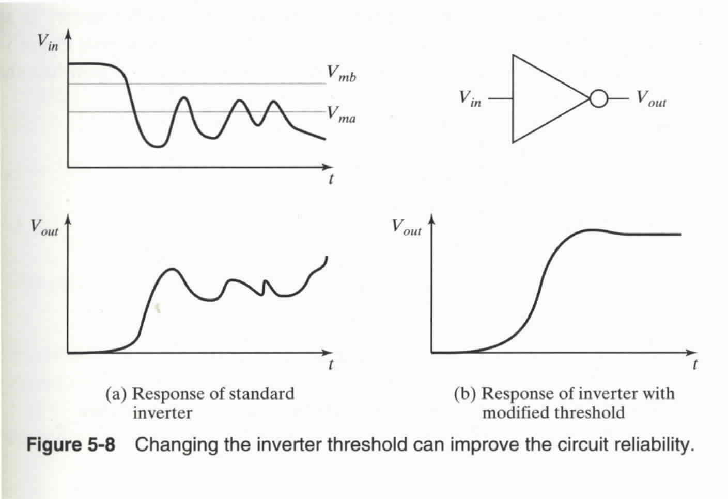
Benefits of V_{M} ≠ V_{DD}/2
E.g. noise immunity in special cases
  Changing the inverter threshold can significantly alter performance

Slide 13
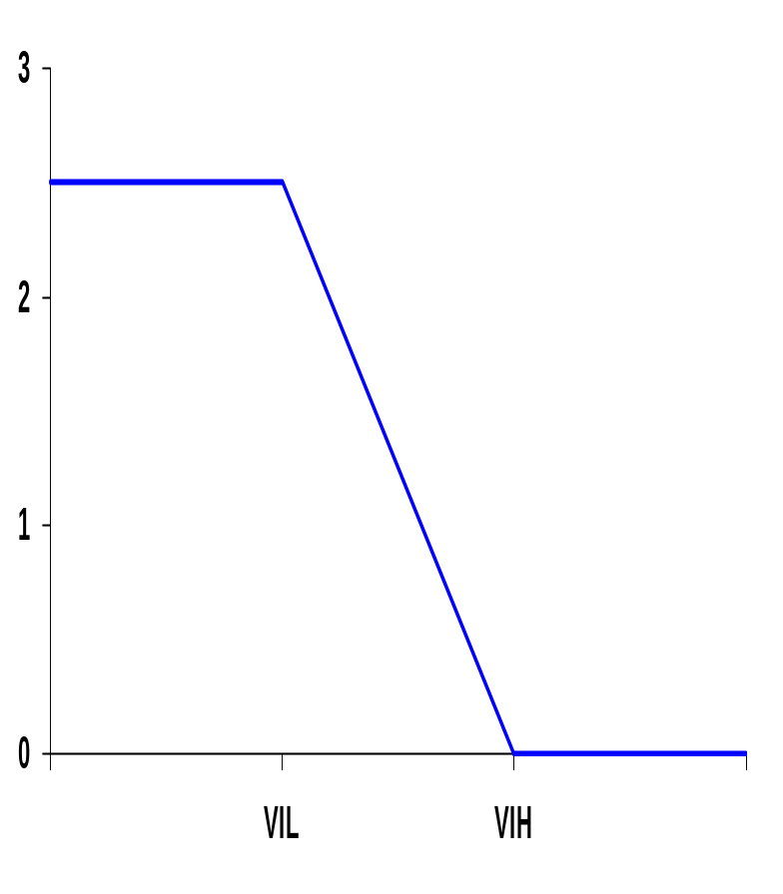
Noise Margins Determining V_{IH} and V_{IL}
By definition, V_{IH} and V_{IL} are where dV_{out}/dV_{in} = -1 (= gain)
V_{OH} = V_{DD}
NM_{H} = V_{DD} - V_{IH}
NM_{L} = V_{IL} - GND
Approximating:
V_{IH} = V_{M} - V_{M} /g
V_{IL} = V_{M} + (V_{DD} - V_{M} )/g
So high gain in the transition region is very desirable
V_{out}
V_{M}
V_{OL} = GND
V_{in}
A piece-wise linear approximation of VTC
Notes:
A high gain in the transition region is VERY desirable. In the extreme case of an infinite gain, the noise margins simplify to VOH – VM and VM – VOL for NMH (ideally, VDD – VM) and NML (ideally, VM – GND), respectively, and span the complete voltage swing.

Slide 14

CMOS Inverter VTC from Simulation
0.25um, (W/L)_{p}/(W/L)_{n} = 3.4
(W/L)_{n} = 1.5 (min size)
V_{DD} = 2.5V
V_{M} ≈ 1.25V,
g = -27.5
V_{IL} = 1.2V, V_{IH} = 1.3V
NM_{L} = NM_{H} = 1.2
(actual values are:
V_{IL} =1.03V, V_{IH}=1.45V
NM_{L} = 1.03V & NM_{H} = 1.05V)
Output resistance
low-output = 2.4kΩ
high-output = 3.3kΩ
V_{out} (V)
V_{in} (V)
Notes:
Note: simulation overestimates the gain – as seen on the next slide, the maximum gain (at VM) is only -17
And piece-wise linear approximation model is optimistic wrt noise margins.
Low output resistance is a good measure of the sensitivity of the gate wrt noise induced at the output and should be as low as possible.

Slide 15
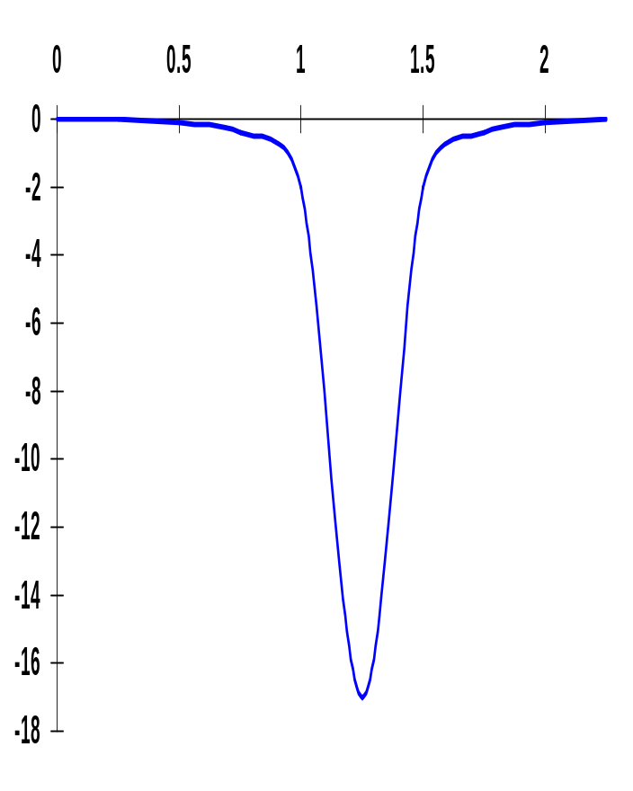
Gain Determinates
V_{in}
Gain is a strong function of the slopes of the currents in the saturation region, for V_{in} = V_{M}
(1+r)
g ≈ ----------------------------------
(V_{M}-V_{Tn}-V_{DSATn}/2)(λ_{n} - λ_{p} )
Determined by technology parameters, especially channel length modulation (λ). Only designer influence through supply voltage and V_{M} (transistor sizing).
gain

Slide 16
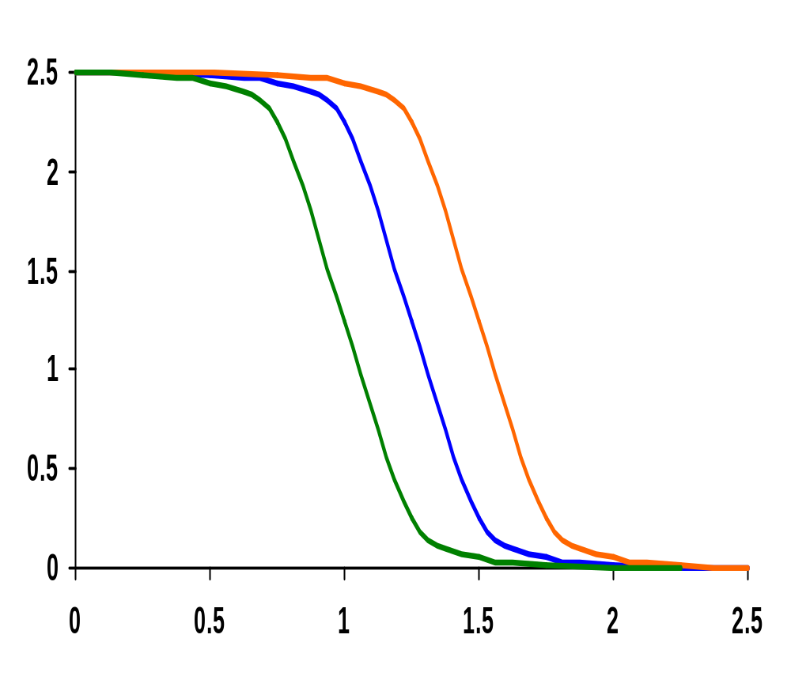
Impact of Process Variation on VTC Curve
Good PMOS
Bad NMOS
V_{out} (V)
Nominal
Bad PMOS
Good NMOS
V_{in} (V)
Process variations (mostly) cause a shift in the switching threshold
Notes:
A good device has a small oxide thickness (-3nm), a small length (-25nm), a higher width (+30nm) and a smaller threshold (-60mV). The opposite is true for a bad device.

Slide 17
Switch Threshold Example
In our generic 0.25 micron CMOS process, using the process parameters, a V_{DD} = 2.5V, and a minimum size NMOS device ((W/L)_{n} of 1.5)
 | V_{T0}(V) | γ(V^{0.5}) | V_{DSAT}(V) | k’(A/V²) | λ(V⁻¹)
NMOS | 0.43 | 0.4 | 0.63 | 115 x 10⁻⁶ | 0.06
PMOS | -0.4 | -0.4 | -1 | -30 x 10⁻⁶ | -0.1
(W/L)_{p} 115 x 10⁻⁶ 0.63 (1.25 – 0.43 – 0.63/2)
(W/L)_{n} -30 x 10⁻⁶ -1.0 (1.25 – 0.4 – 1.0/2)
=
x
x
= 3.5
(W/L)_{p} = 3.5 x 1.5 = 5.25 for a V_{M} of 1.25V
Notes:
For class
goal is to have Vm at Vdd/2
3.5 x 1.5 so (W/L)p = 5.25

