Slide 1
Lecture 8
The CMOS Inverter Performance
EE 115C: Digital Electronic Circuits

Slide 2
Aside: Delay Definitions
V_{in}
V_{out}
V_{in}
Propagation delay
input
waveform
50%
t_{p} = (t_{pHL} + t_{pLH})/2
t
t_{pHL}
t_{pLH}
V_{out}
90%
output
waveform
50%
signal slopes
10%
t
t_{f}
t_{r}
Notes:
Delay is a function of fan-in and fan-out (increases load)

Slide 3
CMOS Inverter: Dynamic
Transient, or dynamic, response determines the maximum speed at which a device can be operated.
V_{DD}
V_{out} = 0
t_{pHL} = f(R_{n}, C_{L})
C_{L}
R_{n}
V_{in} = V _{DD}
Notes:
So propagation delay is determined by the time to charge and discharge the load capacitor CL
Today’s lecture focuses on the CL term
Next lecture focuses on the R term
Next next lecture puts them together to look at dynamic inverter characteristics

Slide 4
Sources of Capacitance
V_{out}
V_{in}
V_{out2}
C_{L}
C_{G4}
M₂
M₄
C_{DB2}
V_{out}
V_{out2}
V_{in}
C_{GD12}
C_{w}
C_{DB1}
M₁
M₃
C_{G3}
intrinsic MOS transistor capacitances
extrinsic MOS transistor (fanout) capacitances
wiring (interconnect) capacitance
Notes:
Parasitic capacitances influencing the transient behavior of the cascaded inverter pair

Slide 5
Review: Avg Distribution of Channel Capacitance
Operation Region | C_{GCB} | C_{GCS} | C_{GCD} | C_{GC} | C_{G}
Cutoff | C_{ox}WL | 0 | 0 | C_{ox}WL | C_{ox}WL + 2C_{o}W
Resistive | 0 | C_{ox}WL/2 | C_{ox}WL/2 | C_{ox}WL | C_{ox}WL + 2C_{o}W
Saturation | 0 | (2/3)C_{ox}WL | 0 | (2/3)C_{ox}WL | (2/3)C_{ox}WL + 2C_{o}W
Channel capacitance components are nonlinear and vary with operating voltage
Most important regions are cutoff and saturation since that is where the device spends most of its time
Notes:
In cutoff – all cap in gate to substrate since there is no channel
Linear – substrate is shielded from the gate by the channel, cap is shared equally between S and D
Saturation – Channel pinched off at drain end, cap between gate and drain is approx. zero and so is the gate-body, so all the cap is between the gate and the source.
The large fluctuation of the channel capacitance around VGS = VT is worth remembering (Figure 3.31 that is not included in these notes)
The total gate capacitance is getting smaller with an increased level of saturation

Slide 6
Review: Expression for Transistor Capacitance
Example: For an NMOS with L = 0.24 μm, W = 0.36 μm, L_{D} = L_{S} = 0.625 μm
C_{GSO} = C_{GDO} = C_{ox} x_{d} W = C_{o} W
C_{GC} = C_{ox} WL =
so C_{gate_cap} = C_{ox}WL + 2C_{o}W =
C_{bp} = C_{j} L_{S} W =
C_{sw} = C_{jsw} (2L_{S} + W) =
so C_{diffusion_cap} =
 | C_{ox} (fF/μm²) | C_{o} (fF/μm) | C_{j} (fF/μm²) | m_{j} | φ_{b} (V) | C_{jsw} (fF/μm) | m_{jsw} | φ_{bsw} (V)
NMOS | 6 | 0.31 | 2 | 0.5 | 0.9 | 0.28 | 0.44 | 0.9
PMOS | 6 | 0.27 | 1.9 | 0.48 | 0.9 | 0.22 | 0.32 | 0.9
Notes:
for class handout

Slide 7
Aside: Miller’s Theorem
Y
+
V1
-
+
V2=KV1
-
+
V1
-
+
V2=KV1
-
Y1
Y2
Y1 = Y ( 1 – K )
Y2 = Y ( 1 – 1/K )

Slide 8
Gate-Drain Capacitance: The Miller Effect
M1 and M2 are either in cut-off or in saturation.
The floating gate-drain capacitor is replaced by a capacitance-to-ground (gate-bulk capacitor).
ΔV
C_{GD1}
V_{out}
V_{out}
ΔV
V_{in}
2C_{GB1}
ΔV
ΔV
M₁
V_{in}
M₁
A capacitor experiencing identical but opposite voltage swings at both its terminals can be replaced by a capacitor to ground whose value is two times the original value
Note: Text ignores the Miller effect at the input
Notes:
The floating gate-drain capacitor must be replaced by a capacitance-to-ground that is accomplished by taking the so-called Miller effect into account.
During a low-high or high-low transition, the terminals of the gate-drain capacitor are moving in opposite directions. The voltage change over the floating capacitor is hence twice the actual output voltage swing.

Slide 9
Drain-Bulk Capacitance: K_{eq}’s (for 0.25 μm)
What is the value of the junction capacitance during a ‘0’ to ‘1’ transition?
  The junction voltage varies, and so does the junction cap.
We can simplify the diffusion capacitance calculations even further by using a K_{eq} to relate the linearized capacitor to the value of the junction capacitance under zero-bias
C_{eq} = K_{eq} C_{j0}
 | high-to-low |  | low-to-high
 | K_{eqbp} | K_{eqsw} | K_{eqbp} | K_{eqsw}
NMOS | 0.57 | 0.61 | 0.79 | 0.81
PMOS | 0.79 | 0.86 | 0.59 | 0.7

Slide 10
Extrinsic (Fan-Out) Capacitance
The extrinsic, or fan-out, capacitance is the total gate capacitance of the loading gates M3 and M4 (see slide 4 of this lecture).
C_{fan-out} = C_{gate} (NMOS) + C_{gate} (PMOS)
= (C_{GSOn}+ C_{GDOn}+ W_{n}L_{n}C_{ox}) + (C_{GSOp}+ C_{GDOp}+ W_{p}L_{p}C_{ox})
Simplification of the actual situation
  Assumes all the components of C_{gate} are between V_{out} and GND (or V_{DD})
  Assumes the channel capacitances of the loading gates are constant
  Ignores Miller effect capacitance at the input of the transistor

Slide 11
Wiring Capacitance
The wiring capacitance depends upon the length and width of the connecting wires and is a function of the fan-out from the driving gate and the number of fan-out gates.
Wiring capacitance is growing in importance with the scaling of technology.

Slide 12
Inverter Propagation Delay
Propagation delay is proportional to the time-constant of the network formed by the pull-down resistor and the load capacitance
t_{pHL} = ln(2) R_{eqn} C_{L} = 0.69 R_{eqn} C_{L}
t_{pLH} = ln(2) R_{eqp} C_{L} = 0.69 R_{eqp} C_{L}
t_{p} = (t_{pHL} + t_{pLH})/2 = 0.69 C_{L}(R_{eqn} + R_{eqp})/2
To equalize rise and fall times make the on-resistance of the NMOS and PMOS approximately equal.
V_{DD}
t_{pHL} = f(R_{n}, C_{L})
V_{out} = 0
R_{n}
C_{L}
V_{in} = V _{DD}
Notes:
Often desirable to have identical propagation delays for both rising and falling inputs. This condition can be achieved by making the on-resistance of the NMOS and PMOS approximately equal. This is the SAME condition as that for a symmetrical VTC.

Slide 13
MOS Structure Resistance
The simplest model assumes the transistor is a switch with an infinite “off” resistance and a finite “on” resistance R_{on}
However R_{on} is nonlinear, so use instead the average value of the resistances, R_{eq}, at the end-points of the transition (V_{DD} and V_{DD}/2)
R_{eq} = ½ (R_{on}(t₁) + R_{on}(t₂))
R_{eq} = ¾ V_{DD}/I_{DSAT} (1 – 7/9 λ V_{DD})
V_{GS} ≥ V_{T}
R_{on}
S
D
V_{DD}(V) | 1 | 1.5 | 2 | 2.5
NMOS(kΩ) | 35 | 19 | 15 | 13
PMOS (kΩ) | 115 | 55 | 38 | 31
R_{eq} (for W/L = 1), for larger devices divide R_{eq} by W/L
Notes:
Main problem is that Ron of the transistor is time variant, non-linear and depends on the operating point of the transistor
lambda is an empirical parameter – channel-length modulation – varies roughly with the inverse of the channel length

Slide 14
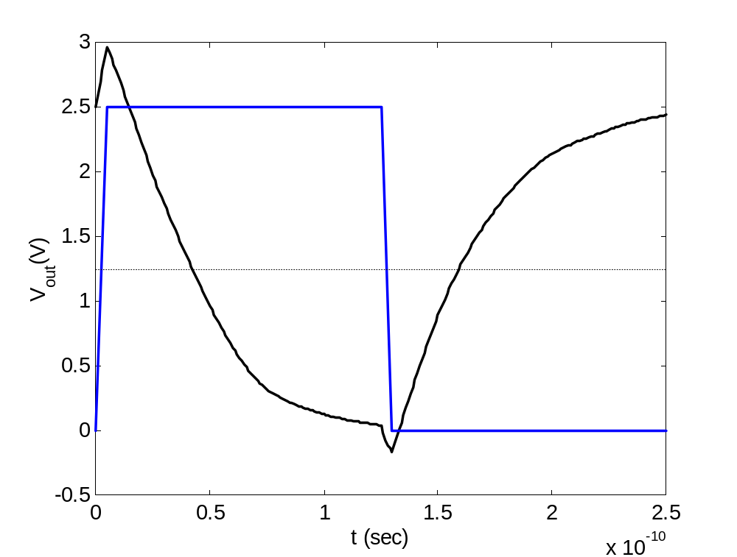
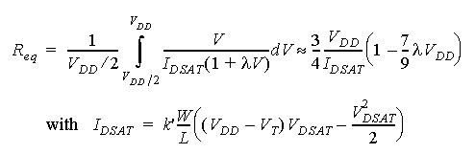
Transient Response
?
t_{p} = 0.69 C_{L} (R_{eqn}+R_{eqp})/2
t_{pLH}
t_{pHL}

Slide 15
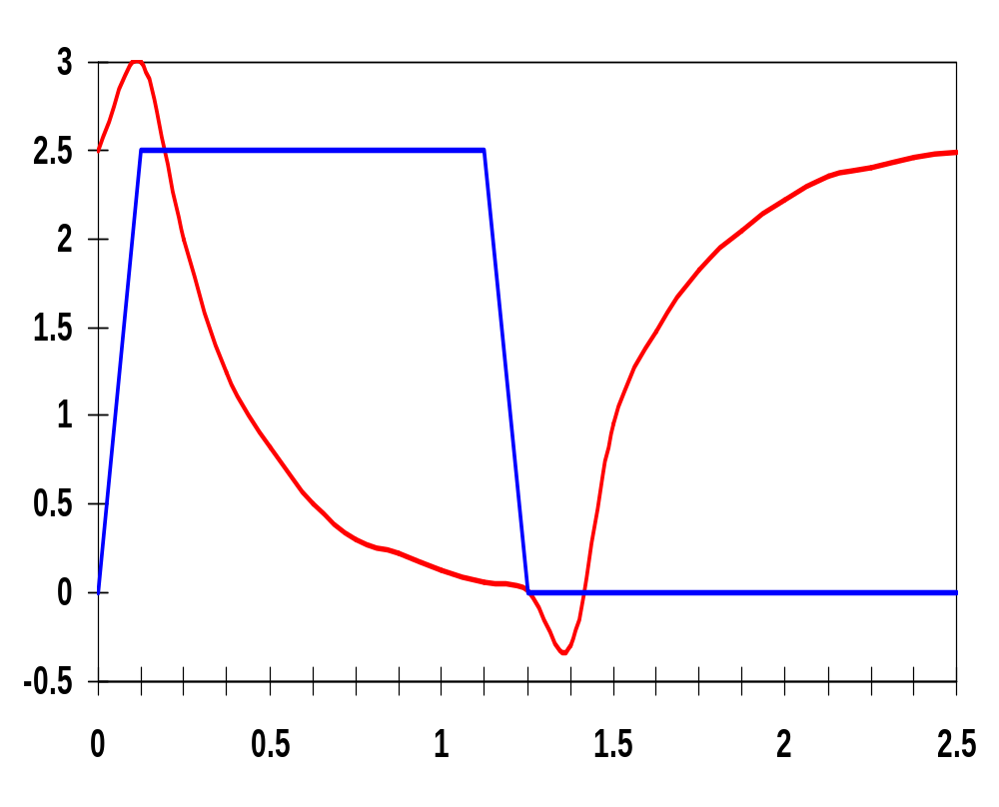
Inverter Transient Response
V_{in}
V_{DD}=2.5V
0.25μm
W/L_{n} = 1.5
W/L_{p} = 4.5
R_{eqn}= 13 kΩ (÷ 1.5)
R_{eqp}= 31 kΩ (÷ 4.5)
V_{out} (V)
x 10⁻¹⁰
t (sec)
Notes:
For class handout

Slide 16
Inverter Transient Response
Hand Calculation
V_{in}
V_{DD}=2.5V
0.25μm
W/L_{n} = 1.5
W/L_{p} = 4.5
R_{eqn}= 13 kΩ (÷ 1.5)
R_{eqp}= 31 kΩ (÷ 4.5)
V_{out} (V)
t_{f}
t_{r}
t_{pHL}
t_{pLH}
t_{pHL} = 36 psec
t_{pLH} = 29 psec
so
t_{p} = 32.5 psec
x 10⁻¹⁰
t (sec)
From simulation: t_{pHL} = 39.9 psec and t_{pLH} = 31.7 psec
Notes:
For lecture
Reqn = 8.67 and Reqp = 6.89
The top time is from simulation
the bottom from solving the (simplified) equations
Note overshoots on simulated output signals. Caused by the gate-drain capacitances of the inverter transistors which couple the steep voltage step at the input node directly to the output before the transistors can even start to react to the changes at the inputs.
These overshoots have a negative effect on gate performance and explain why the simulated delays are larger than the estimations.

Slide 17
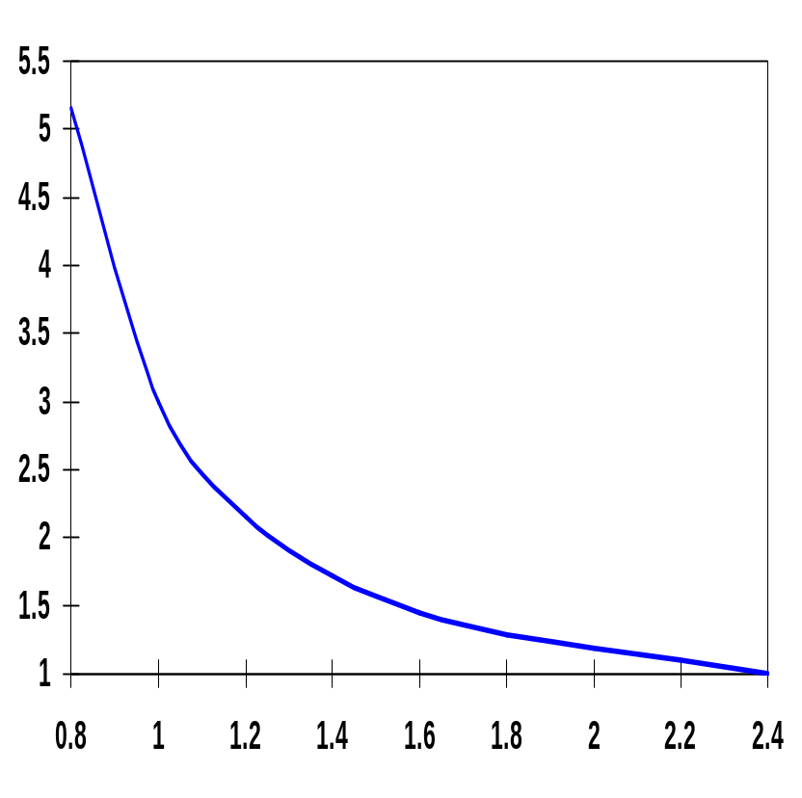
Inverter Propagation Delay, Revisited
To see how a designer can optimize the delay of a gate have to expand the R_{eq} in the delay equation
t_{p(normalized)}
t_{pHL} = 0.69 R_{eqn} C_{L}
  = 0.69 (3/4 (C_{L} V_{DD})/I_{DSATn} )
  ≈ 0.52 C_{L} / (W/L_{n} k’_{n} V_{DSATn} )
V_{DD} (V)
Notes:
If the supply voltage is high enough so that VDD >> VTn + VDSATn/2, the delay becomes virtually independent of the supply voltage!
Similar equation for tpLH based on W/Lp
Propagation delay of a CMOS inverter as a function of supply voltage (normalized wrt delay at 2.5V supply).
While the delay is relatively insensitive to supply variations for higher values of VDD, a sharp increase can be observed starting around 2VT.
This operation regions should be avoided for high performance!
Lowering VDD slows down the gate

Slide 18
Design for Performance
Reduce C_{L}
  internal diffusion capacitance of the gate itself
    keep the drain diffusion as small as possible
  interconnect capacitance
  fanout
Increase W/L ratio of the transistor
  the most powerful and effective performance optimization tool in the hands of the designer
  watch out for self-loading! – when the intrinsic capacitance dominates the extrinsic load
Increase V_{DD}
  can trade-off energy for performance
  increasing V_{DD} above a certain level yields only very minimal improvements
  reliability concerns enforce a firm upper bound on V_{DD}
Notes:
Good design practice keeps drain diffusion areas as small as possible
Self-loading is when the intrinsic capacitance (diffusion capacitance) starts to dominate the extrinsic load formed by wiring and fanout.
Increasing VDD also has reliability concerns - oxide breakdown, hot-electron effects - that enforce firm upper bounds on the supply voltage in deep submicron processes.

Slide 19
NMOS/PMOS Ratio
So far have sized the PMOS and NMOS so that the R_{eq}’s match (ratio of 3 to 3.5)
  symmetrical VTC
  equal high-to-low and low-to-high propagation delays
If speed is the only concern, reduce the width of the PMOS device!
  widening the PMOS degrades the t_{pHL} due to larger parasitic capacitance
β = (W/L_{p})/(W/L_{n})
r = R_{eqp}/R_{eqn} (resistance ratio of identically-sized PMOS and NMOS)
β_{opt} = √r when wiring capacitance is negligible
Notes:
Smaller PMOS - speed at the cost of symmetry and noise margin
Widening PMOS of course improves tpLH because it improves Req of the PMOS (increases charge current)
If wiring capacitance dominates, larger values of beta should be used. The surprising result is that smaller device sizes (and hence smaller area) yield a faster design at the expense of symmetry and noise margin.

Slide 20
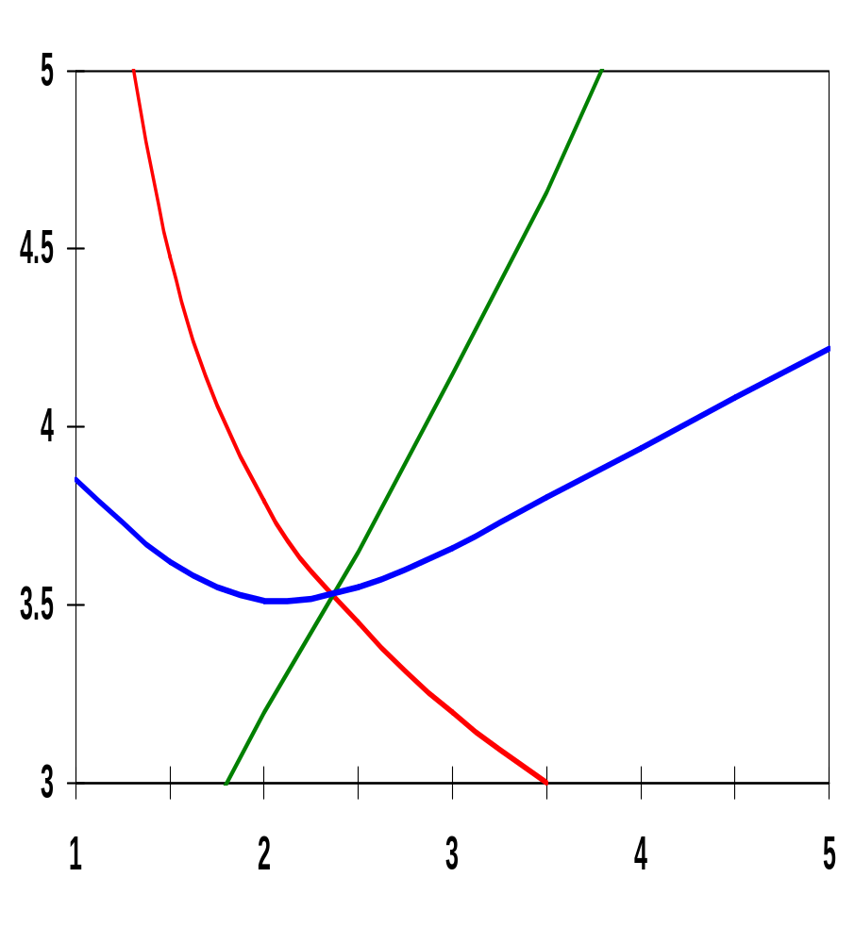
Effects of PMOS/NMOS Ratio on Delay
x 10⁻¹¹
t_{pLH}
t_{pHL}
β of 2.4 (= 31 kΩ/13 kΩ) gives symmetrical response
β of 1.6 to 1.9 gives optimal performance
t_{p}
t_{p}(sec)
β = (W/L_{p})/(W/L_{n})
Notes:
Observe that the rising and falling delays are identical at the predicted point of beta of 2.4 (the crossing point of the three curves) that is the preferred operation point when the worst-case delay is the prime concern.

Slide 21
Device Sizing for Performance
Divide capacitive load, C_{L}, into
  C_{int} : intrinsic - diffusion and Miller effect
  C_{ext} : extrinsic - wiring and fanout
  t_{p} = 0.69 R_{eq} C_{int} (1 + C_{ext}/C_{int}) = t_{p0} (1 + C_{ext}/C_{int})
  where t_{p0} = 0.69 R_{eq} C_{int} is the intrinsic (unloaded) delay of the gate
Widening both PMOS and NMOS by a factor S reduces R_{eq} by an identical factor (R_{eq} = R_{ref}/S), but raises the intrinsic capacitance by the same factor (C_{int} = SC_{iref})
  t_{p} = 0.69 R_{ref} C_{iref} (1 + C_{ext}/(SC_{iref})) = t_{p0}(1 + C_{ext}/(SC_{iref}))
  t_{p0} is independent of the sizing of the gate; with no load the drive of the gate is totally offset by the increased capacitance
  any S sufficiently larger than (C_{ext}/C_{int}) yields the best performance gains with least area impact
Notes:
Making S infinitely large yields the maximum obtainable performance gain – yet any size factor S that is sufficiently larger than (Cext/Cint) will produce good results at substantial gains in silicon area.
For our example a ratio of 1.05 works (Cint – 3.0 fF and Cext = 3.15 fF) and would predict a maximum performance gain of 2.05
A scaling factor of 10 allows us to get within 10% of this optimal performance (larger devices yield negligible additional performance gains)

Slide 22
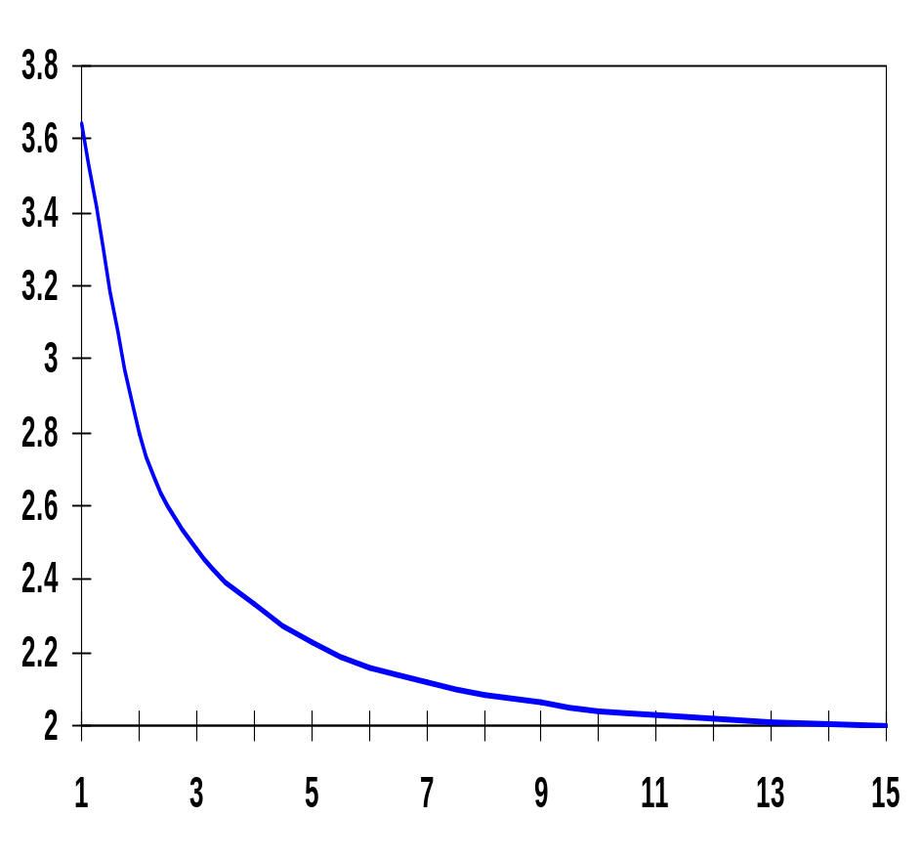
Sizing Impacts on Delay
The majority of the improvement is already obtained for S = 5. Sizing factors larger than 10 barely yield any extra gain (and cost significantly more area).
x 10⁻¹¹
for a fixed load
t_{p}(sec)
S
self-loading effect (intrinsic capacitance dominates)
Widening both PMOS and NMOS by a factor S
Notes:
Making S infinitially large yields the maximum obtainable performance gains.
Bulk of the improvement is already obtained for S = 5, sizing factors larger than 10 barely yield any extra gain.
While sizing up an inverter reduces its delay, it also increase its input capacitance – impacting the delay of the driving gate!

Slide 23
Impact of Fanout on Delay
Extrinsic capacitance, C_{ext}, is a function of the fanout of the gate - the larger the fanout, the larger the external load.
First determine the input loading effect of the inverter. Both C_{g} and C_{int} are proportional to the gate sizing, so C_{int} = γC_{g} is independent of gate sizing and
t_{p} = t_{p0} (1 + C_{ext}/ γC_{g}) = t_{p0} (1 + f/γ)
i.e., the delay of an inverter is a function of the ratio between its external load capacitance and its input gate capacitance: the effective fan-out f
f = C_{ext}/C_{g}
Notes:
gamma is close to 1 for most submicron processes.

Slide 24
Inverter Chain
Real goal is to minimize the delay through an inverter chain
the delay of the j-th inverter stage is
t_{p,j} = t_{p0} (1 + C_{g,j+1}/(γC_{g,j})) = t_{p0}(1 + f_{j}/ γ)
and t_{p} = t_{p1} + t_{p2} + . . . + t_{pN}
so t_{p} = ∑t_{p,j} = t_{p0} ∑ (1 + C_{g,j+1}/(γC_{g,j}))
In
Out
1
2
N
C_{g,1}
C_{L}
Note: Wire Caps
Ignored for now
If C_{L} is given
  How should the inverters be sized?
  How many stages are needed to minimize the delay?
Notes:
ingores wiring capacitance for now

Slide 25
Sizing the Inverters in the Chain
The optimum size of each inverter is the geometric mean of its neighbors – meaning that if each inverter is sized up by the same factor f wrt the preceding gate, it will have the same effective fan-out and the same delay
f = √C_{L}/C_{g,1} = √F
where F represents the overall effective fan-out of the circuit (F = C_{L}/C_{g,1})
and the minimum delay through the inverter chain is
t_{p} = N t_{p0} (1 + ( √F ) / γ)
The relationship between t_{p} and F is linear for one inverter, square root for two, etc.
N
N
Equal to C_{g} of first stage (C_{g,1})
N
Notes:
Next question is, “what is the best N to minimize the delay for a given F?”
but first, an example of inverter chain sizing

Slide 26
Example of Inverter Chain Sizing
In
Out
1
C_{g,1}
C_{L} = 8 C_{g,1}
C_{L}/C_{g,1} has to be evenly distributed over N = 3 inverters
C_{L}/C_{g,1} = 8/1
f =
Notes:
for class handout

Slide 27
Example of Inverter Chain Sizing
In
Out
1
f = 2
f² = 4
C_{g,1}
C_{L} = 8 C_{g,1}
C_{L}/C_{g,1} has to be evenly distributed over N = 3 inverters
C_{L}/C_{g,1} = 8/1
f =
3
√8 = 2
Notes:
For lecture

Slide 28
Determining N: Optimal Number of Inverters
What is the optimal value for N given F (=f^{N}) ?
  if the number of stages is too large, the intrinsic delay of the stages becomes dominate
  if the number of stages is too small, the effective fan-out of each stage becomes dominate
The optimum N is found by differentiating the minimum delay expression divided by the number of stages and setting the result to 0, giving
γ + √F - ( √F lnF)/N = 0
For γ = 0 (ignoring self-loading) N = ln (F) and the effective-fan out becomes f = e = 2.71828
For γ = 1 (the typical case) the optimum effective fan-out (tapering factor) turns out to be close to 3.6
N
N

Slide 29
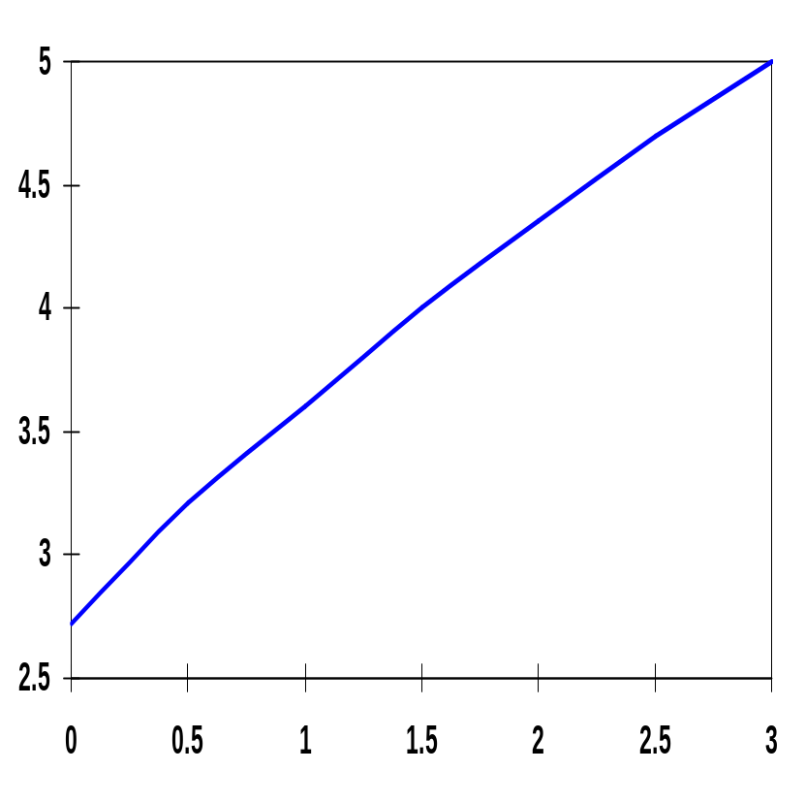
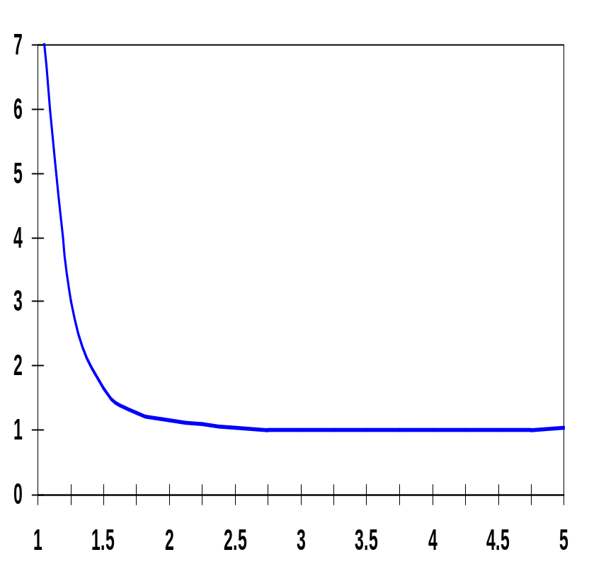
Optimum Effective Fan-Out
normalized delay
F_{opt}
γ
f
Choosing f larger than optimum has little effect on delay and reduces the number of stages (and area).
  Common practice to use f = 4 (for γ = 1)
  But too many stages has a substantial negative impact on delay
Notes:
note that curve on the left starts to increase at 5 ! reinforcing last bullet

Slide 30
Example of Inverter (Buffer) Staging
1
N f t_{p}
1 64 65
2 8 18
3 4 15
4 2.8 15.3
C_{g,1} = 1
C_{L} = 64 C_{g,1}
1
8
C_{g,1} = 1
C_{L} = 64 C_{g,1}
1
4
16
C_{g,1} = 1
C_{L} = 64 C_{g,1}
1
2.8
8
22.6
C_{g,1} = 1
C_{L} = 64 C_{g,1}

Slide 31
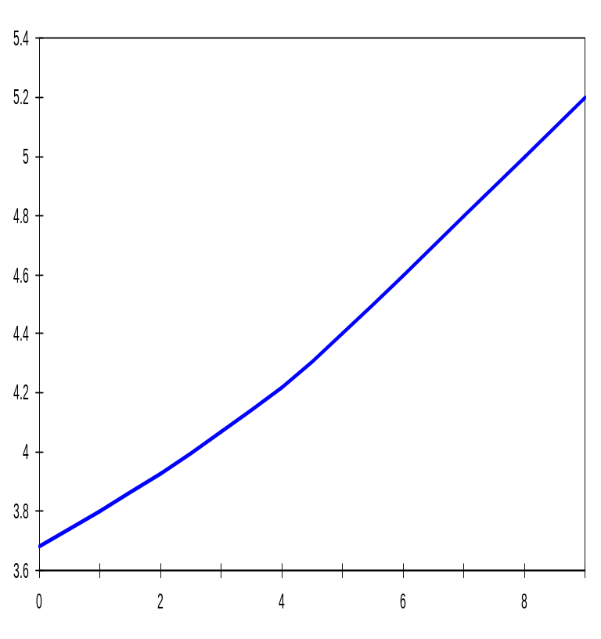
Input Signal Rise/Fall Time
In reality, the input signal changes gradually (and both PMOS and NMOS conduct for a brief time). This affects the current available for charging/discharging C_{L} and impacts propagation delay.
x 10⁻¹¹
t_{p}(sec)
t_{p} increases linearly with increasing input slope, t_{s}, once t_{s} > t_{p}
t_{s} is due to the limited driving capability of the preceding gate
x 10⁻¹¹
t_{s}(sec)
for a minimum-size inverter with a fan-out of a single gate
Notes:
Have assumed until now that the input signal abruptly changes from 0 to Vdd or vice versa. In reality, the input signal changes gradually and, temporarily, the PMOS and NMOS transistors conduct simultaneously).
ts is the input switching time (delay) slope
If the driving gate were infinitely strong, its output slope would be unaffected (by the load).

Slide 32
Design Challenge
A gate is never designed in isolation: its performance is affected by both the fan-out and the driving strength of the gate(s) feeding its inputs.
t^{i}_{p} = t^{i}_{step} + η t^{i-1}_{step} (η ≈ 0.25)
Keep signal rise times smaller than or equal to the gate propagation delays.
  good for performance
  good for power consumption
Keeping rise and fall times of the signals small and of approximately equal values is one of the major challenges in high-performance designs - slope engineering.
Notes:
tstep is for the zero input slope

Slide 33
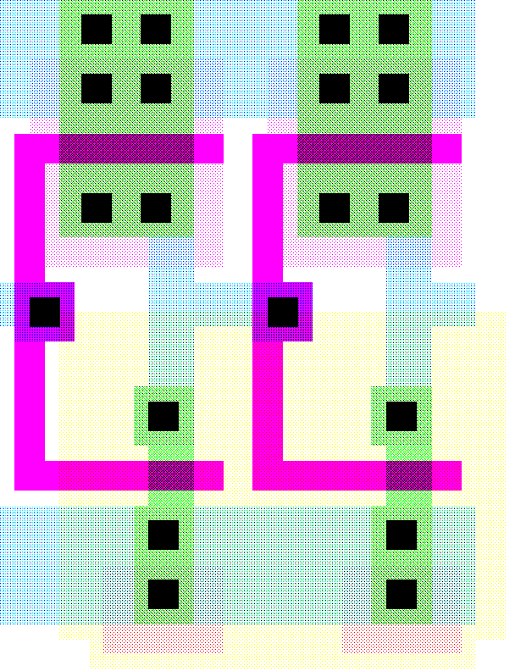
FYI: Layout of Two Chained Inverters
V
DD
PMOS
1.125/0.25
1.2
μ
m
=2λ
Out
In
Metal1
Polysilicon
0.125
0.5
NMOS
0.375/0.25
GND
 | W/L | AD (μm²) | PD (μm) | AS (μm²) | PS (μm)
NMOS | 0.375/0.25 | 0.3 | 1.875 | 0.3 | 1.875
PMOS | 1.125/0.25 | 0.7 | 2.375 | 0.7 | 2.375
Notes:
See new book, Chapter 5 for inverter transistor data if interested
Overlap capacitance
CGDO0n = 0.31 fF/um; CGDOp = 0.27 fF/um
Bottom junction capacitance
Cjn = 2 fF/um**2; Cjp = 1.9 fF/um**2
Side-wall junction capacitance
CJSWn = 0.28 fF/um; CJSWp = 0.22 fF/um
Gate capacitance
Cox = 6 fF/um**2

Slide 34
FYI: Components of C_{L} (0.25 μm)
C Term | Expression | Value (fF) H→L | Value (fF) L→H
C_{GD1} | 2 C_{on} W_{n} | 0.23 | 0.23
C_{GD2} | 2 C_{op} W_{p} | 0.61 | 0.61
C_{DB1} | K_{eqbpn}AD_{n}C_{j} + K_{eqswn}PD_{n}C_{jsw} | 0.66 | 0.90
C_{DB2} | K_{eqbpp}AD_{p}C_{j} + K_{eqswp}PD_{p}C_{jsw} | 1.5 | 1.15
C_{G3} | (2 C_{on})W_{n} + C_{ox}W_{n}L_{n} | 0.76 | 0.76
C_{G4} | (2 C_{op})W_{p} + C_{ox}W_{p}L_{p} | 2.28 | 2.28
C_{w} | from extraction | 0.12 | 0.12
C_{L} | ∑ | 6.1 | 6.0
Notes:
Red shows values that the designer has control over!
Notice that the load capacitance is almost evenly split between its two major components: the intrinsic capacitance (green) composed of the diffusion and overlap capacitances and the extrinsic capacitance (blue) and wiring capacitances (red) contributed by the connecting gate and wire

