Slide 1
Azure DevOps Services
Azure Pipelines

Slide 3
What is Azure Pipelines?
Cloud service that you can use to automatically build and test your code project and make it available to other users
Works with just about any language or project type
Fully featured continuous integration (CI) and continuous delivery (CD) service
Helps to ensure consistent and quality code that's readily available to users
Start with your code on GitHub, GitLab, Bitbucket, or Azure Repos. Then you can automate the build, test, and deployment of your code to Microsoft Azure, Google Cloud, Amazon cloud services or on-prem
Notes:
https://docs.microsoft.com/en-us/azure/devops/pipelines/get-started/what-is-azure-pipelines?view=azure-devops

Slide 4
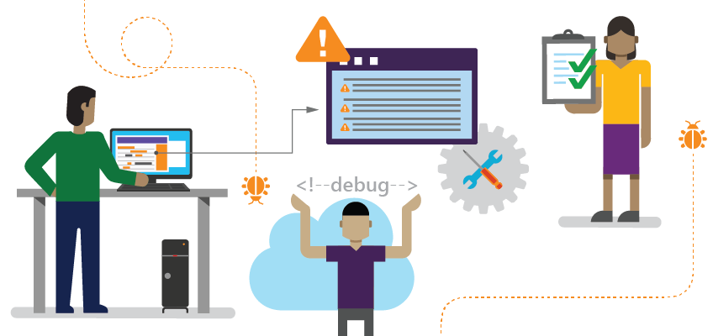
Development Struggles
Notes:
Integration costs time, money, and other resources. As software components become more complicated, the cost to integrate various pieces increases. Another important factor is that as the number of components increases, the number of integration points also increases exponentially.
None CD workflows are non-predictable.
Environments might be misconfigured.
Human element introduces risks.
High risk due to unpredictability.
Global: Use the words integrate and interoperate correctly:
Integrate describes the relationship among features of a single Microsoft product or service. It refers to combining different features, programs, activities, or hardware into a single unit.
Interoperate describes the relationship between two separate Microsoft products or services. It refers to two or more separate units exchanging information, working together, or both.
In general, describing the relationship between a Microsoft product or service and a third-party product, add-in, or service isn’t as sensitive as describing the relationship between two or more Microsoft products or services.

Slide 5
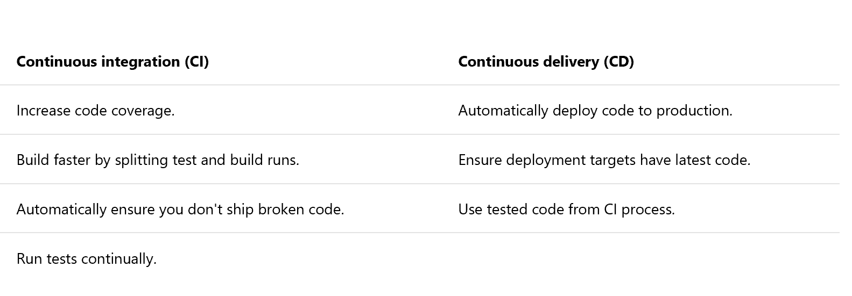
Continuous Integration (CI) and Continuous Delivery (CD)
Notes:
Enter Continuous Integration.
As per Martian Fowler:
“Continuous Integration is a software development practice where members of a team integrate their work frequently, usually each person integrates at least daily - leading to multiple integrations per day. Each integration is verified by an automated build (including test) to detect integration errors as quickly as possible. Many teams find that this approach leads to significantly reduced integration problems and allows a team to develop cohesive software more rapidly.”
Software should always be in a state which can be released to production at any time.
You are doing continuous delivery when:
Your software is deployable throughout its lifecycle.
Your team prioritizes keeping the software deployable over working on new features.
Anybody can get fast, automated feedback on the production readiness of their systems any time somebody makes a change to them.
You can perform push-button deployments of any version of the software to any environment on demand.
You achieve continuous delivery by continuously integrating the software done by the development team, building executables, and running automated tests on those executables to detect problems. Furthermore, you push the executables into increasingly production-like environments to help ensure that the software will work in production. To do this, you use a Release or Deployment pipeline.
CD is the continuation of CI – it is not for everyone, but if implemented right, it’s almost like magic.
CD relies heavily on automation of all the elements and tasks in the delivery pipeline.
The initial effort of setting up this automation can seem overwhelming, but it will save a lot of headaches and effort going forward.
This should be “Martin Fowler” the famous British software developer.
What do you mean by this?
Which article? Do we need this sentence?

Slide 6
Use Azure Pipelines
You can use either YAML or the visual designer to define your pipelines.
When you use YAML, you define your pipeline mostly in code (a YAML file) alongside the rest of the code for your app.
Notes:
https://docs.microsoft.com/en-us/azure/devops/pipelines/get-started/pipelines-get-started?toc=/azure/devops/pipelines/toc.json&bc=/azure/devops/boards/pipelines/breadcrumb/toc.json&view=azure-devops

Slide 7
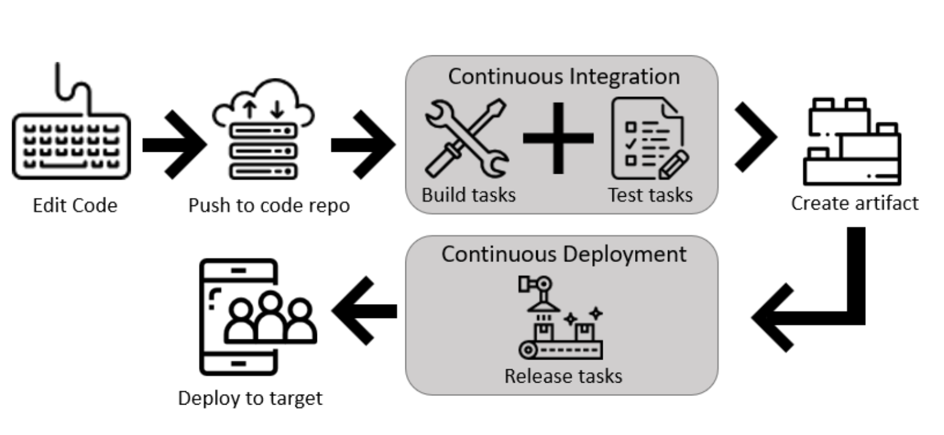
Use Azure Pipelines – Visual Designer
Configure Azure Pipelines to use your Git repo.
Use the Azure Pipelines visual designer to create and configure your build and release pipelines.
Push your code to your version control repository. This action triggers your pipeline and runs tasks such as building or testing code.
The build creates an artifact that's used by the rest of your pipeline to run tasks such as deploying to staging or production.
Your code is now updated, built, tested, and packaged. It can be deployed to any target.
Notes:
https://docs.microsoft.com/en-us/azure/devops/pipelines/get-started/pipelines-get-started?toc=/azure/devops/pipelines/toc.json&bc=/azure/devops/boards/pipelines/breadcrumb/toc.json&view=azure-devops

Slide 8
Use Azure Pipelines – Visual Designer (continued)
The visual designer is great for users who are new to the world of continuous integration (CI) and continuous delivery (CD)
The visual representation of the pipelines makes it easier to get started
Notes:
https://docs.microsoft.com/en-us/azure/devops/pipelines/get-started/pipelines-get-started?toc=/azure/devops/pipelines/toc.json&bc=/azure/devops/boards/pipelines/breadcrumb/toc.json&view=azure-devops

Slide 9
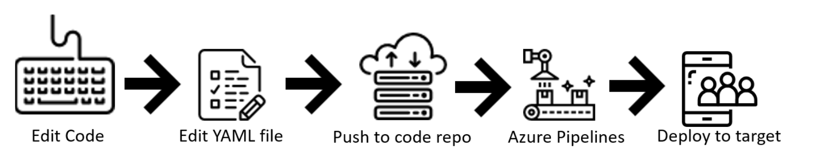
Use Azure Pipelines - YAML
Configure Azure Pipelines to use your Git repo.
Edit your azure-pipelines.yml file to define your build and/or release.
Push your code to your version control repository. This action kicks off the default trigger to build and deploy and then monitor the results.
Your code is now updated, built, tested, and packaged. It can be deployed to any target.
Unified YAML experience, so you can configure each of your pipelines to do CI, CD, or CI and CD together
Notes:
https://docs.microsoft.com/en-us/azure/devops/pipelines/get-started/pipelines-get-started?toc=/azure/devops/pipelines/toc.json&bc=/azure/devops/boards/pipelines/breadcrumb/toc.json&view=azure-devops

Slide 10
Use Azure Pipelines – YAML (continued)
The pipeline is versioned with your code and follows the same branching structure
Validate your changes through code reviews in pull requests and branch build policies
Every branch you use can modify the build policy by modifying the azure-pipelines.yml file.
A change to the build process might cause a break or result in an unexpected outcome. Because the change is in version control with the rest of your codebase, you can more easily identify the issue.
“Export to YAML" feature available for designer build pipelines. Save your pipeline definition, then find "Export to YAML" on the ... menu.
Notes:
https://docs.microsoft.com/en-us/azure/devops/pipelines/get-started/pipelines-get-started?toc=/azure/devops/pipelines/toc.json&bc=/azure/devops/boards/pipelines/breadcrumb/toc.json&view=azure-devops

Slide 11
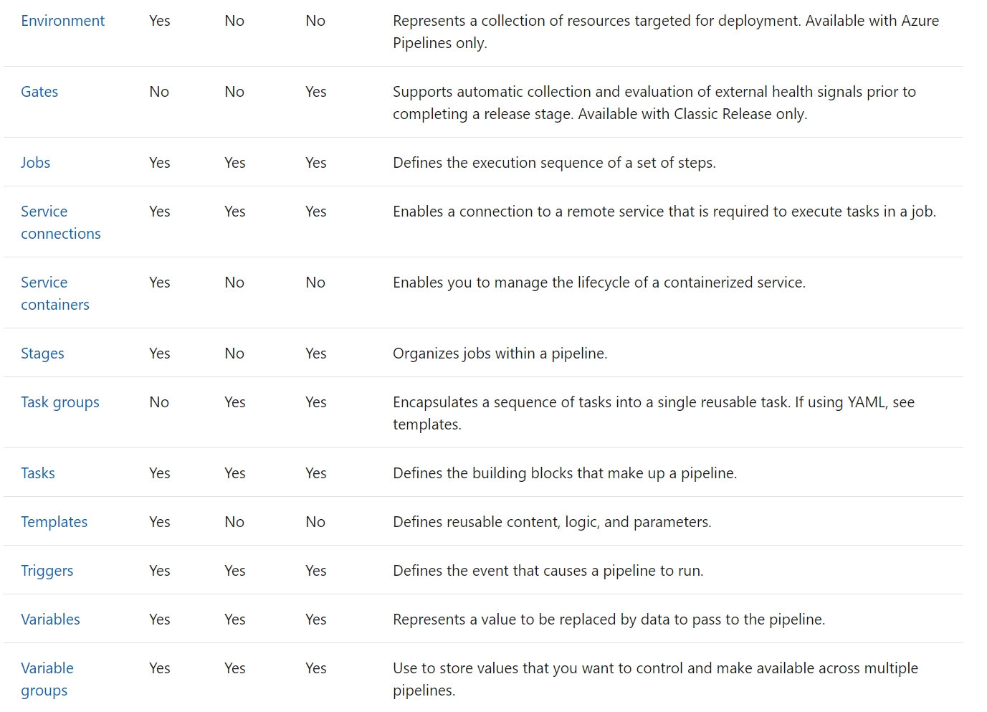
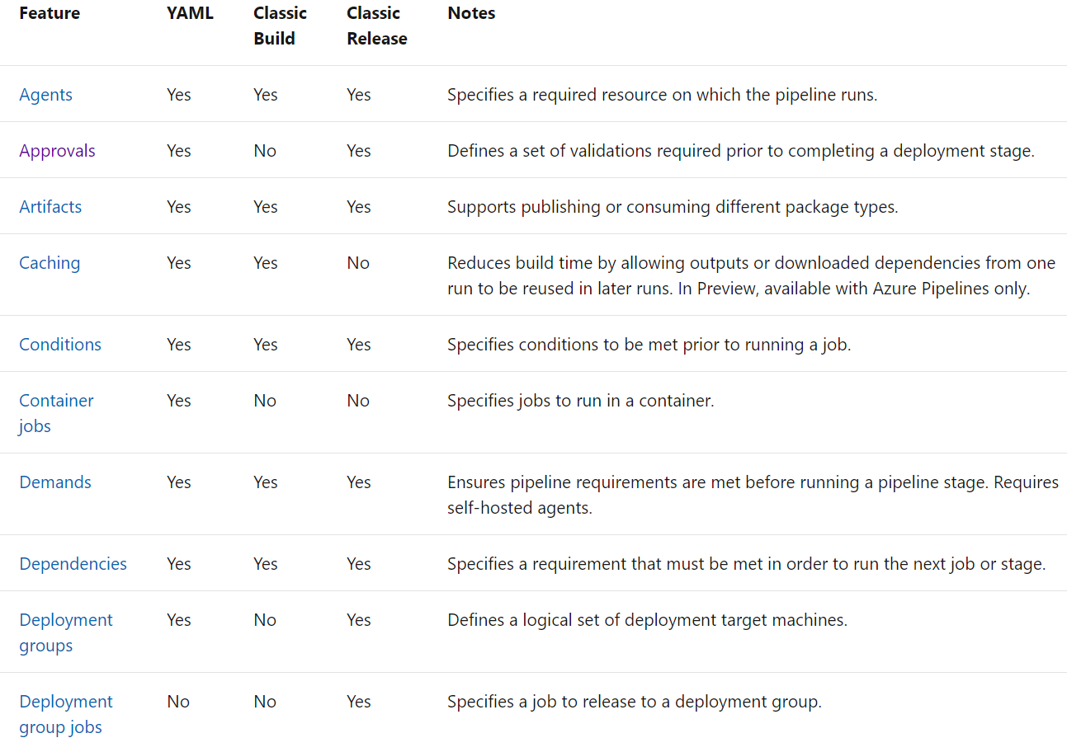
Feature Availability: reference table

Slide 12
Agents and Agent Pools
To build your code or deploy your software you need at least one agent. As you add more code and people, you'll eventually need more.
When your build or deployment runs, the system begins one or more jobs. An agent is installable software that runs one build or deployment job at a time.
Organize agents into agent pools: an agent pool defines the sharing boundary for all agents in that pool.
A project agent pool provides access to an organization agent pool. When you create a build or release pipeline, you specify which pool it uses. Pools are scoped to your project in Azure Pipelines, so you can only use them across build and release pipelines within a project.

Slide 13
Agents (continued)
Microsoft-hosted
Simplest way to build and deploy
Maintenance and upgrades are taken care of for you
Each time you run a pipeline, you get a fresh virtual machine. The virtual machine is discarded after one use.
Self-hosted
Set up and manage on your own to run build and deployment jobs
Gives you more control to install dependent software needed for your builds and deployments
You can install the agent on Linux, macOS, or Windows machines. You can also install an agent on a Linux Docker container.
Can be configured as a service or an interactive process
Notes:
https://docs.microsoft.com/en-us/azure/devops/pipelines/agents/agents?view=azure-devops

Slide 14
Capabilities
Every agent has a set of capabilities that indicate what it can do
Capabilities are name-value pairs either automatically discovered by the agent software (system capabilities), or those that you define (user capabilities)
The agent software automatically determines various system capabilities:
Name of the machine, type of operating system, and versions of certain software installed on the machine
Environment variables defined in the machine
You can specify certain demands of the agent when you author a build or release pipeline or queue a build or deployment
The system sends the job only to agents that have capabilities matching the demands specified in the pipeline
Allows you to direct builds and deployments to specific agents
Notes:
The agent software automatically determines various system capabilities such as the name of the machine, type of operating system, and versions of certain software installed on the machine. Also, environment variables defined in the machine automatically appear in the list of system capabilities.
When you author a build or release pipeline, or when you queue a build or deployment, you specify certain demands of the agent. The system sends the job only to agents that have capabilities matching the demands specified in the pipeline. As a result, agent capabilities allow you to direct builds and deployments to specific agents.

Slide 15
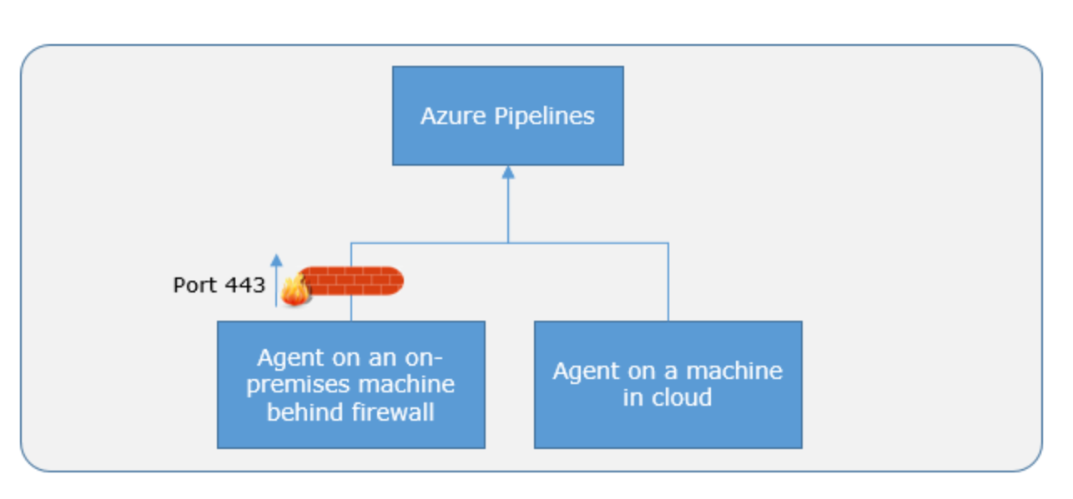
Communication
Agents communicate with Azure Pipelines to determine which job it needs to run, and to report the logs and job status
Communication is always initiated by the agent (HTTP/HTTPS)
Notes:
The agent communicates with Azure Pipelines or TFS to determine which job it needs to run, and to report the logs and job status. This communication is always initiated by the agent. All the messages from the agent to Azure Pipelines or TFS happen over HTTP or HTTPS, depending on how you configure the agent. This pull model allows the agent to be configured in different topologies as shown below.
Here is a common communication pattern between the agent and Azure Pipelines or TFS.
The user registers an agent with Azure Pipelines or TFS by adding it to an agent pool. You need to be an agent pool administrator to register an agent in that agent pool. The identity of agent pool administrator is needed only at the time of registration and is not persisted on the agent, nor is used in any further communication between the agent and Azure Pipelines or TFS. Once the registration is complete, the agent downloads a listener OAuth token and uses it to listen to the job queue.
Periodically, the agent checks to see if a new job request has been posted for it in the job queue in Azure Pipelines/TFS. When a job is available, the agent downloads the job as well as a job-specific OAuth token. This token is generated by Azure Pipelines/TFS for the scoped identity specified in the pipeline. That token is short lived and is used by the agent to access resources (e.g., source code) or modify resources (e.g., upload test results) on Azure Pipelines or TFS within that job.
Once the job is completed, the agent discards the job-specific OAuth token and goes back to checking if there is a new job request using the listener OAuth token.
The payload of the messages exchanged between the agent and Azure Pipelines/TFS are secured using asymmetric encryption. Each agent has a public-private key pair, and the public key is exchanged with the server during registration. The server uses the public key to encrypt the payload of the job before sending it to the agent. The agent decrypts the job content using its private key. This is how secrets stored in build pipelines, release pipelines, or variable groups are secured as they are exchanged with the agent.

Slide 16
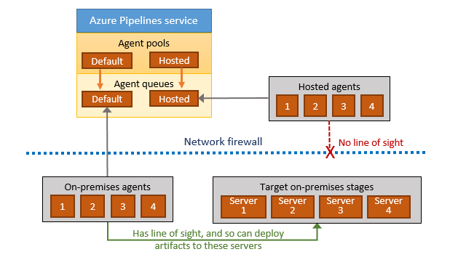
Communication
When you use the agent to deploy artifacts to a set of servers, it must have "line of sight" connectivity to those servers
The Microsoft-hosted agent pools, by default, have connectivity to Azure websites and servers running in Azure
If your on-premises environments do not have connectivity to a Microsoft-hosted agent pool, you'll need to manually configure a self-hosted agent on on-premises computer(s). The agents must have connectivity to the target on-premises environments and access to the internet to connect to Azure Pipelines
Notes:
The agent software automatically determines various system capabilities such as the name of the machine, type of operating system, and versions of certain software installed on the machine. Also, environment variables defined in the machine automatically appear in the list of system capabilities.
When you author a build or release pipeline, or when you queue a build or deployment, you specify certain demands of the agent. The system sends the job only to agents that have capabilities matching the demands specified in the pipeline. As a result, agent capabilities allow you to direct builds and deployments to specific agents.

Slide 17
Azure Pipelines – YAML
Pipelines are made of one or more stages describing a CI/CD process.
Stages are the major divisions in a pipeline. Example: "build this app", "run these tests", and "deploy to pre-production”
Stages consist of one or more jobs, which are units of work assignable to a particular machine.
Both stages and jobs may be arranged into dependency graphs. Example: "run this stage before that one"
Jobs consist of a linear series of steps. Steps can be tasks, scripts, or references to external templates.
Pipeline
Stage A
Job 1
Step 1.1
Step 1.2
...
Job 2
Step 2.1
...
Stage B
...
Create Azure Pipelines from VSCode
Notes:
https://docs.microsoft.com/en-us/azure/devops/pipelines/yaml-schema?view=azure-devops&tabs=schema

Slide 18
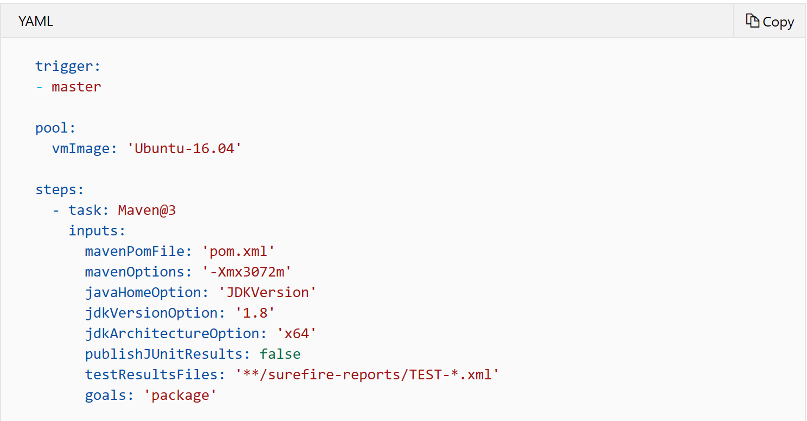
Customize the pipeline
Understand the azure-pipelines.yml file
A pipeline is defined using a YAML file in your repo. Usually, this file is named azure-pipelines.yml and is located at the root of your repo.

Slide 19
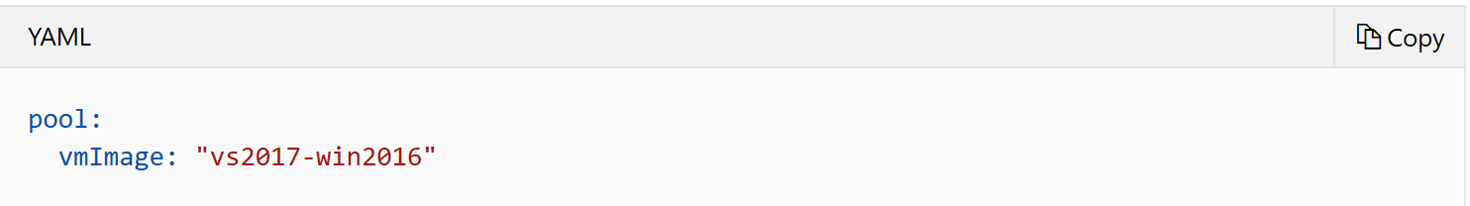
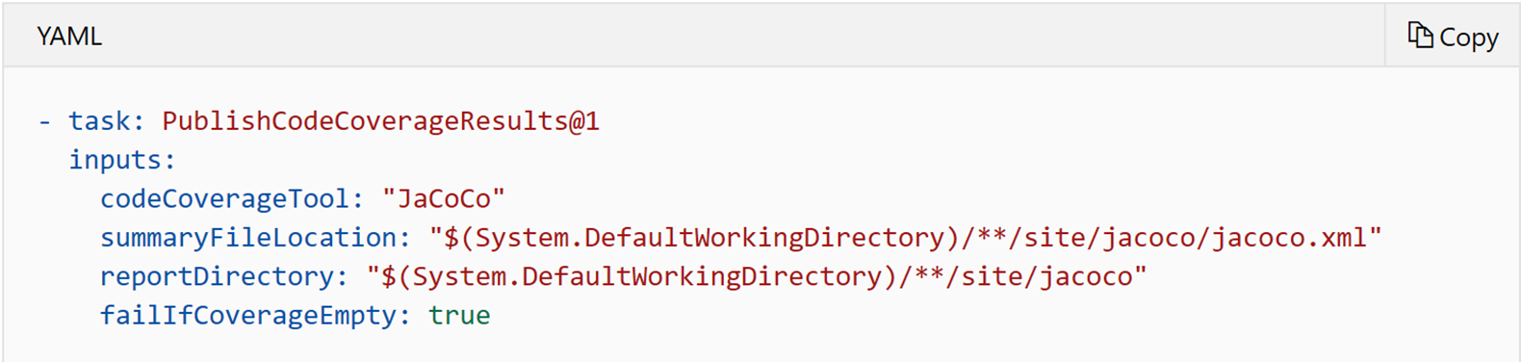
Customize the pipeline (continued)
Change the platform to build on
Build your project on Microsoft-hosted agents that already include SDKs and tools for various development languages. Or, use self-hosted agents with specific tools that you need.
Add steps
Add additional script or task as steps to your pipeline. A task is a pre-packaged script. Use tasks for building, testing, publishing, or deploying your app.
Notes:
https://docs.microsoft.com/en-us/azure/devops/pipelines/customize-pipeline?view=azure-devops

Slide 20
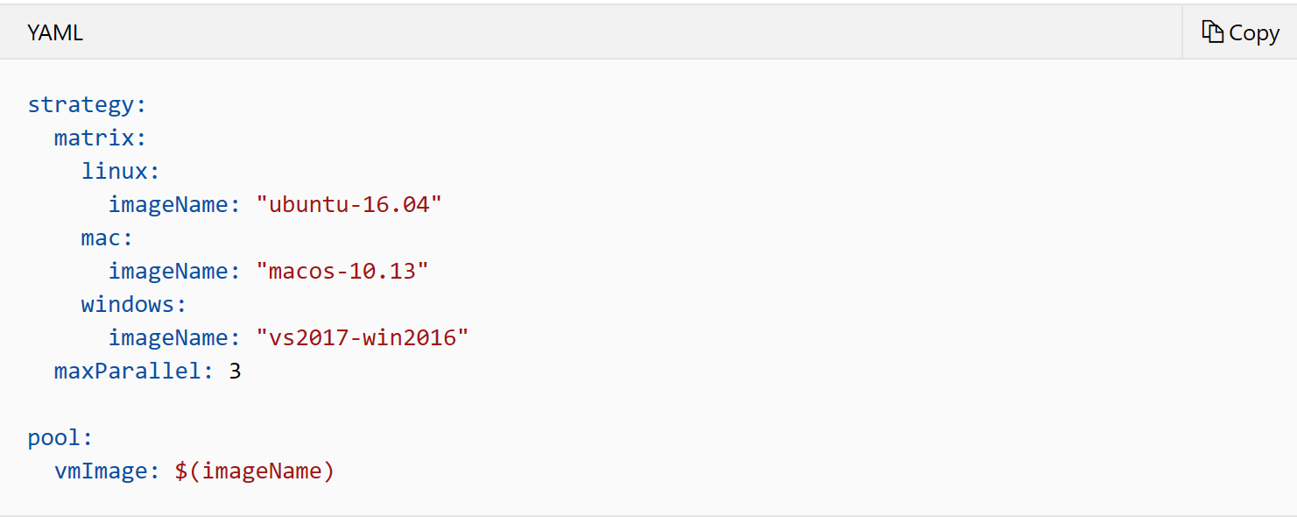
Customize the pipeline (continued)
Build across multiple platforms
Build and test your project on multiple platforms. One way to do it is with strategy and matrix. Use variables to conveniently put data into various parts of a pipeline.
Notes:
https://docs.microsoft.com/en-us/azure/devops/pipelines/customize-pipeline?view=azure-devops

Slide 21
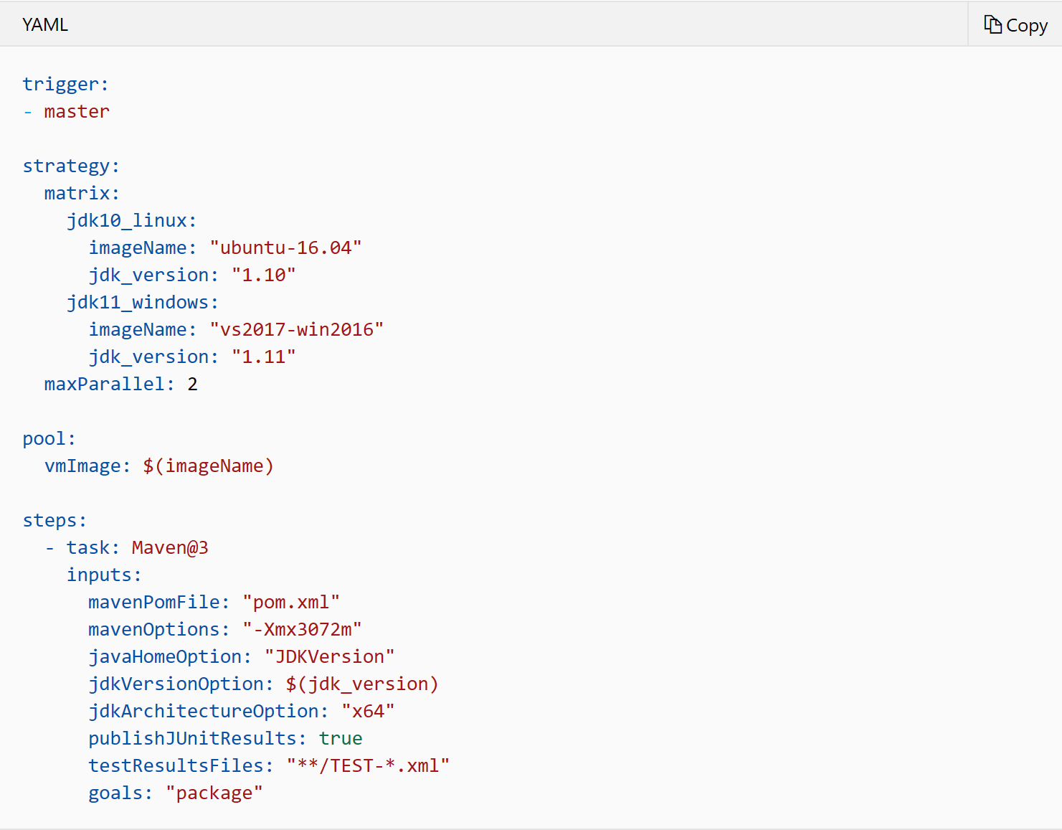
Customize the pipeline (continued)
Build using multiple versions
Build a project using different versions of that language using a matrix of versions and a variable.
Notes:
https://docs.microsoft.com/en-us/azure/devops/pipelines/customize-pipeline?view=azure-devops

Slide 22
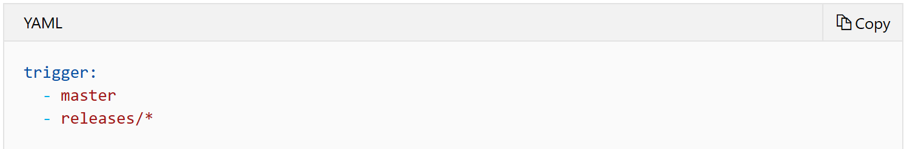
Customize the pipeline (continued)
Customize CI triggers
Use a trigger: to specify the events when you want to run the pipeline. YAML pipelines are configured by default with a CI trigger on your default branch (which is usually master).
Approval policies for YAML pipelines
Make a YAML variable read-only
Support for output variables in a deployment job
Multi-repo triggers
Stages filters for pipeline resource triggers
Notes:
https://docs.microsoft.com/en-us/azure/devops/pipelines/customize-pipeline?view=azure-devops

Slide 23
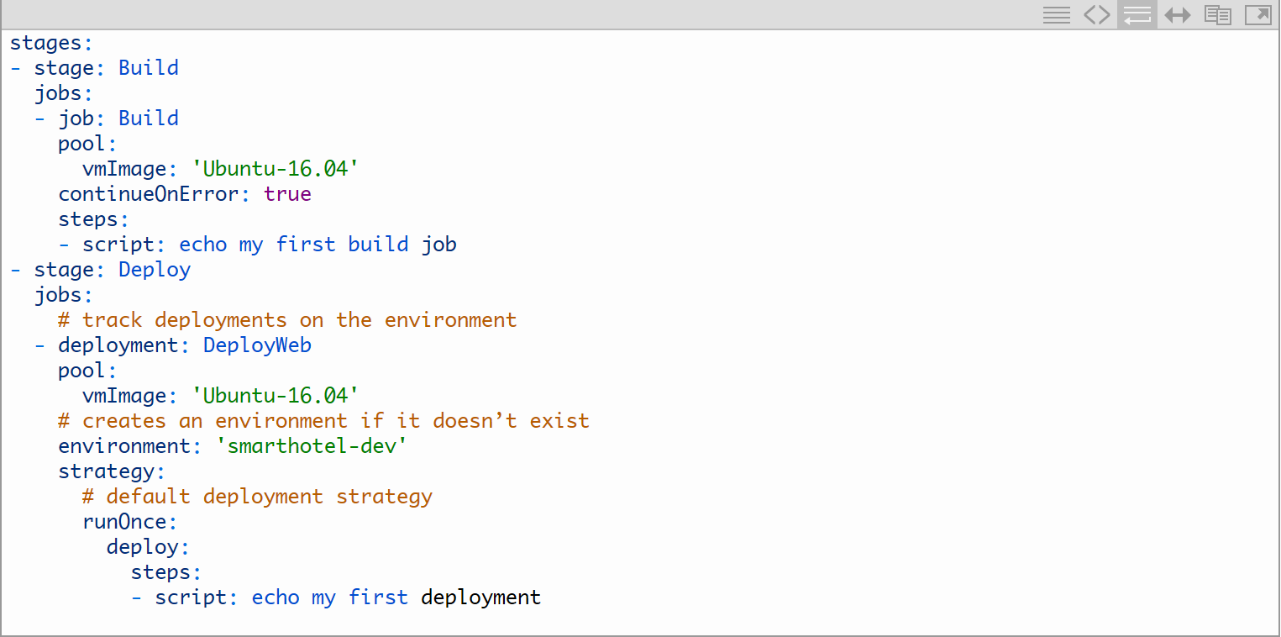
Multi-stage pipelines with environments
Multi-stage pipelines with environments
Notes:
https://devblogs.microsoft.com/devops/whats-new-with-azure-pipelines/
https://docs.microsoft.com/en-us/azure/devops/pipelines/process/stages?view=azure-devops&tabs=yaml

Slide 24
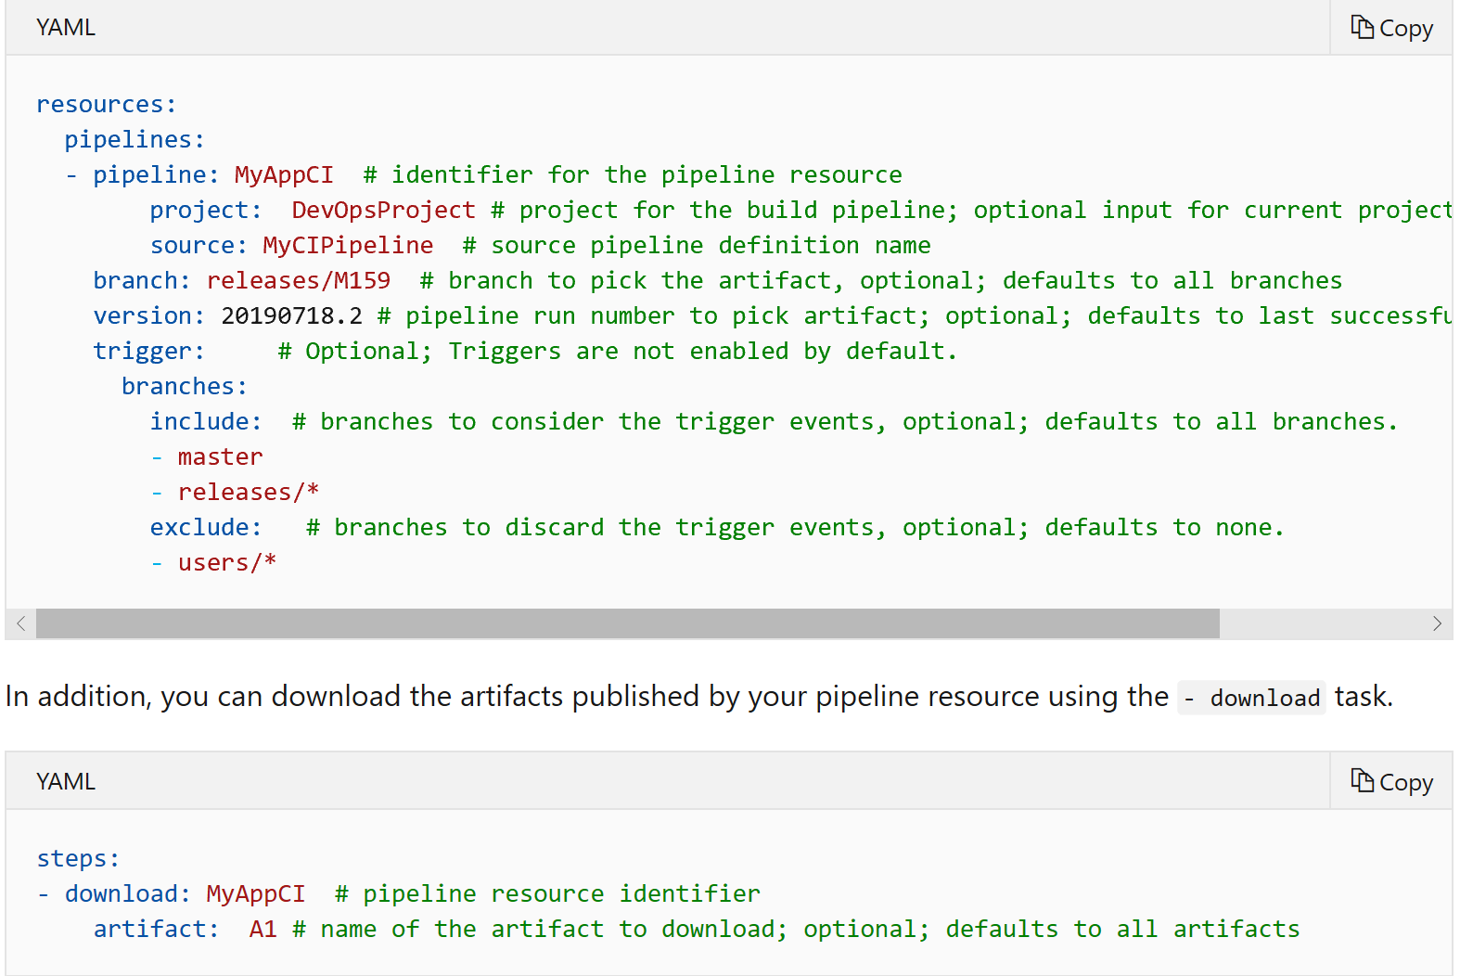
Multi-stage pipelines with environments (continued)
CD capabilities for your multi-stage YAML pipelines
Consume artifacts published by your CI pipeline and enable pipeline completion triggers. In multi-stage YAML pipelines, pipelines are a resource. In your YAML, you can now refer to another pipeline and also enable CD triggers.

Slide 25
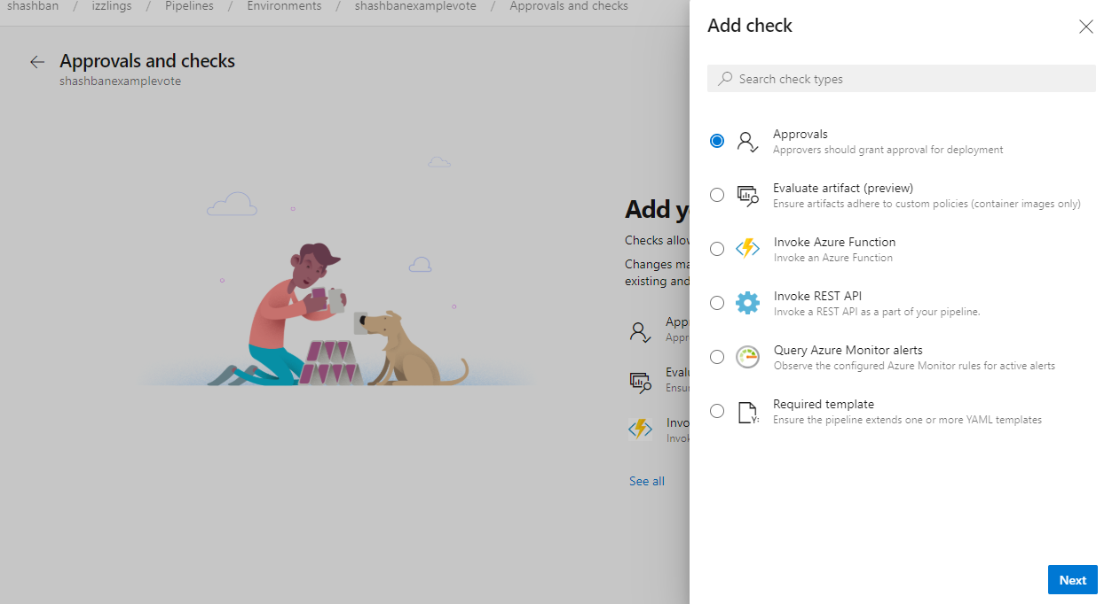
Multi-stage pipelines with environments (continued)
Additional control of your deployments
Approvals and checks
Checks allow you to manage how this resource is used. Changes made to checks are effective immediately, applicable to all existing and new pipelines.

Slide 26
What is a Build Pipeline?
Defines the configuration for a concrete application build process
Key settings:
Name
Triggers
Repository mappings
Build defaults
Retention policy
Process settings:
Tasks
Building block for defining automation in a build pipeline
A packaged script or procedure that has been abstracted with a set of inputs
Every task has its own arguments
Tasks are run in sequence, one after the other, on an agent
To run the same set of tasks in parallel on multiple agents, or to run some tasks without using an agent, use jobs
Microsoft Confidential

Slide 27
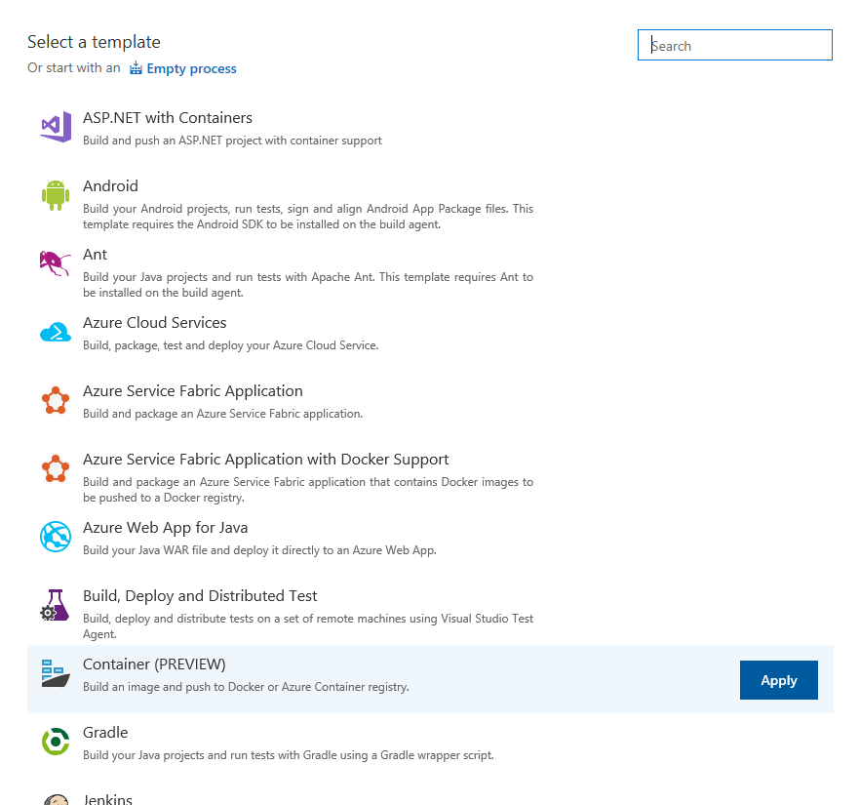
Build for Your Platform, Speaking Your Language
One system for multiple platforms
Build for most platforms:
Windows
iOS
Java (Ant, Maven, or Gradle)
Linux
Microsoft Confidential
Notes:
Build for Windows, iOS, Android, Java (Ant, Maven, or Gradle), or Linux by using the same Domain-Specific Language (DSL) that you use every day on your development machine. We even build Xamarin apps for both iOS and Android and run tests on Xamarin's Test Cloud as part of the build. We intend to enable publishing the Test Cloud test results to the server so that you can view them in your build summary.
Xamarin Test Cloud?
Can we reword this as, “ You can also build Xamarin apps for both…”
Replace, “We intend” with “Microsoft intends….” ?

Slide 28
Features
Real-time Build Status
A live console view on the web that displays the real-time status of each task
Auditing and Diff
Build definition is in JSON
You can identify who changed what in a build pipeline
Variables
Common parameter values can be abstracted into variables
Sensitive values can be marked as secret
CI Support
Branch filter
Template
Reuse pre-defined steps
Create your own template from an existing build pipeline
Task-based
Execute any script
Extensible
Retention Policy
Configure how long builds are to be retained by the system

Slide 29
Build Triggers
Multiple triggers per build:
Manual
Continuous integration
Batch changes
Path filters
Scheduled
Pull request validation
Add as many triggers as you wish
Build completion
Trigger a new build when an upstream dependency change
Microsoft Confidential
Notes:
https://docs.microsoft.com/en-us/azure/devops/pipelines/build/triggers?view=azure-devops&tabs=yaml
Talking Points
Manual
Check-ins do not trigger a new build. New builds have to be manually queued.
Continuous Integration (CI)
Build each check-in after it has been committed to the repository.
Batch Builds
Accumulate check-ins until the previous build finishes.
The build system queues a build of each check-in as long as the build is not running.
If the build is running, the system waits until the build is completed and then queues another build of all check-ins that have not yet been built.
Scheduled
Build every week on the following day(s) at the following times.
Take note of the time zone specified in the build definition.
Useful if you want a CI build, but have a high volume of check-ins or a long-running build process.
Build Completion
Large products have several components that are dependent on each other. These components are often independently built. When an upstream component (a library, for example) changes, the downstream dependencies have to be rebuilt and revalidated.
In situations like these, add a build completion trigger to run your build upon the successful completion of the triggering build. You can select any other build in the same project.

Slide 30
Repository Settings
Select the type of source repository that contains your source files and specify where your sources are
Repository type:
Azure Repos Git or TFVC
GitHub
GitHub Enterprise
Bitbucket Cloud
External Git
Subversion
Microsoft Confidential
Notes:
https://docs.microsoft.com/en-us/azure/devops/pipelines/build/repository?view=azure-devops
TFVC Workspace mapping
During the build process, the build agent compiles and does other work with your source files.
Before the build agent can do this work, it downloads the files from the folders on your version control server into a local working directory. To facilitate downloading these files, the build agent creates a version control workspace, which maps the folders on the server to the local folders in the working directory for the build agent.
For CI, rolling, and gated builds, the paths in the Workspace Mappings tab of the build definition to determine whether a build needs to be triggered for the check-in.
The workspace mappings should be scoped to the minimally required files.
For more information, see Work with Build Workspaces at
http://msdn.microsoft.com/en-us/library/hh190721(v=vs.110).aspx

Slide 31
History
List of changes that includes who made the change and when the change occurred
Compare two different versions
Revert to a specific version
Microsoft Confidential
Notes:
https://docs.microsoft.com/en-us/azure/devops/pipelines/build/history?view=azure-devops
For more information, see Work with Build Workspaces at
http://msdn.microsoft.com/en-us/library/hh190721(v=vs.110).aspx

Slide 32
Export/Import
Export build pipeline as a JSON file
Import and reuse in another Project
Microsoft Confidential
Notes:
For more information, see Work with Build Workspaces at
http://msdn.microsoft.com/en-us/library/hh190721(v=vs.110).aspx

Slide 33
View Logs
Real-time monitoring and logging
Click on a task to view task specific log
Logs are saved with the build after completion
Microsoft Confidential

Slide 34
Release Pipelines (classic)
A release pipeline defines the end-to-end release pipeline for an application to be deployed across various stages
Use Azure Pipelines releases by authoring a release pipeline for your application
Specify the artifacts that make up the application and the release pipeline
An artifact is a deployable component of your application. It is typically produced through a Continuous Integration or a build pipeline. Azure Pipelines releases can deploy artifacts that are produced by a wide range of artifact sources such as Azure Pipelines build, Jenkins, or Team City
Define the release pipeline using stages, and restrict deployments into or out of a stage using approvals
Define the automation in each stage using jobs and tasks
Use variables to generalize your automation and triggers to control when the deployments should be kicked off automatically
Default variables: Use information about the context of the release, stage, artifacts, or agent in which the deployment pipeline is being run
Custom variables: Define a more generic deployment pipeline once, and then customize it easily for each stage
Notes:
https://docs.microsoft.com/en-us/azure/devops/pipelines/release/?view=azure-devops

Slide 35
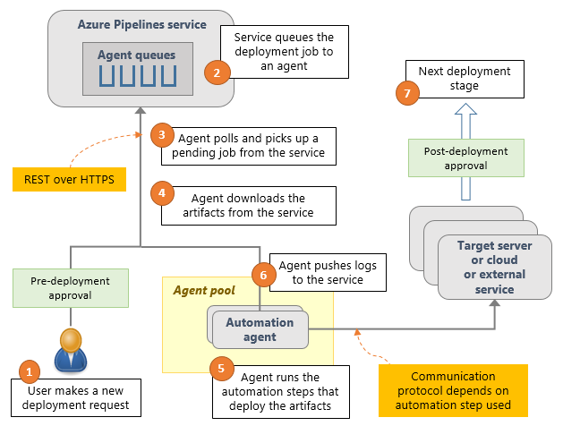
How Do Release Pipelines (classic) Work?
Microsoft Confidential
Notes:
Release Management runs the following steps as part of every deployment:
Pre-deployment approval: When a new deployment request is triggered, Release Management checks whether a pre-deployment approval is required before deploying a release to an environment. If it is required, it sends out email notifications to the appropriate approvers.
Queue deployment job: Release Management schedules the deployment job on an available automation agent. An agent is a piece of software that is capable of running tasks in the deployment.
Agent selection: An automation agent picks up the job. The agents for Release Management are exactly the same as those that run your builds in Azure DevOps Services and TFS. A release definition can contain settings to select an appropriate agent at runtime.
Download artifacts: The agent downloads all the artifacts specified in that release (provided you have not opted to skip the download). The agent currently understands two types of artifacts: Team Build artifacts and Jenkins artifacts.
Run the deployment tasks: The agent then runs all the tasks in the deployment job to deploy the app to the target servers for an environment.
Generate progress logs: The agent creates detailed logs for each step while running the deployment, and pushes these logs back to Azure DevOps Services or TFS.
Post-deployment approval: When the deployment to an environment is complete, Release Management checks if there is a post-deployment approval required for that environment. If no approval is required, or upon completion of a required approval, Release Management proceeds to trigger the deployment to the next environment.

Slide 36
Creating a Release
Releases (and, in some cases, draft releases) can be created:
By a continuous deployment trigger that creates a release when a new version of the source build artifacts is available
By using the Release command in the UI to create a release manually from the Releases or the Builds summary
By sending a command over the network to the REST interface
Microsoft Confidential
Notes:
Creating a release from the RELEASE hub
You will need to create a release manually if you have not specified a continuous deployment or continuous integration trigger in your release definition. When you are ready to manually create a release from a release definition, open the definition and choose Create Release from the Release drop-down list. Or select the release in the left column list of release definitions, open the shortcut menu, and choose Release.
In the CREATE NEW RELEASE dialog box, select the version of the linked build artifacts you want to include in this release. Optionally, enter a description for this release.
Notice that the dialog box contains two sections named Automated deployments and Manual deployments. In the case (above) where there are no environment deployment triggers set, the Manual deployments section shows a list of all the environments. Users will be required to manually initiate deployment to each of these.
Specifying manual deployment for an environment is one way to prevent a deployment from happening until you are sure it is ready to go. However, you can also use approvals at intermediate stages to pause a release and allow it to be cancelled before it reaches the target or final environment. However, if you have specified any environment deployment triggers in the environments in your definition, the CREATE NEW RELEASE dialog box will show this in the Automated deployments and Manual deployments sections.

Slide 37
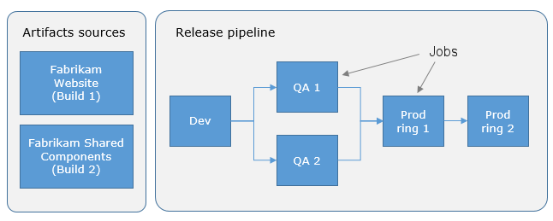
Release Pipelines (classic)

Slide 38
Tracking a Release
The Releases page shows a list of releases
Click on a specific release to see the release log and details.
See the status for each stage.
Click on a stage to view the details of that stage
Logs, test
Can deploy a stage if previously failed.
Microsoft Confidential

Slide 39
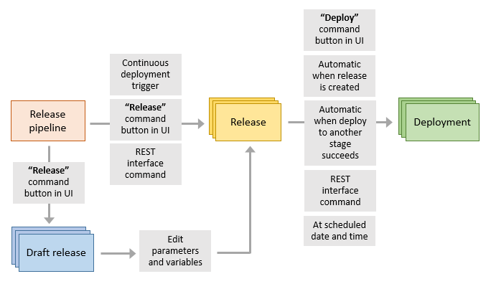
Releases and Deployments
A release is the package or container that holds a versioned set of artifacts specified in a release pipeline in your DevOps CI/CD processes..
A deployment is the action of running the tasks for one stage, which results in the application artifacts being deployed, tests being run, and whatever other actions are specified for that stage.
Microsoft Confidential
Notes:
Understand releases and deployments
In Release Management, the terms release and deployment have very different meanings:
A release is the package or container that holds a versioned set of artifacts specified in a release definition. It includes a snapshot of all the information required to carry out all the tasks and actions in the release definition, such as the environments, the task steps for each one, the values of task parameters and variables, and the release policies such as triggers, approvers, and release queuing options. There can be multiple releases from one released definition, and information about each one is stored and displayed in Release Management for the specified retention period
A deployment is the action of running the tasks for one environment, which results in the application artifacts being deployed, tests being run, and whatever other actions are specified for that environment. A release creates, initializes, and starts each deployment based on the settings and policies defined in the original release definition. There can be multiple deployments from each release.

Slide 40
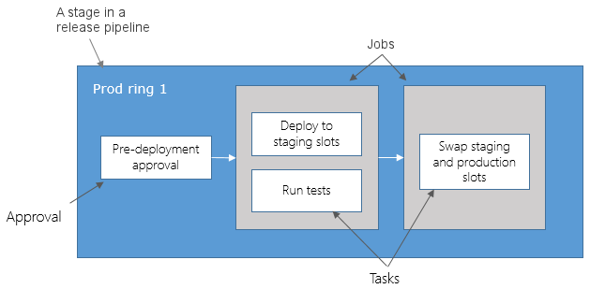
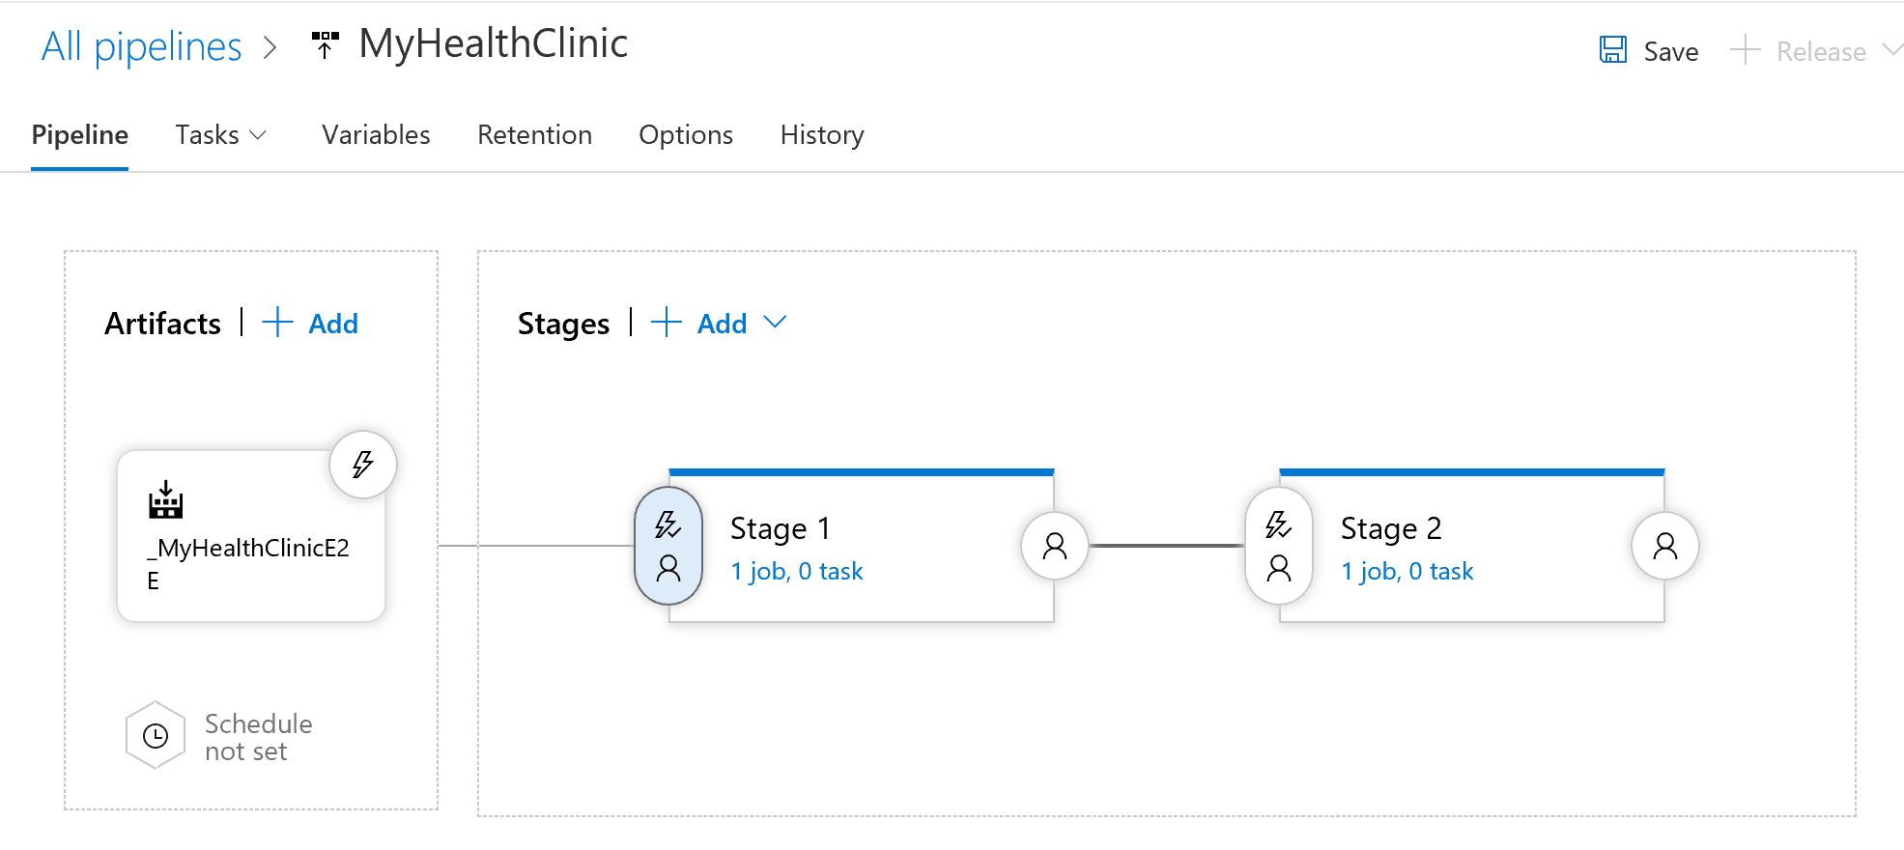
Stages
A stage is a logical and independent entity that represents where you want to deploy a release
The deployment in a stage may be to a collection of servers, a cloud, or multiple clouds
Deploy to a stage independently of other stages in the pipeline
The deployment pipeline of a release to a stage is defined in terms of jobs and tasks
The physical deployment of a release to a stage is controlled through approvals and gates, deployment conditions and triggers, and queuing policies
Microsoft Confidential
Notes:
https://docs.microsoft.com/en-us/azure/devops/pipelines/release/environments?view=azure-devops
Stage is basically a place where you will roll out your software.
Eg: Dev -> QA -> Production.

Slide 41
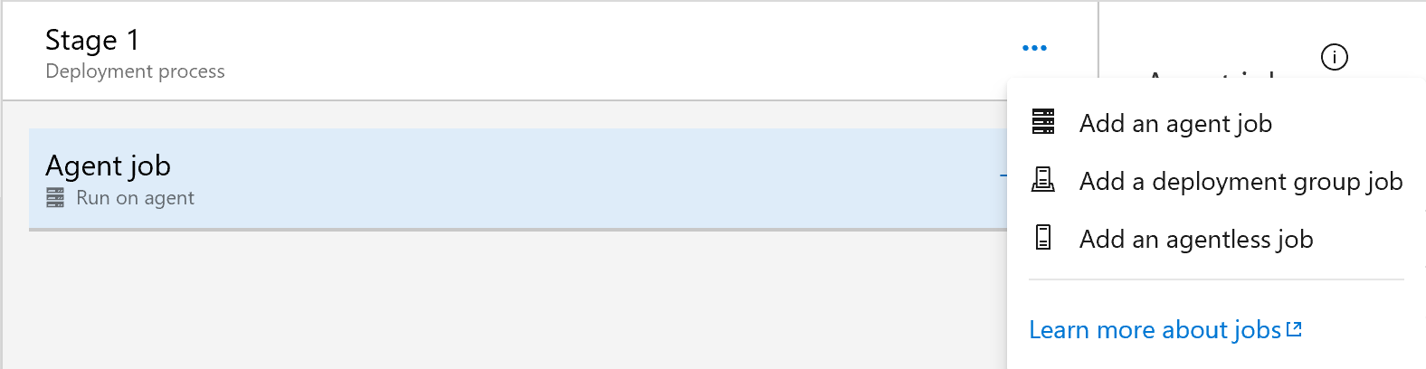
Stages - Jobs
Organize your deployment pipeline into jobs. Every deployment pipeline has at least one job
A job is a series of tasks that run sequentially on the same target
At design time in your job, you specify a series of tasks that you want to run on a common target.
At run time (when the release pipeline is triggered), each job is dispatched as one or more jobs to its target
In a deployment pipeline, the target can be either an agent, a deployment group, or the server
When the target is an agent, the tasks are run on the computer that hosts the agent

Slide 42
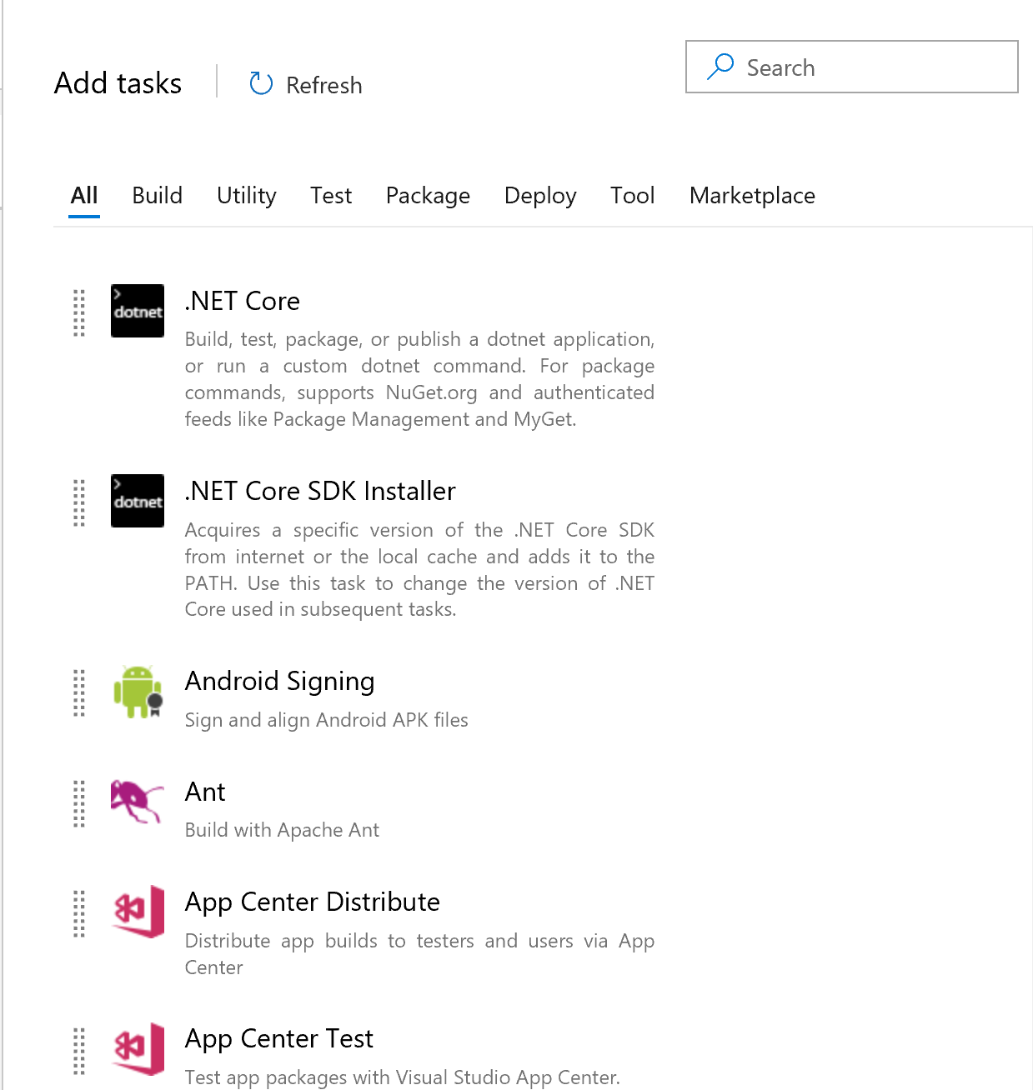
Stages – Tasks
A task is the building block for defining automation in a stage of a release pipeline
Packaged script or procedure that has been abstracted with a set of inputs
All the tasks are run in sequence, one after the other, on an agent
Microsoft Confidential

Slide 43
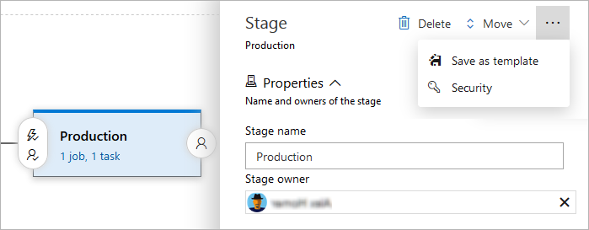
Stages - General
Notes:
While the most important part of defining a stage is the automation tasks, you can also configure several properties and options for a stage in a release pipeline. You can:
Edit the name of the stage here if required.
Designate a single user or a single group to be the stage owner. Stage owners are notified whenever a deployment of a release is completed to that stage. Stage owners are not automatically assigned any additional permissions.
Delete the stage from the pipeline.
Change the order of stages.
Save a copy of the stage as a template.
Manage the security settings for the stage.

Slide 44
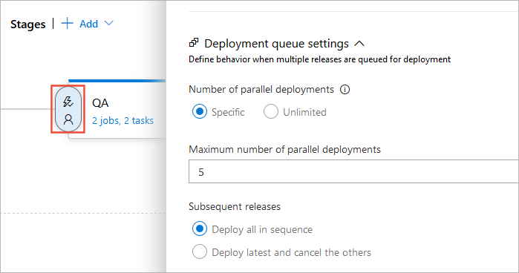
Stages – Queuing Policies
Notes:
The options you can choose for a queuing policy are:
Number of parallel deployments: Use this option if you dynamically provision new resources in your stage and it is physically capable of handling the deployment of multiple releases in parallel, but you want to limit the number of parallel deployments.
If you specify a maximum number of deployments, two more options appear:
Deploy all in sequence: Use this option if you want to deploy all the releases sequentially into the same shared physical resources. By deploying them in turn, one after the other, you ensure that two deployment jobs do not target the same physical resources concurrently, even if there are multiple build and release agents available. You also ensure that pre-deployment approval requests for the stage are sent out in sequence.
Deploy latest and cancel the others: Use this option if you are producing releases faster than builds, and you only want to deploy the latest build.

Slide 45
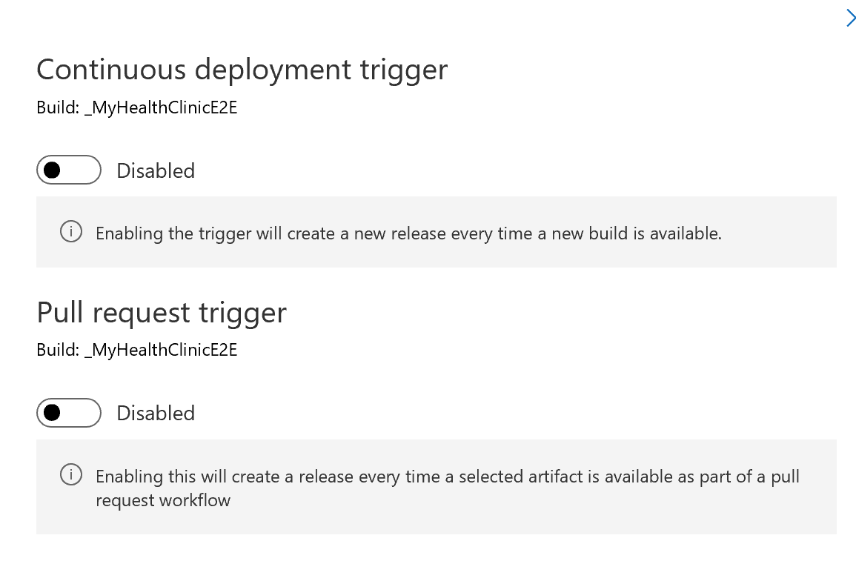
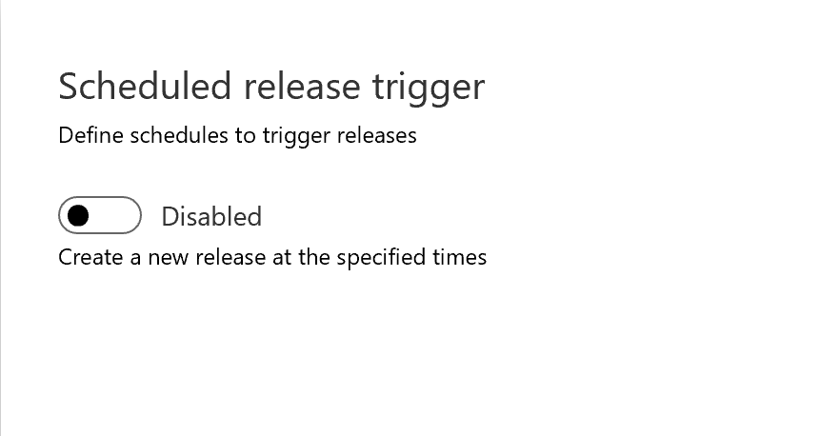
Triggers – Release Triggers
Configure when releases should be created with:
Continuous deployment triggers
Azure Pipelines creates new releases automatically when it detects new artifacts are available
Scheduled release triggers
Create and start a release at specific times
Pull request triggers
Configure a pull request trigger that will create a new release when a pull request uploads a new version of the artifact
Notes:
https://docs.microsoft.com/en-us/azure/devops/pipelines/release/triggers?view=azure-devops

Slide 46
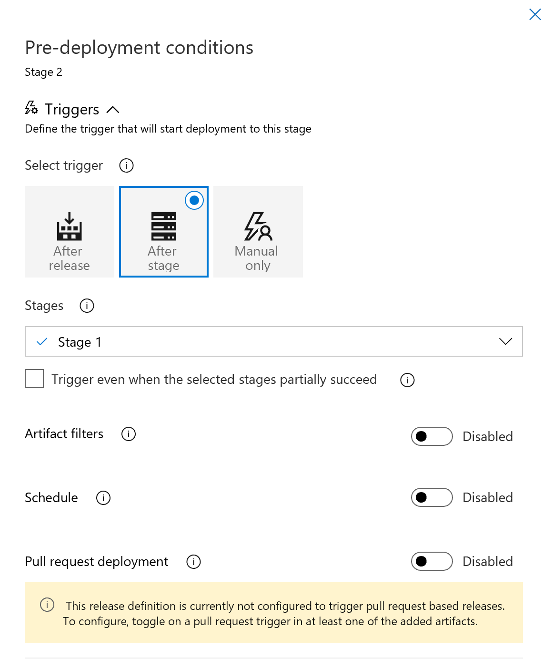
Triggers – Stage Triggers
Trigger deployment to each stage automatically when a release is created by a continuous deployment trigger, based on:
The result of deploying to a previous stage in the pipeline
Filters based on the artifacts
A predefined schedule
A pull request that updates the artifacts
The pull request trigger conditions settings
Manually by a user
Notes:
You can choose to have the deployment to each stage triggered automatically when a release is created by a continuous deployment trigger, based on:
The result of deploying to a previous stage in the pipeline. Use this setting if you want the release to be first deployed and validated in another stage(s) before it is deployed to this stage. Triggers are configured for each stage, but the combination of these allows you to orchestrate the overall deployment - such as the sequence in which automated deployments occur across all the stages in a release pipeline. For example, you can set up a linear pipeline where a release is deployed first to the Test and QA stages. Then, if these two deployments succeed, it will be deployed to a Staging stage. In addition, you can configure the trigger to fire for partially succeeded (but not failed) deployments.
Filters based on the artifacts. You can add one or more filters for each artifact linked to the release pipeline, and specify if you want to include or exclude particular branches of the code. Deployment will be triggered to this stage only if all the artifact conditions are successfully met. Unlike build branch filters, variables cannot be used in artifact filter conditions.
A predefined schedule. When you select this option, you can select the days of the week and the time of day that Azure Pipelines will automatically start a new deployment. Unlike scheduled release triggers, you cannot configure multiple schedules for stage triggers. Note that, with scheduled triggers, a new deployment is created even if a newer version of artifact is not available.
A pull request that updates the artifacts. If you have enabled pull request triggers for your pipeline, you must also enable pull request deployment for the specific stages where you want the release to be deployed. You may also want to set up a branch policy for the branch. For more information, see Deploy pull request builds.
Manually by a user. Releases are not automatically deployed to the stage. To deploy a release to this stage, you must manually start a release and deployment from the release pipeline or from a build summary.

Slide 47
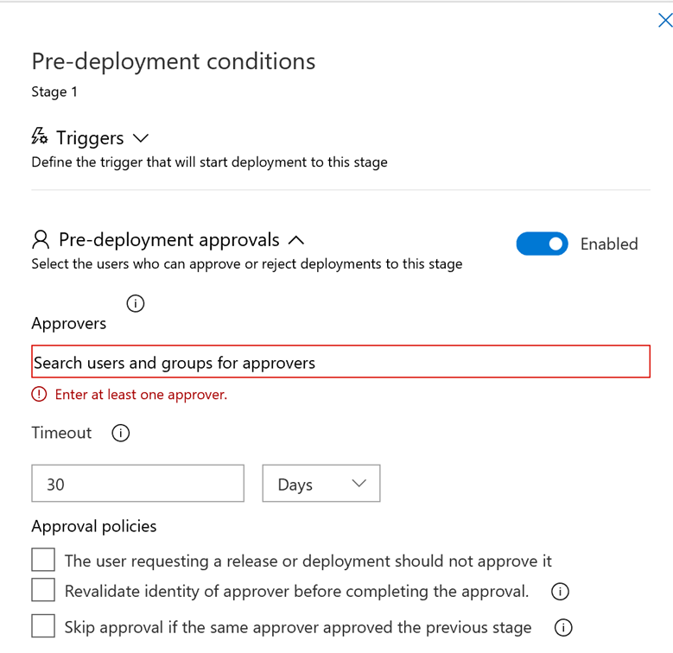
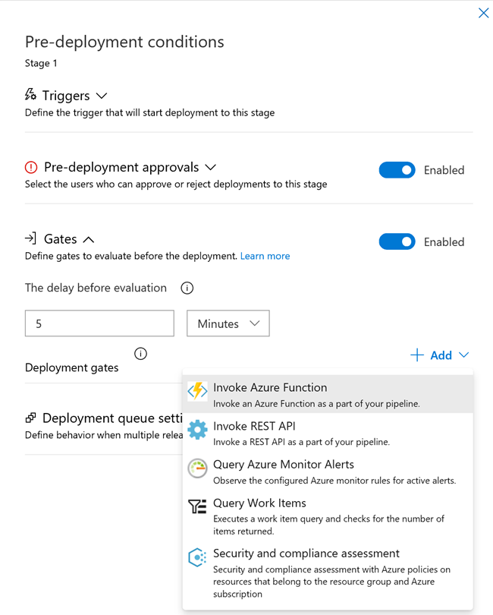
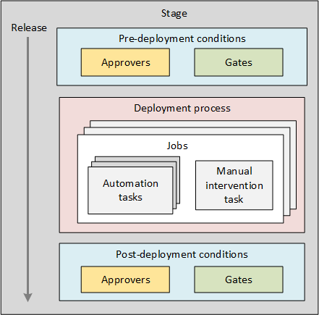
Approvals and Gates
Approvals and gates give you additional control over the start and completion of the deployment pipeline
Configure each stage in a release pipeline with pre- and post-deployment conditions that can include waiting for users to manually approve or reject deployments, and checking with other automated systems until specific conditions are verified
Configure a manual intervention to pause the deployment pipeline and prompt users to carry out manual tasks, then resume or reject the deployment

Slide 48
Deployment Groups
A deployment group is a logical set of deployment target machines that have agents installed on each one.
Deployment groups represent the physical environments; for example, "Dev", "Test", "UAT", and "Production". In effect, a deployment group is just another grouping of agents, much like an agent pool
When authoring an Azure Pipelines Release pipeline, you can specify the deployment targets for a job using a deployment group. This makes it easy to define parallel execution of deployment tasks
Deployment groups:
Specify the security context and runtime targets for the agents.
As you create a deployment group, you add users and give them appropriate permissions to administer, manage, view, and use the group.
Let you view live logs for each server as a deployment takes place and download logs for all servers to track your deployments down to individual machines.
Enable you to use machine tags to limit deployment to specific sets of target servers.

Slide 49
Library
Collection of shared build and release assets for a project
Assets defined in a library can be used in multiple build and release pipelines of the project
Can be accessed directly in Azure Pipelines
Contains two types of assets: variable groups and secure files
Use a variable group to store values that you want to make available across multiple build and release pipelines
Use the Secure Files library to store files such as signing certificates, Apple Provisioning Profiles, Android Keystore files, and SSH keys on the server without having to commit them to your source repository
The contents of the secure files are encrypted and can only be used during the build or release pipeline by referencing them from a task
Security:
Control who can define new items in a library, and who can use an existing item
Roles are defined for library items, and membership of these roles governs the operations you can perform on those items

Slide 50
Service Connections
Connect to external and remote services to execute tasks for a build or deployment by defining service connections in Azure Pipelines
Define and manage service connections from the Admin settings of your project:
https://dev.azure.com/{organization}/{project}/_admin/_services
Created at project scope. A service connection created in one project is not visible in another project.

Slide 51
Microsoft Confidential
Microsoft Confidential

