Slide 1
Activate Azure with PaaS

Slide 3







Enterprise setup
Enterprise Agreement
Enterprise
Enterprise Agreement
Departments
R&D
Marketing
Accounts/ Account Owners
John Smith
Jane Doe
Subscriptions
Project Dev
Production Web Sites
Azure Resource Management
Resource Groups
Resources
Notes:
Talking Points
Migrating business apps to cloud is made easier by Azure
You can have setup where you can separate responsibilities by specific groups; very similar to how it works in current scenario
You can have different Azure subscriptions for different groups
This will split responsibility for cost, development, deployment, management etc. to individual group
You can also have executives access to cost for each subscriptions, managing passwords for all users etc. using Roles – analogous to AD Groups
You can also cross link the resources between two groups so they share a common resource.
For example, SQL database instance can be shared between different development and QA teams.

Slide 4




Key scenarios to get started with Azure
Microsoft SQL Server
Virtual Machine
Microsoft SQL Server VM
LIFT AND SHIFT
AZURE
Application Virtual Machine
Storage
Corporate
Network
Application VM
ARCHIVE
key data inexpensively
PDF
DOCX
JPG
VIDEO
DB
Notes:
Speaker notes:
Easier to move workloads with IaaS or taking backups etc.
Lift and Shift
Take existing work loads and run them in a certified instance. Emphasize image mobility and Azure Files to help move applications that require SMB shared folders very easily to Azure.
Storage
Archive key data in inexpensive cloud storage. Mention corporate finance databases, industry compliance documents and other key data can be inexpensively archived to Azure storage.

Slide 5
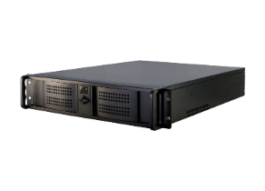
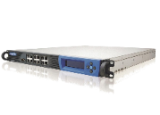
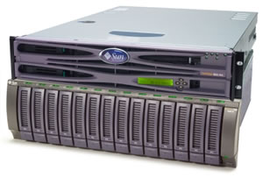
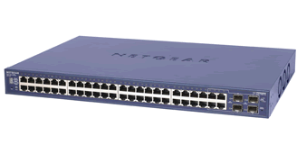
Migrating to Azure: On premise infrastructure
Data
FRONT
MIDDLEWARE
SQL
IIS 1
Business 1
SQL 1
IIS 2
Business 2
SQL 2
Storage
Notes:
Note: The topics mentioned here are critical talking points as we’ll show them how cloud (Azure) is identical or better than on-prem
This is a typical on-prem multi-tier scenario
You have…
Front end servers that are protected behind firewall and are also load balanced
Middle tier that takes care of business logic, they are load balanced and protected by firewall
For example, they are completely shielded from outside world and they are accessible from on-prem only or specific vnets
SQL Database tier takes care of storing critical business data that may be load balanced as well
All these resources are regularly backed up and archived so that we can quickly restore them and recover from catastrophic failure.

Slide 6



Step 1: Migrate to the cloud (lift and shift)
Gains: Do not manage machines, networks, load balancers... anymore. Add remove machines easily.
FRONT
BACK
SQL
IIS 1
Business 1
SQL 1
IIS 2
Business 2
SQL 2
SMB Share
Notes:
This is a typical Azure or cloud multi-tier scenario
You have…
Front end servers that are protected behind firewall (Application Gateway, NSG and ACL or 3rd party firewalls) and
Can be load balanced using Azure internal load balancer
PaaS Web sites are automatically load balanced when we create multiple instances.
We can also use Traffic Manager to load balance traffic across different geographic regions
Middle tier that takes care of business logic, they are load balanced and they are protected like web sites (using say NSG rules)
For example, they are completely shielded from outside world and they are accessible from on-prem only or specific vnets
SQL Database tier takes care of storing critical business data that may be load balanced as well
With some of these services you get similar protection and can use firewall rules, restrict logins to specific users, integrate with Azure AD etc.
DaaS (Database as a Service) can be protected by granting access only to specific sub-net, v-nets or ip addresses
All these resources are regularly backed up and archived so that we can quickly restore them and recover from catastrophic failure.
On top of it …
Azure Security monitor keeps monitoring web sites for security breaches and health of the nodes
For example: DoS protection is available for all PaaS services and you can opt for advanced protection with paid services like DDoS
You get compliance for many different regulations as Azure is compliant with a lot a regulations.
For example, Azure infrastructure includes everything needed for HIPPA compliance. And Microsoft can work with you to make sure you are compliant with HIPPA regulations!
You can also use Advanced Threat Detection (an add-on service)

Slide 7
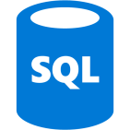





Step 2: Migrate to PaaS
Gains:
No need to manage OS, middleware… anymore.
No need to manage load balancers.
Auto scaling easier.
High availability at lower price.
Data
mySql
Storage blobs
Web
WebApp
WebJob
Notes:
It is easier to migrate web sites to Azure. You may have already tried it out in a lab or will do it soon in the Web Apps module
You can connect to on-prem or Azure SQL databases or Azure SQL Server VM

Slide 8






Step 3: Add features
Gains:
Availability
Performance
Maintainability
Security
Windows / Linux
Azure AD
Redis Cache
ServiceBus
Data
mySql
Storage blobs
WebApp
WebJob
Azure Search
Application Insights
Security Center
Notes:
Then you can start consuming different services

Slide 9


Step 4: Touch the future with Service Fabric and Docker
Gains:
Micro services
Hyper scalability
Hybrid with on premise
Windows / Linux
Azure AD
Redis Cache
ServiceBus
Data
Service Fabric
Container
Services
mySql
OR
Storage blobs
Azure Search
Application Insights
Security Center
Notes:
Note: SF support Docker Containers since 2017. Now it’s a choice among orchestrators, not between SF or Docker.
Move to the advanced development where you not only have services but microservices.
Also the development environment is identical to production except the data it connects to!
And so much more!!!

Slide 10
Typical Architecture in Cloud
Other Azure Services, e.g., Redis Cache
Azure AD
ServiceBus
Azure SQL, mySql etc.
WebApp
WebJob
Web
Storage blobs
Azure Search
Application Insights
Security Center
Notes:
Talking Points:
Typically you’ll have a web app that serves your customer or internal/external users
The web app will contain multiple instances that will consume various services
Azure security will monitor and protect PaaS services. For example basic protection is free and you can opt for advanced protection like DDoS as a paid service.
You can create Webjob to perform long running or background tasks. For example, sending email or generating thumbnail etc.
Azure has open source standardized libraries. Both WebJobs and Azure Functions use the same libraries. We’ll talk about functions later.
Reference Material:
DDoS Basic and DDoS Standard
Basic protection is integrated into the Azure by default at no additional cost. The scale and capacity of the globally deployed Azure network provides defense against common network-layer attacks through always-on traffic monitoring and real-time mitigation. DDoS Protection Basic requires no user configuration or application changes. DDoS Protection Basic helps protect all Azure services, including PaaS services like Azure DNS.
Basic DDoS protection in Azure consists of both software and hardware components. A software control plane decides when, where, and what type of traffic should be steered through hardware appliances that analyze and remove attack traffic. The control plane makes this decision based on an infrastructure-wide DDoS Protection policy. This policy is statically set and universally applied to all Azure customers.
Azure DDoS Protection - Designing resilient solutions
https://docs.microsoft.com/en-us/azure/security/fundamentals/ddos-best-practices#azure-offerings-for-ddos-protection
https://azure.microsoft.com/en-us/services/ddos-protection/
https://azure.microsoft.com/en-us/pricing/details/ddos-protection/
Azure Security and Compliance Blueprint: PaaS Web Application for PCI DSS:
https://docs.microsoft.com/en-us/azure/security/blueprints/pcidss-paaswa-overview

