Slide 1
Guided Capstone Project Slides
Rita Jaynes

Slide 2
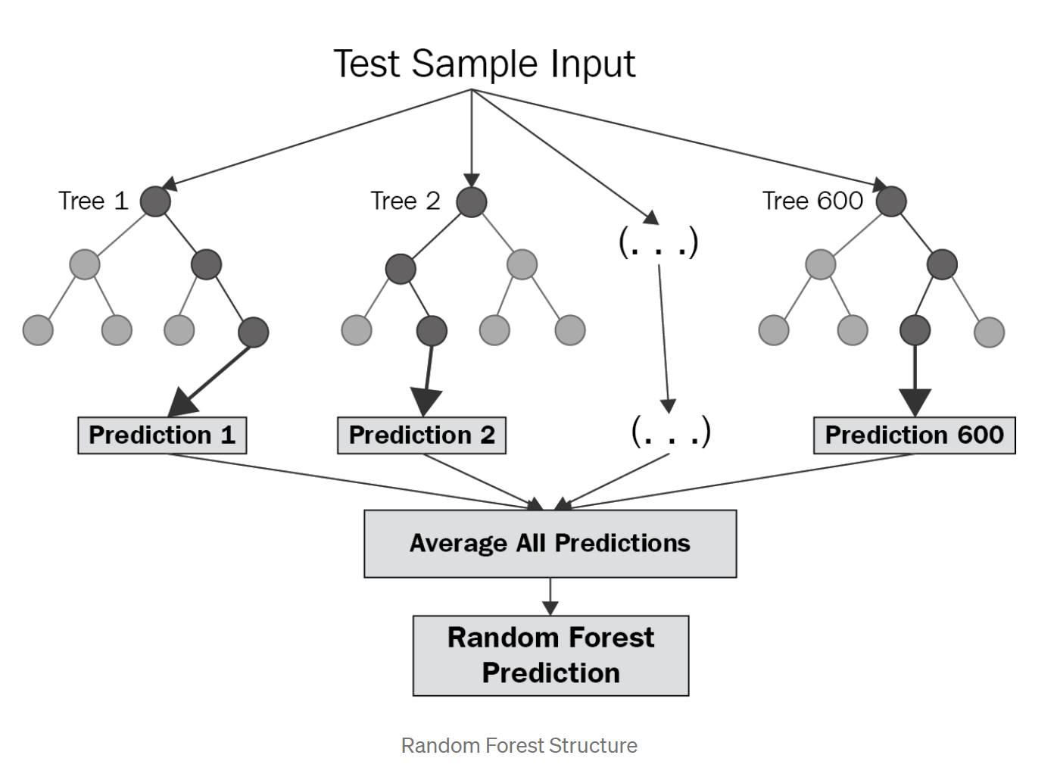
Question: Can Big Mountain Resort ticket prices be raised for this season,
based on prices of other resorts with comparable features?
Currently, Big Mountain Resort sets their ticket prices by setting a premium above the average resort ticket price.
If we examine resorts with similar features, can we raise the price?
Using data from resorts across the country, we used a random tree regression to model and predict ticked cost based on resort features.

Slide 3
Recommendations and key findings:
Our model predicted a ticket price of $94.98. Current price is $81. Even with a mean absolute error of $10.51, that suggests there is room for increase of $1-3.
Scenario 1: Permanently close up to 10 runs to save money?
Model found that permanently closing one run would not affect ticket price or revenue.
Scenario 2: Add a run, increasing the vertical drop by 150 feet, and installing an additional chair lift
Model found that we could increase ticket price $1 for this feature

Slide 4
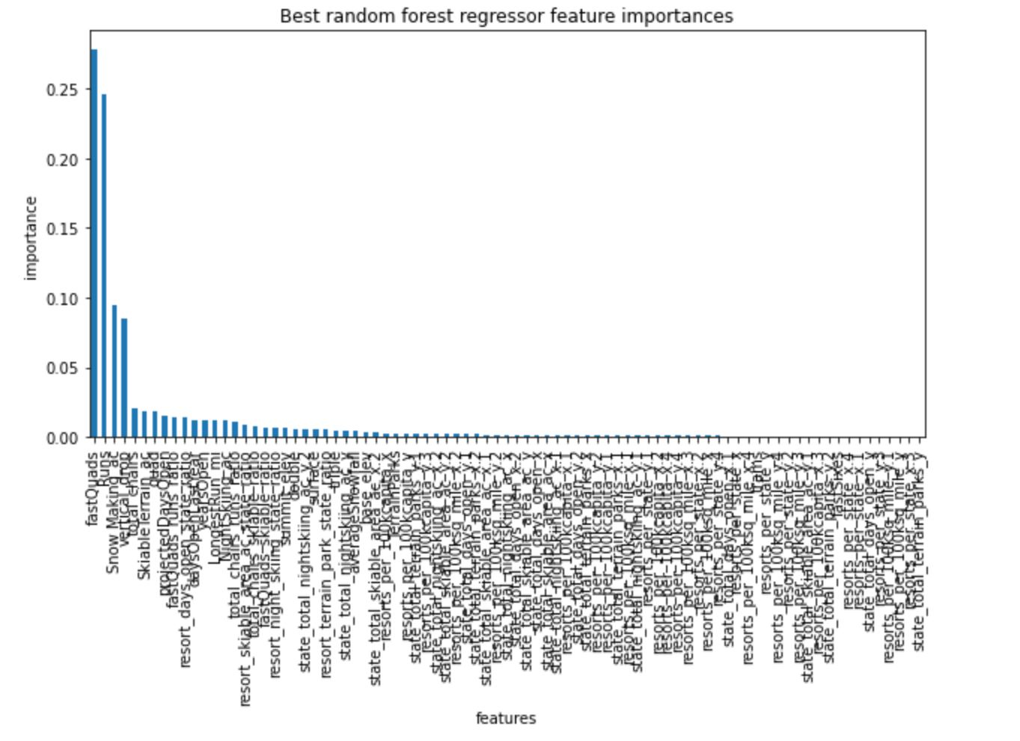
Modeling Results and Analysis:
Our random forest regression showed that the
most important features in deciding ticket pricing
are :
# of Fast Quads
# of runs
Snow-making ability
Vertical Drop
Total Chairs

Slide 5
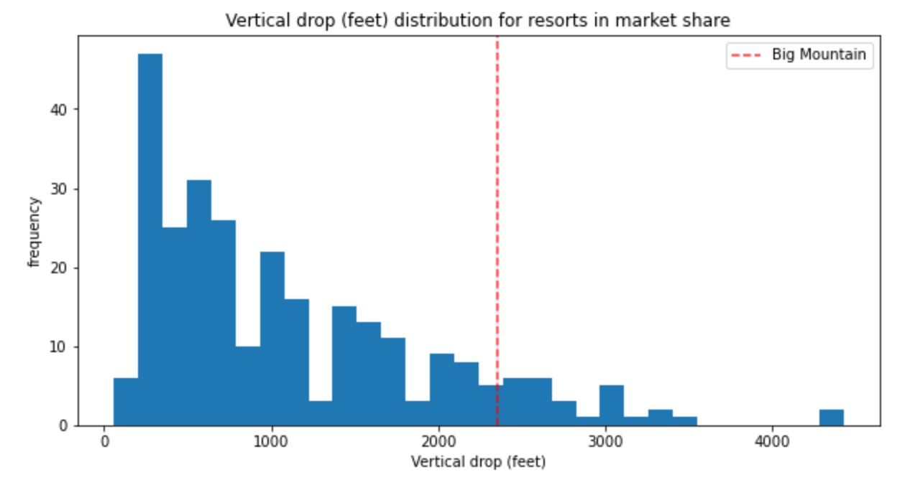
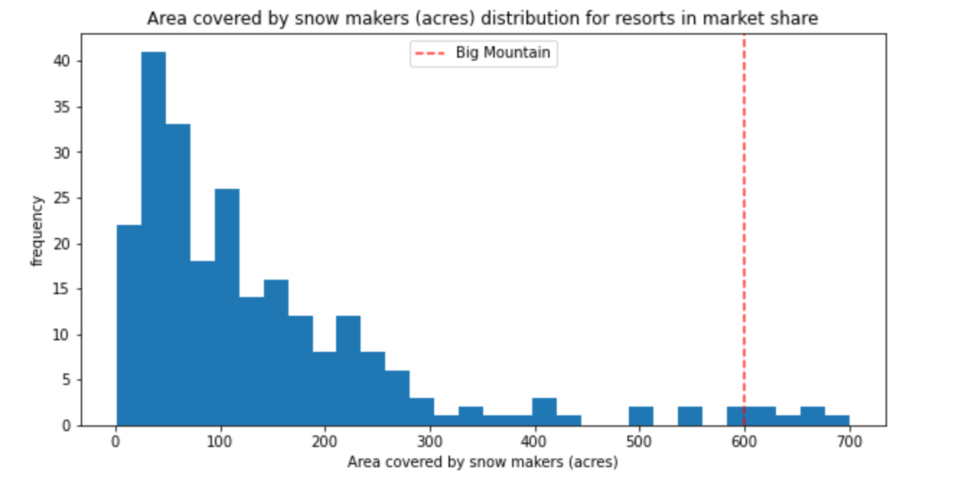
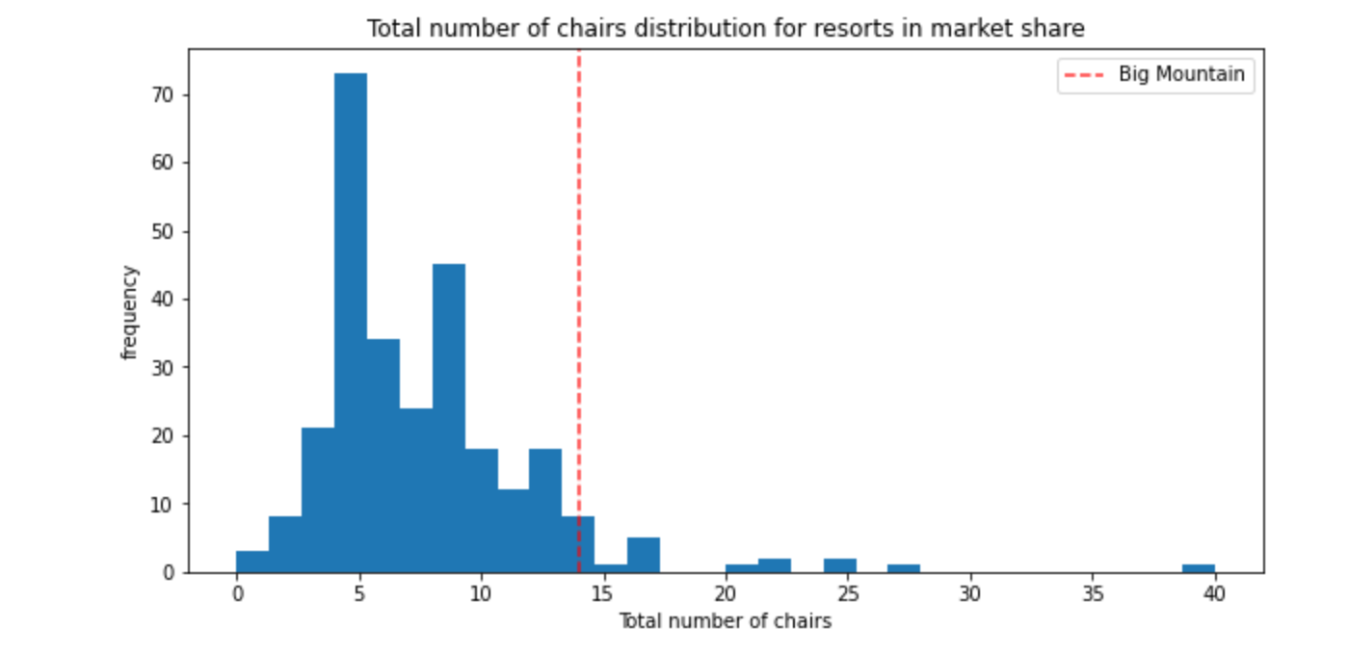
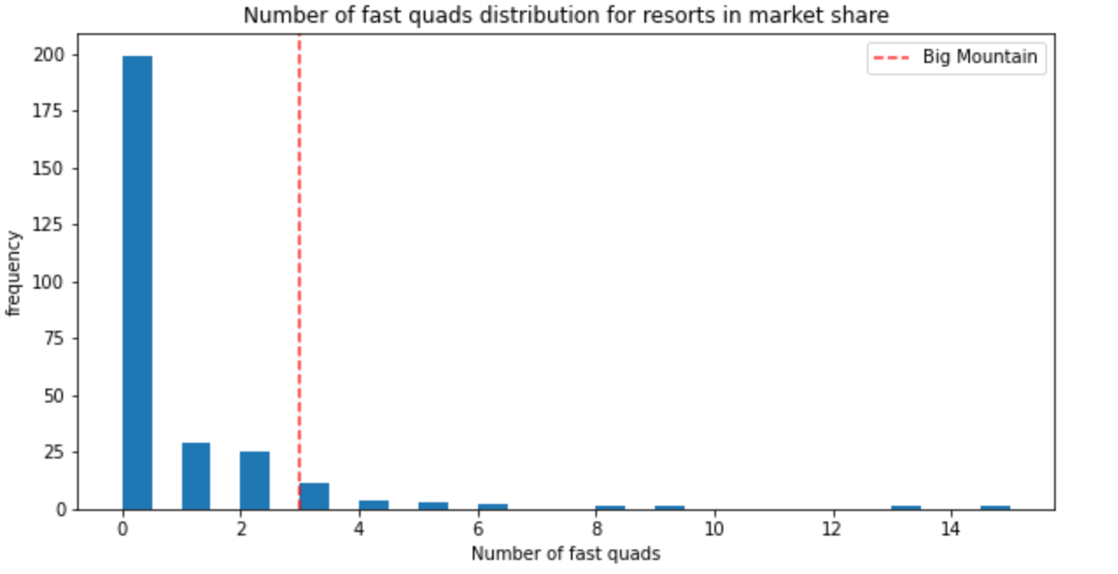
Results cont.
Big Mountain (red line) ranks among top resorts in vertical drop,
Snow-making, total chairs, and fast quads

Slide 6
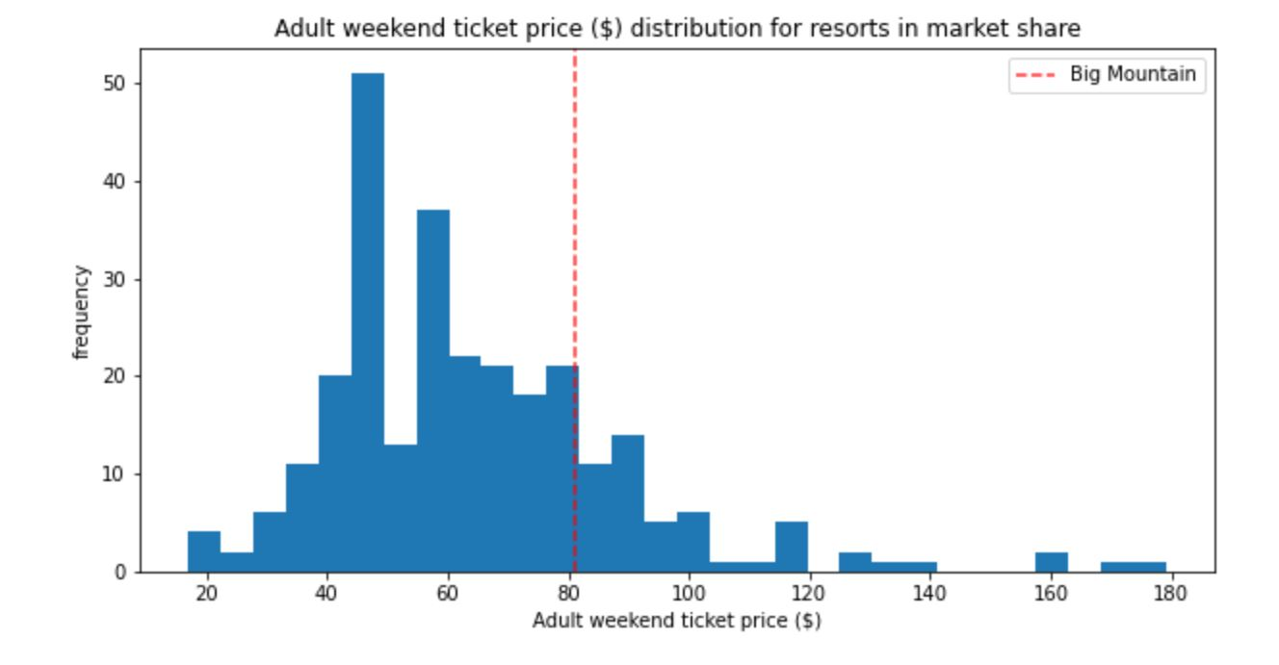
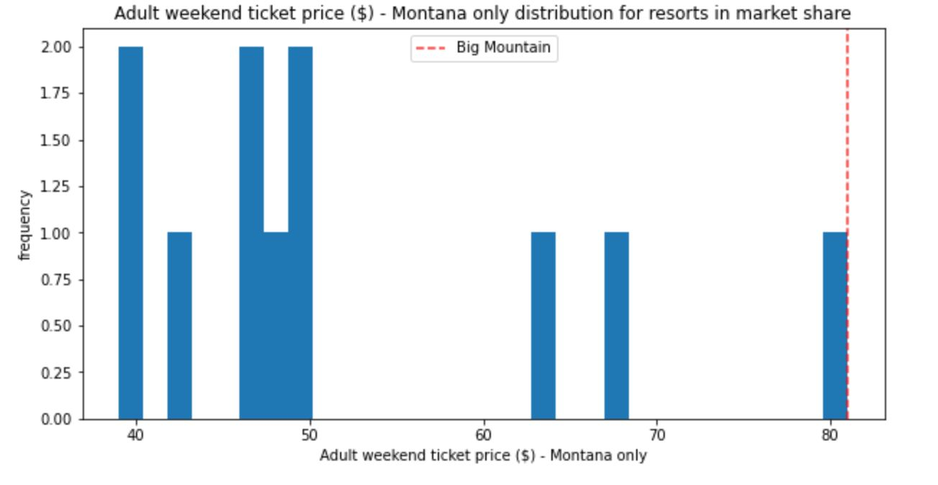
Results cont.
Big Mountain hovers around the middle of overall resort ticket prices, but it is the highest cost in Montana.

Slide 7
Summary and Conclusion:
Although our model predicted a higher price, local competition may be a limiting factor. Montana has the 4th highest number of resorts per capita, and it is already the highest priced.
Scenario 2 (adding 150 vertical feed and additional chair to raise ticket price $1) would profit approx. $335,000 per year. However, that does not account for construction costs.

