Slide 1
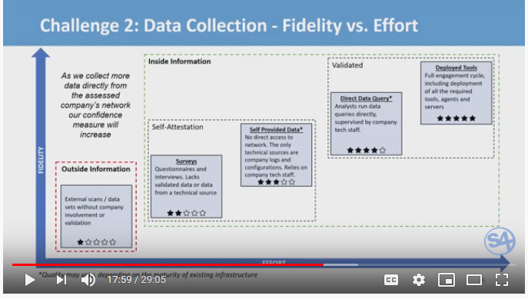
Derek Vadala S4 Talk - 2020
Notes:
The goal of the following slides is to describe a method (see red circle) to improve information fidelity by delivering real-time risk assessment data (evidence data) directly to credit rating agencies or insurance carriers, as part of a software object supply chain risk assessment, performed by the covered entity, using existing Software Assurance Guardian tools and infrastructure, developed by Reliable Energy Analytics.

Slide 2
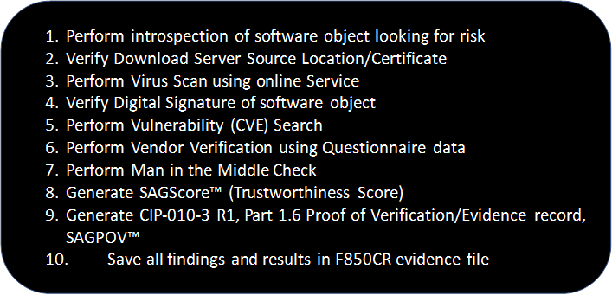
Risk Assessment Process and Scoring
Notes:
The risk assessment process described here is implemented by the Software Assurance Guardian Point Man™ (SAG-PM™) software risk assessment control developed by Reliable Energy Analytics LLC. The process starts with the creation of a software Bill of Materials (SBOM) that drives the risk assessment. Corroborating evidence from each step is used to assign a trustworthiness score, called a SAGScore™. The SAGScore is used by the covered party to make a risk based decision to install, or not install a software package in the Bulk Electric System. The F850CR evidence file can be provided to a Cyber Insurer, Credit Rating Agency or other interested parties, with little effort.

Slide 3
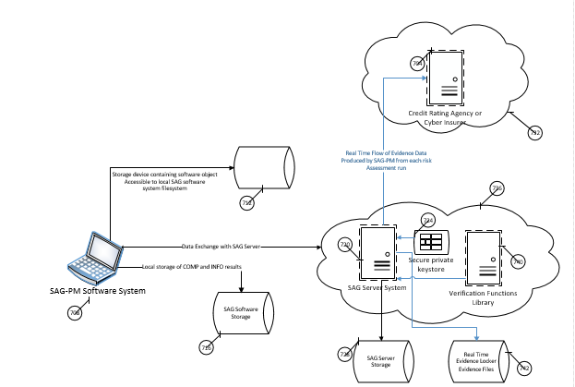
Sharing Evidence Data in Real Time
Notes:
The area inside the red box shows the proposed enhancements to SAG-PM that would deliver evidence data collected during a risk assessment directly to an interested party, such as a Cyber Insurance Carrier, Credit Rating Agency or other parties, e.g. Regulators. Each risk assessment performed by SAG-PM is issued a unique transactionID that is used to track the detailed outcome of each risk assessment step and the final SAGScore. Areas outside the red box represent the operational capabilities of SAG-PM that exist today.

Slide 4
Benefits of This Approach
Remove the latency of reporting risk data to Credit Rating Agencies or Cyber Insurance Carriers
Provide high fidelity, real-time, standard risk assessment evidence data from covered parties to interested parties using common terms and semantics for improved data quality
Provides nearly instant insight of elevated risks taken by Public/Covered entities, enabling the Credit Report Agencies and Cyber Insurance Carriers to take appropriate action, e.g. adjust credit rating scores or increase cyber insurance policy premiums based on elevated risk positions.
Opportunity to increase revenues through transaction fees and storage of evidence data within the SAGServer
Provide the credit rating agencies with the 5 STAR solution described by Derek Vadala in his S4 talk in January 2020

Slide 5
Summary
The SAG-PM™ risk assessment software platform is operational NOW
Risk Assessment evidence data can be delivered directly to an interested party with very little effort
SAG-PM utilizes the very reliable Amazon AWS infrastructure under the Amazon Activate program, provided by the IEEE
A SAG-PM demonstration can be provided upon request via the Contact Form
Never trust software, always verify and report!™

Slide 6
ADDITIONAL BACKGROUND SLIDES FOR REFERENCE

Slide 7
Focus of this demonstration
Verification of Software Object Integrity and Authenticity in the Supply Chain to protect electricity grids, based on NERC CIP-010-3 R1 Part 1.6

Slide 8
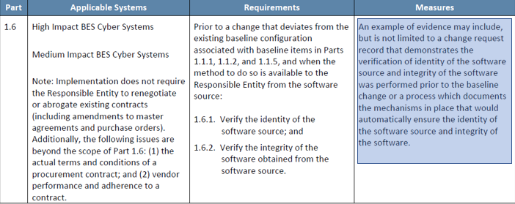
NERC CIP-010-3 R1 Part 1.6 Requirements SAG Proof of Verification Evidence

Slide 9
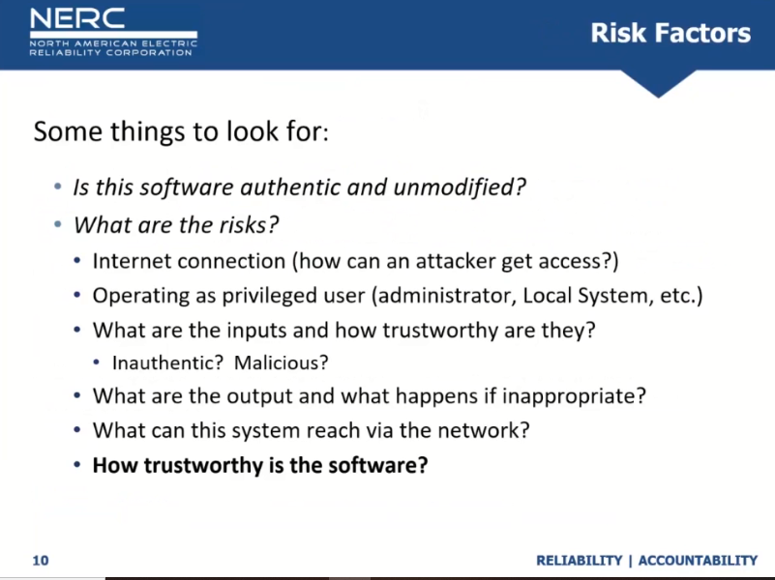
SAG-PM Drivers

Slide 10
Theory vs Practice Digital Signatures
Digitally signed software provides a “veil” of trust that can be exploited
ASUS March 29, 2019 Hackers successfully planted malware posing as an official ASUS security update and signed it with two of the company’s legitimate digital certificates
Sophos Threat Report 2020 Attackers minimize detection by digitally code-signing their ransomware with an Authenticode certificate

Slide 11
Theory vs Practice Digital Signatures
Digitally signed malware ensures that you are receiving high integrity malware, that SHOULD NEVER BE INSTALLED!
The confidence level % that a digitally signed software object is free of malicious taint is ZERO
Let's Encrypt to revoke 3 million certificates on March 4, 2020 due to software bug

Slide 12
Software verification CIP-010-3 (page 36)
The concept of software verification (verifying the identity of the software source and the integrity of the software obtained from the software source) is a key control in preventing the introduction of malware or counterfeit software.
This objective is intended to reduce the likelihood that an attacker could exploit legitimate vendor patch management

Slide 13
Overarching Goal of SAG™ Methods
To fulfill FERC Order 850’s stated objective at 80 on page 49 (below) by implementing appropriate mitigating actions pertaining to software integrity and authenticity verification
The security objective of the supply chain risk management Reliability Standards is to “ensure that [r]esponsible [e]ntities consider the security, integrity, quality, and resilience of the supply chain, and take appropriate mitigating action …

Slide 14
SAG-PM™ Package Contents
Software Assurance Guardian Point Man application installation kit
Software License; Annual Subscription
Supply Chain Risk Management Implementation Plan section covering NERC CIP-010-3 R1, Part 1.6 requirements
90 Days of Customer Support

Slide 15
SAG Software Supply Chain
Software Source Originator: The entity that authored/published a software object and is the authorized licensor of the software i.e. Microsoft Corp
Software Source: The entity that made the software object available to a party wishing to utilize the software object, i.e. https://github.com/microsoft
Software Source Location: Physical location where the software object was obtained from, i.e. Amazon Example: Malwarebytes Security: Virus Cleaner, Anti-Malware
Download instructions: Open the Amazon Underground on your device, then go to Menu → My Apps → Cloud → Refresh to see your newly purchased app to download and install.

Slide 16
SAG-PM™ Process Flow
Customer Downloads Software Object
Customer runs
SAG-PM to verify Software Object
Perform introspection of software object looking for risk
Verify Download Server Source Location/Certificate
Perform Virus Scan using online Service
Verify Digital Signature of software object
Perform Vulnerability (CVE) Search
Perform Vendor Verification using Questionnaire data
Perform Man in the Middle Check
Generate SAGScore™ (Trustworthiness Score)
Generate CIP-010-3 R1, Part 1.6 Proof of Verification/Evidence record, SAGPOV™
Save all findings and results in F850CR evidence file

Slide 17
SAG-PM™ demonstration

Slide 18
Summary
SAG-PM gives companies a means to verify software objects and supply chain actors resulting in a trustworthiness score, SAGScore
Performs a comprehensive investigation involving seven steps, employing best practices
Provide customers with a proof of verification/evidence record as indicated by NERC CIP-010-3, R1, Part 1.6, Measures of proof
Capture the results of each investigation step and other contextual information in a file for posterity and auditing purposes
Areas that should be improved to aid programmatic verification:
JSON CVE results
CVE search using Boolean search criteria and defined parameters, i.e. Product name, version
Completed Vendor Questionnaires, either A2V accessible or other means.

Slide 19

Contact
Dick Brooks
dick@reliableenergyanalytics.com
https://reliableenergyanalytics.com/

