Slide 1
FCC SAG-CTR™ Overview and Demo
Software assurance guardian community trust registry (SAG-CTR)
Dick Brooks, CTO

Slide 2
Background
Reliable Energy Analytics LLC (REA)
Software Engineering Company, Small Business located in Massachusetts started 2018
NIST C-SCRM Solution Provider (SAG-PM™) and Gatekeeper of the SAG-CTR™ Trust Registry
Participant in CISA ICT_SCRM Task Force SMB and Software Assurance work groups and CISA Critical Manufacturing Sector (SRMA) Coordinating Council
SAG-CTR
Goal and Purpose
One stop shop for all known legitimate and verified “Trust Labels” for Trusted Digital Products
Secure Evidence Locker for data submitted to register a trusted product in SAG-CTR™

Slide 3
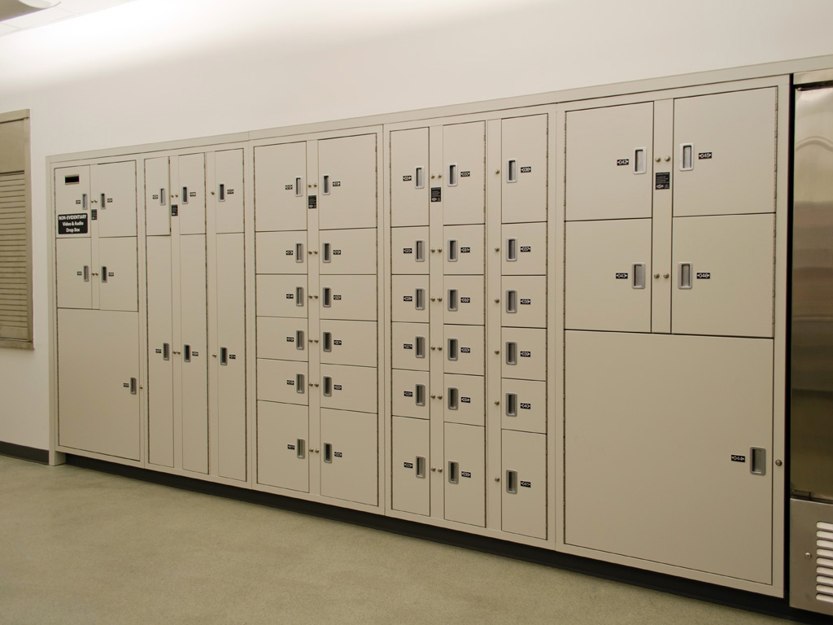
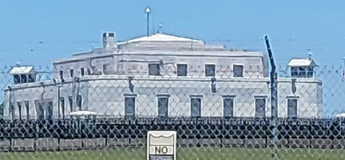
How does this work
Evidence data produced by SAG-PM is submitted to SAG-CTR to be stored in tamper-proof format and listed in SAG-CTR Trusted Product Registry
Risk Assessment produces evidence data and a “Trust Score” (SAGScore)
Trusted Party conducts Risk Assessment on a Digital Product
Tamperproof
Evidence Data is
Produced and product is registered as “trusted product”
SAG-CTR Evidence Locker and
Registry of Trusted Products
SAG-CTR ™
Tamperproof evidence stored in an evidence locker is presented in court when needed

Slide 4
Consumer Access to Label Data
Software Vendor supplies consumer with a link to their product label data in SAG-CTR™
Consumer clicks link provided by Vendor (QR code) to view trust label data in SAG-CTR™
Consumer reviews SAG-CTR™ label data and makes buying decision based on their own risk appetite and threshold using SAGScore™ and Additional Information

Slide 5
SAG-CTR DEMO
SAG-CTR API’s
Get Product Categories
Get Trust Label Types
Get Trusted Products by Product Category and Trust Label Type
Get Trusted Product Label
Get Additional Information (based on CISA Attestation Form Buyers Guide)
Dashboard access to SAG-CTR™, provided by Interlynk; Interlynk Intro

Slide 6
Interlynk : SBOM and RISK Automation
Platform for managing, evaluating and monitoring software risks
Designed for automation and continuous vulnerability assessment
Supports CycloneDX, SPDX, VEX, OpenVEX, CSAF, VDR
Data Enrichment
Integrations: CPE, NuGet, Pypi, RubyGems, Maven, NPM
Vulnerabilities: NVD, OSV, GitHub
Analysis: KEV, EPSS
Risks: OpenSSF Scorecard, End-of-life/service, Deprecation
Enterprise Features
License Manager, Auto-Sharing, RBAC, JIRA, MS Teams
Audit-Log, Reporting

Slide 7

Don’t count on the mercy of hackers Check the trust label BEFORE BUYING A PRODUCT

Slide 8
Summary
SAG-CTR™ is operational now and has been since 2021, but it does have Chinese competition sample product listing
The SAGScore™ is modeled after the FICO score, but for trustworthiness in digital products
Designed to be a one-stop shop for all Digital Product Trust Labels worldwide
Applies CISA attestation form requirements to produce SAGScore™
SAG-CTR™ API’s enable software vendors and other parties to share links to trust labels
Tamper-proof digital evidence supporting a trusted product registration is stored in SAG-CTR™ and available for presentation in any court case or other viable scenario where this detailed data is needed

